Slide 1
Contingencies are the Heart
of Transmission Constraints
Thomas Lee¹, Andy Sun²
¹Institute for Data, Systems, and Society, MIT
²Sloan School of Management, Operations Research Center, MIT
t_lee@mit.edu
Sep. 11, 2026
PowerUp 2026 Conference: Planning Under Uncertainty Workshop

Slide 2
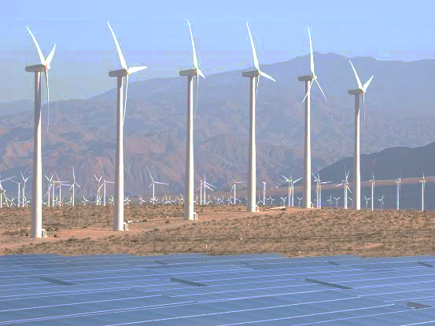
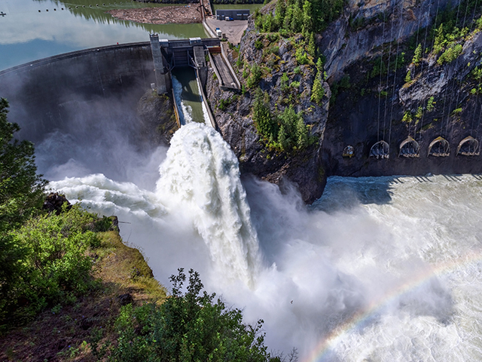
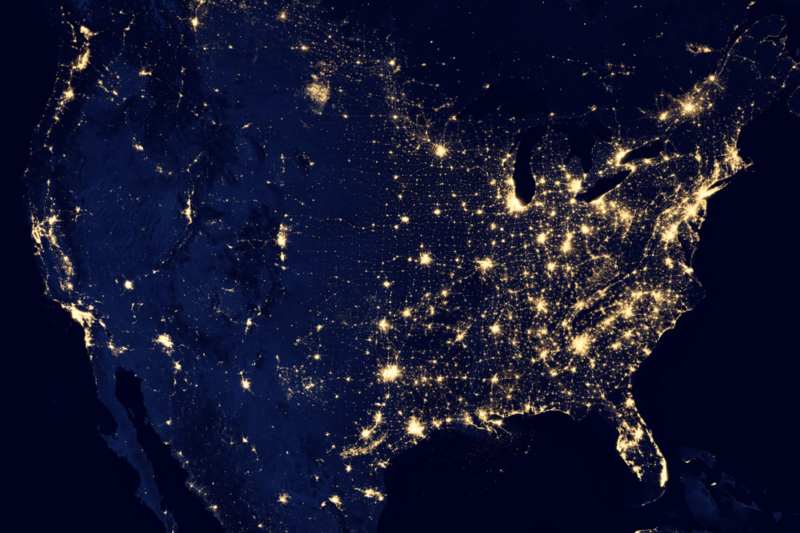

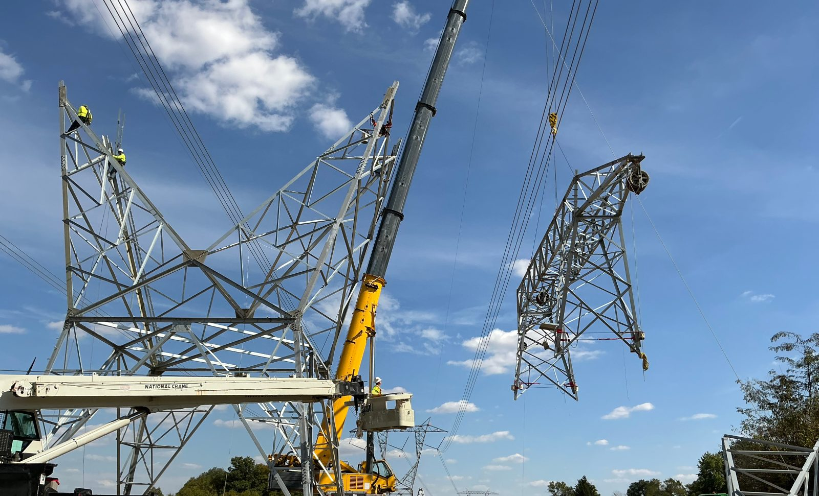
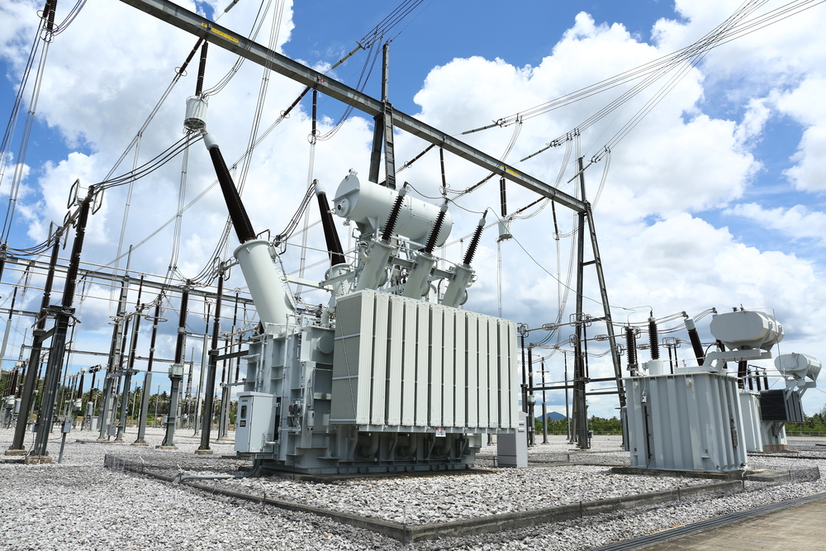
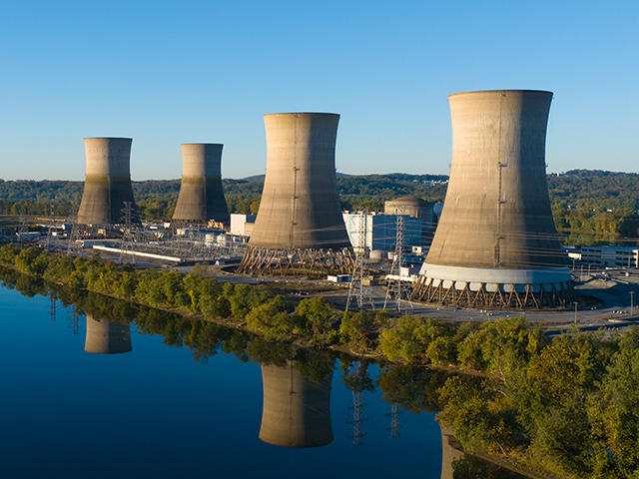
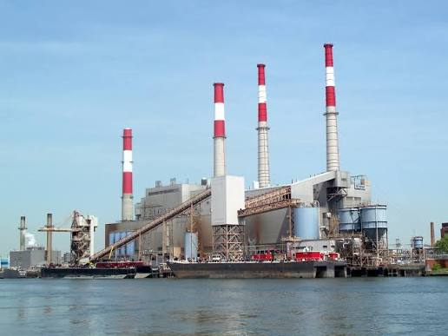
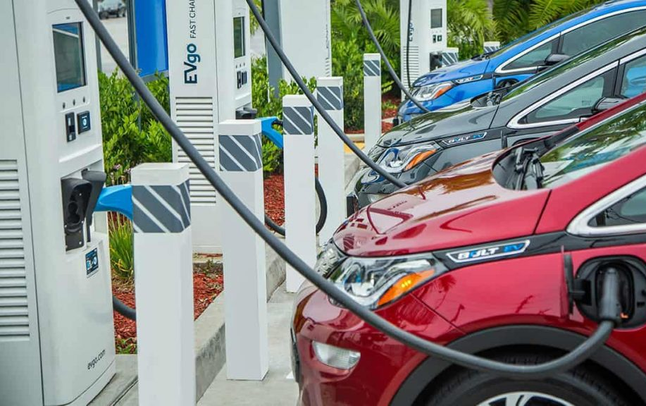
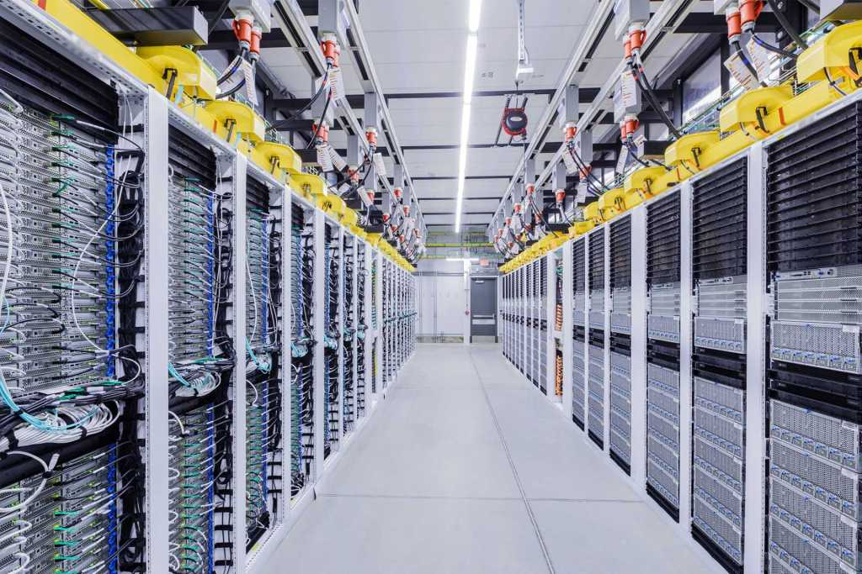
Some types of operational uncertainty in power systems
Terminology: Variability, intermittency, uncertainty, etc. are related but distinct concepts. I will use “uncertainty” as a catch-all term here.
Supply
Transmission & Distribution
Demand
Wind & solar
Hydropower
Residential & commercial demands
Anything missing?
Transmission Lines
(AC & DC)
Substation transformers
Nuclear
Coal & Gas
Electric vehicles
Data centers
Examples of uncertainty:
Weather-driven availability factors
Generator outages
Fuel costs
Examples of uncertainty:
Line outages
Security constraints
(n-1 transmission contingencies)
Dynamic line ratings
(temperature, wind, irradiance)
Examples of uncertainty:
Weather-driven load profiles
Electric vehicle trip demands
Data center computing demands
Today’s talk
Contingency-Aware Nodal Optimal Power Investments with High Temporal Resolution
Thomas Lee
t_lee@mit.edu

Slide 3

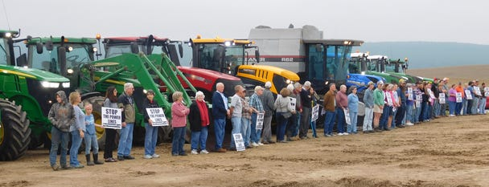
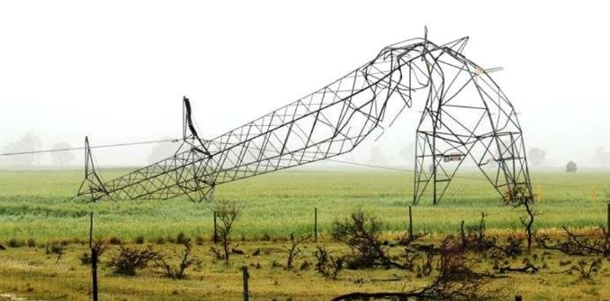
What are transmission contingencies (security constraints)?
NERC TPL–001
“Applicable Facility Ratings shall not be exceeded” under any “P1 Single Contingency: Loss of one... Transmission Circuit [or] Transformer”.
Normative question:
Are security constraints really necessary?
Positivist viewpoint:
Security constraints constitute the vast majority of transmission constraints. Thus, they are important to model.
Grid process | Region | % of transmission constraints caused by a contingency
Interconnection | PJM | 90%
Day-ahead market | PJM | 86%
 | ERCOT | 98%
 | CAISO | 93%
Stricter constraints increase economic & social costs.
(anti-Transource protest, Franklin County, PA, 2018)
Security constraints are needed for reliability & resilience.
Statistics sampled from PJM System Impact Studies, and DAM congestion from July 2024.
Contingency-Aware Nodal Optimal Power Investments with High Temporal Resolution
Thomas Lee
t_lee@mit.edu

Slide 4


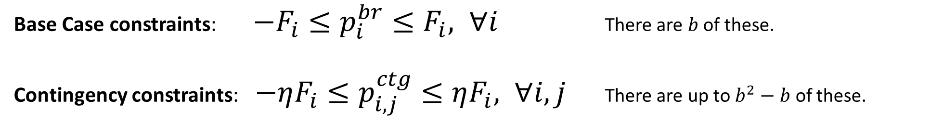



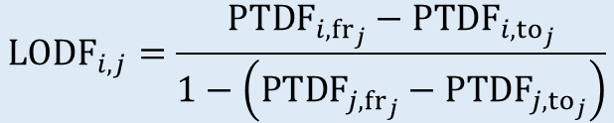



The math of transmission contingencies
Assuming DC power flows¹, branch flows can be expressed as:
¹Even in a state-of-the-art ACOPF formulation (ARPA-E Grid Optimization Competition Challenge 3), transmission contingencies are expressed with a linearized DC model.
Brun, M., Lee, T., Lauinger, D., Chen, X., & Sun, X. A. (2025). Alternating methods for large-scale AC optimal power flow with unit commitment. arXiv preprint arXiv:2505.06211.
$$p^{br}=PTDF p^{ni}$$
$$(b×1)$$
$$(b×n)$$
$$(n×1)$$
Power Transfer
Distribution Factors
Change in branch $i$’s flow per 1MW transfer from branch $j$’s (from bus) → (to bus)
Post-contingency flow on branch $i$, for the loss of branch $j$:
$p_{i,j}^{ctg}=$ $p_{i}^{br}+{LODF}_{i,j}⋅ p_{j}^{br}, ∀i,j$
$${LODF}_{i,j}=\frac{{PTDF}_{i,{fr}_{j}}−{PTDF}_{i,{to}_{j}}}{1−\left({PTDF}_{j,{fr}_{j}}−{PTDF}_{j,{to}_{j}}\right)}$$
Line Outage
Distribution Factors
Portion of this 1MW transfer carried by paths other than branch $j$
Base Case constraints: $−F_{i}≤p_{i}^{br}≤F_{i}, ∀i$ There are $b$ of these.
Contingency constraints: $−ηF_{i}≤p_{i,j}^{ctg}≤ηF_{i}, ∀i,j$ There are up to $b^{2}−b$ of these.
($η$ is typically 1.2)
Contingency-Aware Nodal Optimal Power Investments with High Temporal Resolution
Thomas Lee
t_lee@mit.edu

Slide 5
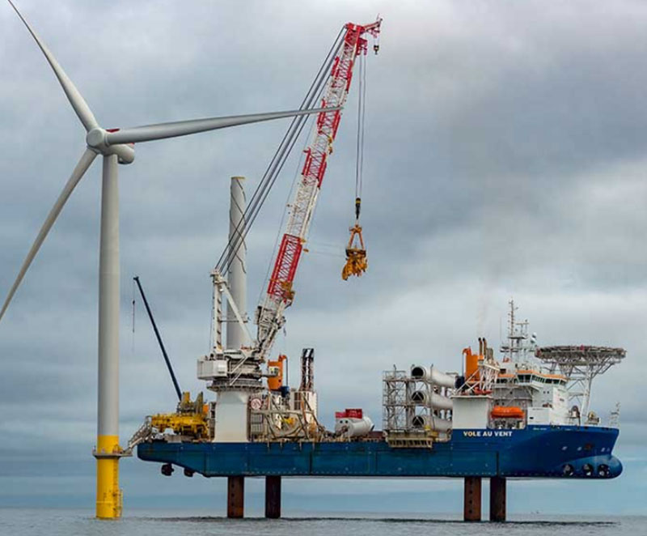

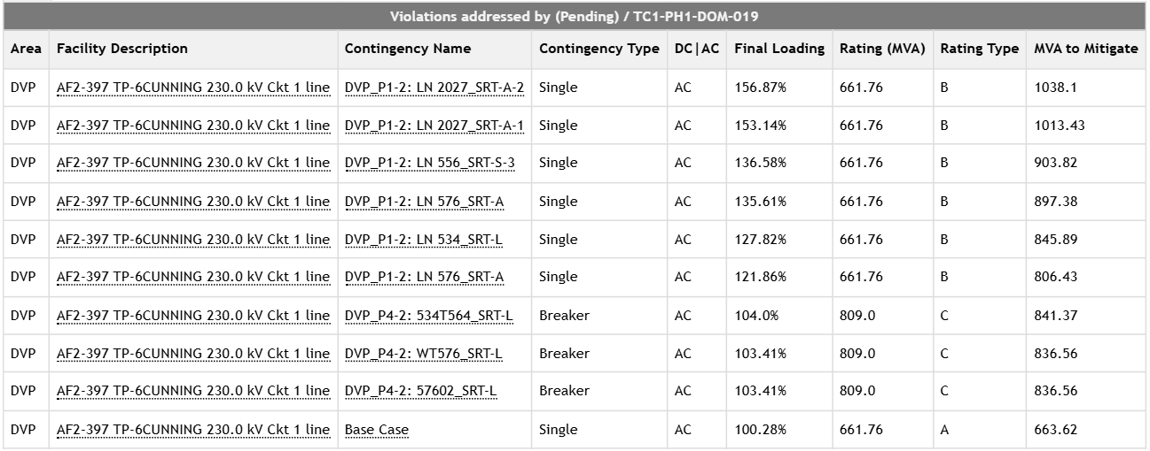
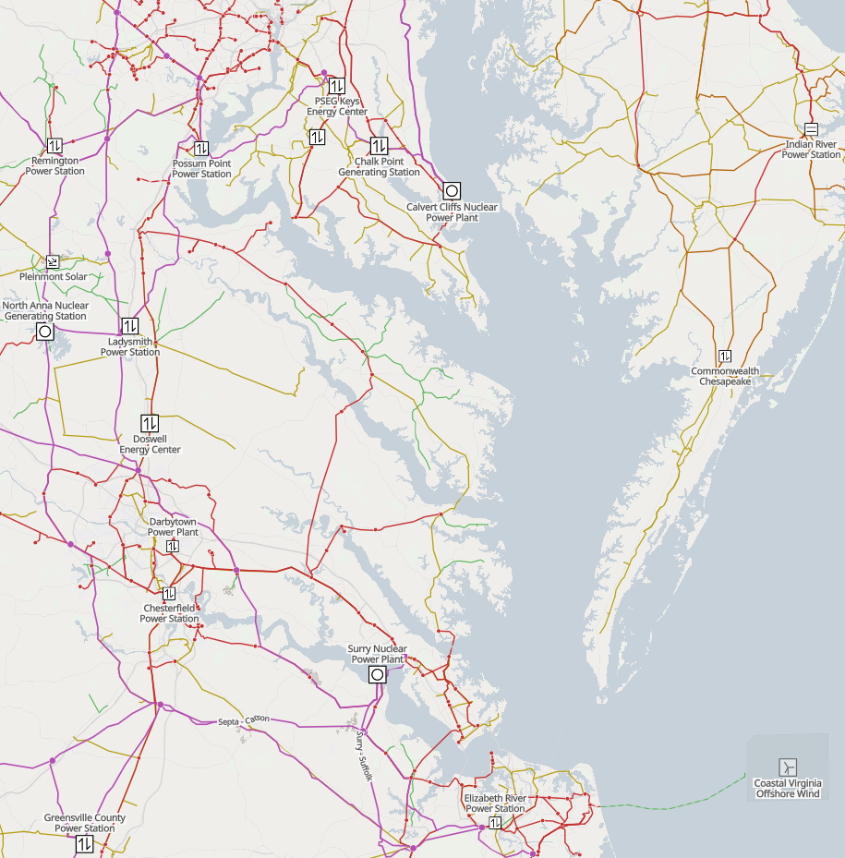
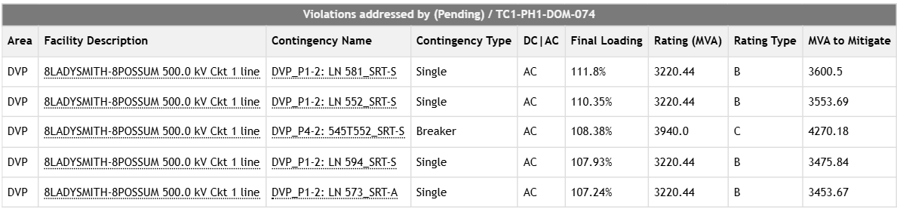
Contingencies in generator interconnection
PJM example: Example upgrades allocated to AF1-123-5: Coastal Virginia Offshore Wind (2.6GW)
$16M upgrade project: “Wreck and rebuild 5.86 miles of 230 kV line 2028 between AF2-397 Tap to Grape Vine (Cunningham)”
When you read “interconnection queue delays”
That effectively means “contingency constraints”
Monitored
Branch
Contingency
Branches
Base Case
$273M upgrade project: “Wreck and rebuild existing Line 568 Ladysmith - Possum Point for single circuit”
Monitored
Branch
Contingency
Branch
Source: https://www.pjm.com/pjmfiles/pub/planning/project-queues/Cluster-Reports/TC1/TC1_PH1_Executive_Summary.htm
LN 581 is Chancellor-Ladysmiwth 500kV: https://www.dominionenergy.com/-/media/content/about/power-line-projects/bristers-ladysmith/pdfs/scc/applicationbristersladysmithappendix-iaiib5.pdf
Thomas Lee
t_lee@mit.edu

Slide 6
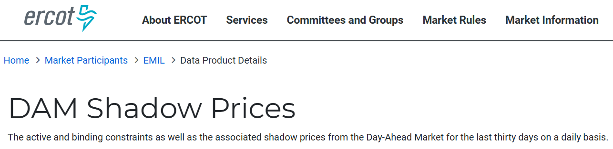
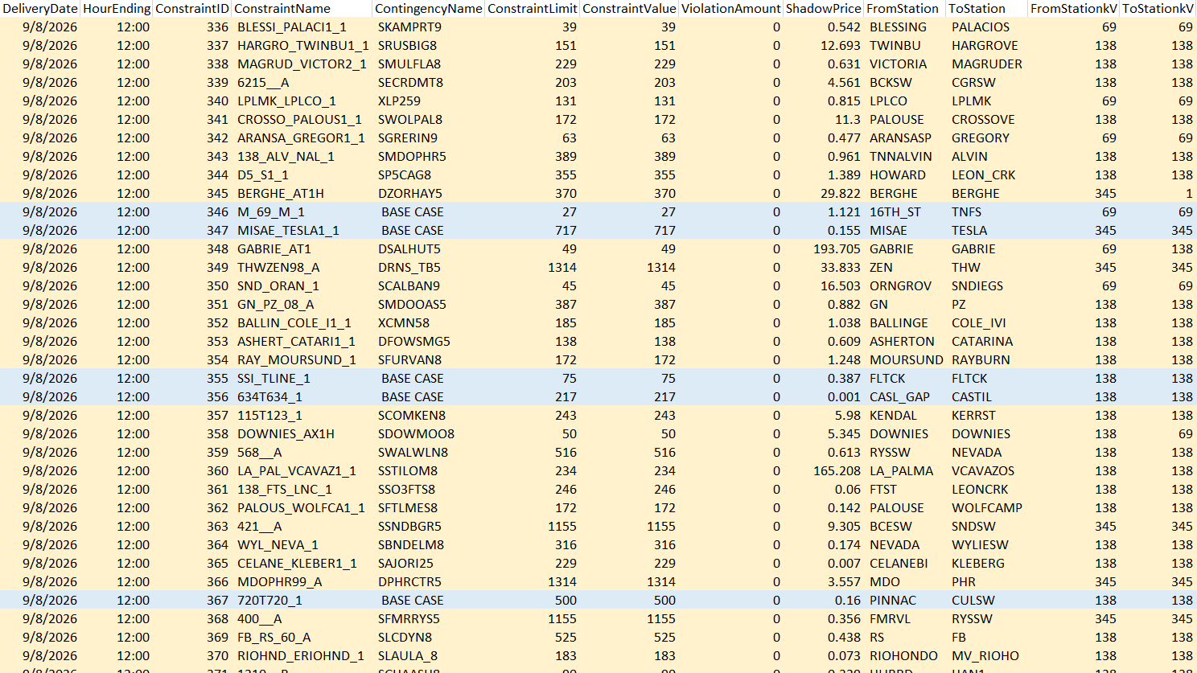
Contingencies in the energy market
Monitored
Branch
Contingency
Branch
When you read “congestion costs” or “renewables curtailment”
That effectively means “contingency constraints”
Source: https://www.ercot.com/mp/data-products/data-product-details?id=NP4-191-CD
Thomas Lee
t_lee@mit.edu

Slide 7



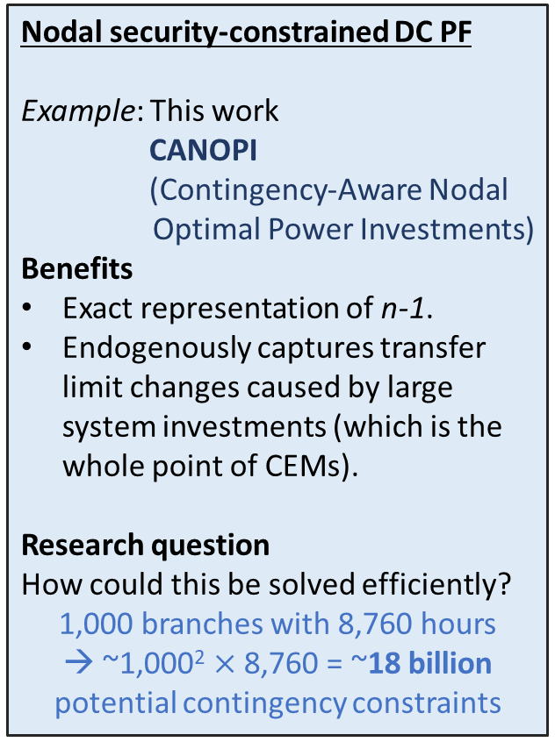
How can CEMs incorporate transmission contingencies?
Zonal network with network flows.
Examples:
Benefits
In theory, n-1 transfer limits could be derived from an underlying nodal network and account
(NLR ReEDS zonal and county-level transfer limits).
Drawbacks
In reality, transfer limits evolve under different loading conditions.
Contingency patterns shift based on endogenous investments.
Nodal DC power flow, derated limits.
Example:
Benefits
Nodal DC base-case power flow can be exactly represented.
Setting ratings to 70% is heuristic approximation of n-1 limits.
Drawbacks
The derating heuristic’s accuracy is not theoretically guaranteed.
Contingencies are 90% of transmission constraints.
Nodal security-constrained DC PF
Example: This work
CANOPI
(Contingency-Aware Nodal Optimal Power Investments)
Benefits
Exact representation of n-1.
Endogenously captures transfer limit changes caused by large system investments (which is the whole point of CEMs).
Research question
How could this be solved efficiently?
1,000 branches with 8,760 hours
→ ~1,000² $×$ 8,760 = ~18 billion potential contingency constraints
Contingency-Aware Nodal Optimal Power Investments with High Temporal Resolution
Thomas Lee
t_lee@mit.edu

Slide 8
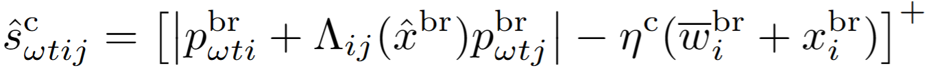
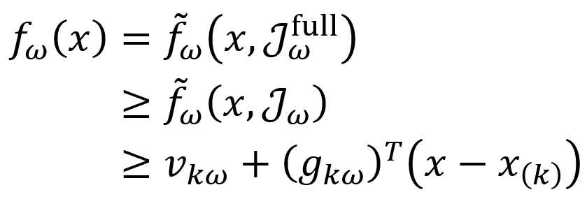

Full problem is (MI)NLP
CANOPI algorithm
Fixed-${\hat{x}}^{br}$ problem is large-scale LP
Bundle method
Investment problem
Transmission correction
Cuts &
Contingency violations
Evaluation
Capacities
Minimal cycle basis
Inexact oracle
Inexact oracle
Identifies and generates contingency constraints “on-the-fly” based on the current investment iterate.
This can be “interleaved” with the bundle method major iterations.
Avoids pre-enumerating all combinatorial contingencies.
Feasible upper bound
Pre-outage flow on i
Pre-outage flow on j
Implied upper bound on contingency slack:
Flow on i, for outage j
LODF
Line rating
Post-outage flow on i
Rating multiplier
Valid lower bound & subgradient
Solve the subproblem with a subset of contingencies
Contingency-Aware Nodal Optimal Power Investments with High Temporal Resolution
Thomas Lee
t_lee@mit.edu

Slide 9
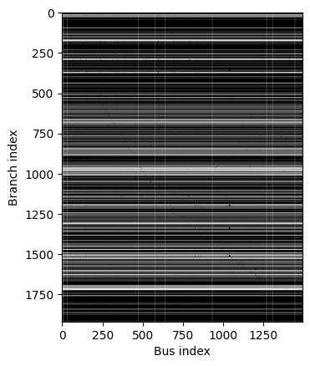
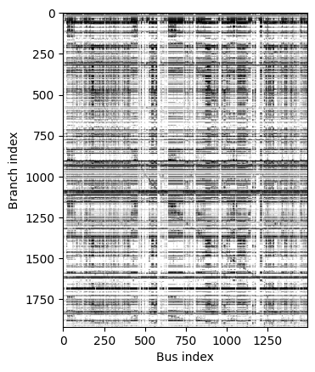
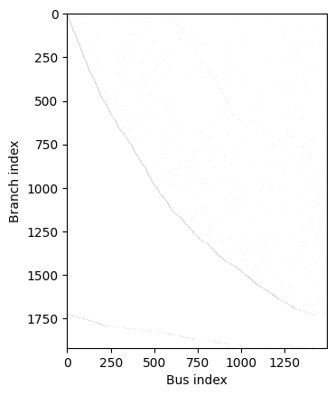
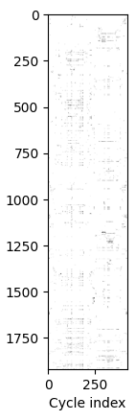

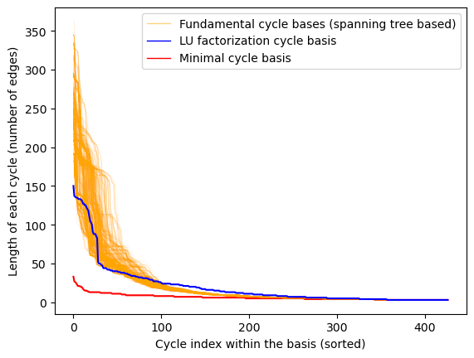
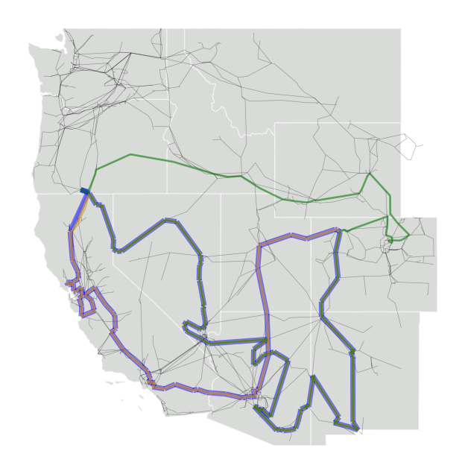
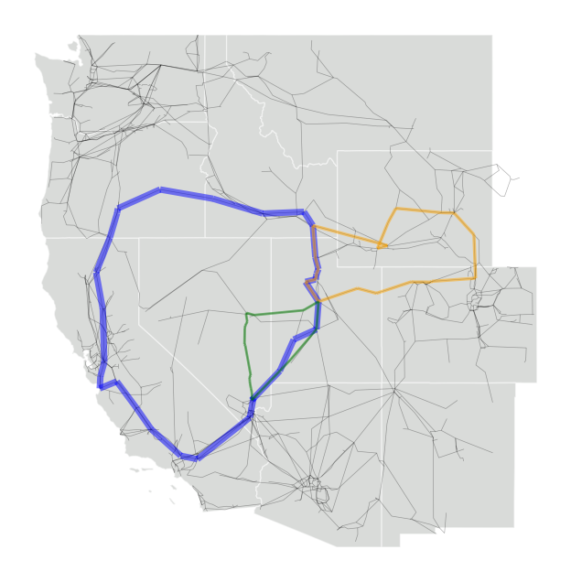


PTDF
PTDF (1%)
Cycle basis
Minimum cycle basis
2,169,984 NZ
842,033 NZ
11,698 NZ
6,593 NZ (0.3% of PTDF)
Exact. No angles needed.
Fundamental
cycle basis
Minimum
cycle basis
$$⊕$$
$$=$$
154
33
27
191
191
26
(Visualizing top 3 cycles)
Contingency-Aware Nodal Optimal Power Investments with High Temporal Resolution
Thomas Lee
t_lee@mit.edu

Slide 10
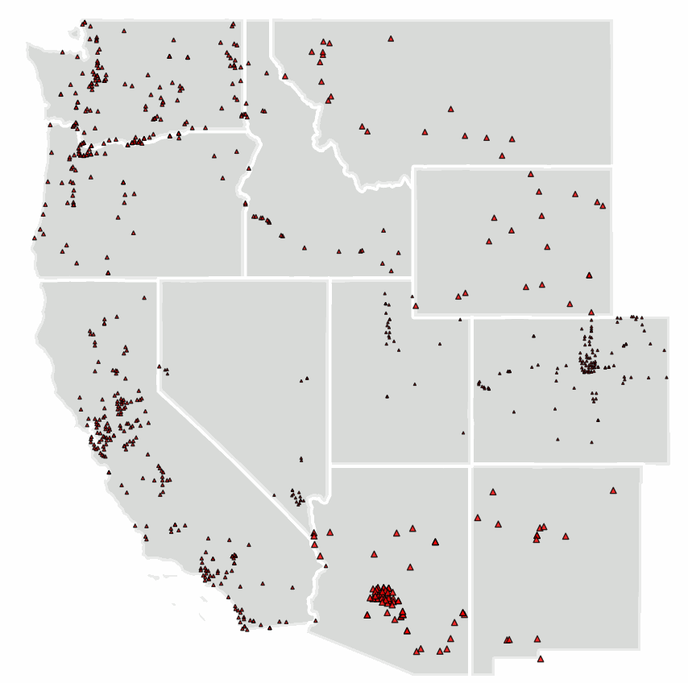
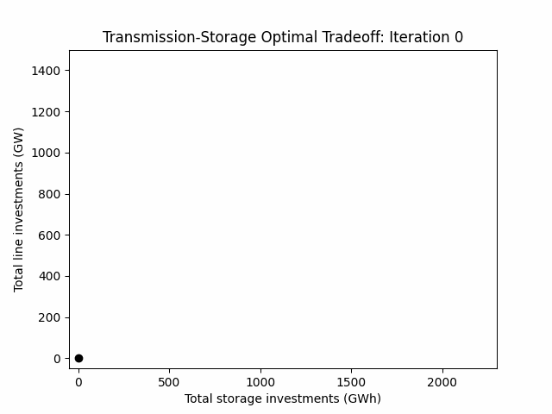
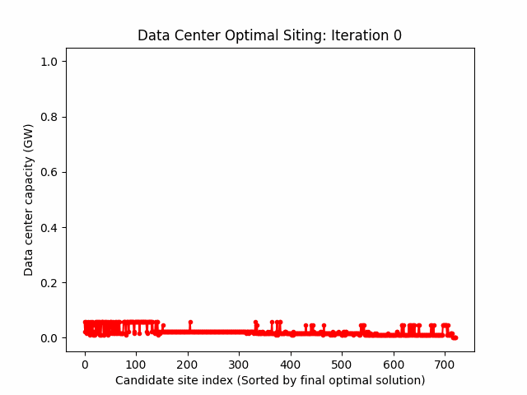
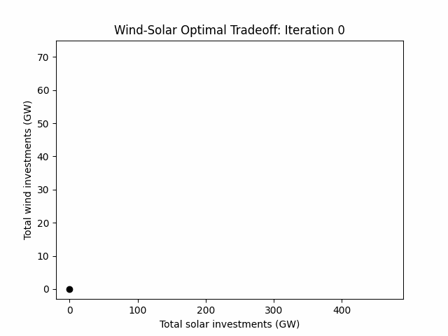
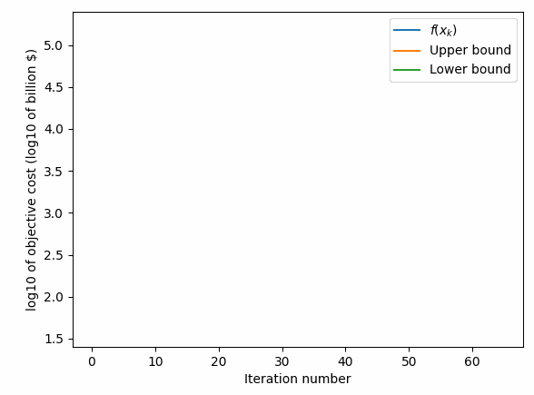
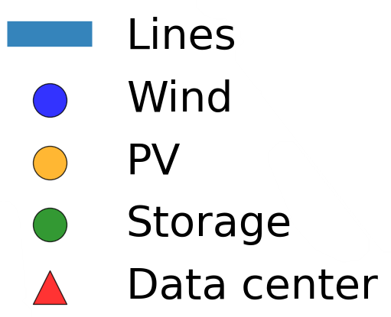
Video demo:
CANOPI (Contingency-Aware Nodal Optimal Power Investments)
Co-Optimized Nodal Capacity Expansion with 8760-Hourly Resolution
Transmission & Storage
Data Center Loads
Convergence to Optimality
Wind &
Solar
Thomas Lee
t_lee@mit.edu

Slide 11
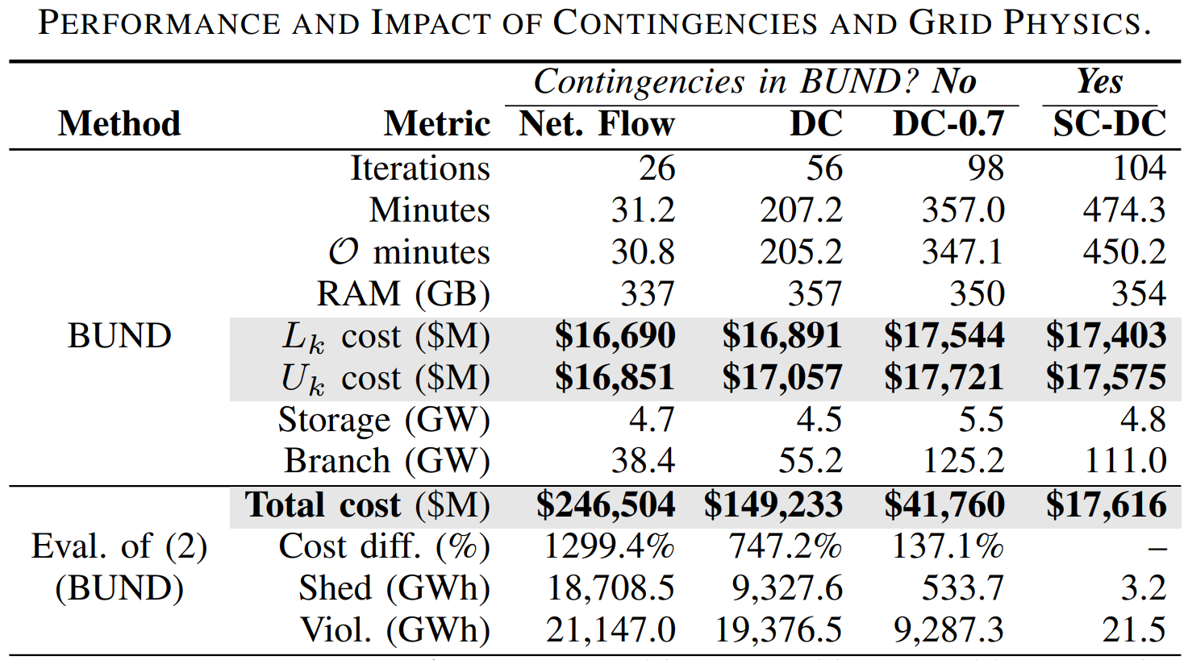
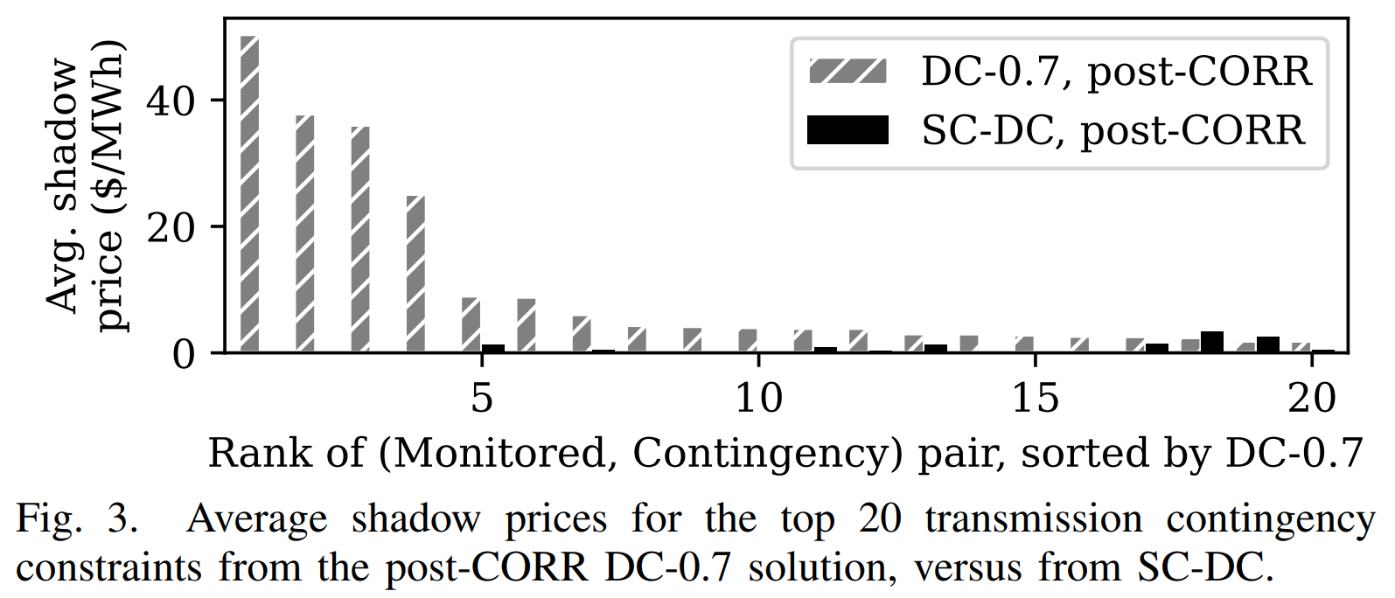
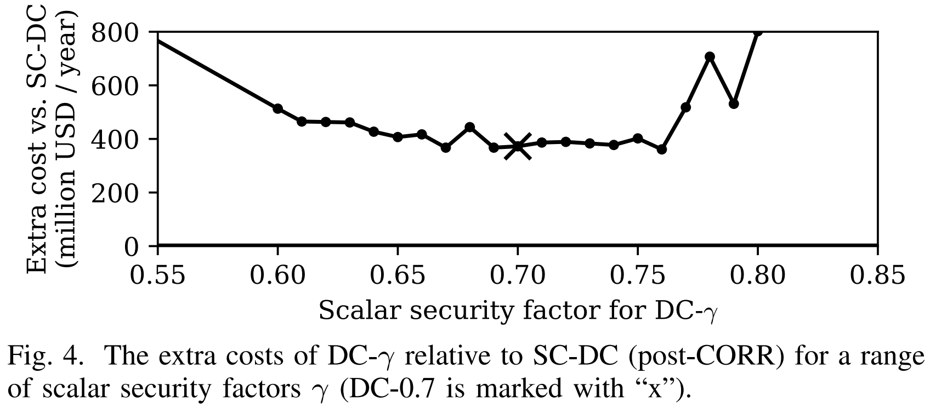
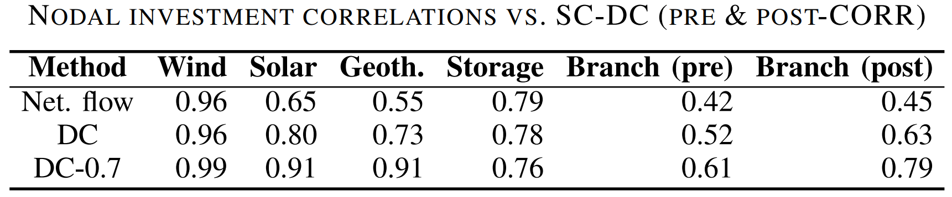
Numerical results: Heuristic methods have 130%~1,300% higher costs
Heuristic methods lead to transmission underinvestment and suboptimal siting, causing load shedding and branch violations when evaluated on “out-of-sample” SC-DCOPF.
Q: What if there’s a chance to “correct” the transmission investments (but keeping the other investments fixed)?
Q: What if we used something other than 70%?
The gap does not close.
Contingency-Aware Nodal Optimal Power Investments with High Temporal Resolution
Thomas Lee
t_lee@mit.edu

Slide 12

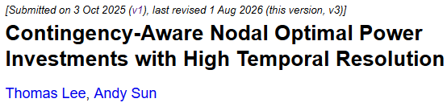
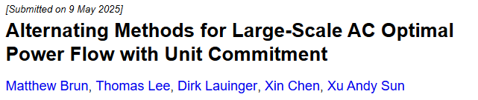

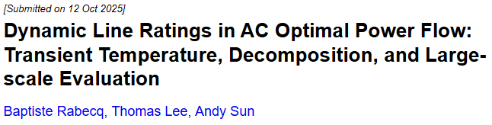

Conclusion
Transmission contingencies (security constraints) are empirically important (~90% of transmission constraints) and underpin a variety of grid phenomena (interconnection delays, congestion, renewables curtailment).
  If your capacity expansion model includes nodal power flows – I encourage you to look into transmission contingencies.
  CANOPI begins to solve capacity expansion on large-scale grid networks with endogenous security-constrained DC power flow, along with high temporal resolution.
t_lee@mit.edu
sunx@mit.edu
Other related works:
Multi-period ACOPF + transmission contingencies
Another source of uncertainty for transmission:
Dynamic line ratings
Contingency-Aware Nodal Optimal Power Investments with High Temporal Resolution

