Slide 1
Wire Frame for Bus Ticket Booking System

Slide 2
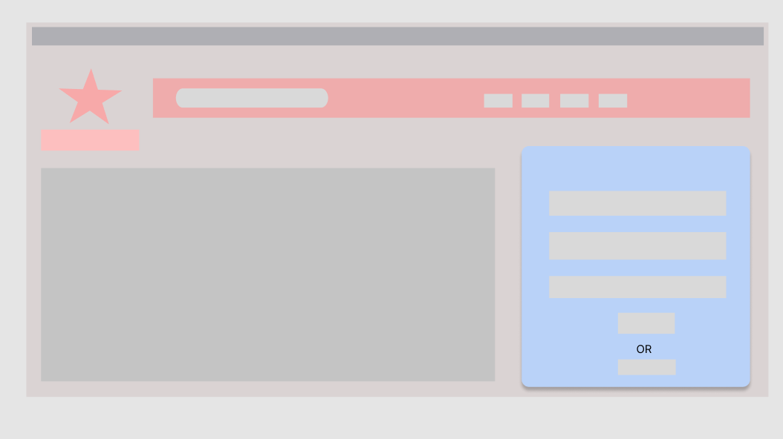
1.Main page/Login page(Admin and User)
About
Search bar
home
logo
Website name
login container
Phone number
Email
password
lmage
Submit button
Signup botton

Slide 3
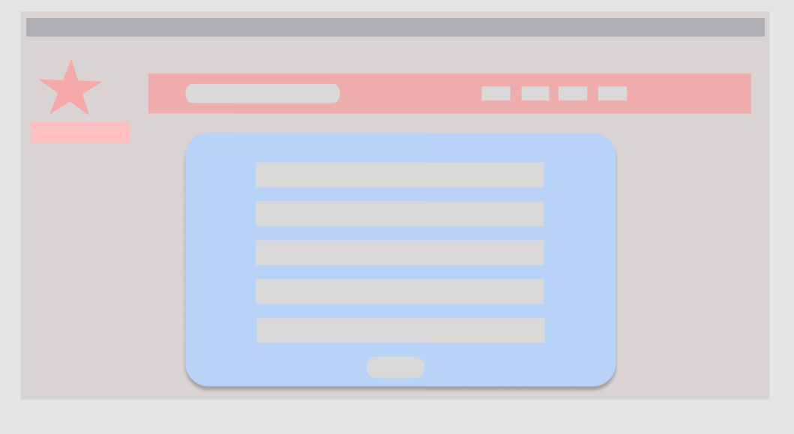
2.Registration/Signup page
username
phone
Email
Password
Confirm password
submit

Slide 4
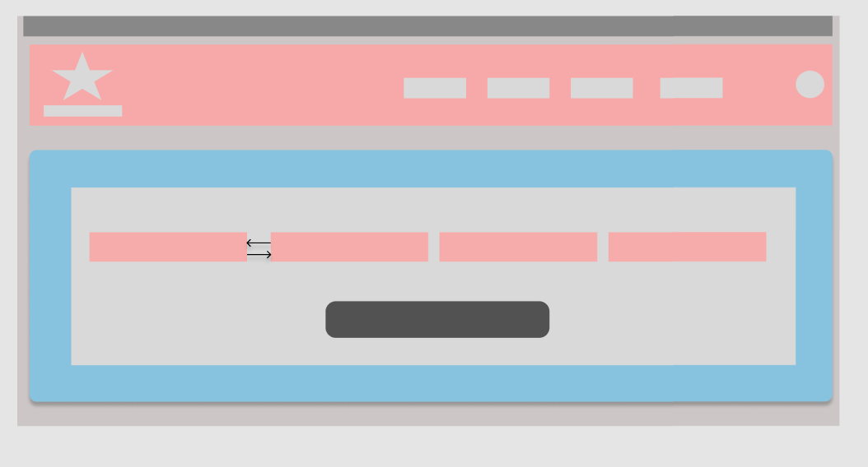
3.Home page/Bus searching page
Date field
Profile
Time Filed
Destination From
Destination To
Search Button

Slide 5
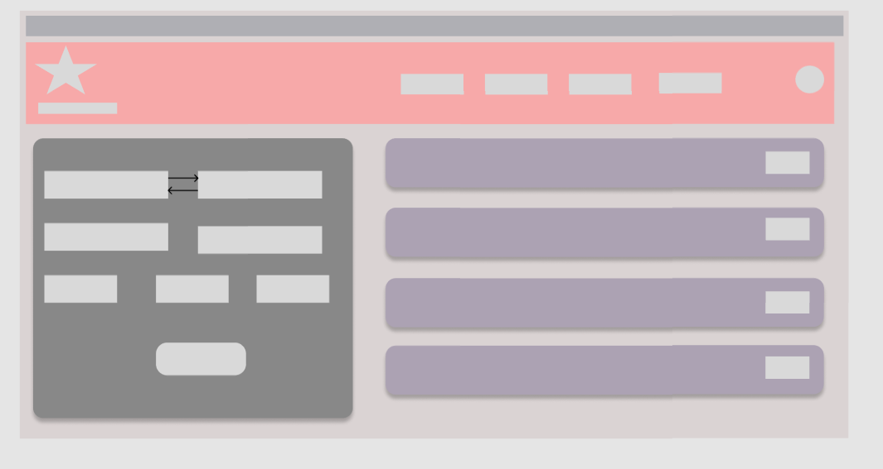
4.Bus booking/selecting page
Destination To
Destination Time To
Destination From
Bus Details
Time From
Bus Type
Submit Button
Number of person

Slide 6
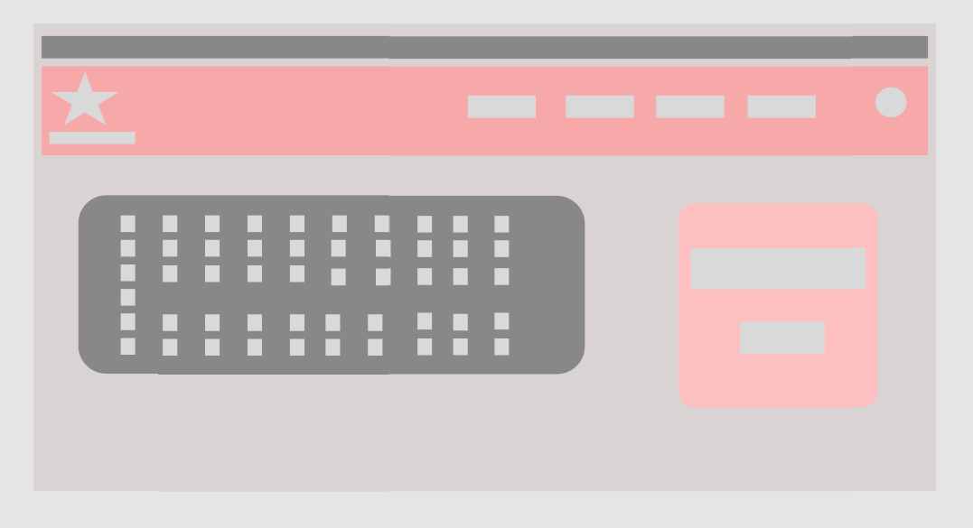
5.Seat selecting &Confirmation page
Bus Seat Demo pic
Bus Details(Name)
Book Now Button

Slide 7
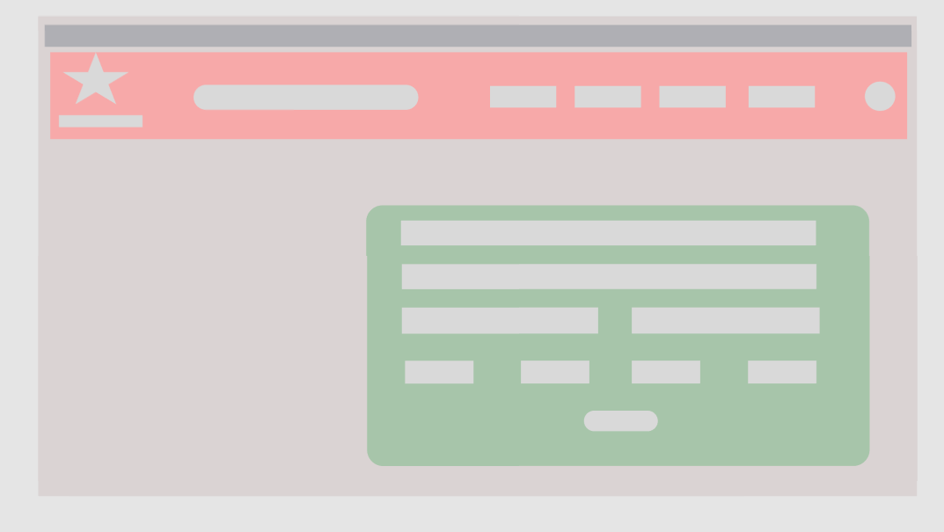
6.Admin home page(Bus details Adding/Searching)
Search Bus
Bus id
Bus Name
Bus Destinations
Bus Time(From/To)
Bus Destination Details
submit Button

Slide 8
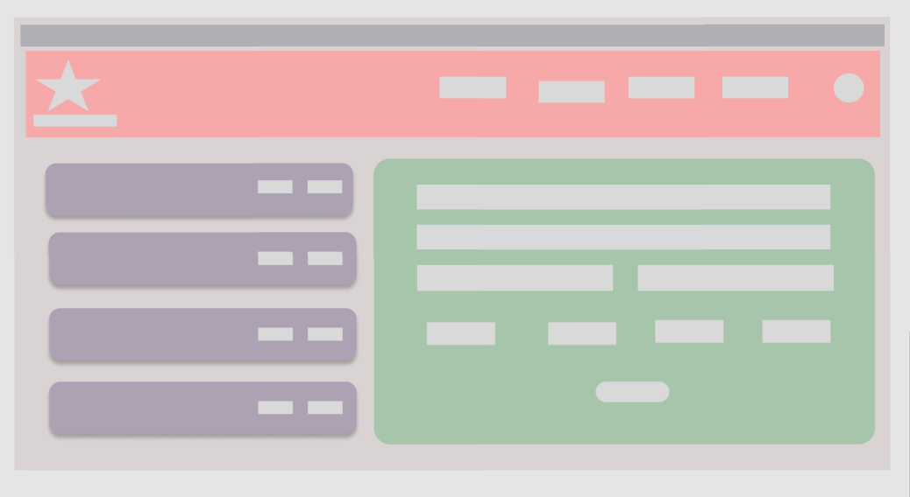
7.Admin Bus details Updating page
Update Button
Bus Details
Updating Bus Details
Delete Button

