Slide 1

Register Page
Logo
Name of the user
Password
Email
Mobile Number
Register Button

Slide 2

Login Page
Logo
Application title
Username
Password
Login button
Forgot Password

Slide 3

Home Page
User profile
Menu
To search for buses
Source place
Destination place
Search button
Manage Bookings
About us
Home page
Help

Slide 4

Available bus details
Menu
Search bar
Bus details

Slide 5
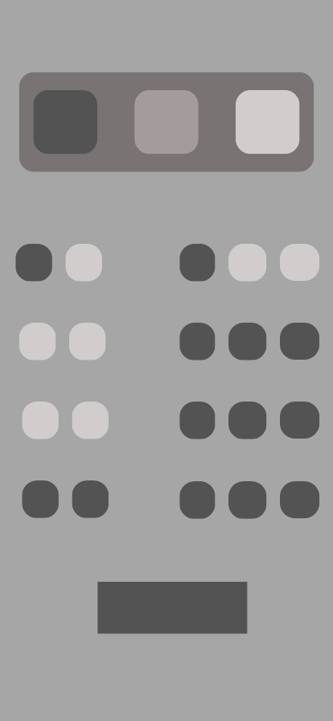
Booking seats
Available seats
Booked seats
Selected seats
Booking button

Slide 6

Admin’s home page
Menu
Admin Profile
Search bar
To add bus details
To delete bus details
To view booking details
Cancel bookings

Slide 7

Updating Bus details
Menu
Bus details
Submit button

