Slide 1
EU Migration
Question 12:
How is the population throughout Europe changing over time? How is it changing based on characteristics of the people (e.g., age, education level)? How well can movements of people between countries be followed? How well can common migration routes in Europe be identified?
Panin Vladimir
Babiy Ivan
Šabanović Ahmed
Chan Yat Hin

Slide 2




Data sources
Data sources we used:
Eurostat,
Transparency International,
MIPEX,
European Coffee Trip,
etc.

Slide 3
Data pre-processing
Data from the year 2021 was used because that was often the only available data.
Relevant columns and rows were filtered.
Datasets often had missing values for some countries.
Techniques such as interpolation and manual data entry were used in order to mitigate this issue.
Data from non-EU countries was deleted.
Finally everything was combined into one dataset.
The final dataset had no missing values, outliers, or inconsistencies.

Slide 4
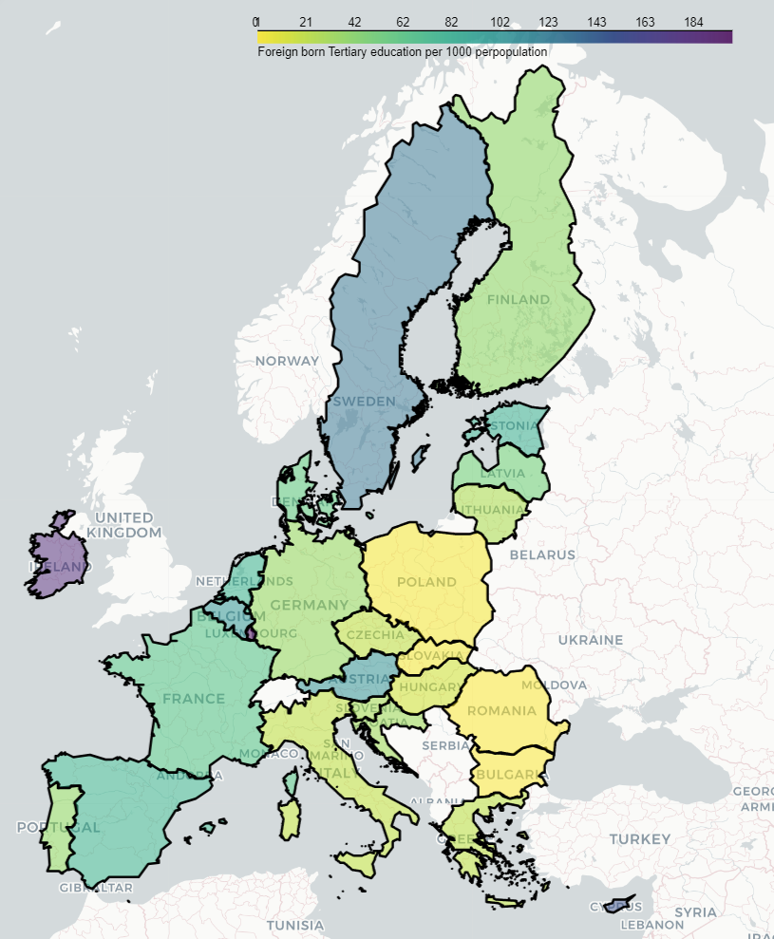
Insights at a Glance
Eastern Europe: Limited presence of foreign-born individuals with tertiary education
Variations exist within Eastern European countries.
Western and Northern Europe: Noticeable disparities
Despite comparable economies, substantial gaps in the number of educated foreigners
Examples: France vs. Germany, Sweden vs. Finland

Slide 5
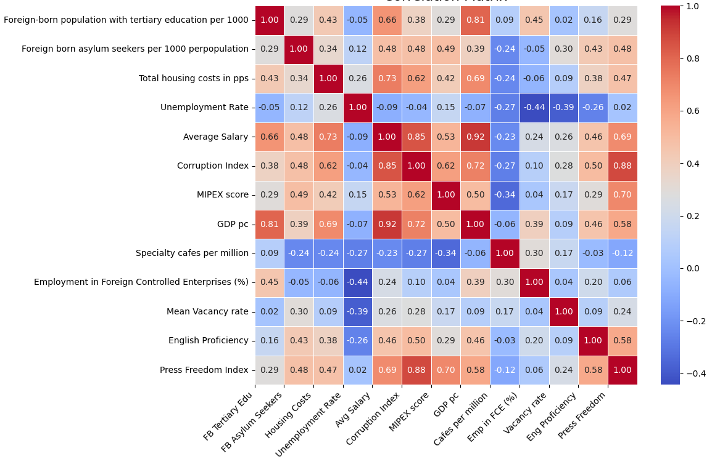

Correlation Matrix

Slide 6
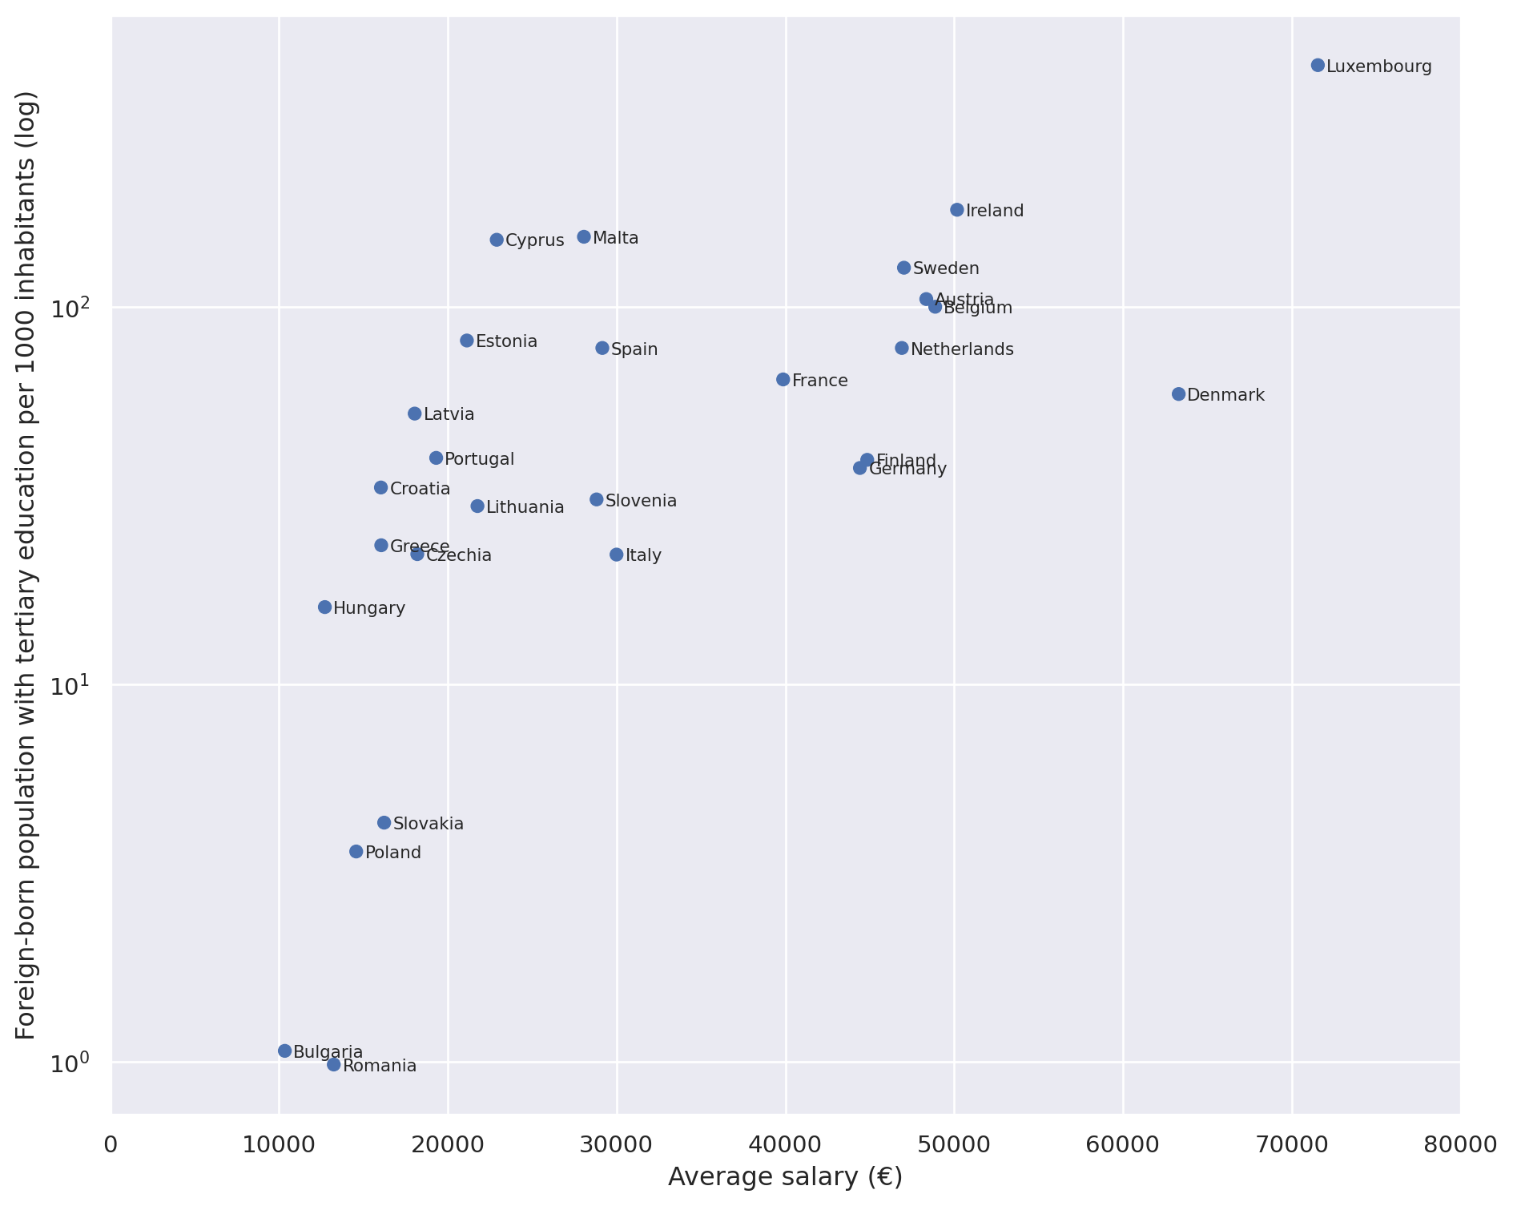
Exploring Economic Factors
To what extent do economic factors play a role in migration patterns?
There is a positive correlation between average salary and educated foreign population.
Salary alone doesn't fully explain everything.
Other factors influence migration patterns.

Slide 7
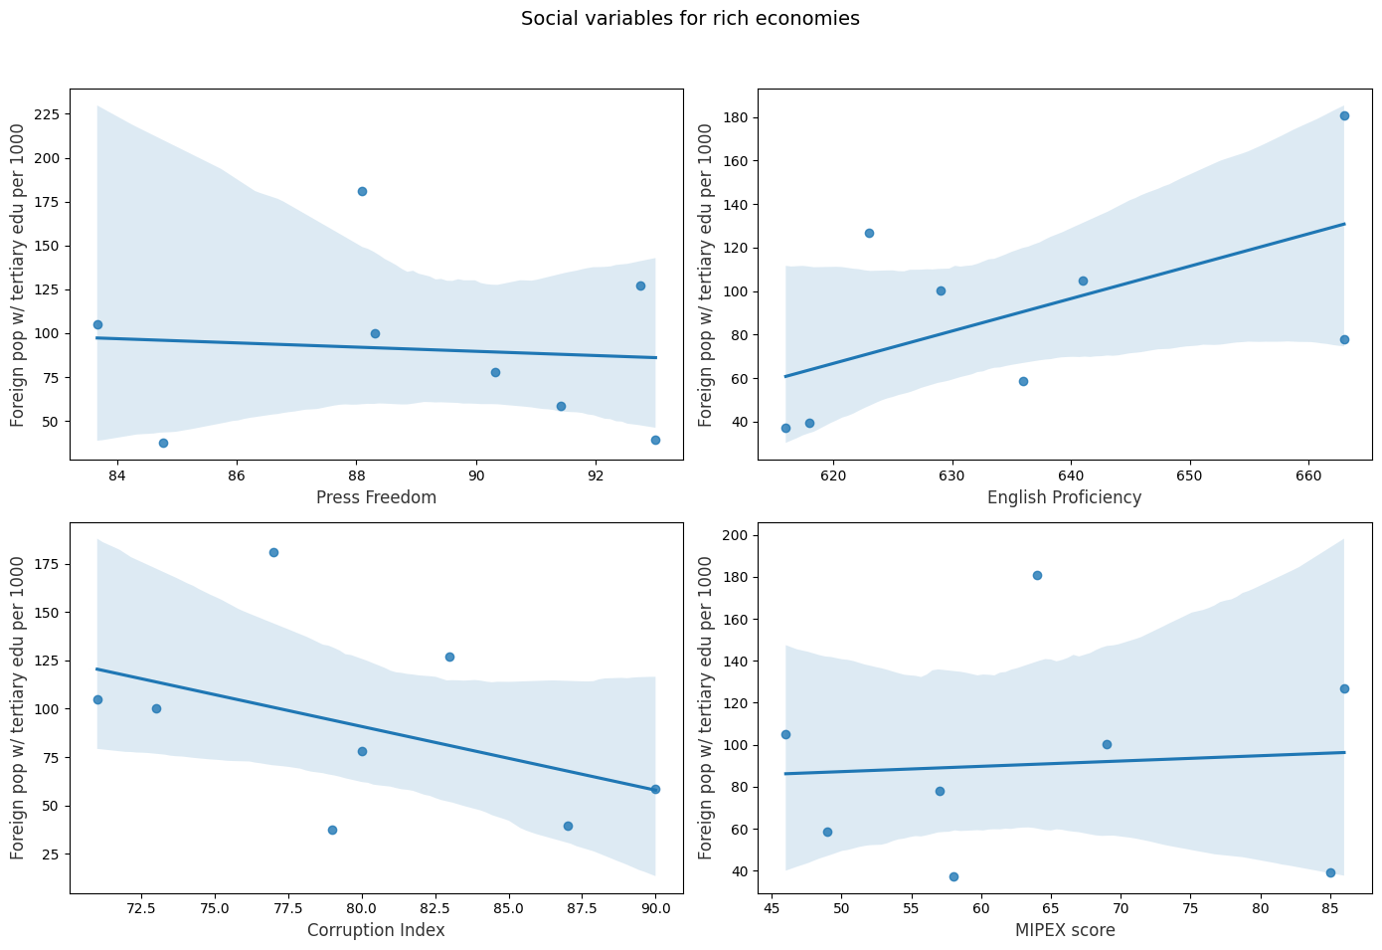
Exploring Social Factors
To what extent do social factors play a role in migration patterns?
First we take a look at the rich economies.
The conclusion are limited due to a low number of observations.

Slide 8
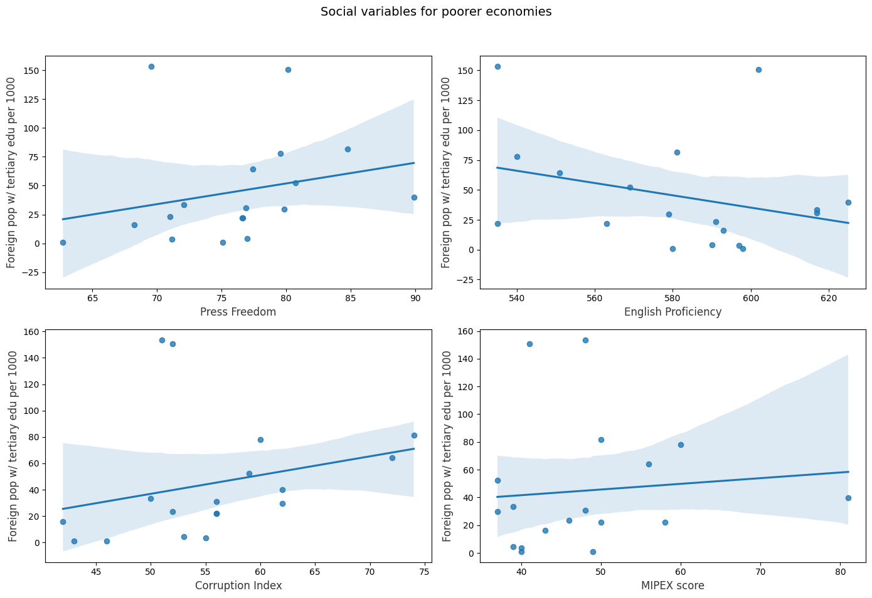
Exploring Social Factors
We have more data points for poorer economies.
The confidence intervals seem to be smaller when compared to the richer economies.
There is a noticeable correlation with the Corruption Index and Press Freedom Index.

Slide 9
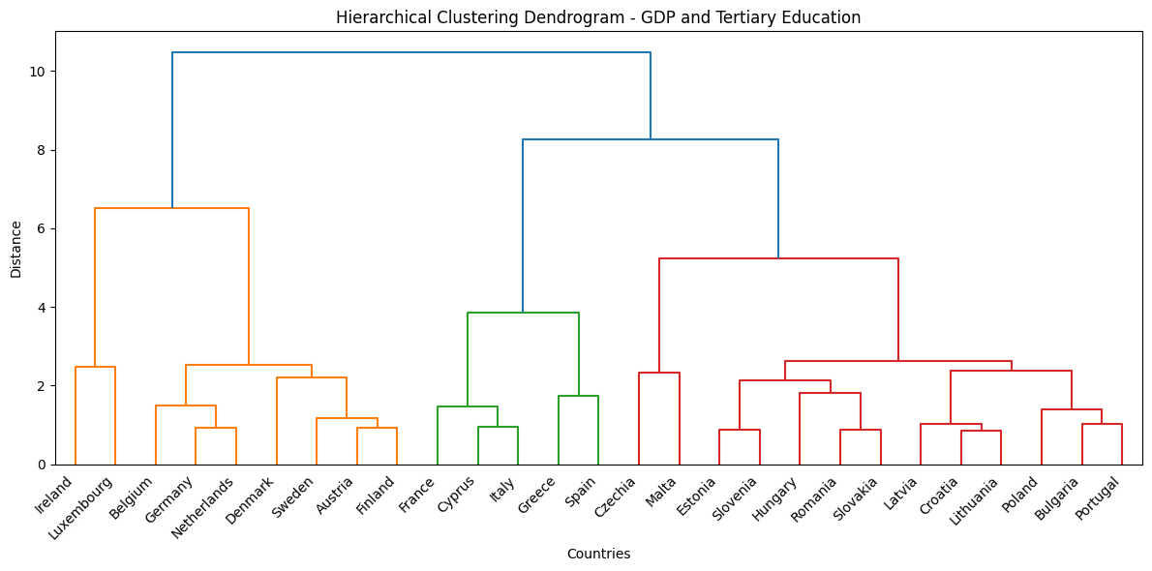
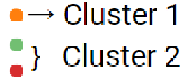
Clustering
Cluster 1:
Emphasis on Economic Factors:
GDP per capita, Average Salary, Corruption Index.
Cluster 2:
Focus on Social Factors:
Specialty cafes per million, Unemployment Rate.

Slide 10
Conclusions
Language barriers, especially among different language families (Slavic, Romance, Germanic), may influence migrants' choices.
Tertiary-educated migrants may prefer countries with higher social variables but similar cultural backgrounds.
There is a tendency for foreign-born tertiaries to migrate to economically developed countries.
Richer countries: No correlation found between proposed social variables and the number of migrants.
Poorer countries: Positive correlation observed with social variables such as Corruption Index or Freedom of Press Index, indicating their influence on migration.

Slide 11
Conclusions
Policy implications:
Improving countries' economies, tends to positively impact social variables.
Enhancing English proficiency across populations tends to attract foreign-born tertiary-educated individuals.
Issues such as migration require domain expertise.
Migration data is very complex and is influenced by cultural, social, and historical factors.
Domain experts are needed to interpret nuances in migration trends.

Slide 12
Contribution overview table
Steps | Vladimir | Ivan | Ahmed | Yat Hin
Obtaining data | X | X | X | X
Pre-processing | X | X | X | X
Exploration & visualization of economic factors | X |  |  | X
Exploration & visualization of social factors | X |  |  | X
Clustering |  |  | X
Insights | X | X | X | X
Prediction with kNN | X | X |  | X
Creating the presentation |  |  | X
Creating the report | X | X |  | X

Slide 13
Thank you for your
Attention !

