Slide 1
Magic Hexagon
Group 17
Christoph Bartmann

Slide 2
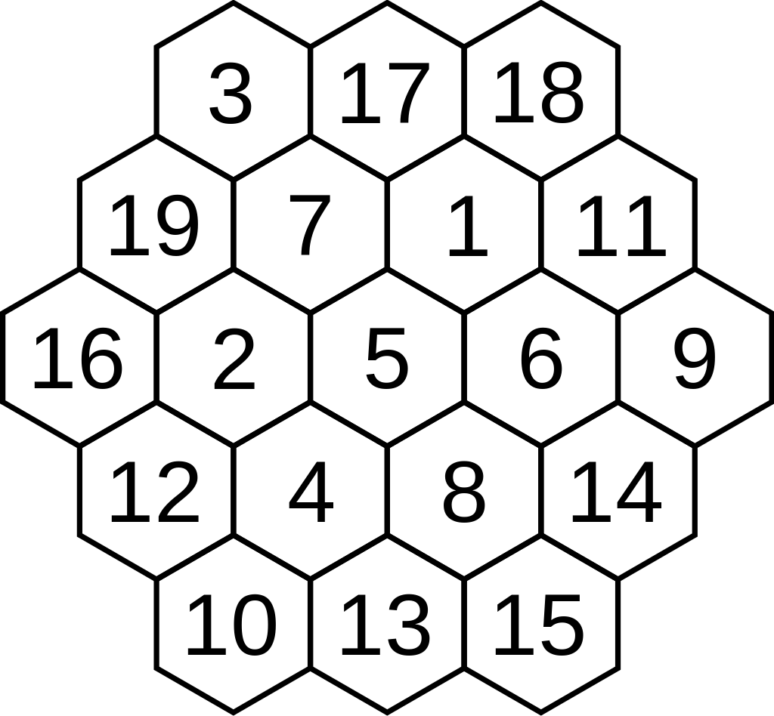
The Problem
Given Program
Consecutive Integers
Arranged in a Hexagon
Each row and diagonals add up to the same constant
Major functions:
labeling: explores the search tree
solve: checks constraints and updates bounds
n=3, M=38

Slide 3
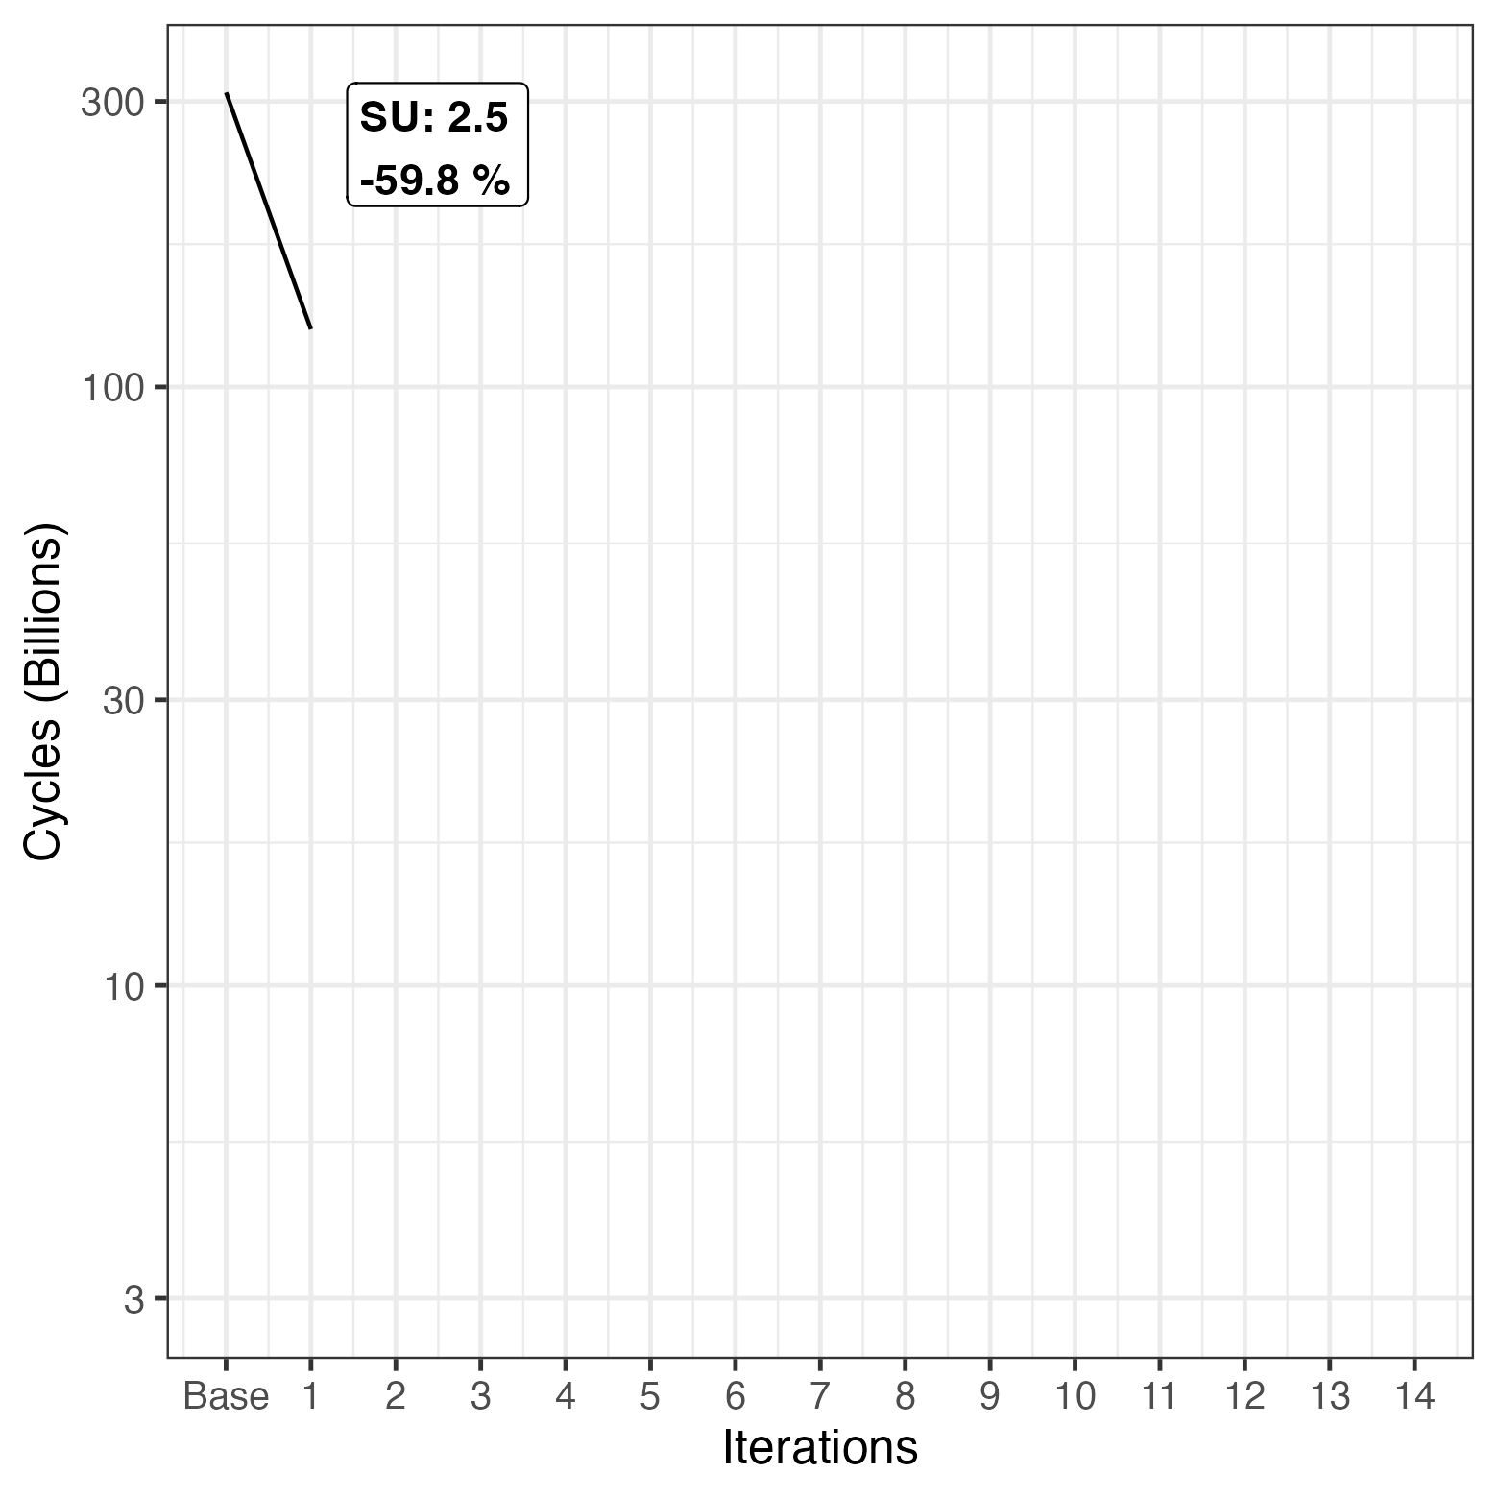
Constraint Check Restart
Check all constraints in solve() before restart
if change_counter > 0 and solution still feasible restart
Don’t restart solutions that are already impossible in not checked constraints
Notes:
Id3

Slide 4
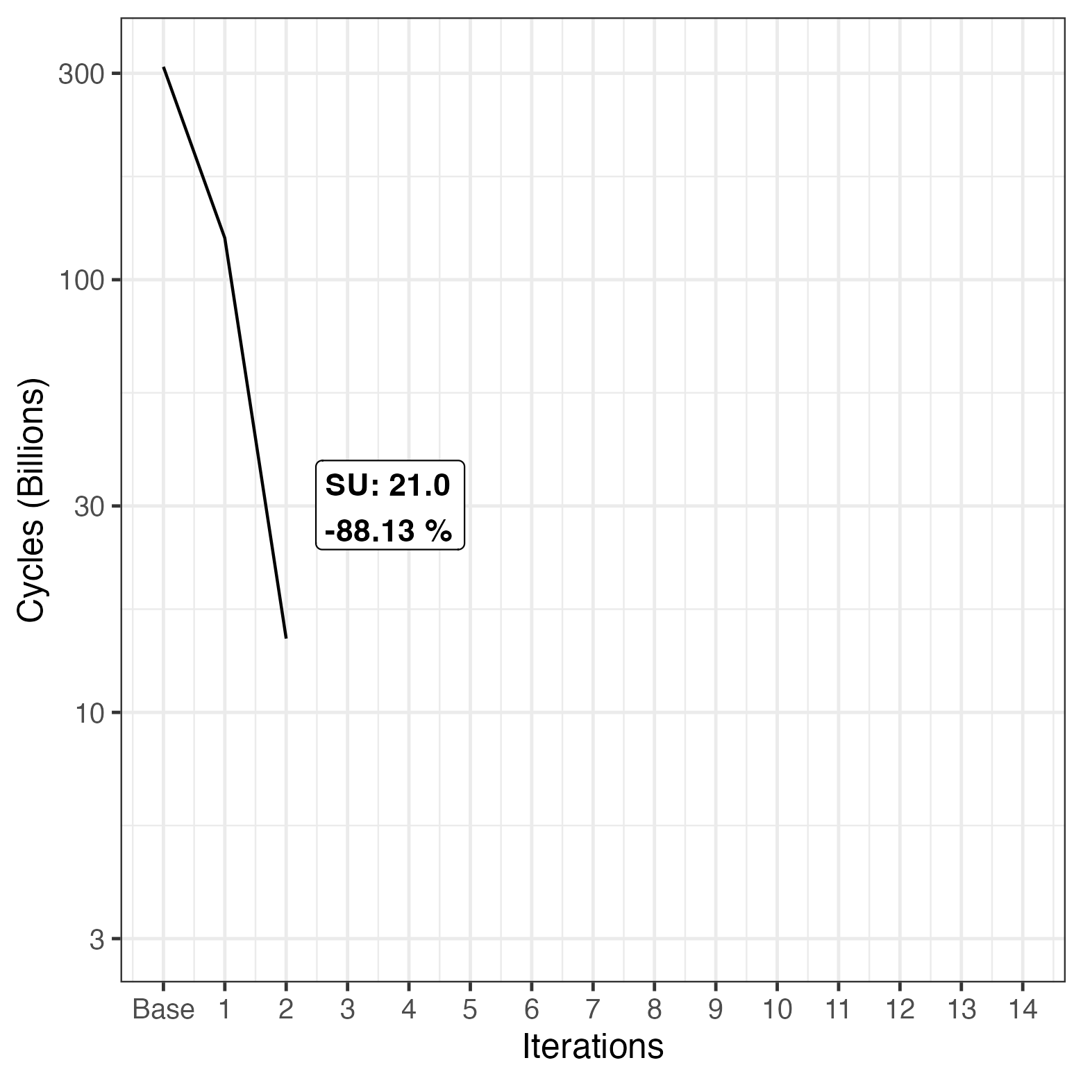
Spirale Labeling
Static index array as a spirale path in labeling()
Outside to inside performed best
Corners first, outer edges first, Center after outer edges all worse
Inside to outside spirale very bad
Notes:
id22(merges previous with 8)

Slide 5
Spirale Labeling
Static index array as a spirale path in labeling()
Outside to inside performed best
Corners first, outer edges first, Center after outer edges all worse
Inside to outside spirale very bad
Description | CPU Time [s] | Cycles (billions)
Corners First | 49.1 | 230.1
Corners First, Outer Edges | 40.6 | 190.5
Spiral outer Edges, Middle, Spiral Inner Edges | 8.3 | 38.9
Spiral | 6.1 | 28.4
Reverse Spiral | timeout
* Metrics without any other optimization
Notes:
id22(merges previous with 8)

Slide 6
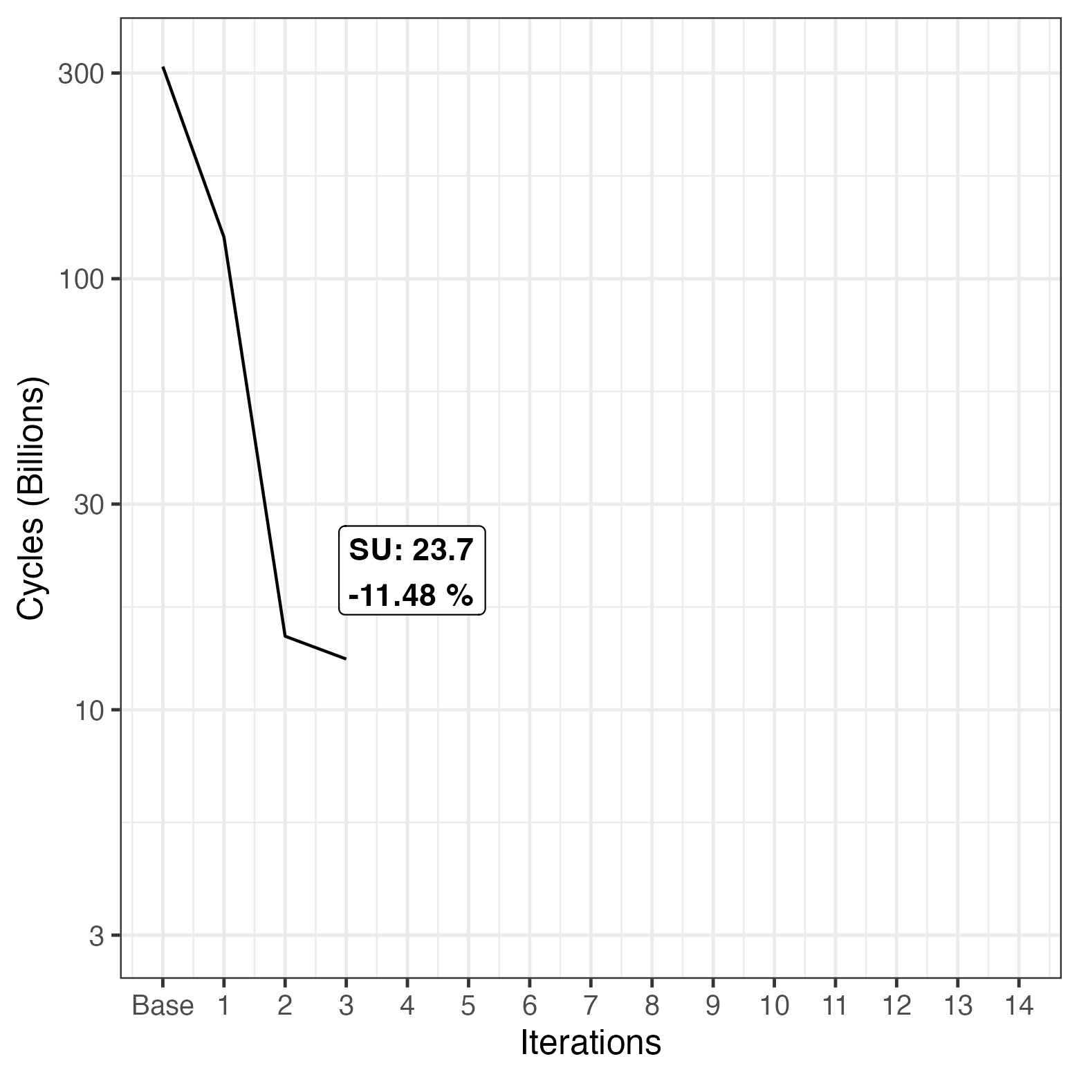
Ignoring Assertions,
Occupation Pointers
Commented out assertions, in total 16
Pointers instead of indices for accessing occupation array in solve()
Notes:
Id 23 megres previous with (10,13)

Slide 7
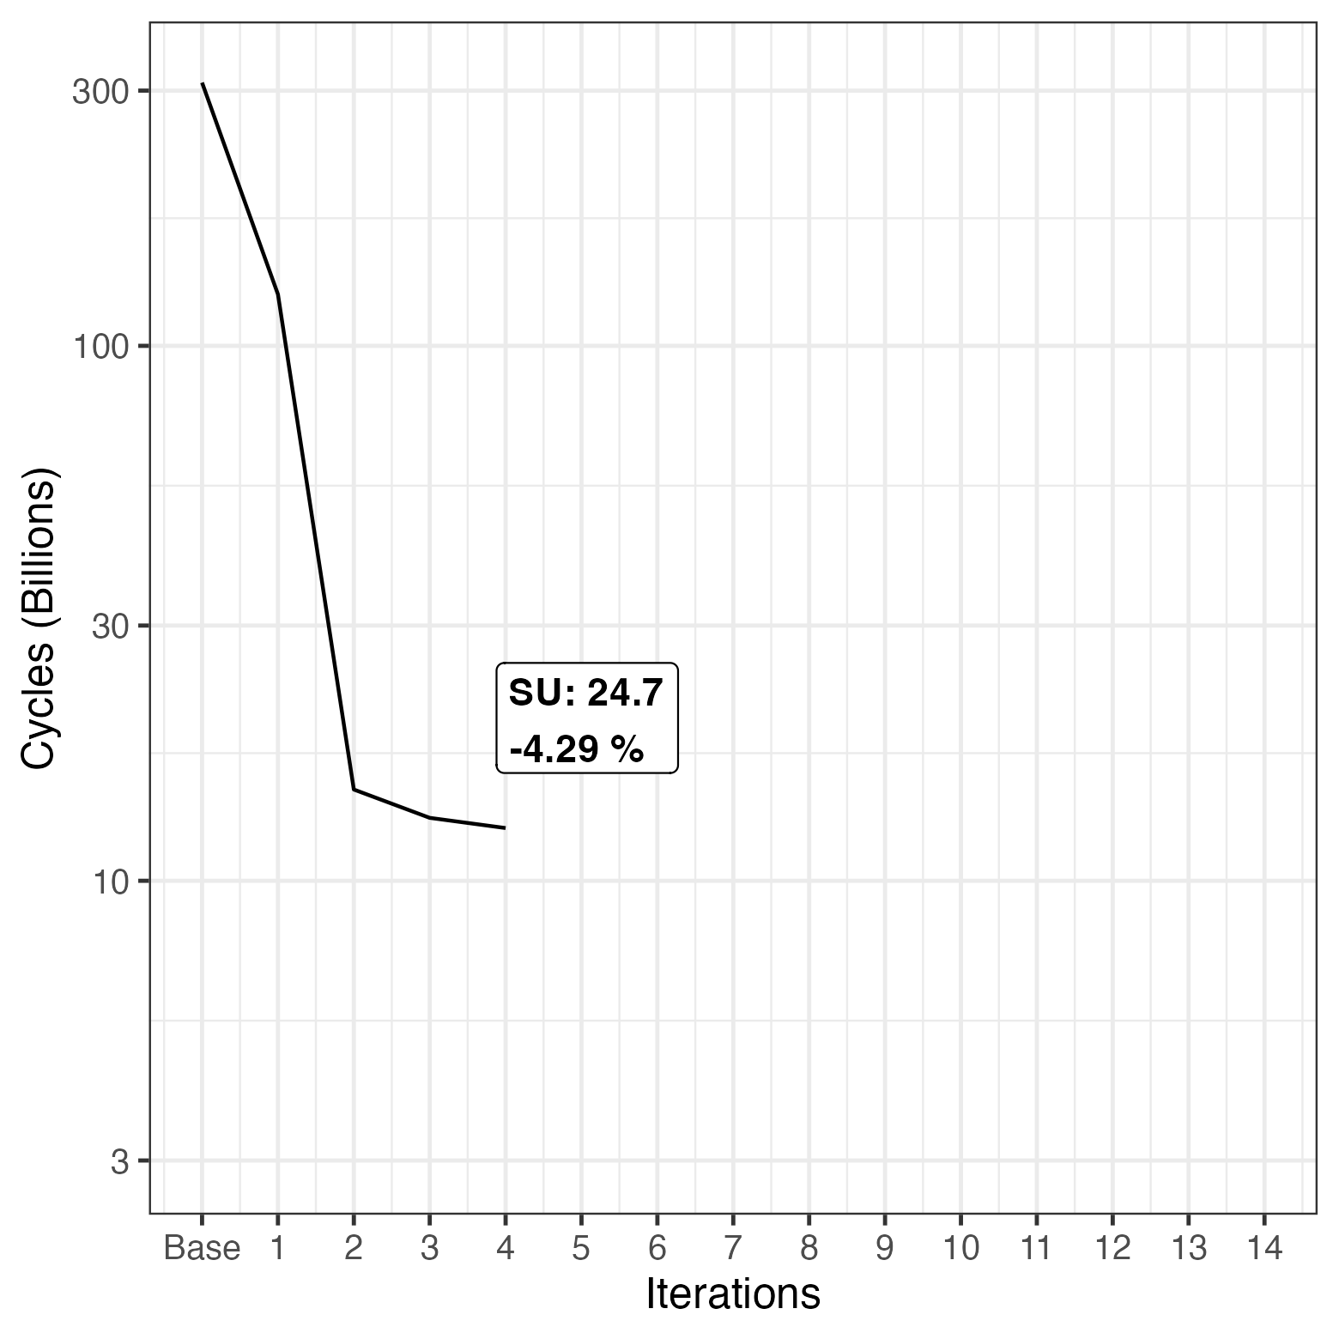
(1/2) Order in Sum Constraint Evaluation
Index array for evaluation of sum constraint
Sum checks now begin from middle and move alternatively to the outside
Earlier failure as middle has more hexagon pieces and more constraints
Notes:
Id 24 combines previous with 15, 17 and 18

Slide 8
(2/2) Optimized sethi/setlo
Change logic evaluation: Check if x >= v->hi first
Most common case, nothing changes
Skips rest of function
Inlining additional improvement
Notes:
Id 24 part 2

Slide 9
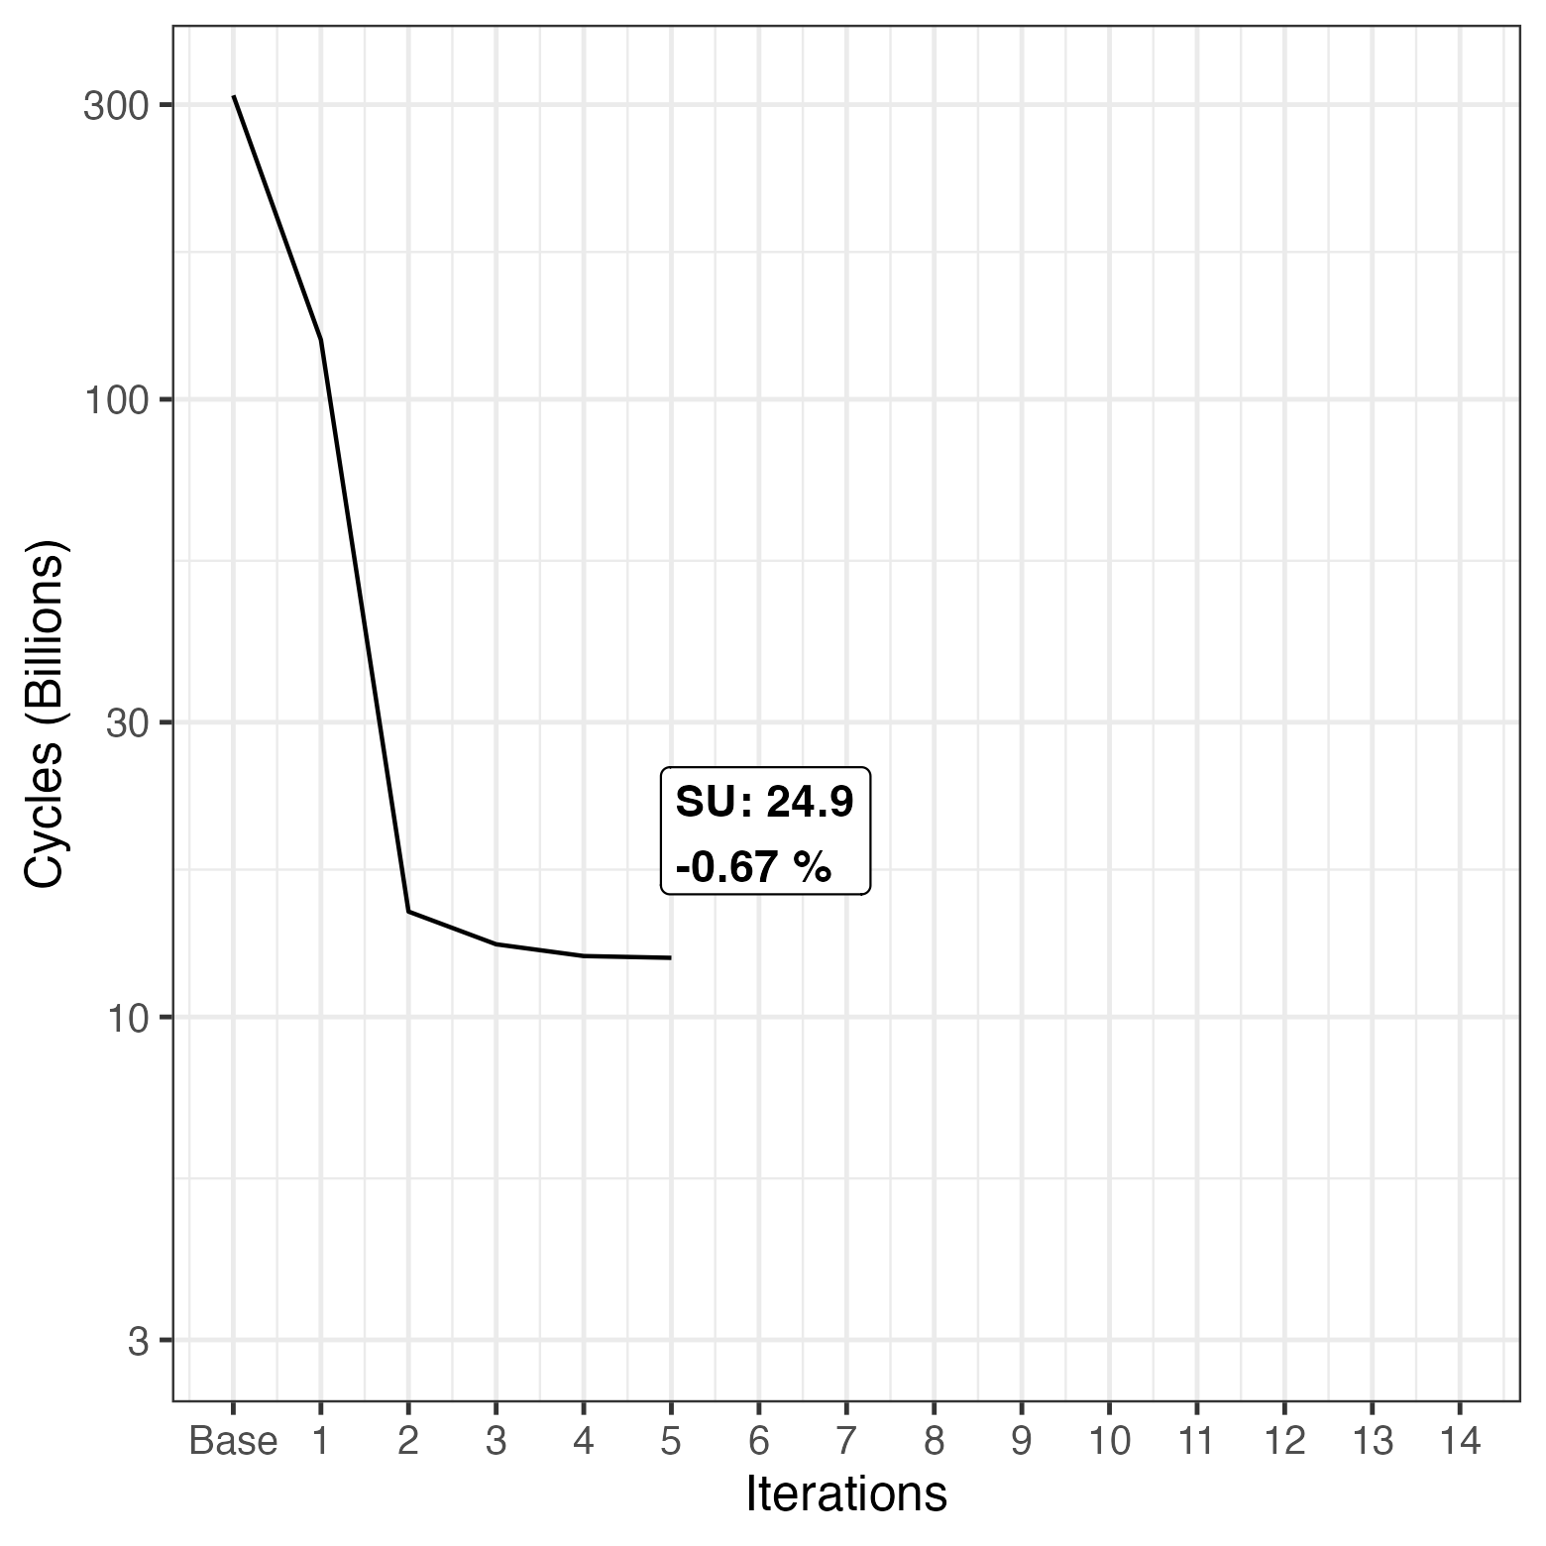
Global Parameter Initialization
Defined global parameters r,H,M,o and corners
Calculated once, not each time solve-function is called
Notes:
Id 26

Slide 10
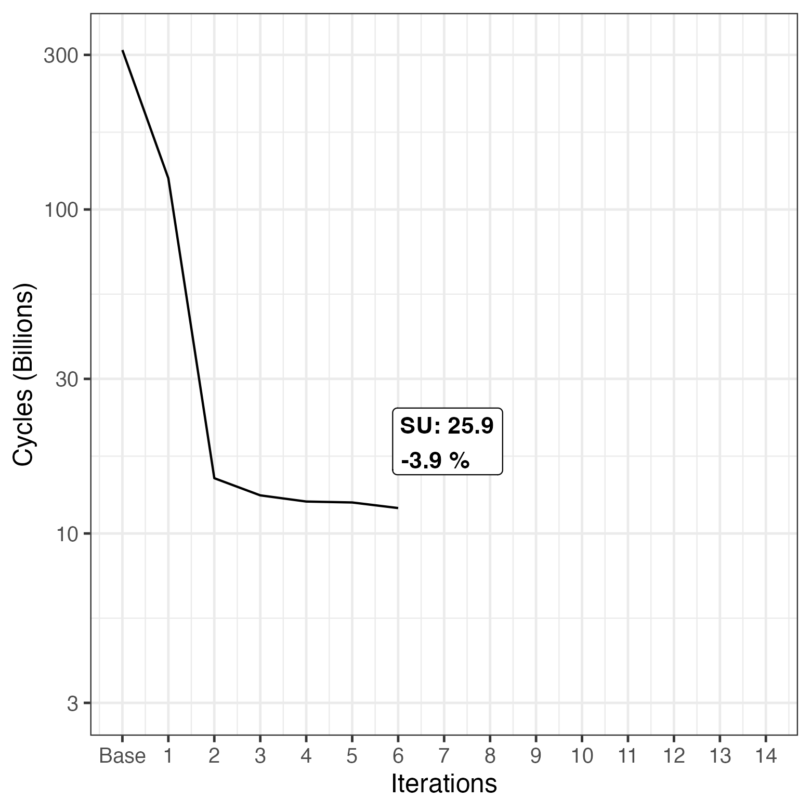
Combined for-loops
Combined the loops that
propagate the alldifferent constraint
propagate the alldifferent results to bounds
They iterate the same scope (redundancy)
Notes:
For the next iteration step, we tried to combine the two for-loops in the solve function, namely the for loop that propagates the alldifferent constraint and the for loop that propagates the alldifferent results to the bounds.
That is possible because they iterate over the same scope and we can therefore remove this redundancy.
This adaption did noch decrease the cycles by a lot as we can see on the right hand side.
Id 27 adds id 11

Slide 11
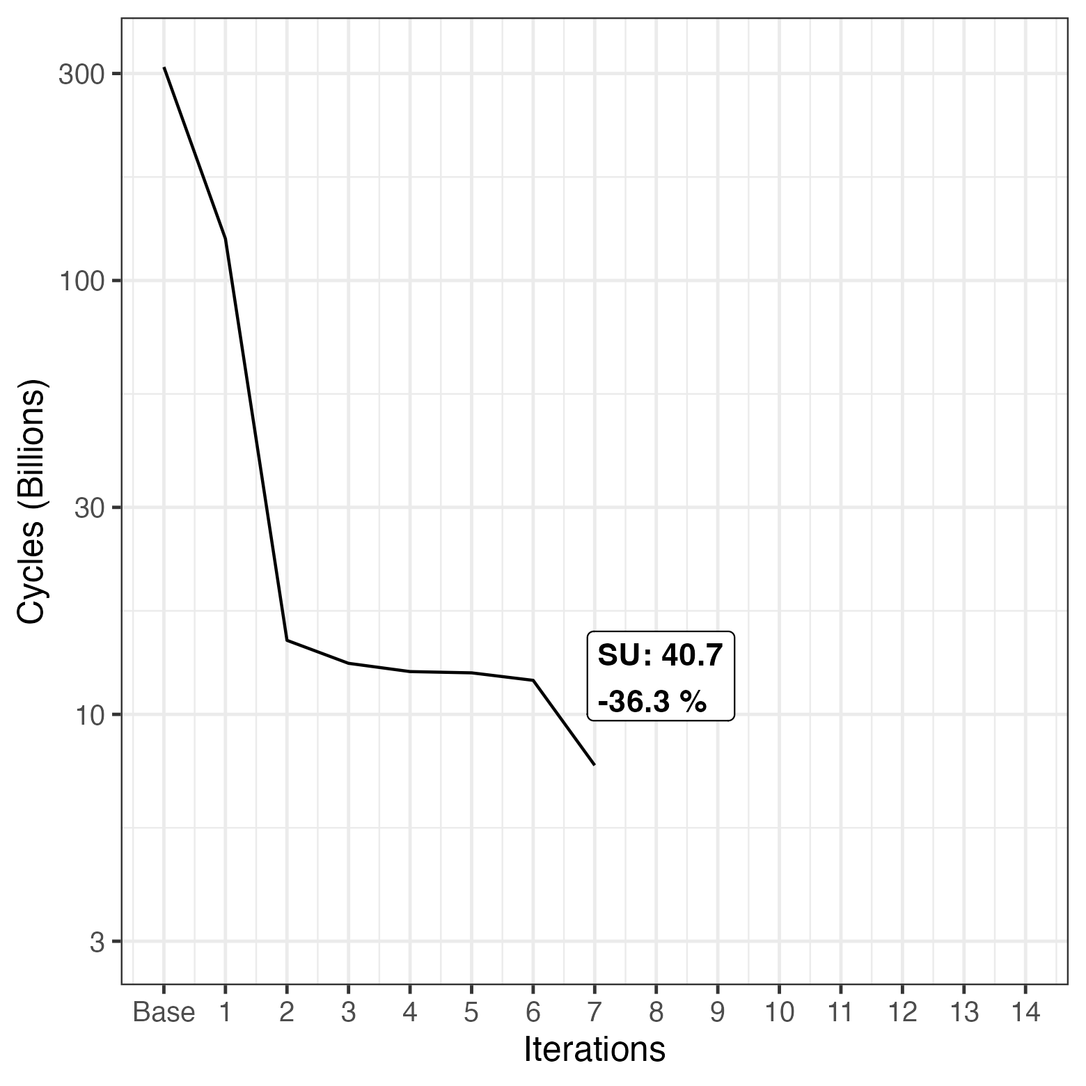
Changed Occupation Array Filling
Include while loop in occupation array filling
As long as free value for low/high, we increase low/high
Removed Combined for-loops from previous slide
Notes:
We then tried to change the occupation array filling logic. For that, we introduced a wile loop to the occupation array filling logic. With that, we iterate as long as there is a free value for low or high and then increase or decrease low or high respectively. To make this iteration possible, we had to remove the adoption from the silde before, where we combine the for loops. This adaption did help quite a lot, reducing the cycles from around 12 billion to around 7 billion.
Id 29 also removed id 11 (combined for-loops)

Slide 12
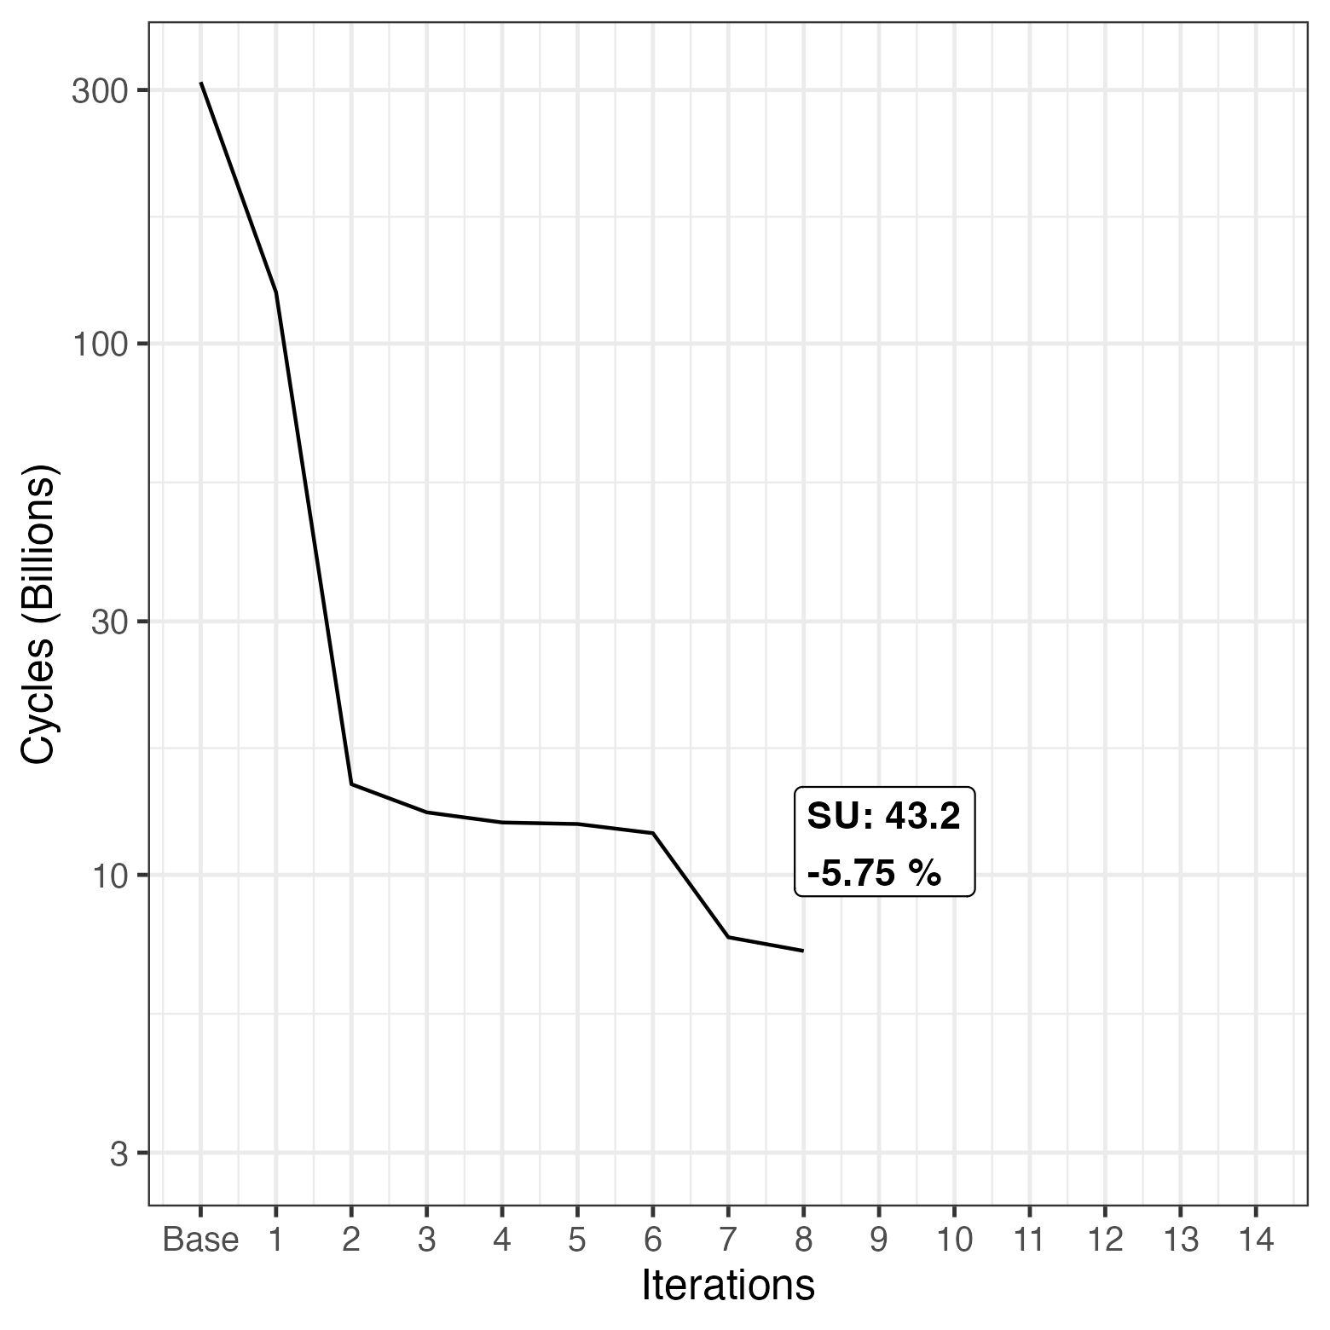
Sum Calculation Changed Flag
Introducing flag in Sum calculation:
Continue sum calculation and not restart once a change is made
Keep track in flag if a change happened
If it did return 1
Introduced equality check of hi and lo, to move to next index
Notes:
The next adaption we tried was to add a flag to the sum calculation, which indicates that a change happened. With that, we can continue the sum calculation and do not restart once a change is made. We just keep track if a change happened and return 1 if so at the end.
We also needed an equality check of high and low, that indicates wether to move to the next index.
Id 30

Slide 13
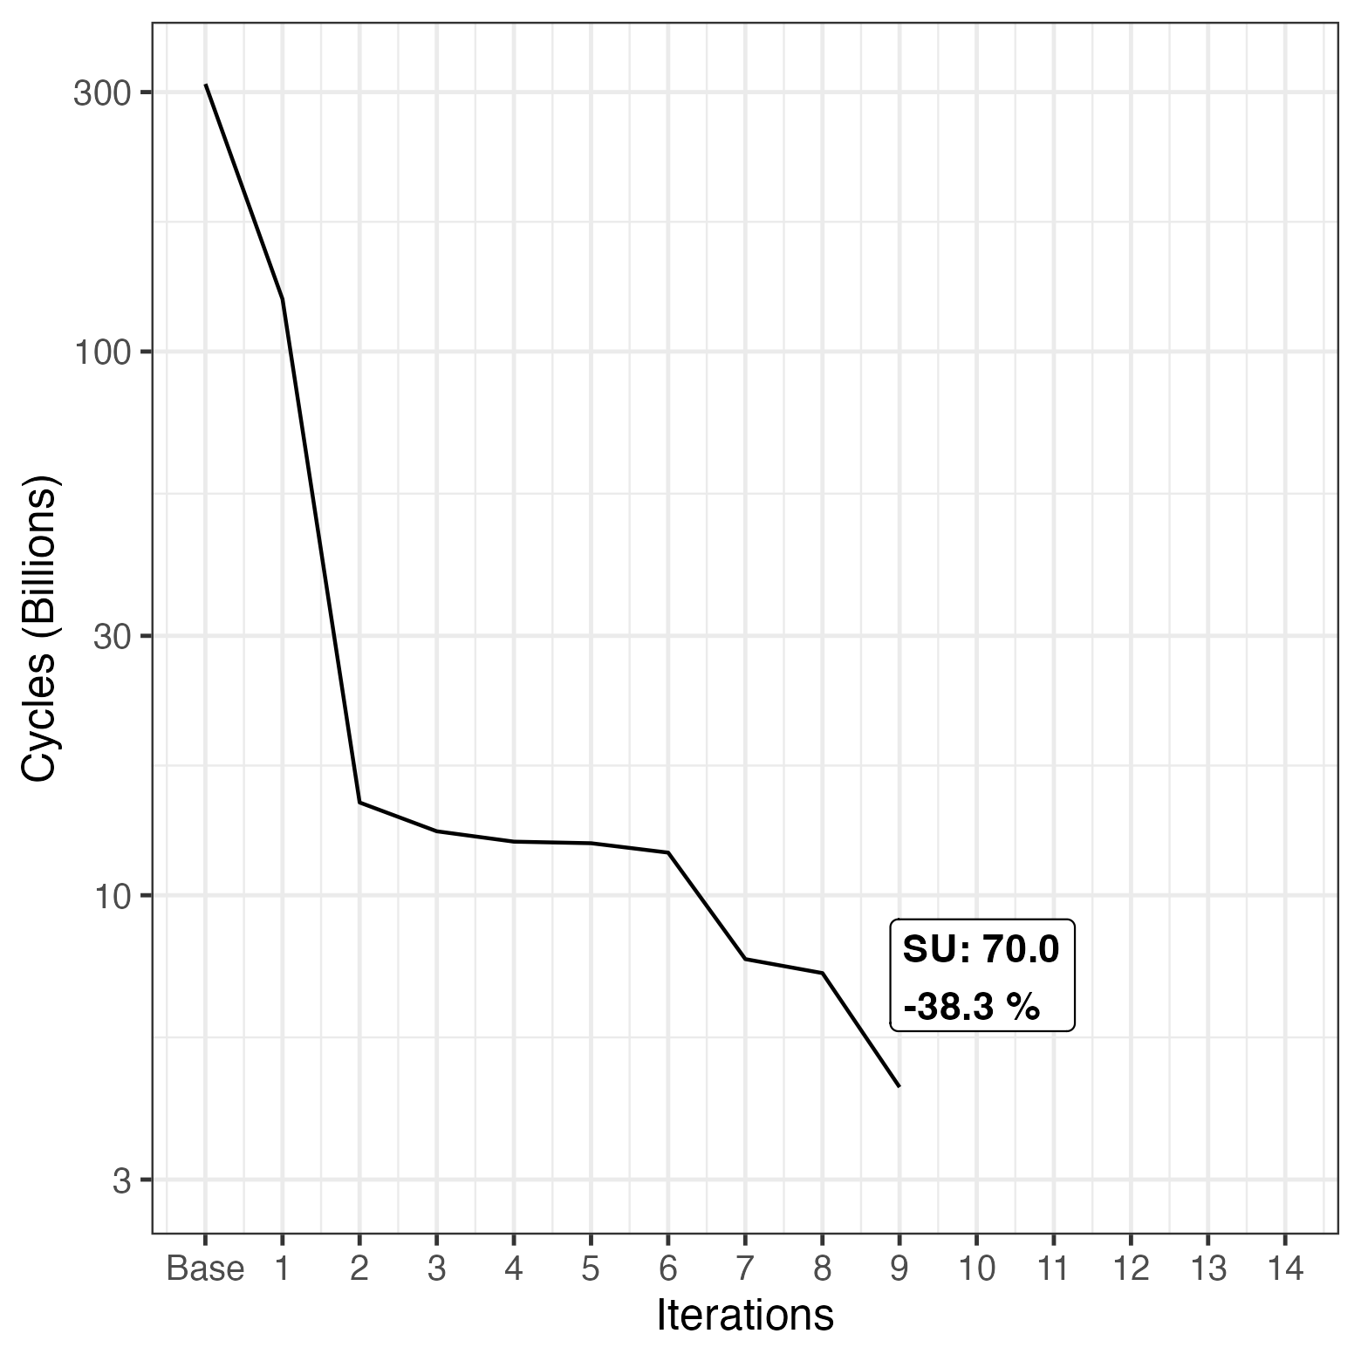
Bisection of Range
Not simply test all values between the lower and higher bound
Bisect range and make two separate calls to solve
Ideally fail early, find that one of these subranges does not contain a solution without exploring it in more depth.
Notes:
As for the next iteration, we bisected the range. The idea was to not simply test all values between lower and higher bound, but to bisect the range and to make two seperate calls to solve.
This adaption ideally fails early. That means to find that one of these subranges does not contain a solution it doesnt need to explore it in more depth. This iteration step also drastically reduced the cycles needed. 4,5 Billion
31 includes 14

Slide 14
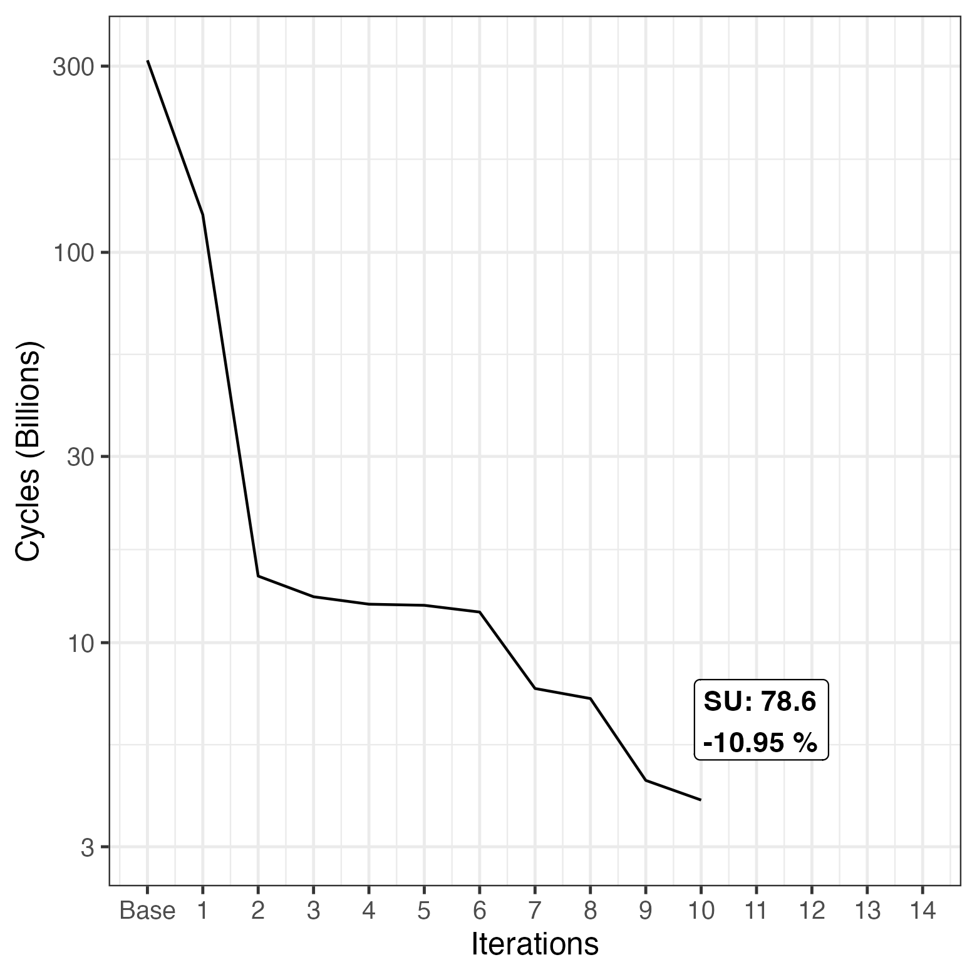
Highest Lower Bound Heuristic
At each labeling step, go through all indices
Select the variable with highest lower bound next
Indices are still at first explored by the spiral but after the first index heuristic takes over
Notes:
Id 32

Slide 15
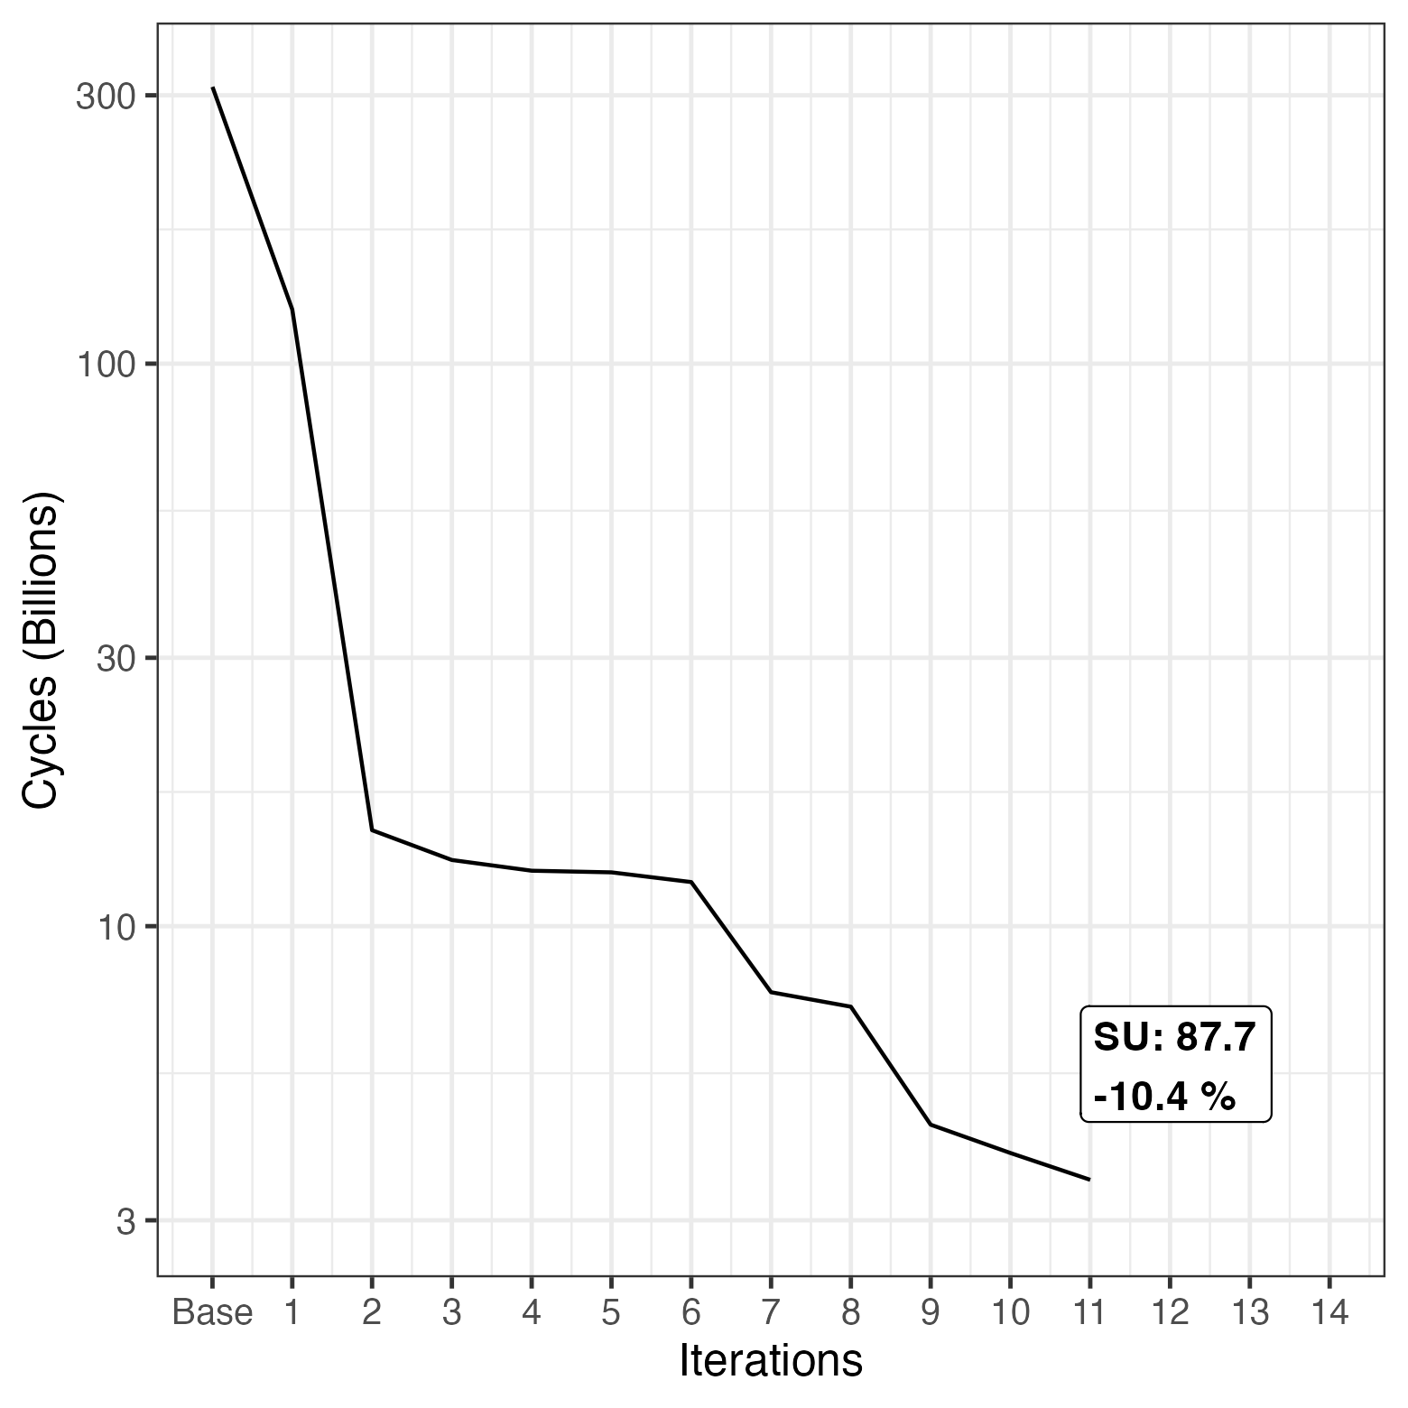
Corners First
Put the corners in the beginning of the static indexing
Remaining static indices are still spiral
Corners are involved in the most constraints
Notes:
Id 33

Slide 16
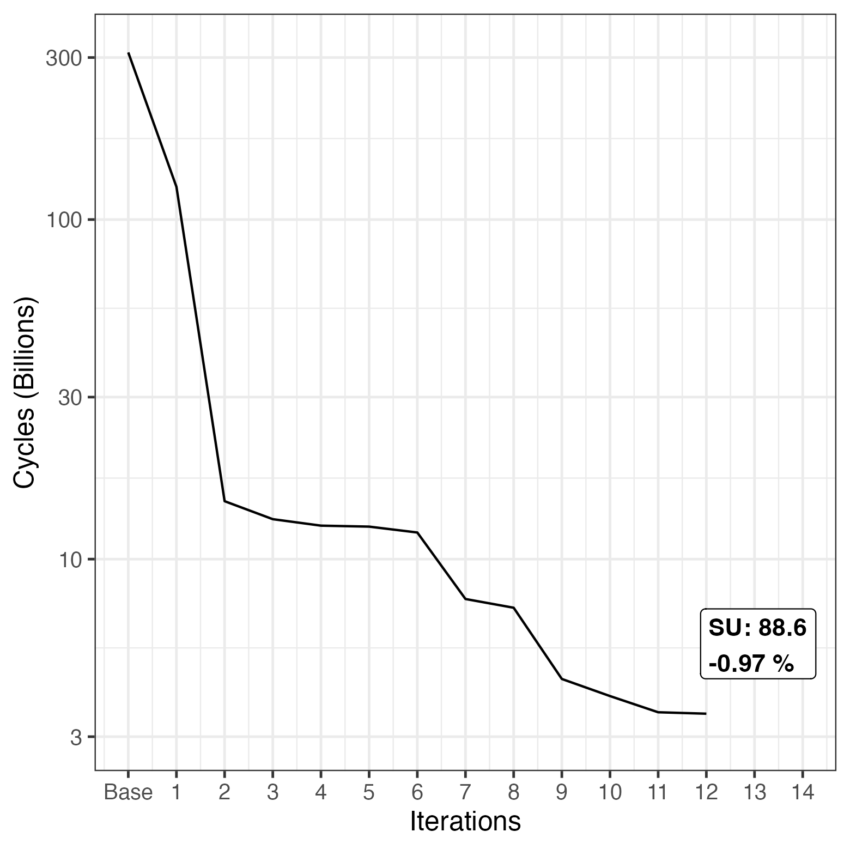
Spiral Path Removal
Remove spiral ordering, redundant at this point
Overhead of spiral computation is removed
Simply have static list with corners in first positions
Index selection is done by heuristic anyway
Notes:
Id 34

Slide 17
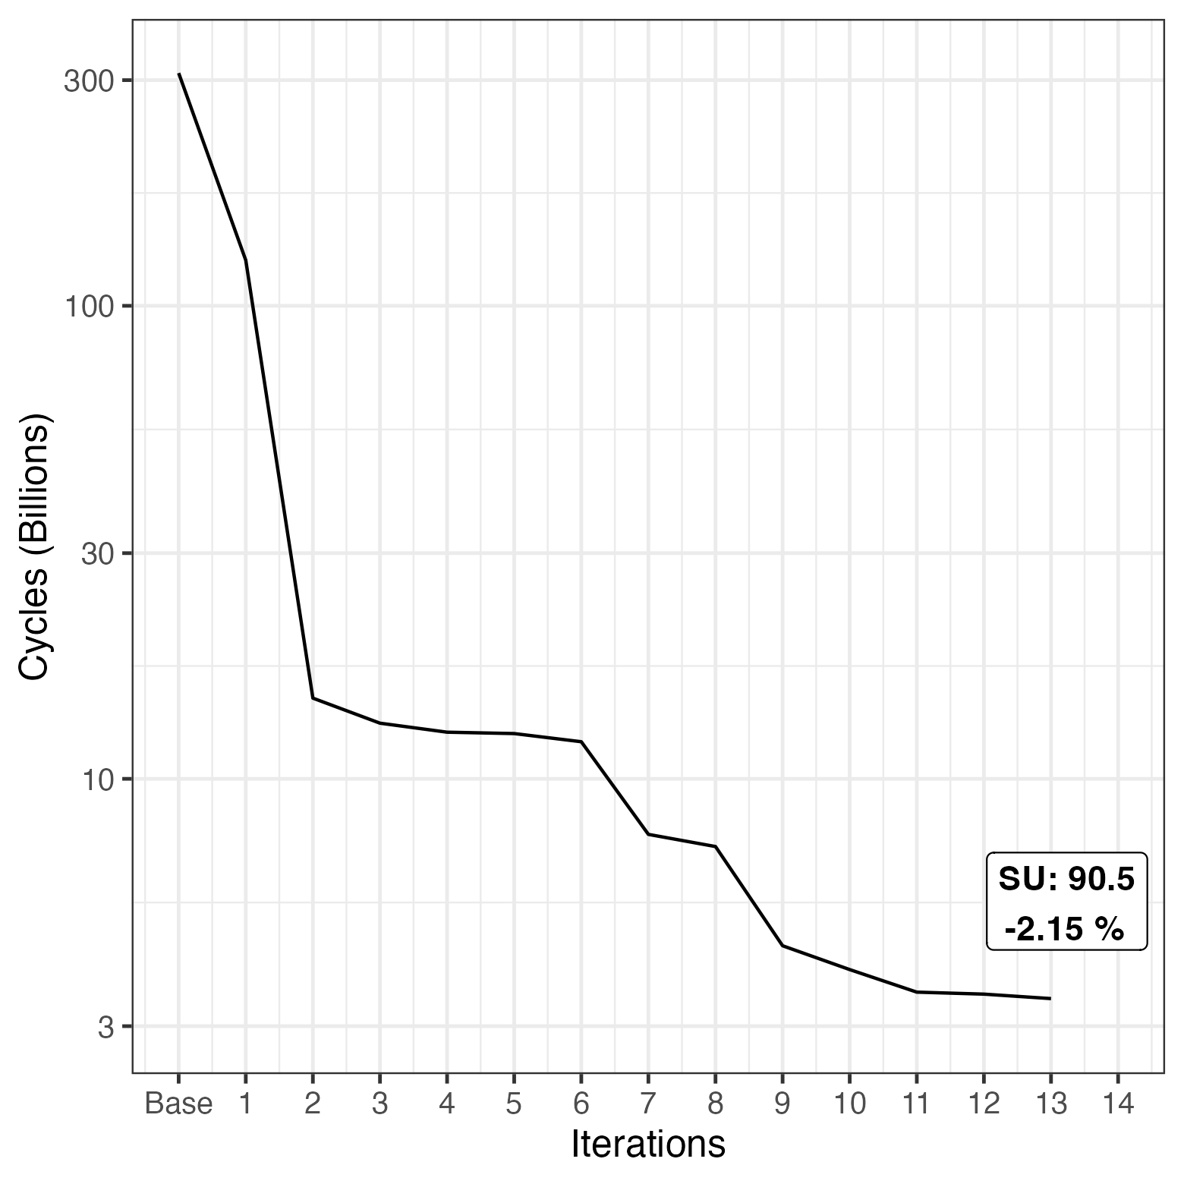
Early Stopping in Sum-Function
Introducing check in sum loop
Assert that hi and lo are still feasible after worst case bound calculation
If not return 0 immediately
Notes:
Id 35

Slide 18
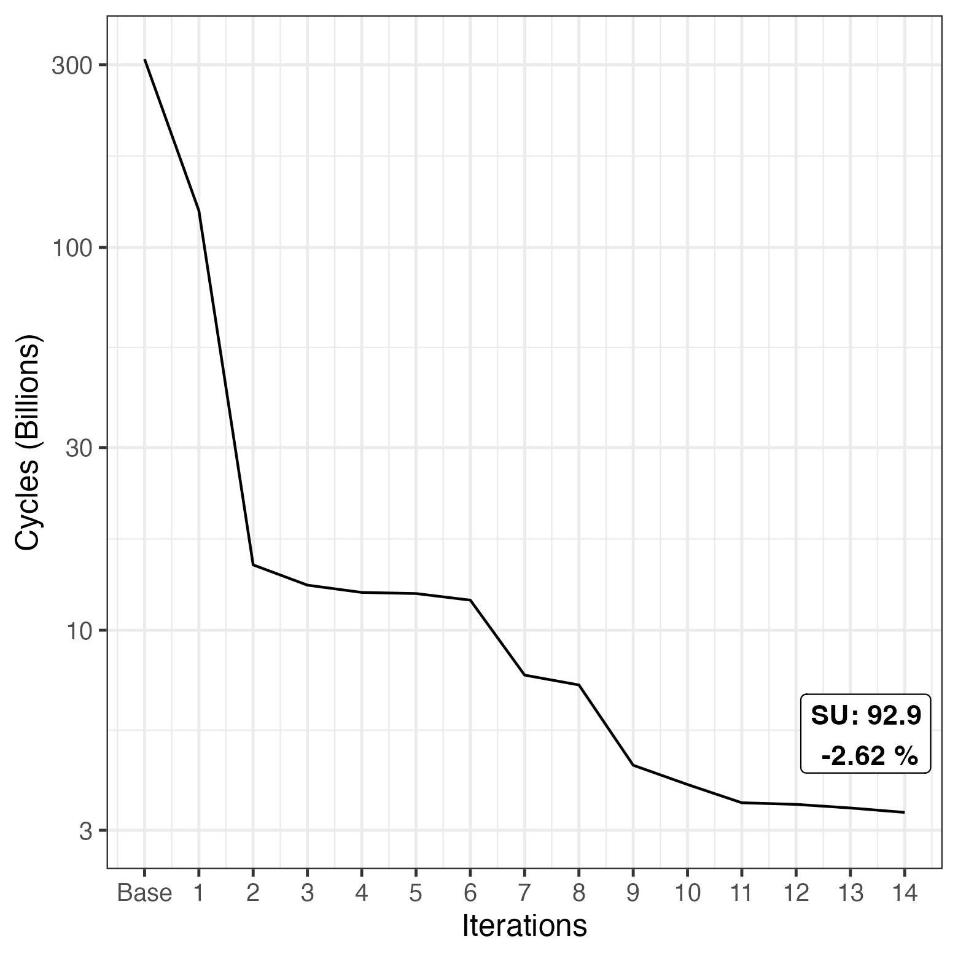
Limited Highest Lower Bound
Add back in spiral static indexing, with corners first
Bias heuristic via a lookahead parameter
Choose index with the best heuristic within the lookahead of the static indices
Best parameter for benchmark: 15

Slide 19
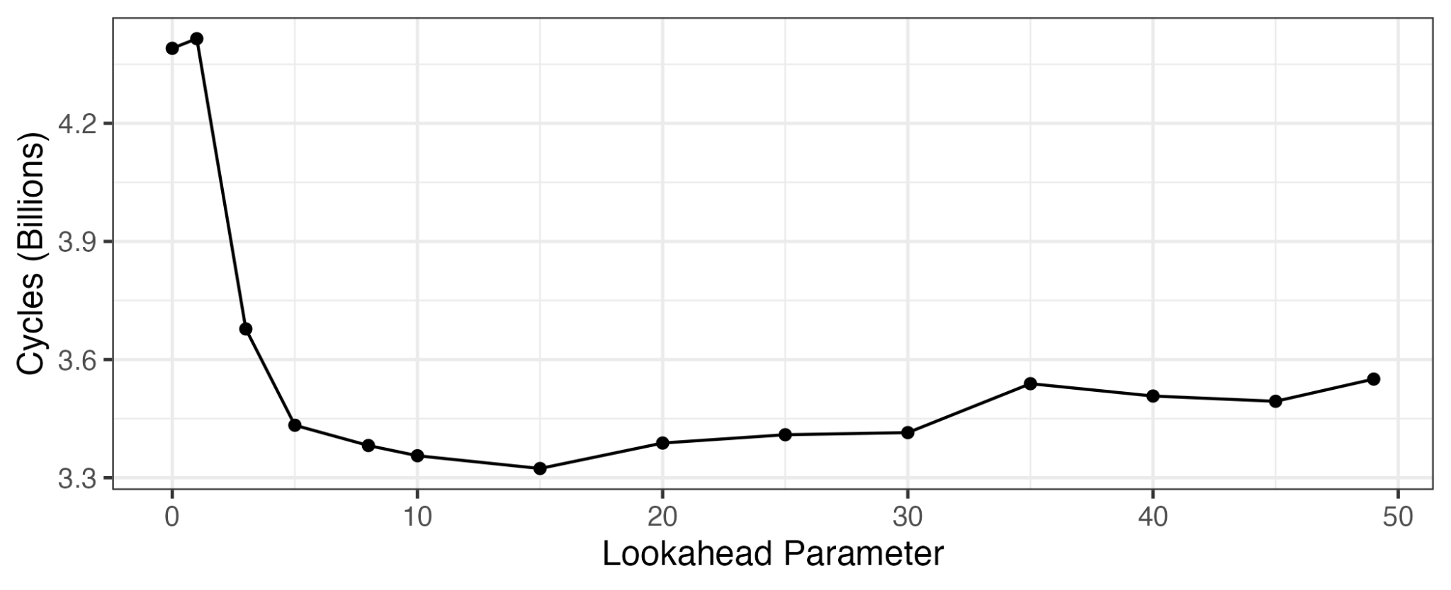
Limited Highest Lower Bound
Add back in spiral static indexing, with corners first
Bias heuristic via a lookahead parameter
Choose index with the best heuristic within the lookahead of the static indices
Best parameter for benchmark: 15

Slide 20
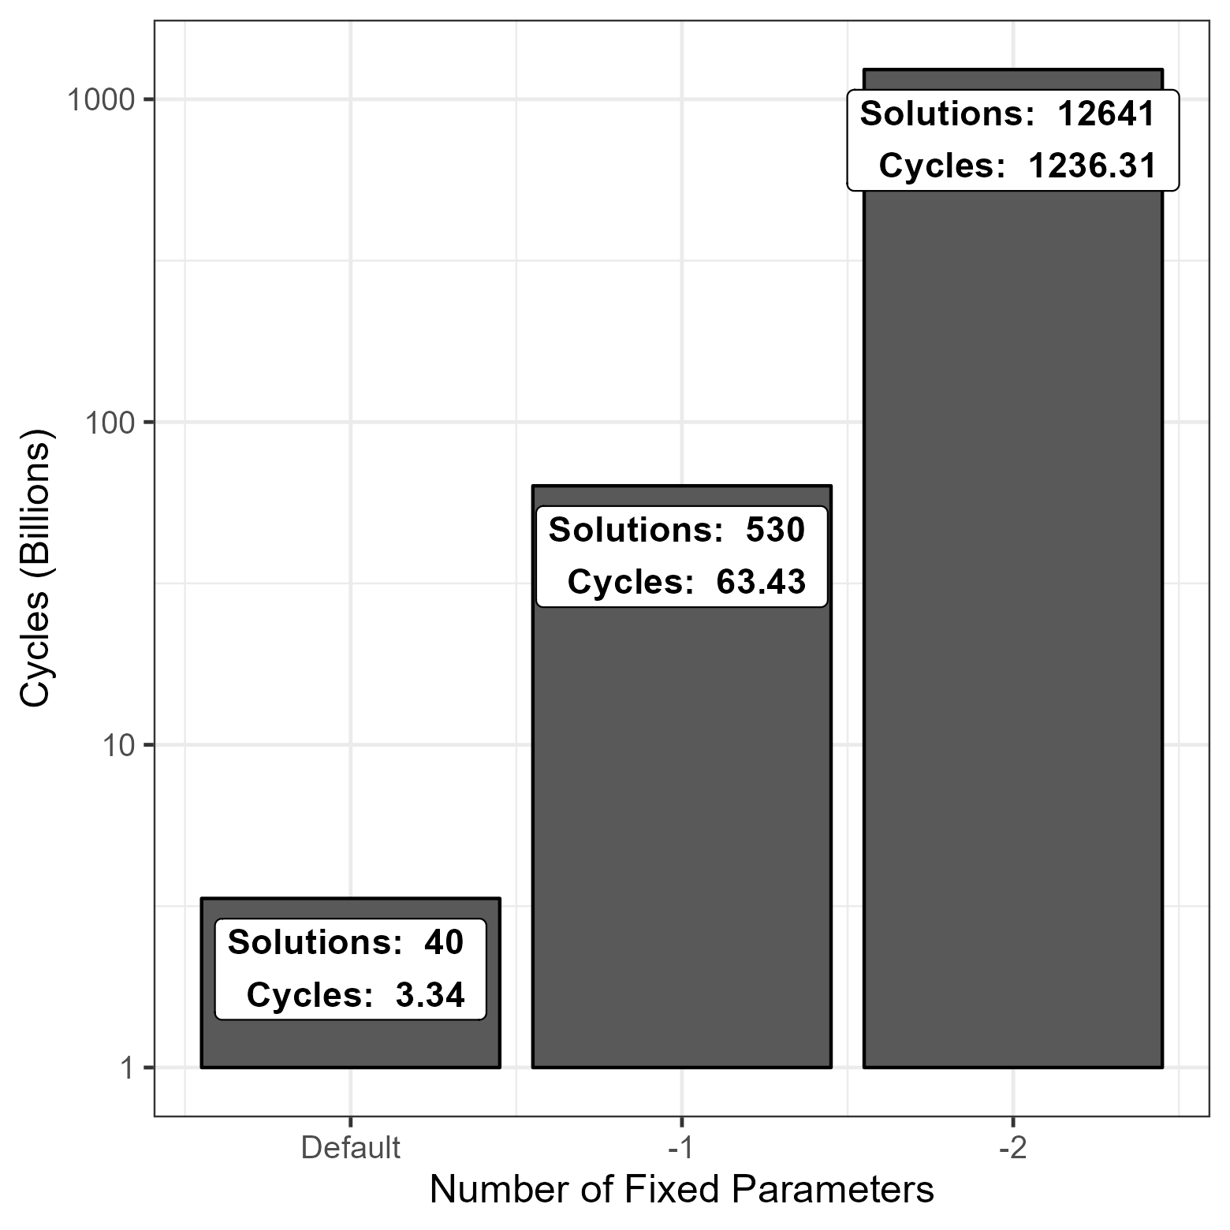
Result overview
N. of Fixed Param. | CPU Time [s] | Elapsed Time [s]
Default | 0.715 | 0.715
-1 | 13.525 | 13.526
-2 | 264.431 | 266.544

Slide 21
Subpar Approaches
Minimal value range heuristic
Trail stack
Loop unrolling
Occupation filling with -1
Remove sizeof calculation
Different order of constraint check
Flags

Slide 22
Thank you for your
Attention !

Slide 23
Appendix
Version | Billion Cycles
Base | 310,51
1 | 124,82
2 | 14,81
3 | 13,11
4 | 12,55
5 | 12,46
6 | 11,98
7 | 7,63
8 | 7,19
9 | 4,44
10 | 3,95
11 | 3,54
12 | 3,51
13 | 3,43
14 | 3,34

