Slide 1
Next Generation Communication
(For the Nation)

Slide 2
Existing Communications
- Has an open source client (good).
- Has end to end encryption in private chats (good).
              BUT…

Slide 3
Existing Communications
Closed source server (bad).
Group communications are not end-to-end encrypted (bad).
Only one service provider (bad).

Slide 4

Option...
(Originally known as jabber.)

Slide 5
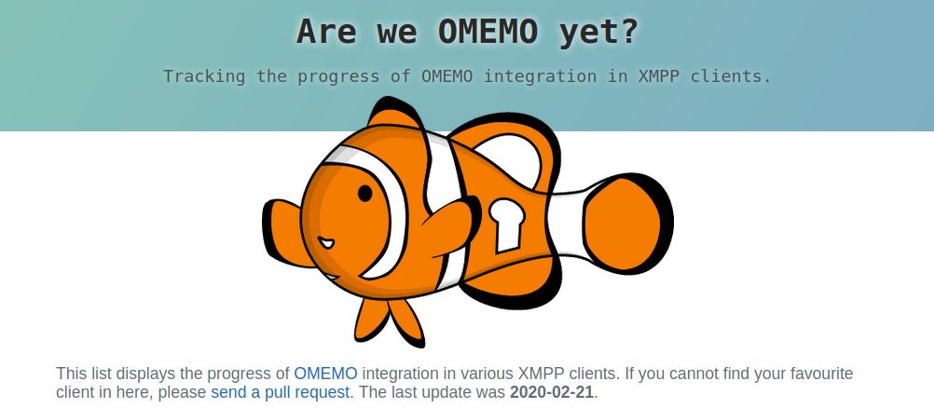
But what about encryption?!
OMEMO is end-to-end encryption for XMPP/Jabber

Slide 6
List of XMPP clients that support OMEMO:
https://omemo.top/
Eg.

Slide 7
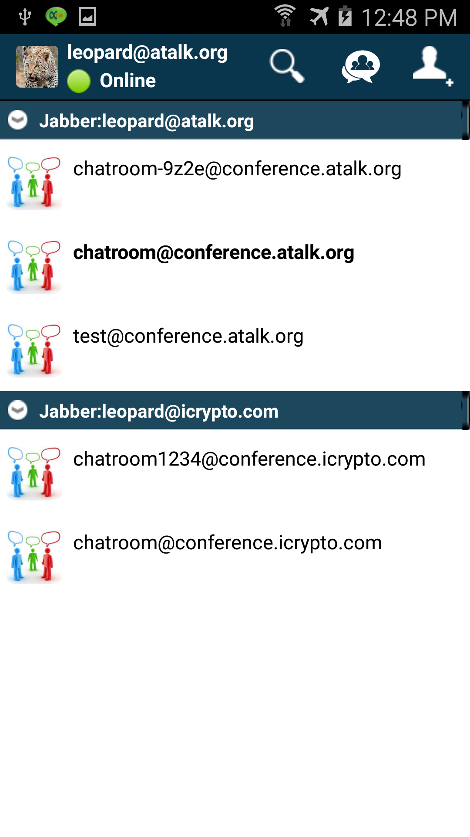
For Android ...
“aTalk”

Slide 8

For Ithing ...
“Monal”

Slide 9
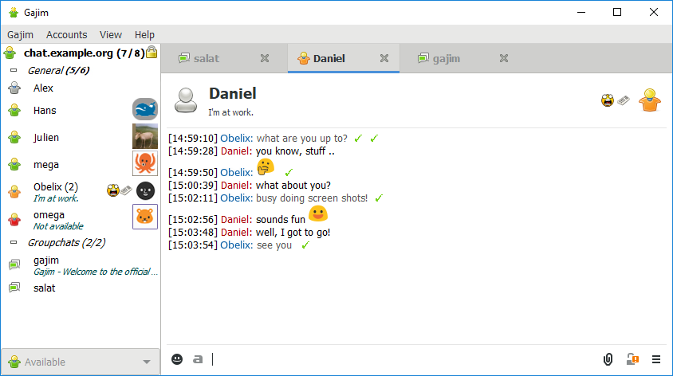
For BSD, Linux and Windows
“Gajim”

Slide 10
Multiple Vendors --> GOOD

Slide 11
How to register?!
Somebody could set up an XMPP server, as open source XMPP servers exist, we could all then join that XMPP server.
OR
Register on one of these servers and use with the above programs:
https://list.jabber.at

Slide 12
Would you want to join the experiment?!
Discuss.

