Slide 1
An Overview of an Electronic Trading Platform

Slide 2
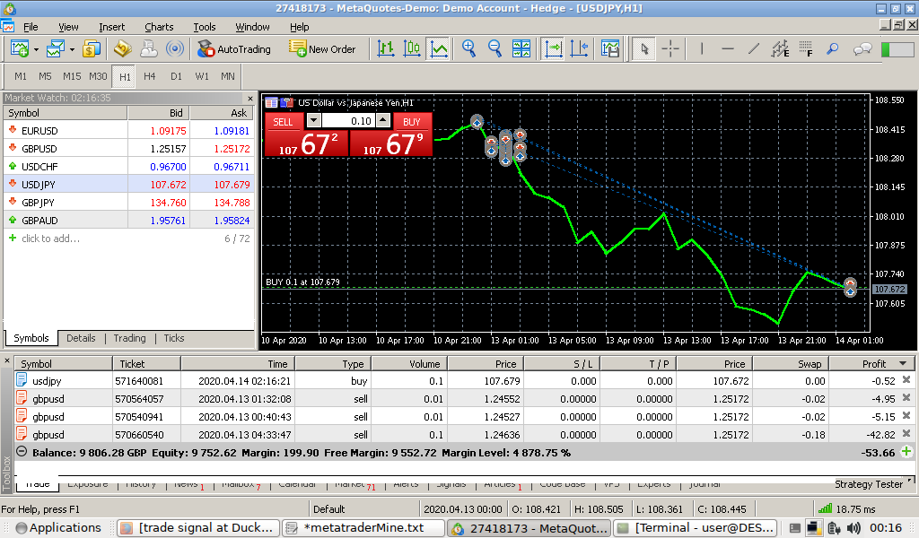
B
C
A
D

Slide 3
Overview
A = Selector For Graph / Symbol ( A symbol is
a tradeable asset)
B = Buy / Sell buttons, for buying and selling, amount can be changed
C = Graph for speculators
D = Trades you’ve made but haven’t closed, when you
close a trade, profit is added or taken from balance.

Slide 4
Things worth considering 1
CFDs are like exchanging contracts instead of stock, some electronic trading platforms only work with CFDs.
CFDs are complex instruments and come with a high risk of losing money rapidly due to leverage. Around 85% of retail investor accounts lose money when trading CFDs

Slide 5
Things worth considering 2
To trade real money you have to go through a broker.
Often the broker takes commission
The broker will often lend money to the speculator so that they can gamble more than they actually have (called leverage ratio).

Slide 6
Things worth considering 3
The buy price is often higher than the sell price (from the get go), therefore traders are automatically disadvantaged.

Slide 7
Tools for speculators
“Signals” are a sign to speculators as when to trade, they are often automated based on “technical indicators”, or other words, crackpot algorithms.
“Exposure” will tell you what symbols you have invested your money in.
You can view the graph over different periods of time, eg. 1 minute, 1 hour, 1 day, 1 week etc.
you can also drag the graph.

Slide 8
The electronic trading platform used was the freeware program metatrader 5 on linux using wine.
To get metatrader 5 working and installed on wine, you need to use the latest version of wine ie. winehq-stable from the wine repositories rather than wine-stable or wine-development from the ubuntu repositories.
In ubuntu this means installing the faudio library from this repo: https://download.opensuse.org/repositories/Emulators:/Wine:/Debian/xUbuntu_18.04/
The program made some funny noises on a clean system
after it updated itself.
If you use this program, you must trust the authors with your money, you must also trust a broker with your money.
As the software is proprietary, people aren’t allowed to inspect the code.

Slide 9
Conclusion
All in all I got insight into electronic trading platforms and the world of trading, which is what I wanted.
I used a demo account so didn’t spend any money.
I think investing in this system is far to risky.
I can see how it operates like a market stall simulation, eg. you buy stock, you sell stock etc. it reminds me of east enders market traders.
I found there was a lot of stock I couldn’t shift easily, because I didn’t want to sell it at a loss. There was a pressure to keep trading (and therefore working), as other people’s money (the broker) had been invested.
All in all, despite the novelty …
I’m out.

