Slide 1

TR 400 – Industrial Training
Premathilaka M.P.U
E/15/280
Training Organization: Millennium IT Software (private) Limited

Slide 2
Millennium IT Software (Pvt) Ltd (MIT)
Millennium IT Software (Pvt) Ltd is a branch of LSEG Technology
London Stock Exchange Group is a global financial service provider
Operation Divisions : Data & Analytics, Capital Markets, Post Trade
Financial Market infrastructure provides services to 35+ clients globally
Some of their clients are CSE, SGX, Namibian Stock Exchange etc.
Millennium Products
Millennium SOR: Designed to process large data volumes at high speed
Millennium Exchange: Extensible trading platform, ability to grow and change as quickly as business does
Millennium Marketdata: Designed to efficiently distribute large data streams across asset classes
Millennium Surveillance: Real-time and offline analysis features
Millennium Risk: Risk calculation engine
Notes:
MIT software pvt limited which is located in Malabe sri Lanka is a branch of London stock exchange group
London stock exchange group is a leading global financial markets infrastructure and data provider which operates in three core divisions.
Those dvisions are data and analytics, in which they deliver data driven insight and products to the customers,
And capital markets in which they support customers across end to end capital markets flow, providing access to liquidity across multiple asset classes and regions
And post trade, in which they provide financial resource management solutions.
LSEG financai market infrastructure provices services to 35+ clinets globally
Apart from services LSEG technology provide set of products.
They are …….

Slide 3
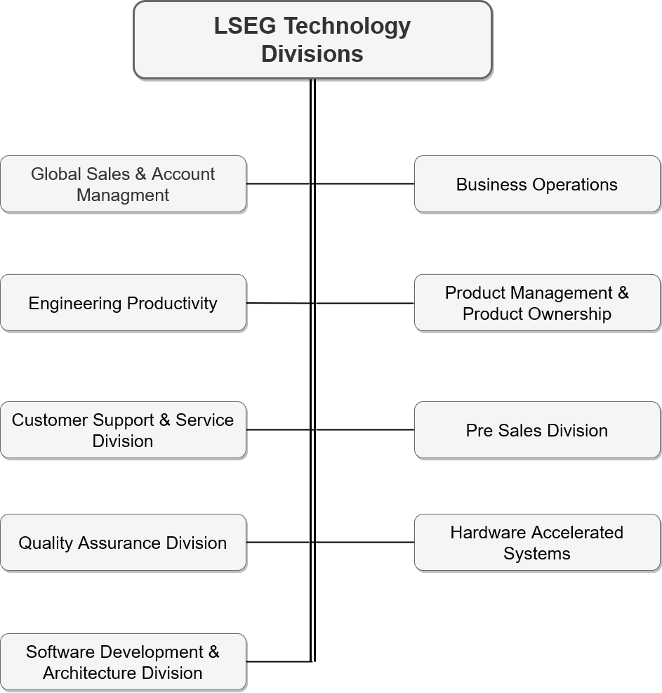
Notes:
-Global Sales & Account Managment
(Maintaining and developing relationships with existing clients and brigining new clinets to the exisitiong services)
Objectives This division:
Building strong, long lasting, business relationships
Understanding what key customers really need
Maintain and grow existiong business
-Business operation division
Roles of Business opearations in MIT
They play the role of a business owner for various services.
They provide required management to the LSEG technology
Drive internal initiatives and change programs to meet objectives of LSEG and imporove long term operational excellence
-Engineering productivity
They define the engieering process and best practices of LSEG services
Provide trainings ,tools and other related support to project teams
The provided concepts are Agile methodoloty and some of the tools are jira, confluence, stash
-Product Management & Product Ownership
They do the management aspect of LSEG tech products as we discussed earlier. There is a speerate manager for each of this product.
-Customer Support & Service Division
Which provide survices to the customers and they do contact relevent division according to the requirement.
-Pre Sales Division
Where they do start contact potential custoemrs before the sale and they are functioning until end of the sale.
-Quality Assurance Division
It Ensure the quality of the software fulfill the expectiations of the clients. And also they help other divisions to prevent defects which may get injected at different stages of software development life cycle.
Their also responsible to test and uncover defects before the software is deliverd to the client.
-Software Development & Architecture Division
They are focused on software development.
The basic two functions of this division is software development and testing.
As a standard before they develop the software they create a system design, a program design and a testing desgin.
Thereafter they start the implementation
-Hardware Accelerated Systems
This is a pure reasreach and development division.
Our cliets are other LSEG divisions. Once a prticular division needs high performace for thier implementaiton, those requests will be deliverd to the hardware accelerate system division.
They look at where the market is heading technologywise as well as business wise.
Most of their implmentations are long term investments but they belive that they will come handy when the time comes.
Their reseach mainly focused on heteregenous computing systems and also they are up-to-date with the latest hardware platforms which they will be using in the future. Currently they are working on NVIDIA, Intel and XILINX platforms
Also they will be developing algorithms to best perform on heteregenous platforms and looking at best practices that they can follow when implementing a system.
*Supporting hetergenous systems,
Group ticker plant (GTP) which a system does market data dissemination of the millennuim exchange product using FPGAs. Currenlty this system is running on LCH and Turquoise solutions
*Millenium risk product
GPU based portfolio margin calculations in Millenium risk product and currently live in LCH MCCP solution.

Slide 4
Training Program of MIT
Workday learning
Courses on LinkedIn
Courses related to financial market
Mandatory Courses
Virtual
Presentation skills development
Toastmasters sessions
Advance MS Excel training
Sessions on Scrum practices
Technical
Relevant to the division

Slide 5
Training Experience
Internship Project: Heterogenous computing system for Gross Exposure calculation
Cooperate GPU-FPGA system
Applications of Engineering knowledge
Experience from the final year project
Synchronization mechanisms
UML diagrams
Programming knowledge on OpenCL, C, C++
Object oriented programming concepts
Additional knowledge/experience gained
CUDA programming
Vitis HLS
Team working
Jira, Outlook courses
Notes:
Here im going to talk about the technical training Im getting on and how I am applying the engineering knowledge I gained from the university.
Basically as I am working in the hardware accelearated system division, they assigned me an individual project to develop a heterogenous computing system using both FPGA and GPU calculations. I will be using OpenCL to develop this system.
In terms of engineering knowledge, My final year university project was also related to an hardware acceleration on an FPGA using OpenCL. Therefore, they have identified my experience and assigned me this project. During this project, I have a mentor and he always supports throughout the project. As for now, One of the challenging section of this project is the FPGA-GPU synchronization. While I was designing the project, synchronization mechanisms I learnt as an undergraduate at the university helped me a lot. And also, even when I was designing diagrams, I had to use UML design diagrams which I learnt in the software engineering course at the faculty. Appart from that I would like to mention about programming languages such as C, C++, OpenCL and object oriented programming.
In terms of additional knowledge and experience gained,
They initially gave a me cuda training and vitis HLS.
Also, I have experienced working as a team.
Apart from that, I used to scrum practices, and I have gone through courses like jira and outlook

Slide 6
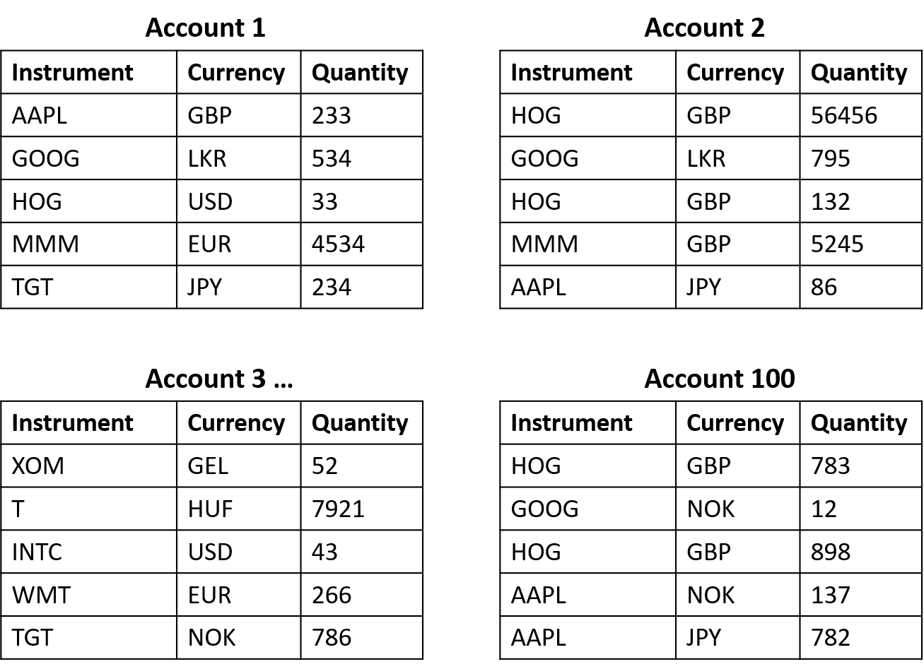
Introduction to Internship Project
Introduction to the Gross Exposure
Gross Exposure refers to the absolute level of a fund’s investments
Can provide an insight into the amount of risk that investor is taking on
Millennium Risk Product
Gross Exposure Calculation
Market Data Update - Graphics Processing Unit (GPU)
Position Update - Field Programmable Gate Array (FPGA)
Notes:
Here I will be summarizing my learning and feedback

Slide 7
Design Specifications
Each “Instrument-Currency” pair map to a unique numeric value
FPGA Command Queue : In-order command queue
GPU Command Queue : Out-of-order command queue
Tools and technologies
Notes:
Here I will be summarizing my learning and feedback

Slide 8
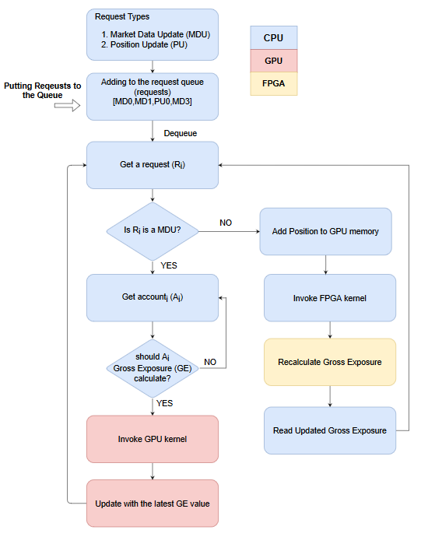
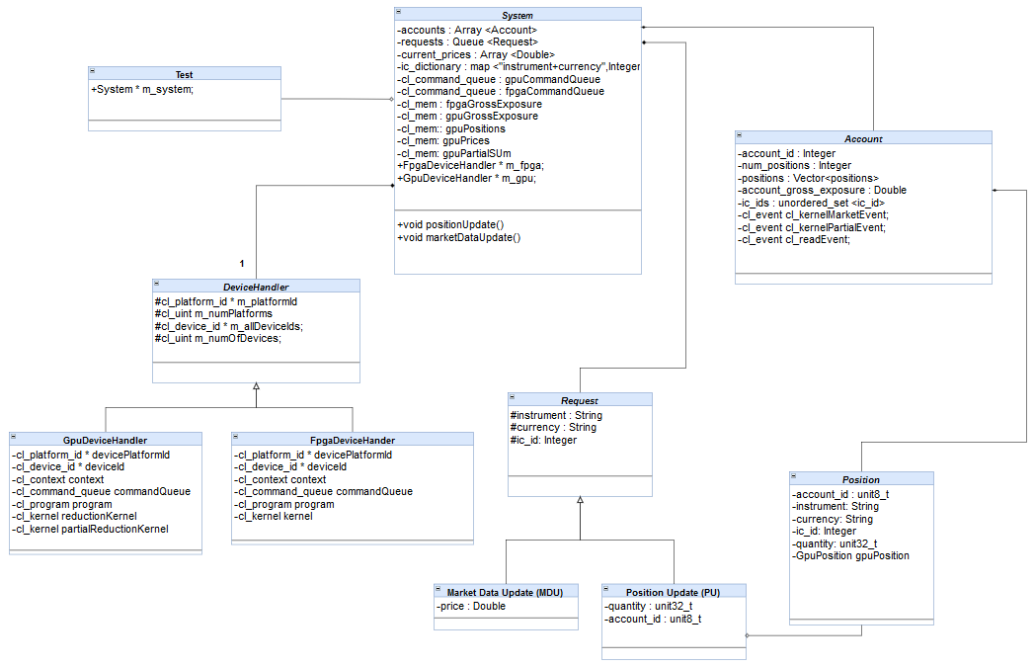
Design Diagrams
Flowchart
Class Diagram
Notes:
Here I will be summarizing my learning and feedback

Slide 9
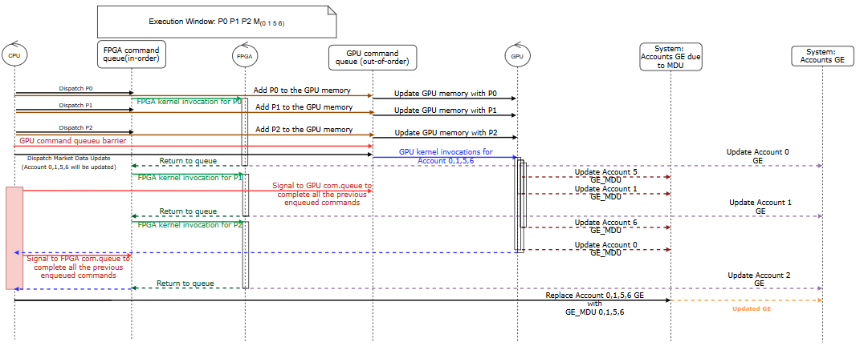
Design Diagrams
Sequence Diagram
Notes:
Here I will be summarizing my learning and feedback

Slide 10
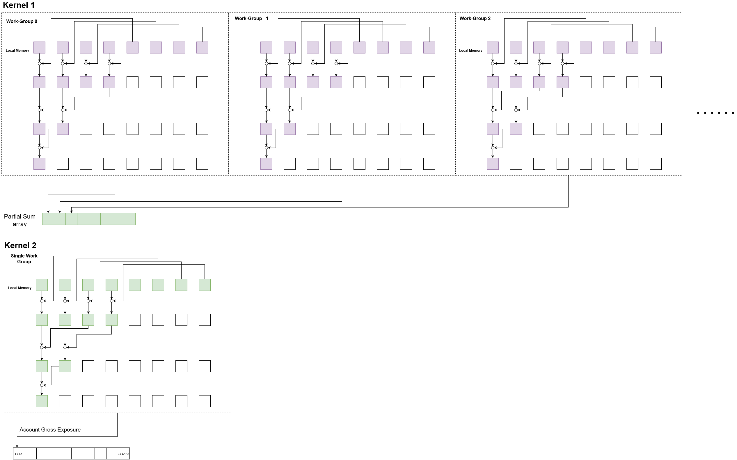
GPU Kernel
Notes:
Here I will be summarizing my learning and feedback

Slide 11
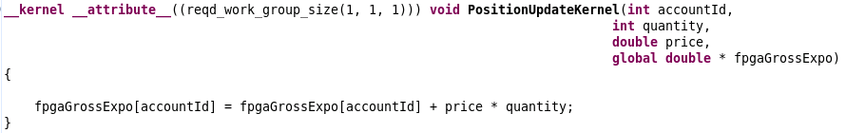
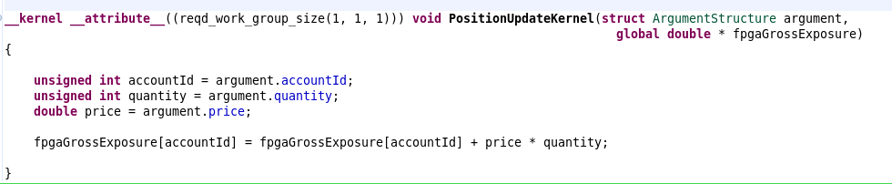
FPGA Kernel
Passing individual kernel arguments
Passing kernel arguments in a structure
Notes:
Here I will be summarizing my learning and feedback

Slide 12
Problems Encountered
Data transfer between GPU and FPGA
Execution order of event callback functions
The implementation Tested on two GPU
Device 1
Device 1
Vendor 1
NVIDIA
Vendor 2
XILINX
Device 2
Platform
Platform
Device 2
Device 1
Data
Device 2
Device 1
Data
Device 2
X
Context
Context
Notes:
Here I will be summarizing my learning and feedback

Slide 13
Performance Test

Slide 14
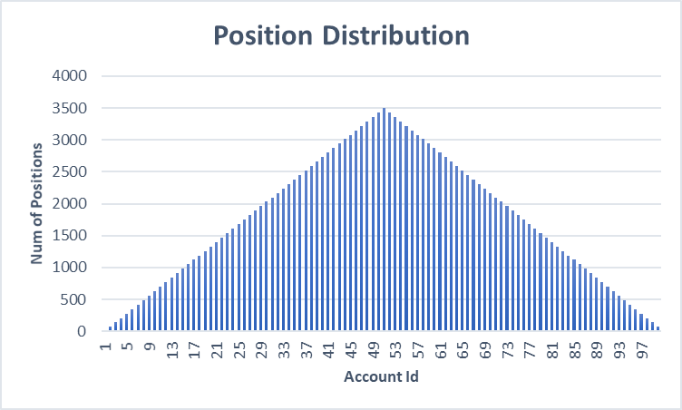
Results
Test Scenario
Pre-Populate Positions with random instrument-currency pair
Generate a market data update with random instrument-currency pair
Recalculate Gross Exposure
Notes:
Here I will be summarizing my learning and feedback

Slide 15
Problems Encountered
Test Scenario
Pre-Populate Positions with random instrument-currency pair
Generate a market data update with random instrument-currency pair
Recalculate Gross Exposure
Notes:
Here I will be summarizing my learning and feedback

Slide 16
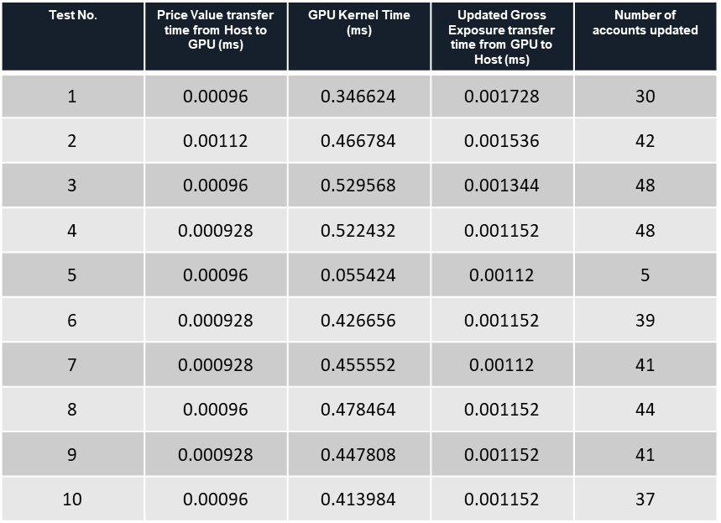
Performance Test for Market Data Update
Results
Notes:
Here I will be summarizing my learning and feedback

Slide 17
Performance Test for Position Update
Results from Hardware Emulation
Kernel Time : 4.7 µs
Observations from Vitis Waveform Analyzer
Observation when passing individual kernel arguments
Observation when passing kernel arguments as a structure
Account ID
230.46
Quantity
340.06
Price
340.06
fpgaGrossExposure
113.35
ap_start
Time (ns)
Argument Structure
683.47
fpgaGrossExposure
113.35
ap_start
Time (ns)
Notes:
Here I will be summarizing my learning and feedback

Slide 18
Performance Test for Position Update
Results using AWS EC2 F1 instance and CPU timers (10 position update requests used to test)
Results using AWS EC2 F1 instance and OpenCL events for time measurement (10 position update requests used to test)
Test No. | Kernel time (ms)
1 | 14.489746
2 | 14.704102
3 | 13.61377
4 | 16.000977
5 | 20.190918
Test No. | Kernel time (ms) | FPGA to CPU data transfer time (ms)
1 | 0.725214 | 0.547448
2 | 0.75604 | 0.574829
3 | 0.820934 | 0.615727
4 | 0.670929 | 0.610295
5 | 0.786347 | 0.636541
Notes:
Here I will be summarizing my learning and feedback

Slide 19
Training Experience cont.
Quality assurance practices and standards
Code reviews
Scrum practice
Design and testing
Performance optimizations
Knowledge transferring sessions
Notes:
Interms of qulity assurance practices and standards,
They conduct a code review at the end of each project.
They adhere to scrum practices
Before starting the implementations they make designs and testbeds
Also, they do performance optimzations
Apart from that there are knwolege transferring sessions where team members share their knowlgede with others.

Slide 20
Summary of Learnings and Feedback
Different functionalities of different divisions of LSEG and how they cooperatively provide services to customers
Experience on Agile practices
How the knowledge transferring happen inside the team
Organizational policies, Data protection, Competition law compliances
OpenCL synchronization mechanisms such as event handling, barriers, call-back functions.
Parallelism on NVIDIA GPUs
SnuCL, EngineCL frameworks
C++ object-oriented programming
Trained to explore
Updates with the latest technologies
Guidance and Freedom
Notes:
Here I will be summarizing my learning and feedback

Slide 21
Q & A

Slide 22
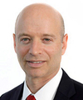
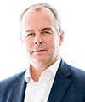
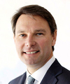
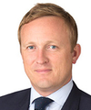

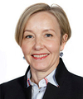

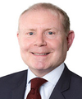
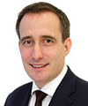

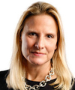

Executive Committee (ExCo)
David Schwimmer
CEO, LSEG
David Craig
Group Head,
Data & Analytics
& CEO, Refinitiv
Murray Ross
Group Head,
Capital Markets
Daniel Maguire
Group Head, Post Trade
&
CEO, LCH Group
David Shalders
Chief Operating Officer
&
Head of Integration
Catherine Johnson
General Counsel
Andrea Remyn Stone
Chief Product Officer, Information Services
Anthony McCarthy
Chief Information Officer
Tom Jones
Chief People Officer
Anna Manz
Group Chief Financial Officer
Brigitte Trafford
Chief Communication & Marketing Officer
Debra Walton
Chief Revenue Officer, Information Services
Notes:
Here I am presenting the executive committee. The CEO of LSEG is David schirmmer.
LSE is a group which is build up with set of subgroups. Therefore, as you can see, there are ExCo members for different subgroups. For example David Craig is the CEO of Refinitve, David Maguire is the CEO of LCH group.
And also here I would like to highlight a specific exco member which is related to hardware aceeleratted systems division which I am working on. That is Anthony MacCarthy who is the chief information officer of LSEG.

Slide 23
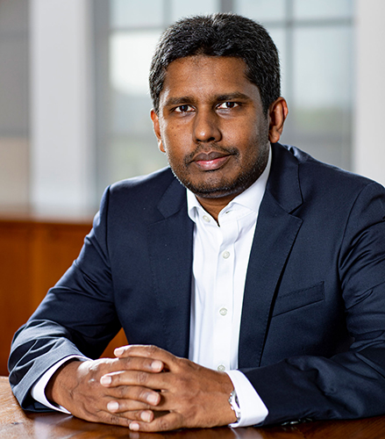
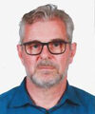

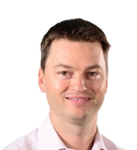
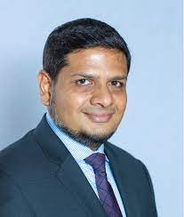

Local Leadership
Feroz Cader
CO Head
Rob Brouwer
Co Head
Ajit Samaranayake
Chief Scientist
Lome Chambers
Global Head of Sales
&
Marketing
Fadhil Jiffry
Chief Financial Officer
Pulasthika Weerasinha
Head of HR LSEG SL

Slide 24
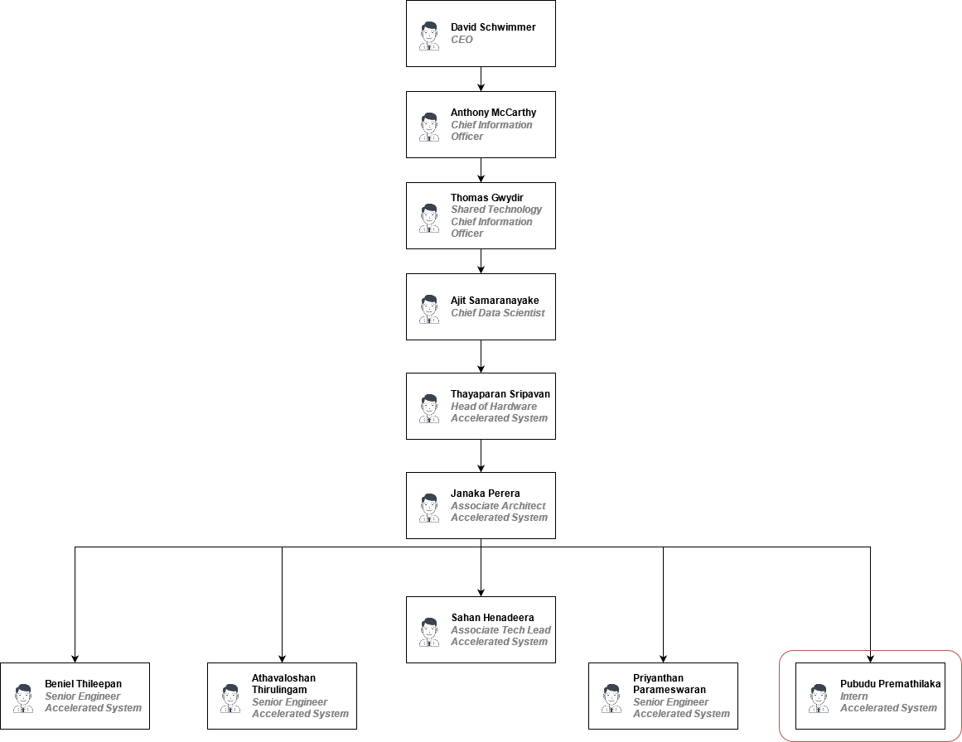
HWAC Management

Slide 25
Flowchart
Notes:
Here I will be summarizing my learning and feedback

Slide 26
Class Diagram
Notes:
Here I will be summarizing my learning and feedback

Slide 27
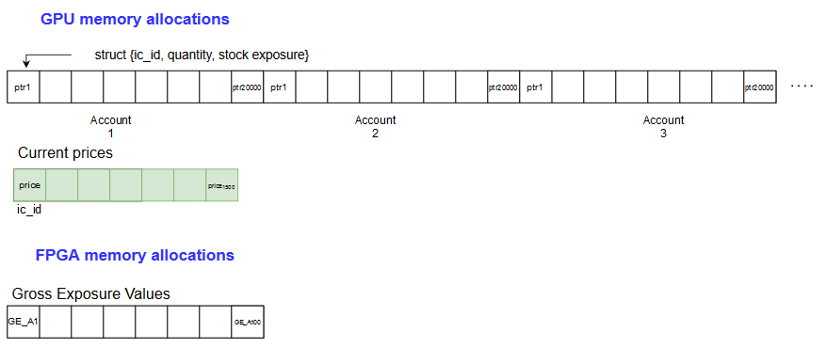
GPU Memory Allocation
Notes:
Here I will be summarizing my learning and feedback

