Slide 1
Data bases 2
JPA Project: Telco Service Applications

Slide 2
Index
Specification interpretation
ER and relational model
Views, Materialized view tables, Trigger design and code
ORM relationship design with explanations
Entities code
Interface diagrams or functional analysis of the specifications
List of components
UML sequence diagrams

Slide 3
Specification interpretation
A service package can only have one service for each service type (e.g cannot have two mobile phone services associated)
The only available validity durations are 12, 24 and 36 months
A service can be associated only to one service package
A validity period can be associated only to one service package
Auditing table takes as amount the sum of the last three failed payments, and is created only when three payments fail (not for four or more)

Slide 4
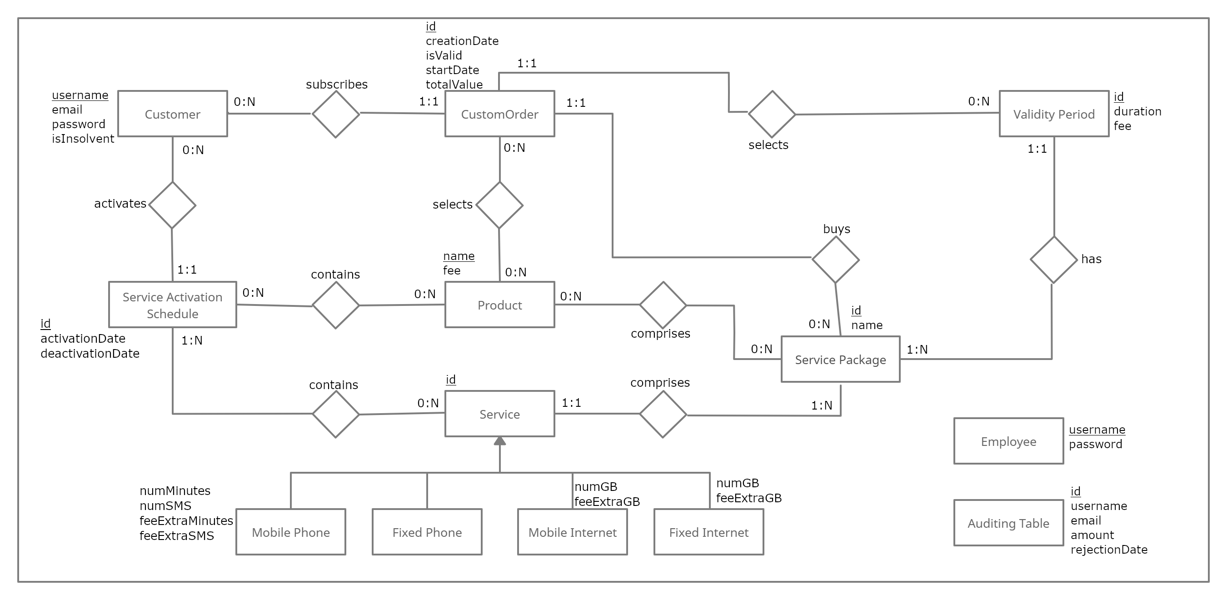
Entity Relationship

Slide 5
Motivations of the ER design
Validity Period and Service have a 1:1 relationship with Service Package because of the interpretation made before
As long as the Service Activation Schedule has to record products and services, I decided to directly associating them without intermediating with the order, just to interpret literally the specification

Slide 6
Relational model
create table customer
(
username varchar(50) NOT NULL,
password varchar(50) NOT NULL,
email varchar(50) UNIQUE NOT NULL,
isInsolvent int NOT NULL DEFAULT 0,
PRIMARY KEY (username),
CONSTRAINT positive_insolvent CHECK (isInsolvent >= 0)
);
create table servicePackage
(
id int NOT NULL auto_increment,
name varchar(50) UNIQUE NOT NULL,
PRIMARY KEY (id)
);

Slide 7
Relational model
create table validityPeriod
(
id int NOT NULL auto_increment,
duration int NOT NULL,
fee int NOT NULL,
servicePackage int,
PRIMARY KEY (id),
CONSTRAINT id_package FOREIGN KEY (servicePackage)
REFERENCES servicePackage (id) ON DELETE CASCADE ON UPDATE CASCADE,
CONSTRAINT duration_12_24_36
CHECK (duration = 12 or duration = 24 or duration = 36)
);

Slide 8
Relational model
create table service
(
id int NOT NULL auto_increment,
serPackage int,
service_type varchar(50) NOT NULL,
num_minutes int,
num_SMS int,
fee_extra_min int,
fee_extra_SMS int,
num_GB int,
fee_extra_GB int,
PRIMARY KEY (id),
CONSTRAINT id_package2 FOREIGN KEY (serPackage)
REFERENCES servicePackage (id) ON DELETE CASCADE ON UPDATE CASCADE
);

Slide 9
Relational model
create table product
(
name varchar(50) NOT NULL,
fee int NOT NULL,
PRIMARY KEY (name)
);
create table optProductsForPackage
(
product varchar(50) NOT NULL,
servicepackage int NOT NULL,
PRIMARY KEY (product, servicepackage),
CONSTRAINT id_product FOREIGN KEY (product)
REFERENCES product (name) ON DELETE CASCADE ON UPDATE CASCADE,
CONSTRAINT id_package3 FOREIGN KEY (servicepackage)
REFERENCES servicePackage (id) ON DELETE CASCADE ON UPDATE CASCADE
);

Slide 10
Relational model
create table customOrder
(
id int NOT NULL auto_increment,
creationDate datetime NOT NULL,
username varchar(50) NOT NULL,
servicePackage int NOT NULL,
validity int NOT NULL,
totalValue int NOT NULL,
startDate date NOT NULL,
isValid int NOT NULL,
PRIMARY KEY(id),
CONSTRAINT id_user FOREIGN KEY (username)
REFERENCES customer (username) ON DELETE CASCADE ON UPDATE CASCADE,
CONSTRAINT id_service4 FOREIGN KEY (servicePackage)
REFERENCES servicePackage (id) ON DELETE CASCADE ON UPDATE CASCADE,
CONSTRAINT id_validity FOREIGN KEY (validity)
REFERENCES validityPeriod (id) ON DELETE CASCADE ON UPDATE CASCADE
);

Slide 11
Relational model
create table selectedProductsForOrder
(
product varchar(50) NOT NULL,
customOrder int NOT NULL,
PRIMARY KEY (product, customOrder),
CONSTRAINT id_product2 FOREIGN KEY (product)
REFERENCES product (name) ON DELETE CASCADE ON UPDATE CASCADE,
CONSTRAINT id_order FOREIGN KEY (customOrder)
REFERENCES customOrder (id) ON DELETE CASCADE ON UPDATE CASCADE
);
create table serviceActivationSchedule
(
id int NOT NULL auto_increment,
username varchar(50) NOT NULL,
activationDate date NOT NULL,
deactivationDate date NOT NULL,
CONSTRAINT id_customer FOREIGN KEY (username)
REFERENCES customer (username) ON DELETE CASCADE ON UPDATE CASCADE,
PRIMARY KEY(id)
);

Slide 12
Relational model
create table productsForActivationSchedule
(
product varchar(50) NOT NULL,
activationSchedule int NOT NULL,
PRIMARY KEY (product, activationSchedule),
CONSTRAINT id_product3 FOREIGN KEY (product)
REFERENCES product (name) ON DELETE CASCADE ON UPDATE CASCADE,
CONSTRAINT id_schedule FOREIGN KEY (activationSchedule)
REFERENCES serviceActivationSchedule (id) ON DELETE CASCADE ON UPDATE CASCADE
);
create table servicesForActivationSchedule
(
service int NOT NULL,
activationSchedule int NOT NULL,
PRIMARY KEY (service, activationSchedule),
CONSTRAINT id_service FOREIGN KEY (service)
REFERENCES service (id) ON DELETE CASCADE ON UPDATE CASCADE,
CONSTRAINT id_schedule2 FOREIGN KEY (activationSchedule)
REFERENCES serviceActivationSchedule (id) ON DELETE CASCADE ON UPDATE CASCADE
);

Slide 13
Relational model
create table auditingTable
(
id int NOT NULL auto_increment,
username varchar(50) NOT NULL,
email varchar(50) NOT NULL,
amount int NOT NULL,
rejectionDateTime datetime NOT NULL,
PRIMARY KEY(id)
);
create table employee
(
username varchar(50) NOT NULL,
password varchar(50) NOT NULL,
PRIMARY KEY (username)
);

Slide 14
Motivations of the logical design
email is unique parameter (to make it more similar to real applications)
inheritance of the services has been designed by creating a single table, with a discriminator field for identifying the four different subclasses and their parameters. This allows a better organization of the association between service and other entities, but service creation must be handled carefully by the application.

Slide 15
Views
create view totalPurchasesPerPackage as
select s.name as package, count(o.id) as total
from servicePackage s left join customOrder o on s.id = o.servicePackage
where o.isValid = 0 or o.isValid is null
group by s.id;
create view totalPurchasesPerPackageAndValidityPeriod as
select s.name as package, v.duration as validityPeriod, count(o.id) as total
from servicePackage s join validityPeriod v on v.servicePackage = s.id
left join customOrder o on o.validity = v.id
where o.isValid = 0 or o.isValid is null and v.servicePackage = s.id
group by s.id, v.duration;

Slide 16
Views
create view salesValue as
select s.name as package, coalesce(sum(o.totalvalue),0) as totalSale,
sum(case when v.id = o.validity then v.duration*v.fee else 0 end) as saleWithoutProd
from servicePackage s join validityPeriod v on v.servicePackage = s.id
left join customOrder o on o.validity = v.id
where o.isValid = 0 or o.isValid is null and v.servicePackage = s.id
group by s.id;
create view averageProductsSoldForPackage as
select package as package, avg(count) as averageProducts
from ( select o.servicePackage as package, count(sp.product) as count
from customOrder o left join selectedProductsForOrder sp on o.id = sp.customOrder
where o.isValid = 0 or o.isValid is null
group by o.id) as counts
group by package;

Slide 17
Views
create view bestSellerProduct as
select p.name as product, sum(p.fee*v.duration) as totalSales
from customOrder o join selectedProductsForOrder sp on o.id = sp.customOrder
join product p on sp.product = p.name
join validityPeriod v on v.id = o.validity
where o.isValid = 0
group by p.name
order by totalSales desc
limit 1;

Slide 18
Materialized view tables
create table totalPurchasesPerPackage
(
package varchar(50) UNIQUE NOT NULL,
total int NOT NULL,
PRIMARY KEY (package)
);
create table totalPurchasesPerPackageAndValidityPeriod
(
id int NOT NULL auto_increment,
package varchar(50) NOT NULL,
validity int NOT NULL,
total int NOT NULL,
PRIMARY KEY (id)
);

Slide 19
Materialized view tables
create table salesValue
(
package varchar(50) UNIQUE NOT NULL,
totalSale int NOT NULL,
saleWithoutProd int NOT NULL,
PRIMARY KEY (package)
);
create table averageProductsSoldForPackage
(
package varchar(50) UNIQUE NOT NULL,
averageProducts float NOT NULL,
PRIMARY KEY (package)
);

Slide 20
Materialized view tables
create table bestSellerProduct
(
product varchar(50) NOT NULL,
totalSales int NOT NULL,
PRIMARY KEY (product)
);

Slide 21
Trigger design & code
create trigger package_insert_totPurchases
after insert on servicePackage
for each row
insert into totalPurchasesPerPackage values (new.name,0);
delimiter $$
create trigger package_insertorder_totPurchases
after insert/update on customOrder
for each row
begin
if new.isValid = 0 then
update totalPurchasesPerPackage set total = total + 1
where package = (select name from servicePackage
where id = new.servicePackage);
end if;
end $$
delimiter ;

Slide 22
Trigger design & code
create trigger validity_insert_totPurchasesAndVP
after insert on validityPeriod
for each row
insert into totalPurchasesPerPackageAndValidityPeriod
values(default,(select name from servicePackage where id = new.servicePackage),new.duration,0);
delimiter $$
create trigger package_insertorder_totPurchasesAndVP
after insert/update on customOrder
for each row
begin
if new.isValid = 0 then
update totalPurchasesPerPackageAndValidityPeriod set total = total + 1
where package = (select name from servicePackage where id = new.servicePackage)
and validity = (select duration from validityPeriod where id = new.validity);
end if;
end $$
delimiter ;

Slide 23
Trigger design & code
create trigger package_insert_salesValue
after insert on servicePackage
for each row
insert into salesValue values (new.name,0,0);
delimiter $$
create trigger package_insertorder_salesValue
after insert/update on customOrder
for each row
begin
if new.isValid = 0 then
update salesValue set totalSale = totalSale + new.totalValue,
saleWithoutProd = saleWithoutProd +
(select fee*duration from validityPeriod v where v.id = new.validity)
where package = (select name from servicePackage where id = new.servicePackage);
end if;
end $$
delimiter ;

Slide 24
Trigger design & code
delimiter $$
create trigger product_updateoptproduct_avgProdPackage
after insert on selectedProductsForOrder
for each row
begin
declare packId int;
if (select o.isValid from customOrder o where o.id = new.customOrder) = 0 then
set packId = (select o.servicePackage
from customOrder o
where o.id = new.customOrder);
update averageProductsSoldForPackage
set averageProducts = ( select avg(count)
from ( select count(sp.product) as count from customOrder o left join selectedProductsForOrder sp on o.id = sp.customOrder
where o.isValid = 0 and o.servicePackage = packId
group by o.id ) as counts)
where package = (select name from servicePackage where id = packId);
end if;
end $$
delimiter ;

Slide 25
Trigger design & code
create trigger package_createoptproduct_avgProdPackage
after insert on servicePackage
for each row
insert into averageProductsSoldForPackage values (new.name,0);
delimiter $$
create trigger order_insertoptproduct_avgProdPackage
after insert/update on customOrder
for each row
begin
if new.isValid = 0 then
update averageProductsSoldForPackage
set averageProducts = …
where package = (select name from servicePackage where id = new.servicePackage);
end if;
end $$
delimiter ;

Slide 26
Trigger design & code
delimiter $$
create trigger insert_selprod_bestSeller
after insert on selectedProductsForOrder
for each row
begin
declare currentMax int;
declare newValue int;
if (select o.isValid from customOrder o where o.id = new.customOrder) = 0 then
set currentMax = (select max(totalSales) from bestSellerProduct);
set newValue = ( select sum(p.fee*v.duration)
from customOrder o join selectedProductsForOrder sp
on o.id = sp.customOrder
join product p on sp.product = p.name
join validityPeriod v on v.id = o.validity
where o.isValid = 0 and p.name = new.product
group by p.name);
…….

Slide 27
Trigger design & code
…….
if currentMax is null then
insert into bestSellerProduct values(new.product,newValue);
elseif currentMax < newValue then
update bestSellerProduct
set product = new.product, totalSales = newValue where product is not null;
end if;
end if;
end $$
delimiter ;

Slide 28
Trigger design & code
delimiter $$
create trigger update_order_bestSeller
after update on customOrder
for each row
begin
declare currentMax int;
declare newValue int;
declare newProd varchar(50);
if new.isValid = 0 then
set currentMax = (select max(totalSales) from bestSellerProduct);
set newValue = (select max(val) from …
if currentMax is null then
set newProd = (select product from … where val = newValue);
insert into bestSellerProduct values(newProd,newValue);
elseif currentMax < newValue then
set newProd = …
update bestSellerProduct set product = newProd, totalSales = newValue where product is not null;
end if;
end if;
end $$
delimiter ;

Slide 29
Trigger design & code
For all triggers specify at high level
Event
Condition
Action
SQL code of the trigger
Trigger design motivation
Also present some triggers for delete (and some update) operations which are not shown here because never activated by the application
product_updateoptproduct_avgProdPackage can also be implemented with a «for each statement» logic, but this command is not supported in MySql

Slide 30
ORM design

Slide 31
Relationship “subscribes”
subscribes
Customer → CustomOrder
@OneToMany, not necessary but implemented for simplicity (owner is entity CustomOrder)
CustomOrder → Customer
@ManyToOne, necessary for showing data in Sales Report page (FetchType.EAGER by default)
Customer
CustomOrder
0:N
1:1
Customer
*
CustomOrder
1
Customer
CustomOrder

Slide 32
Relationship “selects”
selects
ValidityPeriod → CustomOrder
@OneToMany, not necessary but implemented for simplicity (owner is entity CustomOrder)
CustomOrder → ValidityPeriod
@ManyToOne, necessary for showing data in Confirmation page (FetchType.EAGER by default)
ValidityPeriod
CustomOrder
0:N
1:1
ValidityPeriod
*
CustomOrder
1
ValidityPeriod
CustomOrder

Slide 33
Relationship “selects”
selects
Product → CustomOrder
@ManyToMany, not necessary but implemented for simplicity (owner can be both entities)
CustomOrder → Product
@ManyToMany, necessary for showing data in Confirmation page
FetchType.EAGER
Product
CustomOrder
0:N
0:N
*
CustomOrder
Product
*
CustomOrder
Product

Slide 34
Relationship “buys”
buys
ServicePackage → CustomOrder
@OneToMany, not necessary but implemented for simplicity (owner is entity CustomOrder)
CustomOrder → ServicePackage
@ManyToOne, necessary for showing data in Confirmation page (FetchType.EAGER by default)
ServicePackage
CustomOrder
0:N
1:1
ServicePackage
*
CustomOrder
1
ServicePackage
CustomOrder

Slide 35
Relationship “has”
has
ServicePackage → ValidityPeriod
@OneToMany, necessary for showing data in Buy Services page
FetchType.EAGER
CascadeType.ALL, because a validity period has no sense to exist without its association with the package
ValidityPeriod → ServicePackage
@ManyToOne, owner of the relationship
FetchType can be LAZY
ServicePackage
ValidityPeriod
1:N
1:1
ServicePackage
*
ValidityPeriod
1
ServicePackage
ValidityPeriod

Slide 36
Relationship “comprises”
comprises
ServicePackage → Service
@OneToMany, necessary for showing data in Home and Confirmation page
FetchType.EAGER
CascadeType.ALL, because a service has no sense to exist without its association with the package
Service → ServicePackage
@ManyToOne, owner of the relationship
FetchType can be LAZY
ServicePackage
Service
1:N
1:1
ServicePackage
*
Service
1
ServicePackage
Service

Slide 37
Relationship “comprises”
comprises
ServicePackage → Product
@ManyToMany, necessary for showing data in Home and Buy Services page
FetchType.EAGER
Product → ServicePackage
@ManyToMany, not necessary but implemented for simplicity (owner can be both entities)
ServicePackage
Product
0:N
0:N
ServicePackage
*
Product
*
ServicePackage
Product

Slide 38
Relationship “activates”
activates
Customer → Service Activation Schedule
@OneToMany, not necessary but implemented for simplicity (owner is entity Service Activation Schedule)
Service Activation Schedule → Customer
@ManyToOne, schedule not used in the application client
FetchType can be LAZY
Customer
Service Activation Schedule
0:N
1:1
Customer
*
Service Activation Schedule
1
Customer
Service Activation Schedule

Slide 39
Relationship “contains”
contains
Service Activation Schedule → Product
@ManyToMany, schedule not used in the application client
FetchType can be lazy
Product → Service Activation Schedule
@ManyToMany, not necessary but implemented for simplicity (owner can be both entities)
FetchType can be lazy
Service Activation Schedule
Product
0:N
0:N
Service Activation Schedule
*
Product
*
Service Activation Schedule
Product

Slide 40
Relationship “contains”
contains
Service Activation Schedule → Service
@ManyToMany, schedule not used in the application client
FetchType can be lazy
Service → Service Activation Schedule
@ManyToMany, not necessary but implemented for simplicity (owner can be both entities)
FetchType can be lazy
Service Activation Schedule
Service
1:N
0:N
Service Activation Schedule
*
Service
*
Service Activation Schedule
Service

Slide 41
Entity Customer
@Entity
@NamedQueries({ @NamedQuery(name="Customer.checkCredentials", query="SELECT c FROM Customer c WHERE c.username = ?1 and c.password = ?2"),
@NamedQuery(name="Customer.findInsolventUsers", query="SELECT c FROM Customer c WHERE c.isInsolvent > 0")
})
public class Customer implements Serializable {
..
// attributes & their annotations
@Id
private String username;
@Column(unique = true, nullable = false)
private String email;
@Column(nullable = false)
private int isInsolvent;
@Column(nullable = false)
private String password;
// relationships & their annotations
@OneToMany(mappedBy="customer", cascade = CascadeType.ALL, orphanRemoval = true)
private List<CustomOrder> customOrders;
@OneToMany(mappedBy="customer", cascade = CascadeType.ALL, orphanRemoval = true)
private List<ServiceActivationSchedule> serviceActivationSchedules;

Slide 42
Entity ServicePackage
@Entity
@NamedQueries({ @NamedQuery(name="ServicePackage.findAll", query="SELECT s FROM ServicePackage s"),
@NamedQuery(name="ServicePackage.findAllPackageNames", query="SELECT s.name FROM ServicePackage s"),
@NamedQuery(name="ServicePackage.findFormPackage", query="SELECT s FROM ServicePackage s WHERE s.name = ?1")
})
public class ServicePackage implements Serializable {
..
// attributes & their annotations
@Id
@GeneratedValue(strategy = GenerationType.IDENTITY)
private int id;
@Column(unique = true, nullable = false)
private String name;
// relationships & their annotations
@OneToMany(mappedBy="servicePackageBean", cascade = CascadeType.ALL, orphanRemoval = true)
private List<CustomOrder> customOrders;
@ManyToMany(fetch = FetchType.EAGER)
@JoinTable( name="optProductsForPackage", joinColumns={@JoinColumn(name="servicepackage")}, inverseJoinColumns={@JoinColumn(name="product")})
private List<Product> products;
@OneToMany(mappedBy="servicePackage", fetch = FetchType.EAGER, cascade = CascadeType.ALL, orphanRemoval = true)
private List<Service> services;
@OneToMany(mappedBy="servicePackageBean", fetch = FetchType.EAGER, cascade = CascadeType.ALL, orphanRemoval = true)
private List<ValidityPeriod> validityPeriods;

Slide 43
Entity ValidityPeriod
@Entity
@NamedQueries({ @NamedQuery(name="ValidityPeriod.findAll", query="SELECT v FROM ValidityPeriod v")
})
public class ValidityPeriod implements Serializable {
..
// attributes & their annotations
@Id
@GeneratedValue(strategy = GenerationType.IDENTITY)
private int id;
@Column(nullable = false)
private int duration;
@Column(nullable = false)
private int fee;
// relationships & their annotations
@OneToMany(mappedBy="validityPeriod")
private List<CustomOrder> customOrders;
@ManyToOne(fetch = FetchType.LAZY)
@JoinColumn(name="servicePackage")
private ServicePackage servicePackageBean;

Slide 44
Entity Service
@Entity
@Inheritance(strategy = InheritanceType.SINGLE_TABLE)
@DiscriminatorColumn(name="service_type", discriminatorType = DiscriminatorType.STRING)
@NamedQueries({ @NamedQuery(name = “A.query", query = “ . . . "),
. . .})
public class Service implements Serializable {
..
// attributes & their annotations
@Id
@GeneratedValue(strategy = GenerationType.IDENTITY)
private int id;
@Column(nullable = false)
private String service_type;
// relationships & their annotations
@ManyToOne(fetch = FetchType.LAZY)
@JoinColumn(name="serPackage")
private ServicePackage servicePackage;
@ManyToMany(mappedBy="services")
private List<ServiceActivationSchedule> serviceActivationSchedules;

Slide 45
Entity Mobilephoneservice
@Entity
@DiscriminatorValue("Mobilephoneservice")
@NamedQuery(name="Mobilephoneservice.findAll", query="SELECT m FROM Mobilephoneservice m")
public class Mobilephoneservice extends Service implements Serializable {
..
// attributes & their annotations
@Column(name="fee_extra_min")
private int feeExtraMin;
private int fee_extra_SMS;
@Column(name="num_minutes")
private int numMinutes;
private int num_SMS;
Entity Fixedphoneservice
@Entity
@DiscriminatorValue("Fixedphoneservice")
@NamedQuery(name="Fixedphoneservice.findAll", query="SELECT f FROM Fixedphoneservice f")
public class Fixedphoneservice extends Service implements Serializable {

Slide 46
Entity Mobileinternetservice
@Entity
@DiscriminatorValue("Mobileinternetservice")
@NamedQuery(name="Mobileinternetservice.findAll", query="SELECT m FROM Mobileinternetservice m")
public class Mobileinternetservice extends Service implements Serializable {
..
// attributes & their annotations
private int fee_extra_GB;
private int num_GB;
Entity Fixedinternetservice
@Entity
@DiscriminatorValue(“Fixedinternetservice")
@NamedQuery(name=“Fixedinternetservice.findAll", query="SELECT f FROM Fixedinternetservice f")
public class Fixedinternetservice extends Service implements Serializable {
..
// attributes & their annotations
private int fee_extra_GB;
private int num_GB;

Slide 47
Entity Product
@Entity
@NamedQueries({ @NamedQuery(name="Product.findAll", query="SELECT p FROM Product p")
})
public class Product implements Serializable {
..
// attributes & their annotations
@Id
private String name;
@Column(nullable = false)
private int fee;
// relationships & their annotations
@ManyToMany(mappedBy="products")
private List<ServicePackage> servicePackages;
@ManyToMany(mappedBy="products")
private List<ServiceActivationSchedule> serviceActivationSchedules;
@ManyToMany
@JoinTable(name="selectedProductsForOrder“, joinColumns={ @JoinColumn(name="product")}
, inverseJoinColumns={@JoinColumn(name="customOrder")})
private List<CustomOrder> customOrders;

Slide 48
Entity CustomOrder
@Entity
@NamedQueries({ @NamedQuery(name="CustomOrder.findRejectedOrders", query="SELECT o FROM CustomOrder o WHERE o.customer = ?1 AND o.isValid <> 0"),
@NamedQuery(name="CustomOrder.findAllRejectedOrders", query="SELECT o FROM CustomOrder o WHERE o.isValid <> 0"),
@NamedQuery(name="CustomOrder.getAmount", query="SELECT sum(o.totalValue*o.isValid) FROM CustomOrder o WHERE o.isValid <> 0 and o.customer = ?1 GROUP BY o.customer")})
public class CustomOrder implements Serializable {
..
// attributes & their annotations
@Id
@GeneratedValue(strategy = GenerationType.IDENTITY)
private int id;
@Temporal(TemporalType.TIMESTAMP)
@Column(nullable = false)
private Date creationDate;
@Column(nullable = false)
private int isValid;
@Temporal(TemporalType.DATE)
@Column(nullable = false)
private Date startDate;
@Column(nullable = false)
private int totalValue;
// relationships & their annotations
@ManyToOne
@JoinColumn(name="username", nullable = false)
private Customer customer;
@ManyToOne
@JoinColumn(name="servicePackage", nullable = false)
private ServicePackage servicePackageBean;
@ManyToOne
@JoinColumn(name="validity", nullable = false)
private ValidityPeriod validityPeriod;
@ManyToMany(mappedBy="customOrders", fetch = FetchType.EAGER)
private List<Product> products;

Slide 49
Entity ServiceActivationSchedule
@Entity
@NamedQueries({ @NamedQuery(name="ServiceActivationSchedule.findAll", query="SELECT s FROM ServiceActivationSchedule s")
})
public class ServiceActivationSchedule implements Serializable {
..
// attributes & their annotations
@Id
@GeneratedValue(strategy = GenerationType.IDENTITY)
private int id;
@Temporal(TemporalType.DATE)
@Column(nullable = false)
private Date activationDate;
@Temporal(TemporalType.DATE)
@Column(nullable = false)
private Date deactivationDate;
// relationships & their annotations
@ManyToMany
@JoinTable(name="productsForActivationSchedule", joinColumns={@JoinColumn(name="activationSchedule")
, inverseJoinColumns={@JoinColumn(name="product")})
private List<Product> products;
@ManyToOne(fetch = FetchType.LAZY)
@JoinColumn(name="username")
private Customer customer;
@ManyToMany
@JoinTable(name="servicesForActivationSchedule", joinColumns={@JoinColumn(name="activationSchedule")}
, inverseJoinColumns={@JoinColumn(name="service")})
private List<Service> services;

Slide 50
Entity AuditingTable
@Entity
@NamedQueries({ @NamedQuery(name="AuditingTable.findAll", query="SELECT a FROM AuditingTable a")
})
public class A implements Serializable {
..
// attributes & their annotations
@Id
@GeneratedValue(strategy = GenerationType.IDENTITY)
private int id;
@Column(nullable = false)
private int amount;
@Column(nullable = false)
private String email;
@Temporal(TemporalType.TIMESTAMP)
private Date rejectionDateTime;
@Column(nullable = false)
private String username;

Slide 51
Entity Employee
@Entity
@NamedQueries({ @NamedQuery(name="Employee.checkCredentials", query="SELECT e FROM Employee e WHERE e.username = ?1 and e.password = ?2")
})
public class Employee implements Serializable {
..
// attributes & their annotations
private static final long serialVersionUID = 1L;
@Id
private String username;
@Column(nullable = false)
private String password;

Slide 52
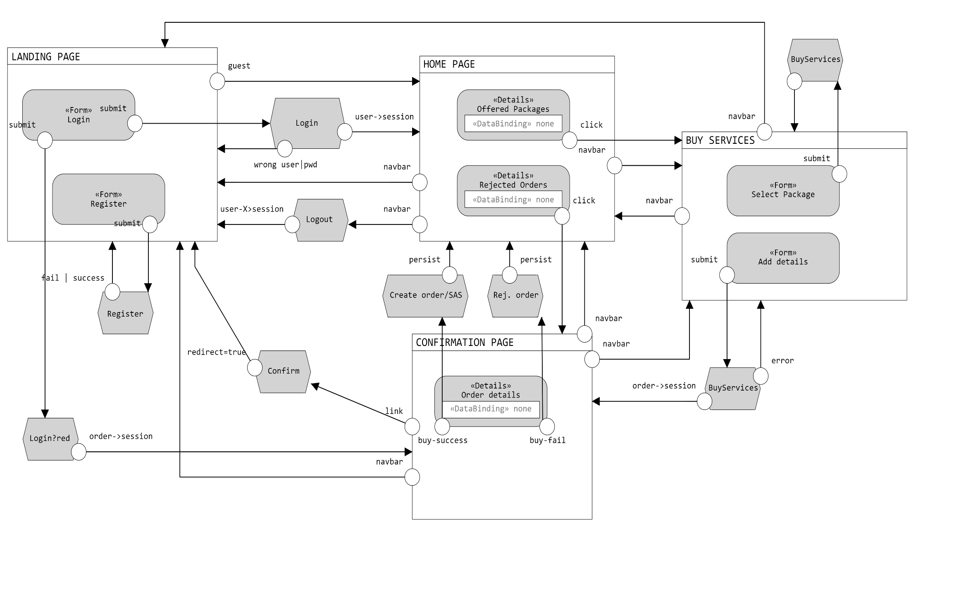
Functional analysis of the interaction

Slide 53
Components
Servlets
EntryPage
Login
Logout
Register
Homepage
BuyServices
Confirm
CreateOrder
EmployeeEntryPage
EmployeeLogin
EmployeeHome
EmployeeSalesReport
CreateProduct
CreateService
CreateServicePackage
Views
index.html
home.html
buy_service.html
confirmation_page.html
employeeIndex.html
employeeHome.html
employeeSalesReport.html

Slide 54
Components
Business Components (EJBs)
CustomerService
stateless
checkCredentials(username,password)
createCustomer(username,password,email)
addInsolvence(username,i)
CustomOrderService
stateless
createAbstractOrder(…)
persistOrder(order)
addToOrderedProduct(product,order)
findRejectedOrder(customer)
findAllRejectedOrders()
findOrder(id)
validateOrder(id)
invalidateOrder(id)
getAmountForAuditingTable(customer)
ServicePackageService
stateless
findAllPackages()
findAllPackageNames()
findFormPackage(name)
createServicePackage(name,vpx,products,services)
ServiceService
stateless
createService()
ProductService
stateless
findAllProducts()
createProduct(name,fee)
ValidityPeriodService
stateless
findValidity(id)

Slide 55
Components
EmployeeService
stateless
checkCredentials(username,password)
TotalPurchasesPerPackageService
stateless
findall()
TotalPurchasesPerPackageAndValidityPeriodService
stateless
findall()
SalesValueService
stateless
findall()
AverageProductsSoldForPackageService
stateless
findall()
BestSellerProductService
stateless
findall()

Slide 56
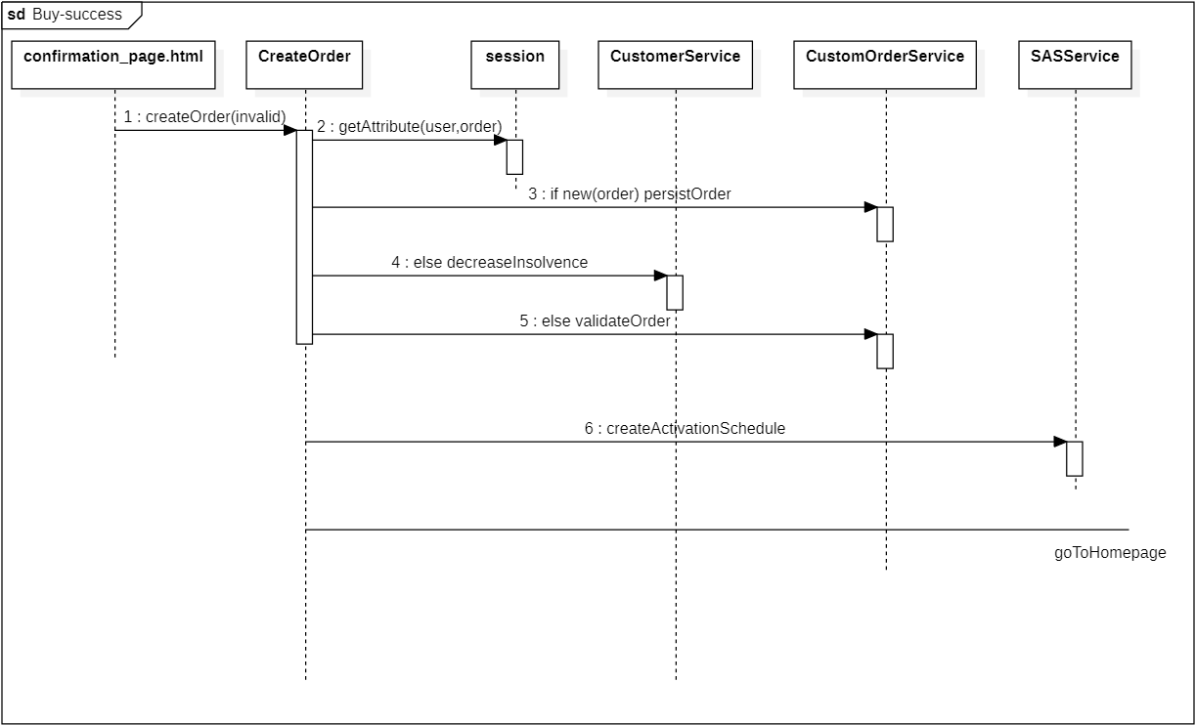
UML sequence diagrams

Slide 57
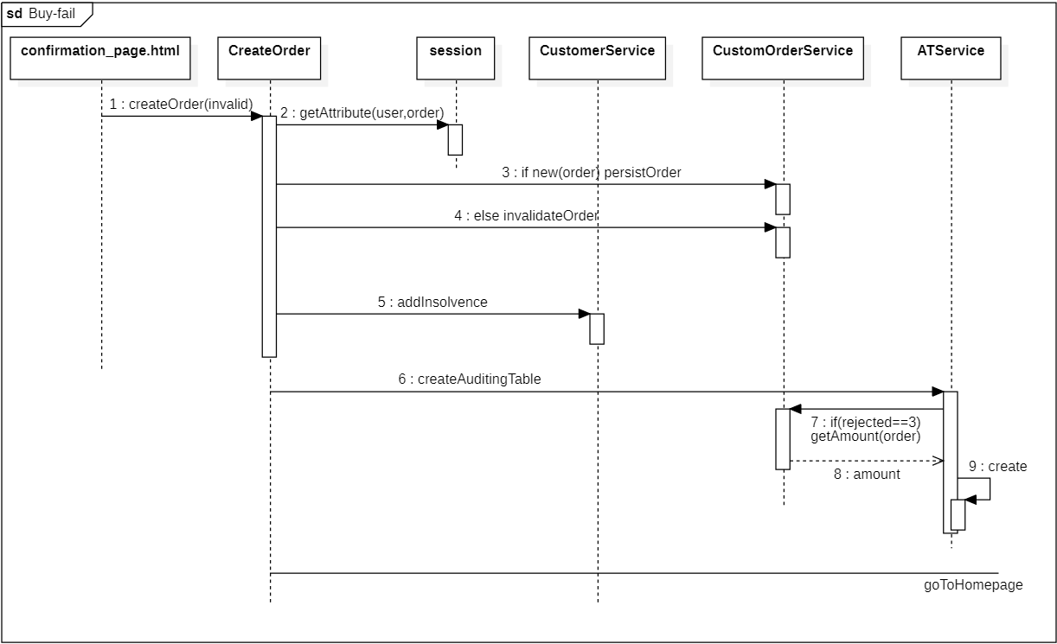
UML sequence diagrams

