Slide 1
Partner Outage Executive Report
Generated automatically using LLM-powered analytics
Confidential — Internal Use Only

Slide 2
BlueRoute Express — Executive Summary
• Unexpected power failure - affected B2B communication
• SFTP server down - affected B2B communication
• File transmission failure - affected B2B communication
• VPN connectivity issue - affected B2B communication
Confidential — Internal Use Only

Slide 3
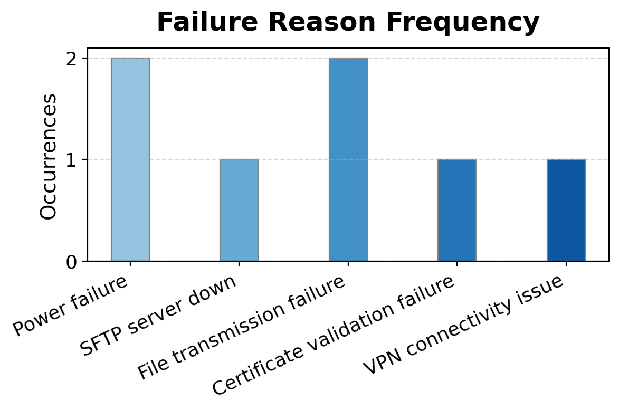
BlueRoute Express — Outage Reason Distribution
Confidential — Internal Use Only

Slide 4
FastLink Shipping — Executive Summary
• SFTP server down - affected B2B communication
• Firewall blocking outbound connections - affected B2B communication
• System maintenance window extension - affected B2B communication
• Database server unresponsive - affected B2B communication
Confidential — Internal Use Only

Slide 5
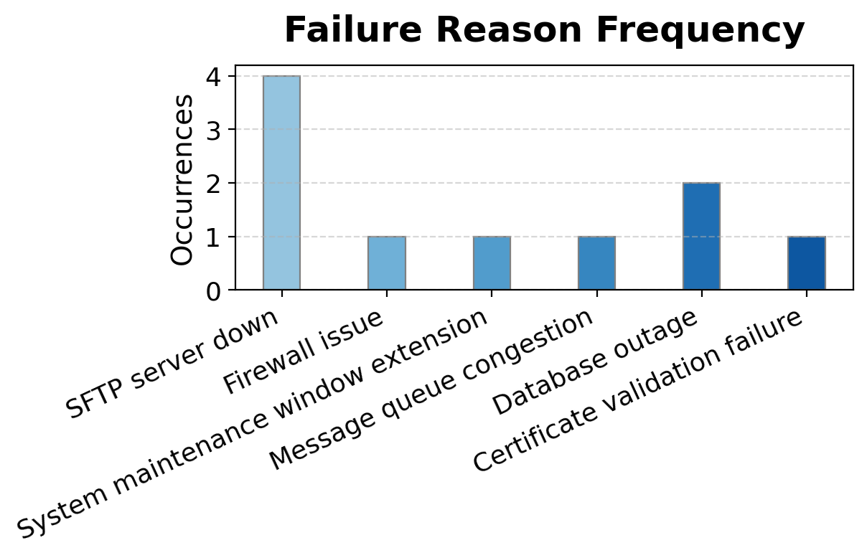
FastLink Shipping — Outage Reason Distribution
Confidential — Internal Use Only

Slide 6
GlobalFreight Connect — Executive Summary
• Network latency affecting EDI flow - caused delays in B2B communication
• Unexpected power failure in data center - disrupted B2B communication
• Network latency impacting EDI flow - caused delays in B2B communication
• File transmission failure to E2Open - hindered B2B communication
Confidential — Internal Use Only

Slide 7
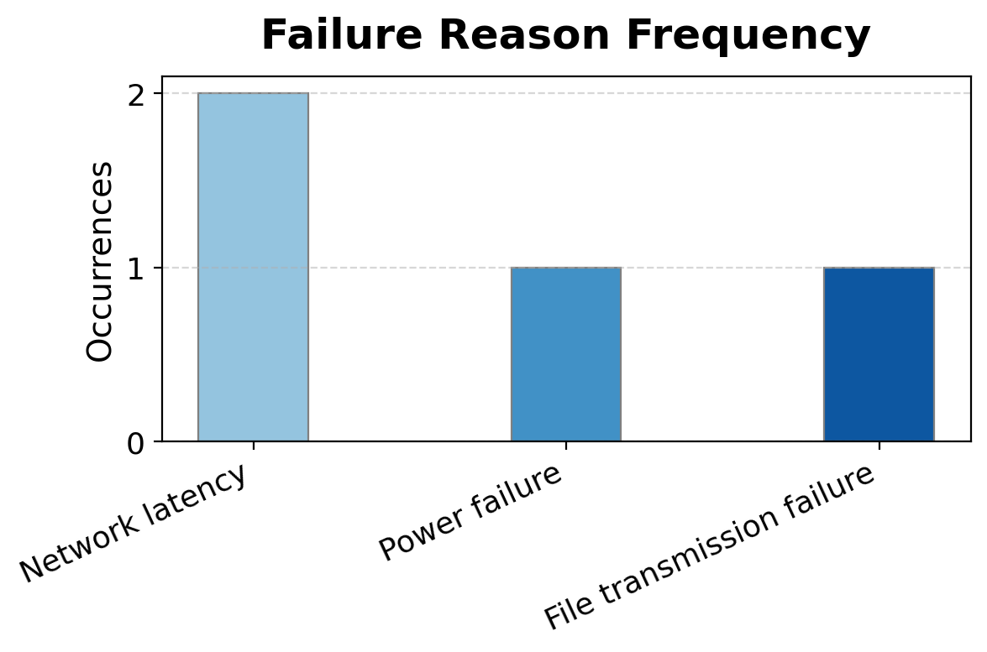
GlobalFreight Connect — Outage Reason Distribution
Confidential — Internal Use Only

Slide 8
OmniCargo Solutions — Executive Summary
• Unexpected power failure - affected B2B communication
• Database server unresponsive - affected B2B communication
• Message queue congestion - affected B2B communication
• Certificate validation failure - affected B2B communication
Confidential — Internal Use Only

Slide 9
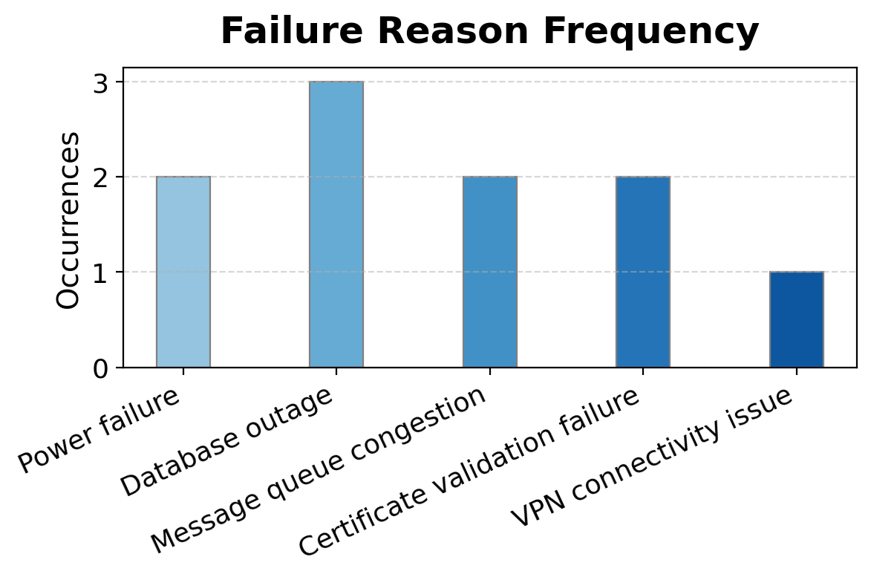
OmniCargo Solutions — Outage Reason Distribution
Confidential — Internal Use Only

Slide 10
TransEdge Logistics — Executive Summary
• Unexpected power failure - affected B2B communication
• Firewall blocking connections - disrupted external system interactions
Confidential — Internal Use Only

Slide 11
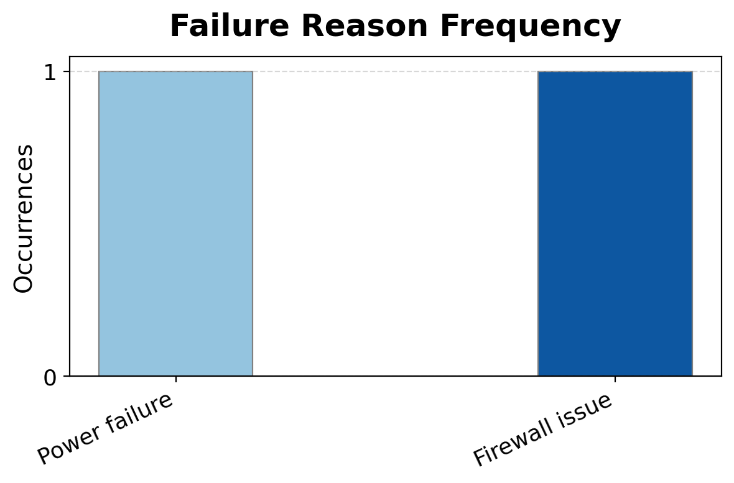
TransEdge Logistics — Outage Reason Distribution
Confidential — Internal Use Only

