Slide 1
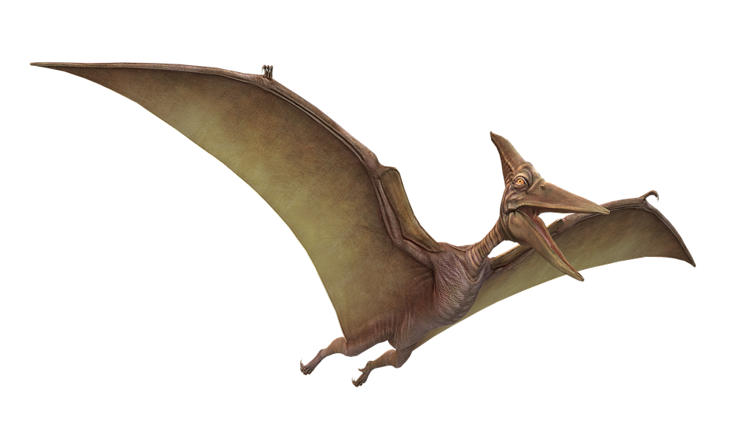
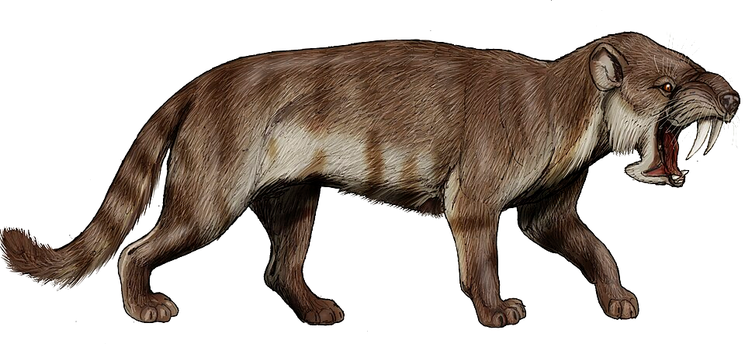
NATURAL LANGUAGE PROCESSING
Vector Space
André Santanchè
Laboratory of Information Systems - LIS
Instituto de Computação - UNICAMP
September 2026

Slide 2
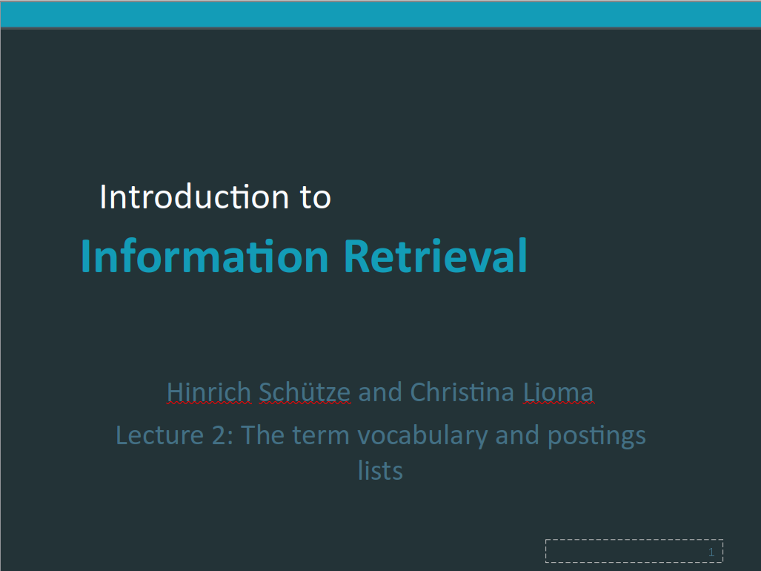
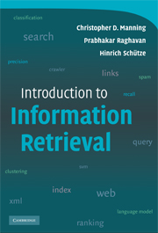
Acknowledgments
Manning, C. D., Raghavan, P., & Schütze, H. (2009). Introduction to Information Retrieval. Cambridge University Press. https://nlp.stanford.edu/IR-book/
Hinrich Schütze and Christina Lioma
08/02/2011
https://nlp.stanford.edu/IR-book/ppt/

Slide 3
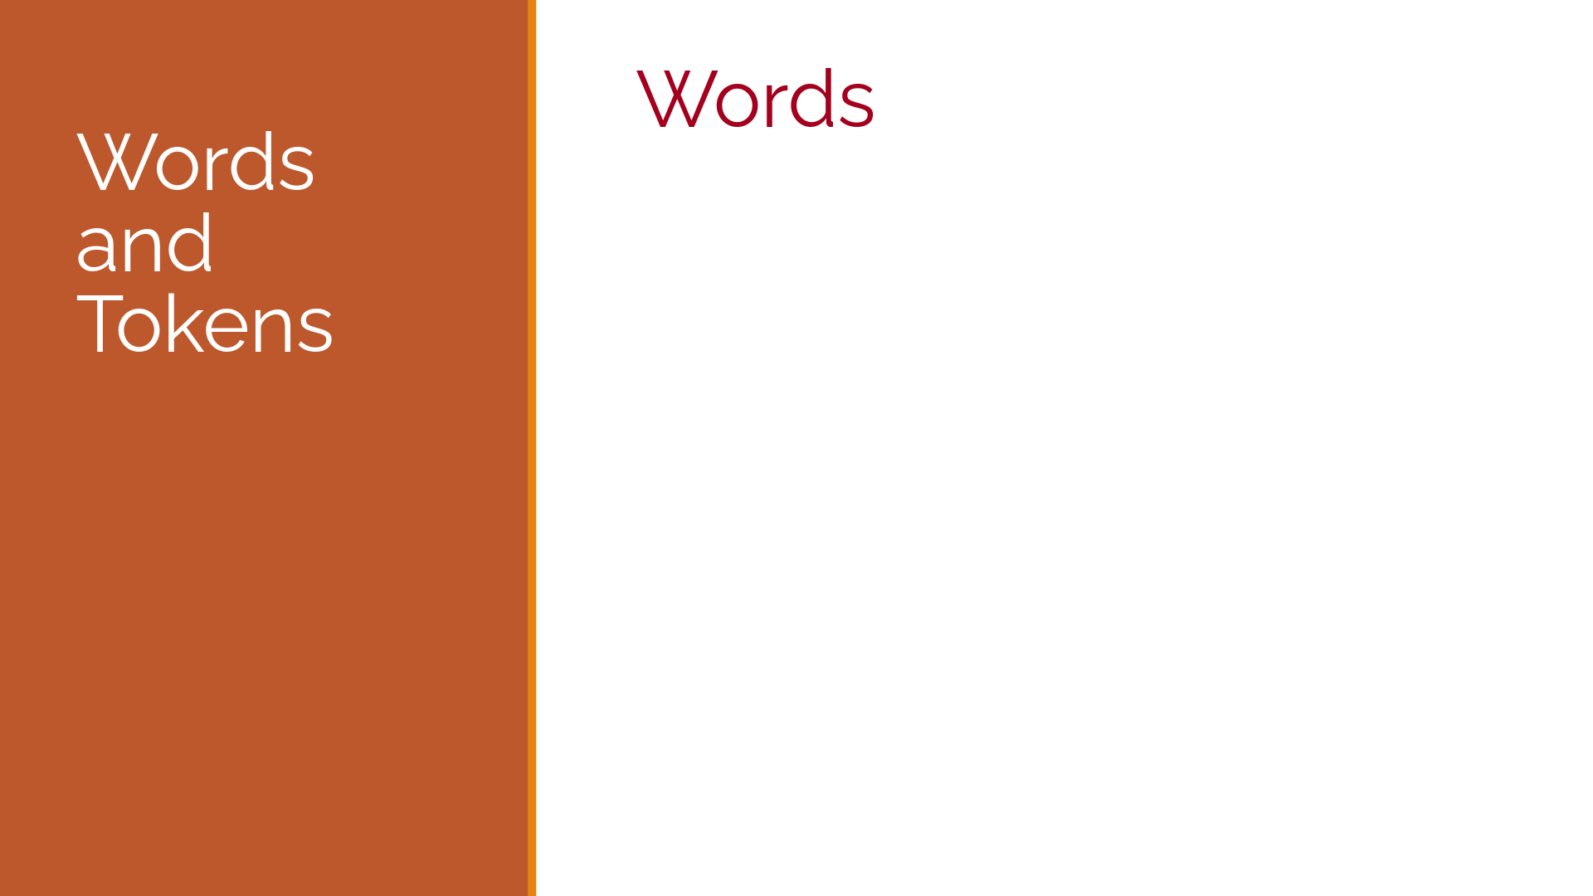
Acknowledgments
Jurafsky, D. and Martin, J. H. (2025). Speech and Language Processing: An Introduction to Natural Language Processing, Computational Linguistics, and Speech Recognition with Language Models. 3rd edition. https://web.stanford.edu/~jurafsky/slp3/
CS 124: From Languages to Information
Dan Jurafsky
Winter 2026
https://web.stanford.edu/class/cs124/

Slide 4

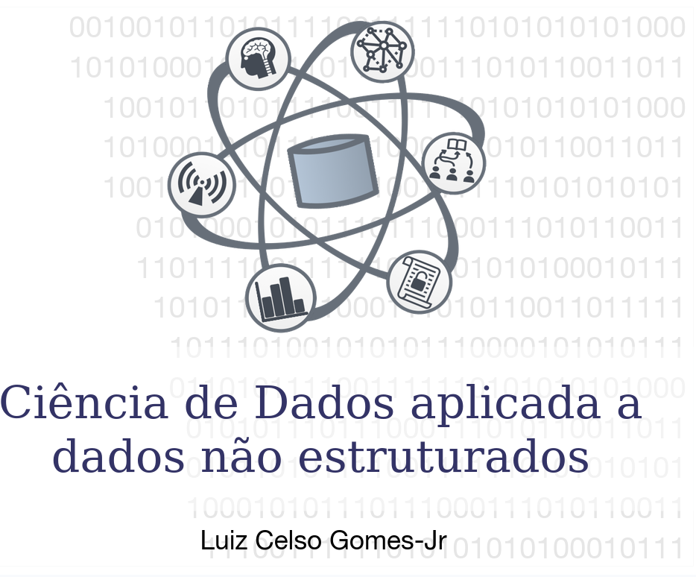
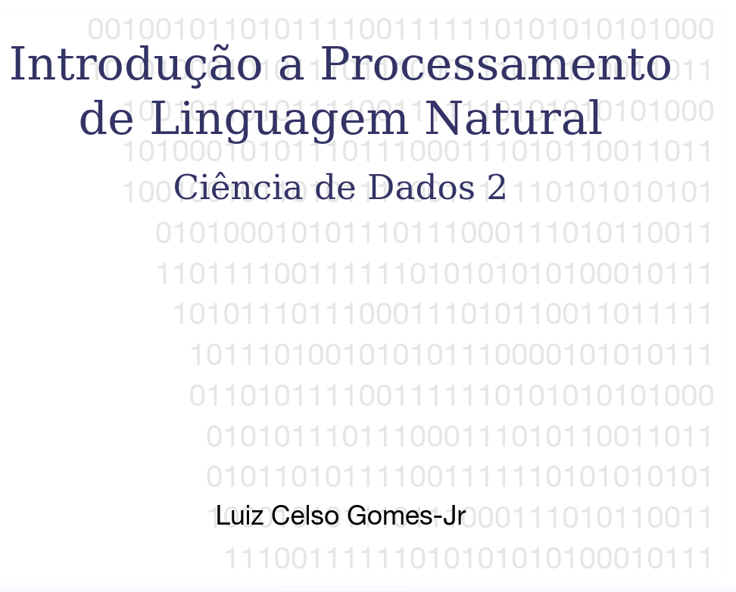
Acknowledgments
This course took the slides of my colleague Luiz Celso Gomes-Jr—to whom I extend my thanks—as a starting point. Slides that have been reused and/or adapted will bear the seal shown here.
https://pessoal.dainf.ct.utfpr.edu.br/lcjunior/
Notes:
Este curso tomou como ponto de partida os slides do colega Luiz Celso Gomes-Jr, a quem agradeço. Slides reutilizados e/ou adaptados receberão o selo ao lado.

Slide 5
Ranked Retrieval

Slide 6
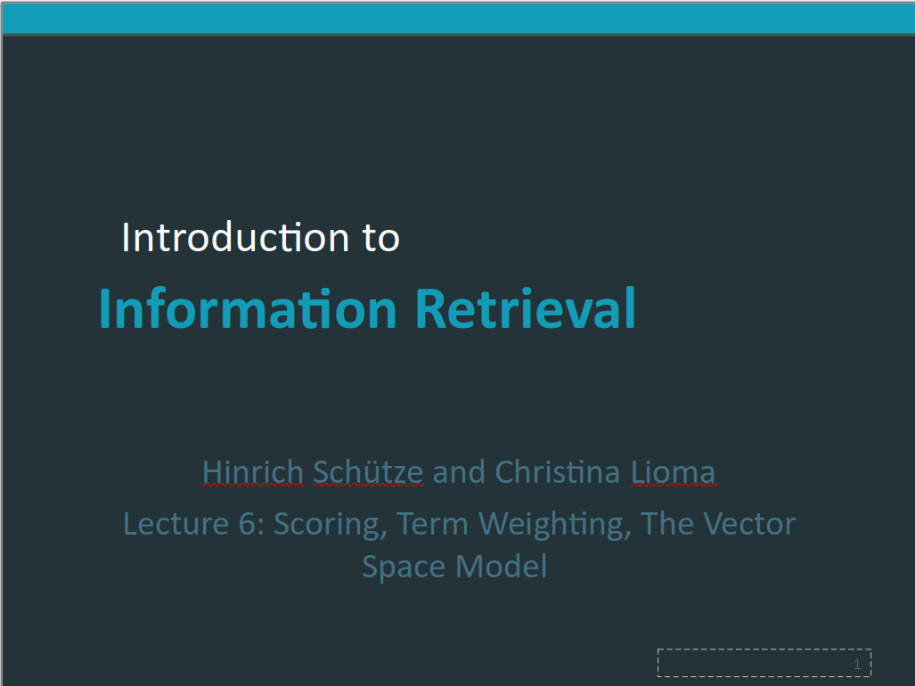
Acknowledgments
Manning, C. D., Raghavan, P., & Schütze, H. (2009). Introduction to Information Retrieval. Cambridge University Press. https://nlp.stanford.edu/IR-book/
Hinrich Schütze and Christina Lioma
30/10/2010
https://nlp.stanford.edu/IR-book/ppt/

Slide 7
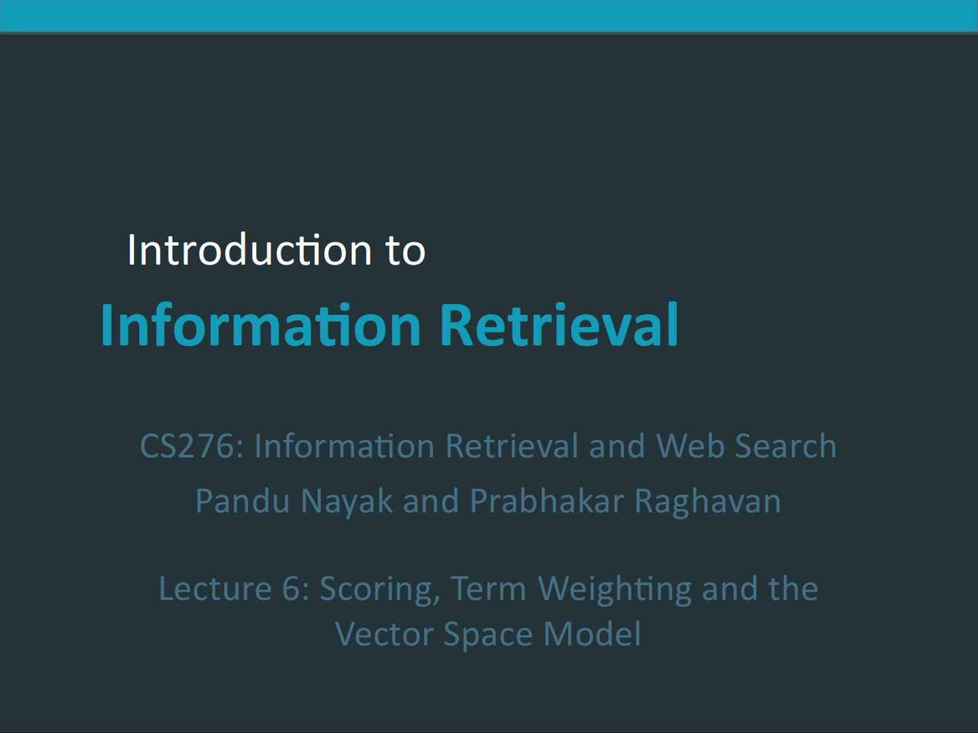
Acknowledgments
Manning, C. D., Raghavan, P., & Schütze, H. (2009). Introduction to Information Retrieval. Cambridge University Press. https://nlp.stanford.edu/IR-book/
Pandu Nayak and Prabhakar Raghavan
CS 276 / LING 286: Information Retrieval and Web Search
Spring quarter 2019
https://web.stanford.edu/class/cs276/

Slide 8
Ranked retrieval
Thus far, our queries have all been Boolean.
  Documents either match or don’t.
Good for expert users with precise understanding of their needs and of the collection.
Also good for applications: Applications can easily consum 1000s of results.
Not good for the majority of users
Most users are not capable of writing Boolean queries . . .
  . . . or they are, but they think it’s too much work.
Most users don’t want to wade through 1000s of results.
This is particularly true of web search.
(Schütze and Lioma, 2010)

Slide 9
No problem in ranked retrieval
With ranking, large result sets are not an issue.
Just show the top 10 results
Doesn’t overwhelm the user
Premise: the ranking algorithm works: More relevant results are ranked higher than less relevant results.
(Schütze and Lioma, 2010)

Slide 10
Binary incidence matrix
(Schütze and Lioma, 2010)
 | Anthony and Cleopatra | Julius Caesar | The Tempest | Hamlet | Othello | Macbeth . . .
ANTHONY BRUTUS CAESAR CALPURNIA CLEOPATRA MERCY WORSER . . . | 1 1 1 0 1 1 1 | 1 1 1 1 0 0 0 | 0 0 0 0 0 1 1 | 0 1 1 0 0 1 1 | 0 0 1 0 0 1 1 | 1 0 1 0 0 1 0
Each document is represented as a binary vector ∈ {0, 1}^{|V|}.

Slide 11
Count matrix
(Schütze and Lioma, 2010)
 | Anthony and Cleopatra | Julius Caesar | The Tempest | Hamlet | Othello | Macbeth . . .
ANTHONY BRUTUS CAESAR CALPURNIA CLEOPATRA MERCY WORSER . . . | 157 4 232 0 57 2 2 | 73 157 227 10 0 0 0 | 0 0 0 0 0 3 1 | 0 2 2 0 0 8 1 | 0 0 1 0 0 5 1 | 1 0 0 0 0 8 5
Each document is now represented as a count vector ∈ N^{|V|}.

Slide 12
Bag of words model
We do not consider the order of words in a document.
John is quicker than Mary and Mary is quicker than John are represented the same way.
This is called a bag of words model.
(Schütze and Lioma, 2010)

Slide 13
tf
Term Frequency
The term frequency tf_{t,d} of term t in document d is defined as the number of times that t occurs in d.
(Schütze and Lioma, 2010)

Slide 14
Term frequency tf
Raw term frequency is not what we want:
  A document with 10 occurrences of the term is more relevant than a document with 1 occurrence of the term.
  But not 10 times more relevant.
Relevance does not increase proportionally with term frequency.
(Schütze and Lioma, 2010)

Slide 15
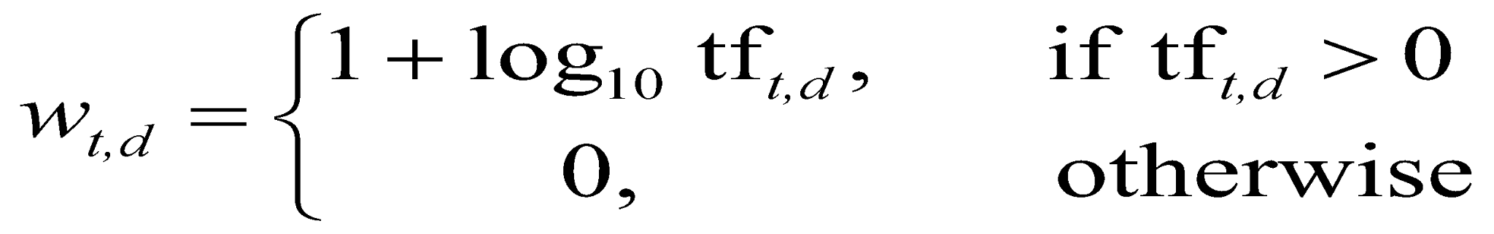
tf
Term Frequency
(Schütze and Lioma, 2010)

Slide 16
idf
Inverse Document Frequency
df_{t} is the document frequency of t: the number of documents that contain t
  df_{t} is an inverse measure of the informativeness of t
  df_{t} ≤ N
(Nayak & Raghavan, 2019)

Slide 17
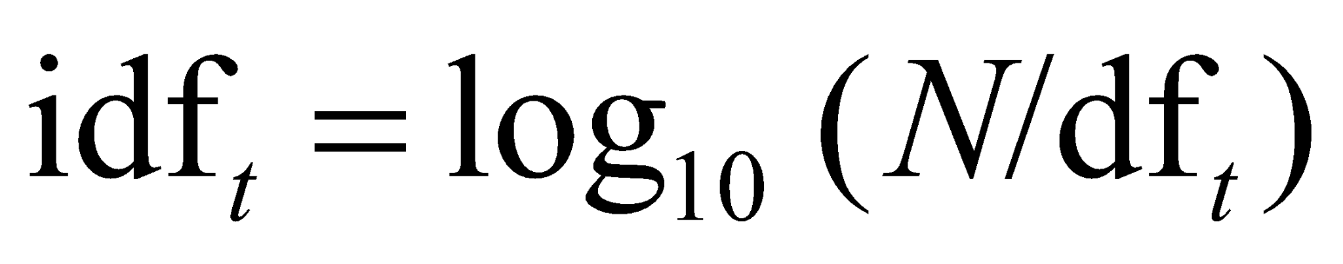
idf
Inverse Document Frequency
(Nayak & Raghavan, 2019)

Slide 18
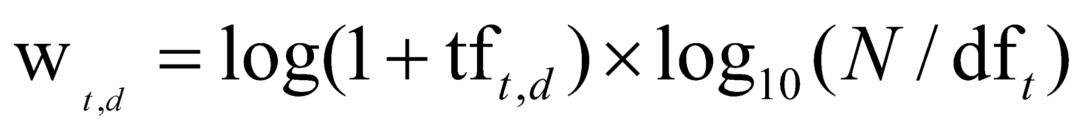
tf-idf
(Nayak & Raghavan, 2019)

Slide 19
tf-idf
Increases with the number of occurrences within a document
Increases with the rarity of the term in the collection
(Nayak & Raghavan, 2019)

Slide 20
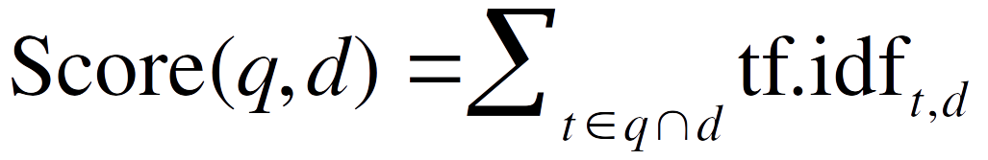
tf-idf
for a document
(Nayak & Raghavan, 2019)

Slide 21
Binary → count → weight matrix
(Schütze and Lioma, 2010)
 | Anthony and Cleopatra | Julius Caesar | The Tempest | Hamlet | Othello | Macbeth . . .
ANTHONY BRUTUS CAESAR CALPURNIA CLEOPATRA MERCY WORSER . . . | 5.25 1.21 8.59 0.0 2.85 1.51 1.37 | 3.18 6.10 2.54 1.54 0.0 0.0 0.0 | 0.0 0.0 0.0 0.0 0.0 1.90 0.11 | 0.0 1.0 1.51 0.0 0.0 0.12 4.15 | 0.0 0.0 0.25 0.0 0.0 5.25 0.25 | 0.35 0.0 0.0 0.0 0.0 0.88 1.95
Each document is now represented as a real-valued vector of tf idf weights ∈ R^{|V|}.

Slide 22
Documents as vectors
So we have a |V|-dimensional vector space
Terms are axes of the space
Documents are points or vectors in this space
Very high-dimensional: tens of millions of dimensions when you apply this to a web search engine
These are very sparse vectors - most entries are zero.
(Nayak & Raghavan, 2019)

Slide 23
Queries as vectors
Key idea 1: Do the same for queries: represent them as vectors in the space
Key idea 2: Rank documents according to their proximity to the query in this space
proximity = similarity of vectors
proximity ≈ inverse of distance
(Nayak & Raghavan, 2019)

Slide 24
Formalizing vector space proximity
First cut: distance between two points
  ( = distance between the end points of the two vectors)
Euclidean distance?
Euclidean distance is a bad idea . . .
. . . because Euclidean distance is large for vectors of different lengths.
(Nayak & Raghavan, 2019)

Slide 25
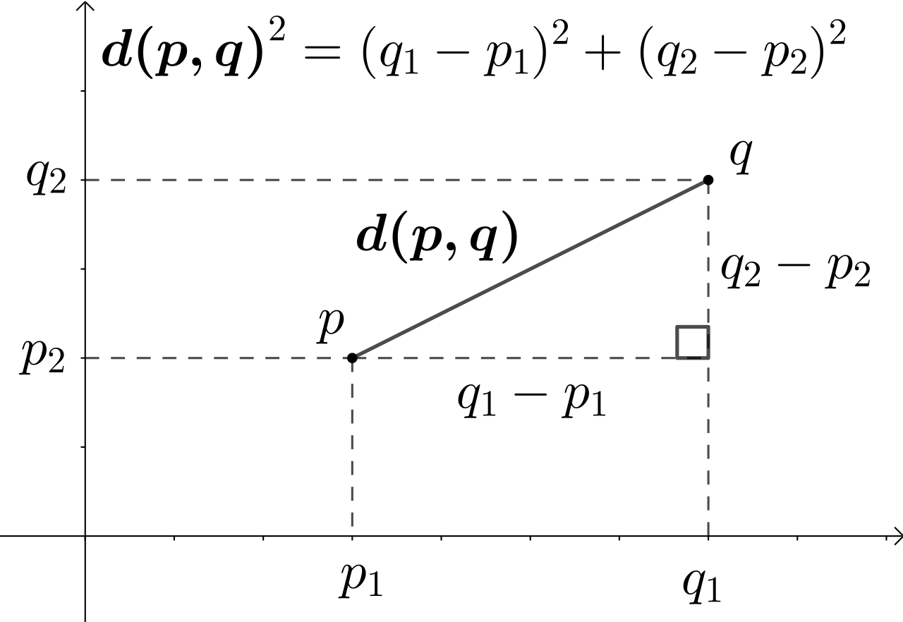
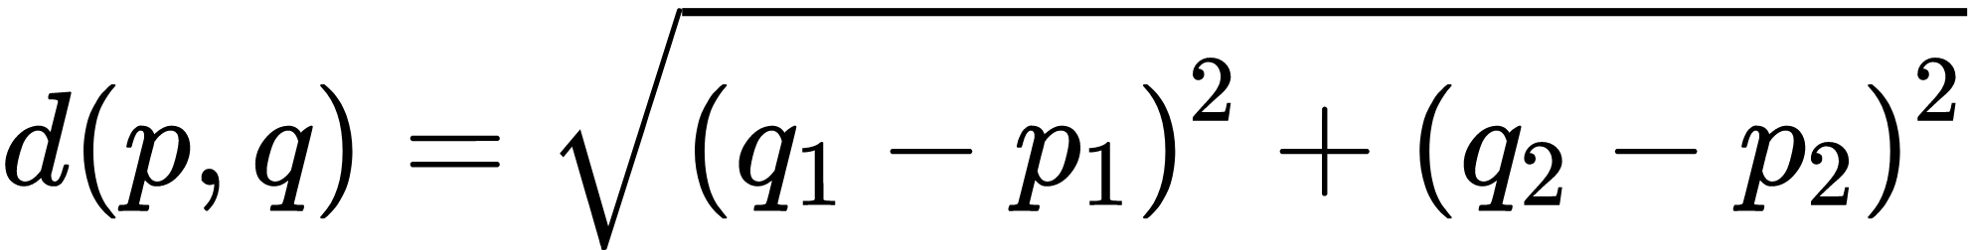
Euclidean Distance in a Plane (2D)
By Kmhkmh - Own work, CC BY 4.0, https://commons.wikimedia.org/w/index.php?curid=67617313

Slide 26
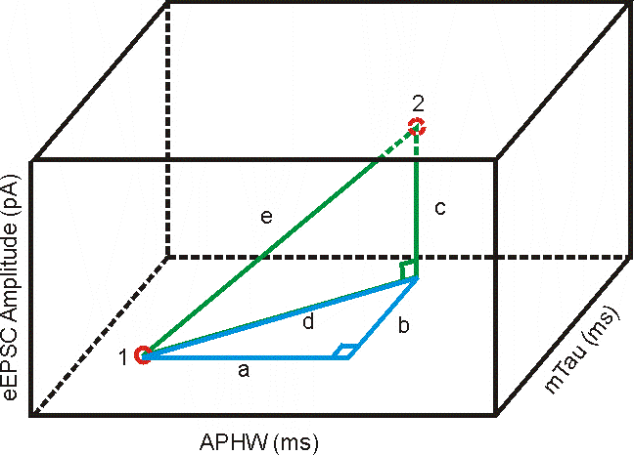
Euclidean Distance in a 3D Space
(Halabisky, 2020)

Slide 27
Properties of Distance Measure
D(A,B) = D(B,A) Symmetry
D(A,A) = 0 Constancy of Self-Similarity
D(A,B) = 0 IIf A= B Positivity (Separation)
D(A,B) <= D(A,C) + D(B,C) Triangular Inequality
(Keogh, 2003)

Slide 28
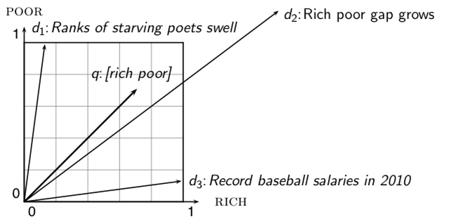
Why distance is a bad idea
(Schütze and Lioma, 2010)
The Euclidean distance of q ⃗ and d₂ ⃗ is large although the distribution of terms in the query q and the distribution of terms in the document d₂ are very similar.

Slide 29
Use angle instead of distance
Thought experiment: take a document d and append it to itself. Call this document d′.
“Semantically” d and d′ have the same content
The Euclidean distance between the two documents can be quite large
The angle between the two documents is 0, corresponding to maximal similarity.
Key idea: Rank documents according to angle with query.
(Nayak & Raghavan, 2019)

Slide 30
From angles to cosines
(Schütze and Lioma, 2010)
The following two notions are equivalent.
  Rank documents according to the angle between query and document in decreasing order
  Rank documents according to cosine(query,document) in increasing order
Cosine is a monotonically decreasing function of the angle for the interval [0◦, 180◦]

Slide 31
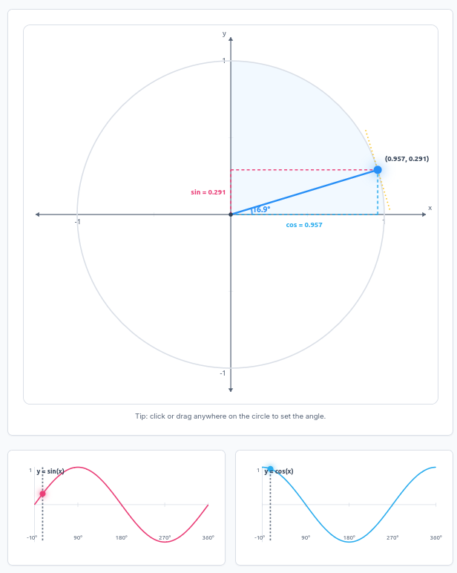
Angles and Cosine
https://toolwaves.com/tools/unit-circle-simulator

Slide 32
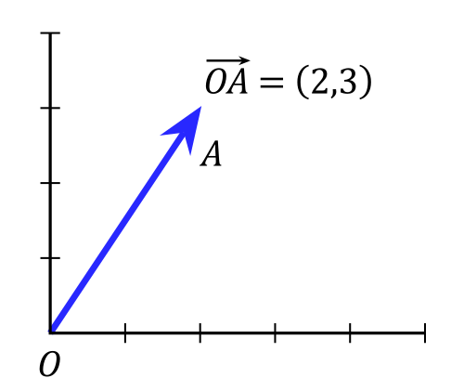
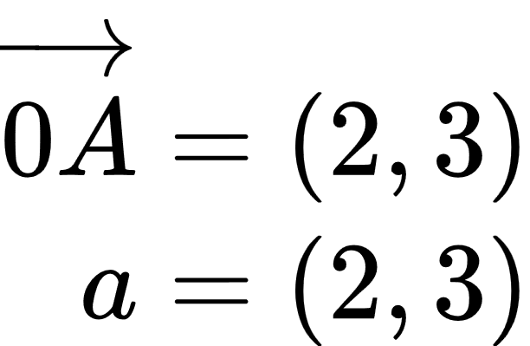
Vector Representation

Slide 33
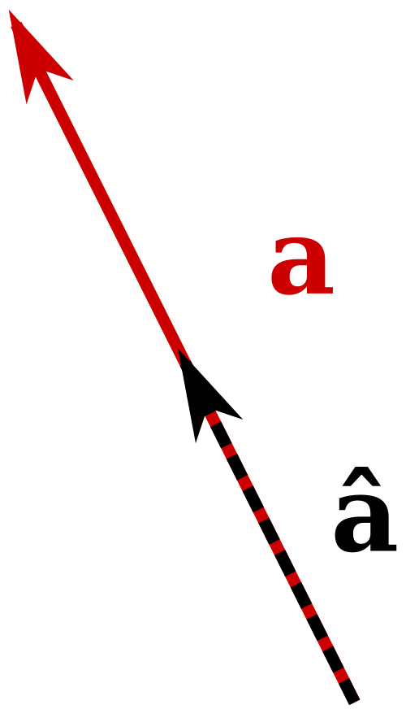
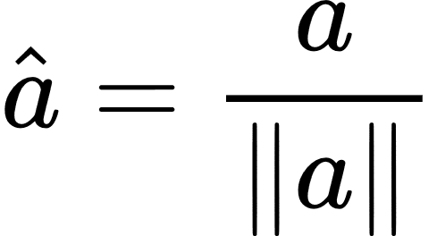
Unit Vector
A unit vector is any vector with a length of one; normally unit vectors are used simply to indicate direction. A vector of arbitrary length can be divided by its length to create a unit vector.

Slide 34
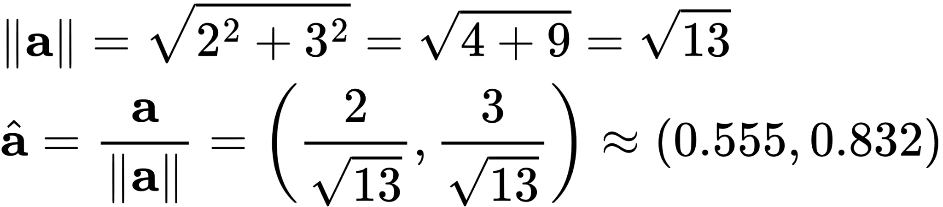
Vector Representation

Slide 35
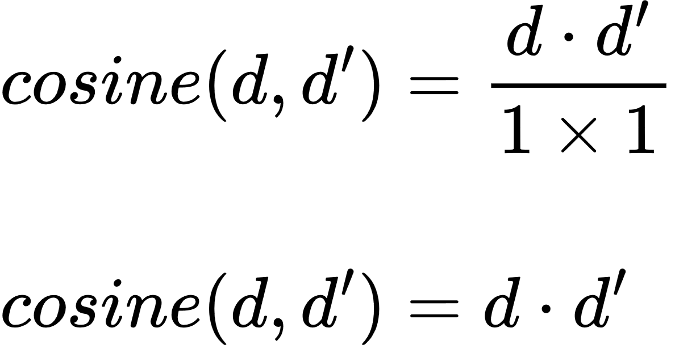

Cosine Two Vectors
Cosine two Unit Vectors

Slide 36
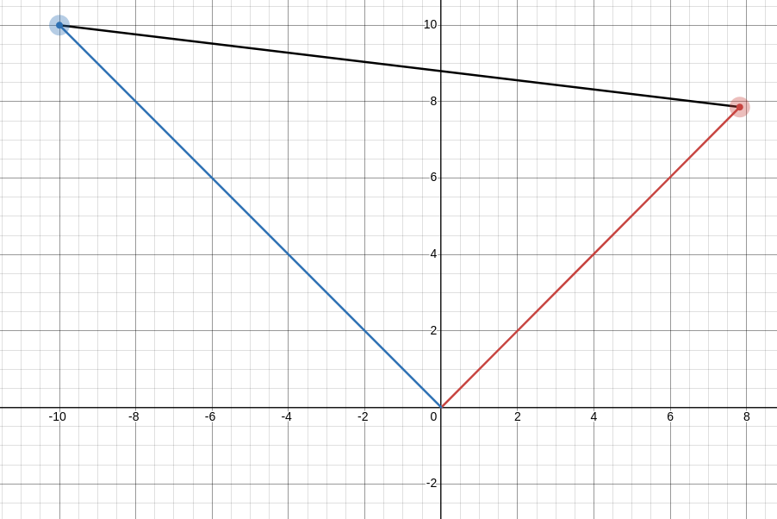
Angle Between Vectors
https://www.desmos.com/calculator/acidu77shs

Slide 37
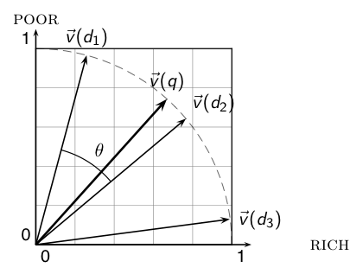
Cosine similarity illustrated
(Schütze and Lioma, 2010)

Slide 38
Cosine: Example
(Schütze and Lioma, 2010)
term frequencies (counts)
  How similar are
  these novels? SaS:
  Sense and
  Sensibility PaP:
  Pride and
  Prejudice WH:
  Wuthering
  Heights
term | SaS | PaP | WH
AFFECTION JEALOUS GOSSIP WUTHERING | 115 10 2 0 | 58 7 0 0 | 20 11 6 38

Slide 39
Cosine: Example
(Schütze and Lioma, 2010)
term frequencies (counts) log frequency weighting
(To simplify this example, we don't do idf weighting.)
term | SaS | PaP | WH
AFFECTION JEALOUS GOSSIP WUTHERING | 115 10 2 0 | 58 7 0 0 | 20 11 6 38
term | SaS | PaP | WH
AFFECTION JEALOUS GOSSIP WUTHERING | 3.06 2.0 1.30 0 | 2.76 1.85 0 0 | 2.30 2.04 1.78 2.58

Slide 40
Cosine: Example
(Schütze and Lioma, 2010)
log frequency weighting log frequency weighting &
cosine normalization
\
term | SaS | PaP | WH
AFFECTION JEALOUS GOSSIP WUTHERING | 3.06 2.0 1.30 0 | 2.76 1.85 0 0 | 2.30 2.04 1.78 2.58
term | SaS | PaP | WH
AFFECTION JEALOUS GOSSIP WUTHERING | 0.789 0.515 0.335 0.0 | 0.832 0.555 0.0 0.0 | 0.524 0.465 0.405 0.588
Cosine Normalization of SaS
||SaS|| = 3.06² + 2² + 1.3² + 0² = 3.879896906
Affection = 3.06 / 3.879896906 = 0.789
Jealous = 2.0 / 3.879896906 = 0.515
Gossip = 1.30 / 3.879896906 = 0.335
Wuthering = 0 / 3.879896906 = 0

Slide 41
Cosine: Example
(Schütze and Lioma, 2010)
log frequency weighting log frequency weighting &
cosine normalization
term | SaS | PaP | WH
AFFECTION JEALOUS GOSSIP WUTHERING | 3.06 2.0 1.30 0 | 2.76 1.85 0 0 | 2.30 2.04 1.78 2.58
term | SaS | PaP | WH
AFFECTION JEALOUS GOSSIP WUTHERING | 0.789 0.515 0.335 0.0 | 0.832 0.555 0.0 0.0 | 0.524 0.465 0.405 0.588
  cos(SaS,PaP) ≈ 0.789 ∗ 0.832 + 0.515 ∗ 0.555 + 0.335 ∗ 0.0 + 0.0 ∗ 0.0 ≈ 0.94.
  cos(SaS,WH) ≈ 0.79
  cos(PaP,WH) ≈ 0.69
  Why do we have cos(SaS,PaP) > cos(SAS,WH)?

Slide 42
NATURAL LANGUAGE PROCESSING
Vector Space
part 2
André Santanchè
Laboratory of Information Systems - LIS
Instituto de Computação - UNICAMP
September 2026

Slide 43
Semantics

Slide 44
Syntax and Semantics
“Colorless green ideas sleep furiously”
(Noam Chomsky, 1957)

Slide 45
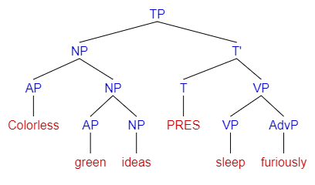
Syntax and Semantics
“Colorless green ideas sleep furiously”
(Noam Chomsky, 1957)
Syntax ✅

Slide 46
Syntax and Semantics
“Colorless green ideas sleep furiously”
(Noam Chomsky, 1957)
Syntax ✅
Semantics❓

Slide 47
Cell?
"Cell of Saint Teresa de Ávila in the Convent of Saint Joseph" (Wikipedia, 2022)
"... is the process by which a cell uses its plasma membrane to engulf a large particle" (Wikipedia, 2022)

Slide 48
Cell and Context
"Cell of Saint Teresa de Ávila in the Convent of Saint Joseph" (Wikipedia, 2022)
"... is the process by which a cell uses its plasma membrane to engulf a large particle" (Wikipedia, 2022)

Slide 49
Desiderata
What should a theory of word meaning do for us?
Let's look at some desiderata
From lexical semantics, the linguistic study of word meaning
(Jurafsky, 2026)

Slide 50
Lemmas and senses
(Jurafsky, 2026)
lemma
mouse (N)
1. any of numerous small rodents...
2. a hand-operated device that controls a cursor...
sense
Modified from the online thesaurus WordNet
A sense or “concept” is the meaning component of a word
Lemmas can be polysemous (have multiple senses)

Slide 51
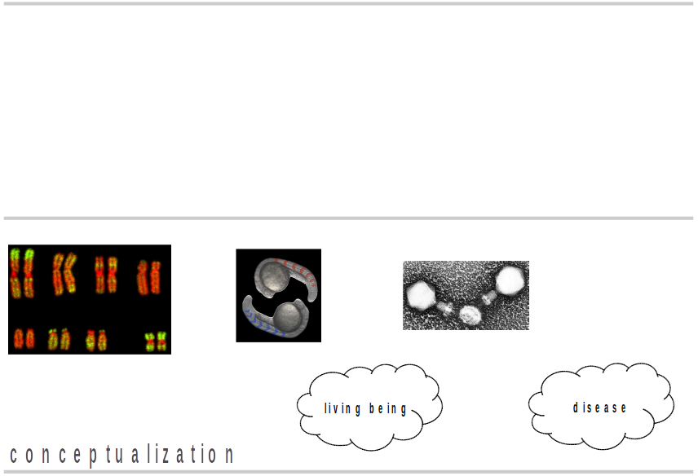
Conceptualization

Slide 52
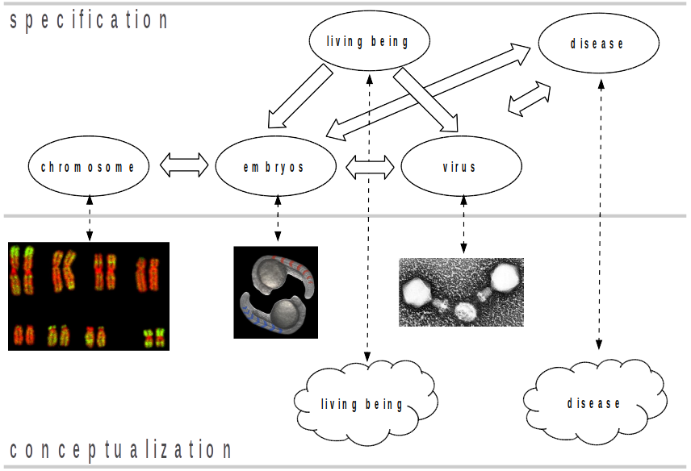
Ontology - Formal, Explicit Specification

Slide 53
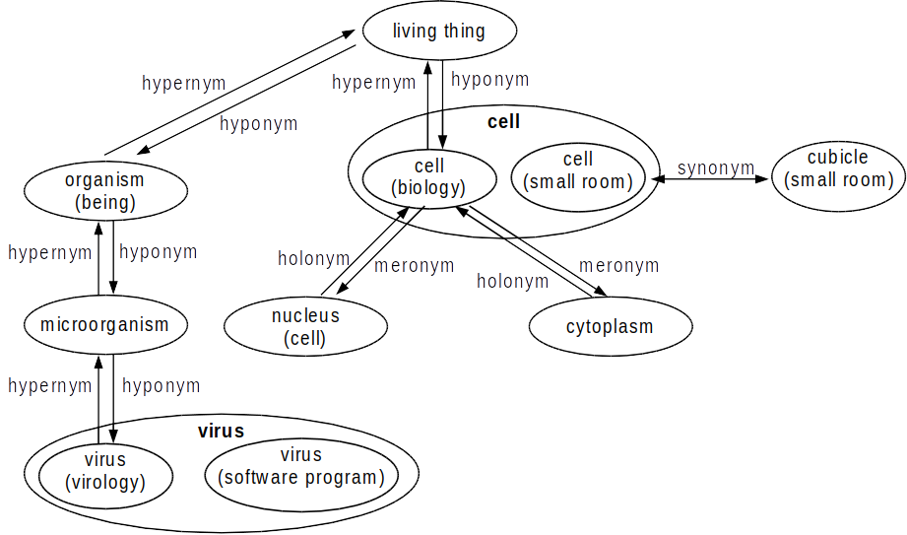
Wordnet

Slide 54
What do words mean?
N-gram or text classification methods we've seen so far
  Words are just strings (or indices wi in a vocabulary list)
  That's not very satisfactory!
Introductory logic classes:
  The meaning of "dog" is DOG; cat is CAT
∀x DOG(x) ⟶ MAMMAL(x)
Old linguistics joke by Barbara Partee in 1967:
  Q: What's the meaning of life?
  A: LIFE
That seems hardly better!
(Jurafsky, 2026)

Slide 55
Relations between senses: Synonymy
Synonyms have the same meaning in some or all contexts.
filbert / hazelnut
couch / sofa
big / large
automobile / car
vomit / throw up
water / H₂0
(Jurafsky, 2026)

Slide 56
Relations between senses: Synonymy
Note that there are probably no examples of perfect synonymy.
Even if many aspects of meaning are identical
Still may differ based on politeness, slang, register, genre, etc.
(Jurafsky, 2026)

Slide 57
Relation: Synonymy?
water/H₂0
  "H₂0" in a surfing guide?
big/large
  my big sister != my large sister
(Jurafsky, 2026)

Slide 58
The Linguistic Principle of Contrast
Difference in form → difference in meaning
(Jurafsky, 2026)

Slide 59
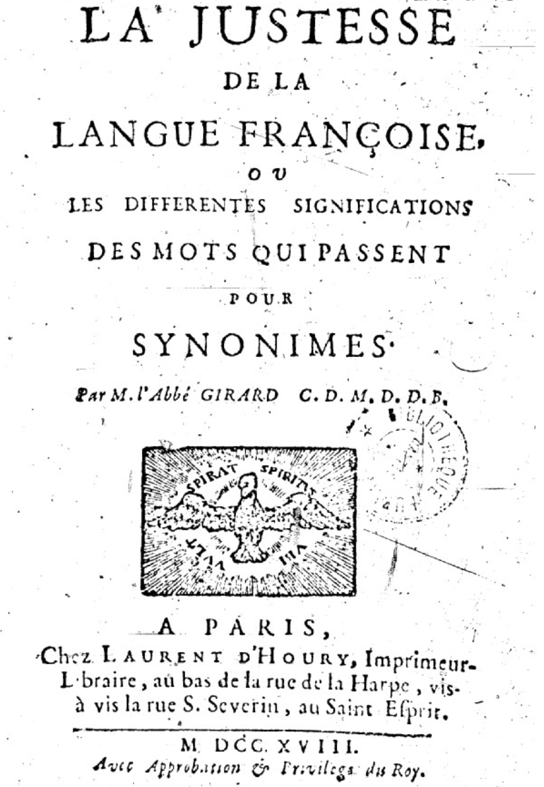
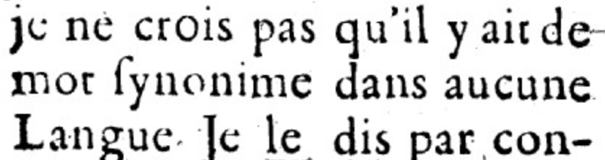
Abbé Gabriel Girard 1718
(Jurafsky, 2026)
Re: "exact" synonyms
[I do not believe that there is a synonymous word in any language]
Thanks to Mark Aronoff!

Slide 60
Relation: Similarity
Words with similar meanings. Not synonyms, but sharing some element of meaning
car, bicycle
cow, horse
(Jurafsky, 2026)

Slide 61
Ask humans how similar 2 words are
word1 | word2 | similarity
vanish | disappear | 9.8
behave | obey | 7.3
belief | impression | 5.95
muscle | bone | 3.65
modest | flexible | 0.98
hole | agreement | 0.3
SimLex-999 dataset (Hill et al., 2015)
(Jurafsky, 2026)
Notes:
One way of getting values for word similarity is to ask humans to judge how similar one word is to another. A number of datasets have resulted from such experiments. For example the SimLex-999 dataset (Hill et al., 2015) gives values on a scale from 0 to 10, from near-synonyms (vanish, disappear) to pairs that scarcely seem to have anything in common (hole, agreement):

Slide 62
Relation: Word relatedness
Also called "word association"
Words can be related in any way, perhaps via a semantic frame or field
coffee, tea: similar
coffee, cup: related, not similar
(Jurafsky, 2026)

Slide 63
Semantic field
Words that cover a particular semantic domain bear structured relations with each other.
hospitals
  surgeon, scalpel, nurse, anaesthetic, hospital
restaurants
  waiter, menu, plate, food, menu, chef
houses
  door, roof, kitchen, family, bed
(Jurafsky, 2026)
Notes:
One common kind of relatedness between words is if they belong to the same
semantic field. A semantic field is a set of words which cover a particular semantic domain and bear structured relations with each other. For example, words might be related by being in the semantic field of hospitals (surgeon, scalpel, nurse, anes- thetic, hospital), restaurants (waiter, menu, plate, food, chef), or houses (door, roof, kitchen, family, bed).

Slide 64
Wordnet

Slide 65
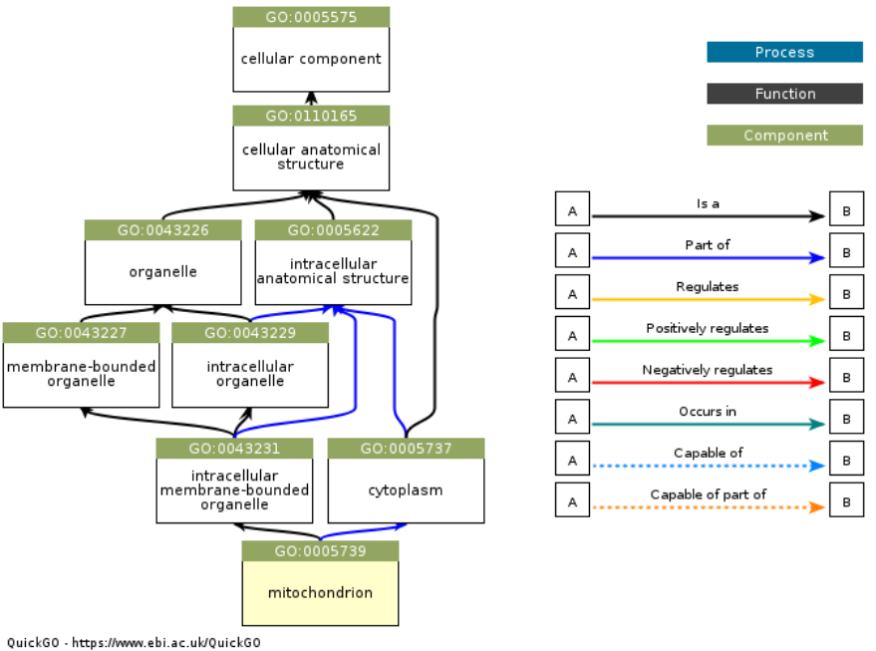
GeneOntology

Slide 66
Relation: Antonymy
Senses that are opposites with respect to only one feature of meaning
Otherwise, they are very similar!
dark/light short/long fast/slow rise/fall
hot/cold up/down in/out
More formally: antonyms can
define a binary opposition or be at opposite ends of a scale
long/short, fast/slow
Be reversives:
rise/fall, up/down
(Jurafsky, 2026)

Slide 67
Connotation (sentiment)
Words have affective meanings
  Positive connotations (happy)
  Negative connotations (sad)
Connotations can be subtle:
  Positive connotation: copy, replica, reproduction
  Negative connotation: fake, knockoff, forgery
Evaluation (sentiment!)
  Positive evaluation (great, love)
  Negative evaluation (terrible, hate)
(Jurafsky, 2026)
Notes:
Finally, words have affective meanings or connotations. The word connotation has different meanings in different fields, but here we use it to mean the aspects of a word’s meaning that are related to a writer or reader’s emotions, sentiment, opinions, or evaluations. For example some words have positive conno- tations (happy) while others have negative connotations (sad). Even words whose meanings are similar in other ways can vary in connotation; consider the difference in connotations between fake, knockoff, forgery, on the one hand, and copy, replica, reproduction on the other
Some words describe positive evaluation (great, love) and others neg- ative evaluation (terrible, hate). Positive or negative evaluation language is called sentiment, as we saw already, and word sentiment plays a role in important tasks like sentiment analysis, stance detection, and applications of NLP to the lan- guage of politics and consumer reviews.

Slide 68
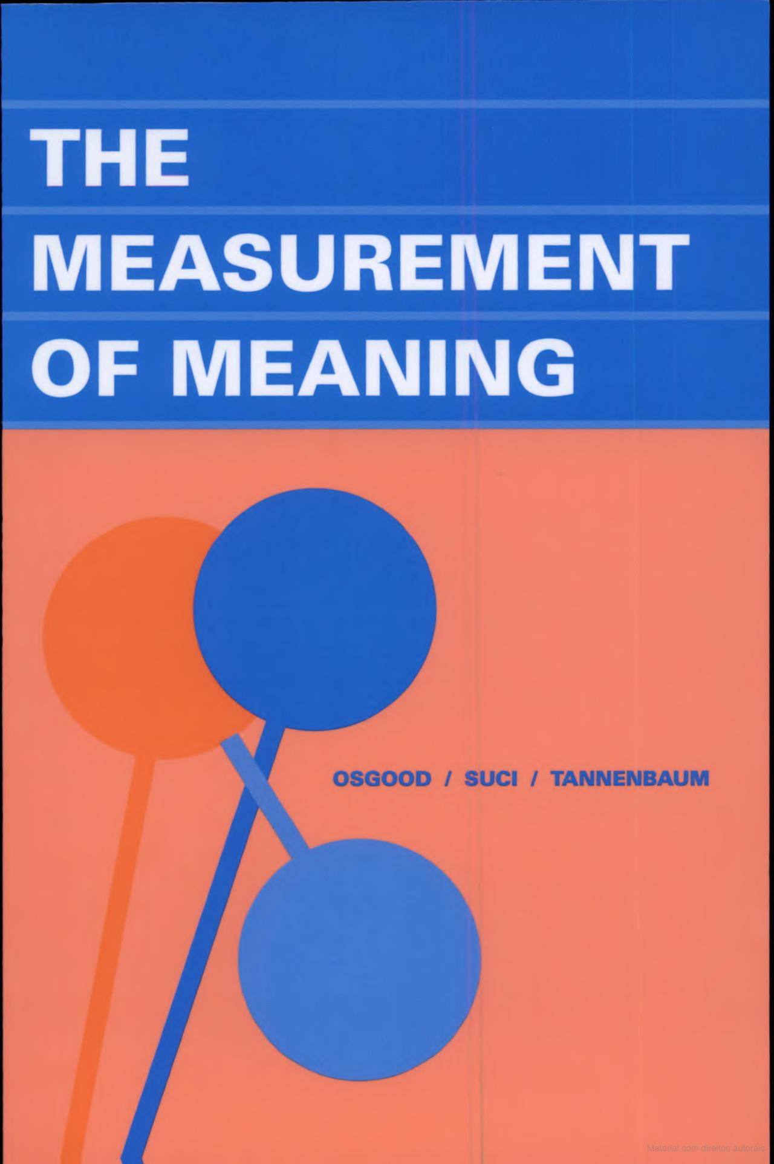
Apart from the studies to be reported here, there have been few, if any, systematic attempts to subject meaning to quantitative measurement. There are probably several reasons for this, even in a period of intense objectivity in psychology: For one thing, the term “meaning” seems to connote, for most psychologists at least, something inherently nonmaterial [...]
(Osgood et al., 1957)

Slide 69
Connotation
(Jurafsky, 2026)
Words seem to vary along 3 affective dimensions:
valence: the pleasantness of the stimulus
arousal: the intensity of emotion provoked by the stimulus
dominance: the degree of control exerted by the stimulus
(Osgood et al., 1957)
 | Word | Score |  | Word | Score
Valence | love | 1.000 |  | toxic | 0.008
 | happy | 1.000 |  | nightmare | 0.005
Arousal | elated | 0.960 |  | mellow | 0.069
 | frenzy | 0.965 |  | napping | 0.046
Dominance | powerful | 0.991 |  | weak | 0.045
 | leadership | 0.983 |  | empty | 0.081
Values from NRC VAD Lexicon (Mohammad, 2018)
Notes:
Early work on affective meaning (Osgood et al., 1957) found that words varied along three important dimensions of affective meaning:

Slide 70
So far
Concepts or word senses
Have a complex many-to-many association with words (homonymy, multiple senses)
Have relations with each other
Synonymy
Antonymy
Similarity
Relatedness
Connotation
(Jurafsky, 2026)

Slide 71
Vector Semantics

Slide 72


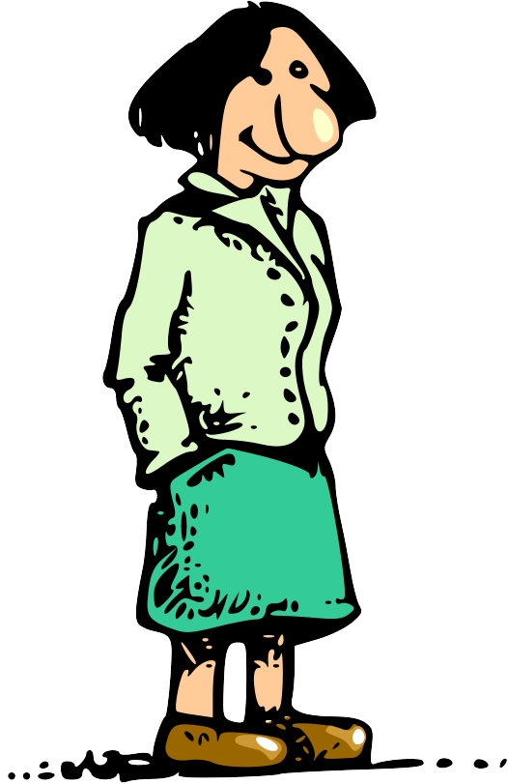
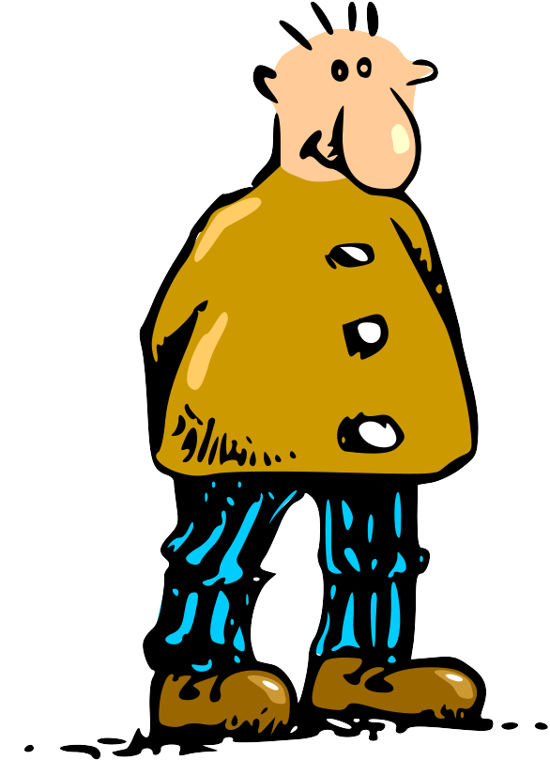
Vector Semantics
Formal Semantics
Person
...
1.0
...
0.7
Royalty
Woman
Man
...
0.1
...
0.5
...
1.0
...
0.2
...
0.1
...
0.1
Queen
King
Peasant
Peasant

Slide 73
Embeddings
Knowledge Graph
Person
...
1.0
...
0.7
Royalty
Woman
Man
...
0.1
...
0.5
...
1.0
...
0.2
...
0.1
...
0.1
Queen
King
Peasant
Peasant

Slide 74

Human Engineered
Knowledge Graph
Person
Royalty
Woman
Man
Queen
King
Peasant
Peasant

Slide 75
Formal Semantics
Person
Royalty
Woman
Man
Queen
King
Peasant
Peasant

Slide 76
Representing Concepts
Queen
King
Woman
Man

Slide 77
Ontology
Person
Royalty
Queen
King
Woman
Man

Slide 78
Ontology
Person
Woman
Man
Royalty
Queen
King
Peasant
Peasant

Slide 79
Ontology
Person
Royalty
female
male
female
male
Queen
King
Woman
Man

Slide 80
Ontology
sex
Person
male
female
Royalty
female
male
female
male
Queen
King
Woman
Man

Slide 81
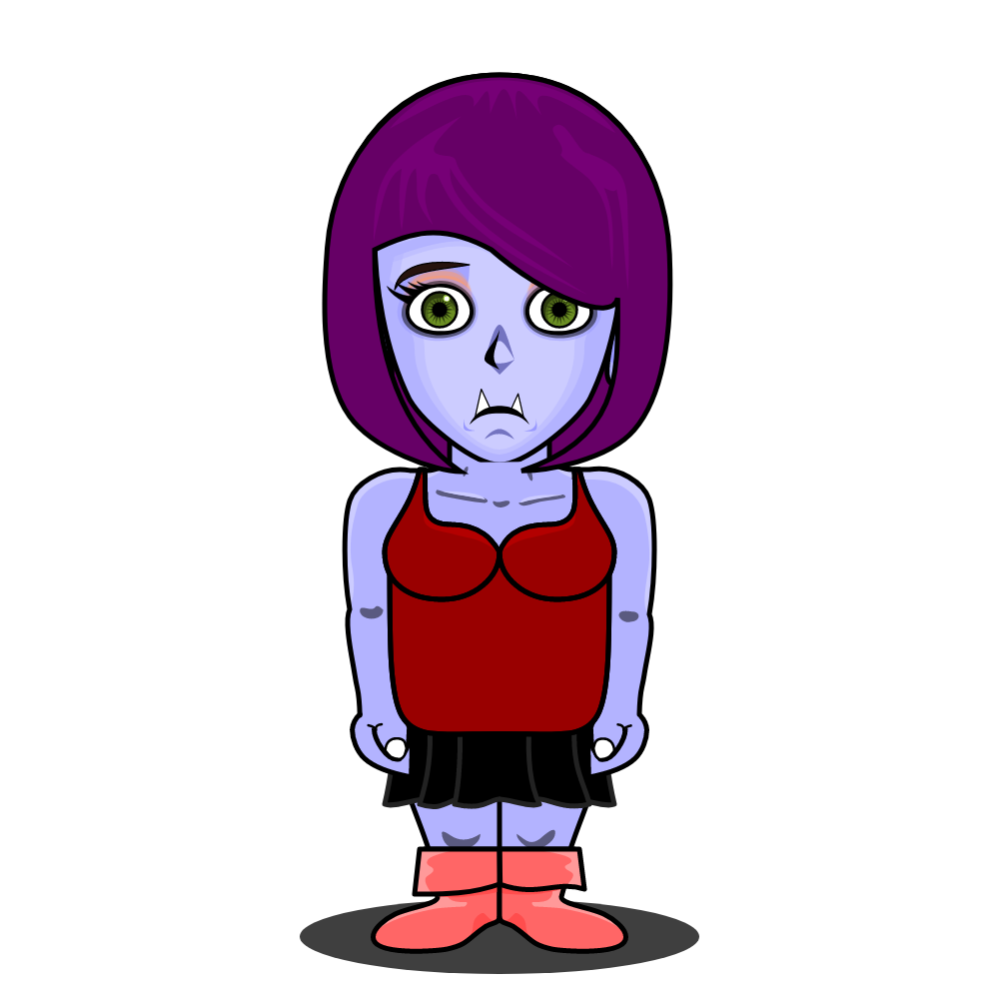
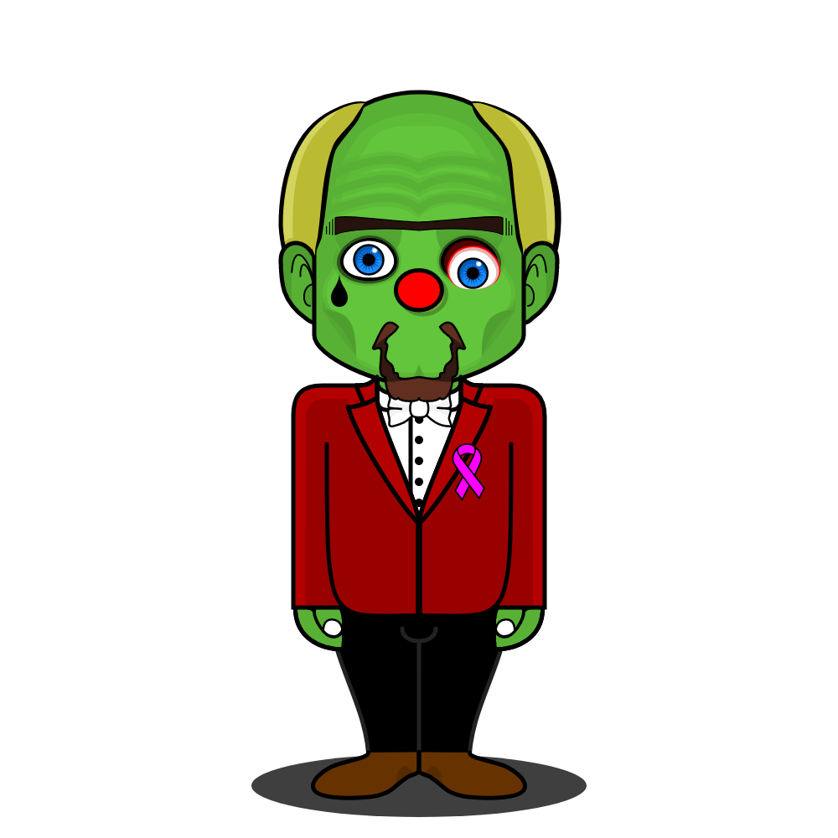

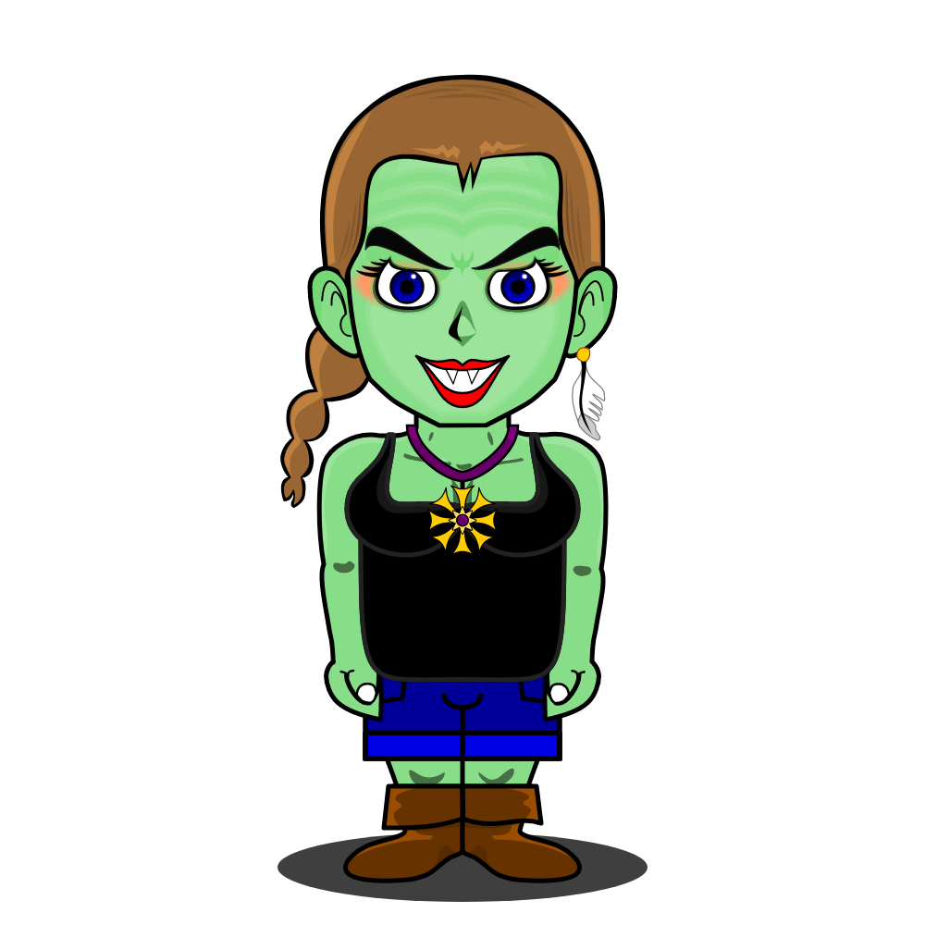

name | height | weight
Doriana | 1.87 | 60
Quincas | 1.81 | 110
Asdrúbal | 1.74 | 74
Lucinda | 1.49 | 46
Dulcinéia | 1.65 | 64
Vector Semantics

Slide 82
Vector Representation
a kind of machine “semantics “

Slide 83
Vectors
female
royalty
1
1
Queen
0
1
King
1
0
Maid
0
0
Servant

Slide 84
Vectors
female
royalty
female
royalty
1
1
1
Queen
Female
0
1
0
King
Male
1
0
1
Woman
Royalty
0
0
0
Man
Peasant

Slide 85
King – Man + Woman = Queen
“[…] the male/female relationship is automatically learned, and with the induced vector representations, “King - Man + Woman” results in a vector very close to “Queen.”
“We find that these representations are surprisingly good at capturing syntactic and semantic regularities in language, and that each relationship is characterized by a relation-specific vector offset. This allows vector-oriented reasoning based on the offsets between words.”
(Mikolov et al., 2013)

Slide 86
Operations with Vectors
Male + Royalty = ?

Slide 87
Operations with Vectors
Male + Royalty = King
0
Male
1
Royalty
0
1
King

Slide 88
Operations with Vectors
Male + Royalty = ?
King – Male + Female = ?

Slide 89
Operations with Vectors
King – Male + Female = Queen
0
1
1
King
Royalty
0
1
Male
Female
1
1
1
Royalty
Queen

Slide 90
Vector in the Space

Slide 91
Height and Weight Chart
name | height | weight
Doriana | 1.87 | 60
Quincas | 1.81 | 110
Asdrúbal | 1.74 | 74
Lucinda | 1.49 | 46
Dulcinéia | 1.65 | 64

Slide 92
Comparing Zombies
name | height | weight
Doriana | 1.87 | 60
Quincas | 1.81 | 110
Asdrúbal | 1.74 | 74
Lucinda | 1.49 | 46
Dulcinéia | 1.65 | 64
height
1,81
60
weight

Slide 93
Comparing Zombies
name | height | weight
Doriana | 1.87 | 60
Quincas | 1.81 | 110
Asdrúbal | 1.74 | 74
Lucinda | 1.49 | 46
Dulcinéia | 1.65 | 64
height
1,87
1,81
60
110
weight

Slide 94
Comparing Zombies
name | height | weight
Doriana | 1.87 | 60
Quincas | 1.81 | 110
Asdrúbal | 1.74 | 74
Lucinda | 1.49 | 46
Dulcinéia | 1.65 | 64
height
1,87
1,81
1,74
60
74
110
weight

Slide 95
Comparing Zombies
name | height | weight
Doriana | 1.87 | 60
Quincas | 1.81 | 110
Asdrúbal | 1.74 | 74
Lucinda | 1.49 | 46
Dulcinéia | 1.65 | 64
height
1,87
1,81
1,74
1,49
46
60
74
110
weight

Slide 96
Comparing Zombies
name | height | weight
Doriana | 1.87 | 60
Quincas | 1.81 | 110
Asdrúbal | 1.74 | 74
Lucinda | 1.49 | 46
Dulcinéia | 1.65 | 64
height
1,87
1,81
1,74
1,65
1,49
46
60
64
74
110
weight

Slide 97
Comparing Zombies
height
1,81
1,65
1,49
46
60
64
weight

Slide 98
Classification based on Height and Weight
height
female
1.87
male
1.81
1.74
1.65
1.49
46
60
64
74
110
weight

Slide 99
Cancer Cells in the Space

Slide 100
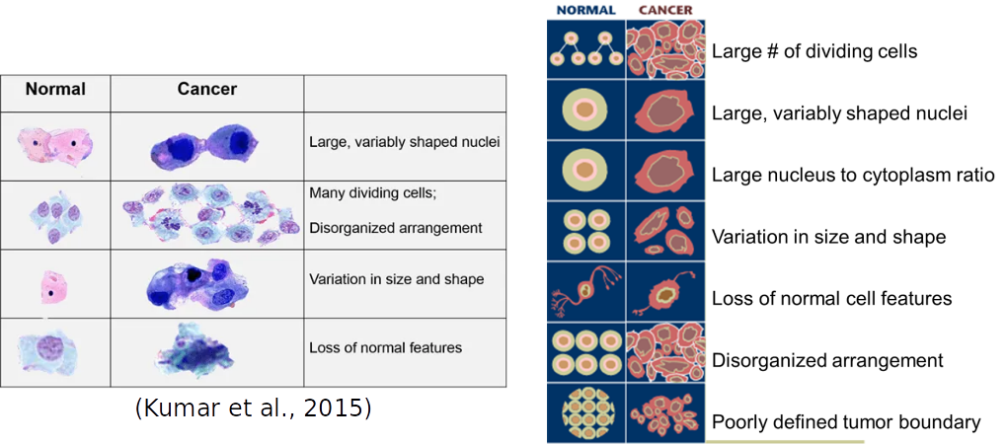
Analyzing Cancer Cells

Slide 101
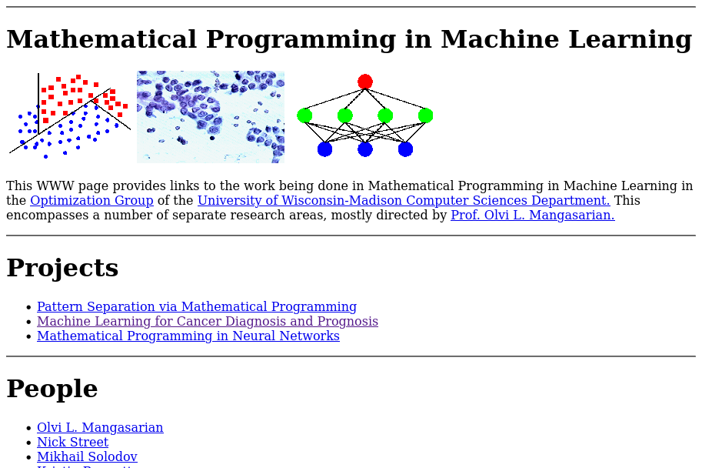
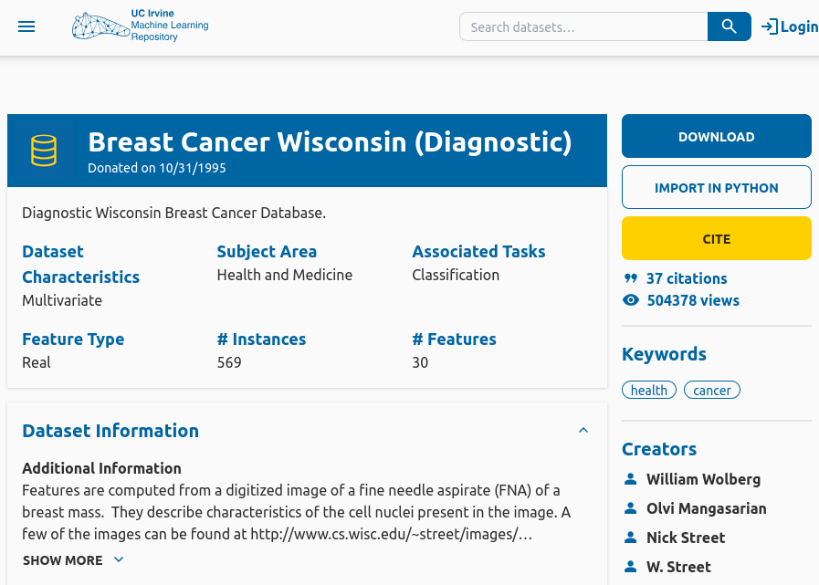
Breast Cancer Wisconsin
Original Data
Prepared Data
https://archive.ics.uci.edu/dataset/17/breast+cancer+wisconsin+diagnostic
http://www.cs.wisc.edu/~olvi/uwmp/mpml.html

Slide 102
DataSci4Health
Dataset and Workflows
DataSci4Health
  https://github.com/datasci4health/datasci4health.github.io
Dados
  https://github.com/datasci4health/datasci4health.github.io/tree/master/data/breast-cancer/wisconsin
Workflows
  https://github.com/datasci4health/datasci4health.github.io/tree/master/workflows/breast-cancer

Slide 103
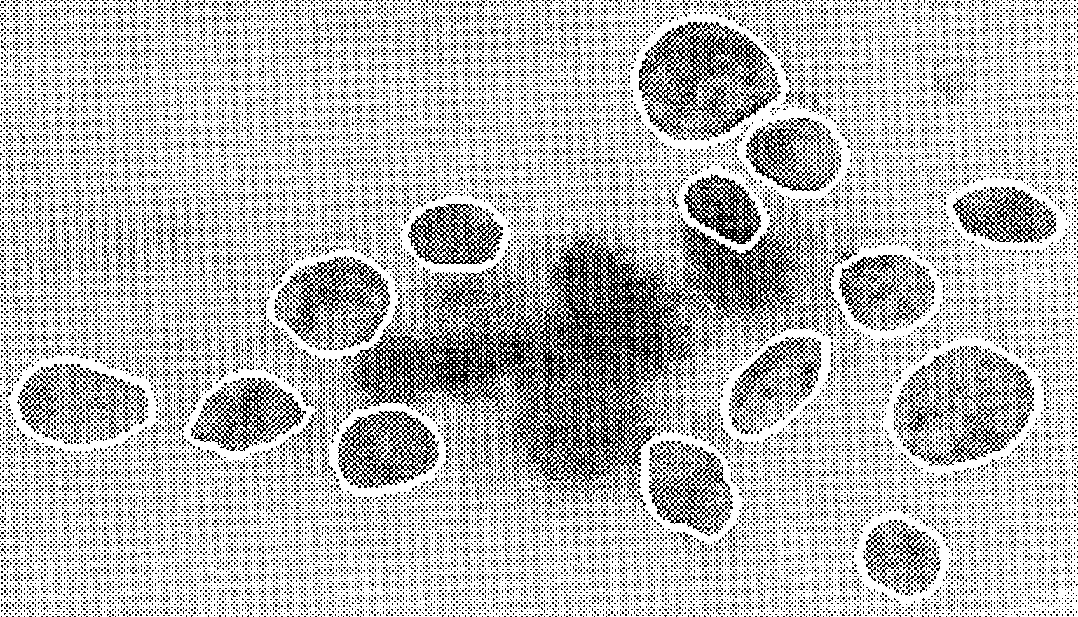
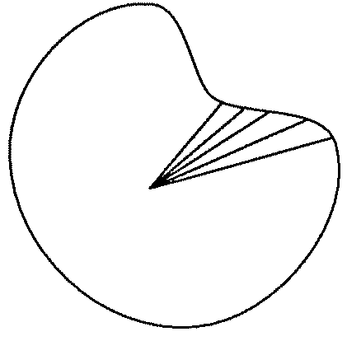
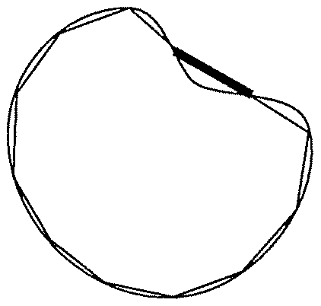
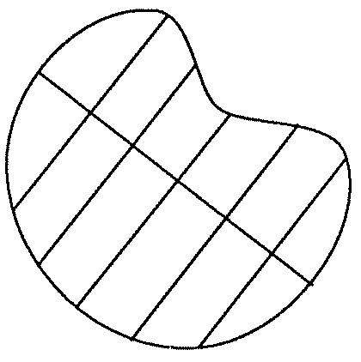
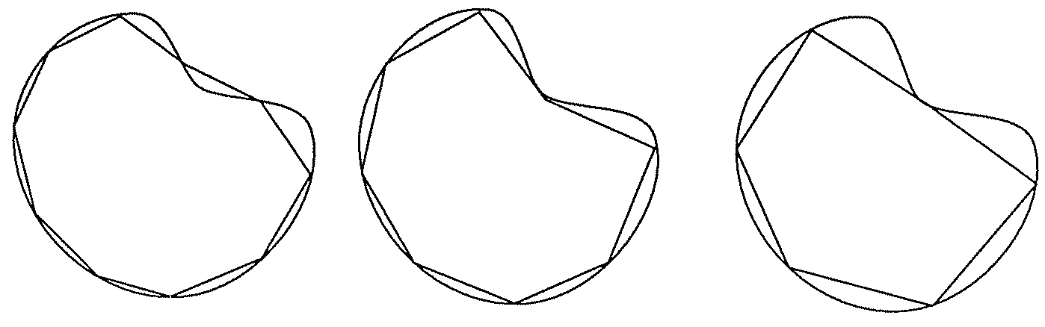
Cancer Cell Metrics
Smoothness
Radius
Perimeter
Area
Compactness
Concave Points
Texture
Concavity
Cancer Cell Nucleus Boundaries
Symmetry
Fractal Dimension
(Street et al., 1993)

Slide 104
Cancer Cells
name | radius | fractal dimension | diagnosis
862722 | 6.981 | 0.07818 | B
9111157302 | 21.100 | 0.05661 | M
889719 | 17.190 | 0.05580 | M
8910251 | 10.600 | 0.06491 | B
8510653 | 13.080 | 0.06811 | B

Slide 105


Cancer Cells in Space
name | radius | fractal dimension | diagnosis
862722 | 6.981 | 0.07818 | B
9111157302 | 21.100 | 0.05661 | M
889719 | 17.190 | 0.05580 | M
8910251 | 10.600 | 0.06491 | B
8510653 | 13.080 | 0.06811 | B
fractal dimension
0.07818
0.06811
0.06491
0.05661
0.05580
6.981
10.600
13.080
17.190
21.100
radius

Slide 106
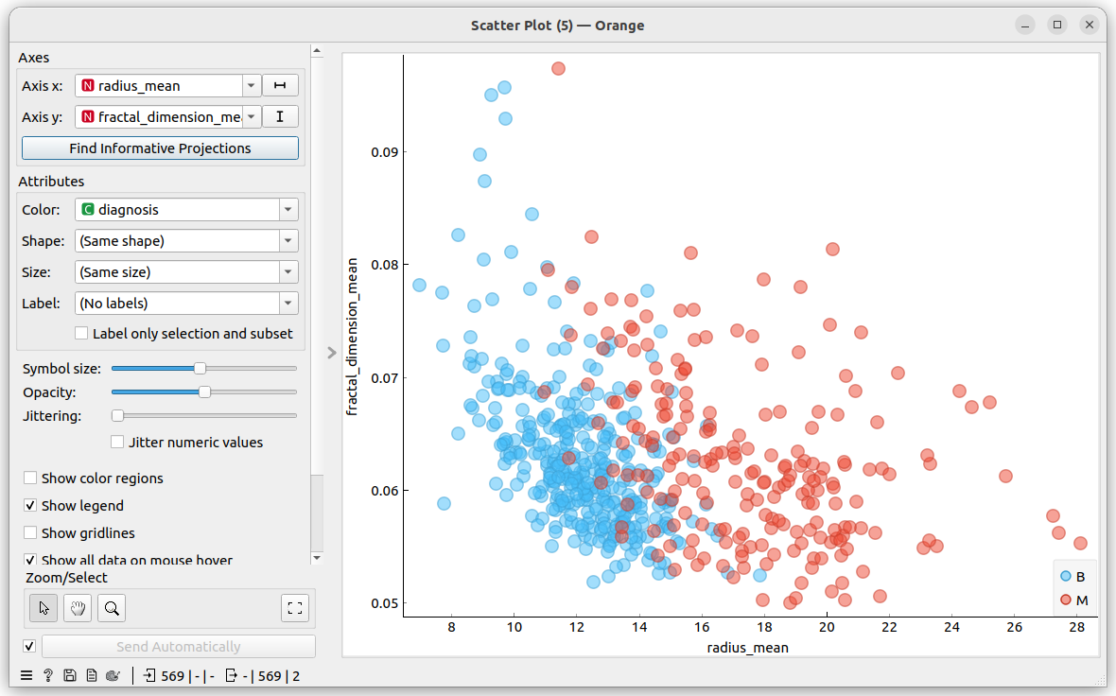
Cancer Cells in Space (Orange)

Slide 107
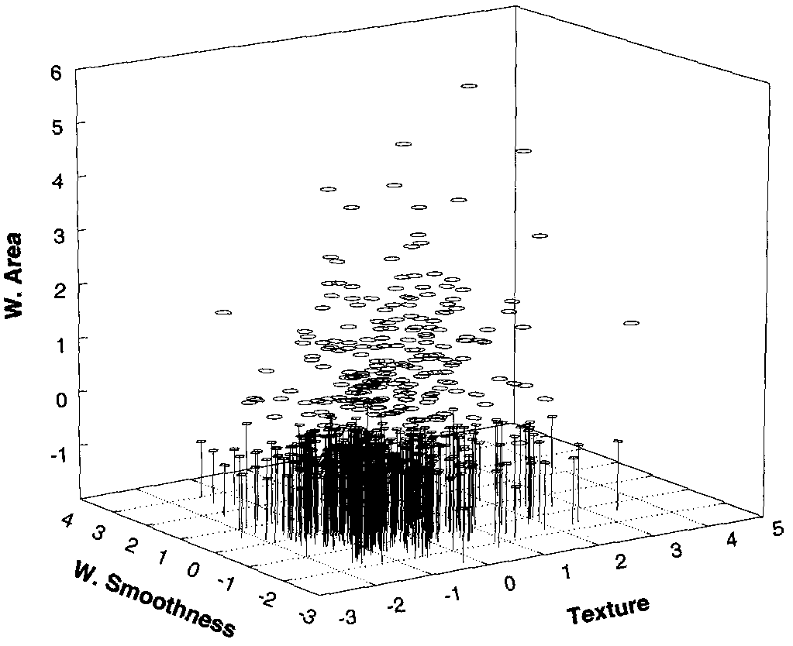
Cancer Cells in Three Dimensional Space
(Wolberg et al., 1995)

Slide 108
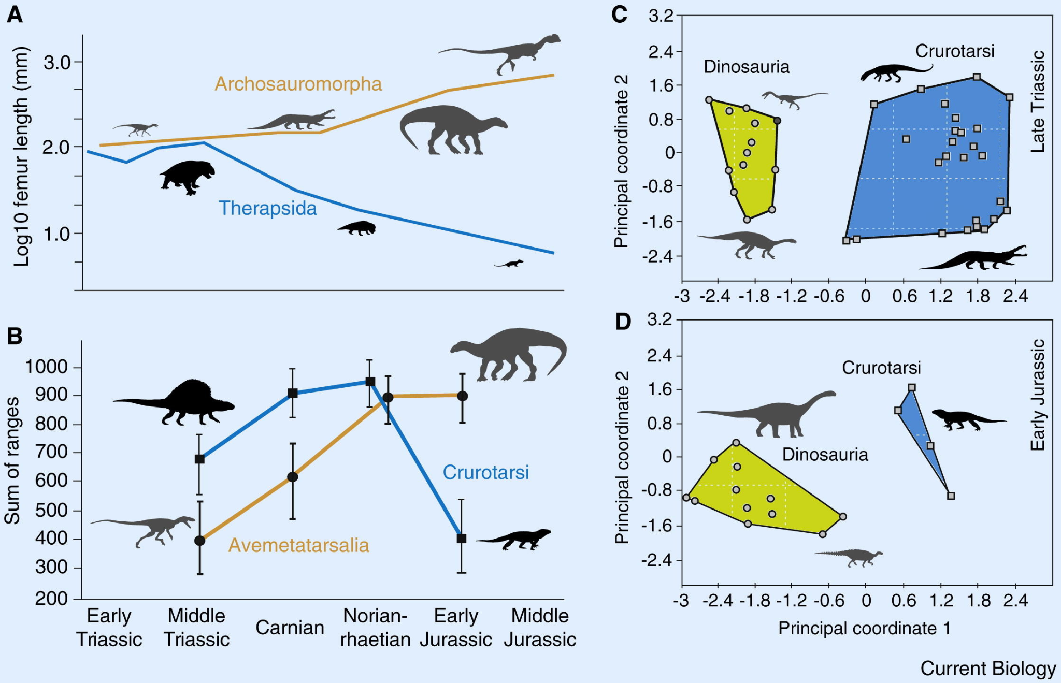
Dinosaurs in Space
(Benton et al., 2014)

Slide 109
Distance Between Cancer Cells
radius
0.07818
0.06811
0.06491
0.05661
0.05580
6.981
10.600
13.080
17.190
21.100
fractal dimension

Slide 110
Comparison with Descriptors
Is a queen more similar to a woman or a man?

Slide 111
Profiles in the Space
female
royalty
1
1
female
Queen
0
1
1
King
1
0
Maid
0
0
0
Servant
royalty
0
1

Slide 112
Distance
female
1
0
royalty
0
1

Slide 113
...
1.0
...
0.7
...
0.1
...
0.5
Words in Space
...
1.0
...
0.2
...
0.1
...
0.1

Slide 114


Similar Contexts

Slide 115
“Words that occur in similar contexts tend to have similar
meanings.”
(Jurafsky & Martin, 2025).
Distributional Hypothesis
The queen breastfed her son.
The maid breastfed her son.

Slide 116
Computational models of word meaning
Can we build a theory of how to represent word meaning, that accounts for at least some of the desiderata?
We'll introduce vector semantics
The standard model in language processing!
Handles many of our goals!
Notes:
Vector semantics is the standard way to represent word meaning in NLP, helping us model many of the aspects of word meaning we saw in the previous section. The roots of the model lie in the 1950s when two big ideas converged:

Slide 117
Ludwig Wittgenstein
PI #43:
  "The meaning of a word is its use in the language"
(Jurafsky, 2026)
Notes:
The first draws on the philosopher Wittgenstein's idea that the meaning of a word should be tied to how it is used

Slide 118
Let's define words by their usages
One way to define "usage":
words are defined by their environments (the words around them)
Zellig Harris (1954):
If A and B have almost identical environments we say that they are synonyms.
(Jurafsky, 2026)
Notes:
linguists like Joos (1950), Harris (1954), and Firth (1957) had the related idea of defining the meaning of a word by its distribution in language use, meaning its neighboring words or grammatical environments.

Slide 119
What does recent English borrowing ongchoi mean?
(Jurafsky, 2026)
Suppose you see these sentences:
  Ong choi is delicious sautéed with garlic.
  Ong choi is superb over rice
  Ong choi leaves with salty sauces
And you've also seen these:
  …spinach sautéed with garlic over rice
  Chard stems and leaves are delicious
  Collard greens and other salty leafy greens
Conclusion:
  Ongchoi is a leafy green like spinach, chard, or collard greens
    We could conclude this based on words like "leaves" and "delicious" and "sauteed"
Notes:
For example, suppose you didn’t know the meaning of the word ongchoi (a recent borrowing from Cantonese) but you see it in the following contexts:
…
We can do the same thing computationally by just counting words in the context of ongchoi.

Slide 120

Ongchoi: Ipomoea aquatica "Water Spinach"
空心菜
kangkong
rau muống
…
(Jurafsky, 2026)
Yamaguchi, Wikimedia Commons, public domain
Notes:
Here's a picture of ongchoi for you food fans

Slide 121
linguistic distribution
Word Vector Semantics
point in multidimensional space

Slide 122

Task 1 - Fruits in the Space
Given the following fruits, choose three flavor components to be used to differentiate them.
Dadas as seguintes frutas, escolha três componentes de sabor para ser usados para diferenciá-las.

Slide 123

Task 2 - Flavor Factor Space
Answer the form:
https://forms.gle/wzicEu8648eSvXMH9

Slide 124

Flavor Factor Space

Slide 125
Idea 1: Defining meaning by linguistic distribution
Let's define the meaning of a word by its distribution in language use, meaning its neighboring words or grammatical environments.
Notes:
So we can express this first intuition as Idea 1:

Slide 126
Task 3 - Words in the Space
Given the following words, choose three components to be used to differentiate them.
Com base nas palavras a seguir, escolha três componentes para diferenciá-las.
love
happy
leadership
toxic
weak
empty

Slide 127
Idea 2: Meaning as a point in space
Factor analysis (Osgood et al., 1957; Russell, 1980, 2003)
Core Dimensions of word Meaning:
  valence (V): positive/pleasure – negative/displeasure
  arousal (A): active/stimulated – sluggish/bored
  dominance (D): powerful/strong – powerless/weak
banquet >_{valence} funeral
nervous >_{arousal} lazy
queen >_{dominance} delicate
arousal
(Jurafsky, 2026)
valence
dominance
(Mohammad, 2018)

Slide 128

VAD Space
https://saifmohammad.com/WebPages/nrc-vad.html

Slide 129
Idea 2: Meaning as a point in space (Osgood et al. 1957)
(Jurafsky, 2026)
3 affective dimensions for a word
valence: pleasantness
arousal: intensity of emotion
dominance: the degree of control exerted
 | Word | Score |  | Word | Score
Valence | love | 1.000 |  | toxic | 0.008
 | happy | 1.000 |  | nightmare | 0.005
Arousal | elated | 0.960 |  | mellow | 0.069
 | frenzy | 0.965 |  | napping | 0.046
Dominance | powerful | 0.991 |  | weak | 0.045
 | leadership | 0.983 |  | empty | 0.081
NRC VAD Lexicon
(Mohammad 2018)
Hence the connotation of a word is a vector in 3-space
Notes:
And the second idea is Osgood’s (1957) idea mentioned in the prior lecture, in which the connotation of a word is represented by 3 numbers, it's valence, arousal, and dominance. That means we are essentially representing a word's connotation by a point in three-dimensional space! But suppose we represent more than just a word's connotation

Slide 130
Idea 1: Defining meaning by linguistic distribution
Idea 2: Meaning as a point in multidimensional space
(Jurafsky, 2026)
Notes:
So we're going to combine these two ideas:

Slide 131
Defining meaning as a point in space based on distribution
Each word = a vector (not just "good" or "w₄₅")
Similar words are "nearby in semantic space"
We build this space automatically by seeing which words are nearby in text
Notes:
In vector semantics, we define meaning as a point in space based on distribution. Each word is a vector, not just a string like "good" or an index like "w_45". Similar words are nearby in semantic space, and, crucially, as we'll see, we build this space automatically by seeing which words are nearby in text. Here we see shows a visualization of embeddings learned for sentiment analysis, showing the location of selected words projected down from 60-dimensional space into a two dimensional space. Notice the distinct regions containing positive words, negative words, and neutral function words.

Slide 132
We define meaning of a word as a vector
Called an "embedding" because it's embedded into a space (see textbook)
The standard way to represent meaning in NLP
Every modern NLP algorithm uses embeddings as the representation of word meaning
Fine-grained model of meaning for similarity

Slide 133
Intuition: why vectors?
Consider sentiment analysis:
  With words, a feature is a word identity
    Feature 5: 'The previous word was "terrible"'
    requires exact same word to be in training and test
  With embeddings:
    Feature is a word vector
    'The previous word was vector [35,22,17…]
    Now in the test set we might see a similar vector [34,21,14]
    We can generalize to similar but unseen words!!!

Slide 134
We'll discuss 2 kinds of embeddings
Simple count embeddings
  Sparse vectors
  Words are represented by the counts of nearby words
  Later for information retrieval we'll augment this model to create the tf-idf model of weighting those counts.
Word2vec
  Dense vectors
  Representation is created by training a classifier to predict whether a word is likely to appear nearby
  Later we'll discuss extensions called contextual embeddings

Slide 135

From now on:
Computing with meaning representations instead of string representations

Slide 136

Words in Space – Linguistic Regularities
(Mikolov et al., 2013)

Slide 137
André Santanchè
https://www.ic.unicamp.br/~santanche/

Slide 138
References
Jurafsky, D. and Martin, J. H. (2025). Speech and Language Processing: An Introduction to Natural Language Processing, Computational Linguistics, and Speech Recognition with Language Models. 3rd edition. https://web.stanford.edu/~jurafsky/slp3/
Manning, C. D., Raghavan, P., & Schütze, H. (2009). Introduction to Information Retrieval. Cambridge University Press. https://nlp.stanford.edu/IR-book/
Mohammad, S. M. (2018). Obtaining Reliable Human Ratings of Valence, Arousal, and Dominance for 20,000 English Words. ACL 2018 - 56th Annual Meeting of the Association for Computational Linguistics, Proceedings of the Conference (Long Papers), 1, 174–184. https://doi.org/10.18653/V1/P18-1017
Osgood, C. E., Suci, G. J., & Tannenbaum, P. H. (1957). The Measurement of Meaning. University of Illinois Press.

Slide 139
Acknowledgement
By KN Dela Cruz - Own work, CC BY-SA 4.0, https://commons.wikimedia.org/w/index.php?curid=117199094

Slide 140




Acknowledgments
https://pixabay.com/illustrations/platypus-character-cartoon-cute-8354976/
https://pixabay.com/illustrations/pterodactyl-dinosaur-creature-8240037/
https://pixabay.com/illustrations/eagle-bird-hawk-wild-animal-prey-1643086/
https://pixabay.com/illustrations/duck-icon-duck-icon-mallard-bird-5569004/
https://pixabay.com/vectors/beaver-animal-rodent-mammal-48437/

Slide 141
Licença
Estes slides são concedidos sob uma Licença Creative Commons. Sob as seguintes condições: Atribuição, Uso Não-Comercial e Compartilhamento pela mesma Licença.
Mais detalhes sobre a referida licença Creative Commons veja no link:
http://creativecommons.org/licenses/by-nc-sa/3.0/

