Slide 1
NATURAL LANGUAGE PROCESSING
Machine Learning and Text Classification
André Santanchè
Laboratory of Information Systems - LIS
Instituto de Computação - UNICAMP
September 2026

Slide 2
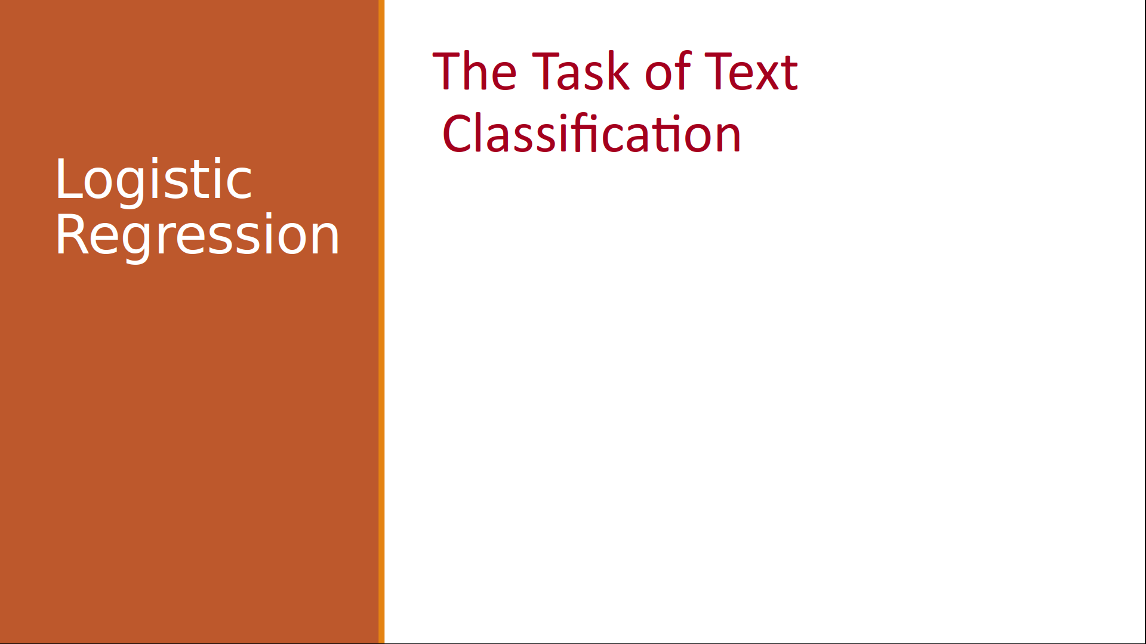
Acknowledgments
Jurafsky, D. and Martin, J. H. (2025). Speech and Language Processing: An Introduction to Natural Language Processing, Computational Linguistics, and Speech Recognition with Language Models. 3rd edition. https://web.stanford.edu/~jurafsky/slp3/
CS 124: From Languages to Information
Dan Jurafsky
Winter 2026
https://web.stanford.edu/class/cs124/

Slide 3
Why Machine Learning in NLP?

Slide 4
Why ML in NLP
Foundation for more advanced techniques (neural networks)
Commonly combined with language models
Help explain how the input relates to the output

Slide 5

Linear/Logistic Regression +
Training and Evaluation

Slide 6
Knowledge Discovery &
Data Mining

Slide 7
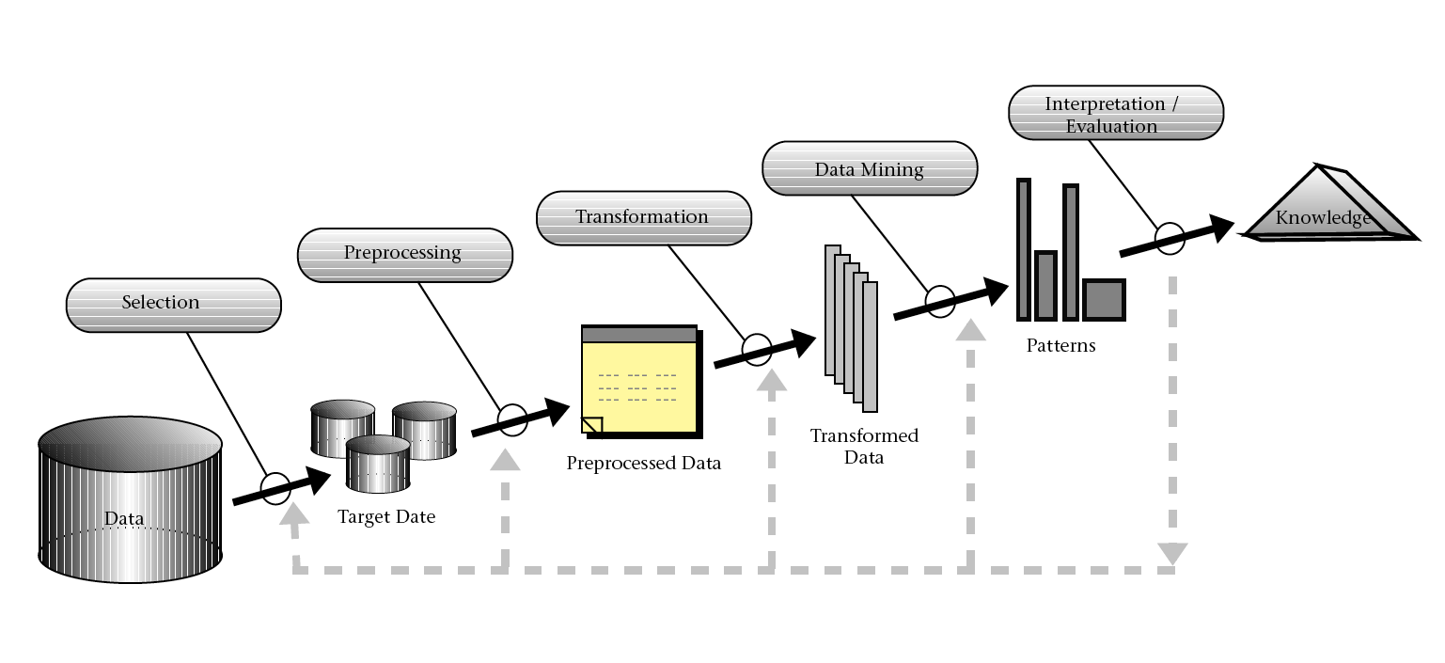
Knowledge Discovery Steps
(Fayyad et al. 1996)

Slide 8
Knowledge Discovery Steps
(Fayyad et al. 1996)

Slide 9
Data Mining
"Knowledge discovery is the nontrivial extraction of implicit, previously unknown, and potentially useful information from data." (Frawley et al., 1992)

Slide 10
Model
A simplified representation of a typically complex phenomenon, typically created from experimental data, that is valid under certain conditions and has some utility.
Notes:
Uma representação simplificada de um fenômeno tipicamente complexo, criado tipicamente a partir de dados experimentais, que é válido sob certas condições e que tem alguma utilidade.

Slide 11
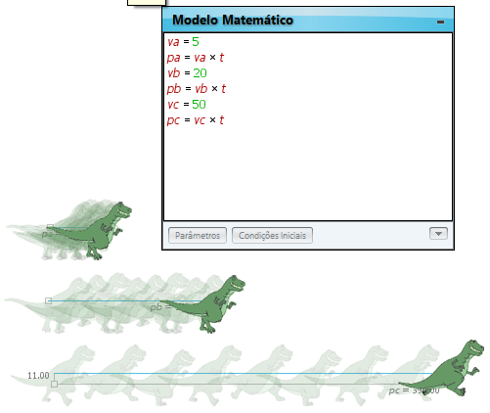
Mathematical Model of Uniform Rectilinear Motion
s = s₀ + v.t

Slide 12
What can I do with this model?
Predict a body's displacement at a given moment in time
Estimate the speed a body must have to cover a certain distance within a specific time period
Compare two moving bodies
Notes:
O que eu consigo fazer com este modelo?
Dado um instante do tempo, predizer o deslocamento do corpo
Estimar a velocidade que um corpo deve estar para realizar um certo deslocamento em um período de tempo
Comparar dois corpos em movimento

Slide 13

Light Box

Slide 14

Light Box

Slide 15
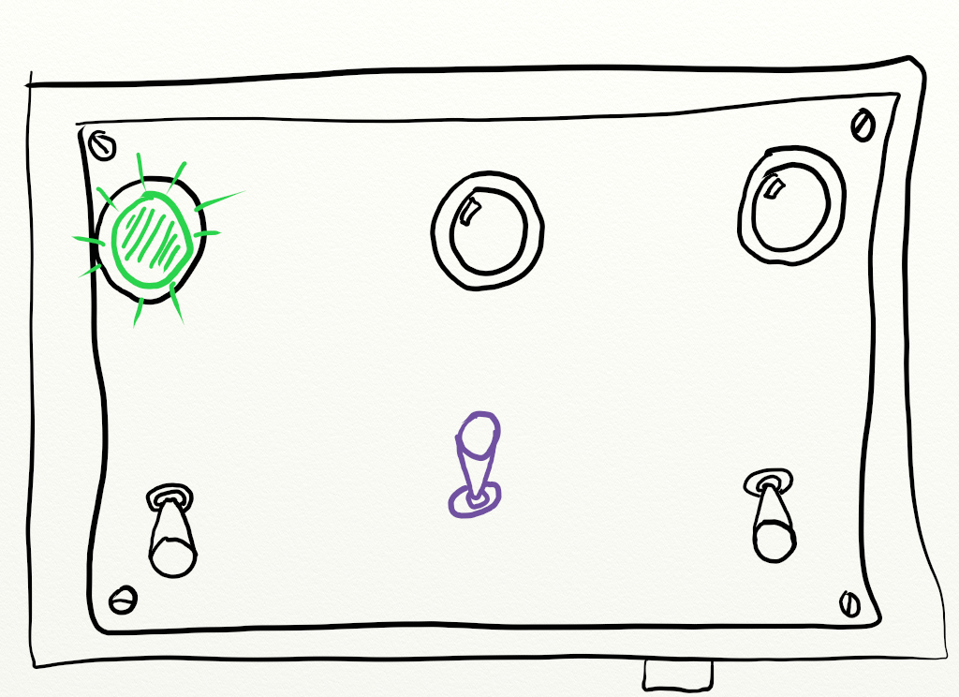
Light Box

Slide 16
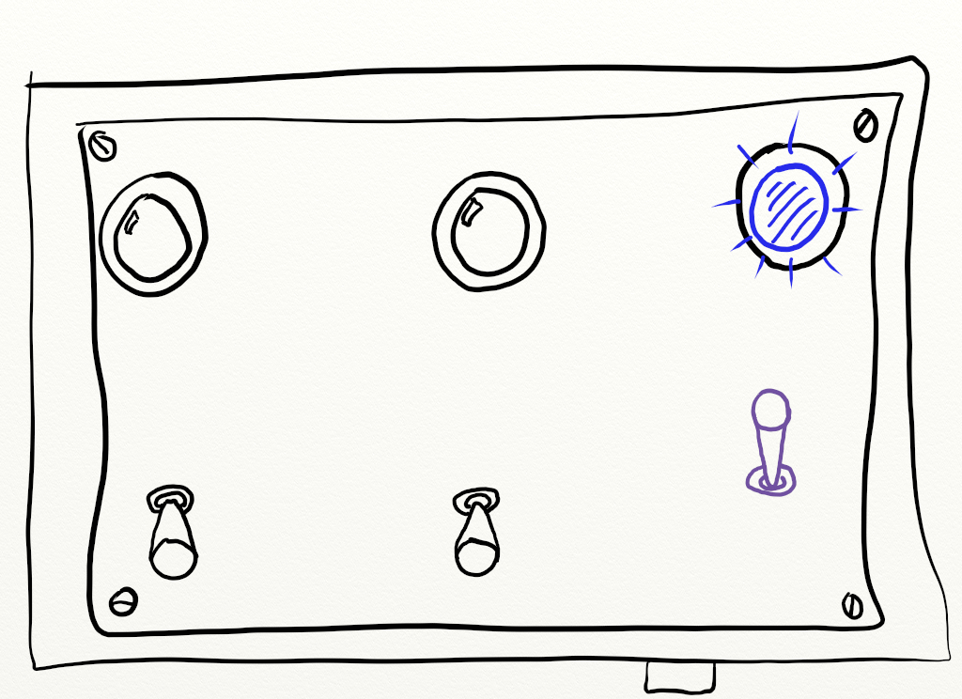
Light Box

Slide 17
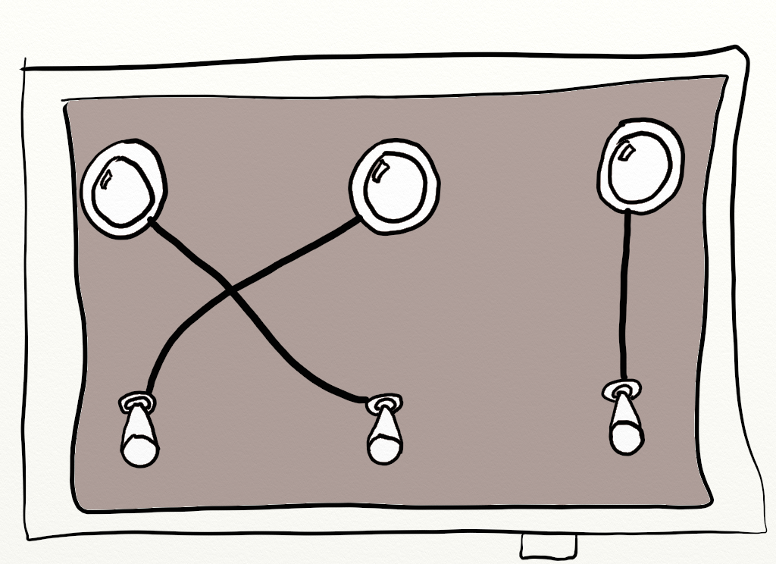
Light Box

Slide 18
Theory-driven x Data-driven
"Theory-driven models encapsulate some kind of understanding (theory, hypothesis, conjecture) about the mechanism underlying the data [...]"
"[...] data-driven models merely seek to summarize or describe the data."
(Hand, 2019)

Slide 19
Data-driven

Slide 20
Theory-driven

Slide 21
Machine Learning

Slide 22
The Major ML Tasks
Regression
  What value will this individual have?
Classification
  What class does this individual belong to?
Clustering
  How can I group these individuals according to some criteria?
Anomaly Detection
  Which individuals deviate significantly from normal patterns?
Dimensionality Reduction
  How can complex data be simplified while retaining its essential information?
Associations
  How does the occurrence of A be related to B?

Slide 23
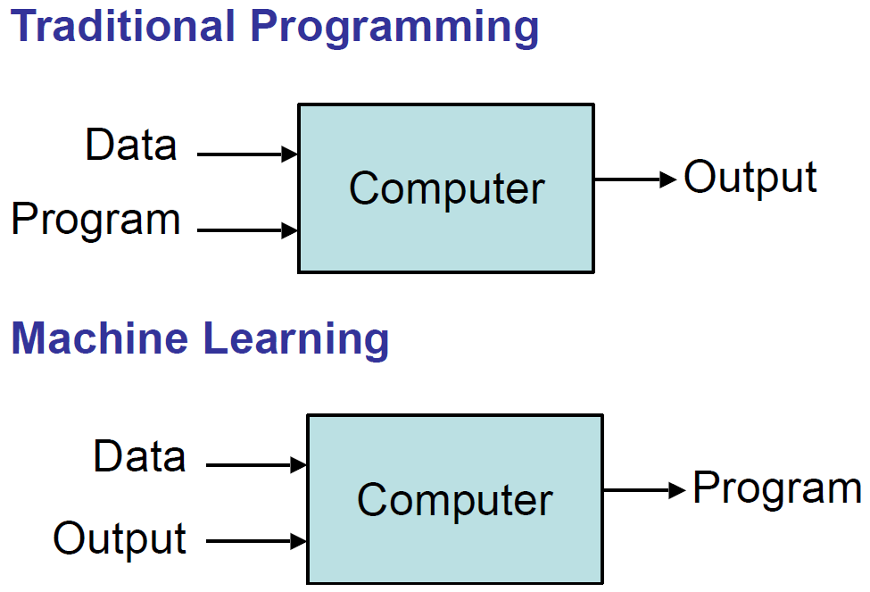
(Domingos, 2017)

Slide 24
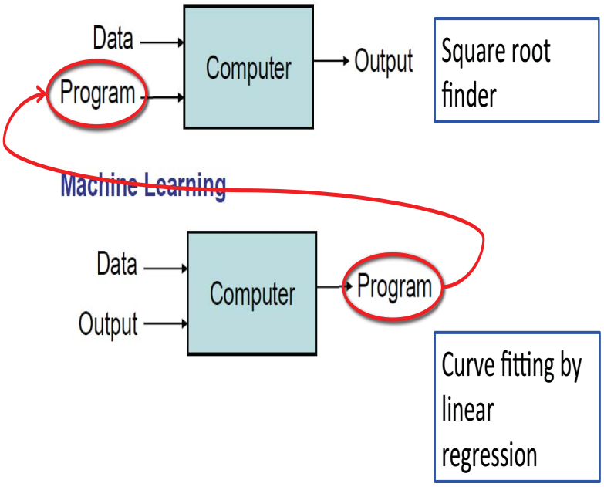
(Grimson et al., 2016)

Slide 25
Types of Learning
Supervised (inductive) learning
  Training data includes desired outputs
Unsupervised learning
  Training data does not include desired outputs
Semi-supervised learning
  Training data includes a few desired outputs
Reinforcement learning
  Rewards from sequence of actions
(Domingos, 2017)
Self-supervised learning
  Training data generates its own desired outputs

Slide 26
Supervised / Unsupervised Machine Learning
Supervised
  "[...] you have input variables (x) and an output variable (Y) and you use an algorithm to learn the mapping function from the input to the output." (Brownlee, 2018)
  Applications
    Regression
    Classification

Slide 27
Supervised / Unsupervised Machine Learning
Unsupervised
  "[...] you only have input data (X) and no corresponding output variables." (Brownlee, 2018)
  Applications
    Clustering
    Association
Semi-Supervised
  "[...] you have a large amount of input data (X) and only some of the data is labeled (Y)" (Brownlee, 2018)

Slide 28
Supervised Machine Learning
Tune
Train
Model
Deploy
Training Data
Final Evaluation
Production
Data Source
Evaluate
Feature Representation
Validation Data
Test
Test Data

Slide 29
Supervised Machine Learning
Tune
Train
Model
Training Data
Data Source
Evaluate
Feature Representation
Validation Data

Slide 30
Supervised Machine Learning
Tune
Train
Model
Training Data
Data Source
Evaluate
Feature Representation
Validation Data

Slide 31
Supervised Machine Learning
Tune
Train
Model
Training Data
Data Source
Evaluate
Feature Representation
Validation Data

Slide 32
Supervised Machine Learning
Tune
Train
Model
Training Data
Data Source
Evaluate
Feature Representation
Validation Data

Slide 33
Supervised Machine Learning
Tune
Train
Model
Training Data
Data Source
Evaluate
Feature Representation
Validation Data

Slide 34
Supervised Machine Learning
Tune
Train
Model
Deploy
Training Data
Final Evaluation
Production
Data Source
Evaluate
Feature Representation
Validation Data
Test
Test Data

Slide 35
Classification
What class does this individual belong to?

Slide 36
Classification
Input
Output
Classification
Model
Atribute set
(x)
Class label
(y)
(Tan et al., 2016)

Slide 37
Classification Examples
Binary Classification
  Spam filtering
    classes: spam x non-spam
    features: extracted from email content - header and body
  Tumor identification
    classes: malignant x benign
    features: extracted from MRI images
Multiclass Classification
  Galaxy classification
    classes: elliptical, spiral, or irregular-shaped
    features: extracted from telescope images
(Tan et al., 2016)

Slide 38
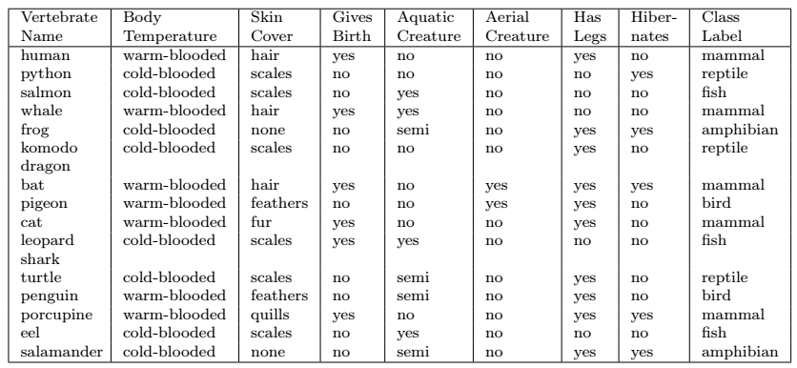
Vertebrate Classification
(Tan et al., 2016)

Slide 39


Zombie
Anemia
GS - Green Substance
MCGS - Mean Corpuscular Green Substance
MCGSC - Mean Corpuscular Green Substance Concentration
MCV - Mean Corpuscular Volume
gs | mcgs | mcgsc | mcv | gender | anemia
14.9 | 22.7 | 29.1 | 83.7 | male | not anemia
15.9 | 25.4 | 28.3 | 72 | female | not anemia
9 | 21.5 | 29.6 | 71.2 | female | anemia
14.9 | 16 | 31.4 | 87.5 | female | not anemia
14.7 | 22 | 28.2 | 99.5 | male | not anemia
11.6 | 22.3 | 30.9 | 74.5 | female | anemia
12.7 | 19.5 | 28.9 | 82.9 | male | anemia
12.7 | 28.5 | 28.2 | 92.3 | male | anemia
14.1 | 29.7 | 30.5 | 75.2 | female | not anemia
14.9 | 25.8 | 31.3 | 82.9 | male | not anemia
13 | 18.3 | 29.6 | 87.8 | male | anemia
https://github.com/datasci4health/home/blob/master/data/zombie/raw/zombie-anemia.csv

Slide 40




GS - Green Substance
MCGS - Mean Corpuscular Green Substance
  average of green substance in Green Blood Cells
MCGSC - Mean Corpuscular Green Substance Concentration
  average of green substance per unit of volume in Green Blood Cells
MCV - Mean Corpuscular Volume
  Average size of Green Blood Cells

Slide 41
Labeled Data
gs | mcgs | mcgsc | mcv | gender | anemia
14.9 | 22.7 | 29.1 | 83.7 | male | not anemia
15.9 | 25.4 | 28.3 | 72 | female | not anemia
9 | 21.5 | 29.6 | 71.2 | female | anemia
14.9 | 16 | 31.4 | 87.5 | female | not anemia
14.7 | 22 | 28.2 | 99.5 | male | not anemia
11.6 | 22.3 | 30.9 | 74.5 | female | anemia
12.7 | 19.5 | 28.9 | 82.9 | male | anemia
12.7 | 28.5 | 28.2 | 92.3 | male | anemia
14.1 | 29.7 | 30.5 | 75.2 | female | not anemia
14.9 | 25.8 | 31.3 | 82.9 | male | not anemia
13 | 18.3 | 29.6 | 87.8 | male | anemia
features
labels

Slide 42
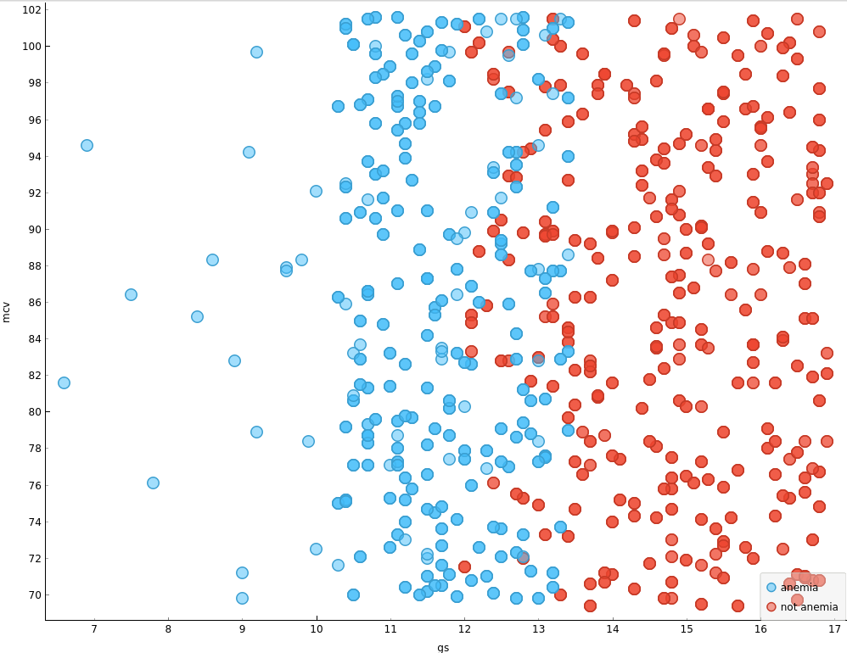
MCV X GS ￫ Anemia
MCV - Mean Corpuscular Volume
Anemia
Not anemia
GS - Green Substance

Slide 43
Task 1
What insights can I learn from this graph?
MCV - Mean Corpuscular Volume
Anemia
Not anemia
GS - Green Substance

Slide 44
Task 1
MCV - Mean Corpuscular Volume
low or no influence
high influence
GS - Green Substance

Slide 45
Classification in NLP

Slide 46
Classification Tasks in NLP?

Slide 47
Is this spam?
Dear Sir,
Please find attached the forms you requested.
Special Note: Student needs to provide the hand signed forms on the very first day of registration- (Forms attached)
IMPORTANT NOTE:
We will be needing additional bank statements and proof for justification if students have completed education outside their home state.(Legitimate documents- electricity bill, Rental Agreement, Bank Statement, College/University ID )
Please feel free to reach us in case any queries arise.
Study Abroad Partners
(Jurafsky, 2026)
Notes:
Text classification comes up in lots of very practical applications. One is spam detection

Slide 48

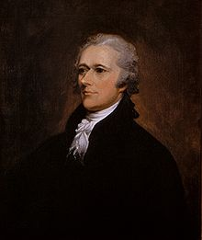
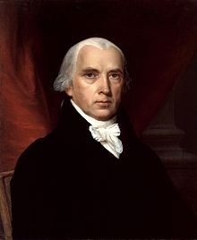
Who wrote which Federalist Papers?
(Jurafsky, 2026)
1787-8: essays anonymously written by:
Alexander Hamilton, James Madison, and John Jay
to convince New York to ratify U.S Constitution
Authorship of 12 of the letters unclear between:
1963: solved by Mosteller and Wallace using Bayesian methods
Alexander Hamilton
James Madison
Wikimedia commons
Notes:
Text classification is also a task that was addressed very early in the history of what became natural language processing and machine learning. Perhaps the most famous early example is the question of authorship identification.

Slide 49


Positive or negative movie review?
unbelievably disappointing
Full of zany characters and richly applied satire, and some great plot twists
this is the greatest screwball comedy ever filmed
It was pathetic. The worst part about it was the boxing scenes.
(Jurafsky, 2026)
Notes:
Another practical text classification task is sentiment analysis: using the language in a text to classify the author's expressed attitude toward something, either as a binary outcome (positive vs negative), or a scalar value. Sentiment is commonly computed on product reviews, like these examples extracted from online movie reviews.

Slide 50
Even language modeling can be viewed as classification!
Let the set of classes be the words (vocabulary V)
Predicting the next word is classifying
  the context-so-far
  into a class for each possible next word
(Jurafsky, 2026)
Notes:
Even language modeling can be viewed as classification….

Slide 51
Text Classification
Spam detection
Authorship identification (who wrote this?)
Language Identification (is this Portuguese?)
Sentiment analysis
Language modeling (what next word does this context expect)
(Jurafsky, 2026)
Notes:
In summary, lots of very disparate tasks can be modeled as assigning a class label to a text

Slide 52
Many kinds of classifiers!
Logistic regression (this lecture)
Naive Bayes
Neural networks
k-nearest neighbors
LLMs
  Fine-tuned as classifiers
  Prompted to give a classification
(Jurafsky, 2026)

Slide 53
Task 2
Project 2
Develop and evaluate a process for extracting a clinical knowledge graph from MultiCaRe texts, enhancing and expanding Project 1 using statistical techniques and/or machine learning, but without the use of LLMs or embeddings.
Task
Discuss and list the machine learning techniques that could be used to produce a knowledge graph (KG).

Slide 54
ML and Classification

Slide 55
Probabilistic Classifiers
A subset of classifiers that return a probability for each possible output class.
(Jurafsky, 2026)
Notes:
We're going to define logistic regression, which is a probabilistic classifier

Slide 56
Probabilistic Text Classification: definition
Input:
a "document" (any text) d
a fixed set of output classes Y = {y₁, y₂,…, y_{J}}
Output: the probability (for each possible class y_{i} ) that the true class y is y_{i} :
P(y=y_{i}|d) ∀ y_{i}∈ Y
These probabilities sum to one: ∑_{i} P(y=y_{i}|d)=1
So for binary classification Y = {0,1} and
P(y=1|d) = 1 – P(y=0|d)
(Jurafsky, 2026)

Slide 57
Probabilistic Text Classification is usually a kind of
Supervised Machine Learning
(Jurafsky, 2026)
Training
Input:
  a fixed set of classes Y = {y₁, y₂,…, y_{J}}
  a training set of m hand-labeled inputs (x⁽¹⁾,y⁽¹⁾),....,(x^{(m)},y^{(m}))
Learning algorithm
Output:
  a learned classifier that maps from d → P(y=y_{i}|d) ∀ y_{i}∈ Y
Inference or Test
Input: a document d
Output: a distribution over the output classes P(y=yi|d) ∀ yi∈ Y
So for binary classification that means P(y=1|d) and P(y=0|d)
Notes:
Probabilistic classification is usually a kind of supervised machine learning

Slide 58
Supervised Machine Learning
Tune
Train
Model
Deploy
Training Data
Final Evaluation
Production
Data Source
Evaluate
Feature Representation
Validation Data
Test
Test Data

Slide 59
Classification
Model
{features}
Training Data
Classification Function
{updated parameters (θ)}
{predicted class (ŷ)}
Optimization
Algorithm
{true class (y)}
training loss
Objective Function

Slide 60
Classification
Model
{features}
Training Data
Classification Function
{updated parameters (θ)}
{features}
{predicted class (ŷ)}
Optimization
Algorithm
{true class (y)}
training loss
Validation Data
Objective Function
{true class (y)}
Hyperparameter Tuning & Model Selection
validation loss

Slide 61
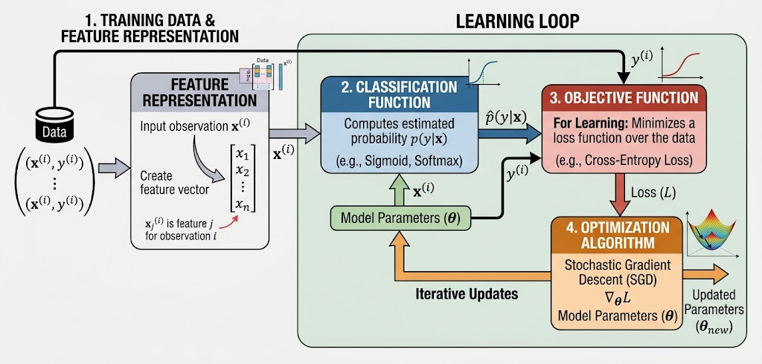
Components of a probabilistic machine learning classifier
by Gemini

Slide 62
Classification
Model
Classification Function
Feature Representation
Optimization
Algorithm
Objective Function

Slide 63
Feature Representation
Model
Classification Function
Feature Representation
Optimization
Algorithm
Objective Function

Slide 64
Zombie Health Example

Slide 65
Zombie
Health
name | type | gender | height | weight | gbc | gs | pbc | sp
Lossack Slossir | biological | male | 73.84701702 | 241.8935632 | 0.8 | 14 | 5.1 | 3.5
Aight Man | biological | female | 61.79887853 | 106.233687 | 0.8 | 13 | 5.5 | 3.5
Gebbonnulsh Ross | technological | male | 70.01336535 | 209.5264998 | 10 | 61 | 7.2 | 3.6
Siffash Rangrer | technological | male | 72.76536995 | 220.6780415 | 8.8 | 67 | 7.7 | 3.8
Backom Gadduff | biological | female | 62.85037864 | 114.9690383 | 1.6 | 15 | 5.4 | 3.4
Beashithadd Chuckemp | chemical | female | 56.54797498 | 84.87212365 | 5.6 | 48 | 6.8 | 2.8
Boss Bluckrast | chemical | male | 68.1440328 | 192.3439766 | 5.6 | 47 | 7 | 3.2
Relleest Cattierl | chemical | male | 68.49641536 | 154.3426389 | 6 | 46 | 6.5 | 2.8
Giemmedd Ark | biological | male | 68.34851551 | 167.9711105 | 0.8 | 15 | 5 | 3.4
Spriss Anne | biological | male | 72.41831663 | 196.0285063 | 1.6 | 13 | 5.4 | 3.9
Nur Slabblir | chemical | female | 63.40728979 | 128.8483894 | 5.2 | 41 | 5.6 | 3
Shorpest Herhock | biological | female | 61.89023374 | 111.6761992 | 0.8 | 14 | 5.5 | 4.2

Slide 66
Types of Zombies
Biological
  parasites modify the host
Chemical
  strange chemicals meant to bring back to life
Technological
  advanced technology applied to bring back to life

Slide 67



GBC - Green Blood Cells (million cells per microliter - mcL)
GS - Green Substance (gm/dL - grams per deciliter)
PBC - Purple Blood Cells (million cells per microliter - mcL)
SP - Sticky Paste (gm/dL - grams per deciliter)

Slide 68
Classification Function
Model
Classification Function
Feature Representation
Optimization
Algorithm
Objective Function

Slide 69
Linear Regression
to understand Logistic Regression

Slide 70
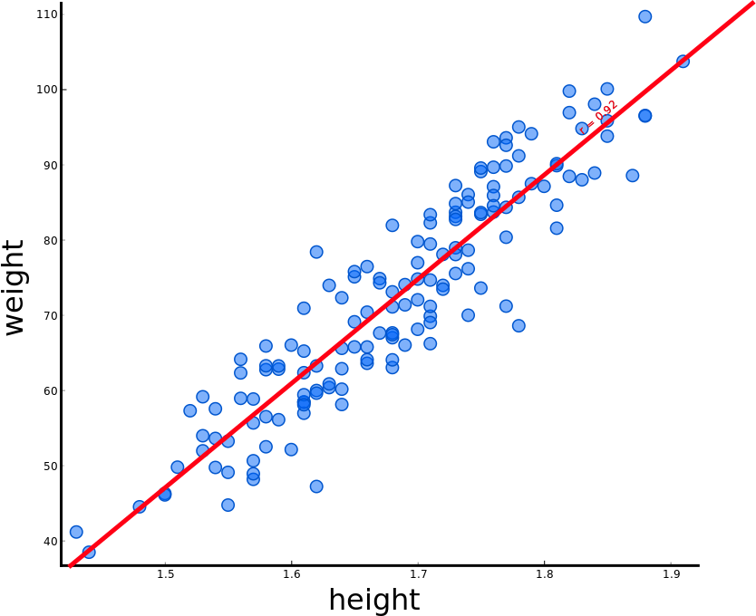
Linear Regression (intuitive)
The line of best fit for the data

Slide 71
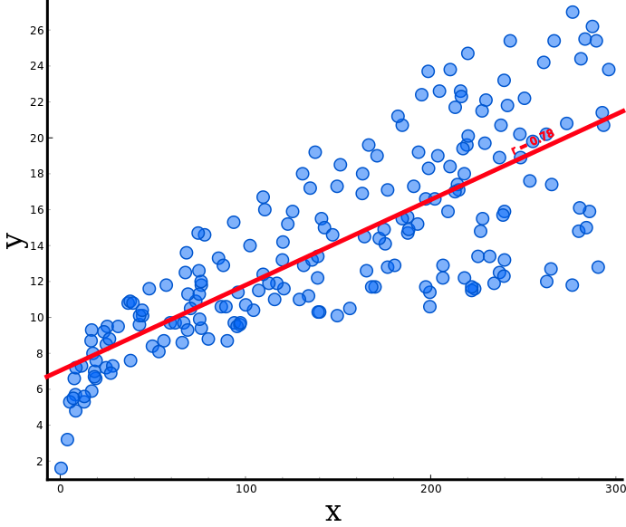
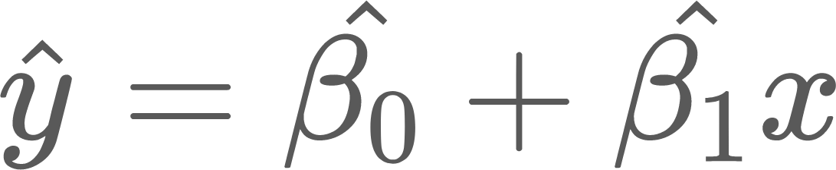
Simple Linear Regression
Linear Function
β₁
1
β₀

Slide 72
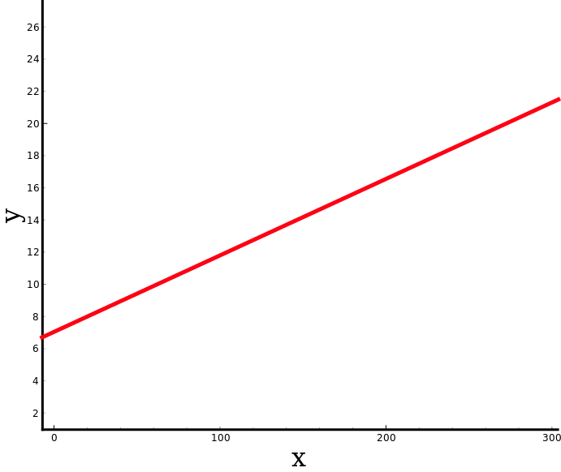


Simple Linear Regression
Linear Function
intercept
slope
β₁
1
β₀

Slide 73
Linear Regression
Linear approach to modeling the relationship between:
one or more independent variables
a dependent variable
Regression does not imply causality
Notes:
Abordagem linear para modelar o relacionamento entre:
uma ou mais variáveis independentes
uma variável dependente
Regressão não implica em
causalidade

Slide 74
Linear Regression
Linear approach to modeling the relationship between:
one or more independent variables
a dependent variable
dependent
independent
Notes:
Abordagem linear para modelar o relacionamento entre:
uma ou mais variáveis independentes
uma variável dependente
Regressão não implica em
causalidade

Slide 75
Linear Regression
Linear approach to modeling the relationship between:
one or more independent variables
a dependent variable
Multiple Linear Regression
dependent
independent
independent
independent

Slide 76
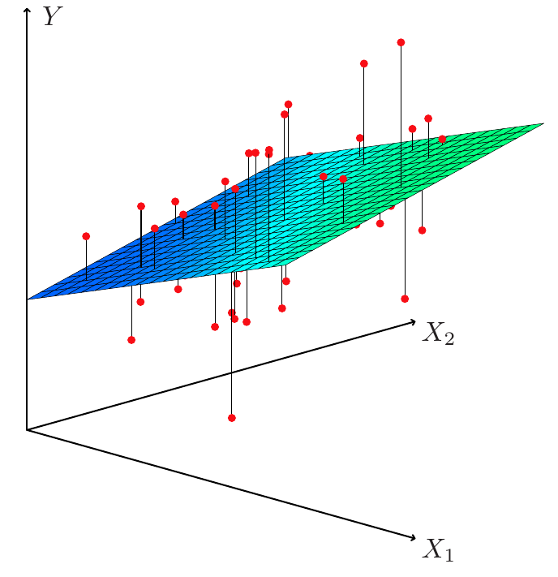
Multiple Linear Regression and Hyperplane
Hyperplane for two dimensions (difficult to draw for 3+)

Slide 77
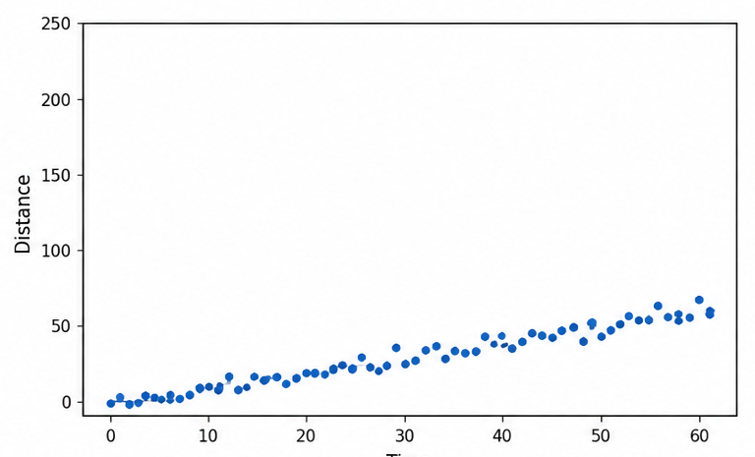

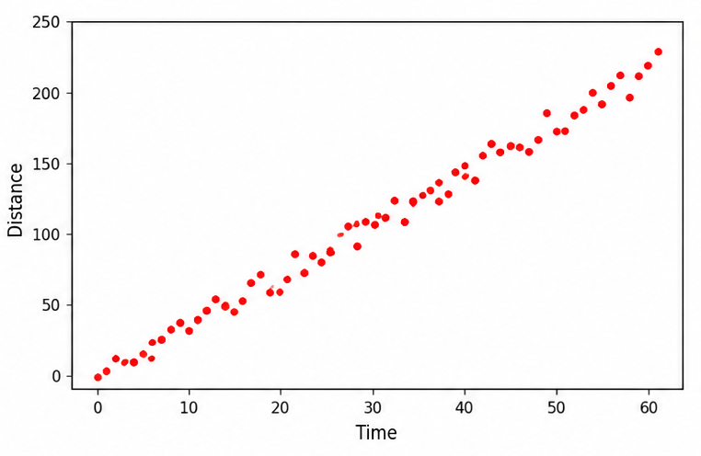

Slope and Weight
Which is the most powerful engine?

Slide 78
Slope and Weight
Which is the most powerful engine?
β₁
β₀
β₁
β₁
β₁
β₀

Slide 79
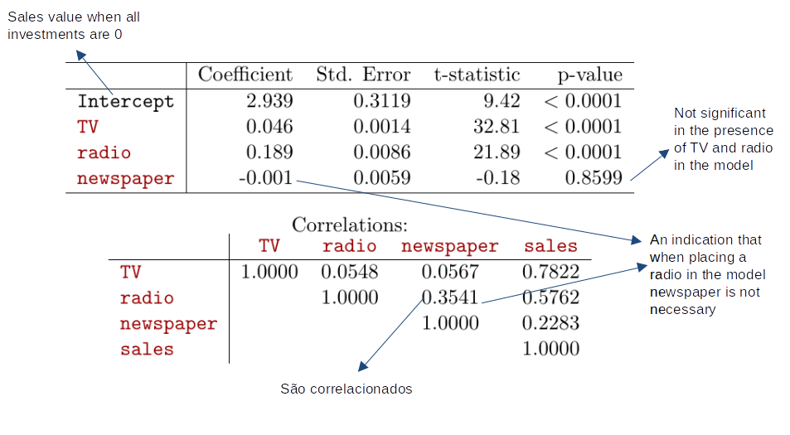
Slope and Weight
(James et al., 2000)

Slide 80
Logistic Regression

Slide 81
Logistic Regression
Important analytic tool in natural and social sciences
Baseline supervised machine learning tool for classification
Is also the foundation of neural networks

Slide 82
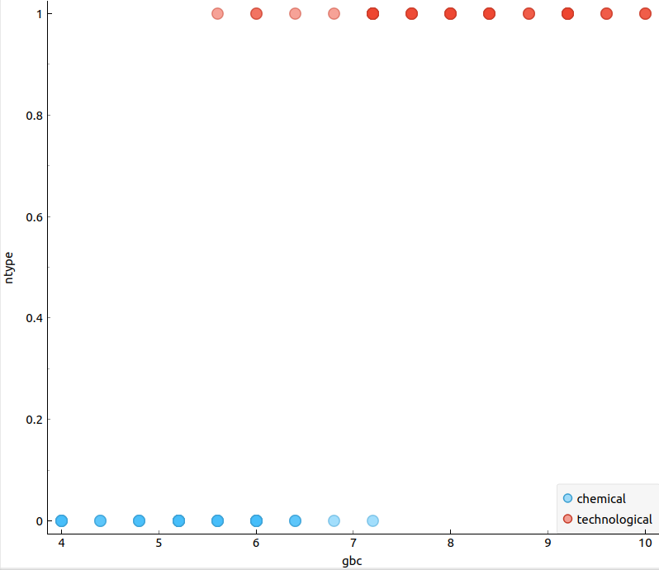
Logistic Regression
The sigmoid curve that best classifies the data.

Slide 83
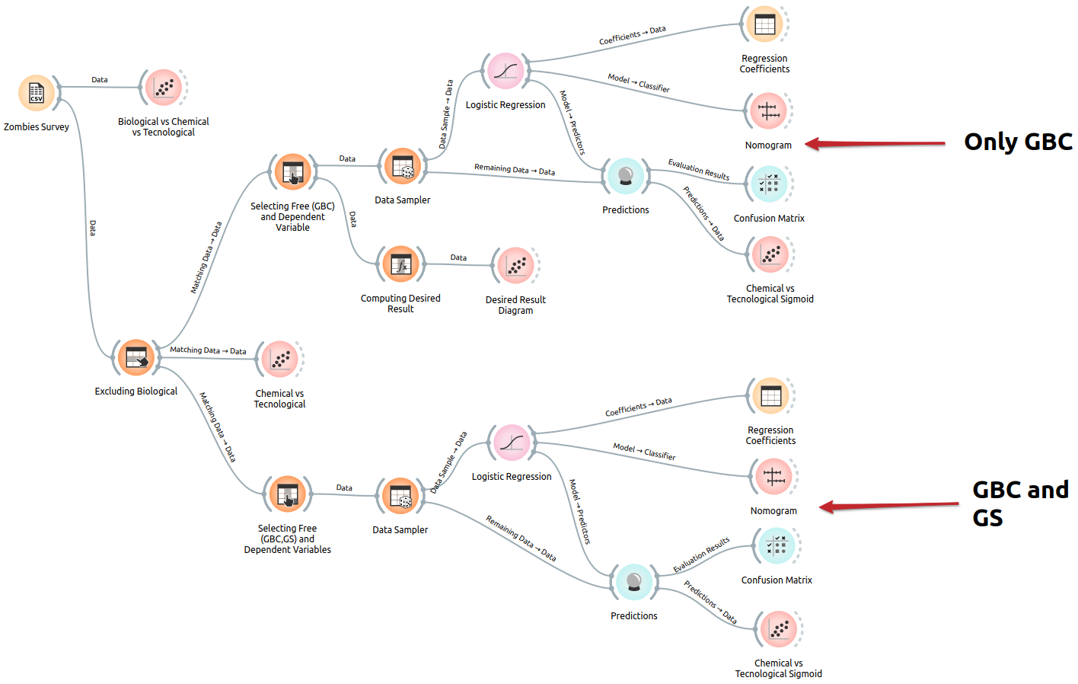
Logistic Regression in Orange
https://github.com/santanche/nlp2learn/tree/main/machine-learning/logistic-regression

Slide 84
Orange

Slide 85
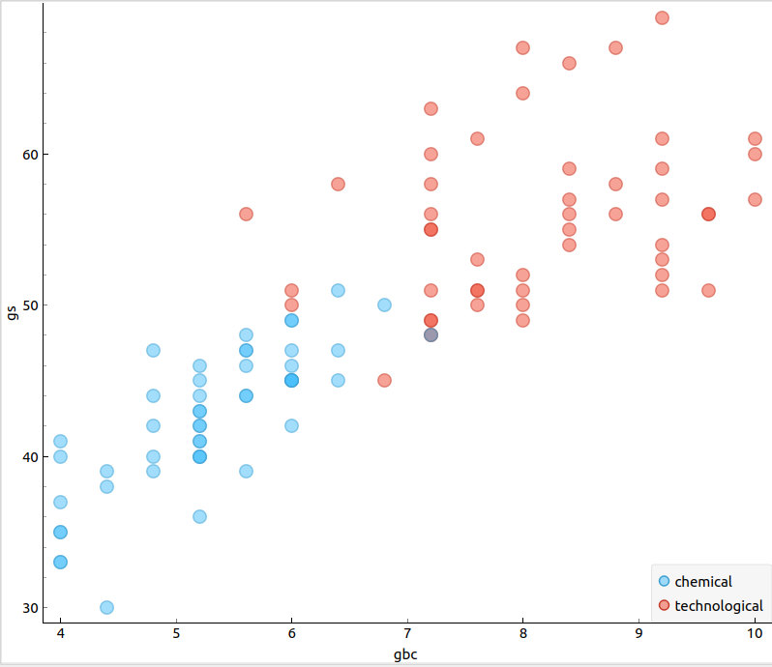
Removing Biological
GBC - Green Blood Cells
GS - Green Substance

Slide 86
GBC x Desired Classification
GBC - Green Blood Cells
Desired Classification

Slide 87
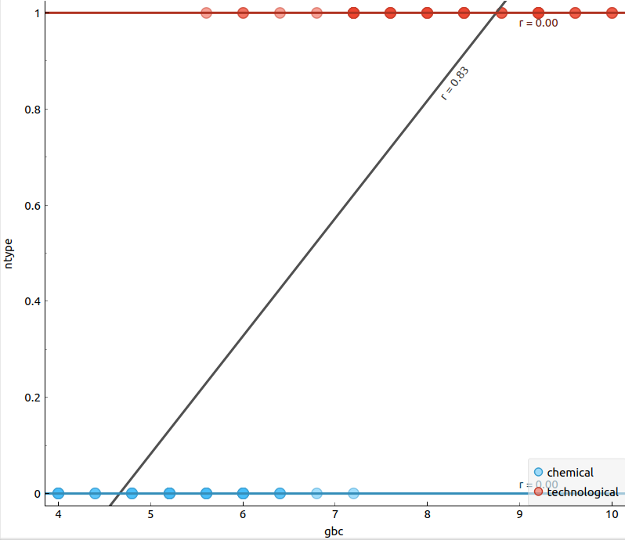
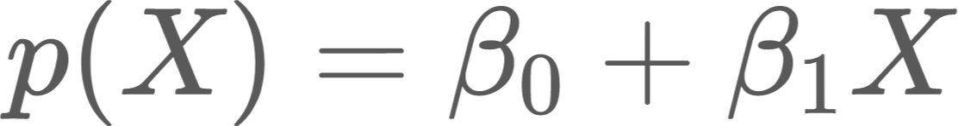
Linear Regression?
above 1?
Probability
p(X)
below 0?

Slide 88
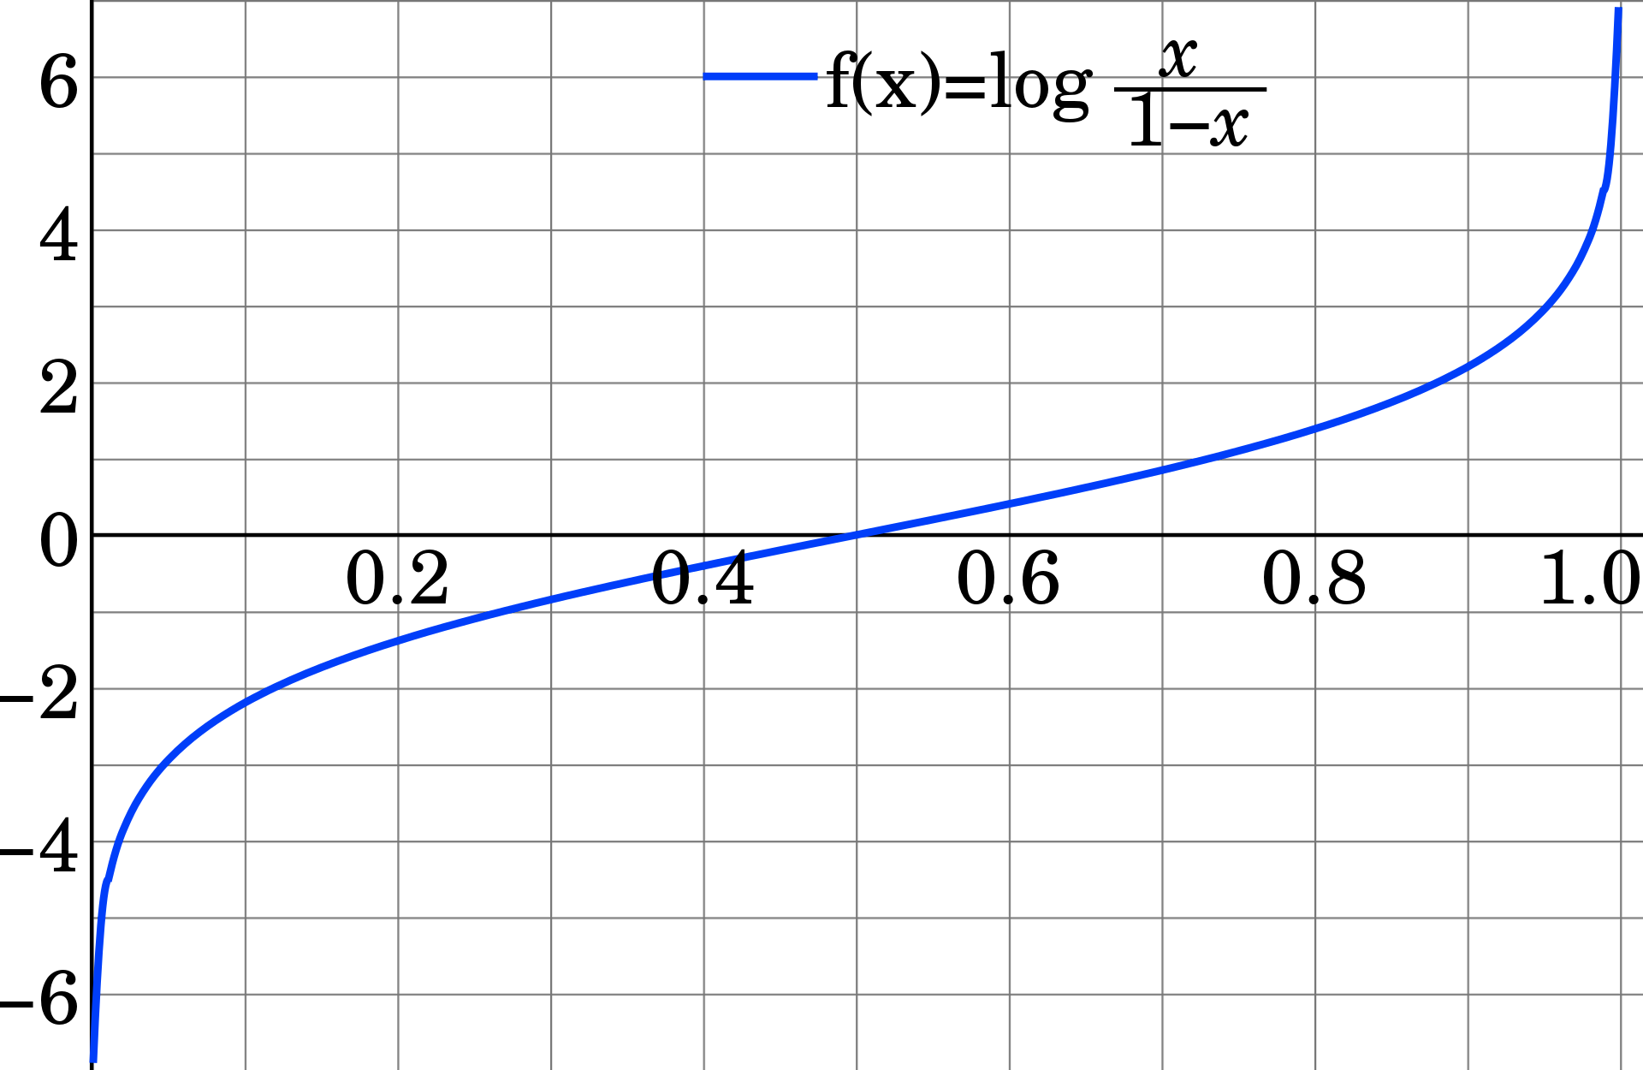
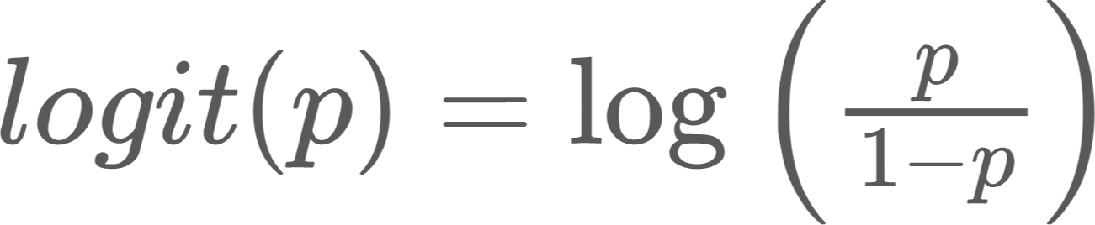
Logit Function
Log-odds = logarithm of odds
Maps probability:
  from (0, 1)
  to (-∞, +∞)

Slide 89
Linear Regression?
above 1?
Probability
p(X)
below 0?

Slide 90
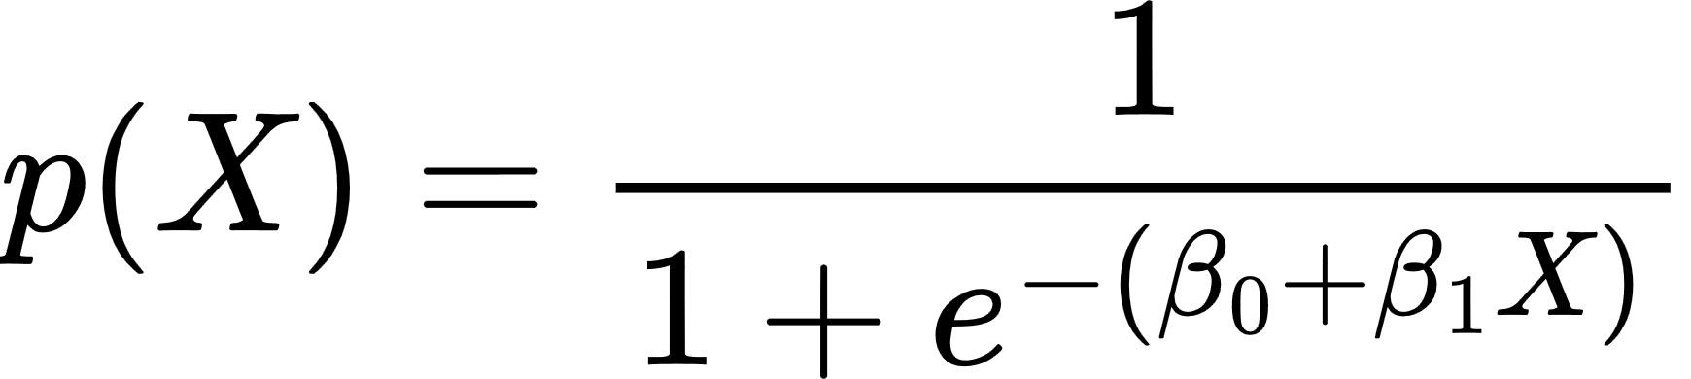
Logistic Regression
Probability
p(X)

Slide 91
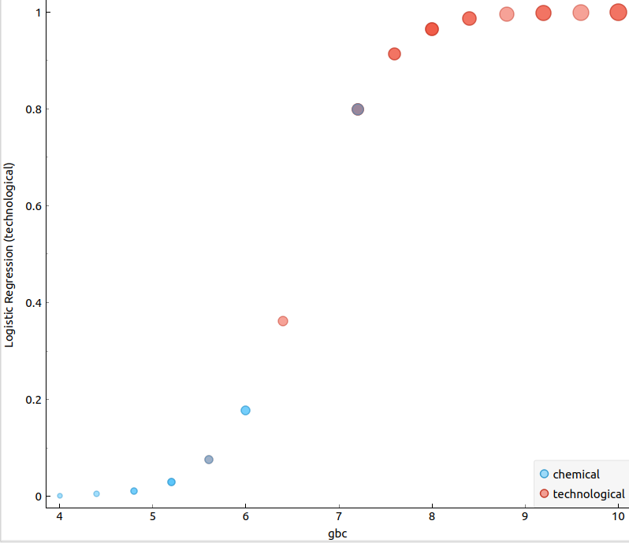
Logistic Regression
Probability
p(X)

Slide 92
Logistic Regression
Probability
p(X)
linear regression formula

Slide 93
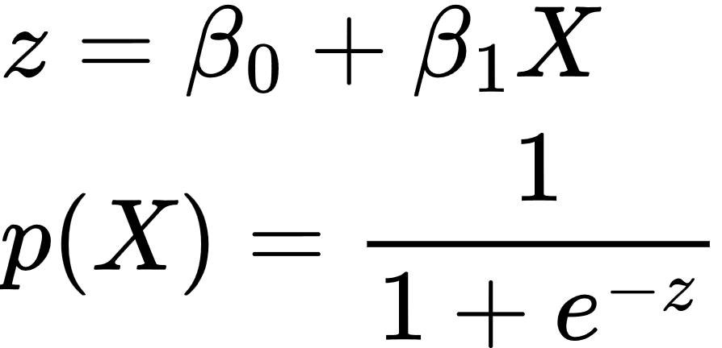
Logistic Regression
Probability
p(X)

Slide 94
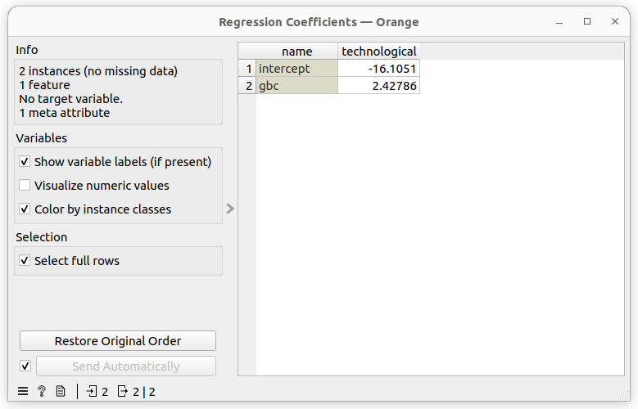
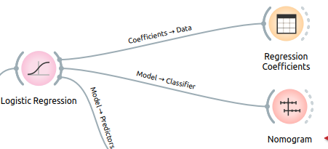
Logistic Regression

Slide 95
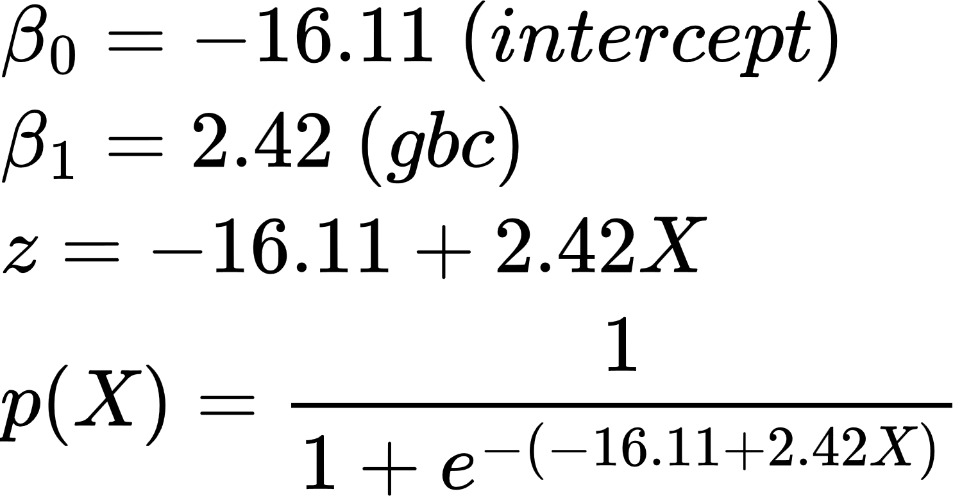
Logistic Regression
technological
0.5
Probability
p(X)
chemical

Slide 96
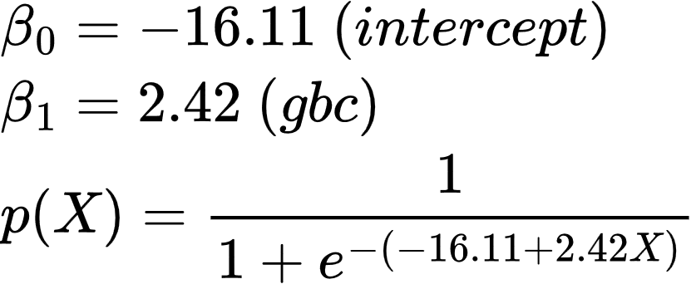
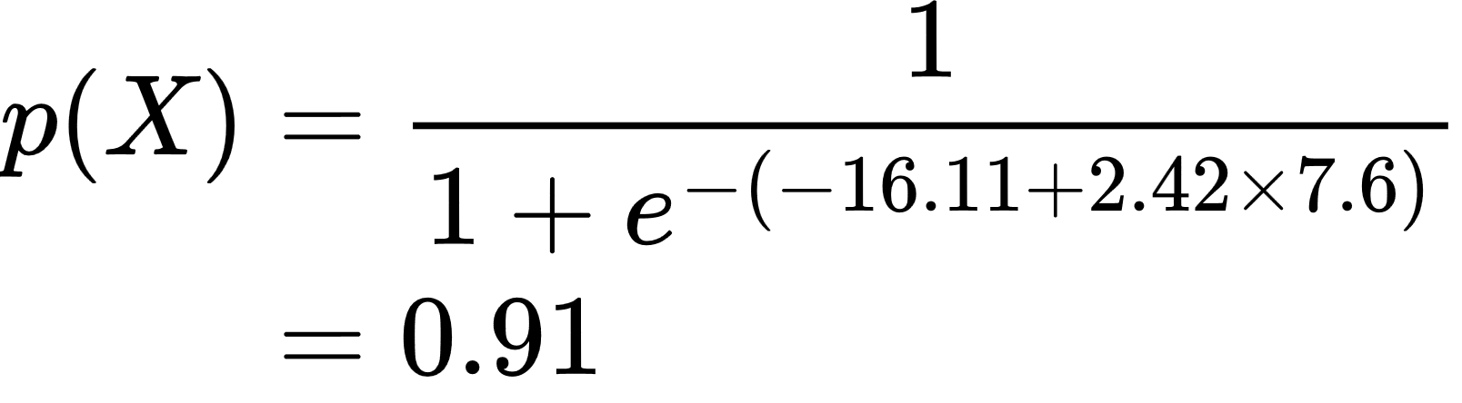
Logistic Regression
0.91
technological
0.5
X=7.6
chemical
7.6
Notes:
\begin{align*}
p(X) &= \frac{1}{1 + e^{-(-16.11 + 2.42 \times 7.6)}} \\
&= 0.91
\end{align*}

Slide 97
Two Features
GBC - Green Blood Cells
GS - Green Substance

Slide 98
Orange

Slide 99
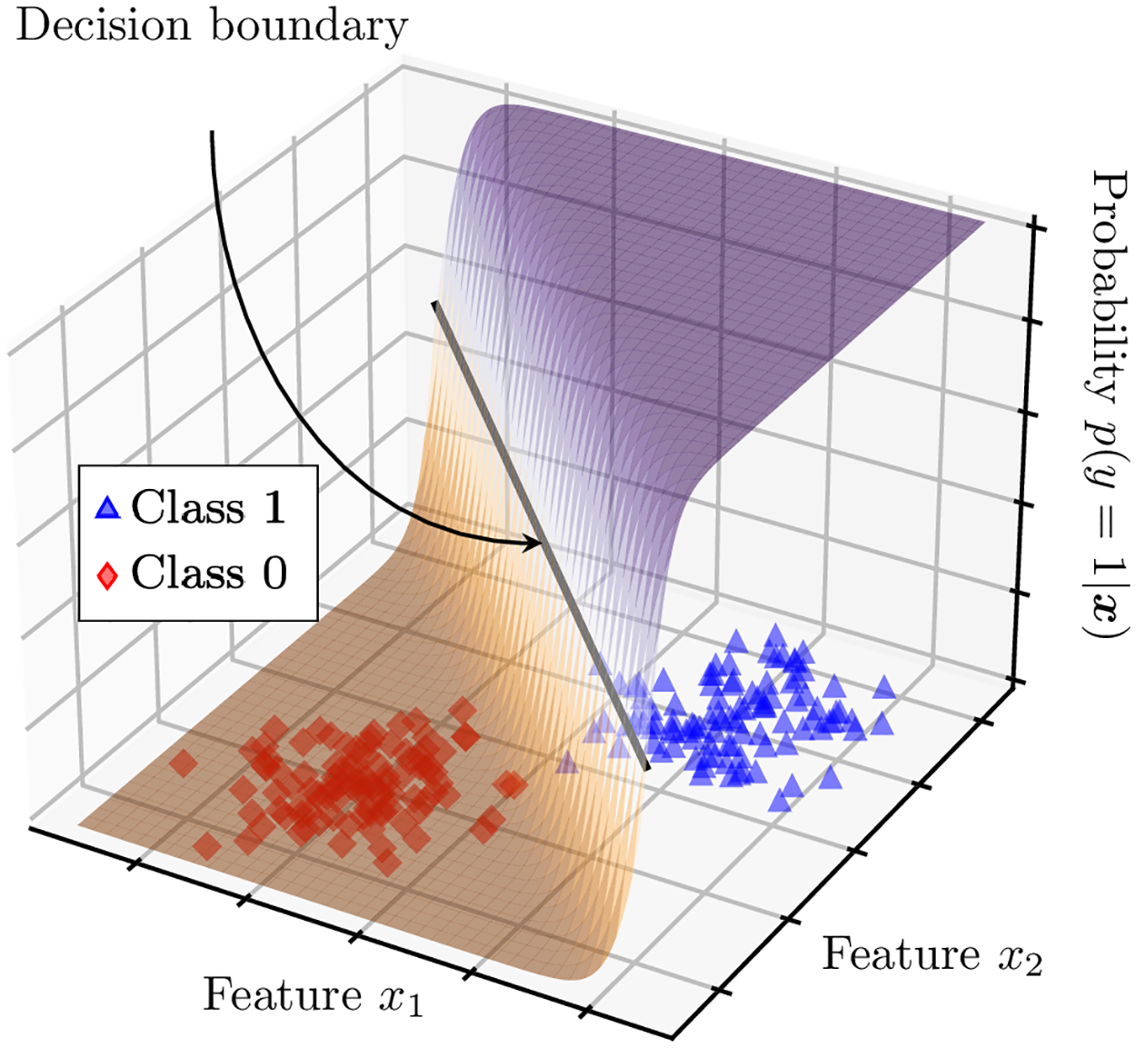
Sigmoid-based Surfaces
(Shyrokykh et al., 2023)

Slide 100
NATURAL LANGUAGE PROCESSING
Machine Learning and Text Classification
part 2
André Santanchè
Laboratory of Information Systems - LIS
Instituto de Computação - UNICAMP
September 2026

Slide 101
Logistic Regression for one observation x
Input observation: vector x = [x₁, x₂,…, x_{n}]
Weights: one per feature: W = [w₁, w₂,…, w_{n}]
  Sometimes we call the weights θ = [θ₁, θ₂,…, θ_{n}]
Output: a predicted class probability P(y=1|x, θ)
and then P(y=0 | x, θ) = 1-P(y=1 | x, θ)
We sometimes introduce the term ŷ = P(y=1|x, θ)
So ŷ (pronounced y-hat) means
"our estimated probability that x is a positive example"
(Jurafsky, 2026)

Slide 102

Linear

Slide 103

Linear

Slide 104

Linear
Logistic

Slide 105
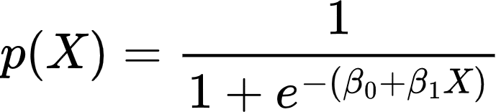
Linear
Logistic

Slide 106
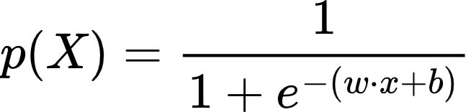
Linear
Logistic

Slide 107
Logistic Regression: a text example on sentiment classification

Slide 108
Sentiment example: does y=1 or y=0?
It's hokey . There are virtually no surprises , and the writing is second-rate . So why was it so enjoyable ? For one thing , the cast is
great . Another nice touch is the music . I was overcome with the urge to get off the couch and start dancing . It sucked me in , and it'll do the same to you .
(Jurafsky, 2026)
Notes:
Suppose we are doing binary sentiment classification on movie review text, and we would like to know whether to assign the sentiment class 1=positive or 0=negative to the following review

Slide 109
Task 3
Which aspects would you use to classify the sentiment of this text?
(Jurafsky, 2026)

Slide 110
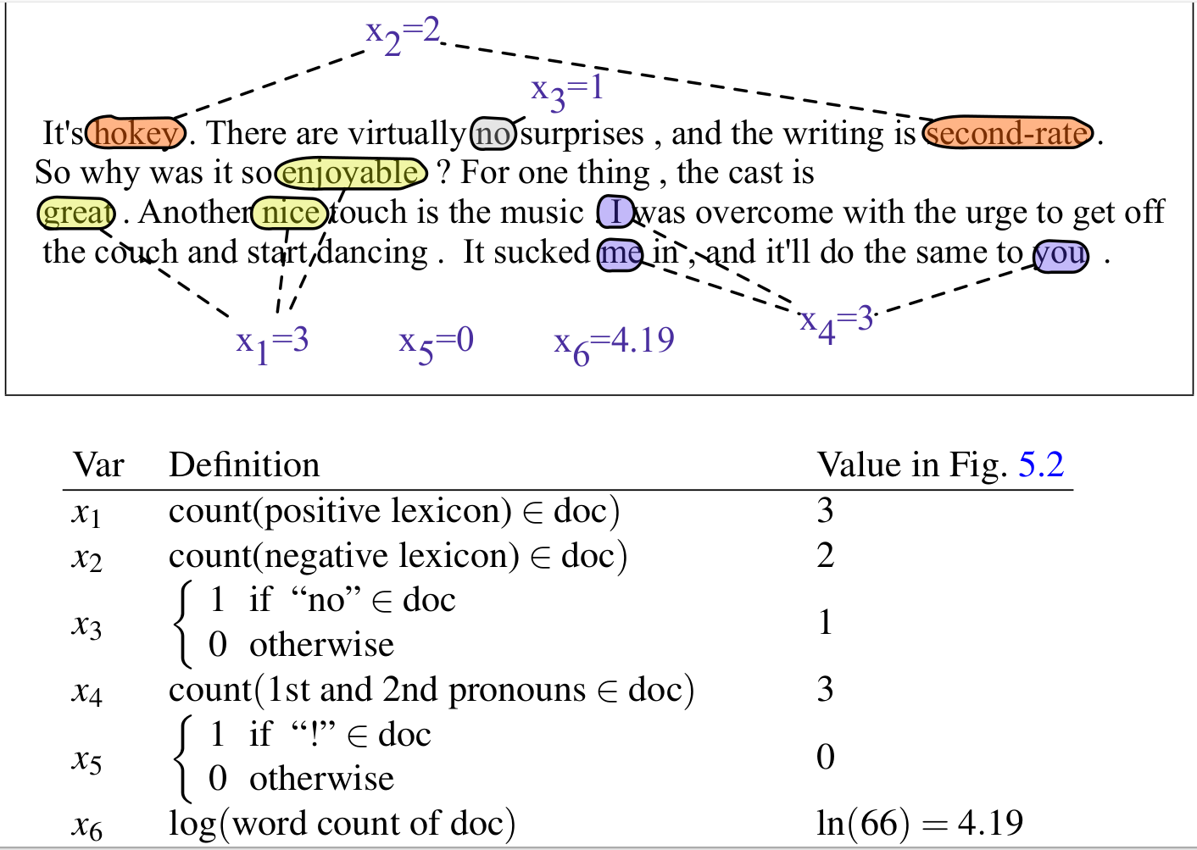
(Jurafsky, 2026)
Notes:
We’ll represent each input observation by the 6 features x1...x6 of the input

Slide 111
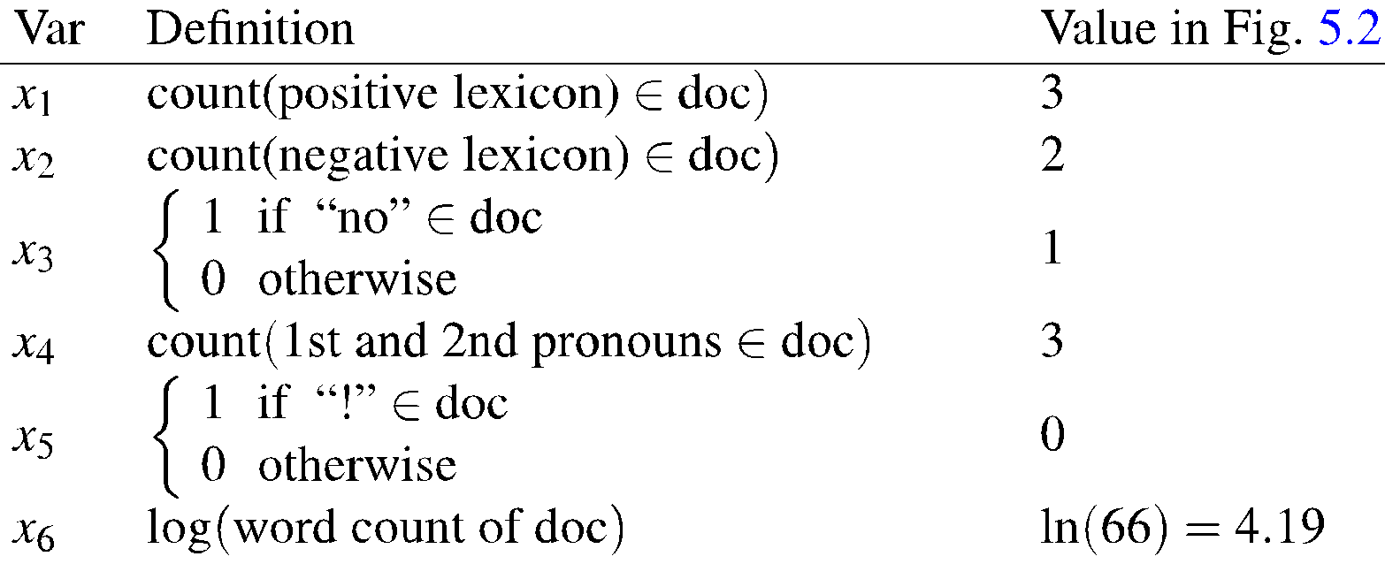
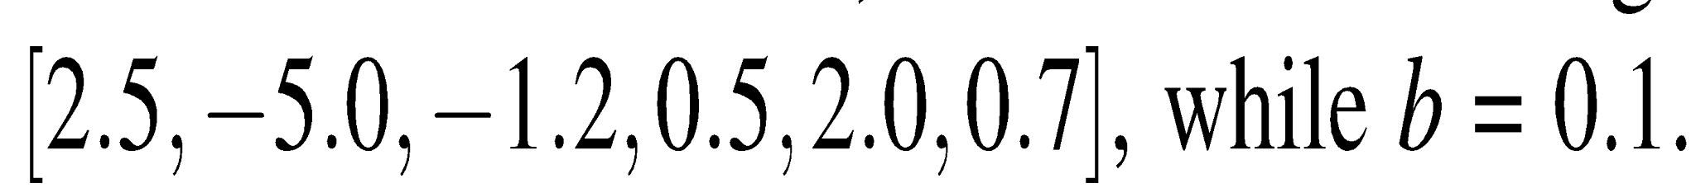
Classifying sentiment for input x
Suppose w =
(Jurafsky, 2026)
b = 0.1
Notes:
Let’s assume for the moment that we’ve already learned a real-valued weight for each of these features, and that the 6 weights corresponding to the 6 features are as follows. The weight w1, for example indicates how important a feature the number of positive lexicon words (great, nice, enjoyable, etc.) is to a positive sentiment decision, while w2 tells us the importance of negative lexicon words. Note that w1 = 2.5 is positive, while w2 = −5.0, meaning that negative words are negatively associated with a positive sentiment decision, and are about twice as important as positive words.

Slide 112
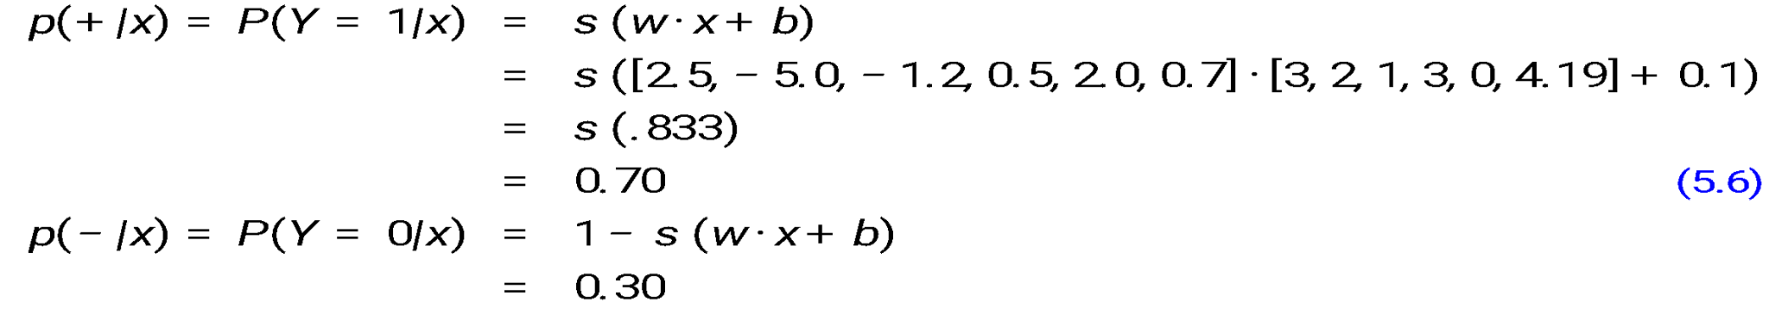
Classifying sentiment for input x
(Jurafsky, 2026)
Notes:
Given these 6 features and the input review x, we can compute P(+|x) and P(−|x)

Slide 113
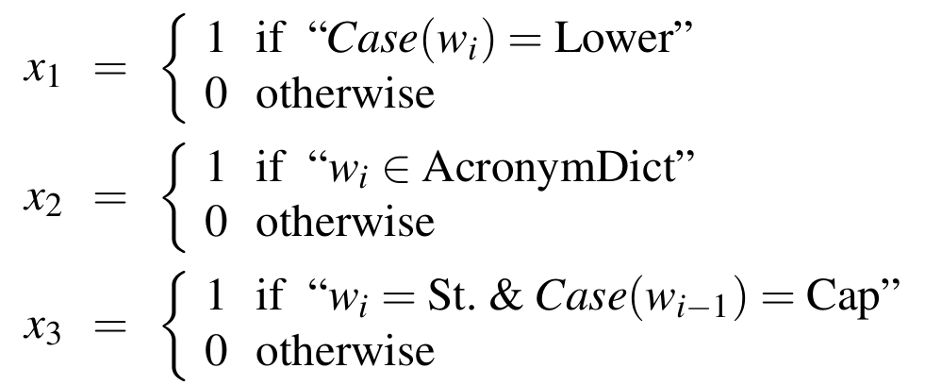
We can build features for logistic regression for any classification task: period disambiguation
End of sentence
This ends in a period.
The house at 465 Main St. is new.
Not end
(Jurafsky, 2026)
Notes:
We might use features like x1 below expressing that the current word is lower case and the class is EOS (perhaps with a positive weight), or that the current word is in our abbreviations dictionary (“Prof.”) and the class is EOS (perhaps with a negative weight). A feature can also express a quite complex combination of properties. For example a period following an upper case word is likely to be an EOS, but if the word itself is St. and the previous word is capitalized, then the period is likely part of a shortening of the word street.

Slide 114
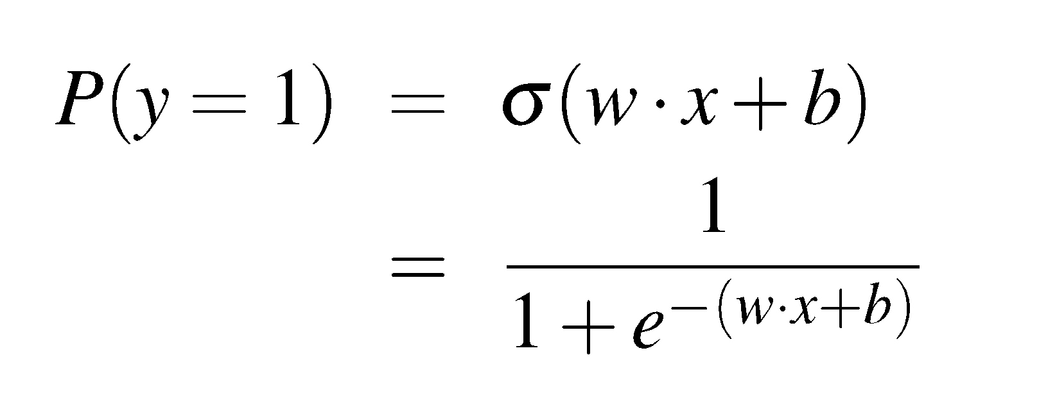
Classification in (binary) logistic regression: summary
Given:
  a set of classes: (chemical, technological)
  a vector x of features [x]
      x = gbc
  A vector w of weights [w]
    w_{i} for each feature f_{i}

Slide 115
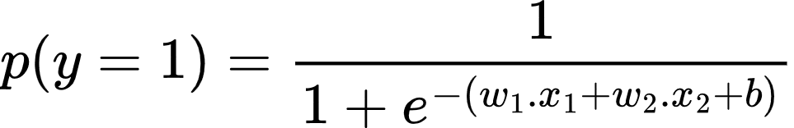
Classification in (binary) logistic regression: summary
Given:
  a set of classes: (chemical, technological)
  a vector x of features [x₁, x₂]
      x₁ = gbc
      x₂ = gs
  A vector w of weights [w₁, w₂]
    w_{i} for each feature f_{i}

Slide 116
Classification in (binary) logistic regression: summary
Given:
  a set of classes: (+ sentiment,- sentiment)
  a vector x of features [x₁, x₂, …, x_{n}]
      x1= count( "awesome")
      x2 = log(number of words in review)
  A vector w of weights [w₁, w₂, …, w_{n}]
    w_{i} for each feature f_{i}
(Jurafsky, 2026)

Slide 117
Task 4
Project 2
Develop and evaluate a process for extracting a clinical knowledge graph from MultiCaRe texts, enhancing and expanding Project 1 using statistical techniques and/or machine learning, but without the use of LLMs or embeddings.
Task 2
Discuss and list the machine learning techniques that could be used to produce a knowledge graph (KG).
This Task
How logistic regression could be combined with other techniques for KG generation.

Slide 118
Objective
Function
Model
Classification Function
Feature Representation
Optimization
Algorithm
Objective Function

Slide 119
Learning components
A loss function:
    cross-entropy loss
An optimization algorithm:
    stochastic gradient descent
(Jurafsky, 2026)
Notes:
This requires two components. The first is a metric for how close the current label (yˆ) is to the true gold label y. Rather than measure similarity, we usually talk about the opposite of this: the distance between the system output and the gold output, and we call this distance
the loss function or the cost function. We'll we’ll introduce the loss function that is commonly used for logistic regression and also for neural networks, the cross-entropy loss.
The second thing we need is an optimization algorithm for iteratively updating
the weights so as to minimize this loss function. The standard algorithm for this is gradient descent; we’ll introduce the stochastic gradient descent algorithm in the following section.

Slide 120
Cross-entropy loss
for a Single Observation
Goal: maximize the probability of the correct label p(y|x)

Slide 121
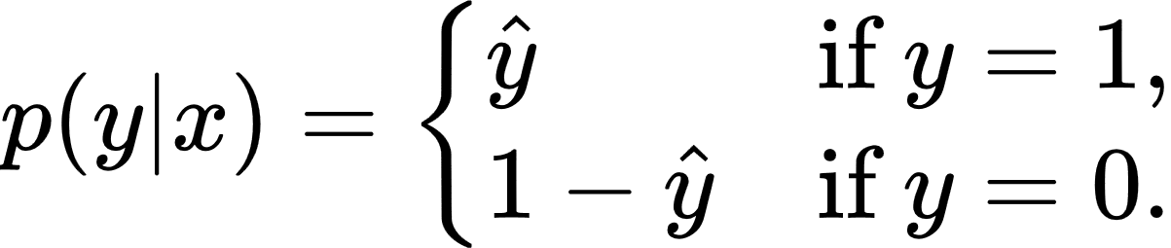
Bernoulli Distribution
Discrete probability distribution of a random variable:
value 1 with probability p
value 0 with probability q = 1 − p.

Slide 122
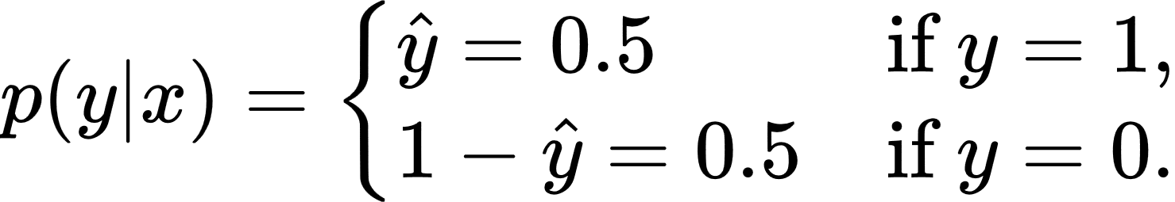
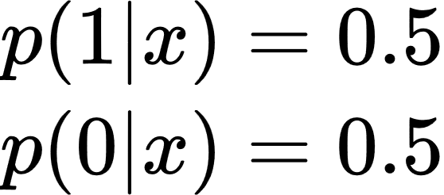
Bernoulli Distribution
1.0
0
1
0.5
0.0
chemical
technological

Slide 123
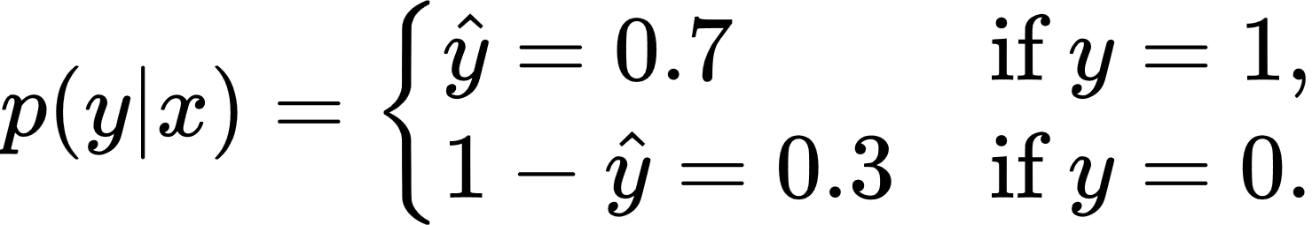

Bernoulli Distribution
1.0
1
0.7
0
0.3
0.0
chemical
technological

Slide 124


Bernoulli Distribution
1.0
0
1
0.8
0.2
0.0
chemical
technological

Slide 125

Bernoulli Distribution
Equivalent to:

Slide 126


Task 4
Compute the probabilities for

Slide 127

Task 4
Compute the probabilities for

Slide 128


One-hot Vector
✔
✗
[1 , 0]
Allosaurus
Dilophosaurus
✗
✔
[0 , 1]
Allosaurus
Dilophosaurus

Slide 129


[1 , 0]
Dilophosaurus
[0 , 1]
Allosaurus

Slide 130


[1 , 0]
[0.7 , 0.3]
Dilophosaurus
[0 , 1]
[0.7 , 0.3]
Allosaurus

Slide 131

Cross-Entropy Loss (L_{CE})

Slide 132
Dilophosaurus
Allosaurus

Slide 133

Cross-Entropy Loss (L_{CE})

Slide 134


Goal
For the correct label:
maximize
minimize

Slide 135
Summary
[ 1 , 0 ]
[0.7 , 0.3]
Dilophosaurus
[0 , 1]
[0.7 , 0.3]
Allosaurus

Slide 136
[ 1 , 0 ]
[0.7 , 0.3]
Dilophosaurus
[0 , 1]
[0.7 , 0.3]
Allosaurus

Slide 137
[ 1 , 0 ]
[0.7 , 0.3]
0.7
Dilophosaurus
[0 , 1]
[0.7 , 0.3]
0.3
Allosaurus

Slide 138
[ 1 , 0 ]
[0.7 , 0.3]
0.7
Dilophosaurus
ln(0.7)=0.36
[0 , 1]
[0.7 , 0.3]
0.3
ln(0.3)=1.20
Allosaurus

Slide 139

Task 5
What is the loss for each case, considering the probability vector [0.5, 0.3, 0.2]?
Dilophosaurus
Allosaurus
Pachycephalosaurus

Slide 140
[1,0,0]
[0.5,0.3,0.2]
-ln(0.5)=0.69
Dilophosaurus
[0,1,0]
[0.5,0.3,0.2]
-ln(0.3)=1.20
Allosaurus
[0,0,1]
[0.2,0.4,0.4]
-ln(0.4)=0.92
Pachycephalosaurus

Slide 141
Objective Function
In details

Slide 142
Logistic Regression in Machine Learning

Slide 143
Components of a probabilistic machine learning classifier
Given m input/output pairs (x^{(i)},y^{(i)}):
A feature representation of the input. For each input observation x^{(i)}, a vector of features [x₁, x₂, ... , x_{n}]. Feature j for input x^{(i)} is x_{j}, more completely x_{j}^{(i)}, or sometimes f_{j}(x).
A classification function that computes the estimated probability p(y|x), like the sigmoid or softmax functions.
An objective function for learning, like cross-entropy loss.
An algorithm for optimizing the objective function: stochastic gradient descent.
(Jurafsky, 2026)

Slide 144
The two phases of logistic regression
Training (next lecture):
We learn weights w and b using stochastic gradient descent and cross-entropy loss.
Test (also called inference) (this lecture):
Given a test example x we compute p(y|x) using learned weights w and b
Then return whichever label (y = 1 or y = 0) has higher probability
(Jurafsky, 2026)

Slide 145

Binary Classification in Logistic Regression
(Jurafsky, 2026)

Slide 146
Features in logistic regression
For feature x_{i}, weight w_{i} tells is how important is x_{i}
  x_{i} ="review contains ‘awesome’": w_{i} = +10
  x_{j} ="review contains ‘abysmal’": w_{j} = -10
  x_{k} =“review contains ‘mediocre’": w_{k} = -2
(Jurafsky, 2026)
Notes:
The weight w_{i} represents how important that input feature is to the classification decision, and can be positive (providing evidence that the instance being classified belongs in the positive class) or negative (providing evidence that the instance being classified belongs in the negative class). Thus we might expect in a sentiment task the word awesome to have a high positive weight, and abysmal to have a very negative weight.

Slide 147
Logistic Regression for one observation x
Input observation: vector x = [x₁, x₂,…, x_{n}]
Weights: one per feature: W = [w₁, w₂,…, w_{n}]
  Sometimes we call the weights θ = [θ₁, θ₂,…, θ_{n}]
Output: a predicted class probability P(y=1|x, θ)
and then P(y=0 | x, θ) = 1-P(y=1 | x, θ)
We sometimes introduce the term ŷ = P(y=1|x, θ)
So ŷ (pronounced y-hat) means
"our estimated probability that x is a positive example"
(Jurafsky, 2026)

Slide 148

How to do classification
For each feature x_{i}, weight w_{i} tells us importance of x_{i}
(Plus we'll have a bias b)
We'll sum up all the weighted features and the bias
If this sum is high, we say y=1; if low, then y=0
(Jurafsky, 2026)
Notes:
The bias term, also called the intercept, is another real number that’s added to the weighted inputs.
(We'll represent such sums using the dot product notation. The dot product of two vectors a and b, is the sum of the products of the corresponding elements of each vector.)

Slide 149
But we want a probabilistic classifier
We need to formalize “sum is high”.
We’d like a principled classifier that gives us a probability and can tell us
p(y=1|x; θ)
p(y=0|x; θ)
(Jurafsky, 2026)
Notes:
We said "if this sum is high we say y=1.

Slide 150


The problem: z isn't a probability, it's just a number!
Solution: use a function of z that goes from 0 to 1
(Jurafsky, 2026)
Notes:
Nothing forces z to be a legal probability, that is, to lie between 0 and 1. In fact, since weights are real-valued, the output might even be negative; z ranges from −∞ to ∞.

Slide 151


The very useful sigmoid or logistic function
(Jurafsky, 2026)
Notes:
The sigmoid function The 1/1+e^-z (so-named because it looks like an s) is also called the logistic function. It takes a real value and maps it to the range [0, 1
It is nearly linear around 0 but outlier values get squashed toward 0 or 1.

Slide 152
Idea of logistic regression
We’ll compute w∙x+b
And then we’ll pass it through the sigmoid function:
σ(w∙x+b)
And we'll just treat it as a probability
(Jurafsky, 2026)

Slide 153


Making probabilities with sigmoids
(Jurafsky, 2026)
Notes:
We’re almost there. If we apply the sigmoid to the sum of the weighted features, we get a number between 0 and 1. To make it a probability, we just need to make sure that the two cases, p(y = 1) and p(y = 0), sum to 1. We can do this as follows:

Slide 154


By the way:
=
Because
(Jurafsky, 2026)
Notes:
The sigmoid function has the property

Slide 155

Turning a probability into a classifier
0.5 here is called the decision boundary
(Jurafsky, 2026)

Slide 156
The probabilistic classifier
P(y=1)
wx + b
(Jurafsky, 2026)

Slide 157

Turning a probability into a classifier
if w∙x+b > 0
if w∙x+b ≤ 0
(Jurafsky, 2026)

Slide 158

Wait, where did the W’s come from?
(Jurafsky, 2026)
Notes:
Logistic regression is an instance of supervised classification in which we know the correct label y (either 0 or 1) for each observation x. But what the system produces is an estimate, ^y. We want to learn parameters (meaning w and b) that make yˆ for each training observation as close as possible to the true y.

Slide 159


(Jurafsky, 2026)
Notes:
We need a loss function that expresses, for an observation x, how close the classifier output (yˆ = σ (w · x + b)) is to the correct output (y, which is 0 or 1).

Slide 160
Intuition of negative log likelihood loss
= cross-entropy loss
A case of conditional maximum likelihood estimation
We choose the parameters w,b that maximize
the log probability
of the true y labels in the training data
given the observations x
(Jurafsky, 2026)
Notes:
We do this via a loss function that prefers the correct class labels of the training examples to be more likely. This is called conditional maximum likelihood estimation: we choose the parameters w,b that maximize the log probability of the true y labels in the training data given the observations x. The resulting loss function is the negative log likelihood loss, generally called the cross-entropy loss.

Slide 161


Deriving cross-entropy loss for a single observation x
(Jurafsky, 2026)
Notes:
Let’s derive this loss function, applied to a single observation x. We’d like to learn weights that maximize the probability of the correct label, that's p(y|x).

Slide 162

Deriving cross-entropy loss for a single observation x
Goal: maximize probability of the correct label p(y|x)
Maximize:
Now take the log of both sides (mathematically handy)
Maximize:
Whatever values maximize log p(y|x) will also maximize p(y|x)
(Jurafsky, 2026)

Slide 163
Deriving cross-entropy loss for a single observation x
(Jurafsky, 2026)
Goal: maximize probability of the correct label p(y|x)
Maximize:
Now flip sign to turn this into a loss: something to minimize
Minimize:
Or, plugging in definition o ŷ:

Slide 164
Let's see if this works for our sentiment example
(Jurafsky, 2026)
We want loss to be:
smaller if the model estimate is close to correct
bigger if model is confused
Let's first suppose the true label of this is y=1 (positive)
It's hokey . There are virtually no surprises , and the writing is second-rate . So why was it so enjoyable ? For one thing , the cast is great . Another nice touch is the music . I was overcome with the urge to get off the couch and start dancing . It sucked me in , and it'll do the same to you .

Slide 165

Let's see if this works for our sentiment example
True value is y=1. How well is our model doing?
Pretty well! What's the loss?
(Jurafsky, 2026)

Slide 166

Let's see if this works for our sentiment example
Suppose true value instead was y=0.
What's the loss?
(Jurafsky, 2026)
Notes:
By contrast, let’s pretend instead that the example was actually negative, i.e., the true y = 0 (perhaps the reviewer went on to say “But bottom line, the movie is terrible! I beg you not to see it!”) . In this case our model is confused, the model is wrong, so we’d want the loss to be higher. Let's plug in y = 0 and 1−σ(w·x+b) = .31

Slide 167
Let's see if this works for our sentiment example
(Jurafsky, 2026)
The loss when model was right (if true y=1)
Is lower than the loss when model was wrong (if true y=0):
Sure enough, loss was bigger when model was wrong!

Slide 168
Optimization Algorithm
Model
Classification Function
Feature Representation
Optimization
Algorithm
Objective Function

Slide 169




Making Explicit CE Loss Parameters

Slide 170


Our goal: minimize the loss
(Jurafsky, 2026)
Notes:
Our goal with gradient descent is to find the optimal weights: minimize the loss function we’ve defined for the model. We’ll explicitly represent the fact that the loss function L is parameterized by the weights, which we can refer to in machine learning in general as θ (in the case of logistic regression θ = w, b). And we’ll represent 𝑦 ̂ as f (x; θ ) to make the dependence on θ more obvious. So the goal is to find the set of weights which minimizes the loss function, averaged over all examples: EQ

Slide 171

Gradient Descent

Slide 172

Intuition of gradient descent
(Jurafsky, 2026)
How do I get to the bottom of this river canyon?
Look around me 360∘
Find the direction of steepest slope down
Go that way
x
Notes:
How do we find the minimum of a loss function? Gradient descent is a method that finds a minimum of a function by figuring out in which direction (in the space of the parameters θ) the function’s slope is rising the most steeply, and moving in the opposite direction.
The intuition is that if you are hiking in a canyon and trying to descend most quickly down to the river at the bottom, you might look around yourself 360 degrees, find the direction where the ground is sloping the steepest, and walk downhill in that direction.

Slide 173
Our goal: minimize the loss
For logistic regression, loss function is convex
A convex function has just one minimum
Gradient descent starting from any point is guaranteed to find the minimum
  (Loss for neural networks is non-convex)
(Jurafsky, 2026)
Notes:
For logistic regression, this loss function is conveniently convex. A convex function has just one minimum; there are no local minima to get stuck in, so gradient descent starting from any point is guaranteed to find the minimum. (By contrast, the loss for multi-layer neural networks is non-convex, and gradient descent may get stuck in local minima for neural network training and never find the global optimum.)

Slide 174

Let's first visualize for a single scalar w
Q: Given current w, should we make it bigger or smaller?
A: Move w in the reverse direction from the slope of the function
(Jurafsky, 2026)
Notes:
Although the algorithm (and the concept of gradient) are designed for direction vectors, let’s first consider a visualization of the case where the parameter of our system is just a single scalar w. Given a random initialization of w at some value w1, and assuming the loss function L happened to have this shape, we need the algorithm to tell us whether at the next iteration we should move left (making w2 smaller than w1) or right (making w2 bigger than w1) to reach the minimum. The gradient descent algorithm answers this question by finding the gradient of the loss function at the current point and moving in the opposite direction.

Slide 175


Gradient Descent
by Gemini

Slide 176


Gradient Descent
by ChatGPT

Slide 177

Let's first visualize for a single scalar w
Q: Given current w, should we make it bigger or smaller?
A: Move w in the reverse direction from the slope of the function
  So we'll move positive
(Jurafsky, 2026)
Notes:
The gradient of a function of many variables is a vector pointing in the direction of the greatest increase in a function. The gradient is a multi-variable generalization of the slope, so for a function of one variable like the one in this figure, we can informally think of the gradient as the slope. The dotted line shows the slope of this hypothetical loss function at point w = w1 . You can see that the slope of this dotted line is negative.

Slide 178

Let's first visualize for a single scalar w
Q: Given current w, should we make it bigger or smaller?
A: Move w in the reverse direction from the slope of the function
  So we'll move positive
(Jurafsky, 2026)
Notes:
Thus to find the minimum, gradient descent tells us to go in the opposite direction: moving w in a positive direction.

Slide 179
Gradients
The gradient of a function of many variables is a vector pointing in the direction of the greatest increase in a function.
Gradient Descent: Find the gradient of the loss function at the current point and move in the opposite direction.
(Jurafsky, 2026)

Slide 180


Cross-Entropy Loss - Specific Kind of Loss

Slide 181


How much do we move in that direction ?
The value of the gradient (slope in our example)
weighted by a learning rate η
Higher learning rate means move w faster
Notes:
The magnitude of the amount to move in gradient descent is the value of the slope of the loss function (with respect to w) weighted by a learning rate η . A higher (faster) learning rate means that we should move w more on each step. The change we make in our parameter is the learning rate times the gradient (or the slope, in our single-variable example)

Slide 182

Decent: opposite direction to the slope with a learning rate η

Slide 183
Learning: updating weights with the descent

Slide 184

Gradient Descent - Learning Rate
by ChatGPT

Slide 185
Now let's consider N dimensions
We want to know where in the N-dimensional space (of the N parameters that make up θ ) we should move.
The gradient is just such a vector; it expresses the directional components of the sharpest slope along each of the N dimensions.
(Jurafsky, 2026)
Notes:
Now let’s extend the intuition from a function of one scalar variable w to many variables, because we don’t just want to move left or right, we want to know where in the N-dimensional space (of the N parameters that make up θ ) we should move. The gradient is just such a vector; it expresses the directional components of the sharpest slope along each of those N dimensions.

Slide 186

Imagine 2 dimensions, w and b
(Jurafsky, 2026)
Visualizing the gradient vector at the red point
It has two dimensions shown in the x-y plane
Notes:
If we’re just imagining two weight dimensions (say for one weight w and one bias b), the gradient might be a vector with two orthogonal components, each of which tells us how much the ground slopes in the w dimension and in the b dimension. This figure shows a visualization of the value of a 2-dimensional gradient vector taken at the red point.

Slide 187
Real gradients
Are much longer; lots and lots of weights
For each dimension w_{i} the gradient component i tells us the slope with respect to that variable.
“How much would a small change in w_{i} influence the total loss function L?”
We express the slope as a partial derivative ∂ of the loss ∂w_{i}
The gradient is then defined as a vector of these partials.
Notes:
In an actual logistic regression, the parameter vector w is much longer than 1 or 2, since the input feature vector x can be quite long, and we need a weight wi for each xi. For each dimension/variable wi in w (plus the bias b), the gradient will have a component that tells us the slope with respect to that variable. Essentially we’re asking: “How much would a small change in that variable wi influence the total loss function L?” In each dimension wi, we express the slope as a partial derivative of the loss function with respect to wi. The gradient is then defined as a vector of these partials.

Slide 188


The gradient
We’ll represent ŷ as f (x; θ) to make the dependence of θ more obvious:
The final equation for updating θ based on the gradient is thus
Notes:
Here's a vector of gradients. We’ll represent yˆ as f (x; θ ) to make the dependence on θ more obvious:

Slide 189

What are these partial derivatives for logistic regression?
The loss function
The elegant derivative of this function (see textbook 5.8 for derivation)
Notes:
In order to update θ , we need a definition for the gradient ∇L( f (x; θ ), y). Recall that for logistic regression, the cross-entropy loss function is: EQ
It turns out that the derivative of this function for one observation vector x is EQ
Note that the gradient with respect to a single weight w j represents a very intuitive value: the difference between the true y and our estimated yˆ = σ (w · x + b) for that observation, multiplied by the corresponding input value x j .

Slide 190

Summary
Notes:
\begin{align}
p(y|x) &=\hat{y}^y(1-\hat{y})^{1-y}
\\
L_{CE}(\hat{y},y) &= -\ln{p(y|x)}
\\
&= -\ln\hat{y}^y(1-\hat{y})^{1-y}
\\
&= - \left[ y \ln\hat{y} + (1 - y) \ln(1 - \hat{y}) \right]
\\
\frac{\partial L_{CE}(\hat{y},y)}{\partial w_j} &= (\hat{y} - y) x_j
\\
\_\_\_\_\_\_\_\_\_\_&\_\_\_\_\_\_\_\_\_\_\_\_\_\_\_\_\_\_
\\
\hat{y} &= \sigma(w \cdot x + b)
\\
L_{CE}(\hat{y},y) &= - \left[ y \ln \sigma(w \cdot x + b) + (1 - y) \ln(1 - \sigma(w \cdot x + b)) \right]
\\
\frac{\partial L_{CE}(\hat{y},y)}{\partial w_j} &= (\sigma(w \cdot x + b) - y) x_j
\end{align}

Slide 191

Notes:
Stochastic gradient descent is an online algorithm that minimizes the loss function by computing its gradient after each training example, and nudging θ in the right direction (the opposite direction of the gradient). The algorithm can terminate when it converges (or when the gradient norm < ε), or when progress halts (for example when the loss starts going up on a held-out set).

Slide 192
Hyperparameters
The learning rate η is a hyperparameter
too high: the learner will take big steps and overshoot
too low: the learner will take too long
Hyperparameters:
Briefly, a special kind of parameter for an ML model
Instead of being learned by algorithm from supervision (like regular parameters), they are chosen by algorithm designer.
Notes:
The learning rate η is a hyperparameter that must be adjusted. If it’s too high, the learner will take steps that are too large, overshooting the minimum of the loss function. If it’s too low, the learner will take steps that are too small, and take too long to get to the minimum. It is common to start with a higher learning rate and then slowly decrease it. Hyperparameters are a special kind of parameter for any machine learning model. Unlike regular parameters of a model (weights like w and b), which are learned by the algorithm from the training set, hyperparameters are special parameters chosen by the algorithm designer that affect how the algorithm works.

Slide 193
Classification
Summary
Model
Classification Function
Feature Representation
Optimization
Algorithm
Objective Function

Slide 194

Label Probability
(Bernoulli Probability Mass Function - PMF)
Notes:
p(y|x) = \hat{y}^y(1-\hat{y})^{1-y}

Slide 195

Probability becomes Cross-Entropy Loss
Notes:
L_{CE}(\hat{y},y) = -\ln{p(y|x)}
\begin{align*}
L_{CE}(\hat{y},y) &= -\ln{p(y|x)}
\\
&= -\ln\hat{y}^y(1-\hat{y})^{1-y}
\\
&= - \left[ y \ln\hat{y} + (1 - y) \ln(1 - \hat{y}) \right]
\end{align*}

Slide 196

Loss Slope as Derivative
Notes:
\frac{\partial L_{CE}(\hat{y},y)}{\partial w_j} = (\hat{y} - y) x_j

Slide 197


Decent: opposite direction to the slope with a learning rate η
Notes:
\Delta w_j = -\eta (\hat{y} - y) x_j
\begin{align*}
\Delta w_j &= -\eta \frac{\partial L_{CE}(\hat{y},y)}{\partial w_j}
\\
&= -\eta (\hat{y} - y) x_j
\end{align*}

Slide 198


Learning: updating weights with the descent
Notes:
\Delta w_j = -\eta (\hat{y} - y) x_j
w^{t+1} = w^t + \Delta w_j
\begin{align*}
w^{t+1} &= w^t + \Delta w_j
\\
&= w^t-\eta \frac{\partial L_{CE}(\hat{y},y)}{\partial w_j}
\\
&= w^t - \eta (\hat{y} - y) x_j
\end{align*}

Slide 199

Short Summary
Notes:
\begin{align}
p(y|x) &=\hat{y}^y(1-\hat{y})^{1-y}
\\
L_{CE}(\hat{y},y) &= -\ln{p(y|x)}
\\
\frac{\partial L_{CE}(\hat{y},y)}{\partial w_j} &= (\hat{y} - y) x_j
\\
\Delta w_j &= -\eta (\hat{y} - y) x_j
\\
w^{t+1} &= w^t + \Delta w_j
\end{align}

Slide 200

Emphasizing the
σ function
Notes:
\begin{align}
\hat{y} &= \sigma(w \cdot x + b)
\\
L_{CE}(\hat{y},y) &= - \left[ y \ln \sigma(w \cdot x + b) + (1 - y) \ln(1 - \sigma(w \cdot x + b)) \right]
\\
\frac{\partial L_{CE}(\hat{y},y)}{\partial w_j} &= (\sigma(w \cdot x + b) - y) x_j
\\
\Delta w_j &= - \eta (\sigma(w \cdot x + b) - y) x_j
\\
w^{t+1} &= w^t - \eta (\sigma(w \cdot x + b) - y) x_j
\end{align}

Slide 201

Detailed Summary
Notes:
\begin{align}
p(y|x) &=\hat{y}^y(1-\hat{y})^{1-y}
\\
L_{CE}(\hat{y},y) &= -\ln{p(y|x)}
\\
&= -\ln\hat{y}^y(1-\hat{y})^{1-y}
\\
&= - \left[ y \ln\hat{y} + (1 - y) \ln(1 - \hat{y}) \right]
\\
\frac{\partial L_{CE}(\hat{y},y)}{\partial w_j} &= (\hat{y} - y) x_j
\\
\Delta w_j &= -\eta \frac{\partial L_{CE}(\hat{y},y)}{\partial w_j}
\\
&= -\eta (\hat{y} - y) x_j
\\
w^{t+1} &= w^t + \Delta w_j
\\
&= w^t-\eta \frac{\partial L_{CE}(\hat{y},y)}{\partial w_j}
\\
&= w^t - \eta (\hat{y} - y) x_j
\end{align}

Slide 202
André Santanchè
https://www.ic.unicamp.br/~santanche/

Slide 203
Acknowledgement
Imagem de Clker-Free-Vector-Images por Pixabay
https://pixabay.com/pt/vectors/velhote-dirigir-carros-antigos-23793/

Slide 204
Acknowledgement
Imagem de OpenClipart-Vectors por Pixabay
https://pixabay.com/pt/vectors/carro-engra%C3%A7ado-ve%C3%ADculo-autom%C3%B3vel-158544/

Slide 205
Acknowledgement
By Jacopo Bertolotti - https://twitter.com/j_bertolotti/status/1121054414066810881, CC0, https://commons.wikimedia.org/w/index.php?curid=78332649

Slide 206
References
Shyrokykh, K., Girnyk, M., & Dellmuth, L. (2023). Short text classification with machine learning in the social sciences: The case of climate change on Twitter. PLOS ONE, 18(9), e0290762. https://doi.org/10.1371/JOURNAL.PONE.0290762
James, G., Witten, D., Hastie, T., & Tibshirani, R. (2000). An introduction to Statistical Learning. Springer. https://doi.org/10.1007/978-1-4614-7138-7
  Chapter 3 - Linear Regression

Slide 207
References
Bertsimas, Dimitris. 15.071 The Analytics Edge. Spring 2017. Massachusetts Institute of Technology: MIT OpenCourseWare, https://ocw.mit.edu. License: Creative Commons BY-NC-SA.
Berwick, Bob (2011). 6.034 Artificial Intelligence - Recitations, fall 2011. http://web.mit.edu/6.034/wwwbob/
Conway, D., & White, J. M. (2012). Machine learning for hackers. O’Reilly.
Domingos, Pedro (2017). Slides of the course CSEP 546 - Data Mining / Machine Learning - Autumn 2017. Retrieved from: https://courses.cs.washington.edu/courses/csep546/17au/slides/intro.pdf
Fayyad, U., Piatetsky-Shapiro, G., & Smyth, P. (1996). From Data Mining to Knowledge Discovery in Databases. AI Magazine, 17(3). https://wvvw.aaai.org/ojs/index.php/aimagazine/article/view/1230
Frawley, W. J., Piatetsky-Shapiro, G., & Matheus, C. J. (1992). Knowledge Discovery in Databases: An Overview. AI Magazine, 13(3), 57–57. https://doi.org/10.1609/AIMAG.V13I3.1011

Slide 208
References
Gandhi, R. (2018). Support Vector Machine — Introduction to Machine Learning Algorithms. Towards Data Science. https://towardsdatascience.com/support-vector-machine-introduction-to-machine-learning-algorithms-934a444fca47
Grimson, E., Guttag, J. and Bell, A. 6.0002 (2016) Introduction to Computational Thinking and Data Science. Fall 2016. Massachusetts Institute of Technology: MIT OpenCourseWare, https://ocw.mit.edu. License: Creative Commons BY-NC-SA.
Halabisky, B. (2020). Classification of Neuronal Data. https://hlab.stanford.edu/brian/cluster_analysis.html
Keogh, E. J. (2003). A Gentle Introduction to Machine Learning and Data Mining for the Database Community. Proc. of XVIII Brazilian Symposium on Databases, 2. https://dblp.org/rec/conf/sbbd/Keogh03

Slide 209
References
Patel, Nitin (2003). 15.062 Data Mining. Spring 2003. Massachusetts Institute of Technology: MIT OpenCourseWare, https://ocw.mit.edu. License: Creative Commons BY-NC-SA.
The Pennsylvania State University (2020). STAT 555 - 10.1 - Hierarchical Clustering. https://online.stat.psu.edu/stat555/node/85/
Rosebrock, A. (2018). Face clustering with Python. PyImage Search. https://www.pyimagesearch.com/2018/07/09/face-clustering-with-python/
Rudin, Cynthia (2012). 15.097 Prediction: Machine Learning and Statistics. Spring 2012. Massachusetts Institute of Technology: MIT OpenCourseWare, https://ocw.mit.edu. License: Creative Commons BY-NC-SA.
Tan, P.-N., Steinbach, M., & Kumar, V. (2016). Introduction to data mining. Pearson Education India.
Zumel, N., & Mount, J. (2019). Practical Data Science with R (second edition). Manning Publications. Retrieved from https://www.manning.com/books/practical-data-science-with-r-second-edition

Slide 210
References
Akinsola, J. E. T., O, A., & J, A. (2017). A Framework for Web Based Detection of Journal Entries Frauds using Data Mining Algorithm. International Journal of Computer Trends and Technology, 51, 1–9. http://doi.org/10.14445/22312803/IJCTT-V51P101
Alvarado, P. (2016). Building the Machine Learning Infrastructure. Retrieved March 12, 2018, from http://blogs.teradata.com/data-points/building-machine-learning-infrastructure-2/
Brailsford, S. C. (2007). Advances and Challenges in Healthcare Simulation Modeling: Tutorial. In Proc. of the 39th Conf. on Winter Simulation (pp. 1436–1448). Washington D.C.: IEEE Press.
Brito, A. F., & Pinney, J. W. (2017). Protein–Protein Interactions in Virus–Host Systems. Frontiers in Microbiology, 8, 1557.
Brownlee, J. (2018). Supervised and Unsupervised Machine Learning Algorithms. Retrieved March 12, 2018, from https://machinelearningmastery.com/supervised-and-unsupervised-machine-learning-algorithms/

Slide 211
References
Cheng, F., Liu, C., Jiang, J., Lu, W., Li, W., Liu, G., … Tang, Y. (2012). Prediction of Drug-Target Interactions and Drug Repositioning via Network-Based Inference. PLoS Computational Biology, 8(5), e1002503. http://doi.org/10.1371/journal.pcbi.1002503
Clancy, S. & Brown, W. (2008) Translation: DNA to mRNA to Protein. Nature Education 1(1):101
Combs, C. D., Sokolowski, J. A., & Banks, C. M. (Eds.). (2016). The Digital Patient : Advancing Healthcare, Research, and Education. New Jersey: John Wiley & Sons.
Cook, S., Conrad, C., Fowlkes, A. L., & Mohebbi, M. H. (2011). Assessing Google Flu Trends Performance in the United States during the 2009 Influenza Virus A (H1N1) Pandemic. PLoS ONE, 6(8), e23610.
Crick, F. (1970). Central Dogma of Molecular Biology. Nature, 227(5258), 561–563. https://doi.org/10.1038/227561a0
Carlos Greg, Duik (2014) The Formation of Love. Retrieved from https://www.facebook.com/notes/facebook-data-science/the-formation-of-love/10152064609253859

Slide 212
References
Holzinger, A. (2014). Biomedical Informatics : Discovering Knowledge in Big Data. Switzerland: Springer.
Wiltgen, M., Holzinger, A., & Tilz, G. P. (2007). Interactive Analysis and Visualization of Macromolecular Interfaces between Proteins. In HCI and Usability for Medicine and Health Care (pp. 199–212). Berlin, Heidelberg: Springer Berlin Heidelberg. http://doi.org/10.1007/978-3-540-76805-0_17
Jeong, H., Mason, S. P., Barabási, A.-L., & Oltvai, Z. N. (2001). Lethality and centrality in protein networks. Nature, 411(6833), 41–42. http://doi.org/10.1038/35075138
KhanAcademy (2018). The genetic code. 5 March 2018. Retrieved from https://www.khanacademy.org/science/biology/gene-expression-central-dogma/central-dogma-transcription/a/the-genetic-code-discovery-and-properties
Lee, T.B.; Hendler, J. & Lassila, O. The Semantic Web. Scientific American, 2001, 284, 28-37
Leise, F.; Fast, K.; Steckel, M. What Is A Controlled Vocabulary? Boxes and Arrows, Dezembro 2002, online: http://www.boxesandarrows.com/view/what_is_a_controlled_vocabulary_

Slide 213
References
Miettinen, P. (2012). Decomposing Binary Matrices: Where Linear Algebra Meets Combinatorial Data Mining. Bristol: ECML-PKDD 2012. Retrieved from https://people.mpi-inf.mpg.de/~pmiettin/bmf_tutorial/
Mungall, C. (2009) Integrating phenotype ontologies across multiple species. Caltech.
Peabody, G. (1922). The physician and the laboratory. Boston Medical Surgery Journal, 187 , 324.
Raja, K., Patrick, M., Elder, J. T., & Tsoi, L. C. (2017). Machine learning workflow to enhance predictions of Adverse Drug Reactions (ADRs) through drug-gene interactions: application to drugs for cutaneous diseases. Scientific Reports, 7(1), 3690. http://doi.org/10.1038/s41598-017-03914-3
Shortliffe, E. H., & Cimino, J. J. (Eds.). (2014). Biomedical Informatics - Computer Applications in Health Care and Biomedicine. London: Springer London.

Slide 214
References
Spiegler, I., & Maayan, R. (1985). Storage and retrieval considerations of binary data bases. Information Processing & Management, 21(3), 233–254. https://doi.org/10.1016/0306-4573(85)90108-6
Stratton, M. R. et al. (2009) Nature 458, 719-724 doi:10.1038/nature07943
Studer, R., Benjamins, V. R., & Fensel, D. (1998). Knowledge engineering: Principles and methods. Data & Knowledge Engineering, 25(1-2), 161-197.
Tatonetti, N. P., Ye, P. P., Daneshjou, R., & Altman, R. B. (2012). Data-Driven Prediction of Drug Effects and Interactions. Science Translational Medicine, 4(125), 125ra31-125ra31. https://doi.org/10.1126/scitranslmed.3003377
O'Connor, Timothy and Wong, Hong Yu, (2012) Emergent Properties, The Stanford Encyclopedia of Philosophy (Spring 2012 Edition), Edward N. Zalta (ed.), URL = <http://plato.stanford.edu/archives/spr2012/entries/properties-emergent/>.

Slide 215
References
van Riel, Raphael and Van Gulick, Robert. (2016) "Scientific Reduction", The Stanford Encyclopedia of Philosophy (Winter 2016 Edition), Edward N. Zalta (ed.), URL = <https://plato.stanford.edu/archives/win2016/entries/scientific-reduction/>.
Wang, X., Gorlitsky, R., & Almeida, J. S. (2005). From XML to RDF: how semantic web technologies will change the design of “omic” standards. Nat Biotech, 23(9), 1099-1103.
Welty, C., Lehmann, F., Gruninger, G., and Uschold, M. (1999) Ontology: Expert Systems All Over Again? Invited panel at AAAI-99: The National Conference on Artificial Intelligence. Austin, Texas
Wiltgen, M., Holzinger, A., & Tilz, G. P. (2007). Interactive Analysis and Visualization of Macromolecular Interfaces between Proteins. In HCI and Usability for Medicine and Health Care (pp. 199–212). Berlin, Heidelberg: Springer Berlin Heidelberg. http://doi.org/10.1007/978-3-540-76805-0_17
Zhou, X., Menche, J., Barabási, A.-L., & Sharma, A. (2014). Human symptoms–disease network. Nature Communications, 5(1), 4212. https://doi.org/10.1038/ncomms5212

Slide 216
Licença
Estes slides são concedidos sob uma Licença Creative Commons. Sob as seguintes condições: Atribuição, Uso Não-Comercial e Compartilhamento pela mesma Licença.
Mais detalhes sobre a referida licença Creative Commons veja no link:
http://creativecommons.org/licenses/by-nc-sa/3.0/

