Slide 1
NATURAL LANGUAGE PROCESSING
Neural Networks for NLP
André Santanchè
Laboratory of Information Systems - LIS
Instituto de Computação - UNICAMP
October 2026

Slide 2


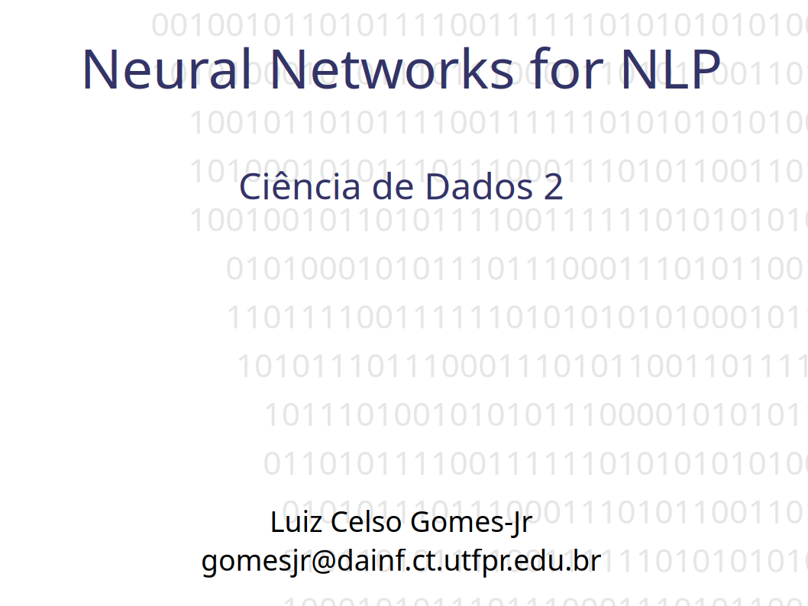
Acknowledgments
This course took the slides of my colleague Luiz Celso Gomes-Jr—to whom I extend my thanks—as a starting point. Slides that have been reused and/or adapted will bear the seal shown here.
https://pessoal.dainf.ct.utfpr.edu.br/lcjunior/
Notes:
Este curso tomou como ponto de partida os slides do colega Luiz Celso Gomes-Jr, a quem agradeço. Slides reutilizados e/ou adaptados receberão o selo ao lado.

Slide 3
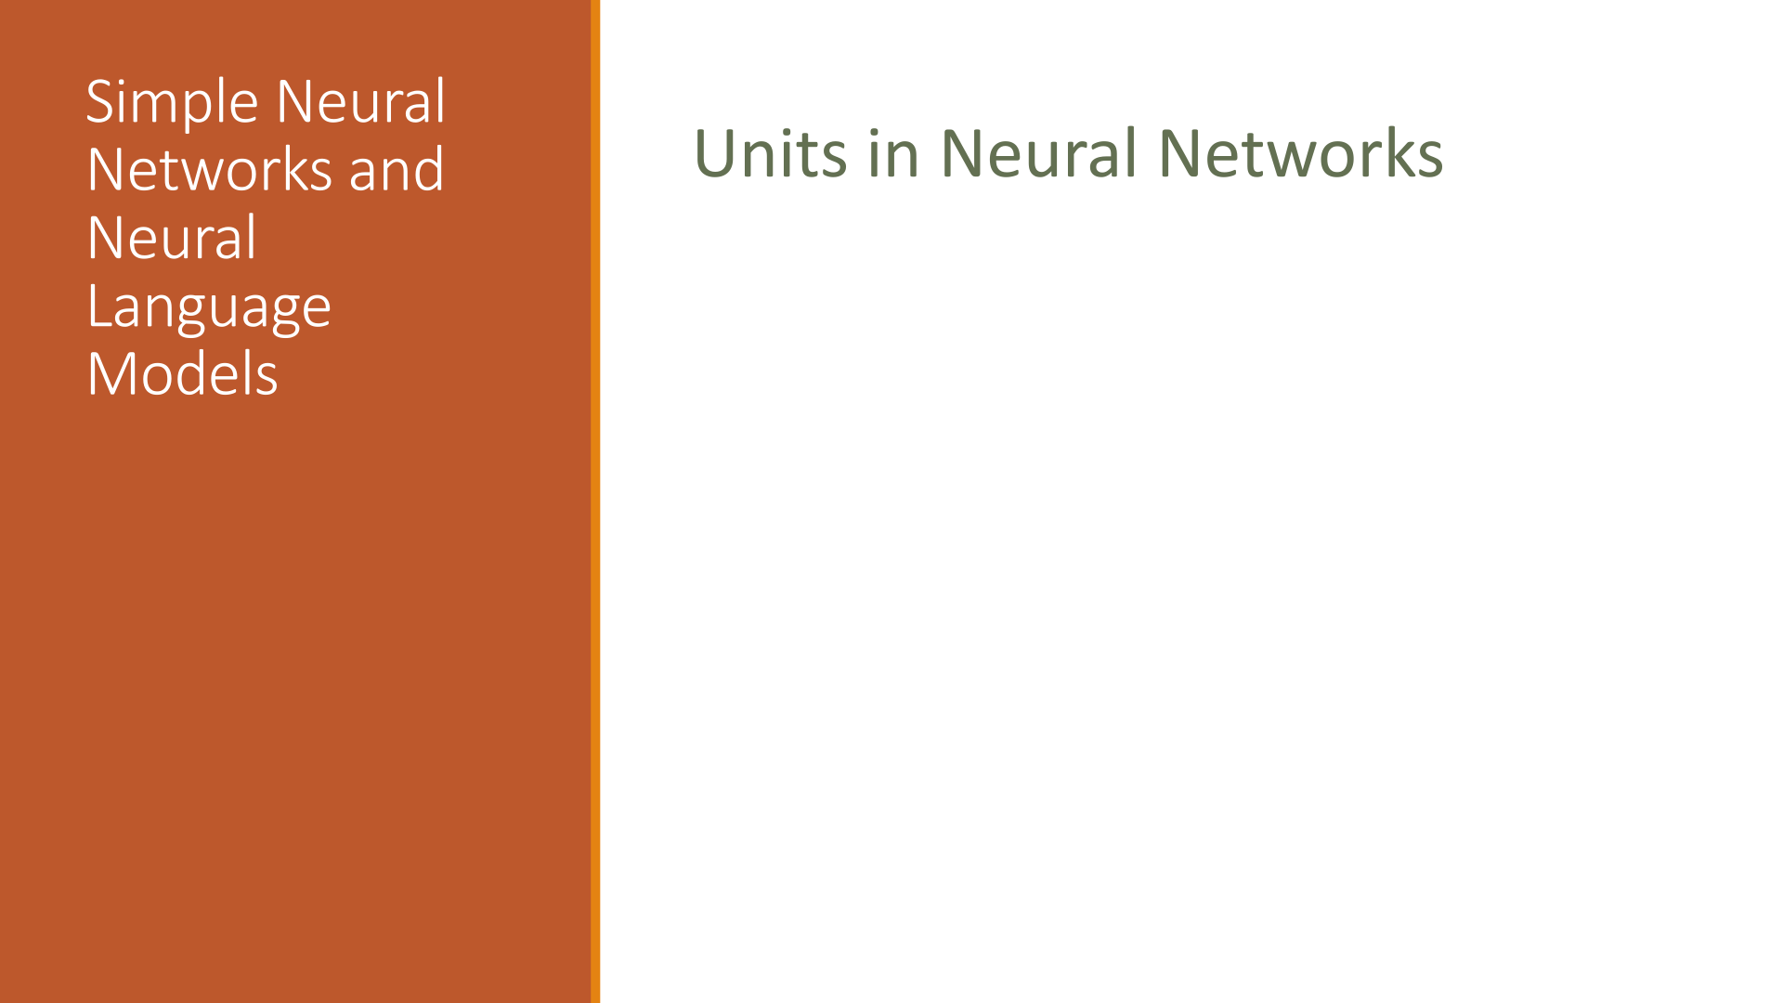
Acknowledgments
Jurafsky, D. and Martin, J. H. (2025). Speech and Language Processing: An Introduction to Natural Language Processing, Computational Linguistics, and Speech Recognition with Language Models. 3rd edition. https://web.stanford.edu/~jurafsky/slp3/
CS 124: From Languages to Information
Dan Jurafsky
Winter 2026
https://web.stanford.edu/class/cs124/

Slide 4
Logistic Regression
Revision

Slide 5
Classification
Summary
Model
Classification Function
Feature Representation
Optimization
Algorithm
Objective Function

Slide 6
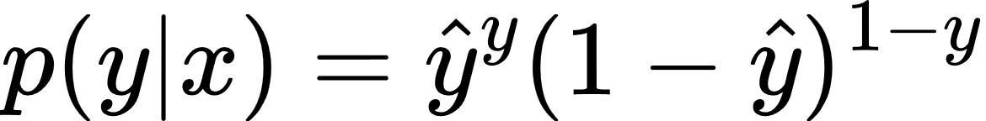
Label Probability
(Bernoulli Probability Mass Function - PMF)
Notes:
p(y|x) = \hat{y}^y(1-\hat{y})^{1-y}

Slide 7
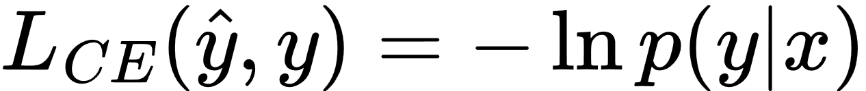
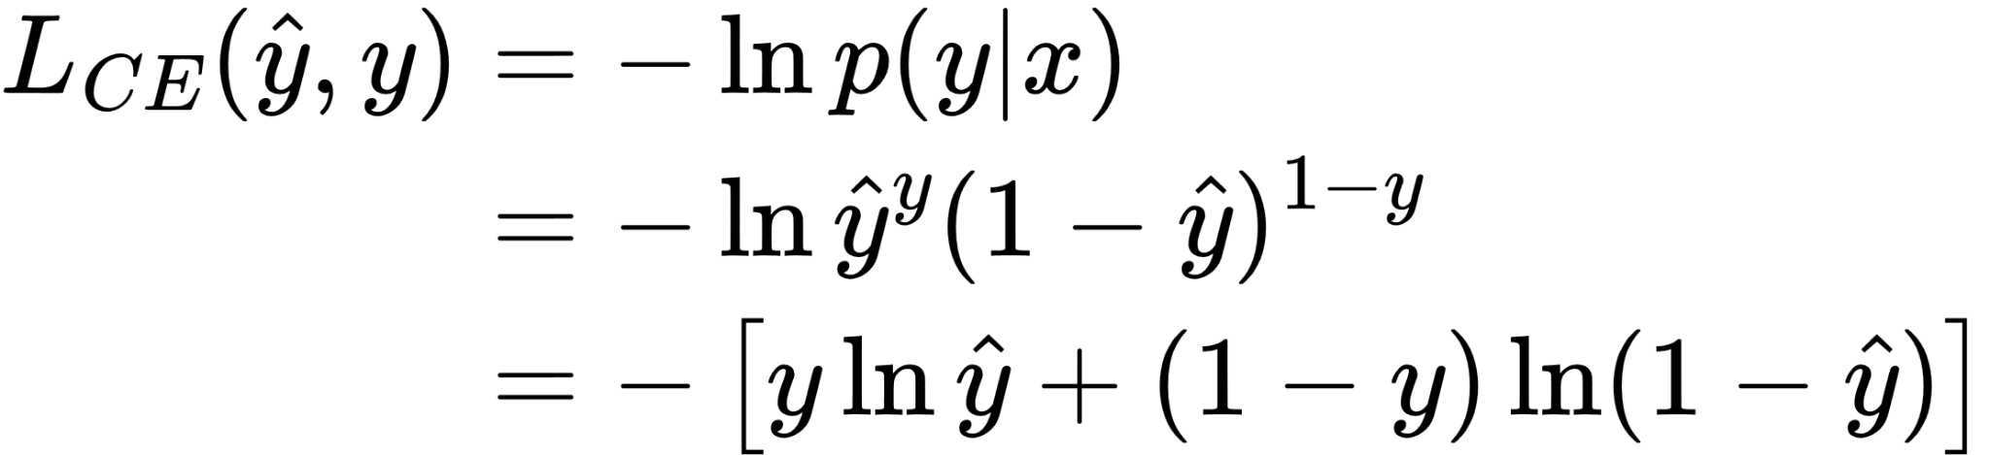
Probability becomes Cross-Entropy Loss
Notes:
L_{CE}(\hat{y},y) = -\ln{p(y|x)}
\begin{align*}
L_{CE}(\hat{y},y) &= -\ln{p(y|x)}
\\
&= -\ln\hat{y}^y(1-\hat{y})^{1-y}
\\
&= - \left[ y \ln\hat{y} + (1 - y) \ln(1 - \hat{y}) \right]
\end{align*}

Slide 8
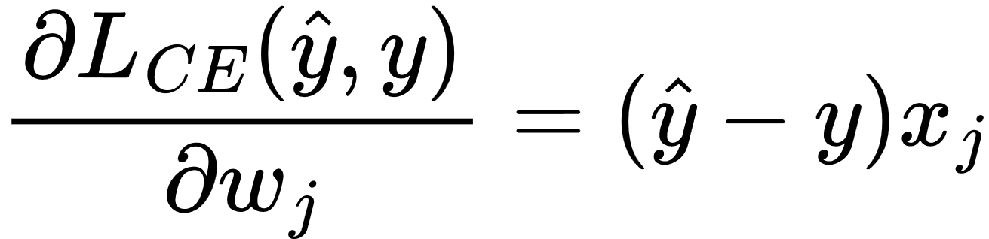
Loss Slope as Derivative
Notes:
\frac{\partial L_{CE}(\hat{y},y)}{\partial w_j} = (\hat{y} - y) x_j

Slide 9
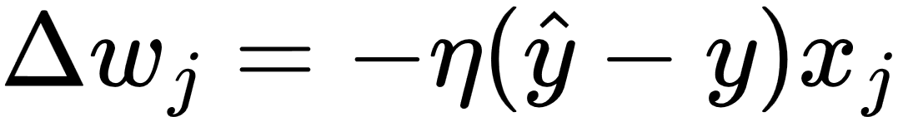
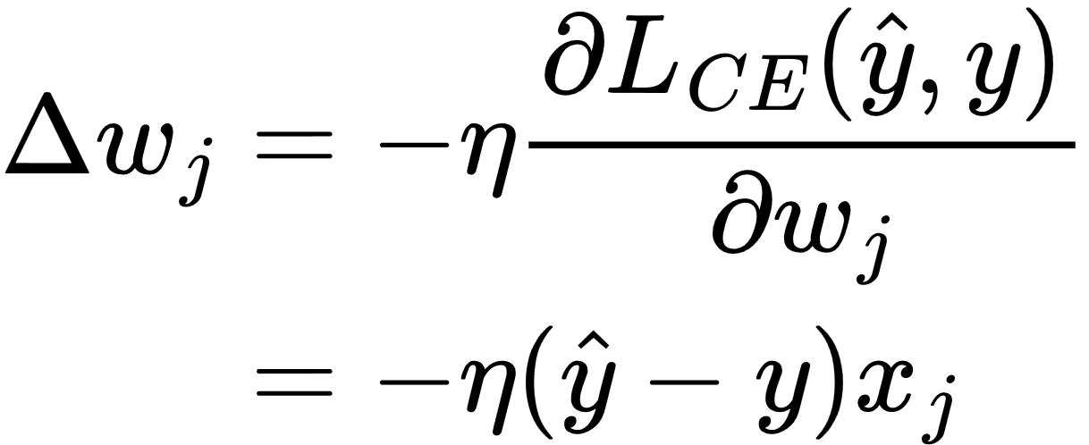
Decent: opposite direction to the slope with a learning rate η
Notes:
\Delta w_j = -\eta (\hat{y} - y) x_j
\begin{align*}
\Delta w_j &= -\eta \frac{\partial L_{CE}(\hat{y},y)}{\partial w_j}
\\
&= -\eta (\hat{y} - y) x_j
\end{align*}

Slide 10
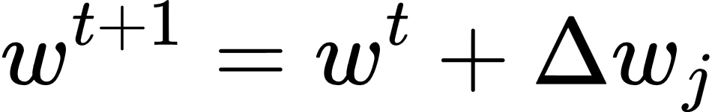
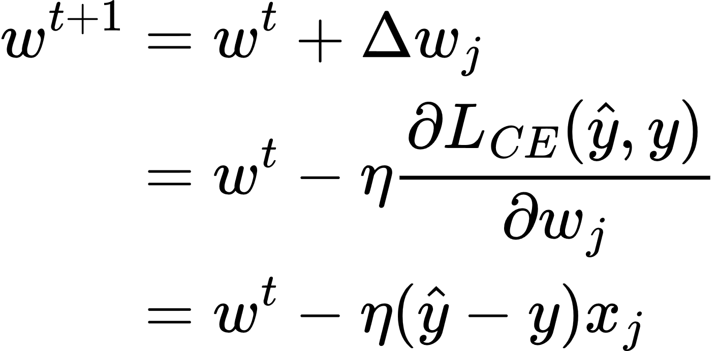
Learning: updating weights with the descent
Notes:
\Delta w_j = -\eta (\hat{y} - y) x_j
w^{t+1} = w^t + \Delta w_j
\begin{align*}
w^{t+1} &= w^t + \Delta w_j
\\
&= w^t-\eta \frac{\partial L_{CE}(\hat{y},y)}{\partial w_j}
\\
&= w^t - \eta (\hat{y} - y) x_j
\end{align*}

Slide 11
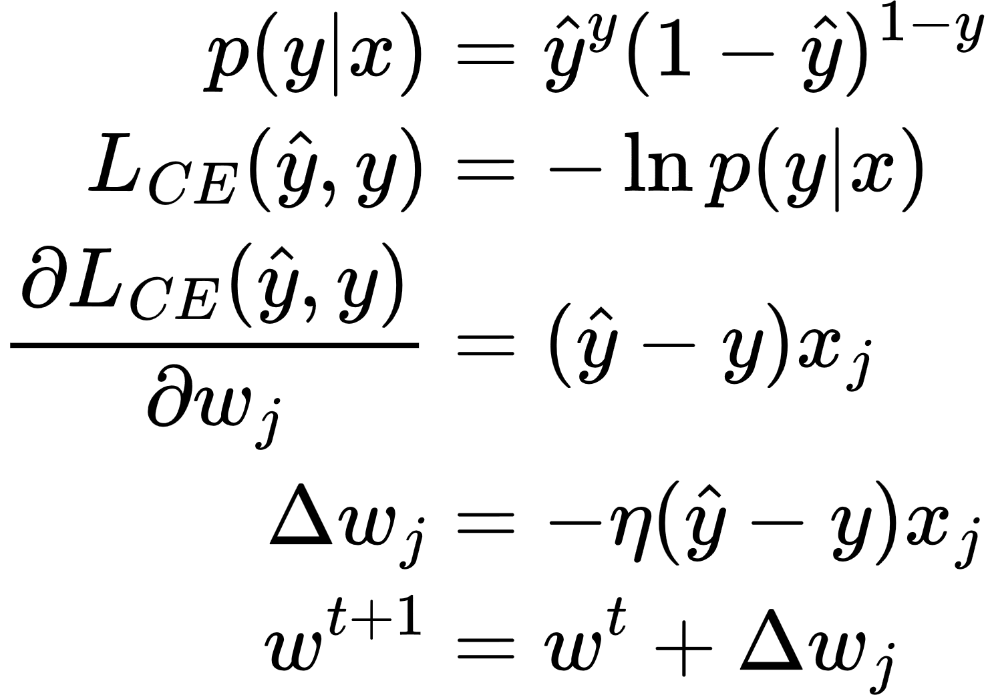
Short Summary
Notes:
\begin{align}
p(y|x) &=\hat{y}^y(1-\hat{y})^{1-y}
\\
L_{CE}(\hat{y},y) &= -\ln{p(y|x)}
\\
\frac{\partial L_{CE}(\hat{y},y)}{\partial w_j} &= (\hat{y} - y) x_j
\\
\Delta w_j &= -\eta (\hat{y} - y) x_j
\\
w^{t+1} &= w^t + \Delta w_j
\end{align}

Slide 12
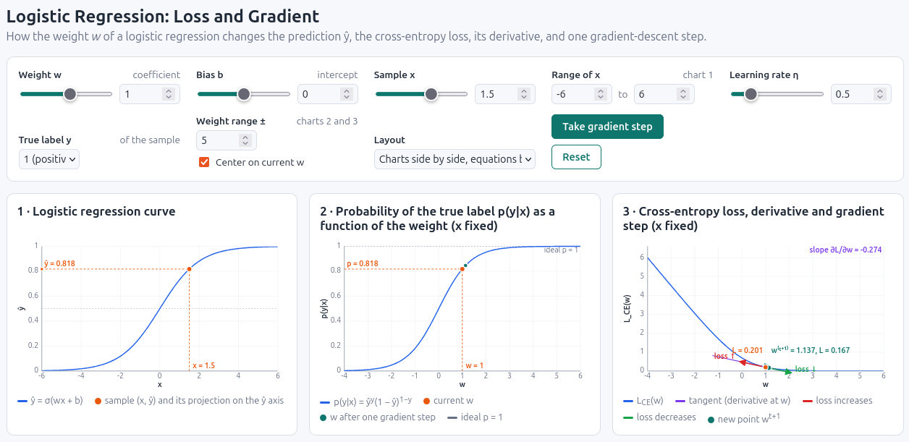
Simulator
https://santanche.github.io/nlp2learn/machine-learning/logistic-regression/simulation/

Slide 13
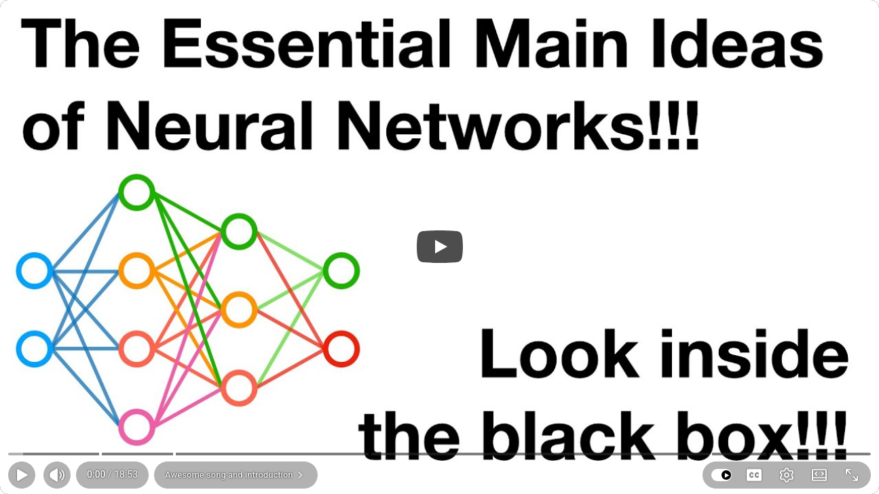
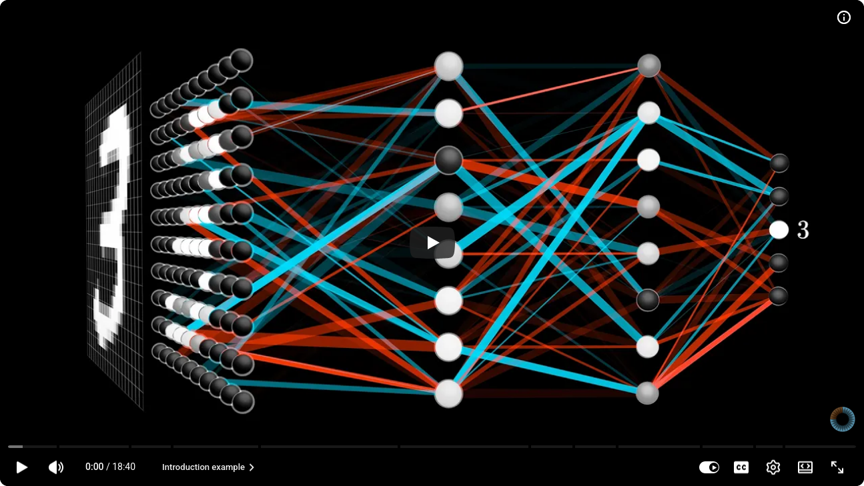
Two Essential Videos
https://youtu.be/CqOfi41LfDw?si=KkASDA7PCG6RRldr
https://youtu.be/aircAruvnKk?si=dXsjeYu0sFc-eoFv

Slide 14
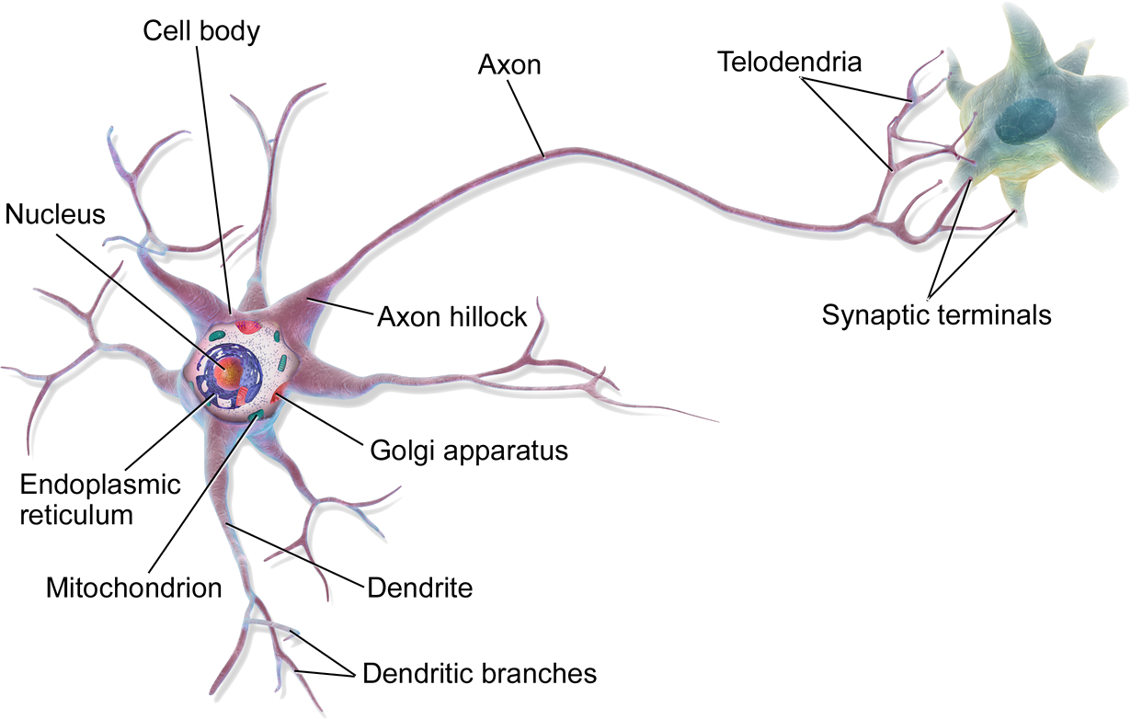
Neural Network Unit
x₀=1
b
inspiration
x₁
w₁
Z
f
y
w₂
x₂
w_{n}
x_{n}

Slide 15
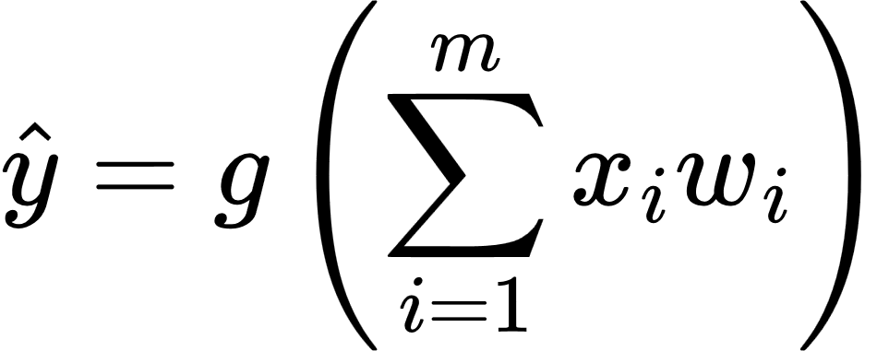
Neural Network Unit
linear combination of inputs
x₁
w₁
Z
f
y
output
w₂
x₂
output
inputs
w_{n}
x_{n}
linear
function
activation
function
non-linear activation function
Notes:
\hat{y} = g \left(\sum_{i=1}^{m} x_i w_i \right)

Slide 16
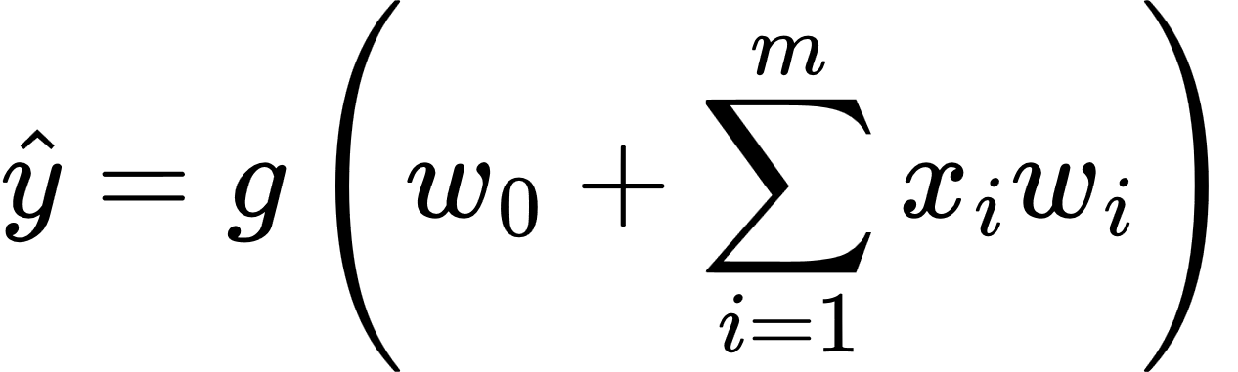
Neural Network Unit
x₀=1
bias
w₀
linear combination of inputs
x₁
w₁
Z
f
y
output
w₂
inputs
x₂
output
w_{n}
x_{n}
linear
function
activation
function
bias
non-linear activation function
Notes:
\hat{y} = g \left( w_0 + \sum_{i=1}^{m} x_i w_i \right)

Slide 17
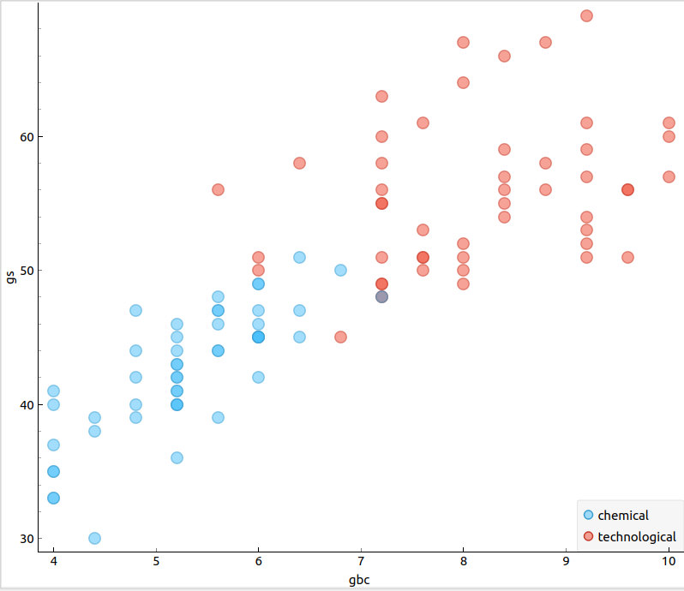

Zombie Logistic Regression
GBC - Green Blood Cells

Slide 18

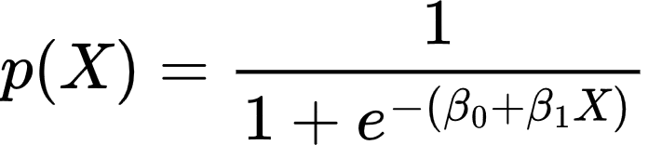


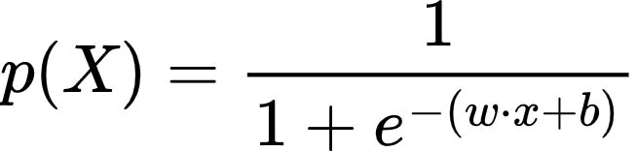
Linear
Logistic

Slide 19
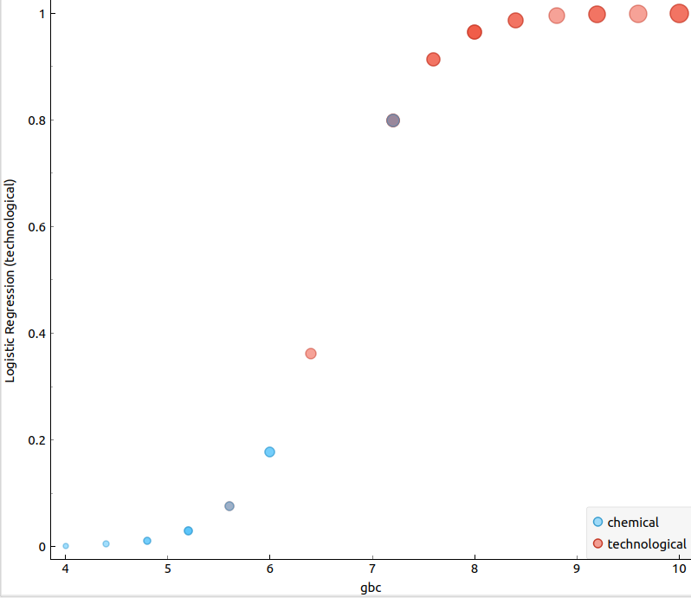
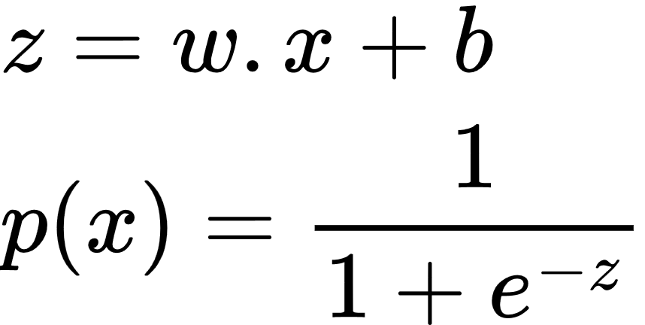
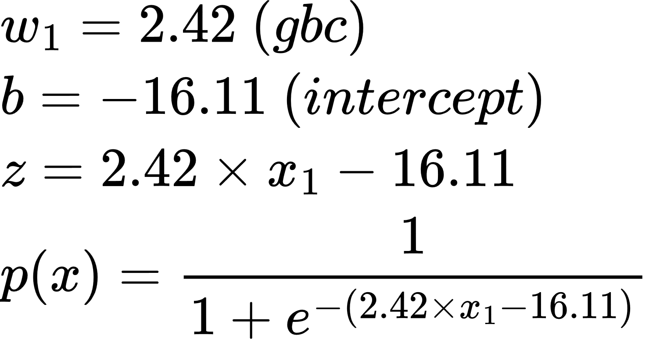
Logistic Regression
technological
0.5
Probability
p(X)
chemical
Notes:
\begin{align*}
& z=\beta_0+\beta_1X
\\
& p(X) = \frac{1}{1 + e^{-z}}
\end{align*}
\begin{align*}
& w_1 = 2.42 \ (gbc)
\\
& b = -16.11 \ (intercept)
\\
& z=2.42 \times x_1-16.11
\\
& p(x) = \frac{1}{1 + e^{-(2.42 \times x_1-16.11)}}
\end{align*}

Slide 20
Logistic Regression
0.91
technological
0.5
x=[x₁]
w=[w₁]
b
chemical
7.6

Slide 21
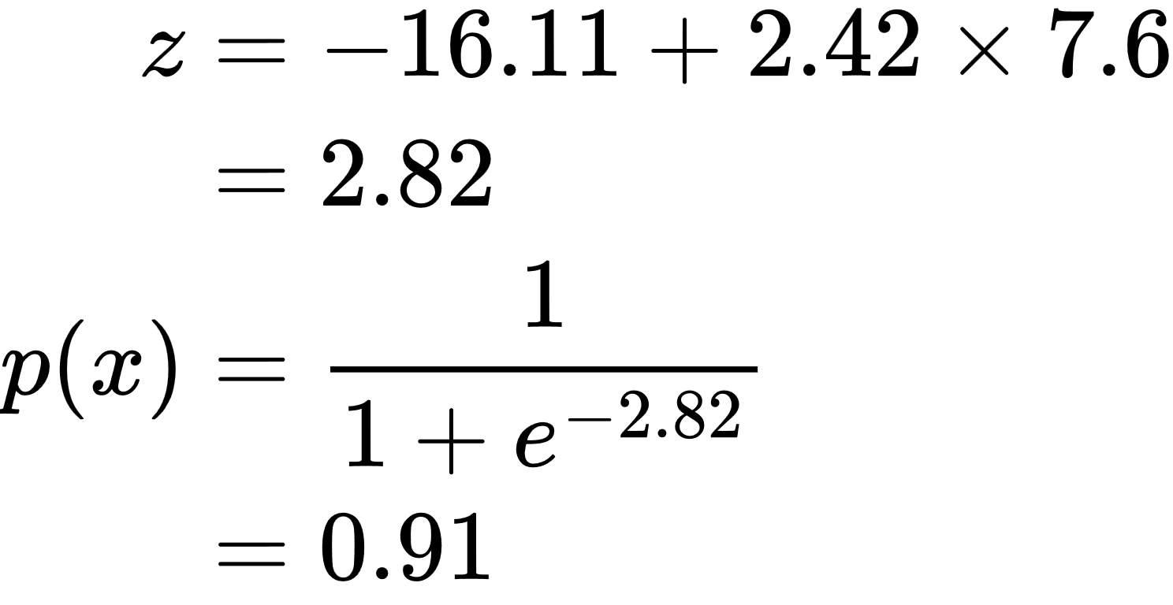
Logistic Regression
0.91
technological
0.5
x=[7.6]
w=[2.42]
b=-16.11
chemical
7.6
Notes:
\begin{align*}
z &= -16.11+2.42 \times 7.6
\\
&= 2.82
\\
p(x) &= \frac{1}{1 + e^{-2.82}} \\
&= 0.91
\end{align*}

Slide 22
Sigmoid Activation Function
x=[7.6]
w=[2.42]
b=-16.11
x₀=1
b
w₁
x₁
y
Z
f

Slide 23
Logistic Regression
x=[7.6]
w=[2.42]
b=-16.11
1
x₀=1
b
w₁
7.6
x₁
y
Z
f

Slide 24
Logistic Regression
x=[7.6]
w=[2.42]
b=-16.11
1
x₀=1
-16.11
x₁
2.42
7.6
y
Z
f

Slide 25
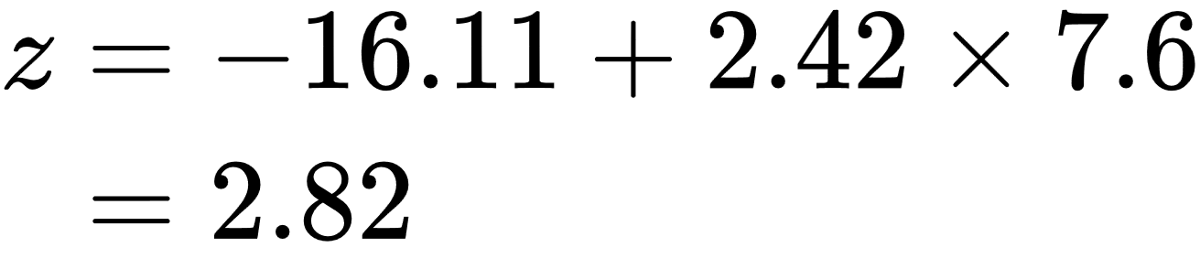
Logistic Regression
x=[7.6]
w=[2.42]
b=-16.11
1
x₀=1
-16.11
x₁
2.42
7.6
y
Z
f
z=-16.11+2.42x7.6=2.82
Notes:
\begin{align*}
z &= -16.11+2.42 \times 7.6
\\
&= 2.82
\end{align*}

Slide 26
Logistic Regression
0.91
technological
x=[7.6]
w=[2.42]
b=-16.11
0.5
chemical
7.6
1
x₀=1
-16.11
x₁
2.42
7.6
0.91
Z
f
z=-16.11+2.42x7.6=2.82

Slide 27
Sigmoid Activation Function
X=[7.6]
w=[2.42]
b=-16.11
x₀=1
w₀
w₁
x₁
y
X=[1,7.6]
w=[-16.11,2.42]
Z
f

Slide 28

Two Features
GBC - Green Blood Cells
GS - Green Substance

Slide 29
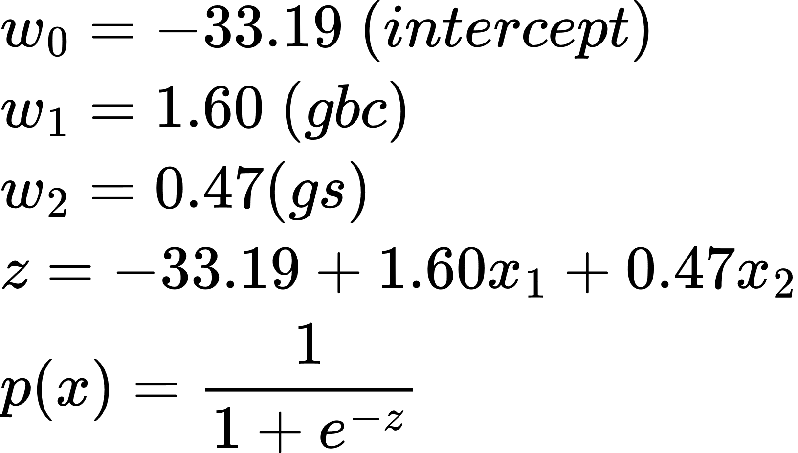
Sigmoid Activation Function
Two Features
x₀=1
w₀
w₁
x₁
y
x=[1,5.6,46]
w=[-33.19,1.60,0.47]
Z
f
w₂
x₂
Notes:
\begin{align*}
& w_0 = -33.19 \ (intercept)
\\
& w_1 = 1.60 \ (gbc)
\\
& w_2 = 0.47 (gs)
\\
& z=-33.19+1.60x_1+0.47x_2
\\
& p(x) = \frac{1}{1 + e^{-z}}
\end{align*}

Slide 30
Sigmoid Activation Function
Two Features
x₀=1
w₀
x=[1,5.6,46]
w=[-33.19,1.60,0.47]
w₁
x₁
y
Z
f
w₂
x₂

Slide 31
Sigmoid Activation Function
Two Features
1
x₀=1
w₀
x=[1,5.6,46]
w=[-33.19,1.60,0.47]
w₁
5.6
x₁
y
Z
f
w₂
46
x₂

Slide 32
Sigmoid Activation Function
Two Features
1
x₀=1
-33.19
x=[1,5.6,46]
w=[-33.19,1.60,0.47]
1.6
5.6
x₁
y
Z
f
0.47
46
x₂

Slide 33
Sigmoid Activation Function
Two Features
1
x₀=1
-33.19
x=[1,5.6,46]
w=[-33.19,1.60,0.47]
y=0.94
1.6
5.6
x₁
0.94
Z
f
0.47
46
x₂

Slide 34
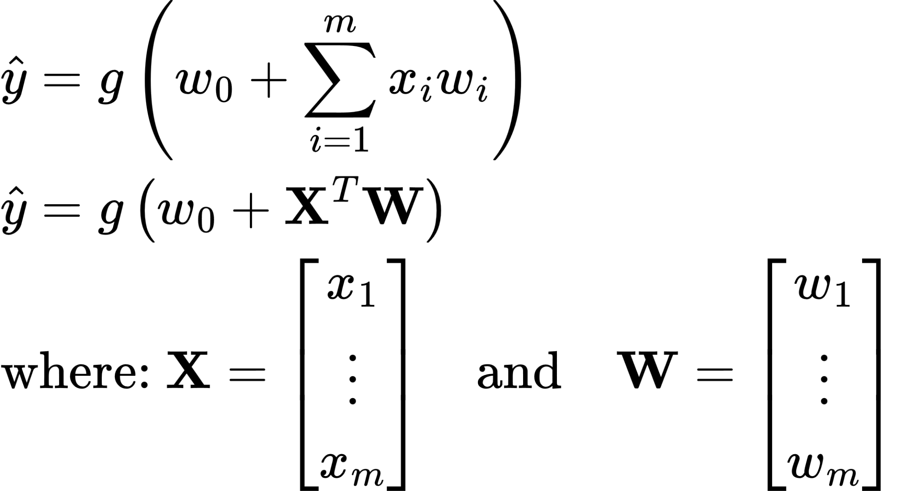
Vector Representation
Notes:
\begin{align*}
% Summation Form (Top)
& \hat{y} = g \left( w_0 + \sum_{i=1}^{m} x_i w_i \right)
\\
% Vectorized Form (Middle)
& \hat{y} = g \left( w_0 + \mathbf{X}^T \mathbf{W} \right)
\\
% Definitions (Bottom)
& \text{where: } \mathbf{X} = \begin{bmatrix} x_1 \\ \vdots \\ x_m \end{bmatrix} \quad \text{and} \quad \mathbf{W} = \begin{bmatrix} w_1 \\ \vdots \\ w_m \end{bmatrix}
\end{align*}

Slide 35
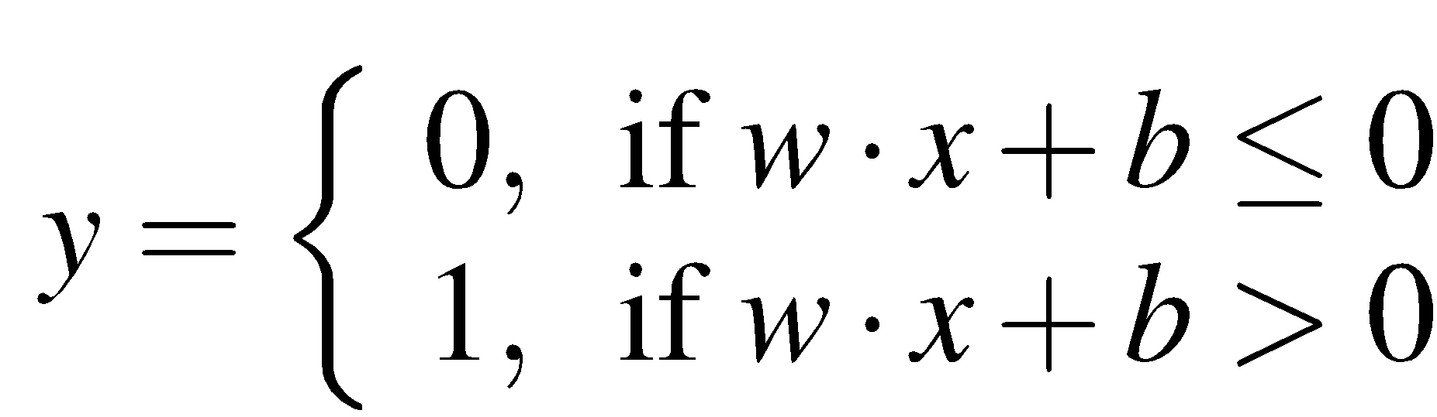
Perceptrons
A very simple neural unit
Binary output (0 or 1)
No non-linear activation function
(Jurafsky, 2026)
Notes:
This example was first shown for the perceptron, which is a very simple neural unit that has a binary output and does not have a non-linear activation function. The output y of a perceptron is 0 or 1, and is computed as follows (using the same weight
w, input x, and bias b we've seen already

Slide 36
Task 1
Compute the value of y for each input.
x₁ | x₂ | y
0 | 0
0 | 1
1 | 0
1 | 1
-1
x₀=1
perceptron
1
y
x₁
1
x₂

Slide 37
Task 1
Compute the value of y for each input.
AND
x₁ | x₂ | y
0 | 0 | 0
0 | 1 | 0
1 | 0 | 0
1 | 1 | 1
-1
x₀=1
perceptron
1
y
x₁
1
x₂

Slide 38
Task 2
What are the weights for computing the OR?
OR
x₁ | x₂ | y
0 | 0 | 0
0 | 1 | 1
1 | 0 | 1
1 | 1 | 1
?
x₀=1
perceptron
?
y
x₁
?
x₂

Slide 39
Task 2
What are the weights for computing the OR?
OR
x₁ | x₂ | y
0 | 0 | 0
0 | 1 | 1
1 | 0 | 1
1 | 1 | 1
0
x₀=1
perceptron
1
y
x₁
1
x₂

Slide 40
Task 3
Set up a network to compute the XOR.
XOR
x₁ | x₂ | y
0 | 0 | 0
0 | 1 | 1
1 | 0 | 1
1 | 1 | 0

Slide 41
Not possible to capture XOR with a single perceptron
adapted from (Jurafsky, 2026)

Slide 42
Why? Perceptrons are linear classifiers
Perceptron equation given x₁ and x₂, is the equation of a line
w₁x₁ + w₂x₂ + b = 0
(in standard linear format: x₂ = (−w₁/w₂)x₁ + (−b/w₂) )
This line acts as a decision boundary
0 if input is on one side of the line
1 if on the other side of the line
(Jurafsky, 2026)
Notes:
Why? Crucially, the perceptron is a linear classifier. For a two-dimensional input x1 and x2, the perception equation, w1 x1 + w2 x2 + b = 0 is the equation of a line. (We can see this by putting it in the standard linear format: x2 = (−w1/w2)x1 + (−b/w2).)
This line acts as a decision boundary in two-dimensional space in which the output 0 is assigned to all inputs lying on one side of the line, and the output 1 to all input points lying on the other side of the line
If we had more than 2 inputs, the decision boundary becomes a hyperplane instead of a line, but the idea is the same, separating the space into two categories.

Slide 43
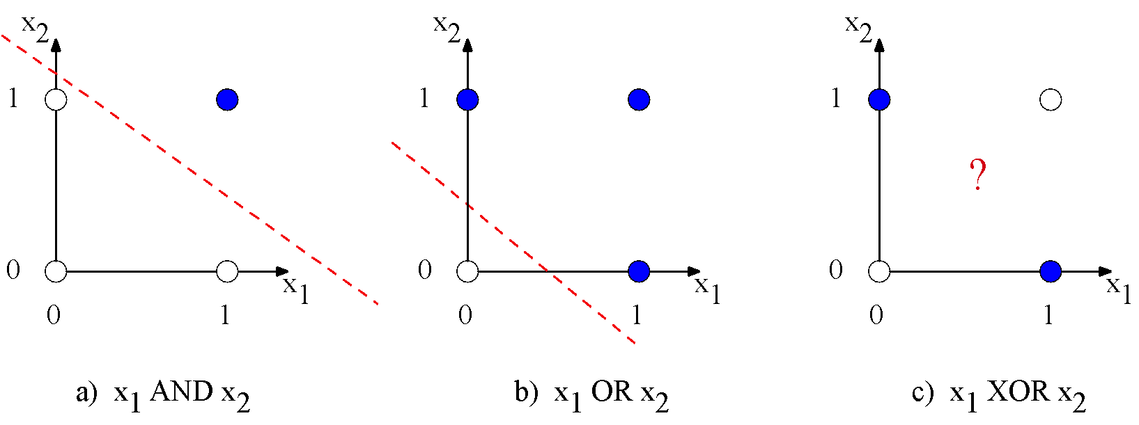
Decision boundaries
(Jurafsky, 2026)
XOR is not a linearly separable function!
Notes:
These figures shows the possible logical inputs (00, 01, 10, and 11) and the line drawn by one possible set of parameters for an AND and an OR classifier. Notice that there is simply no way to draw a line that separates the positive cases of XOR (01 and 10) from the negative cases (00 and 11).
CLICK
We say that XOR is not a linearly separable function. Of course we could draw a boundary with a curve, or some other function, but not a single line.

Slide 44
Task 3
XOR
x₁ | x₂ | y
0 | 0 | 0
0 | 1 | 1
1 | 0 | 1
1 | 1 | 0
-0.5
h₀=1
x₀=1
0
-1.5
OR
1
1
x₁
XOR
-1
1
AND
1
x₂
1

Slide 45
Task 3
XOR
x₁ | x₂ | y
0 | 0 | 0
0 | 1 | 1
1 | 0 | 1
1 | 1 | 0
-0.5
h₀=1
x₀=1
0
OR
-1.5
XOR
h₁=0
1
1
x₁=0
AND
-1
y=0
1
h₂=0
1
x₂=0
1

Slide 46
Task 3
XOR
x₁ | x₂ | y
0 | 0 | 0
0 | 1 | 1
1 | 0 | 1
1 | 1 | 0
-0.5
h₀=1
x₀=1
0
OR
-1.5
XOR
h₁=1
1
1
x₁=0
AND
-1
y=1
1
h₂=0
1
x₂=1
1

Slide 47
Task 3
XOR
x₁ | x₂ | y
0 | 0 | 0
0 | 1 | 1
1 | 0 | 1
1 | 1 | 0
-0.5
h₀=1
x₀=1
0
OR
-1.5
XOR
h₁=1
1
1
x₁=1
AND
-1
y=1
1
h₂=0
1
x₂=0
1

Slide 48
Task 3
XOR
x₁ | x₂ | y
0 | 0 | 0
0 | 1 | 1
1 | 0 | 1
1 | 1 | 0
-0.5
h₀=1
x₀=1
0
OR
-1.5
XOR
h₁=1
1
1
x₁=1
AND
-1
y=0
1
h₂=1
1
x₂=1
1

Slide 49
ReLU
1
Rectified Linear Unit
0
1
g(z)=max(0,z)

Slide 50
XOR with ReLU
XOR
x₁ | x₂ | y
0 | 0 | 0
0 | 1 | 1
1 | 0 | 1
1 | 1 | 0
0
h₀=1
x₀=1
0
-1
σ
1
1
x₁
σ
1
σ
-2
ReLU
1
x₂
ReLU
1
adapted from (Jurafsky, 2026)
Notes:
Let’s see an example of how to compute XOR using two layers of ReLU-based units.
The middle layer (called h) has two units, and the output layer (called y) has one unit. These weights and biases will computes XOR.
Consider input x = [0, 0] ]. If we multiply each input value by the appropriate weight, sum, and then add the bias b, DO THIS ON SLIDE we get the vector [0 -1] apply the ReLU and we get [0 0], and the final value is 0.

Slide 51
XOR with ReLU
XOR
x₁ | x₂ | y
0 | 0 | 0
0 | 1 | 1
1 | 0 | 1
1 | 1 | 0
0
h₀=1
x₀=1
0
-1
h₁=0
1
1
x₁=0
y=0
1
h₁=0
-2
1
x₂=0
1

Slide 52
XOR with ReLU
XOR
x₁ | x₂ | y
0 | 0 | 0
0 | 1 | 1
1 | 0 | 1
1 | 1 | 0
0
h₀=1
x₀=1
0
-1
h₁=1
1
1
x₁=0
y=1
1
h₁=0
-2
1
x₂=1
1

Slide 53
XOR with ReLU
XOR
x₁ | x₂ | y
0 | 0 | 0
0 | 1 | 1
1 | 0 | 1
1 | 1 | 0
0
h₀=1
x₀=1
0
-1
h₁=1
1
1
x₁=1
y=1
1
h₁=0
-2
1
x₂=0
1

Slide 54
XOR with ReLU
XOR
x₁ | x₂ | y
0 | 0 | 0
0 | 1 | 1
1 | 0 | 1
1 | 1 | 0
0
h₀=1
x₀=1
0
-1
h₁=2
1
1
x₁=1
y=0
1
h₁=1
-2
1
x₂=1
1

Slide 55
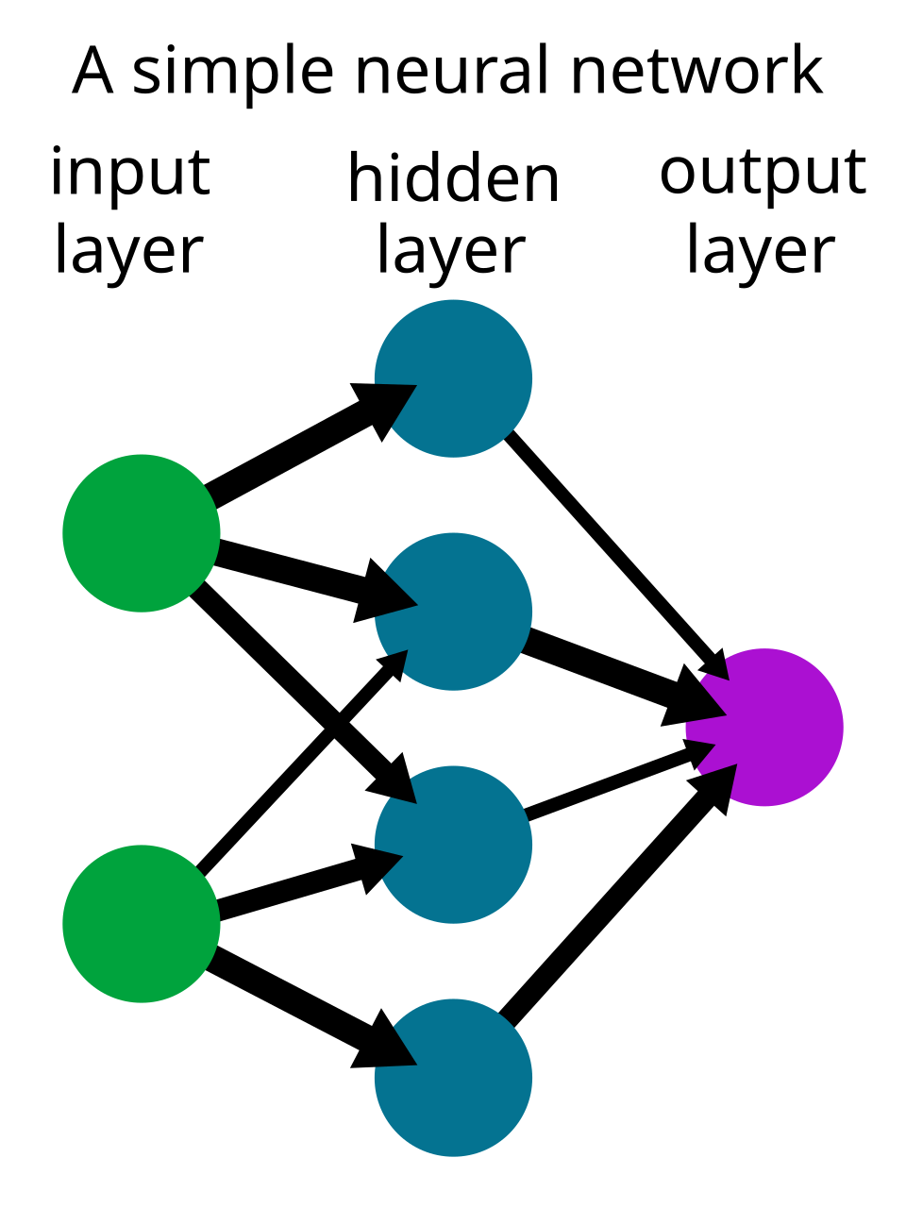
Neural Network

Slide 56
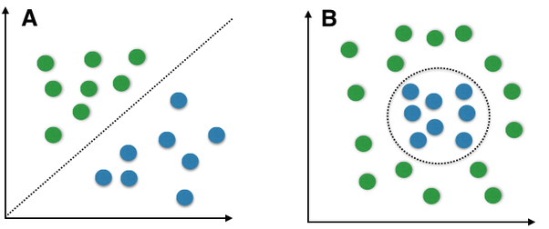
Complexity Problem
Linearly Separable

Slide 57
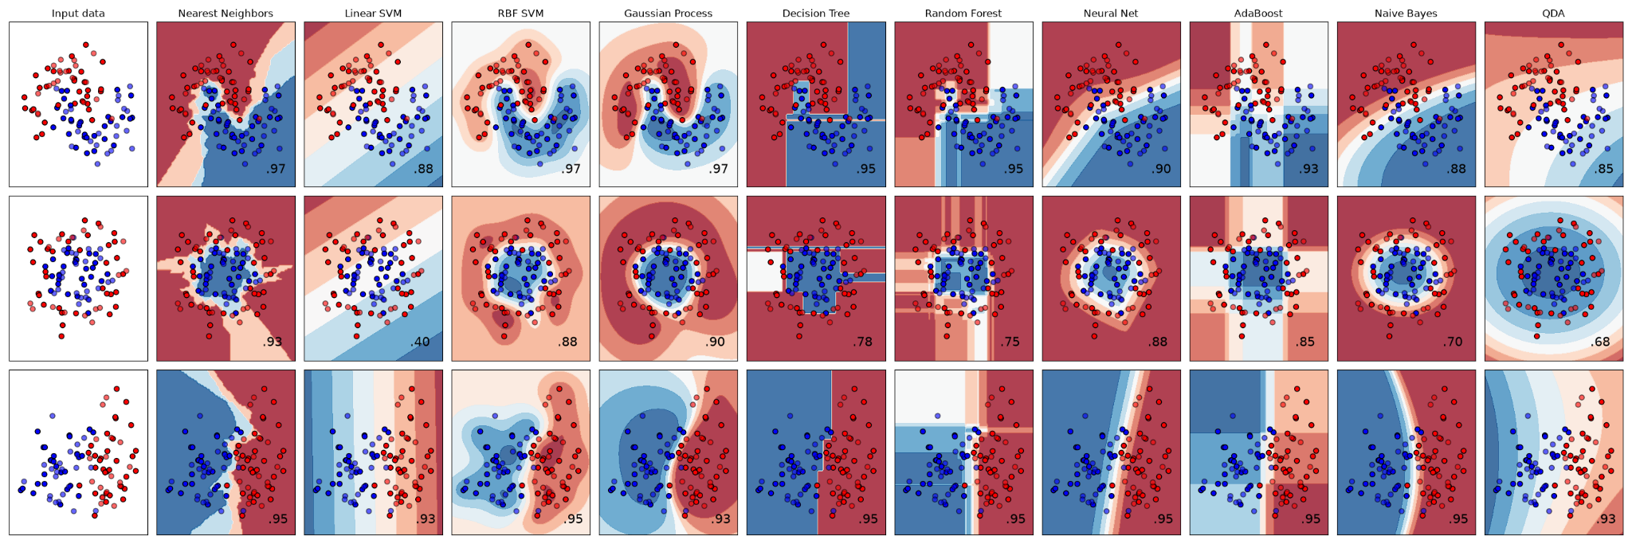
Complexity Problem
Linearly Separable

Slide 58
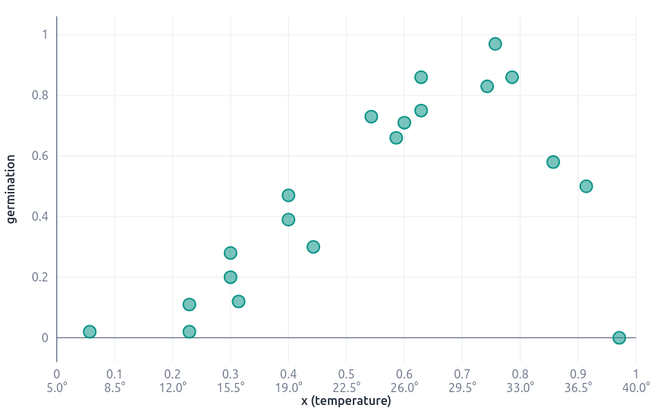
Task 4
Given the following sample distribution comparing the temperature and germination rate of a seed type, propose a function capable of predicting the germination rate based on the temperature.
_________
Dada a seguinte distribuição de amostras, que confronta a temperatura e taxa de germinação de um tipo de semente. Proponha uma função capaz de predizer a taxa de germinação a partir da temperatura.

Slide 59
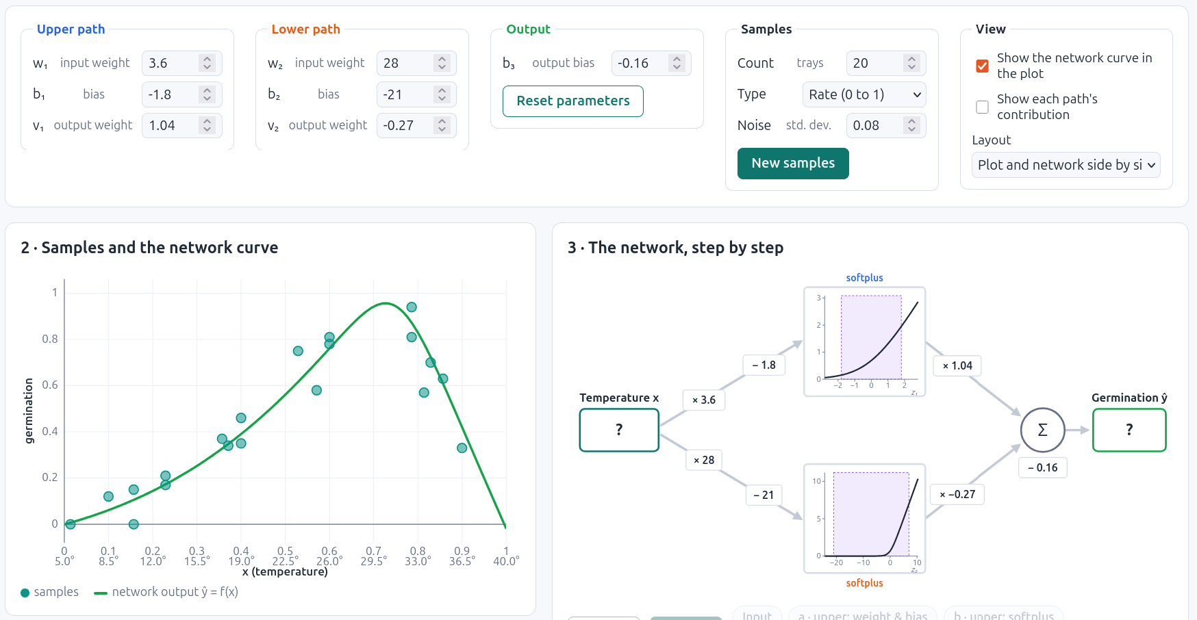
Composing Functions
https://santanche.github.io/nlp2learn/machine-learning/neural-network/essential/simulation/index.html

Slide 60
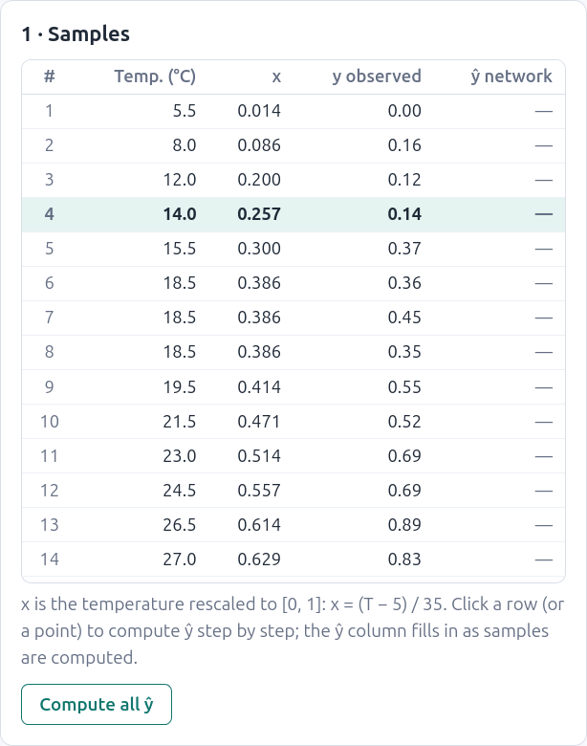
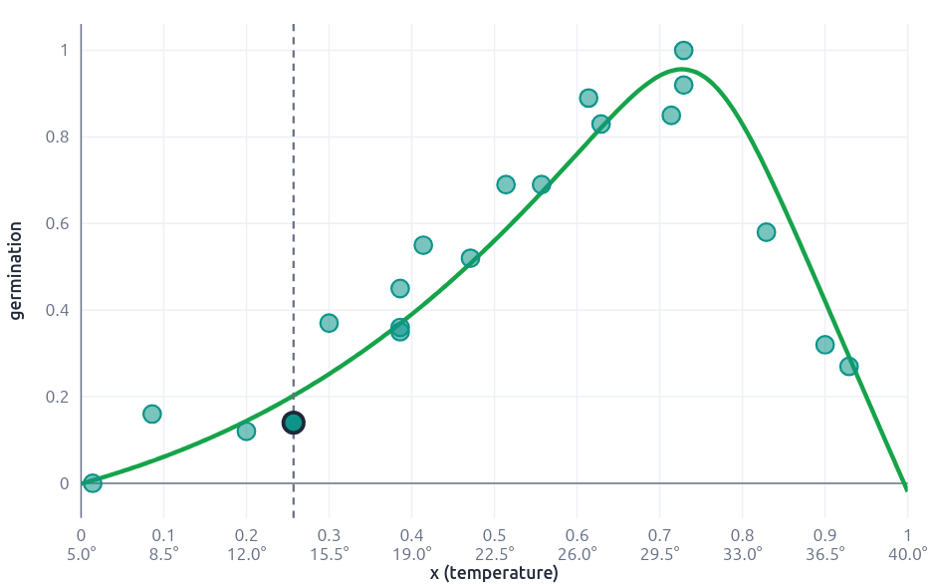
Selecting a Sample

Slide 61
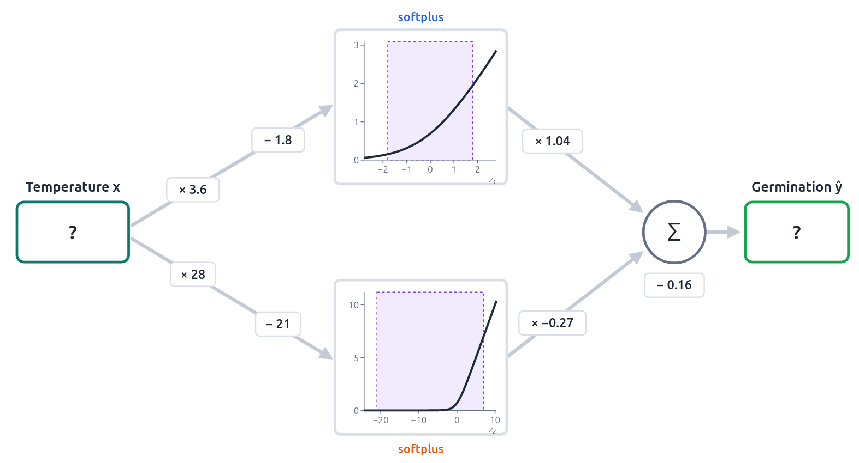
Functions connected as “neurons”

Slide 62
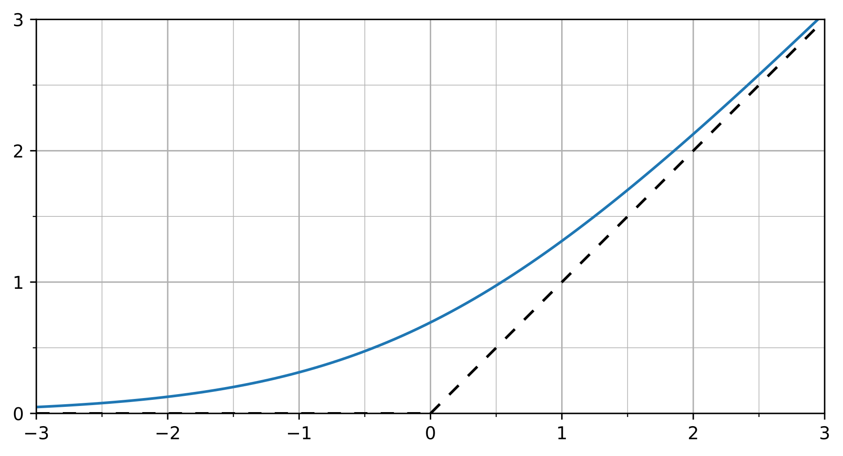
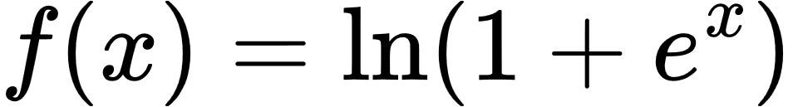
Softplus Activation Function
Notes:
f(x)=\ln(1+e^x)

Slide 63
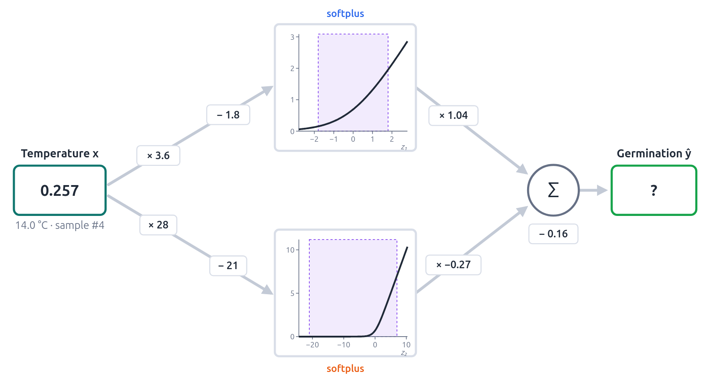
Entering a sample value

Slide 64
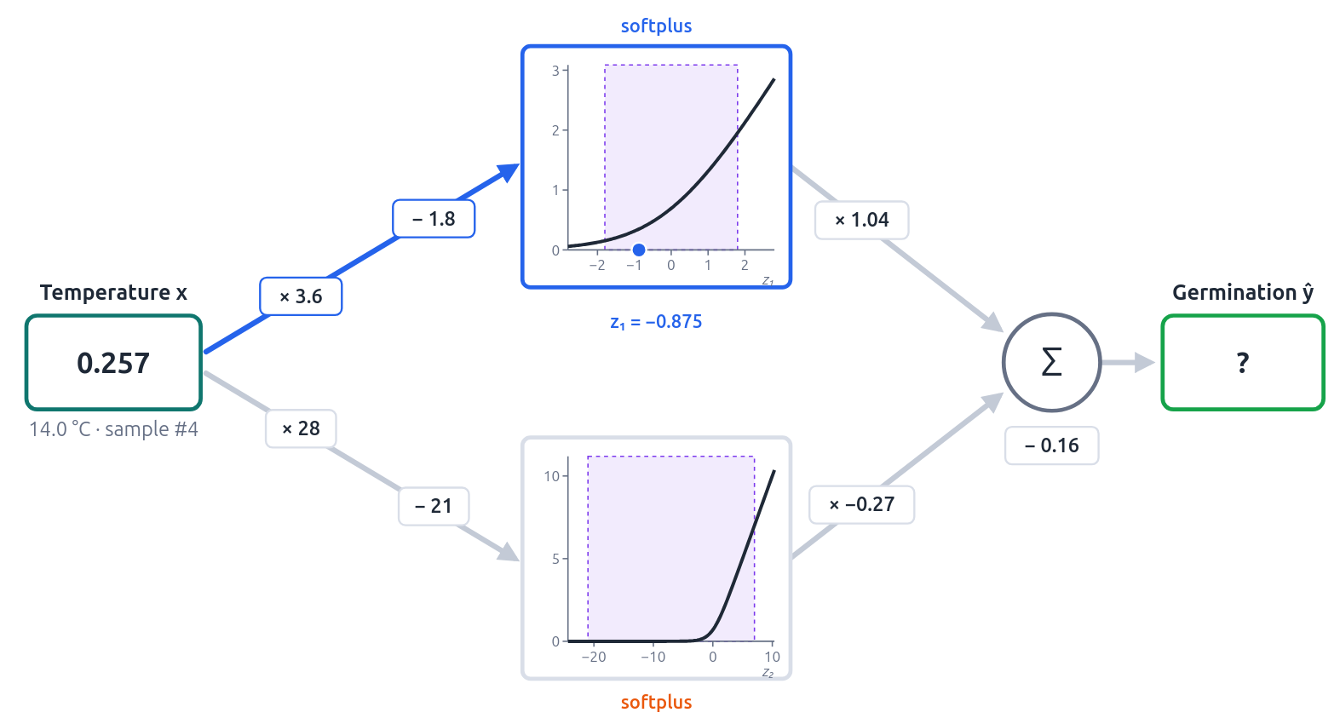
Computing Weight and Bias (path a)

Slide 65
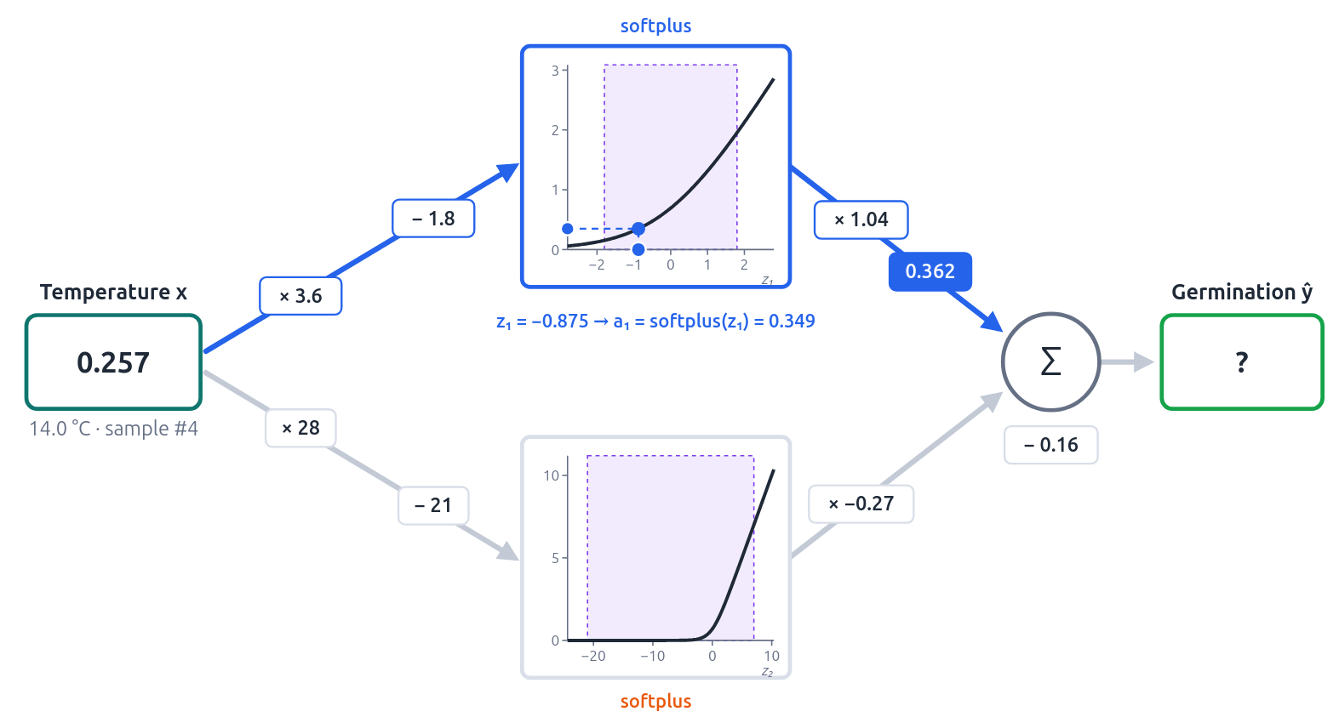
Computing the Softplus (path a)

Slide 66
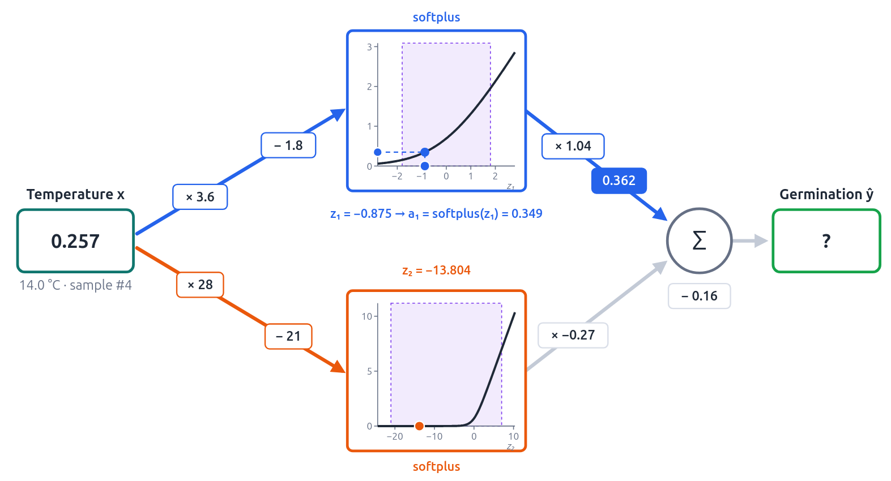
Computing Weight and Bias (path b)

Slide 67
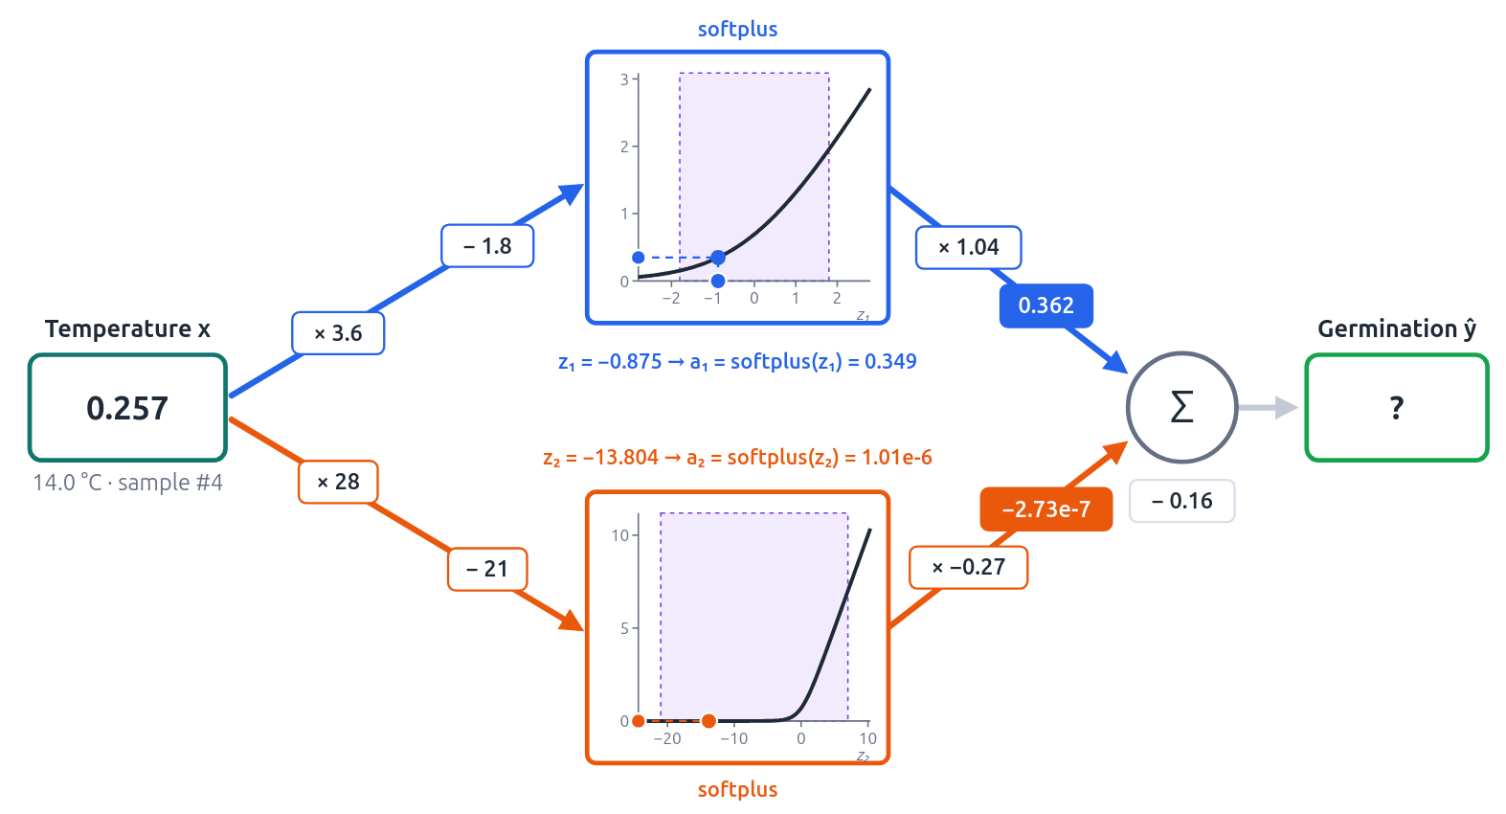
Computing the Softplus (path b)

Slide 68
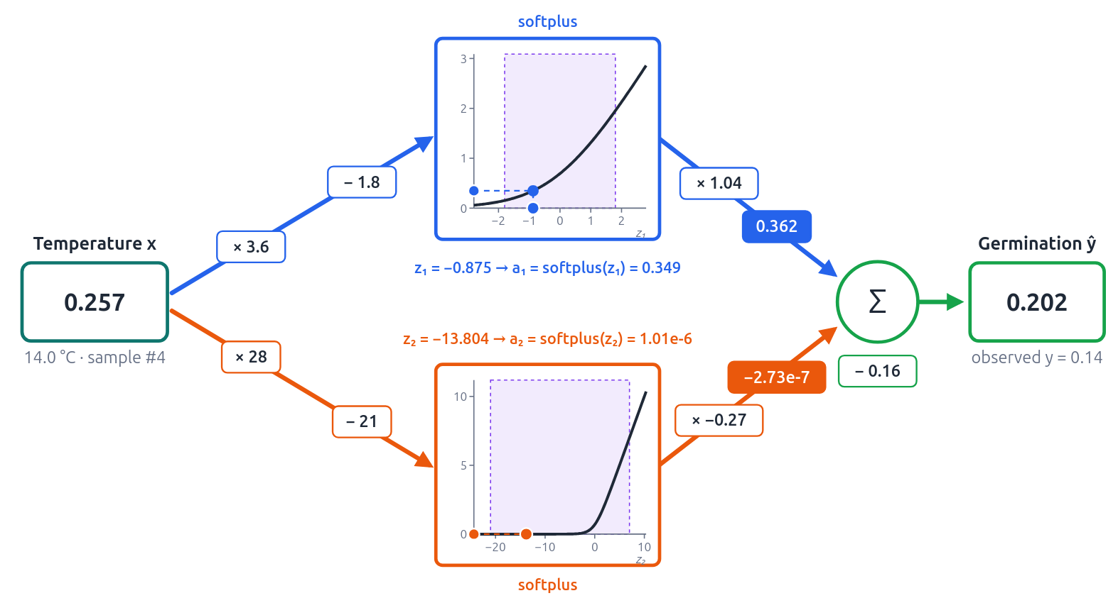
Adding both with their weights

Slide 69
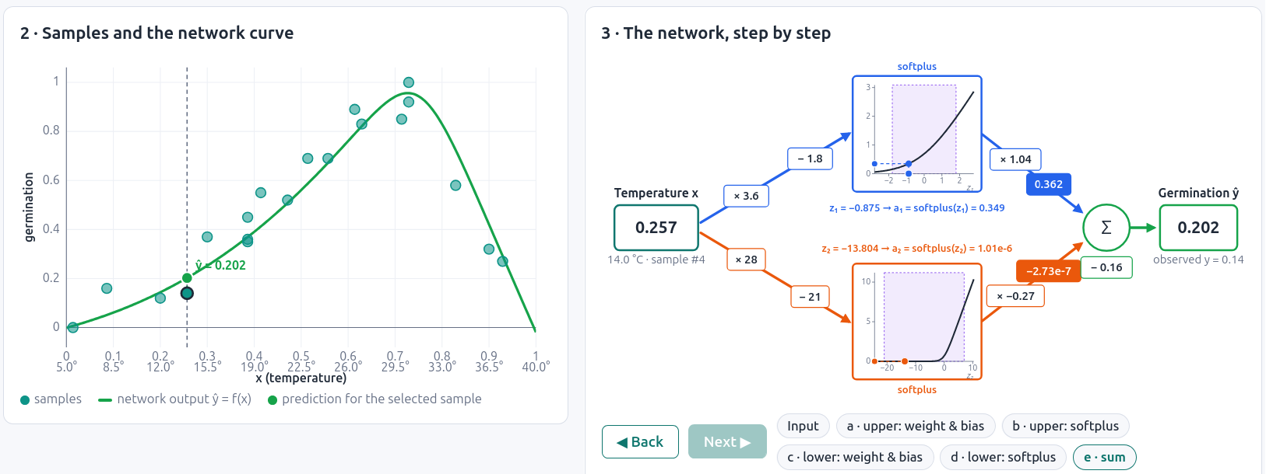
Side by Side

Slide 70
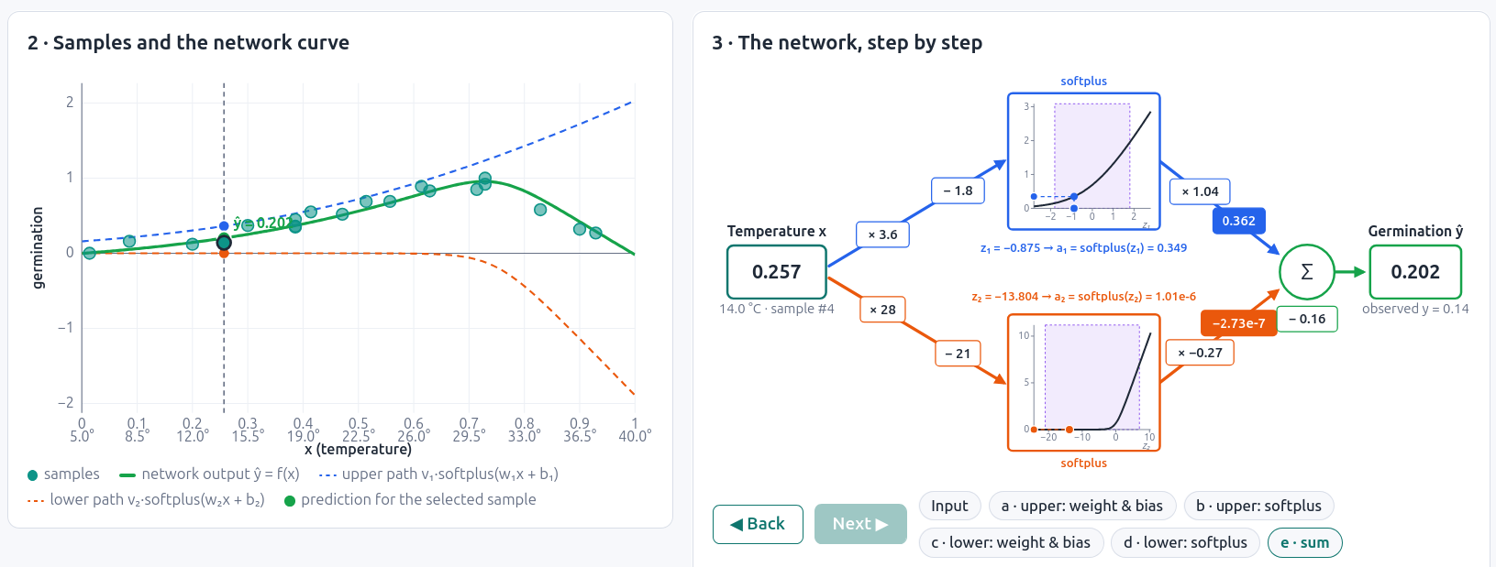
Curves Contribution

Slide 71
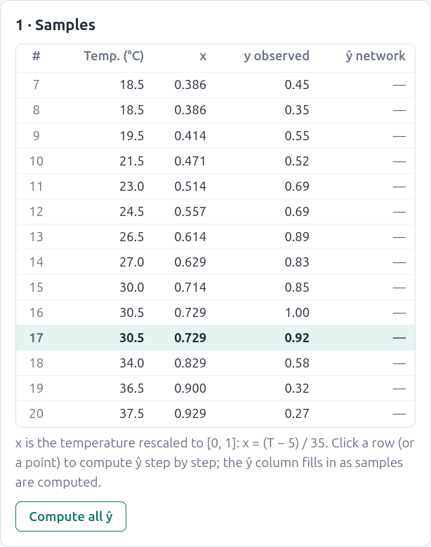
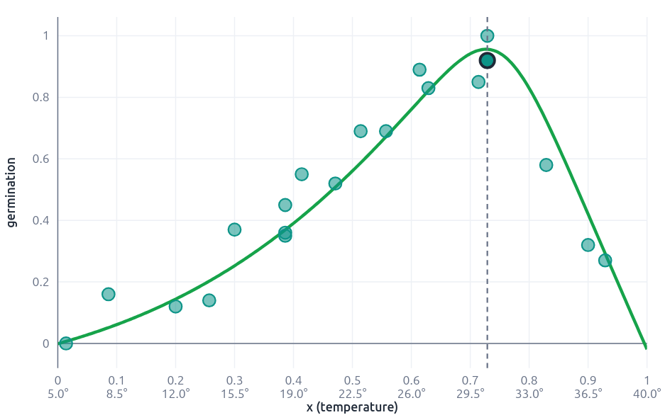
Selecting a Sample

Slide 72
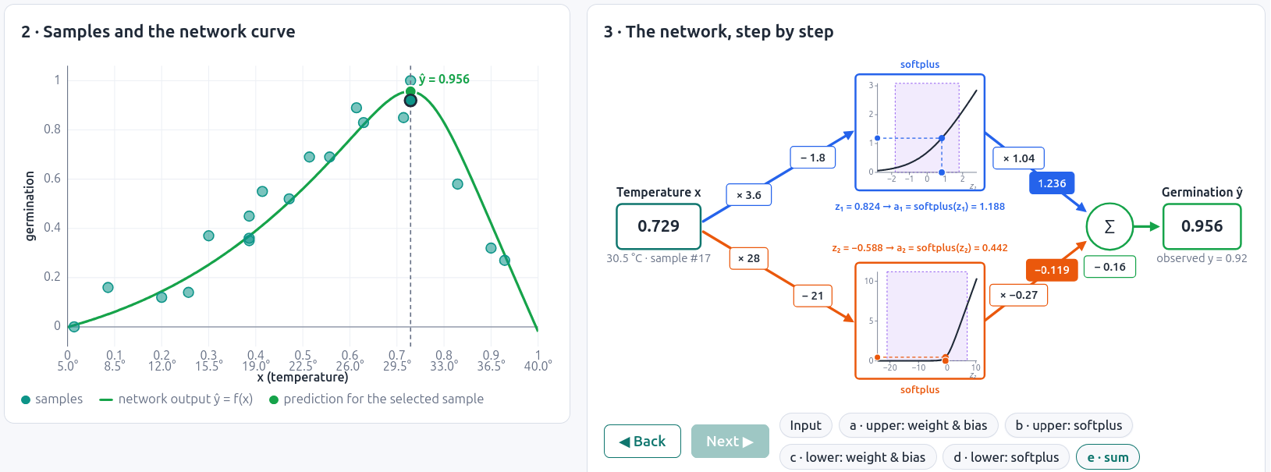
Network Perspective

Slide 73

Activation Functions

Slide 74

Feedforward Neural Networks
Can also be called multi-layer perceptrons (or MLPs) for historical reasons
(Jurafsky, 2026)
Notes:
A feedforward network is a multilayer network in which the units are connected with no cycles; the outputs from units in each layer are passed to units in the next higher layer, and no outputs are passed back to lower layers.
For historical reasons feed-forward netowrks can also be called multi-layer perceptrons or MLPs (although they aren't technically composed of perceptrons any more).
Simple feedforward networks have three kinds of nodes: input units, hidden units, and output units.

Slide 75
Returning to the Neural Network Unit
x₀=1
w₀
x₁
w₁
Z
f
y
w₂
x₂
w_{n}
x_{n}

Slide 76

Binary Logistic Regression as a 1-layer Network
(we don't count the input layer in counting layers!)
input layer
(vector x)
output layer
(σ node)
x₀=1
w₀
x₁
w₁
σ
y
w₂
x₂
y is a scalar
w_{n}
x_{n}
w is a vector
adapted from (Jurafsky, 2026)

Slide 77
Binary Logistic Regression as a 1-layer Network
(we don't count the input layer in counting layers!)
input layer
(vector x)
output layer
(σ node)
W is a vector
x₀=1
w₀
x₁
w₁
S
w₂
x₂
w_{n}
x_{n}
y is a scalar
adapted from (Jurafsky, 2026)

Slide 78

Multinomial Logistic Regression as a 1-layer Network
input layer
(vector x)
output layer
(softmax nodes)
W is a matrix
x₀=1
S
x₁
S
x₂
S
x_{n}
y is a vector
adapted from (Jurafsky, 2026)

Slide 79

Softmax Function
One component:
Proportion of the component relative to the vector.
Notes:
softmax(z_i)=\frac{e^{z_i}}{\sum_{j=1}^ke^{z_j}}

Slide 80


Softmax Function
Reminder: softmax: a generalization of sigmoid
(Jurafsky, 2026)
For a vector z of dimensionality k, the softmax is:
Example:
z = [0.6, 1.1, -1.5, 1.2, 3.2, -1.1]
softmax(z) = [0.055, 0.090, 0.006, 0.099, 0.74, 0.010]
Notes:
softmax(z)=\left[ \frac{e^{z_1}}{\sum_{j=1}^ke^{z_j}}, \frac{e^{z_2}}{\sum_{j=1}^ke^{z_j}}, ..., \frac{e^{z_n}}{\sum_{j=1}^ke^{z_j}} \right]
softmax(z_i)=\frac{e^{z_i}}{\sum_{j=1}^ke^{z_j}} \ \ 1 \le i \le k

Slide 81


Two-Layer Network with scalar output
input layer
(vector x)
hidden units
(σ nodes)
output layer
(σ node)
W
x₀=1
U
σ
x₁
σ
σ
x₂
σ
x_{n}
adapted from (Jurafsky, 2026)
could be a ReLU or tanh
Notes:
We're showing the activation function here as sigma, but it can be the sigmoid, tanh, or ReLU activation function we defined earlier.
Notice that we’re applying the σ function here to a vector, allowing σ(·), to apply to a vector element-wise, so g[z1,z2,z3] = [g(z1),g(z2),g(z3)].
As we saw in the lecture on XOR, the resulting value h (for hidden) forms a representation of the input. The role of the output layer is to take this new representation h and compute a final output. This output could be a real- valued number, but in many cases the goal of the network is to make some sort of classification decision, and so we will focus on the case of classification.
If we are doing a binary task like sentiment classification, we might have a single output node, and its value y is the probability of positive versus negative sentiment.
The output layer has a weight matrix U, but some models don’t include a bias vector b in the output layer, so we’ll simplify by eliminating the bias vector in this example. The weight matrix is multiplied by its input vector (h) to produce the intermediate output z.
z=Uh
And then we use the sigmoid to turn this into a probability.

Slide 82

Two-Layer Network with scalar output
input layer
(vector x)
hidden units
(σ nodes)
output layer
(σ nodes)
W
x₀=1
U
σ
σ
x₁
σ
x₂
σ
σ
x_{n}
adapted from (Jurafsky, 2026)
could be a ReLU or tanh
Notes:
We're showing the activation function here as sigma, but it can be the sigmoid, tanh, or ReLU activation function we defined earlier.
Notice that we’re applying the σ function here to a vector, allowing σ(·), to apply to a vector element-wise, so g[z1,z2,z3] = [g(z1),g(z2),g(z3)].
As we saw in the lecture on XOR, the resulting value h (for hidden) forms a representation of the input. The role of the output layer is to take this new representation h and compute a final output. This output could be a real- valued number, but in many cases the goal of the network is to make some sort of classification decision, and so we will focus on the case of classification.
If we are doing a binary task like sentiment classification, we might have a single output node, and its value y is the probability of positive versus negative sentiment.
The output layer has a weight matrix U, but some models don’t include a bias vector b in the output layer, so we’ll simplify by eliminating the bias vector in this example. The weight matrix is multiplied by its input vector (h) to produce the intermediate output z.
z=Uh
And then we use the sigmoid to turn this into a probability.

Slide 83


Recognizing Images
https://www.3blue1brown.com/lessons/neural-networks/

Slide 84
Task 5
Putting together everything you have learned, how would you use a multilayer network to classify words?
__________
Combinando tudo o que você aprendeu, como você utilizaria uma rede multicamadas para classificar palavras?

Slide 85
André Santanchè
https://www.ic.unicamp.br/~santanche/

Slide 86
Acknowledgement
Most used activation functions in Neural Networks
AI ML – Artificial Intelligence and Machine Learning https://ai-artificial-intelligence.webyes.com.br/most-used-activation-functions-in-neural-networks/

Slide 87
Acknowledgement
By Nbarth - This vector image includes elements that have been taken or adapted from this file:, CC0, https://commons.wikimedia.org/w/index.php?curid=150411524

Slide 88

Acknowledgement
By BruceBlaus - Own work, CC BY 3.0, https://commons.wikimedia.org/w/index.php?curid=28761830

Slide 89
Acknowledgement
By User:Wiso - from en:Image:Neural network example.svg, vetorialization of en:Image:Neural network example.png, Public Domain, https://commons.wikimedia.org/w/index.php?curid=5084582

Slide 90
Acknowledgement
By Sebastian Raschka - http://sebastianraschka.com/Articles/2014_naive_bayes_1.html, CC BY-SA 4.0, https://commons.wikimedia.org/w/index.php?curid=60535469

Slide 91
Acknowledgement
Scikit Learn
Examples/Classification
Classifier Comparison
https://scikit-learn.org/stable/auto_examples/classification/plot_classifier_comparison.html

Slide 92
Licença
Estes slides são concedidos sob uma Licença Creative Commons. Sob as seguintes condições: Atribuição, Uso Não-Comercial e Compartilhamento pela mesma Licença.
Mais detalhes sobre a referida licença Creative Commons veja no link:
http://creativecommons.org/licenses/by-nc-sa/3.0/

