Slide 1
NATURAL LANGUAGE PROCESSING
Neural Networks for NLP
Learning
André Santanchè
Laboratory of Information Systems - LIS
Instituto de Computação - UNICAMP
October 2026

Slide 2
Logistic Regression
Revision

Slide 3
Classification
Summary
Model
Classification Function
Feature Representation
Optimization
Algorithm
Objective Function

Slide 4
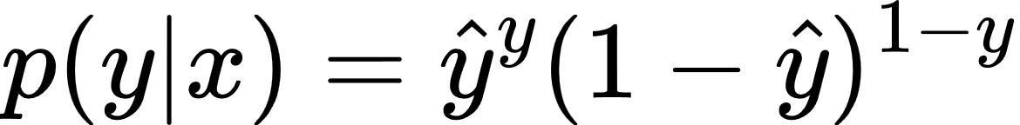
Label Probability
(Bernoulli Probability Mass Function - PMF)
Notes:
p(y|x) = \hat{y}^y(1-\hat{y})^{1-y}

Slide 5
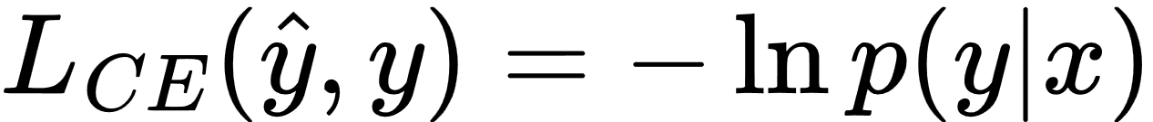
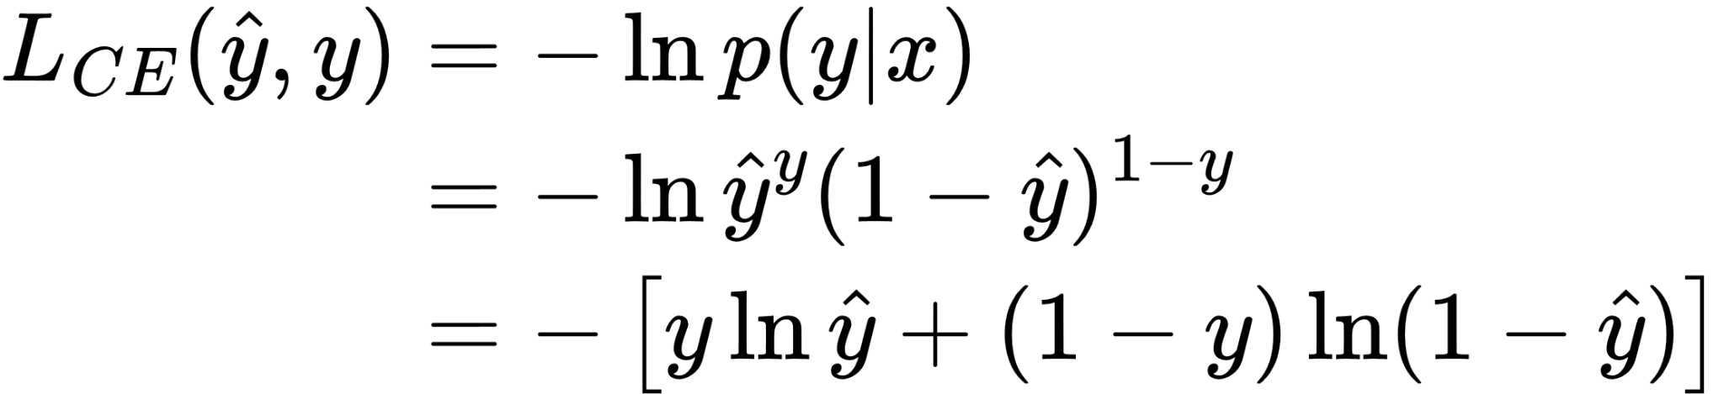
Probability becomes Cross-Entropy Loss
Notes:
L_{CE}(\hat{y},y) = -\ln{p(y|x)}
\begin{align*}
L_{CE}(\hat{y},y) &= -\ln{p(y|x)}
\\
&= -\ln\hat{y}^y(1-\hat{y})^{1-y}
\\
&= - \left[ y \ln\hat{y} + (1 - y) \ln(1 - \hat{y}) \right]
\end{align*}

Slide 6
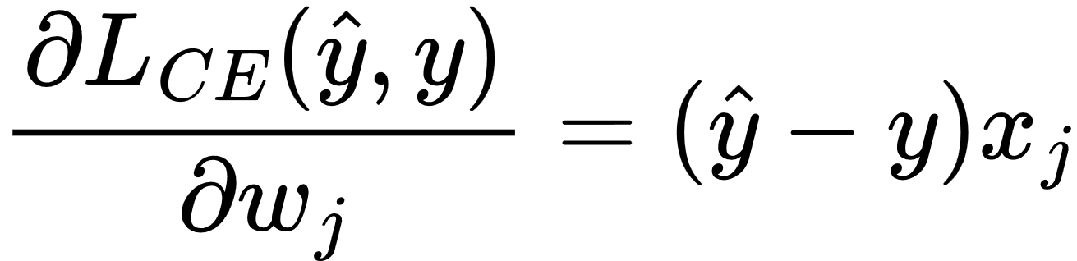
Loss Slope as Derivative
Notes:
\frac{\partial L_{CE}(\hat{y},y)}{\partial w_j} = (\hat{y} - y) x_j

Slide 7
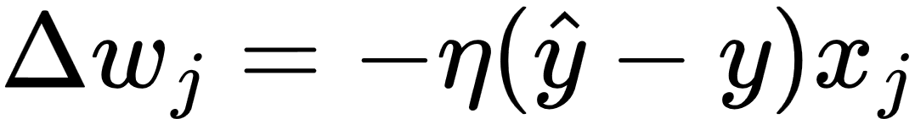
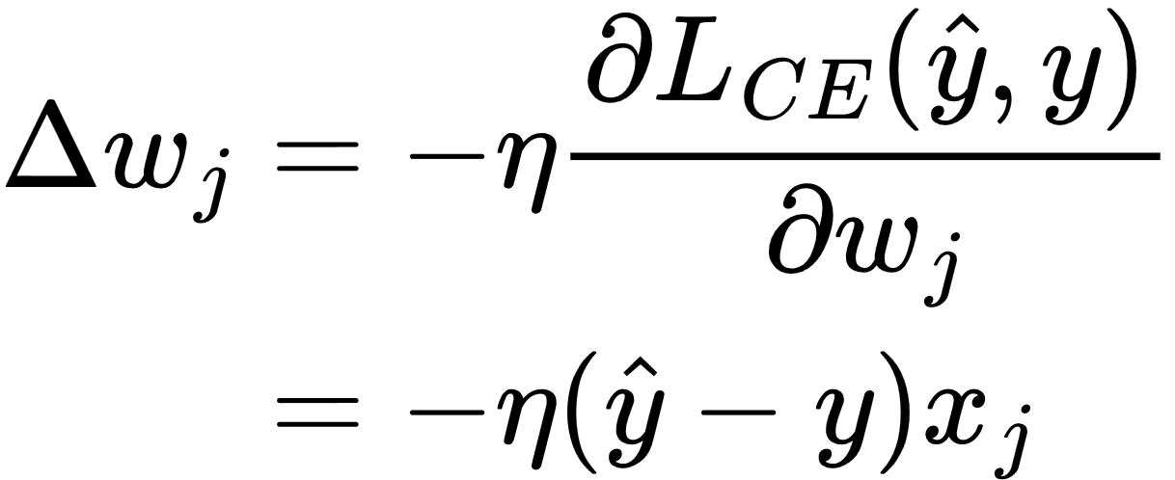
Decent: opposite direction to the slope with a learning rate η
Notes:
\Delta w_j = -\eta (\hat{y} - y) x_j
\begin{align*}
\Delta w_j &= -\eta \frac{\partial L_{CE}(\hat{y},y)}{\partial w_j}
\\
&= -\eta (\hat{y} - y) x_j
\end{align*}

Slide 8
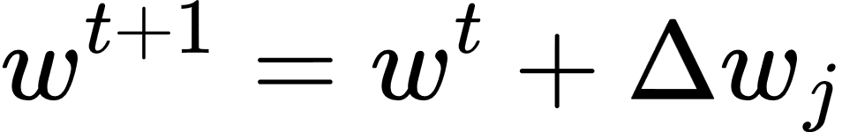
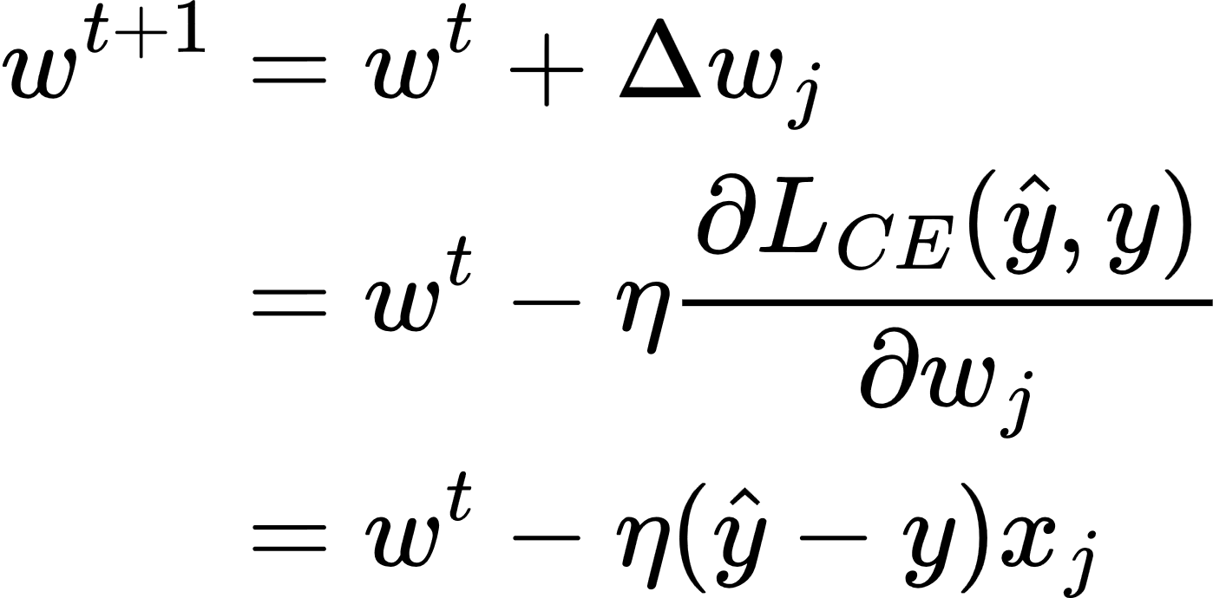
Learning: updating weights with the descent
Notes:
\Delta w_j = -\eta (\hat{y} - y) x_j
w^{t+1} = w^t + \Delta w_j
\begin{align*}
w^{t+1} &= w^t + \Delta w_j
\\
&= w^t-\eta \frac{\partial L_{CE}(\hat{y},y)}{\partial w_j}
\\
&= w^t - \eta (\hat{y} - y) x_j
\end{align*}

Slide 9
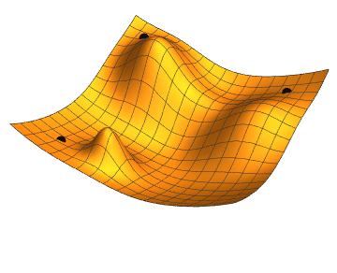
Gradient Descent

Slide 10
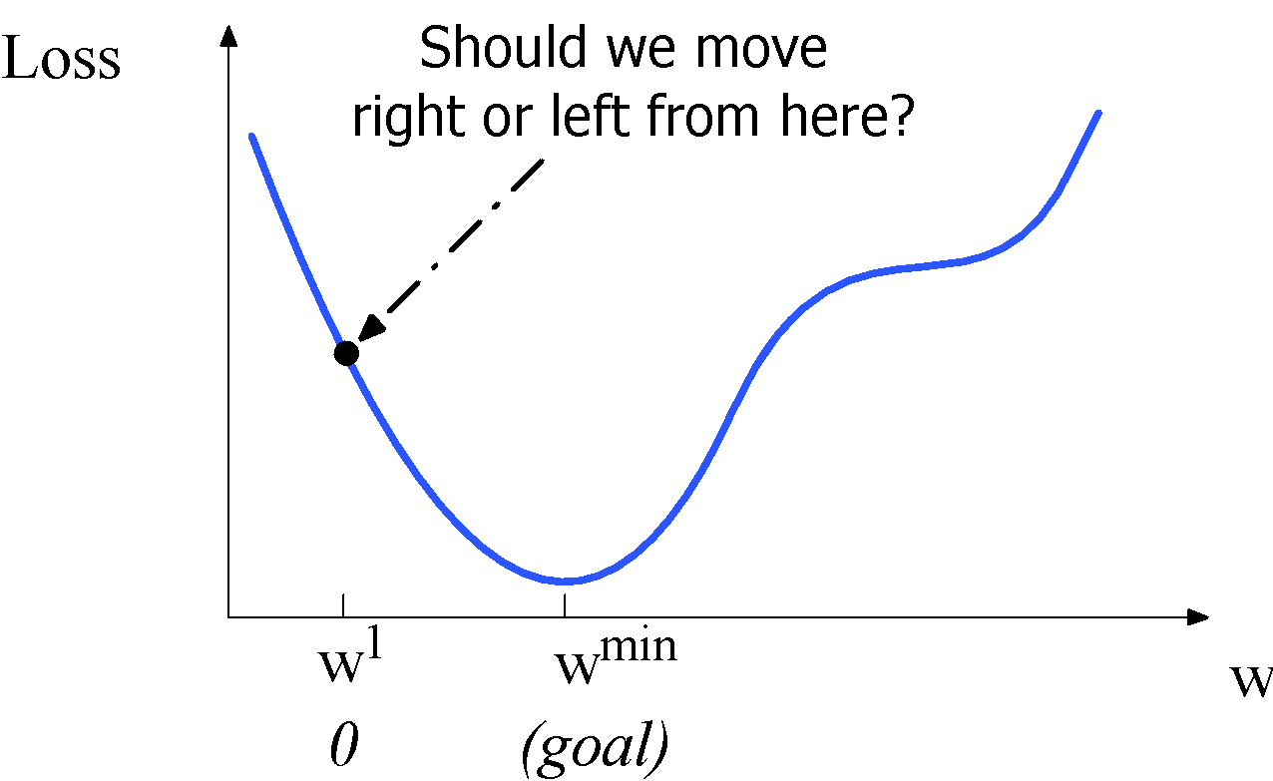
Let's first visualize for a single scalar w
(Jurafsky, 2026)
Notes:
Although the algorithm (and the concept of gradient) are designed for direction vectors, let’s first consider a visualization of the case where the parameter of our system is just a single scalar w. Given a random initialization of w at some value w1, and assuming the loss function L happened to have this shape, we need the algorithm to tell us whether at the next iteration we should move left (making w2 smaller than w1) or right (making w2 bigger than w1) to reach the minimum. The gradient descent algorithm answers this question by finding the gradient of the loss function at the current point and moving in the opposite direction.

Slide 11
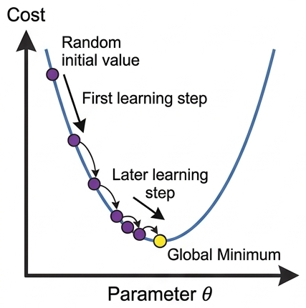
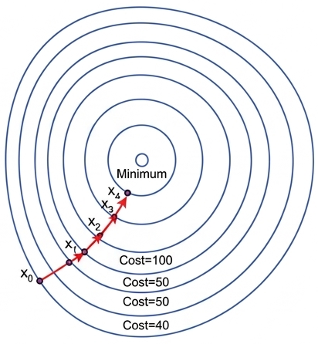
Gradient Descent
by Gemini

Slide 12
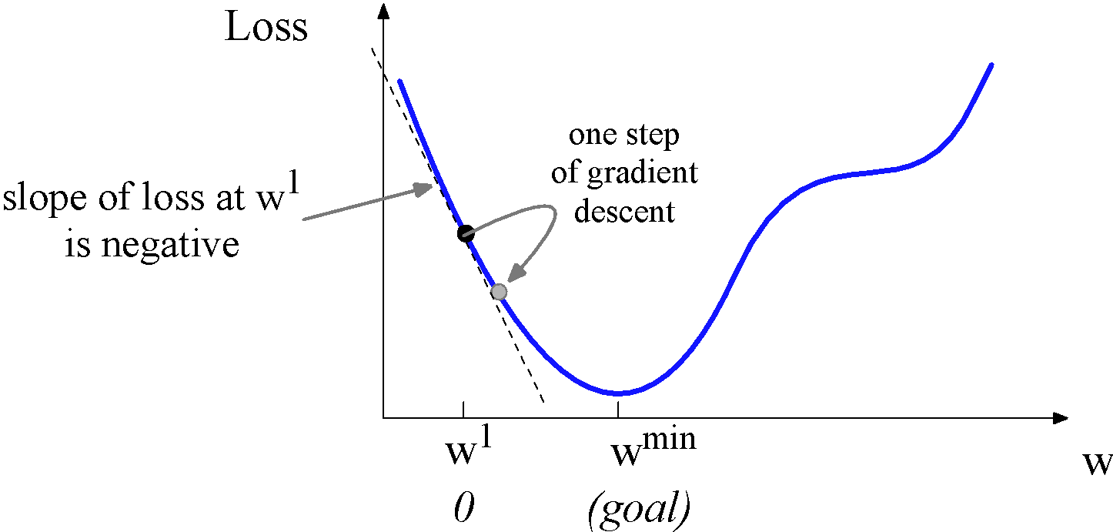
Let's first visualize for a single scalar w
  So we'll move positive
(Jurafsky, 2026)
Notes:
Thus to find the minimum, gradient descent tells us to go in the opposite direction: moving w in a positive direction.

Slide 13
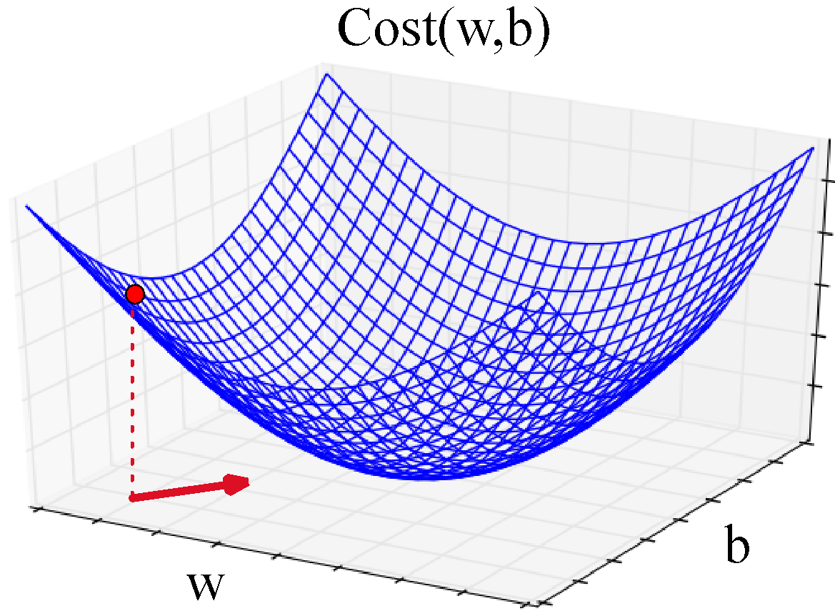
Imagine 2 dimensions, w and b
(Jurafsky, 2026)
Visualizing the gradient vector at the red point
It has two dimensions shown in the x-y plane
Notes:
If we’re just imagining two weight dimensions (say for one weight w and one bias b), the gradient might be a vector with two orthogonal components, each of which tells us how much the ground slopes in the w dimension and in the b dimension. This figure shows a visualization of the value of a 2-dimensional gradient vector taken at the red point.

Slide 14
[5,10,2]
10
2
5

Slide 15
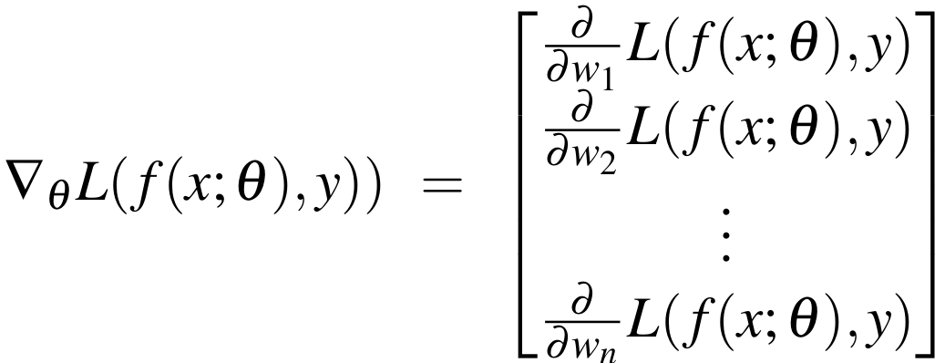

The gradient
(Jurafsky, 2026)
We’ll represent ŷ as f (x; θ) to make the dependence of θ more obvious:
The final equation for updating θ based on the gradient is thus
Notes:
Here's a vector of gradients. We’ll represent yˆ as f (x; θ ) to make the dependence on θ more obvious:

Slide 16
Computation Graphs
f(x)=-x²
x
v=x²
u=-v

Slide 17
Why Computation Graphs
For training, we need the derivative of the loss with respect to each weight in every layer of the network
But the loss is computed only at the very end of the network!
Solution: error backpropagation (Rumelhart, Hinton, Williams, 1986)
Backprop is a special case of backward differentiation
Which relies on computation graphs.
(Jurafsky, 2026)
Notes:
For training a neural network with gradient descent, we need the relevant gradients for each weight: the derivative of the loss with respect to each weight in every layer of the network.
But the loss is computed only at the very end of the network. How do we find these gradients for weights in the early layers?
The solution is a method called error backpropagation, or backprop in the neural network world. It turns out that backprop is a special case of backward differentiation, a method that relies on computation graphs.

Slide 18
Computation Graphs
A computation graph represents the process of computing a mathematical expression
(Jurafsky, 2026)
Notes:
A computation graph is a representation of the process of computing a mathematical expression, in which the computation is broken down into separate operations, each of which is modeled as a node in a graph.

Slide 19
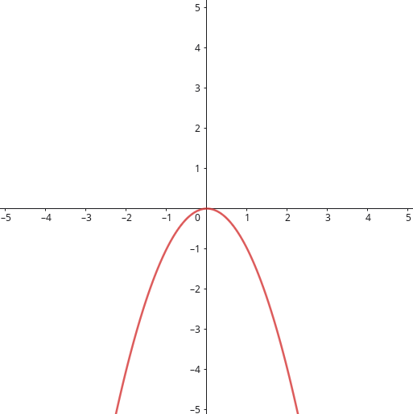
Function
f(x)=-x²

Slide 20
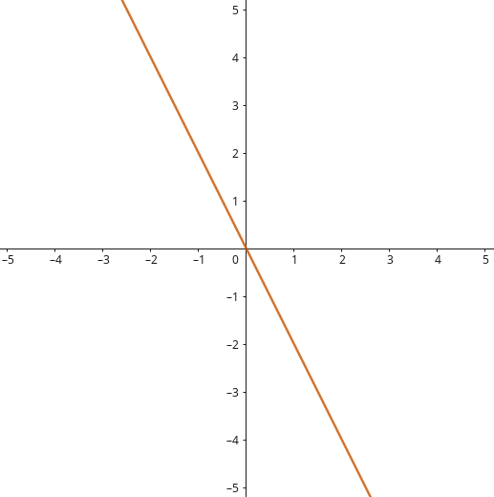
Derivative
df
—-=-2x
dx
f(x)=-x²

Slide 21
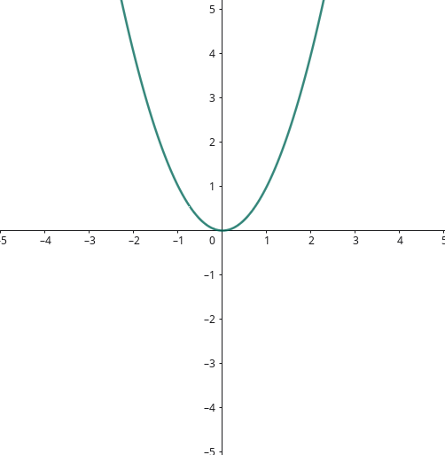
Functions
v(x) = x²
u(y) = -y
f(x) = u(v(x))

Slide 22
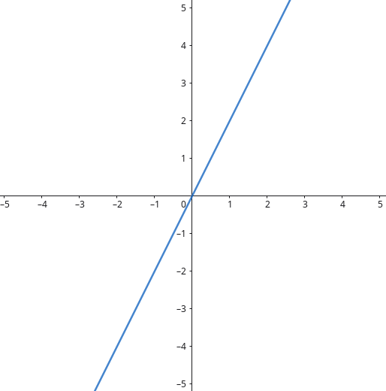
Derivatives
dv
—- = 2x
dx
v(x) = x²
du
—- = -1
dy
u(y) = -y
f(x) = u(v(x))
df du dv
—- = —- . —- = -1.2.x = -2.x
dx dv dx

Slide 23
Computation Graph
dv
—- = 2x
dx
df du dv
—- = —- . —- = -1.2.a = -2.a
dx dv dx
v(x) = x²
f(x) = u(v(x))
du
—- = -1
dy
u(y) = -y
x
v=x²
u=-v

Slide 24
Forward Pass
dv
—- = 2x
dx
df du dv
—- = —- . —- = -1.2.a = -2.a
dx dv dx
v(x) = x²
f(x) = u(v(x))
du
—- = -1
dy
u(y) = -y
x=2
x
v=x²
u=-v

Slide 25
Forward Pass
dv
—- = 2x
dx
df du dv
—- = —- . —- = -1.2.a = -2.a
dx dv dx
v(x) = x²
f(x) = u(v(x))
du
—- = -1
dy
u(y) = -y
x=2
v=4
x
v=x²
u=-v

Slide 26
Forward Pass
dv
—- = 2x
dx
df du dv
—- = —- . —- = -1.2.a = -2.a
dx dv dx
v(x) = x²
f(x) = u(v(x))
du
—- = -1
dy
u(y) = -y
x=2
v=4
u=-4
x
v=x²
u=-v

Slide 27
Backward Pass
dv
—- = 2x
dx
df du dv
—- = —- . —- = -1.2.a = -2.a
dx dv dx
v(x) = x²
f(x) = u(v(x))
du
—- = -1
dy
u(y) = -y
x=2
v=4
u=-4
x
v=x²
u=-v
du
—-=1
du

Slide 28
Backward Pass
dv
—- = 2x
dx
df du dv
—- = —- . —- = -1.2.a = -2.a
dx dv dx
v(x) = x²
f(x) = u(v(x))
du
—- = -1
dy
u(y) = -y
x=2
v=4
u=-4
x
v=x²
u=-v
du
—-=-1
dv
du
—-=1
du

Slide 29
Backward Pass
dv
—- = 2x
dx
df du dv
—- = —- . —- = -1.2.a = -2.a
dx dv dx
v(x) = x²
f(x) = u(v(x))
du
—- = -1
dy
u(y) = -y
x=2
v=4
u=-4
x
v=x²
u=-v
du
—-=-1
dv
du
—-=-1
dv
du
—-=1
du

Slide 30
Backward Pass
dv
—- = 2x
dx
df du dv
—- = —- . —- = -1.2.a = -2.a
dx dv dx
v(x) = x²
f(x) = u(v(x))
du
—- = -1
dy
u(y) = -y
x=2
v=4
u=-4
x
v=x²
u=-v
dv
—-=4
dx
du
—-=-1
dv
du
—-=-1
dv
du
—-=1
du

Slide 31
Backward Pass
dv
—- = 2x
dx
df du dv
—- = —- . —- = -1.2.a = -2.a
dx dv dx
v(x) = x²
f(x) = u(v(x))
du
—- = -1
dy
u(y) = -y
x=2
v=4
u=-4
x
v=x²
u=-v
dv
—-=4
dx
du
—-=-1
dv
du
—-=-4
dx
du
—-=-1
dv
du
—-=1
du

Slide 32
Computation Graphs
more complex example

Slide 33

Task 1
Produce the computation graph for:

Slide 34
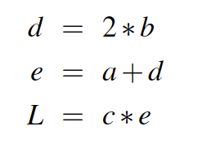
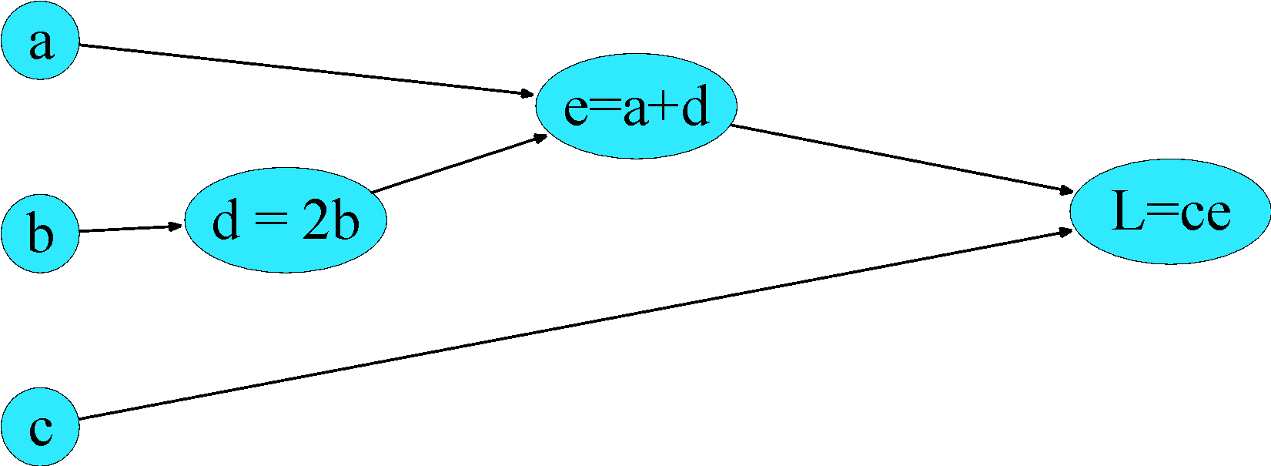
Example:
(Jurafsky, 2026)
Computations:
Notes:
Consider computing the function L(a, b, c) = c(a + 2b). If we make each of the component addition and multiplication operations explicit, and add names (d and e) for the intermediate outputs, the resulting series of computations is:
D=2*b
E=a+d
L=c*e
We can now represent this as a graph, with nodes for each operation, and directed edges showing the outputs from each operation as the inputs to the next.. The simplest use of computation graphs is to compute the value of the function with some given inputs. Lets assume the inputs a = 3, b = 1, c = −2,
We can walk forward and compute a value for d, and then a value for e, and then a value for C

Slide 35
Task 2
Compute the forward pass considering: a=3, b=1, and c=-2.

Slide 36
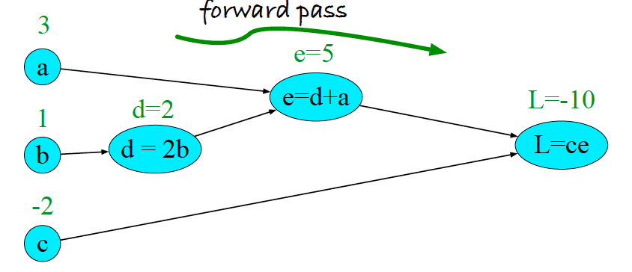
Example:
(Jurafsky, 2026)
Computations:
Notes:
Here it is without my messy handwriting.

Slide 37
Backwards differentiation in computation graphs
The importance of the computation graph comes from the backward pass
This is used to compute the derivatives that we’ll need for the weight update.
(Jurafsky, 2026)
Notes:
The importance of the computation graph comes from the backward pass, which is used to compute the derivatives that we’ll need for the weight update.

Slide 38
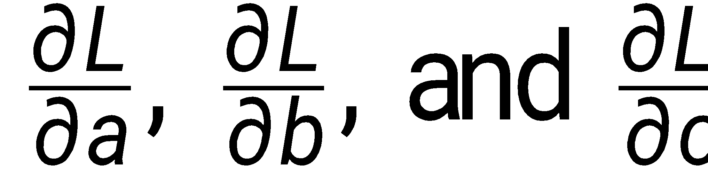
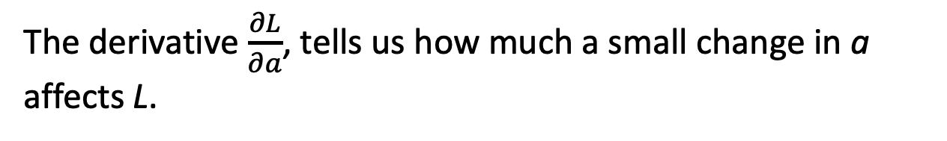
Example
(Jurafsky, 2026)
We want:
Notes:
In this example our goal is to compute the derivative of the output function L with respect to each of the input variables, i.e., ∂L /∂a, ∂L /∂b, and ∂L/∂c . The derivative ∂L/∂a tells us how much a small change in a affects L, while holding the others constant"

Slide 39
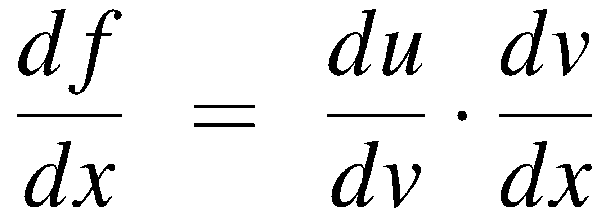
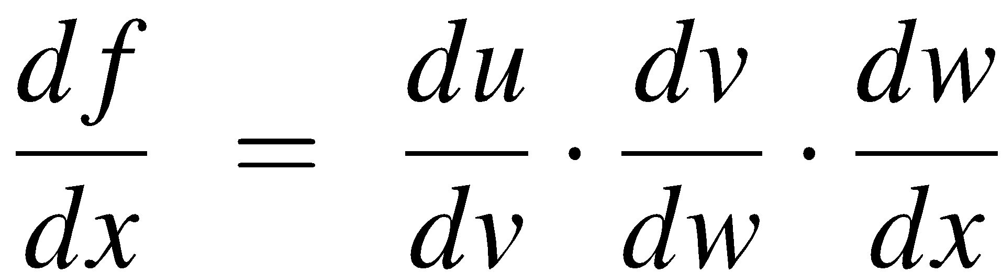
The chain rule
(Jurafsky, 2026)
Computing the derivative of a composite function:
f (x) = u(v(x))
f (x) = u(v(w(x)))
Notes:
Consider a composite function f(x) = u(v(x)). CLICK. The derivative of f (x) is the derivative of u(x) with respect to v(x) times the derivative of v(x) with respect to x
The chain rule extends to more than two functions. If computing the derivative of a composite function f (x) = u(v(w(x))), the derivative of f (x) is:

Slide 40
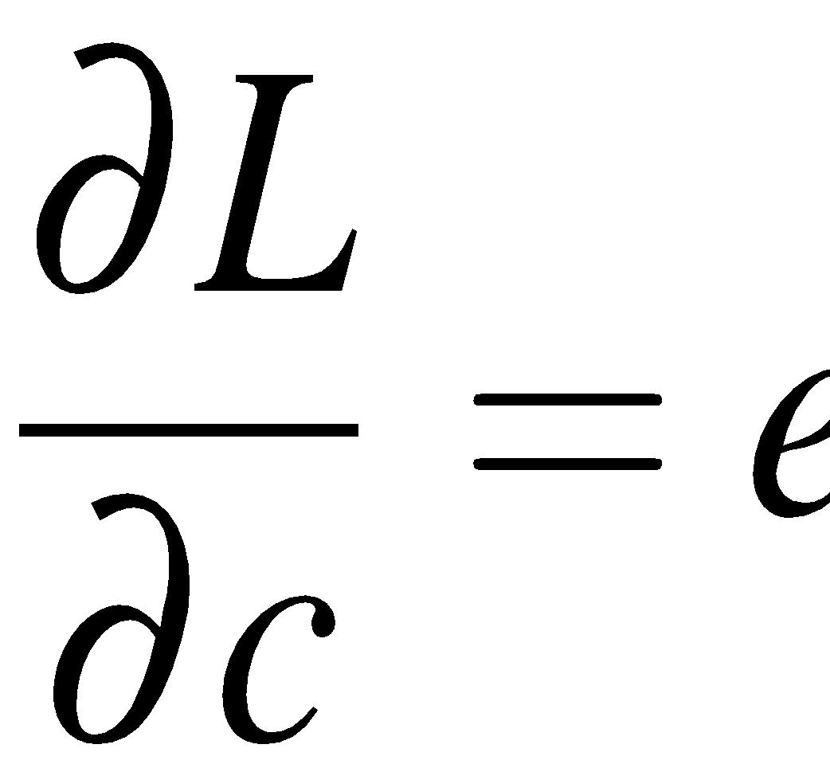

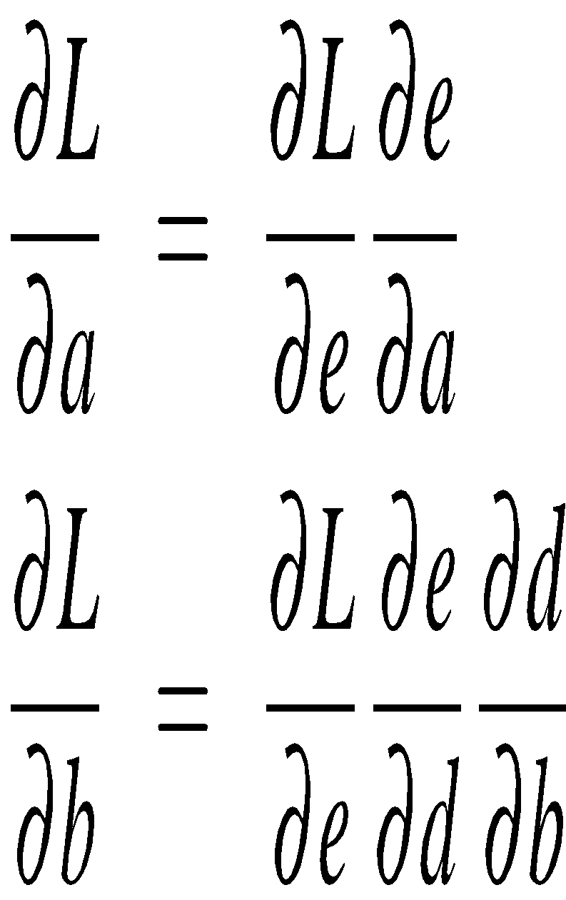
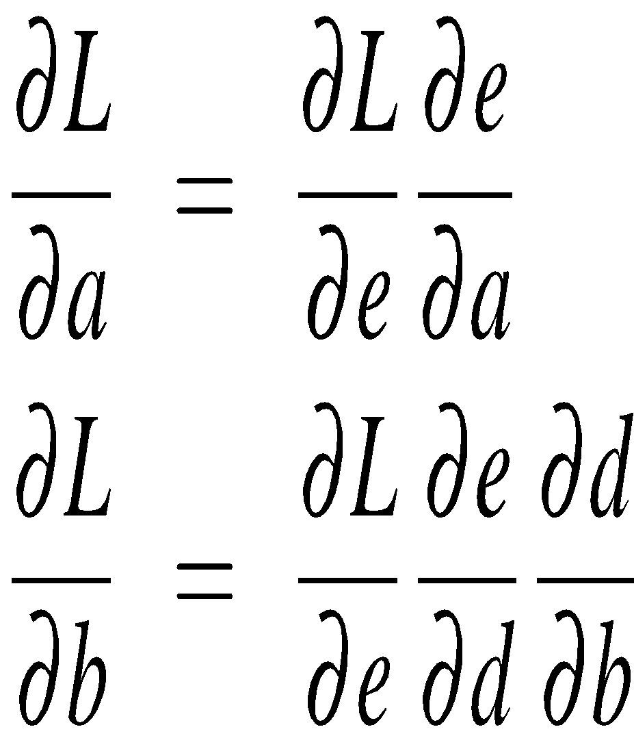
Example
(Jurafsky, 2026)
Notes:
Let’s now compute the 3 derivatives we need. Since in the computation graph L = ce, we can directly compute the derivative ∂ L /∂c: it will be e.
For the other two, we'll need to use the chain rule

Slide 41
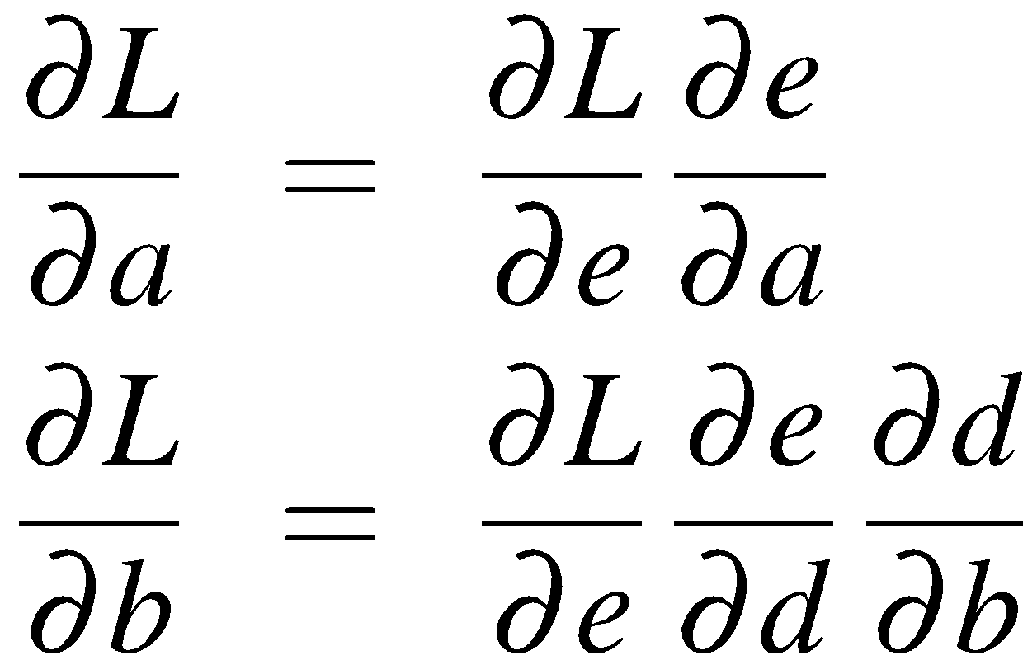
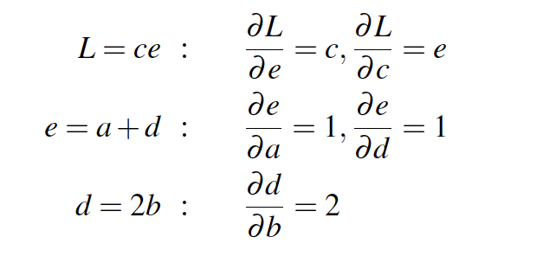
Example
(Jurafsky, 2026)
Notes:
Those equations, we've put them here on the top, thus require five intermediate derivatives: ∂L/∂e , ∂L/∂c , ∂e/∂a , ∂e/∂d , and ∂d/∂b , which are as follows (making use of the fact that the derivative of a sum is the sum
of the derivatives):

Slide 42
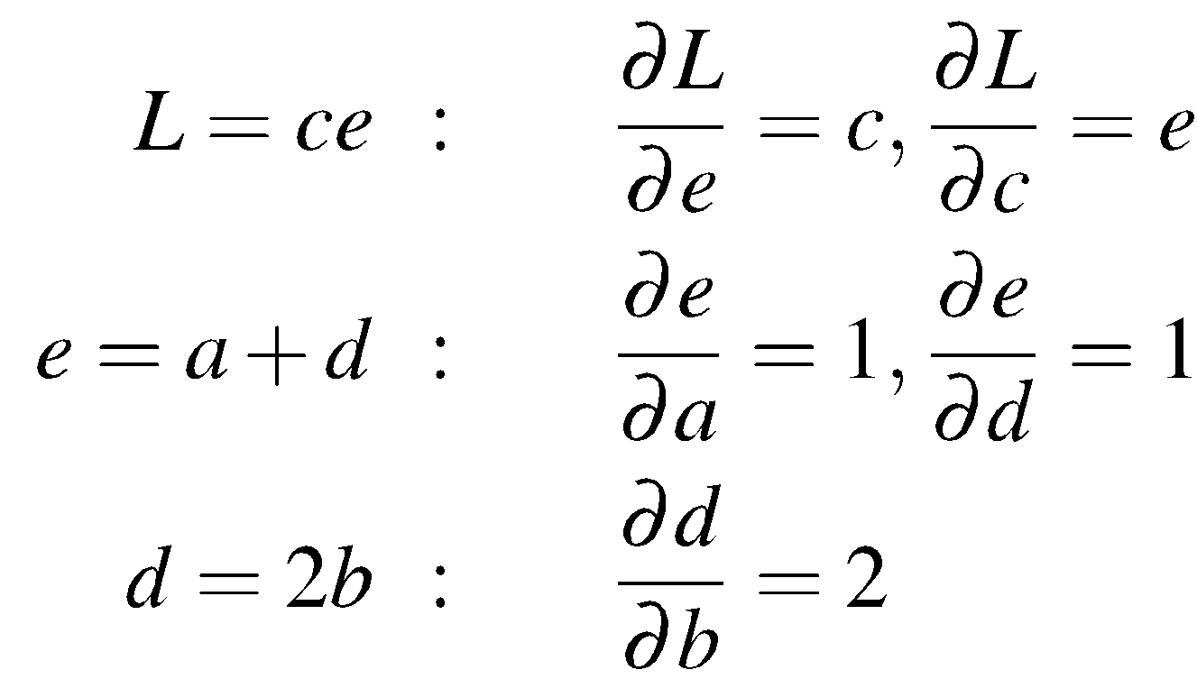
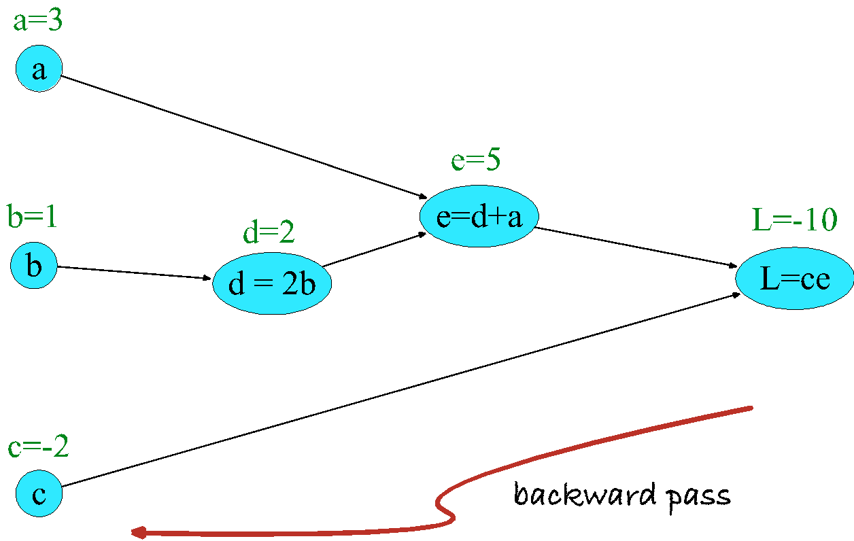
Example
(Jurafsky, 2026)
Notes:
In the backward pass, we compute each of these partials along each edge of the graph
from right to left, multiplying the necessary partials to result in the final derivative
we need. Thus we begin by annotating the final node with ∂ L/∂L = 1. Moving to the
left, we then compute ∂ L/ ∂c and ∂L/∂e , and so on, until we have annotated the graph all the way to the input variables. The forward pass conveniently already will have computed the values of the forward intermediate variables we need (like d and e) to compute these derivatives.

Slide 43
Task 3
Compute the backward pass for the graph:

Slide 44
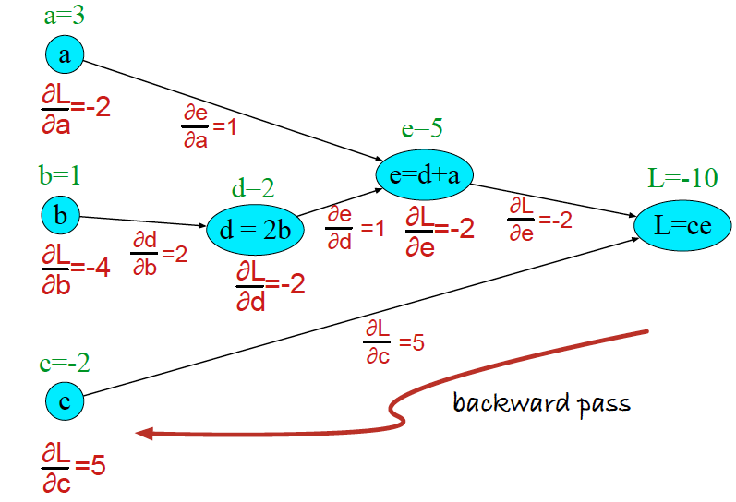
Example
(Jurafsky, 2026)
Notes:
n the backward pass, we compute each of these partials along each edge of the graph
from right to left, multiplying the necessary partials to result in the final derivative
we need.
At each node we need to compute the local partial derivative with respect to the parent, multiply it by the partial derivative that is being passed down from the parent, and then pass it to the child.
Thus we begin by annotating the final node with ∂ L/∂L = 1. Moving to the
left, we then compute ∂ L/ ∂c and ∂L/∂e , and so on, until we have annotated the graph all the way to the input variables. The forward pass conveniently already will have computed the values of the forward intermediate variables we need (like d and e) to compute these derivatives.

Slide 45
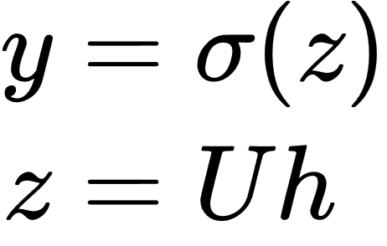
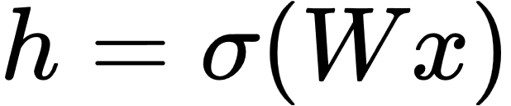
Two-Layer Network with scalar output
hidden units
(σ nodes)
input layer
(vector x)
output layer
(σ node)
h₀=1
x₀=1
σ₁
x₁
σ₂
σ
x₂
σ₃
x_{n}
adapted from (Jurafsky, 2026)
could be a ReLU or tanh
Notes:
We're showing the activation function here as sigma, but it can be the sigmoid, tanh, or ReLU activation function we defined earlier.
Notice that we’re applying the σ function here to a vector, allowing σ(·), to apply to a vector element-wise, so g[z1,z2,z3] = [g(z1),g(z2),g(z3)].
As we saw in the lecture on XOR, the resulting value h (for hidden) forms a representation of the input. The role of the output layer is to take this new representation h and compute a final output. This output could be a real- valued number, but in many cases the goal of the network is to make some sort of classification decision, and so we will focus on the case of classification.
If we are doing a binary task like sentiment classification, we might have a single output node, and its value y is the probability of positive versus negative sentiment.
The output layer has a weight matrix U, but some models don’t include a bias vector b in the output layer, so we’ll simplify by eliminating the bias vector in this example. The weight matrix is multiplied by its input vector (h) to produce the intermediate output z.
z=Uh
And then we use the sigmoid to turn this into a probability.

Slide 46
Multi-layer Notation
a^{[1]}
a^{[0]}
a^{[2]}
h₀=1
b^{[1]}
b^{[2]}
x₀=1
σ₁
x₁
σ₂
σ
x₂
σ₃
x_{n}
W^{[2]}
W^{[1]}
adapted from (Jurafsky, 2026)

Slide 47
a^{[0]}
a^{[1]}
a^{[0]}
a^{[2]}
h₀=1
b^{[1]}
b^{[2]}
x₀=1
σ₁
x₁
σ₂
σ
x₂
σ₃
x_{n}
W^{[2]}
W^{[1]}
adapted from (Jurafsky, 2026)

Slide 48
a^{[1]}=g^{[1]}(z^{[1]})
z^{[1]}=W^{[1]}a^{[0]}+b^{[1]}
e.g., ReLU
a^{[0]}
a^{[1]}
a^{[0]}
a^{[2]}
h₀=1
b^{[1]}
b^{[2]}
x₀=1
σ₁
x₁
σ₂
σ
x₂
σ₃
x_{n}
W^{[2]}
W^{[1]}
adapted from (Jurafsky, 2026)

Slide 49
a^{[1]}=g^{[1]}(z^{[1]})
z^{[1]}=W^{[1]}a^{[0]}+b^{[1]}
y=a^{[2]}
a^{[2]}=g^{[2]}(z^{[2]})
z^{[2]}=W^{[2]}a^{[1]}+b^{[2]}
e.g., ReLU
a^{[0]}
e.g., sigmoid or sofmax
a^{[1]}
a^{[0]}
a^{[2]}
h₀=1
b^{[1]}
b^{[2]}
x₀=1
σ₁
x₁
σ₂
σ
x₂
σ₃
x_{n}
W^{[2]}
W^{[1]}
adapted from (Jurafsky, 2026)

Slide 50

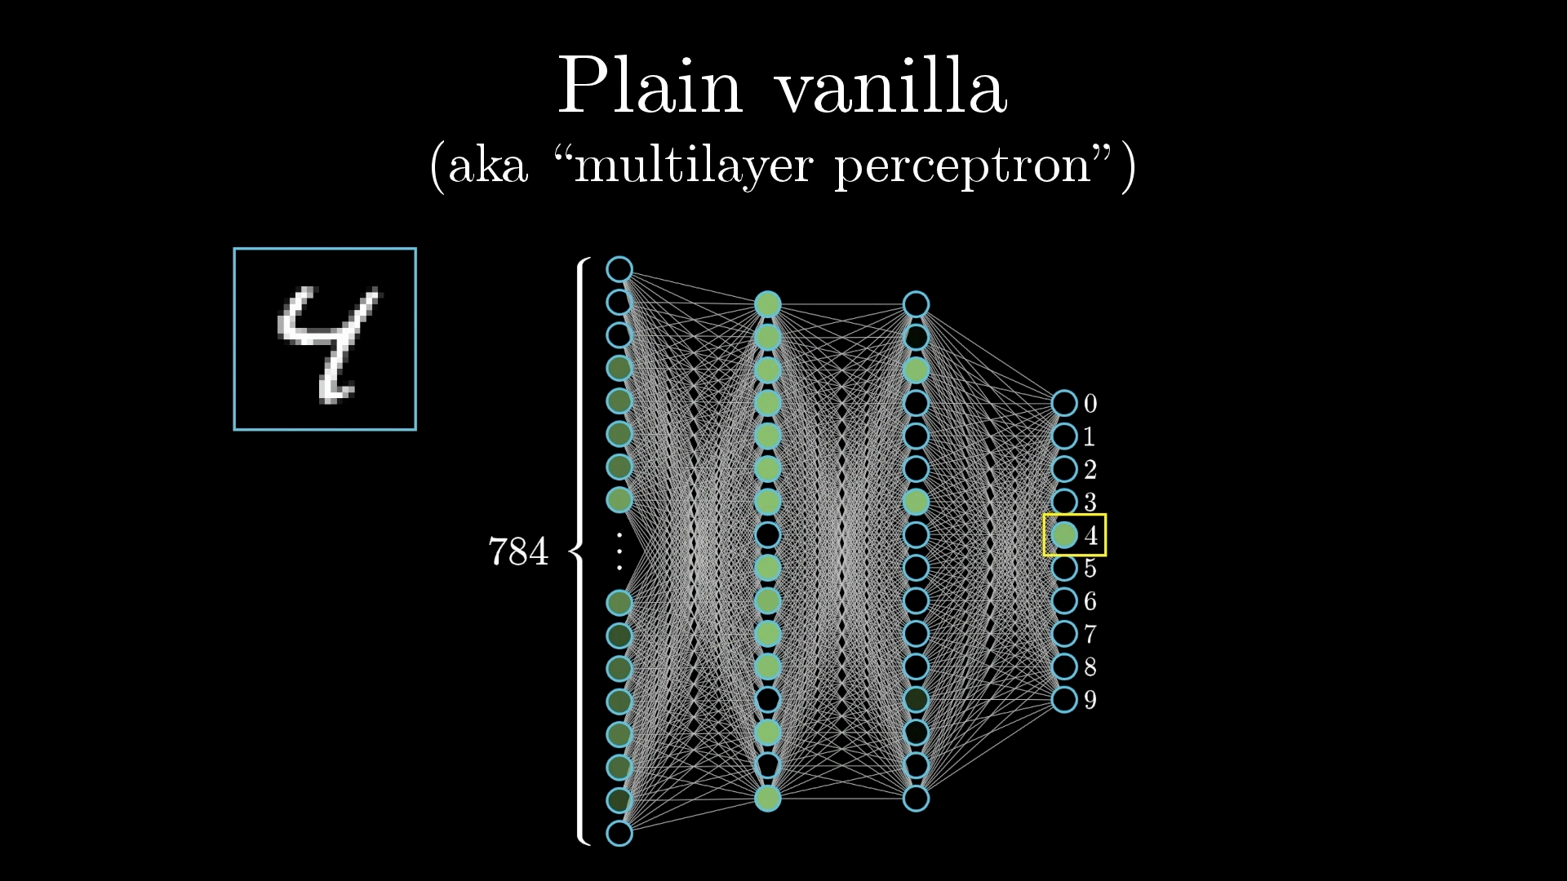
Recognizing Images
https://www.3blue1brown.com/lessons/neural-networks/

Slide 51
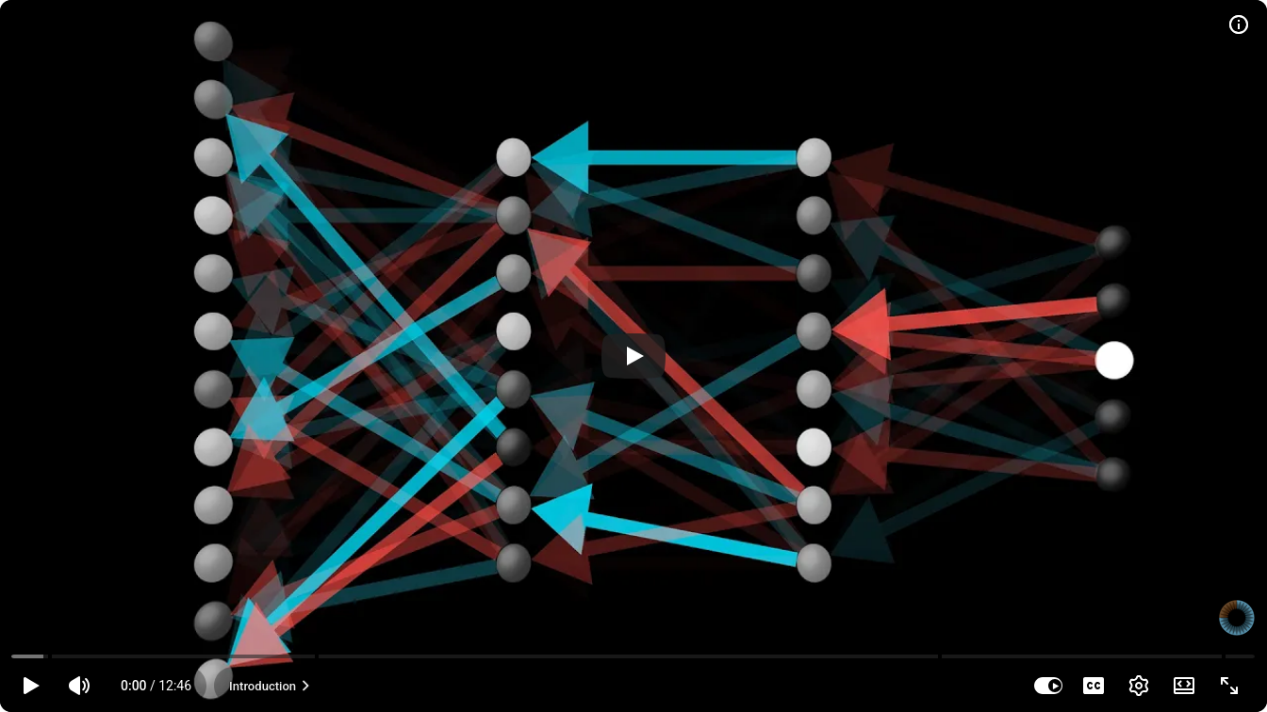
What is backpropagation really doing?
https://www.3blue1brown.com/lessons/backpropagation

Slide 52
Cost vs Loss
Loss Function (or Error Function): Quantifies how wrong a model's prediction is on a single training example.
Cost Function (or Objective Function): Quantifies the average (or total) error across the entire dataset or mini-batch.

Slide 53
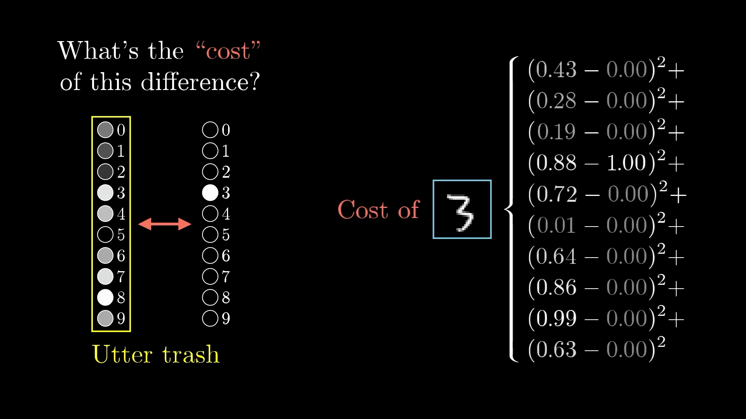
Cost

Slide 54
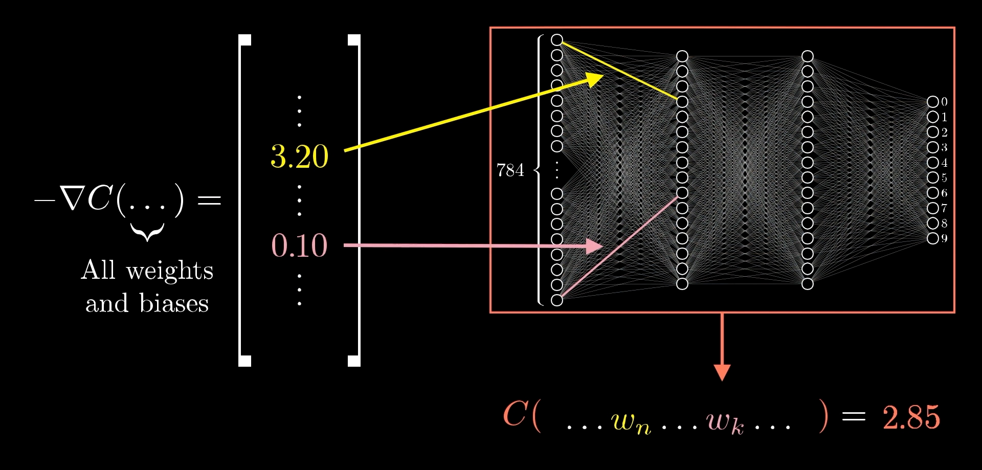
How Weight Affects Cost
see animation: https://www.3blue1brown.com/lessons/backpropagation

Slide 55
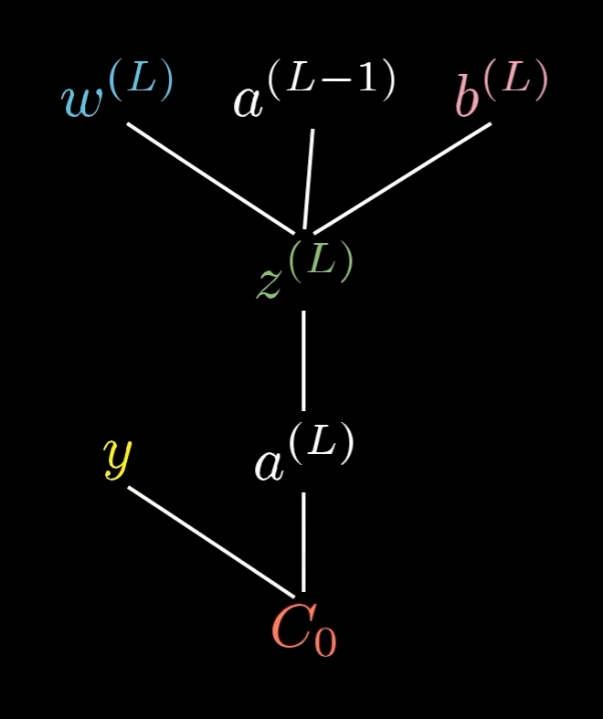
Multi-layer Notation
a^{[0]}
a^{[1]}
a^{[2]}
b^{[1]}
x₀=1
b^{[2]}
σ
x₁
σ
σ
x₂
σ
x_{n}
W^{[2]}
W^{[1]}

Slide 56
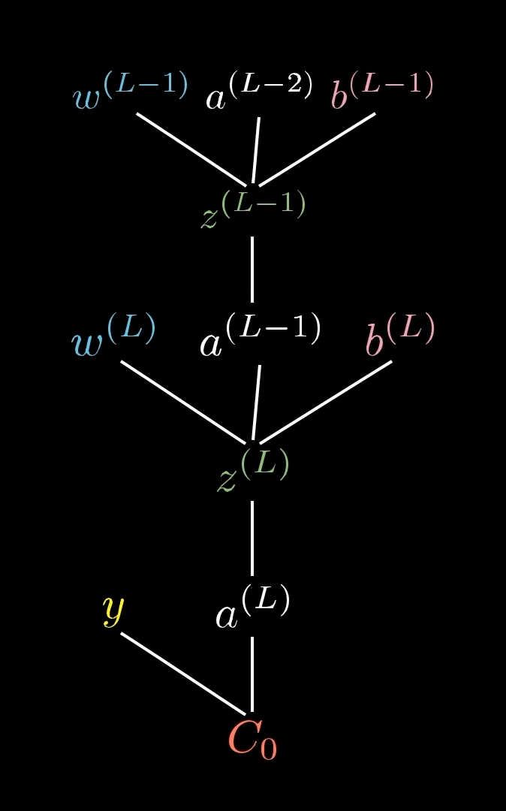
Multi-layer Notation
a^{[0]}
a^{[1]}
a^{[2]}
b^{[1]}
x₀=1
b^{[2]}
σ
x₁
σ
σ
x₂
σ
x_{n}
W^{[2]}
W^{[1]}

Slide 57
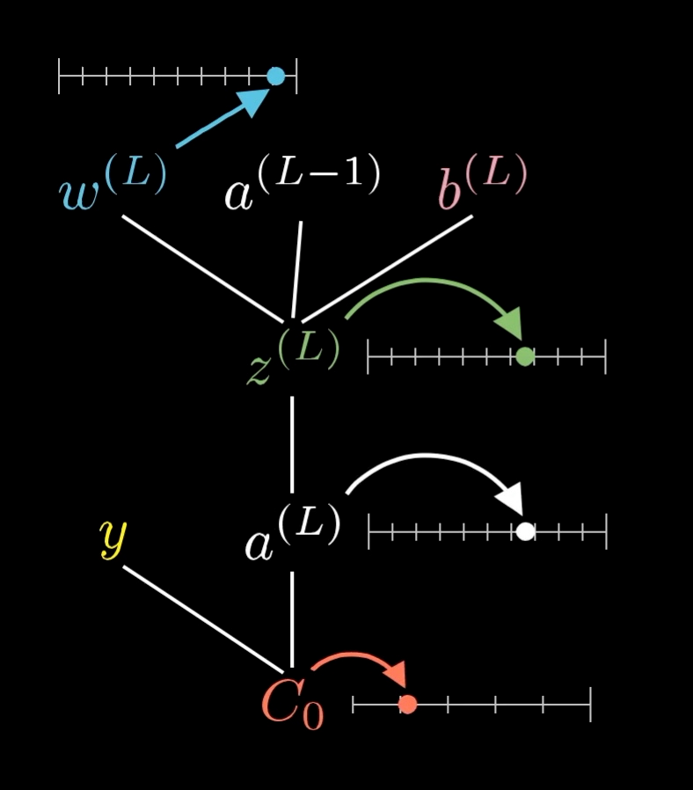
How Weight Affects Cost
see animation: https://www.3blue1brown.com/lessons/backpropagation

Slide 58
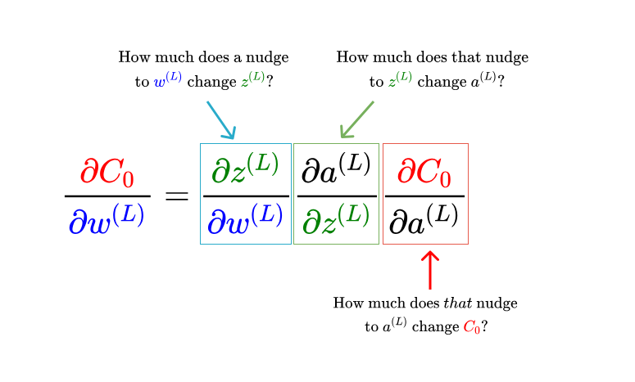
Cost vs Computation Graph
dv
—-
dx
v(x) = x²
C₀(a^{[L]}(z^{[L]}(w^{[L]}))
du
—-
dy
u(y) = -y
df du dv
—- = —- . —-
dx dv dx
f(x) = u(v(x))
x
v=x²
u=-v

Slide 59


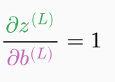


Computation Graph

Slide 60
André Santanchè
https://www.ic.unicamp.br/~santanche/

Slide 61
Acknowledgement
By Jacopo Bertolotti - https://twitter.com/j_bertolotti/status/1121054414066810881, CC0, https://commons.wikimedia.org/w/index.php?curid=78332649

Slide 62
Licença
Estes slides são concedidos sob uma Licença Creative Commons. Sob as seguintes condições: Atribuição, Uso Não-Comercial e Compartilhamento pela mesma Licença.
Mais detalhes sobre a referida licença Creative Commons veja no link:
http://creativecommons.org/licenses/by-nc-sa/3.0/

