Slide 1
NATURAL LANGUAGE PROCESSING
Deep Learning for NLP
André Santanchè
Laboratory of Information Systems - LIS
Instituto de Computação - UNICAMP
October 2026

Slide 2

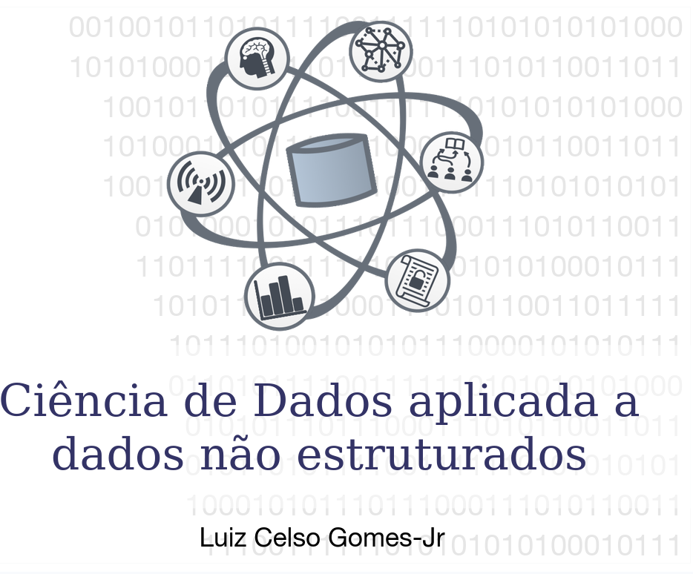
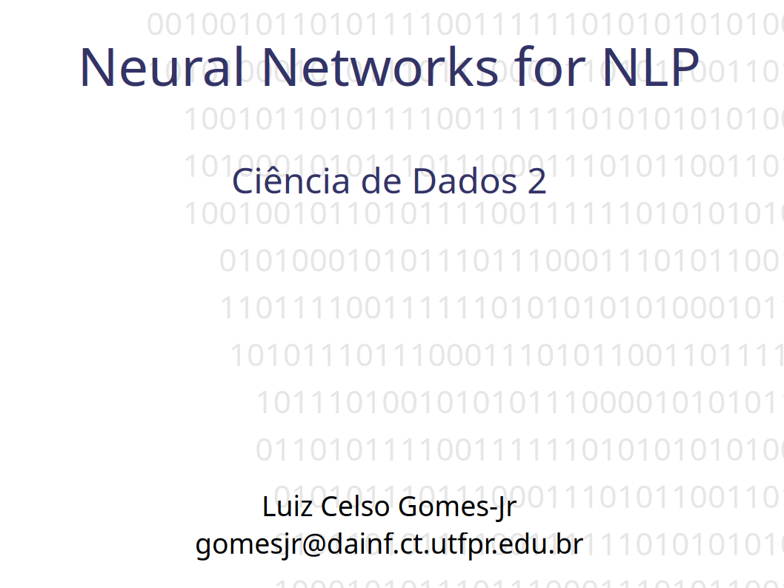
Acknowledgments
This course took the slides of my colleague Luiz Celso Gomes-Jr—to whom I extend my thanks—as a starting point. Slides that have been reused and/or adapted will bear the seal shown here.
https://pessoal.dainf.ct.utfpr.edu.br/lcjunior/
Notes:
Este curso tomou como ponto de partida os slides do colega Luiz Celso Gomes-Jr, a quem agradeço. Slides reutilizados e/ou adaptados receberão o selo ao lado.

Slide 3
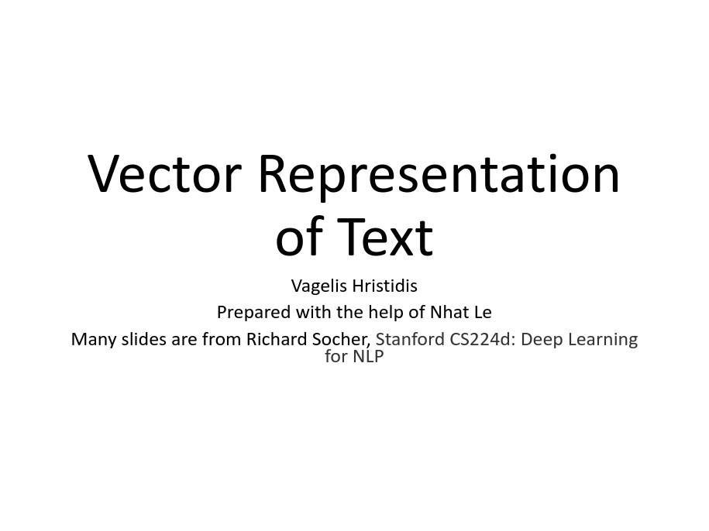
Acknowledgments
CS 242: Information Retrieval & Web Search
Vagelis Hristidis
Spring 2015
https://web.archive.org/web/20180520170332/http://www.cs.ucr.edu/%7Evagelis/classes/CS242/

Slide 4
Neural Network Design Patterns

Slide 5
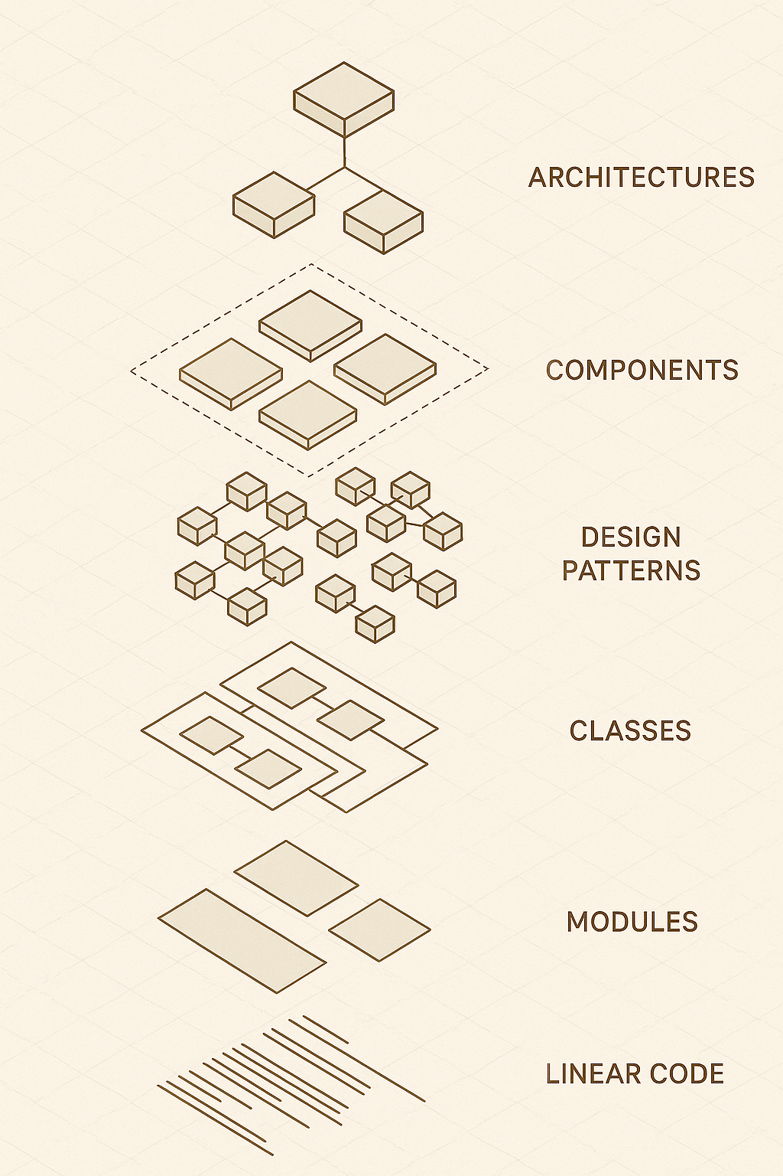
Níveis de Abstração

Slide 6
Feedforward Neural Network
Presentation Approach

Slide 7
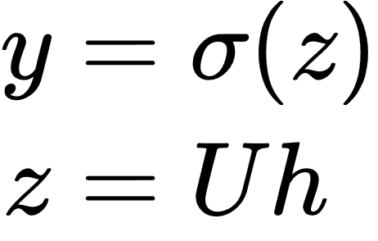
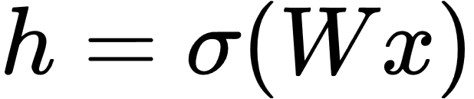
Two-Layer Network with scalar output
hidden units
(σ nodes)
input layer
(vector x)
output layer
(σ node)
h₀=1
x₀=1
σ₁
x₁
σ₂
σ
x₂
σ₃
x_{n}
adapted from (Jurafsky, 2026)
could be a ReLU or tanh
Notes:
We're showing the activation function here as sigma, but it can be the sigmoid, tanh, or ReLU activation function we defined earlier.
Notice that we’re applying the σ function here to a vector, allowing σ(·), to apply to a vector element-wise, so g[z1,z2,z3] = [g(z1),g(z2),g(z3)].
As we saw in the lecture on XOR, the resulting value h (for hidden) forms a representation of the input. The role of the output layer is to take this new representation h and compute a final output. This output could be a real- valued number, but in many cases the goal of the network is to make some sort of classification decision, and so we will focus on the case of classification.
If we are doing a binary task like sentiment classification, we might have a single output node, and its value y is the probability of positive versus negative sentiment.
The output layer has a weight matrix U, but some models don’t include a bias vector b in the output layer, so we’ll simplify by eliminating the bias vector in this example. The weight matrix is multiplied by its input vector (h) to produce the intermediate output z.
z=Uh
And then we use the sigmoid to turn this into a probability.

Slide 8
a^{[1]}=g^{[1]}(z^{[1]})
z^{[1]}=W^{[1]}a^{[0]}+b^{[1]}
y=a^{[2]}
a^{[2]}=g^{[2]}(z^{[2]})
z^{[2]}=W^{[2]}a^{[1]}+b^{[2]}
e.g., ReLU
a^{[0]}
e.g., sigmoid or sofmax
a^{[1]}
a^{[0]}
a^{[2]}
h₀=1
b^{[1]}
b^{[2]}
x₀=1
σ₁
x₁
σ₂
σ
x₂
σ₃
x_{n}
W^{[2]}
W^{[1]}
adapted from (Jurafsky, 2026)

Slide 9
n+1
4
3
h₀=1
b^{[1]}
b^{[2]}
x₀=1
σ₁
1
x₁
σ₂
σ
n+1
x₂
σ₃
a^{[2]}
x_{n}
W^{[2]}
a^{[1]}
W^{[1]}
a^{[0]}

Slide 10
Simplified Representation
(hiding bias)
n+1
4
3
x₁
σ₁
1
x₂
σ₂
σ
n+1
σ₃
x_{n}

Slide 11
Word2Vec as a Neural Network

Slide 12
Word2Vec
Popular embedding method
Very fast to train
(Jurafsky, 2026)

Slide 13
Two Matrices
embedding size
e.g., 300
embedding size
e.g., 300
number of words
e.g., 30.000
Target
Context

Slide 14
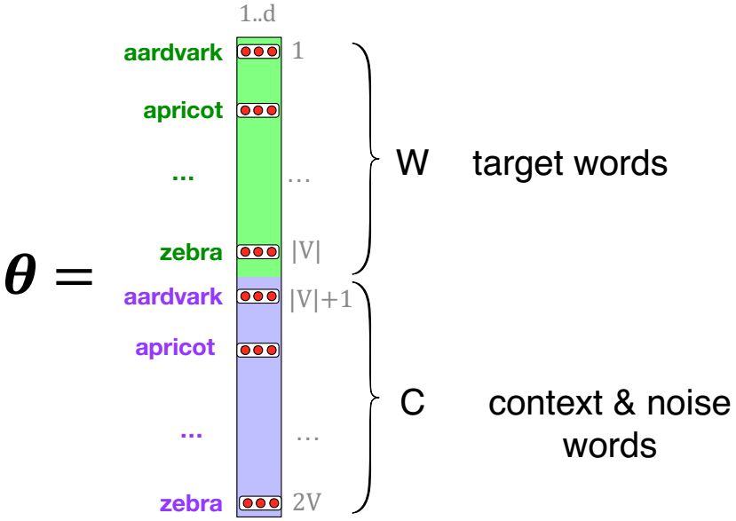
Word2Vec
Target and Context
(Jurafsky, 2026)
Notes:
Here's the intuition of parameters we’ll need. Skip-gram actually stores two embeddings for each word, one for the word as a target, and one for the word considered as context. Thus the parameters we need to learn are two matrices W and C, each containing an embedding for every one of the |V | words in the vocbulary

Slide 15
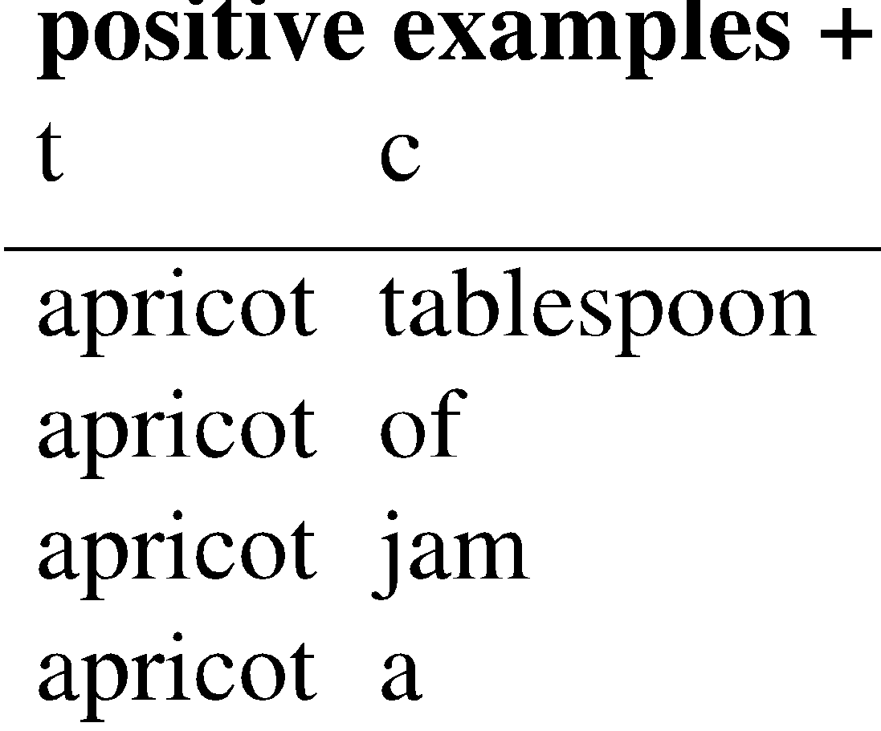
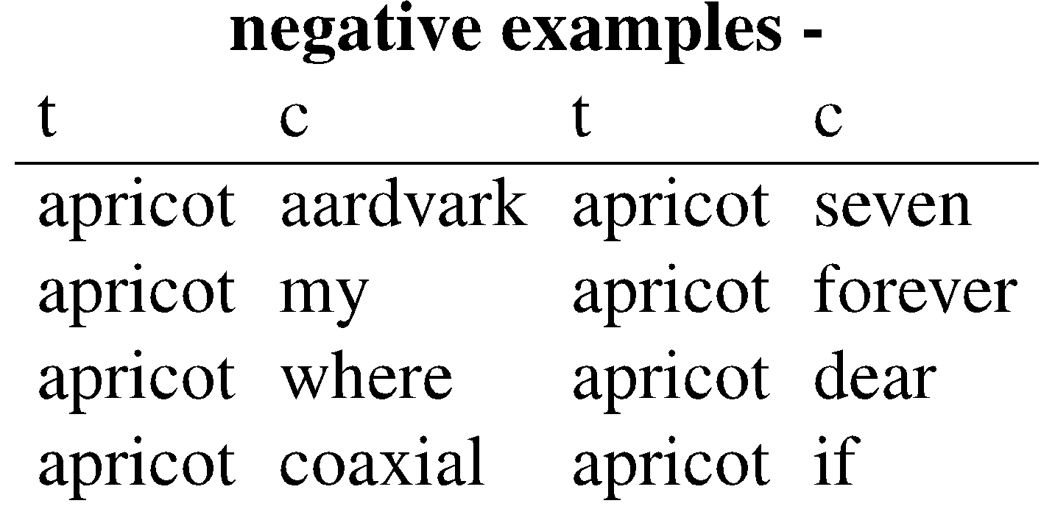
Skip-Gram Training data
(Jurafsky, 2026)
  …lemon, a [tablespoon of apricot jam, a] pinch…
c1 c2 c3 c4
[target]
Notes:
Here's the setting where k = 2, so we’ll have 2 negative examples in the negative training set − for each positive example w,cpos. The noise words are chosen according to their weighted unigram frequency.

Slide 16
Word2vec: how to learn vectors
Given the set of positive and negative training instances, and an initial set of embedding vectors
The goal of learning is to adjust those word vectors such that we:
Maximize the similarity of the target word, context word pairs (w , c_{pos}) drawn from the positive data
Minimize the similarity of the (w , c_{neg}) pairs drawn from the negative data.
(Jurafsky, 2026)
Notes:
Given the set of positive and negative training instances, and an initial set of embeddings, the goal of the learning algorithm is to adjust those embeddings to
• Maximize the similarity of the target word, context word pairs (w,cpos) drawn from the positive examples
• Minimize the similarity of the (w,cneg) pairs from the negative examples.

Slide 17
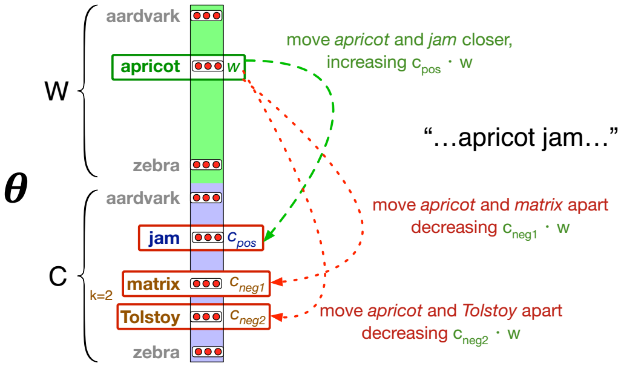
Intuition of one step of gradient descent
(Jurafsky, 2026)
Notes:
Let's look at the intuition of one step of gradient descent. The skip-gram model tries to shift embeddings so the target embeddings (here for apricot) are closer to (have a higher dot product with) context embeddings for nearby words (here jam) and further from (lower dot product with) context embeddings for noise words that don’t occur nearby (here Tolstoy and matrix).

Slide 18
Task 1
Draw a neural network diagram for Word2Vec that, upon training, yields the same Target and Context matrices.
___________
Escreva um diagrama de uma rede neural para o Word2Vec que, ao ser treinada, resulte nas mesmas matrizes Target e Context.
embedding size
e.g., 300
embedding size
e.g., 300
number of words
e.g., 30.000
Target
Context

Slide 19
Subtask 1.1
Autoencoder inspired mapping.

Slide 20
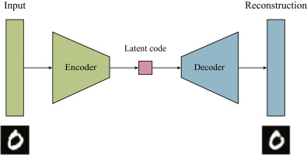
Autoencoder
Proposed by (LeCun, 1987)
Reconstruct d-dimensional input (i.e., observation) vectors as d-dimensional output vectors (Bourlard & Kabil, 2022)
Two parts: an encoder and a decoder
(Lopez Pinaya et al., 2020)

Slide 21
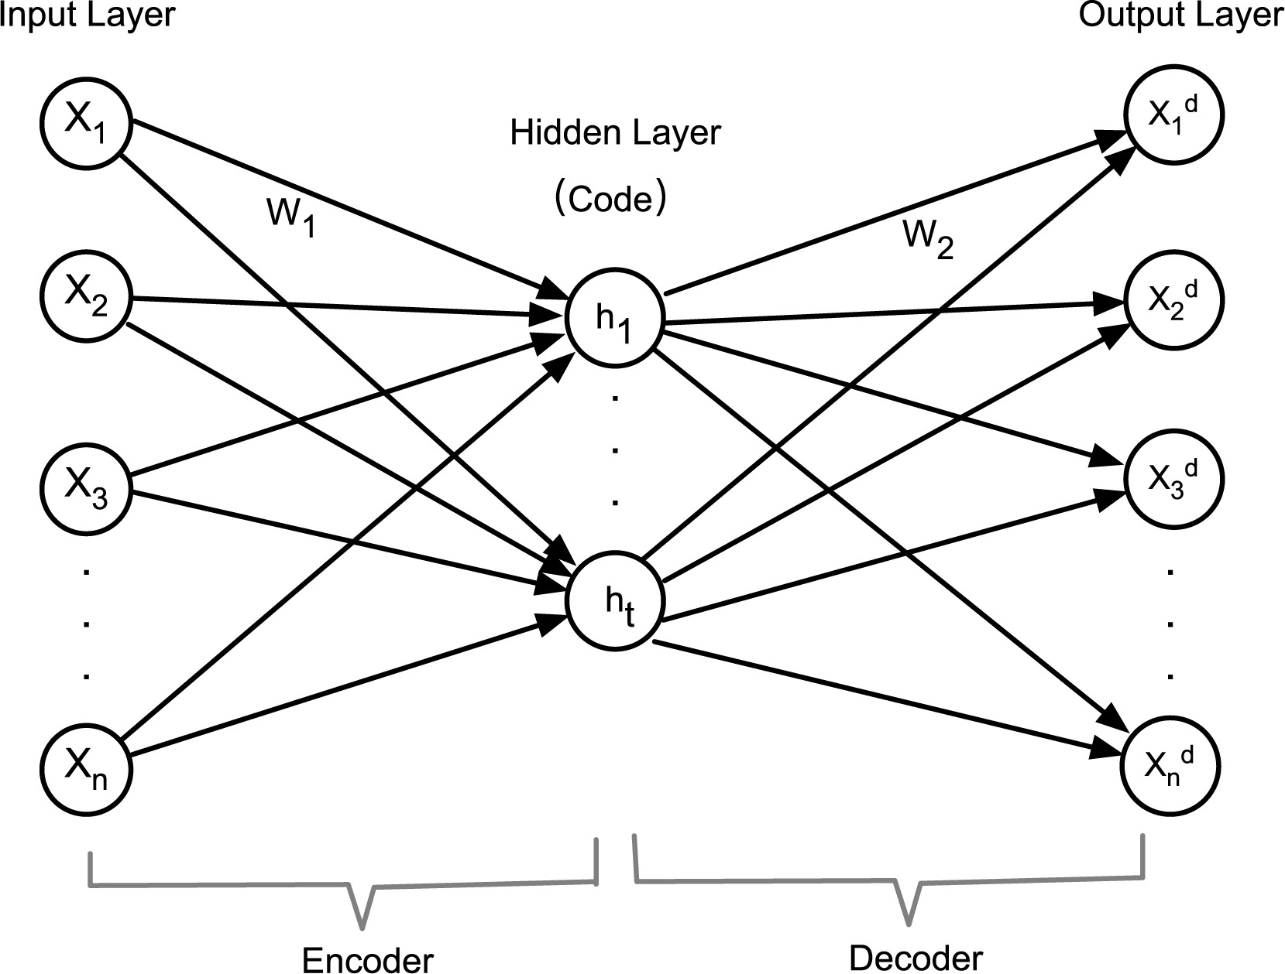
Autoencoder Architecture
(Lopez Pinaya et al., 2020)
(Li et al., 2020)

Slide 22
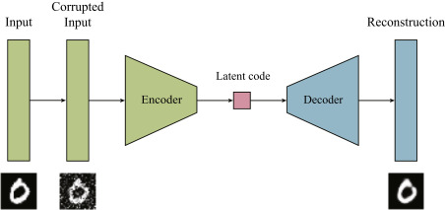
Autoencoder Applications
Undercomplete autoencoder
Denoising autoencoder
(Lopez Pinaya et al., 2020)

Slide 23
Subtask 1.1
Consider the labels for the cardinal directions: north, south, east, and west. Propose an autoencoder network architecture to reconstruct the four labels using two hidden neurons.
_____
Considere os rótulos para os pontos cardeais: norte, sul, leste e oeste. Proponha uma arquitetura de rede autoencoder para reconstruir os quatro rótulos utilizando dois neurônios ocultos.

Slide 24
Subtask 1.1
One-hot Encoding
north
south
east
west
1
0
0
0
north
0
1
0
0
south
0
0
1
0
east
0
0
0
1
west

Slide 25
Subtask 1.1
5
3
4
I₁
2
O₁
1
σ₁
north
I₂
O₂
north
5
south
south
east
I₃
O₃
east
σ₂
west
west
I₄
O₄

Slide 26
Subtask 1.1
Embedding
5
3
4
2

Slide 27
Subtask 1.2
Manually set the weights between the layers to achieve the desired result.
_____
Defina manualmente os pesos entre as camadas para obter o resultado desejado.

Slide 28
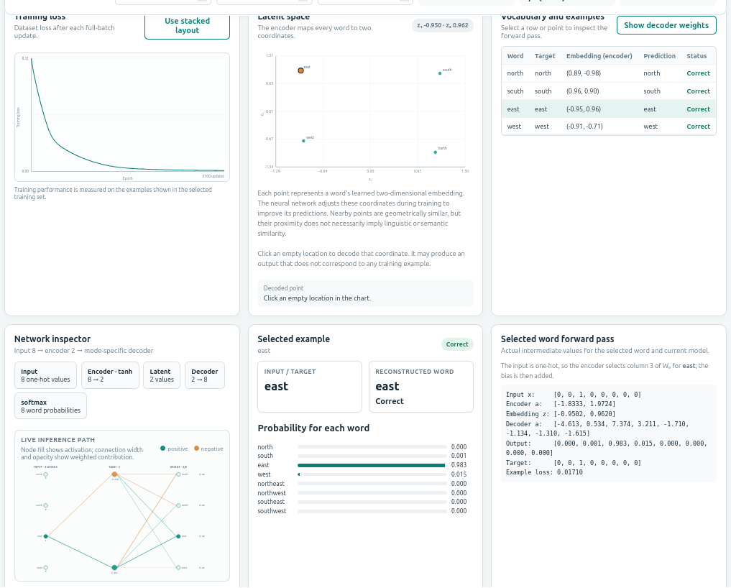
Cardinal Directions Embeddings
https://santanche.github.io/nlp2learn/machine-learning/neural-network/feedforward/

Slide 29
Classification
Summary
Model
Classification Function
epoch
Feature Representation
Optimization
Algorithm
Objective Function

Slide 30
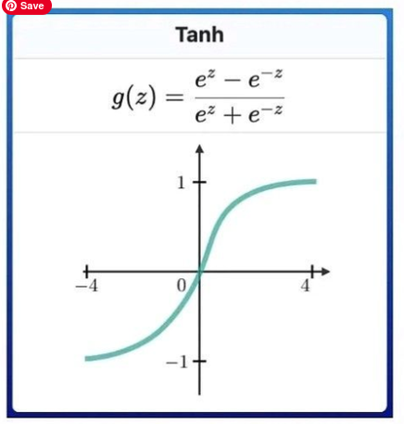
Tanh Activation Function

Slide 31
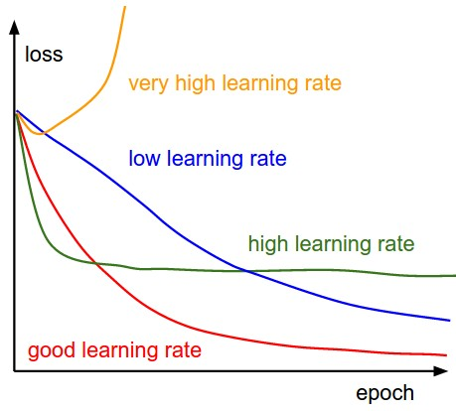
Epoch x Loss
CS231n: Deep Learning for Computer Vision
https://cs231n.github.io/neural-networks-3/

Slide 32
Subtask 1.3
Adapt the network to perform the following translation into a sequence of two symbols:
_____
Adapte a rede para realizar a seguinte tradução para uma sequência de dois símbolos:
north | |^
south | |v
east | ->
west | <-

Slide 33




Subtask 1.4
Adapt the network to perform the following translation for the images:
_____
Adapte a rede para realizar a seguinte tradução para as imagens:
north
south
east
west

Slide 34
Word2Vec
Two model architectures:
  continuous bag-of-words (CBOW): predicts the current word from the window of surrounding context words. faster.
  continuous skip-gram: uses the current word to predict the surrounding window of context words. weighs nearby context words more heavily than more distant context words. more precise.

Slide 35
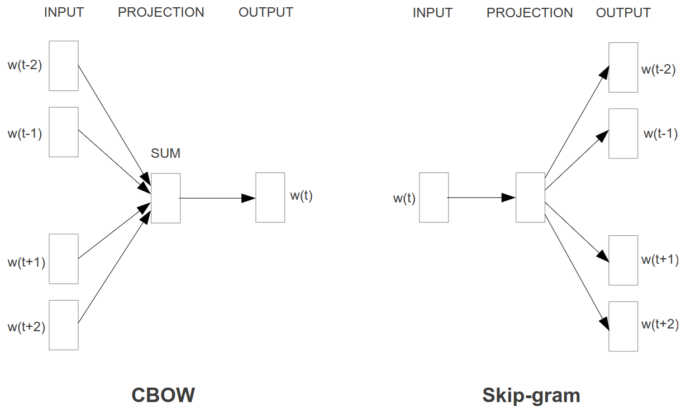
Architectures
(Mikolov et al., 2013)

Slide 36
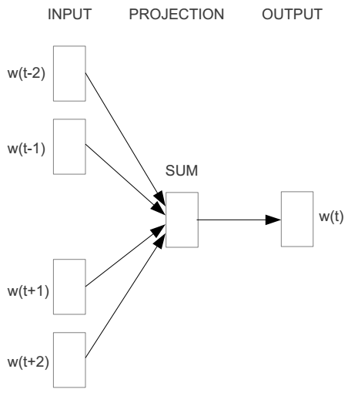
Word2vec – Continuous Bag of Word
E.g. “The cat sat on floor”
  Window size = 2
the
cat
sat
on
floor
(Hristidis, 2015)

Slide 37



We must learn W and W’
Input layer
0
1
0
0
Hidden layer
Output layer
cat
0
0
0
0
0
0
…
0
V-dim
0
0
0
sat
0
0
0
0
1
0
N-dim
…
1
0
V-dim
on
0
0
0
0
V-dim
…
N will be the size of word vector
(Hristidis, 2015)
0

Slide 38
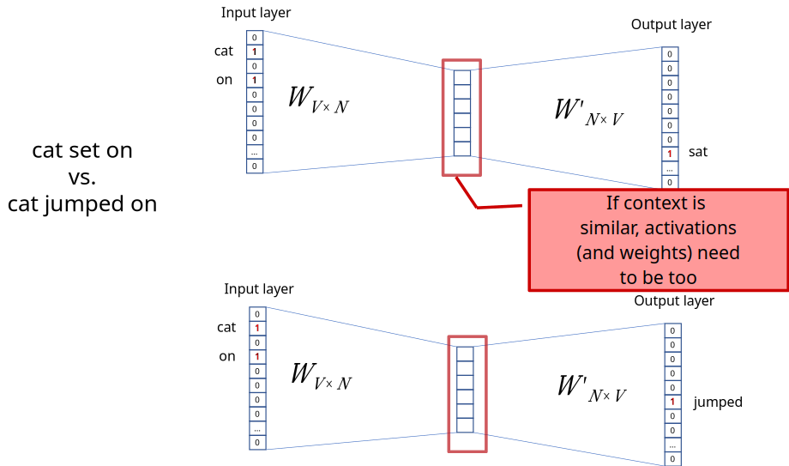
(Hristidis, 2015)

Slide 39
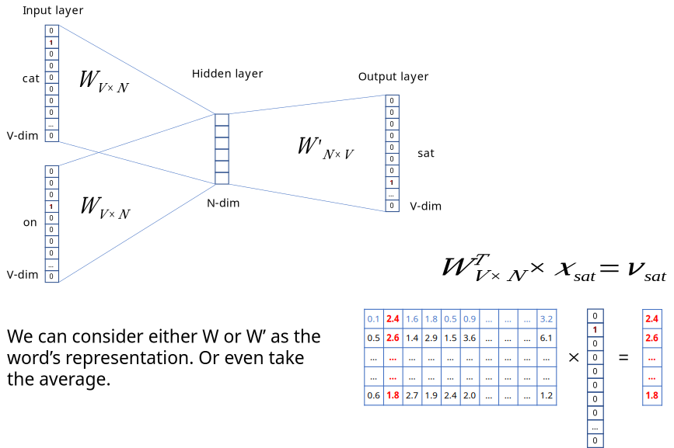
(Hristidis, 2015)

Slide 40
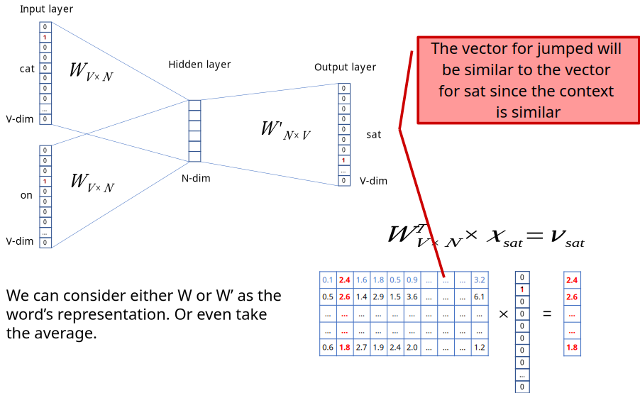
(Hristidis, 2015)

Slide 41
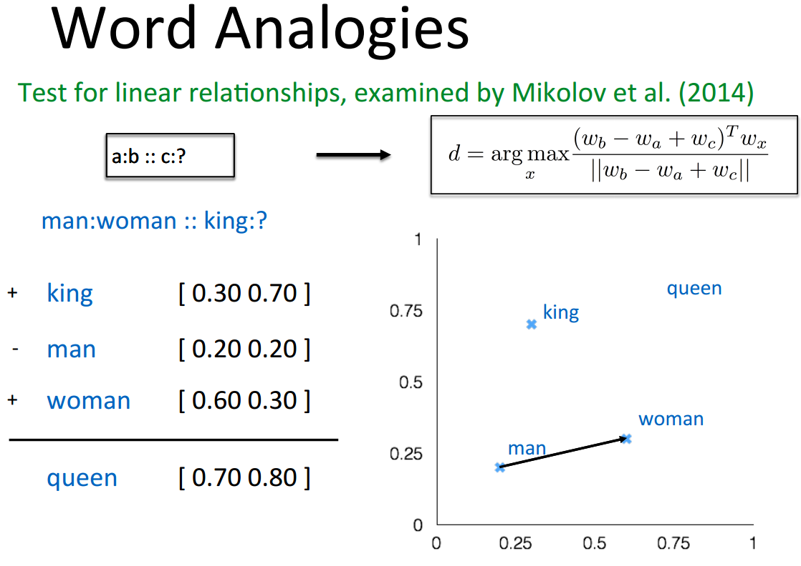
(Hristidis, 2015)

Slide 42
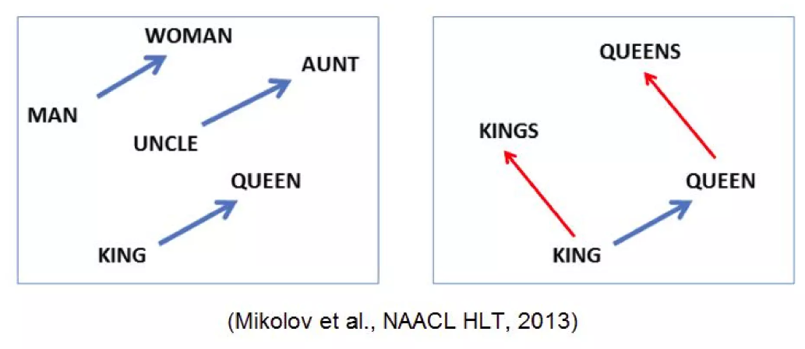
(Mikolov et al., 2013)

Slide 43
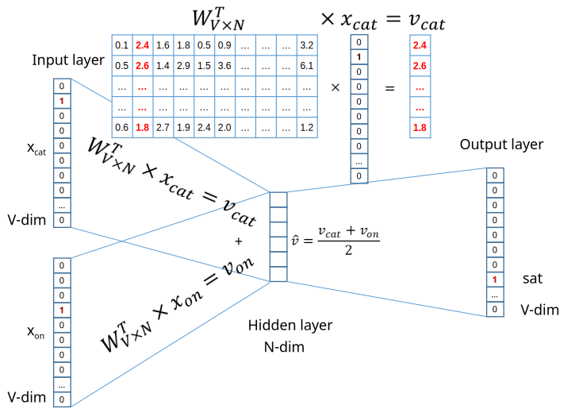

Slide 44
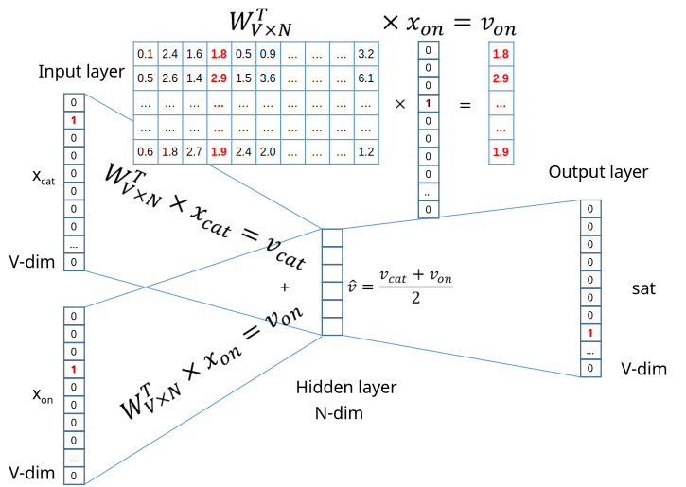

Slide 45
André Santanchè
https://www.ic.unicamp.br/~santanche/

Slide 46
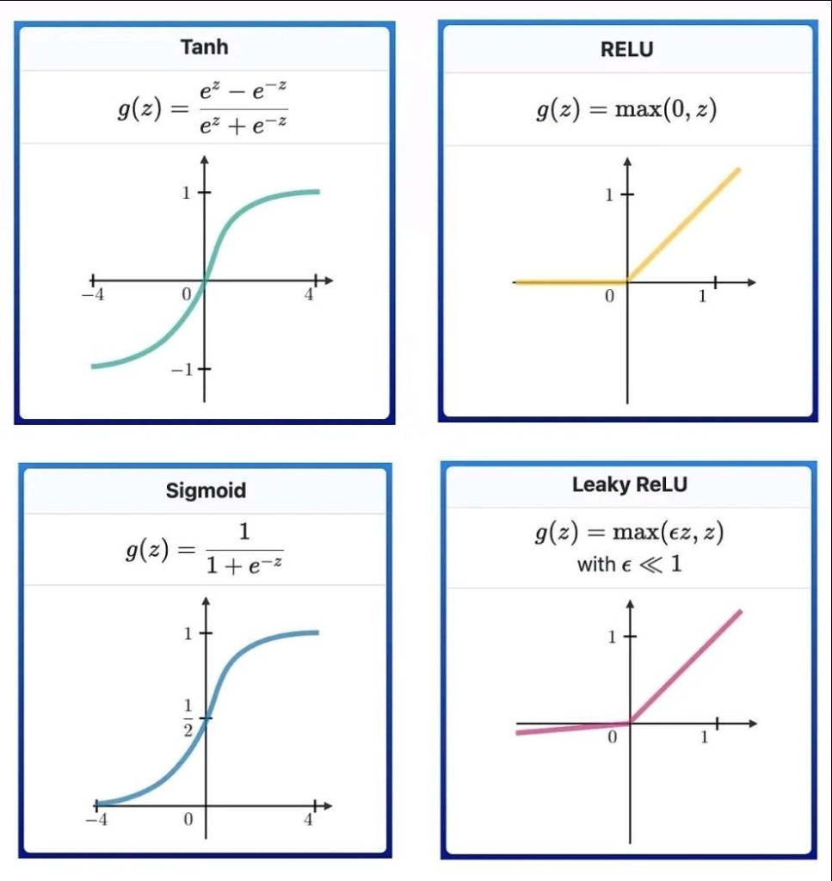
Acknowledgement
Most used activation functions in Neural Networks
AI ML – Artificial Intelligence and Machine Learning https://ai-artificial-intelligence.webyes.com.br/most-used-activation-functions-in-neural-networks/

Slide 47
References
Bourlard, H., & Kabil, S. H. (2022). Autoencoders reloaded. Biological Cybernetics, 116(4), 389–406. https://doi.org/10.1007/S00422-022-00937-6
Jurafsky, Dan. CS 124: From Languages to Information. Winter 2026. https://web.stanford.edu/class/cs124/
LeCun, Y. (1987). PhD thesis: Modeles connexionnistes de l’apprentissage (connectionist learning models).
Lopez Pinaya, W. H., Vieira, S., Garcia-Dias, R., & Mechelli, A. (2020). Autoencoders. Machine Learning: Methods and Applications to Brain Disorders, 193–208. https://doi.org/10.1016/B978-0-12-815739-8.00011-0
Li, P., Pei, Y., & Li, J. (2023). A comprehensive survey on design and application of autoencoder in deep learning. Applied Soft Computing, 138, 110176. https://doi.org/10.1016/J.ASOC.2023.110176
Mikolov, T., Chen, K., Corrado, G., & Dean, J. (2013). Efficient Estimation of Word Representations in Vector Space. 1st International Conference on Learning Representations, ICLR 2013 - Workshop Track Proceedings. https://arxiv.org/abs/1301.3781v3
Mikolov, T., Yih, W., & Zweig, G. (2013). Linguistic Regularities in Continuous Space Word Representations. Proc. 2013 Conf. of the North American Chapter of the Association for Computational Linguistics: Human Language Technologies, 746–751. https://aclanthology.org/N13-1090

Slide 48
Licença
Estes slides são concedidos sob uma Licença Creative Commons. Sob as seguintes condições: Atribuição, Uso Não-Comercial e Compartilhamento pela mesma Licença.
Mais detalhes sobre a referida licença Creative Commons veja no link:
http://creativecommons.org/licenses/by-nc-sa/3.0/

