Slide 1
4.13.11 设计模式及其应用 – 生成模式
Abstract Factory 模式
The Problem: We want to to be able to encapsulate the implementation of class creation so that parallel hierarchies of classes can be created and clients can avoid hard-coding the name of the class to be constructed.

Slide 2
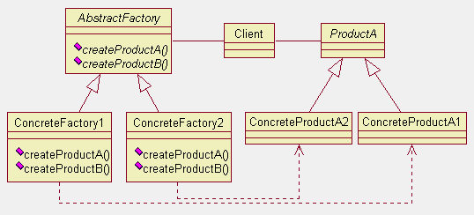
4.13.11 设计模式及其应用 – 生成模式
Abstract Factory 模式的类图

Slide 3
4.13.11 设计模式及其应用 – 生成模式
适用 Abstract Factory 模式的场合
A system should be independent of how its components (products) are created and composed.
A system should be configured with one family of components from a set of multiple (parallel) families of components.
A family of related products should be used together and you want to enforce this.

Slide 4
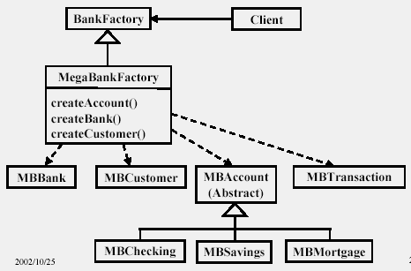
4.13.11 设计模式及其应用 – 生成模式
使用 Abstract Factory 模式的例子

Slide 5
4.13.11 设计模式及其应用 – 生成模式
使用 Abstract Factory 模式的例子

Slide 6
4.13.11 设计模式及其应用 – 生成模式
Factory Method 模式与 Abstract Factory 模式的比较
Both patterns allow you to parameterize a system by the classes of objects it creates.
Factory Method requires creating a new subclass of the creator just to change the class of the product.
Abstract Factory encapsulates object creation in a single object, which can create many kinds of products.

Slide 7
4.13.11 设计模式及其应用 – 结构模式
Bridge 模式
The Problem: We want to decouple an abstraction from its implementation so that the two can vary independently.
The Bridge Pattern provides an interface separate from the implementation, and the implementation can vary. By contrast, the Adapter Pattern provides an alternative interface to one kind of object.

Slide 8
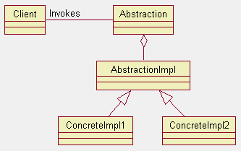
4.13.11 设计模式及其应用 – 结构模式
Bridge 模式的类图

Slide 9
4.13.11 设计模式及其应用 – 结构模式
适用 Bridge 模式的场合
Use the Bridge Pattern when you want to vary the implementation of an interface or set of interfaces at run-time, independently of the interface.

Slide 10
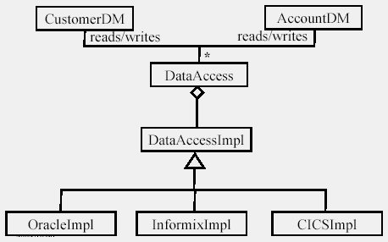
4.13.11 设计模式及其应用 – 结构模式
使用 Bridge 模式的例子

Slide 11
4.13.11 设计模式及其应用 – 结构模式
使用 Bridge 模式的例子

Slide 12
4.13.11 设计模式及其应用 – 结构模式
Proxy 模式
The Problem: We want to provide a surrogate（代理） or a placeholder（占位者） for an object that allows us to control access to it.

Slide 13
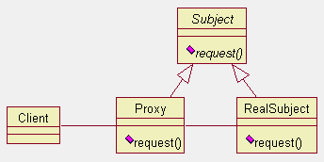
4.13.11 设计模式及其应用 – 结构模式
Proxy 模式的类图
Here we have an abstract class or interface called Subject that defines the behavior
that must be supported by both the Proxy class and the RealSubject class. The
Proxy has a set of methods that's repeated in the RealSubject. When the Client
invokes the method request() on a Proxy, Proxy does whatever work it wants to do
itself, and then calls through to the RealSubject.

Slide 14
4.13.11 设计模式及其应用 – 结构模式
适用 Proxy 模式的场合
When you want to hide details such as reference counting.
When you want provide security checks on the real object.
When you want to separate the interface from the implementation so they can be in separate processes or on separate machines.

Slide 15
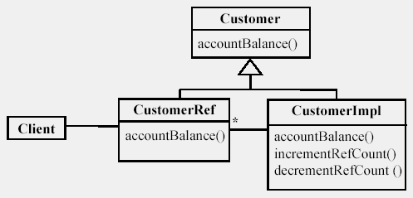
4.13.11 设计模式及其应用 – 结构模式
使用 Proxy 模式的例子

Slide 16
4.13.11 设计模式及其应用 – 结构模式
使用 Proxy 模式的例子

Slide 17
4.13.11 设计模式及其应用 – 行为模式
Mediator 模式
The Problem: We want to be able to encapsulate the way that a group of objects interacts so that the objects in the group don’t have to know about each other explicitly. This reduces an n x n communication problem to an n + n problem.

Slide 18
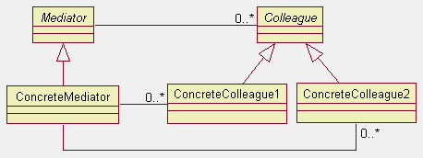
4.13.11 设计模式及其应用 – 行为模式
Mediator 模式的类图
The Mediator class has a 1-to-many relationship with the Colleague
objects, which carries over to families of subclasses. Put another
way, a Colleague will participate in an interaction governed by only
one Mediator.

Slide 19
4.13.11 设计模式及其应用 – 行为模式
适用 Mediator 模式的场合
When objects interact in an unstructured, complex way.
When you want to make the colleagues reusable in situations where not all the objects are present.
When the behavior that’s distributed among several classes should be customizable without a lot of subclassing.

Slide 20
4.13.11 设计模式及其应用 – 行为模式
State 模式
The Problem: We want to allow an object to alter its behavior when its internal state changes (as if the object had changed its class).
Use the State Pattern when an object can have different behavior based on its current state, there are many possible states, and you want to to avoid many state-dependent switch statements.

Slide 21
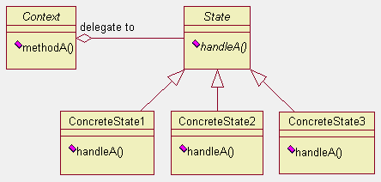
4.13.11 设计模式及其应用 – 行为模式
State 模式的类图
… ...
… ...
… ...
… ...
… ...
The Context object is the object that clients manipulate. Context in turn implements
its methods in terms of the corresponding methods of class State. Here we show
that the method names need not be the identical. The concrete subclasses of State
provide (possibly different) implementations of the methods.

Slide 22
4.13.11 设计模式及其应用 – 行为模式
适用 State 模式的场合
Use the State Pattern when an object must respond differently to the same request based on the state it is in.

Slide 23
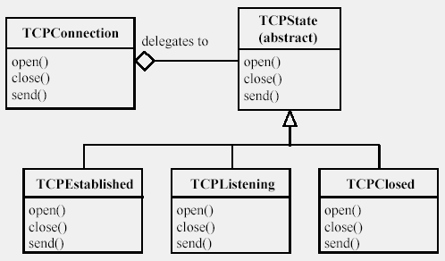
4.13.11 设计模式及其应用 – 行为模式
… ...
… ...
使用 State 模式的例子
… ...
… ...
… ...

Slide 24
4.13.11 设计模式及其应用 – 行为模式
Strategy 模式
The Problem: We want to define and use a family of algorithms as if they were interchangeable.
  Example: Encapsulating multiple sorting algorithms. Here the Strategy class would be a generic sort() operation. Subclasses would define specific sorting methods. Clients would pass an instance of a concrete subclass to the list to be sorted. By packaging the sorting algorithm as a class, it is possible to pass along the data needed for the sort as members of the class, for instance, a start and end point in an array.

Slide 25
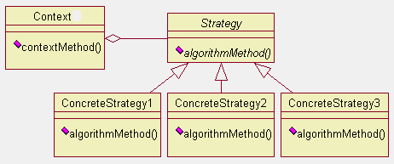
4.13.11 设计模式及其应用 – 行为模式
Strategy 模式的类图
… …
… …
… …
… …

Slide 26
4.13.11 设计模式及其应用 – 行为模式
适用 Strategy 模式的场合
Use the Strategy Pattern when
  You have many variants of the same algorithm.
  You want to encapsulate the algorithm-specific data in the algorithm, not the structure to which the algorithm applies.

Slide 27
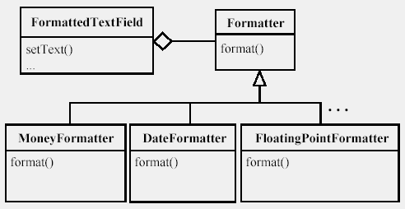
4.13.11 设计模式及其应用 – 行为模式
使用 Strategy 模式的例子
… …
… …
… …
… …

Slide 28
4.13.11 设计模式及其应用 – 行为模式
Template Method 模式
The Problem: We want to define an operation that contains the outline of an algorithm. The steps in the outline are calls to virtual methods that can be overidden in subclasses. Thus the outline is defined only once and subclasses can "fill-in-the-blanks” by overriding each step.
This lets subclasses define what each step should be for its instances.

Slide 29
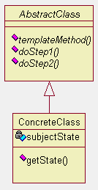
4.13.11 设计模式及其应用 – 行为模式
Template Method 模式的类图
This pattern lets the AbstractClass provide an interface
that's written once and called by Client objects. If an object
of a subclass gets substituted, the "outline" is still executed,
but the implementations in the derived class are called.
The ConcreteClass does not override templateMethod();
it overrides the primitive methods, doStep1(), etc, as required.
In the figure shown, where there are only two primitive
steps, the TemplateMethod() would look like:
// set up
// invoke the algorithm steps
doStep1();
doStep2();
// cleanup and terminate

Slide 30
4.13.11 设计模式及其应用 – 行为模式
适用 Template Method 模式的场合
When you have an algorithm that follows a fixed sequence of steps, but the steps can vary according to the class of the object performing the algorithm.

Slide 31
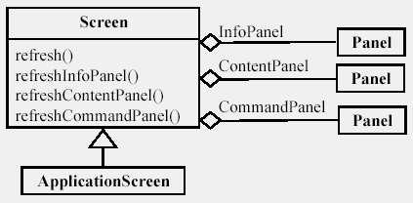
4.13.11 设计模式及其应用 – 行为模式
使用 Template Method 模式的例子

Slide 32
4.13.11 设计模式及其应用 – 行为模式
使用 Template Method 模式的例子

