Slide 1
BLASX
Linnan Wang, Georgia Institute of Technology
wei wu, University of Tennessee, Knoxville
Yang yi, NEC Laboratories, USA
zenglin xu, UESTC and Jianxiong xiao, Princeton
Notes:
Hello everyone, my name is Linnan Wang from Gatech. Today I will present fantastic BLASX.
BLASX is a high performance level 3 BLAS library for heterogeneous multi-GPU computing. It’s fast, communication-efficient, and it’s amazingly easy to use.

Slide 2
Motivation
Question:
solve large scale matrix multiplications with multi-GPUs?
Challenges:
Limited GPU RAM Size
Communications and Computations Overlapping
Reduce Communications
Load Balancing
Ease of Use, Backward Compatibility
Notes:
BLASX target on this problem: “how to efficiently solve a large scale matrix multiplication with multiGPUs?”
However, using multi-GPU machines entails the following challenges:
(click) The first challenge is the limited GPU memory. A forty-thousands by forty-thousands [40000x40000] double precision matrix is 12.8 GB. While a matrix multiplication involves input matrices A & B, and a output matrix C. So, it totally requires 38.4 GB memory to perform a matrix multiplication at this scale. That’s really a lot(!!!) of memory! However, the largest onboard GPU memory is 12 GB. This is far from enough to solve a large scale matrix multiplication.
Although we can approach a large matrix multiplication by dissecting matrices into smaller ones with tile algorithms, this approach introduces excessive communications as tiles have to be moved into GPU RAM on demand. To ensure high-performance, we must address these challenges: a) (click) communication and computation overlapping. b ) (click) and the reduction of communications.
Also, the speed of GPUs can be dramatically different. (click) This poses another challenges to load balancing on the system with heterogeneous multi-GPU setup.
Last, CPU BLAS is already an industrial standard, CBLAS and FORTRAN interfaces are widely used by a lot of applications. Therefore, maintaining the backward compatibility is important. But this means we need a multi-GPU library computes in a CPU fashion while still guarantee the performance.

Slide 3
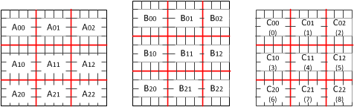
Tile Algorithm
i = 1,
j = 1,
k = 2
i = 1,
j = 1,
k = 0
i = 1,
j = 1,
k = 1
Notes:
Let’s start with recaping the tile algorithm. Basically, it dissects a matrix into a set of tiles demonstrated in the figure. Then we operate on these tiles to construct the final results.
In here, Matrix A, B are input, and matrix C is the output. Now, we are trying to calculate tile C11.
Here is an animation to demonstrate the calculation procedure:
Please note the indices. We’re calculating C11, so both I and J is 1. We increment the k, and we use [i, k] and [k, j] to find the tile in A and B. Then we perform the calculation according to the equation.

Slide 4
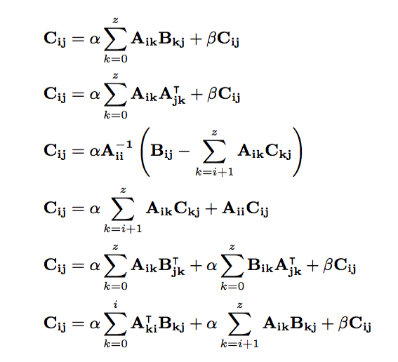
Leve3 BLAS in Tiles
GEMM
SYRK
TRSM
TRMM
SYR2K
SYMM
Notes:
In Level 3 BLAS, there are 6 basic matrix operations, which are listed here.
Please note the indices i, j, k are used to pinpoint tiles, and equations guide calculations.

Slide 5
Pipeline
GPU Out-of-core
Operation
Step 1 2 3 4 5 6 7 8
Stream 0
A₀₀,B₀₀
A₀₀*B₀₀
A₀₁,B₁₀
A₀₁*B₁₀
A₀₂,B₂₀
A₀₀*B₀₀
C₀₀
Stream 1
A₁₀,B₀₁
A₁₀*B₀₁
A₁₁,B₁₁
A₁₁*B₁₁
A₁₂,B₂₁
A₁₂*B₂₁
C₁₁
communications
computations
Notes:
Based on tile algorithm, we introduce a pipeline to interleave tiles on GPU streams so that computations can perfectly overlap with communications.
Let’s illustrate this with an example:
(click) Stream 0 calculates C00 and Stream 1 calculates C11. At the first time step, Stream 0 moves in the tile A00 and B00. It calculates A00*B00 in time step 2 while Stream 1 is moving in operands A10 and B01. Next, stream 0 move in the required data for the next step, and Stream 1 calculates A10 * B01, which was moved in the previous step. These two streams follow the similar procedures in the rest of time steps.
The benefit from this schemes:
(click) We are able to compute in a out-of-core fashion, which means the operands located at the Host RAM before and after computations. This enables a multiGPU library to compute in a CPU fashion.
Communications are overlapped with computations.
It only uses a little GPU RAM as we always move in the data on demand. And the operands size is bounded by cheaper and bigger CPU RAM.

Slide 6

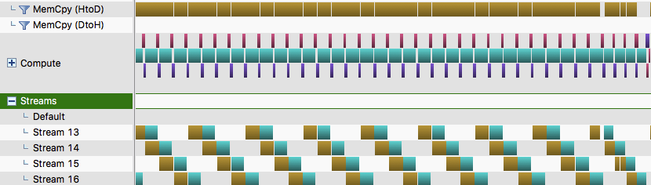
Pipeline
Perfect Communications and Computations Overlapping
Notes:
This slide presents the GPU profile of the proposed pipeline algorithm. The yellow blocks are memory copy between host and GPU, while the green blocks are kernel computations. Are you can see, computations overlaps with communications.
(click) If we view it globally, most communications are overlapped.
Please note the pipeline always moves in the data for computations, but this aggressive data movement is not desired.

Slide 7
Motivation
Question:
solve large scale matrix multiplications with multi-GPUs?
Challenges:
Limited GPU RAM Size
Communications and Computations Overlapping
Reduce Communications
Load Balancing
Ease of Use, Backward Compatibility
Notes:
With this pipeline design, we are able to tackle the challenges of 1) limited GPU RAM, 2) communication and computation overlapping and 3) backward compatibility. However, this pipeline introduce the problem of excessive communications. So we need reduce unnecessary tile movements.

Slide 8
Temporal Locality
tile reuse
Notes:
Let’s exam the tile algorithm again.
(click) C00 requires the first row of A and the first column of B. (click) C01 requires the first row of A and the second column of B.
(click) There exists tile reuse. This finding leads us to explore the tile temporal locality so that redundant communications can be reduced.

Slide 9
TiLE Cache
L1 tile cache: GPU onboard RAM
L2 tile cache: the combined RAM Spaces
Notes:
We propose a 2 level hierarchical tile cache to reduce the overall communications.
Basically, L1 tile cache is built upon the GPU onboard RAM. The purpose of it is to reuse tiles.
L2 tile cache is the the combined multi-GPU memory spaces. The purpose of it is to transform the CPU-GPU data transfer to GPU-GPU data transfer.

Slide 10
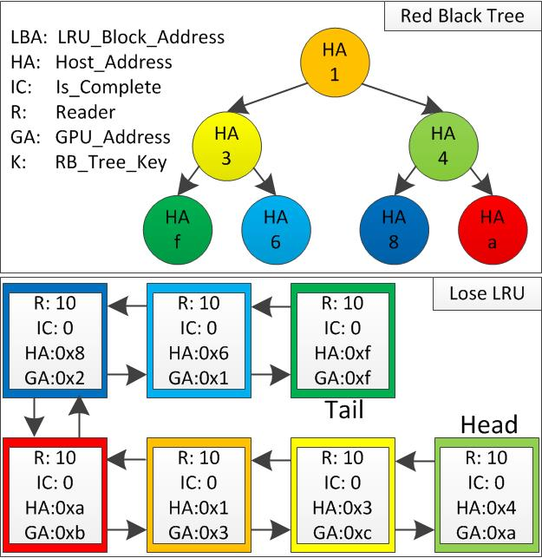
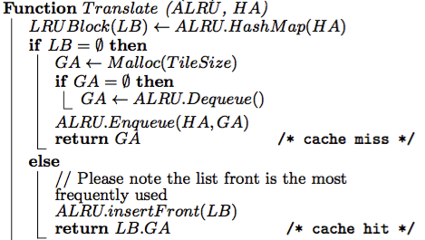
L1 TiLE Cache
LRU
LRU search: O(logn)
LRU in : O(1)
LRU out: O(1)
Notes:
This slide demonstrates data structures used in building the L1 tile cache. It has a red-black tree and a doubly, linked list based, LRU. The red black tree is used to facilitate the lookup, so searching a tile in a LRU only takes log(n) time. The LRU front represents the most frequently used tile, and the LRU end represents the least frequently used ones. Therefore, (click) the LRU in and out are guaranteed in O(1).
(click) The algorithm indicates basic procedures to the L1 tile cache. it looks up the red black tree to see if there is a LRU block for this tile.
If it does exist, we rearrange the tile to the LRU front to make it most frequently used.
If the tile is not in LRU, that means this is a new tile. We try to allocate a segment of GPU memory, link the tile with the newly allocated memory.
If there is no GPU RAM left, we need deque a least used tile in LRU, free the resources. Then we use the resource for the new tile.

Slide 11
L1 TiLE Cache
High Frequency Malloc
=>
Performance Degeneration
Notes:
Please note this translate algorithm involves memory allocation on GPU. (click) With increasing size of matrix, this incurs high frequency memory allocation.
(click) The direct effect of high frequent memory allocation is the performance degeneration, which is demonstrated in the figure.

Slide 12
L1 TiLE Cache
Solution: Pre-allocate a big chunk of GPU RAM,
and mange the chunk with BLASX_Malloc.
Steady
Performance
Notes:
We resolve this issue by pre-allocating a big chunk of GPU RAM and manage the RAM by BLASX_Malloc, which is developed by us.
(click) There are 3 components in BLASX_Malloc, which are meta-data list, occupied list and empty list. Their names explains the usages.
(click) Here is a comparison between CUDA_Malloc and BLASX_Malloc. As we can see, BLASX_Malloc delivery steady performance even if the matrix size exceeds 25 thousands.

Slide 13
L2 TiLE Cache
multiple LRUs, grouped by the P2P accessibility.
If L1 tile cache miss, search other LRUs in the
group.
group0
group1
LRU0
LRU1
LRU2
LRU3
Notes:
L2 Tile cache is essentially a set of LRUs, grouped by the P2P accessibility. The purpose of L2 tile cache is to search the tile on other LRUs if L1 tile miss. If find, we initiate GPU-GPU data transfer.

Slide 14

TiLE Cache Usage
L1 Tile Cache Hit: find the tile in LRU, get GPU Addr
L1 Tile Cache Miss: find the tile in other LRUs
within the P2P group.
L2 Tile Cache Hit: initiate P2P transfer
L2 Tile Cache Miss: retrieve from host RAM.
Notes:
This slide demonstrates the basic workflow of our 2 level tile cache.
(click) If L1 Tile Cache Hit: find the tile in LRU, get GPU Addr, there is no communication involved.
(click) If L1 Tile Cache Miss: find the tile in other LRUs within the P2P group.
(click) If L2 Tile Cache Hit: initiate P2P transfer.
(click) If L2 Tile Cache Miss: retrieve the tile from host RAM.
(click) The table demonstrates inter-GPU data transfer rate is 7.8 GB/s, while CPU-GPU data transfer rate is 6.54 GB/s, which justify L2 tile cache design.

Slide 15
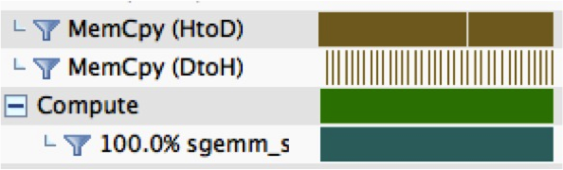
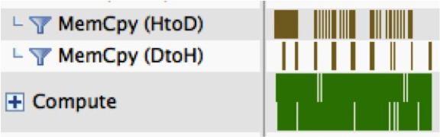
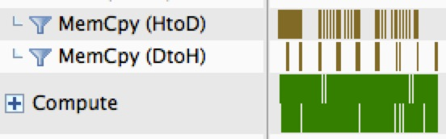
TiLE Cache Results
Without Tile Cache
Excessive
Comm
Tile Cache
Much
Less !!!
Notes:
Okay, let’s see the result with the proposed hierarchical tile cache.
(click) This figure demonstrate the case without tile cache. (click)We can see, the pipeline algorithm always move in the data, thereby incurs excessive communications.
(click) With tile cache, (click) the communication is significantly(!!!!) reduced.

Slide 16
Motivation
Question:
solve large scale matrix multiplications with multi-GPUs?
Challenges:
Limited GPU RAM Size
Communications and Computations Overlapping
Reduce Communications
Load Balancing
Ease of Use, Backward Compatibility
Notes:
Alright, this is our solution to reduce communications. Let’s tackle the load balancing.

Slide 17
Define Tasks
Independent!!!
Task: solving a tile C_{ij}
1. Reading the inputs for a task is data dependency free
2. Concurrent writing a task’s output is data race free
3. The workload of each task varies
Notes:
First, we define a task as solving a tile in the output matrix C. (click) This definition enables us to decompose a matrix multiplication into a set of independent tasks. Three features of a task are:
1) 1. Reading the inputs for a task is data dependency free
2) 2. Concurrent writing a task’s output is data race free
3) 3. The workload of each task varies for routines such as SYMM, and TRSM.

Slide 18
Task Scheduling
Infrastructures:
GPU Computation Thread
CPU Computation Thread
Reservation Station
Non-blocking Task Queue
Notes:
This is the structure of our scheduling runtime, it consists of 4 major components:
(click) GPU computation threads
(click) CPU computation thread
(click) reservation station
(click) Non-blocking task queue
Now, let’s delve into each component.

Slide 19
Computation Threads
GPU Comp Thread
CPU Comp Thread
Submit Instructions to GPUs
Can be Disable or Enable
Bind to a Dedicated CPU Core
Solve Tasks with a Multi-
Threaded CPU BLAS
Overlap Tasks on GPU Streams
Notes:
There are two kinds of computation threads, one for GPU and the other for CPU.
GPU threads intend to
Submit Instructions to GPUs.
And they are bind to a dedicated CPU core by setting a affinity.
They are also responsible for interleaving tasks on GPU streams.
CPU threads intend to solve a task by a multithreaded CPU BLAS. It can be disable or enable.

Slide 20
Reservation Station
Priority: holds the potential of cache hits.
Task: holds the metadata of future tasks.
Slot ID: match with stream id.
Notes:
(click) here is the reservation station. The purpose of it is to hold the information for future tasks. In a reservation station, it holds 3 kinds of information:
(click) Task priority: we set the priority based on the potential of cache hits, which can be figured out by referring to LRU.
(click) Task slot holds the meta-data of a task such information about indices I,j, k
(click) Slot id and GPU stream are 1-to-1 matched. For example, tasks in slots 1,2,3,4 will be mapped to streams 1,2,3,4.

Slide 21
Task Scheduling
Strategies:
Demand Driven Tasks Assignment
Work Stealing
Priority Scheduling
Notes:
Our runtime supports 3 kinds of scheduling strategies:
The first is the demand driven task assignment. This is achieved by the non-blocking task queue. The basic logic is a faster processor consumes more tasks, while the slower ones consume less.
We also support work stealing in reservation station. It is possible that one reservation station is full but the global task queue is empty. In this case, we allow an idle GPU to steal a task from other GPUs so that work load can be balanced at finer level.
We support priority scheduling. As demonstrated in the previous slide, we prioritize the task with more cache hits.

Slide 22
Motivation
Question:
solve large scale matrix multiplications with multi-GPUs?
Challenges:
Limited GPU RAM Size
Communications and Computations Overlapping
Reduce Communications
Load Balancing
Ease of Use, Backward Compatibility
Notes:
Okay, the only challenge left is the usability.

Slide 23




Usability
BLASX features CBLAS and FORTRAN Interfaces and
Out-of-core computing
Calling BLASX is as easy as
OpenBLAS, MKL, or GotoBLAS
Change the BLAS linkage
Notes:
BLASX features CBLAS and FORTRAN Interfaces and Out-of-core computing.
(click) This means Calling BLASX is amazingly as easy as OpenBLAS, MKL, or GotoBLAS.
In practice, we have successfully applied BLASX to a a lot of real world applications such as MATLAB. (click) It enables MATLAB to calculate a 20 thousands x 20 thousands dense double precision matrix multiplication in less than 1 second on 3 NVIDIA K40.
R (click), NumPy(Numb Pie)(click), and Deep Learning frameworks such as tensor-flow also benefit from BLASX.
(click) And all you need is to change the BLAS linkage.

Slide 24
Performance
Benchmarked on 3 K40c
BLASX
cuBLAS-XT
SuperMatrix
Notes:
Alright, let’s take a look at the performance of BLASX. The figure demonstrates the performance of DGEMM, and we compare BLASX against the NVIDIA’s cuBLAS-XT, and UT- Austin’s SuperMatrix. We benchmark the data with 3 NVIIDA K40.
BLASLX demonstrates 18% performance gain against cuBLAS-XT. cuBLAS-XT always move in the tile on demand, which incurs significant amount of communications. While BLSAX successfully reduce the communications thanks to the tile cache.
SuperMatrix does not optimize toward GPU, the performance is the worst.

Slide 25
Performance
Benchmarked on 3 K40c
BLASX
MAGMA
cuBLAS-XT
SuperMatrix
Notes:
The slide demonstrates the performance of DSYR2K on 3 NVIDIA K40, and we add UTK’s MAGMA into the comparison.
In this figure, BLASLX demonstrates 50% performance gain against cuBLAS-XT. Excessive communication is one issue. Besides, cuBLAS-XT employs a static scheduler, which fails to consider the work load variations in each task. While we have a dynamic scheduling runtime to tackle such issue.
Please note MAGMA computes in-core, the data here does not include the cost of initial data move-in and final data move-out. Therefore, it is a little bit faster than BLASX in the beginning. However, the in-core computing nature limits MAGMA only be able to handle matrix size within 25 thousands by 25 thousands.

Slide 26
Performance
Heterogeneous Benchmarks on 2 K40c + 2 TITAN-X
BLASX, 4x Speedup
cuBLAS-XT
Notes:
On a heterogeneous setup with 2 NVIIDA K40 and 2 NVIDIA TITAN-X, BLASX demonstrates 4x speedup against cuBLAS-XT. This is because the static scheduling policy clog tasks on a slow processor, dragging down the entire performance.
So, that’s BLASX. it’s fast, communication-efficient, and amazingly easy to use.
Please star us on Github. Thank you.

