Slide 1




Dynamic GPU Memory Management for Training Deep Neural Networks
Linnan Wang, Tim Kraska
Jinmian Ye, Yiyang Zhao, Zenglin Xu
Wei Wu, ang li, shuaiwen song
Notes:
Good day, my name is Linnan Wang from Brown University.
Today, I will talk about the “dynamic GPU memory management for training deep neural networks”,
the techniques covered in this talk, are implemented in a brand new deep learning framework, called SuperNeurons.

Slide 2
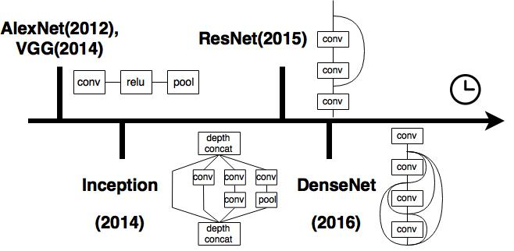
Architecture evolution
Top Accuracies:
Linear Networks: AlexNet(16.4%), VGG (7.3%)
Nonlinear Networks: Inception(6.7%), ResNet (3.6%), DenseNet(5.3%)
Notes:
Let’s take a review of network evolution since the imagent contest.
AlexNet is the first CNN based winner. Introduced in 2012, AlexNet has 9 sequential layers.
From the structure perspective, it is very similar to LeNet back to 1998,
that Yann Lecun (乐昆) used for the document recognition.
VGG also has a similar structure, consisting of 19 sequential layers.
From these two networks, we learned one important lesson:
Convolutional Neural Networks need many layers to work well.
Since 2014, the non-linear networks start to dominate.
GoogleNet was forerunner of nonlinear connections.
It shows a novel fan structure with each branch containing small convolutions.
The motivation is to replace one huge convolution,
with several small convolutions to improve, the memory and computation efficiency.
Please note all the architecture discussed so far are,
25 or less deep.
At that time, we can’t really go deep because of the “gradient vanishing” issue.
ResNet is the first architecture that reaches 100 layers. It introduces a novel join connection,
that practically solves the gradient vanishing issue.
In fact, this is the first network surpasses the human capability.
Motivated by this join concept, DenseNet uses a full join to further improve the computation efficiency of ResNet.

Slide 3
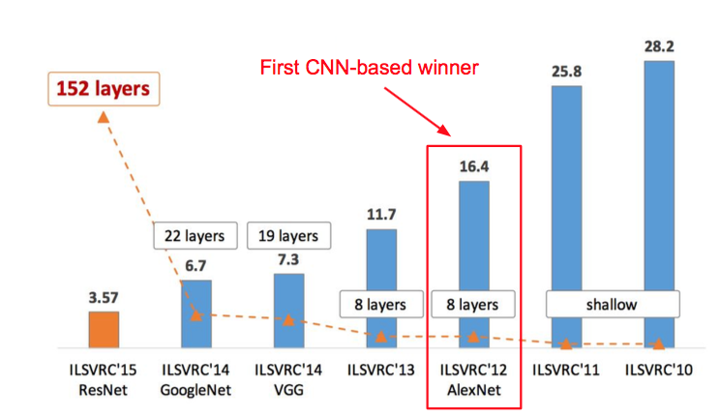
Depth matters
DEPTH
Figure copyright by Kaiming He, 2016
Notes:
I want to reinforce the importance of depth. The accuracy has always been improved from a deeper design since 2012.

Slide 4

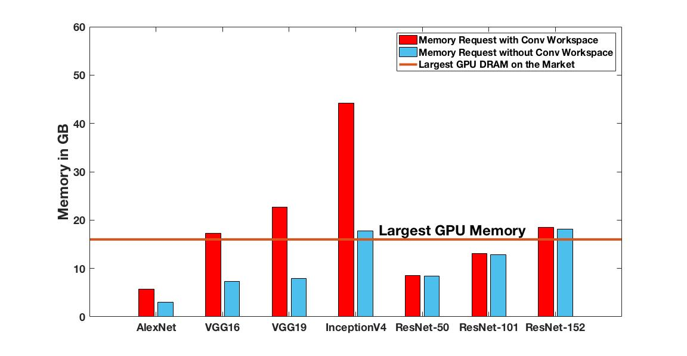

GPU memory shortage
even for
batch of
32
32
Notes:
Training Neural Networks on the GPU is a common practice nowadays.
(CLICK)
While the increasing depth in the neural network also drastically increases the memory demand for the GPU.
In this plot,
the red bar is the training memory demand with convolution workspace,
while the blue one is the memory demand without the convolution workspace.
Convolution workspace is used to speedup the convolution, thereby it is critical to the overall performance.
As of today, the largest onboard GPU RAM is only 16 GB,
but it is far from sufficient from satisfy the training, (CLICK)
even using batch of 32.

Slide 5




No Liveness Analysis, Limited Support in
Non-linear Networks
Memory Offloading
Trade
Computations
for Memory
The Largest Trainable Network
Is NOT Bounded by the Layer
Consuming the Most Memory
Notes:
Let’s take a look at how existing frameworks handle the memory shortage issue.
Caffe and Torch direct reuse the forward tensors in the backward computation, but this scheme is limited in the non-linear cases.
With a full support of data flow analysis, later developed TensorFlow and MXNet perform much better in the tensor reusing.
They also introduce other memory saving techniques.
TensorFlow offloads some memory to the CPU, but it fails to optimize the communication between CPU and GPU.
We propose an abstraction of Unified Tensor Pool (UTP) to address this issue.
MXNet trades computations for memory, but the strategy raises the peak memory for neglecting the none-uniform memory distribution. We propose Cost-aware re-computations to resolve this issue.
Most importantly, none of these frameworks achieve the best scenario in computing at the layer-wise granularity.
That is, a network should be trainable as long as the layer with the most memory usage can fit into the GPU.

Slide 6
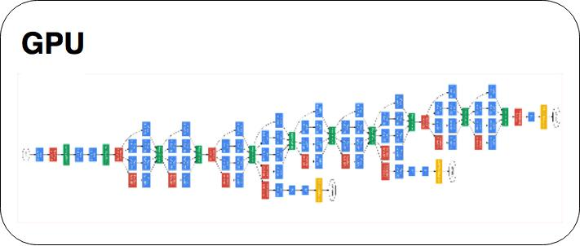
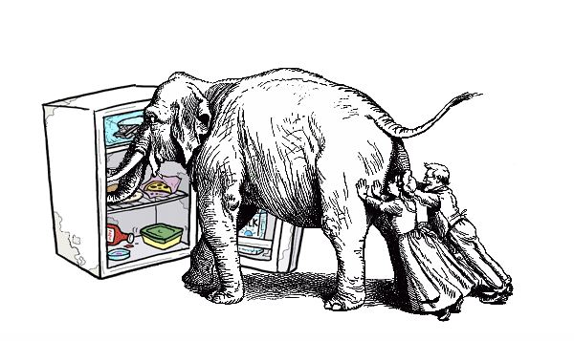

Our goal
Largest GPU DRAM
Training Memory Request
16 GB
1000 GB
how?
Notes:
So, we want to achieve this best case. Apart from that, we also want to maintain a high training speed.

Slide 7
Outline of our techniques
Liveness Analysis
Unified Tensor Pool
Cost-aware Re-computation
Notes:
We propose three memory optimization techniques to address this issue.
They are Liveness Analysis, Unified Tensor Pool, and Cost-aware Re-computations.
These three techniques jointly work together,
successfully reduce the network-wide peak memory usage ,
down to the maximal memory usage among layers.

Slide 8
computation patterns
LINEAR
None-LINEAR
AlexNet, VGG16 and VGG19
ResNet, Inception and DenseNet
join
fan
Static Dependency
Predictable
Dynamic Dependency
Unpredictable
Notes:
let’s analyze the data flow of linear and non-linear networks first.
In the linear networks, data is sequentially propagated in the forward pass;
and a layer’s backward computation simply depends on the previous layer.
Their computation and dependency patterns are static
regardless of the total layers involved,
and the dependency is predictable
even without pre-specifing the network architecture.
The dependencies are much more complicated in the non-linear cases.
We generalize two types of non-linear connections.
The first is join connections, which is used in ResNet and DenseNet.
It forwards the output of a layer to sevearl layers ahead.
The second is the fan connection, which is used in Inception Unit.
It spans multiple branches and merges them together.
In general, the data dependency is unpredictable
without pre-specifying the network architecture.

Slide 9
Opportunity 1: reusing at different time
Core Idea:
reuse the same physical memory at different time partitions
Liveness Analysis
Notes:
We found the first memory saving opportunity in the data flow.
The core observation here is
“ Not all the tensors are in use at the same time”.
For example, in the top left figure, the tensors in red
are no longer needed when back-propagated to POOL layer.
This is also true for the non-linear architecture on the right.
This implies we can reuse the same physical memory
at different time partitions, (CLICK)
and this motivates us applying Liveness Analysis in the training.

Slide 10
Liveness analysis, 50% memory saving
Step 1
t0
t0
CONV
CONV
POOL
FC
S
t0
CONV
CONV
POOL
FC
S
Live Tensor
Freed Tensor
t0,
Notes:
Here is an animation about how “liveness analysis” works.
In general, we will check the dependency of subsequent computation steps.
If a tensor will be needed, we keep the tensor “live”, and free them otherwise.
Let’s start with the forward propagation.

Slide 11
Liveness analysis, 50% memory saving
Step 2
t0
t0
t1
CONV
CONV
POOL
FC
S
t0
t1
CONV
CONV
POOL
FC
S
Live Tensor
Freed Tensor
t0, t1,
Notes:
Here we keep the output for the backward pass.

Slide 12
Liveness analysis, 50% memory saving
Step 3
t0
t0
t1
t2
CONV
CONV
POOL
FC
S
t0
t1
t2
CONV
CONV
POOL
FC
S
Live Tensor
Freed Tensor
t0, t1, t2,

Slide 13
Liveness analysis, 50% memory saving
Step 4
t0
t0
t1
t2
t3
CONV
CONV
POOL
FC
S
t0
t1
t2
CONV
CONV
POOL
FC
S
Live Tensor
Freed Tensor
t0, t1, t2, t3,

Slide 14
Liveness analysis, 50% memory saving
Step 5
t0
t0
t1
t2
t3
CONV
CONV
POOL
FC
S
t0
t1
t2
t4
CONV
CONV
POOL
FC
S
Live Tensor
Freed Tensor
t0, t1, t2, t4,
t3,
Notes:
We start to free the first tensor here, as T3 is no longer needed in the subsequent computations.

Slide 15
Liveness analysis, 50% memory saving
Step 6
t0
t0
t1
t2
t3
CONV
CONV
POOL
FC
S
t0
t1
t2
t4
CONV
CONV
POOL
FC
S
t5
Live Tensor
Freed Tensor
t0, t1, t2, t5,
t3, t4,

Slide 16
Liveness analysis, 50% memory saving
Step 7
t0
t0
t1
t2
t3
CONV
CONV
POOL
FC
S
t0
t1
t2
t4
t6
CONV
CONV
POOL
FC
S
t5
t6
Live Tensor
Freed Tensor
t0, t1, t6,
t2, t3, t4, t5,

Slide 17
Liveness analysis, 50% memory saving
Step 8
t0
t0
t1
t2
t3
CONV
CONV
POOL
FC
S
t0
t1
t2
t4
t7
t6
CONV
CONV
POOL
FC
S
t5
t6
Live Tensor
Freed Tensor
t0, t6, t7,
t1, t2, t3, t4, t5,

Slide 18
Liveness analysis, 50% memory saving
Step 9
t0
t0
t1
t2
t3
CONV
CONV
POOL
FC
S
t0
t1
t2
t4
t8
t7
t6
CONV
CONV
POOL
FC
S
t5
t6
Live Tensor
Freed Tensor
t6, t8,
t0, t1, t2, t3, t4, t5, t7,

Slide 19
Liveness analysis, 50% memory saving
Step 10
t0
t0
t1
t2
t3
CONV
CONV
POOL
FC
S
t0
t1
t2
t4
t8
t7
t6
CONV
CONV
POOL
FC
S
t5
t6
Live Tensor
Freed Tensor
t0, t1, t2, t3, t4, t5, t6, t7, t8
Notes:
Here I want to point out,
“Liveness Analysis” stash/free all the data tensors in a forward and backward pass.
This involves a lot of memory allocation and de-allocation.
If use cudaMalloc and cudaFree, it incurs significant overhead.
So, these heavy memory operations must be optimized.

Slide 20
Liveness analysis, 50% memory saving
Step 5
Max Memory !!!
t0
t0
t1
t2
t3
CONV
CONV
POOL
FC
S
t0
t1
t2
t4
CONV
CONV
POOL
FC
S
Liveness Analysis
Baseline
t0, t1, t2, t4,
t0, t1, t2, t3, t4, t5, t6, t7, t8
4 Tensors
9 Tensors
Notes:
Let’s use the baseline of keeping all the tensors in the GPU.
We compare the effect of liveness analysis against the baseline.
With liveness analysis, we reach the maximal memory at Step 5 with 4 live tensors,
while the baseline uses 9 tensors.
This demonstrates over half memory reduction.
In general, we start freeing tensors in the backward,
therefore liveness analysis offers round 50% memory saving.

Slide 21
Liveness analysis, on alexNet
Notes:
AlexNet has 23 forward steps and 23 backward steps;
The forward and backward steps are splitted by the black vertical line in the middle.
This figure tells us the memory and tensor profile about the baseline.
The blue axis is the memory usage, while the orange axis is the live tensor count.
Since the baseline keeps all the tensor in the GPU RAM, they are two horizontal lines.

Slide 22
Liveness analysis, on alexNet
Notes:
After applying the liveness analysis,
the blue line represents the actual memory usage at individual steps,
while the orange line represents the live tensor counts.
We see live tensor counts keep increasing in the forward,
and start decreasing in the backward.
With liveness analysis, the peak memory gets reduced by almost 800 MB from the baseline.

Slide 23
Liveness analysis, performance issue
Problem:
Frequent Memory Operations, e.g. Malloc and Free
Solution:
Pre-allocated Heap
Notes:
As I stressed out earlier, Liveness Analysis involves a lot of heavy memory operations.
We propose a pre-allocated heap to solve this issue.
Basically, we initialize a huge memory pool at the beginning,
and directly reuse the memory for allocation.
The figure demonstrates the speedup of using proposed pre-allocated heap to the cudaMalloc and cudaFree.
The speed up on deep networks,
such as ResNet, is more obvious on
Shallow the networks， such as AlexNet and VGG.
Because deep networks involve more tensors in a training iteration.

Slide 24
Opportunity 2: using external buffer
Notes:
We observe the second memory saving opportunity in the computation patterns. (CLICK) (CLICK)
The top figure is the percentage of computation, while the bottom figure is the memory usage.
As highlighted in the figure, Convolution dominates most of the time,
suggesting the opportunity to overlap communications with computations.
This motivates us to use an external memory pool for offloading.

Slide 25
Unified Tensor POOL (UTP)
Key Operations:
Offload
Pre-fetch
Move outputs of CONV layers to CPU DRAM
Retrieve outputs of CONV layers back to GPU
Extensible to Various Physical Memory Pools
Notes:
So, the second memory reduction technique proposed by us is “Offload and Pre-fetch”.
Offload is to move outputs of CONV layers to CPU DRAM,
while Pre-fetch is to retrieve the offloaded outputs back to GPU.
In our implementation, we use the relatively large CPU DRAM as a the external buffer for tensor offloading.
But the concept is extensible to a broad physical memory. (CLICK)
We propose an Unified Tensor Pool Abstraction or UTP to integrate various physical memory.
The runtime allocates tensors, and each tensor requests memory from the UTP.
UTP manages the actual memory locations, and it can be located at the local CPU DRAM, or other remote places such as other Network GPU DRAM.
Each remote allocations need communications to retrieve the actual content,
and the communication type depends on the location of remote memory.
For example, If the memory is at other network CPU DRAM, the communication can be RDMA.

Slide 26
Pre-fetch and offload
Step 1
Offload
Pre-fetch
GPU
DRAM
t0
t0
CONV
CONV
POOL
FC
S
t0
CONV
CONV
POOL
FC
S
CPU
DRAM
Live Tensor
Freed Tensor
CPU:
GPU: t0,
Notes:
This is an animation about how “offload and pre-fetch” work in a typical training iteration.

Slide 27
Pre-fetch and offload
Step 2
Offload(t0)
Pre-fetch
GPU
DRAM
t1
CONV
CONV
POOL
FC
S
t1
CONV
CONV
POOL
FC
S
CPU
DRAM
t0,
Live Tensor
Freed Tensor
CPU: t0,
GPU: t1,
Notes:
Here, we do offload right after the first CONV,
and the communication will overlap with the second convolution.
Generally, we do offload after a convolution layer,
and sync the event after the next convolution layer.
This enables communication to overlap with the computation
starting from the current CONV layer to the next one.

Slide 28
Pre-fetch and offload
Step 3
Offload(t1)
Pre-fetch
GPU
DRAM
t2
CONV
CONV
POOL
FC
S
t2
CONV
CONV
POOL
FC
S
CPU
DRAM
t0, t1,
Live Tensor
Freed Tensor
CPU: t0, t1,
GPU: t2,
Notes:
Here we offload the t1 to CPU DRAM, and we sync t1 at layer s.
This enables communications to overlap with computations in the subsequent layers
including POOL, Fully Connected and Softmax.

Slide 29
Pre-fetch and offload
Step 4
Offload
Pre-fetch
GPU
DRAM
t2
t3
CONV
CONV
POOL
FC
S
t2
CONV
CONV
POOL
FC
S
CPU
DRAM
t0, t1,
Live Tensor
Freed Tensor
CPU: t0, t1,
GPU: t2, t3,

Slide 30
Pre-fetch and offload
Step 5
Offload
Pre-fetch
GPU
DRAM
t2
t3
CONV
CONV
POOL
FC
S
t2
t4
CONV
CONV
POOL
FC
S
CPU
DRAM
t0, t1,
Live Tensor
Freed Tensor
CPU: t0, t1,
GPU: t2, t4,
t3,

Slide 31
Pre-fetch and offload
Step 6
Offload
Pre-fetch
GPU
DRAM
t2
t3
CONV
CONV
POOL
FC
S
t2
t4
CONV
CONV
POOL
FC
S
t5
CPU
DRAM
t0, t1,
Live Tensor
Freed Tensor
CPU: t0, t1,
GPU: t2, t5,
t3, t4,

Slide 32
Pre-fetch and offload
Step 7
Offload
Pre-fetch(t1)
GPU
DRAM
t1
t2
t3
CONV
CONV
POOL
FC
S
t1
t2
t4
t6
CONV
CONV
POOL
FC
S
t5
CPU
DRAM
t0, t1,
Live Tensor
Freed Tensor
CPU: t0, t1,
GPU: t6
t3, t4, t5, t2,
Notes:
We can pre-fetch the tensors of several layers ahead
if they are located on the CPU DRAM.
Here we set the pre-fetch distance to 1,
therefore we prefetch t1 for POOL layer at FC layer.

Slide 33
Pre-fetch and offload
Step 8
Offload
Pre-fetch(t0)
GPU
DRAM
t0
t0
t1
t2
t3
CONV
CONV
POOL
FC
S
t0
t1
t2
t4
t7
t6
CONV
CONV
POOL
FC
S
t5
CPU
DRAM
t0,
Live Tensor
Freed Tensor
CPU: t0,
GPU: t6, t7,
t3, t4, t5, t2, t1
Notes:
Similarly, we prefetch t0 for the second CONV layer at POOL.

Slide 34
Pre-fetch and offload
Step 9
Offload
Pre-fetch
GPU
DRAM
t0
t0
t1
t2
t3
CONV
CONV
POOL
FC
S
t0
t1
t2
t4
t8
t7
t6
CONV
CONV
POOL
FC
S
t5
CPU
DRAM
Live Tensor
Freed Tensor
CPU:
GPU: t6, t8,
t3, t4, t5, t2, t1, t0, t7

Slide 35
Pre-fetch and offload
Step 10
Offload
Pre-fetch
GPU
DRAM
t0
t0
t1
t2
t3
CONV
CONV
POOL
FC
S
t0
t1
t2
t4
t8
t7
t6
CONV
CONV
POOL
FC
S
t5
CPU
DRAM
Live Tensor
Freed Tensor
CPU:
GPU:
t3, t4, t5, t2, t1, t0, t7, t6, t8,

Slide 36
Liveness analysis, Pre-fetech and offload on alexNet
Liveness Analysis
Notes:
This figure is the memory and tensor profile with only liveness analysis,
it is brought from the pervious slide.

Slide 37
Liveness analysis, Pre-fetech and offload on alexNet
Liveness Analysis + Pre-fetch and Offload
Notes:
After applying Prefetch and Offloading,
the peak memory has been further reduced by 350 MB
by offloading the outputs of convolution layers.

Slide 38
The problem of on-demand offload and pre-fetch
What if a subset of network can fit in GPU DRAM?
LRU based Tensor Cache
Notes:
The pre-fetch and offloading always swap the tensors. However, this is unnecessary if GPU memory is big enough.
To solve this issue, we built a LRU based tensor cache on the top of GPU DRAM
to avoid unnecessary communications.
Please refer to our paper for specific LRU operations,
We agree LRU is not necessary the optimal cache replacement policy to be used in this case.
Since our goal is to reduce down communications, LRU works well in this sense.
Figuring out an optimal tensor replacement policy can be a good future work.

Slide 39

Benefits of Tensor Cache
Notes:
Here are the evaluations of Tensor Cache.
We increase the batch size for AlexNet from 256 to 1024.
Without tensor cache, the communications linearly increase with the batch size.
With Tensor Cache, the communications remain zero till the batch size reaches 1024.
The bar plot demonstrates the speed up brought by the tensor cache.
Because the communication can not perfectly overlap with the computations,
we see the performance gain with less communications.

Slide 40
Opportunity 3: using external buffer
Cost-aware Re-computations
Notes:
We also observe the third memory saving opportunity the computation pattern.
The time of non-convolution layers such as Activation and Batch Normalization are relatively small,
but the memory usages of these layers are not trivial.
These are highlighted by the red box in both figures.
So, it suggests an opportunity to reconstruct their results with little extra computations. (CLICK)
We introduce a new cost-aware re-computation strategy to
maintain a good performance
while the core idea of the re-computation for memory
is to re-construct the forward dependency from the nearby convolution layers.
Let’s first exam two basic re-computation strategy, Memory Centric and Speed Centric strategy.

Slide 41
How to re-compute? Memory centric strategy
t0
CONV
ACT
POOL
BN
ACT
t0
CONV
ACT
POOL
BN
ACT
Max Live Tensor: 1
Notes:
Memory centric strategy is designed for saving the most memory.

Slide 42
How to re-compute? Memory centric strategy
t0
t1
CONV
ACT
POOL
BN
ACT
t0
t1
CONV
ACT
POOL
BN
ACT
Max Live Tensor: 2
Notes:
Let’s first compute the forward. During the forward, we free the outputs of none convolution layers for the re-construction.

Slide 43
How to re-compute? Memory centric strategy
t0
t2
CONV
ACT
POOL
BN
ACT
t0
t2
CONV
ACT
POOL
BN
ACT
Max Live Tensor: 2

Slide 44
How to re-compute? Memory centric strategy
t0
t3
CONV
ACT
POOL
BN
ACT
t0
t3
CONV
ACT
POOL
BN
ACT
Max Live Tensor: 2

Slide 45
How to re-compute? Memory centric strategy
t0
t4
CONV
ACT
POOL
BN
ACT
t0
CONV
ACT
POOL
BN
ACT
Max Live Tensor: 2

Slide 46
How to re-compute? Memory centric strategy
t0
t1
CONV
ACT
POOL
BN
ACT
t0
t1
t5
CONV
ACT
POOL
BN
ACT
Recomputed layers: 1
Max Live Tensors: 3
Notes:
For the backward of ACT, it needs the output of BN layer. It reconstructs the BN output from the CONV layer.

Slide 47
How to re-compute? Memory centric strategy
t0
t2
CONV
ACT
POOL
BN
ACT
t0
t2
t5
CONV
ACT
POOL
BN
ACT
Recomputed layers: 2
Max Live Tensor: 3

Slide 48
How to re-compute? Memory centric strategy
t0
t3
CONV
ACT
POOL
BN
ACT
t0
t3
t5
CONV
ACT
POOL
BN
ACT
Recomputed layers: 3
Max Live Tensor: 3

Slide 49
How to re-compute? Memory centric strategy
t0
t1
CONV
ACT
POOL
BN
ACT
t0
t1
t6
CONV
ACT
POOL
BN
ACT
Recomputed layers: 4
Max Live Tensor: 3

Slide 50
How to re-compute? Memory centric strategy
t0
t2
CONV
ACT
POOL
BN
ACT
t0
t2
t6
CONV
ACT
POOL
BN
ACT
Recomputed layers: 5
Max Live Tensor: 3

Slide 51
How to re-compute? Memory centric strategy
t0
t1
CONV
ACT
POOL
BN
ACT
t0
t1
CONV
POOL
t7
ACT
ACT
BN
Recomputed layers: 6
Max Live Tensor: 3

Slide 52
How to re-compute? Memory centric strategy
t0
CONV
ACT
POOL
BN
ACT
t0
CONV
ACT
t8
POOL
BN
ACT
Recomputed layers: 6
Max Live Tensor: 3

Slide 53
How to re-compute? Memory centric strategy
t0
CONV
ACT
POOL
BN
ACT
t0
CONV
t9
ACT
POOL
BN
ACT
Recomputed layers: 6
Max Live Tensor: 3
Pros: the least live tensors
Cons: the most re-computations
Memory is bounded by the layer with the maximal memory usage
Notes:
As you can see, the benefits of memory centric strategy is the least memory, but the downside is the most re-computations.
If the length of re-computation segment is N, we need re-compute up to N^2 layers.
Please also note, the segment memory usage is bounded by the layer with the maximal memory usage along the re-computation path.

Slide 54
How to re-compute? Speed centric strategy
t0
t1
CONV
ACT
POOL
BN
ACT
t0
t1
t6
CONV
ACT
POOL
BN
ACT
Recomputed layers: 1
Max Live Tensor: 3
Notes:
The second basic strategy is the speed centric strategy. It is deigned for the minimal re-computation.
In general, we re-compute once and store the recomputed tensors to reuse them for the subsequent backward layers.
Here is an animation:
we starts recomputing dependencies for the backward ACT layer.

Slide 55
How to re-compute? Speed centric strategy
t0
t1
t2
CONV
ACT
POOL
BN
ACT
t0
t1
t2
t6
CONV
ACT
POOL
BN
ACT
Recomputed layers: 2
Max Live Tensor: 4
Notes:
We store intermediate tensors, such as t1, t2 for reusing at backward POOL and BN.

Slide 56
How to re-compute? Speed centric strategy
t0
t1
t2
t3
CONV
ACT
POOL
BN
ACT
t0
t1
t2
t3
t6
CONV
ACT
POOL
BN
ACT
Recomputed layers: 3
Max Live Tensor: 5
Notes:
Now we have the dependency for the ACT layer.

Slide 57
How to re-compute? Speed centric strategy
t0
t1
t2
t3
CONV
ACT
POOL
BN
ACT
t0
t1
t2
t3
CONV
POOL
t7
ACT
ACT
BN
Recomputed layers: 3
Max Live Tensor: 5
Notes:
We can directly reuse the t2 for BN layer.

Slide 58
How to re-compute? Speed centric strategy
t0
t1
t2
t3
CONV
ACT
POOL
BN
ACT
t0
t1
t2
t3
CONV
ACT
t8
POOL
BN
ACT
Recomputed layers: 3
Max Live Tensor: 5
Notes:
Similiarly, we reuse t1.

Slide 59
How to re-compute? Speed centric strategy
t0
t1
t2
t3
CONV
ACT
POOL
BN
ACT
t0
t1
t2
t3
CONV
t9
ACT
POOL
BN
ACT
Recomputed layers: 3
Max Live Tensor: 5

Slide 60
Speed centric V.s. Memory Centric
t0
t1
t2
t3
CONV
ACT
POOL
BN
ACT
t0
t1
t2
t3
CONV
ACT
POOL
BN
ACT
Speed Centric:
Recomputed layers: 3
Max Live Tensor: 5
Memory Centric:
Recomputed layers: 6
Max Live Tensor: 3
Pros: the least re-computations
Cons: the most live tensors
Notes:
Here is a comparison between the speed centric strategy and the memory centric strategy.
The Speed Centric Strategy bounds the network peak memory to the memory usage of a re-computation segment,
but it incurs the least additional computations.
The attributes of memory centric strategy is the opposite,
It bounds the network wide peak memory usage to the memory usage of a layer,
but it incurs a lot re-computations.
Our goal here is to take advantages of the least memory in the memory centric strategy
but also the least re-computation in the speed centric strategy.

Slide 61
Cost-aware re-computations
GOAL: combine pros of both approaches
Iterate through the network to find the bottleneck layer with the maximal layer-wise memory usage
For a re-computation segment: if( segment memory < bottleneck memory ): use the speed centric strategy else use the memory centric strategy
Speedup
constrain
peak memory
Notes:
We propose a cost-aware re-computation strategy to achieve this goal.
The key observation is the memory distribution of recomputation segments are not uniform.
Here is a basic steps of cost-aware re-computations:
First, we try to find the layer with the maximal memory usage, and we set it as the bottleneck.
If the memory usage of a re-computation segment is less than the bottleneck,
We use the speed centric strategy to speedup the process.
Otherwise, we use the memory centric strategy to constraint the peak memory below the bottleneck.
The bar plot on the left is the number of recomputed layers of 3 strategies, while the bar plot on the right is the peak memory usage.
On AlexNet and ResNet 50 and 101, we see cost-aware strategy has the similar recomputed layers with the speed centric strategy (it’s the red and yellow bars in the left figure), and the peak memory usage is identical to the memory centric one (it’s the green and yellow bars in the right figure).

Slide 62
Cost-aware recomputations on alexnet
Liveness Analysis + Pre-fetch and Offload
Notes:
This figure is the memory and tensor profile with Liveness Analysis + Prefetch and Offload.

Slide 63
Cost-aware recomputations on alexnet
Liveness Analysis + Pre-fetch and Offload + Cost-aware Re-computations
Notes:
The newly added curves are the memory and live tensor profile for 3 memory optimization techniques.
In AlexNet, the bottleneck layer uses around 900 MB, it’s the horizontal red line.
We can see 3 memory optimization techniques consistently keep the memory usage at each step below the bottleneck. This is the best we can do if compute at the layer granularity.

Slide 64
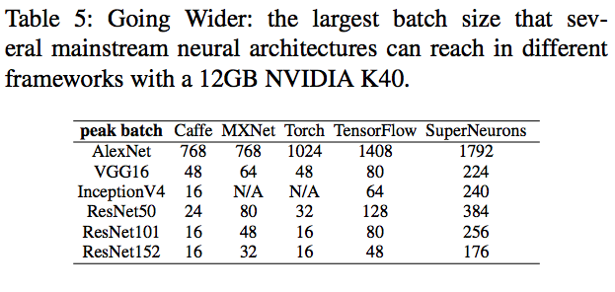
Overall Evaluations
Going Wider
Notes:
Okay, here are evaluations of 3 memory optimization techniques against TensorFlow, Torch MxNet and Caffe.
First, we increase the batch size to make the network wider
to see what’s the largest batch size can be handled by each frameworks.
Table 5 demonstrates our runtime consistently outperforms all the major DL frameworks,
and the bottom figure is the corresponding memory usage for the each peak batch.
Our framework can handle up to 20 times wider network than Caffe.

Slide 65
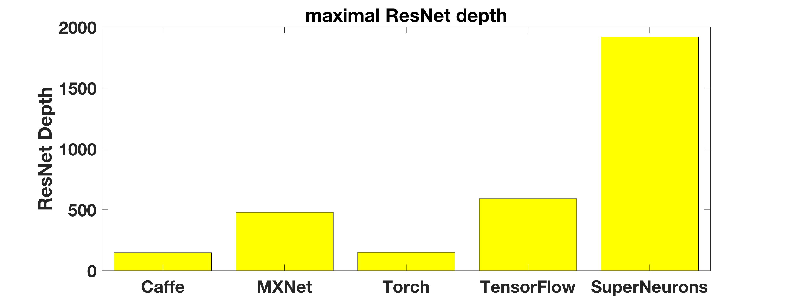
Overall Evaluations
Going Deeper
Note: depth = 3*(n1 + n2 + n3 + n4)+2. We fix n1 =6, n2 =32, and n4 =6, while adding n3 to increase the depth.
Notes:
We also try to increase the depth of ResNet to see what’s the deepest ResNet
that each framework can train.
In this case, our runtime trains almost 4 times deeper ResNet than the second best TensorFlow.

Slide 66
speed Evaluations
AlexNet
ResNet101
Inception v4
VGG 16
Notes:
Here is an evaluation of speed among different frameworks.
Our runtime consistent delivery the leading speed even though we can handle a much bigger network.
There is a trend for the performance to decrease with the increasing batch size. This is because of the increasing communications,
and it is hard to perfectly overlap computations with communication especially on the non-linear networks.

Slide 67
Thank you, Questions?
Notes:
That’s my talk today, and please let me know if you have any questions. Thank you.

Slide 68
Backup slides

Slide 69
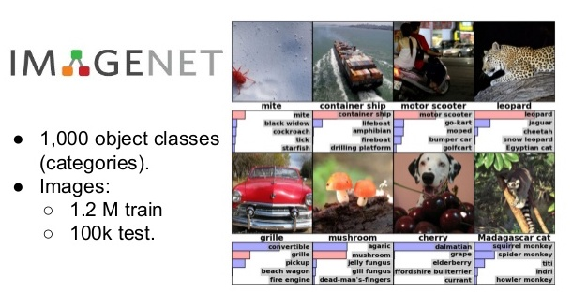
Imagenet 1k contest
Figure ©ImageNet
Notes:
Okay, let’s start with a brief introduction of the 1K ImageNet contest. Launched in 2010, ImageNet provides 1.2 million training images to classify them into 1000 object categories. Given an image, it asks the algorithm to provide top-5 guesses. If none of them is correct, we say the prediction is incorrect. This is referred to as the top-5 error rate.

Slide 70
Solving Imagenet with deep learning and GPU
Figure ©Kaiming He
Notes:
In 2011 and 2010, most teams use shallow methods from traditional Computer Vision algorithms such as SIFT. Those methods delivery up to 75% accuracies, as shown by the two leftmost bars.
In 2012, Alex and Geoffrey E. Hinton introduced the first CNN based winner, AlexNet. The network has 8 sequential layers, and it drastically improves the error of shallow methods. This marks a milestone of deep learning revolution. In the subsequent years, all the winners used CNN based models to improve the accuracy. As of today, the best CNN model has successfully surpassed the human in dealing with the image recognition task.

Slide 71
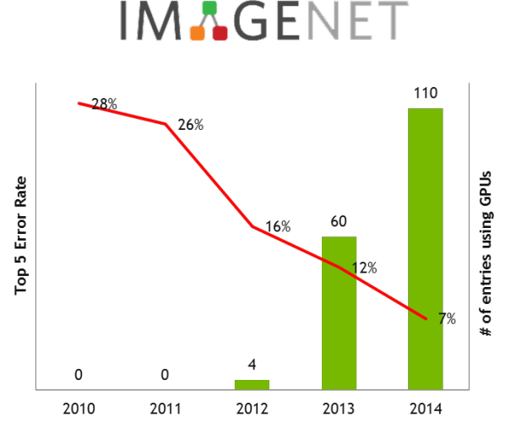
Solving Imagenet with deep learning and GPU
92%
83%
18%
Figure ©NVIDIA
Notes:
Training an Neural Network is extremely computing-intensive. With high floating point throughput, almost every teams deploy the network training on GPUs for the high performance. This figure demonstrates the number of teams using GPU in the ImageNet contest from 2010 to 2014. The trend is consistent with the DL revolution. Almost every team used GPU in 2014.
Therefore, GPU is an important tool for the neural network training nowadays.

Slide 72
Basic LRU operations
LRU in: place the tensor in the front
LRU out: 1. check the free memory 2. IF: free memory < tensor memory: offload unlocked tensors into CPU till enough memory 4. malloc the GPU memory
Check(LRU, Tensor): 1. isFound = LRU.find(Tensor) 2. IF: isFound, place to the LRU front 3. ELSE:
try malloc(Tensor) on GPU
IF: not enough memory:
LRU.out() ELSE:
LRU.in()
LRU is not optimal
Read the paper
Notes:
This slides demonstrates 3 basic operations in the LRU.
First, LRU-in places an tensor in the cache to the most frequently used position.
Second, LRU-out seek memory for a new tensors by offloading the least frequently used ones to the CPU.
Third, LRU-check provisions GPU RAM for a tensor. It first checks if the tensor is already in the cache. If yes, it place to the front.
If this is a new tensor, it tries to malloc GPU memory. If the GPU memory is not enough, we invoke LRU.out to offload those the least frequently used tensors to free memory. Otherwise, we place it into the LRU with LRU.in().
These are pretty much the standard LRU operations.

