Slide 1

Project Title -
[Student Name:-Pudari Naga Santhosh
College Name:- Oriential University ]
AICTE STU ID : (STU6a66d61c324831785124380)

Slide 2

PROBLEM STATEMENT
Agricultural activities are influenced by seasonal variations in environmental conditions, farming practices, resource availability and market conditions. As a result, agricultural performance may differ from one season to another. However, raw agricultural data does not clearly explain how agricultural performance changes across seasons or what patterns can be observed in different seasonal conditions. The problem is to analyze the given agricultural dataset and investigate seasonal differences in agricultural performance by identifying meaningful patterns, trends, relationships and variations within the available data.

Slide 3
Project Description End-to-end data analytics project examining agricultural performance across Kharif, Rabi, and Zaid seasons using Python, Pandas, and Seaborn. Investigates crop yields, resource efficiency, irrigation impacts, and farm profitability to deliver data-driven planning recommendations.]

Slide 4

WHO ARE THE END USERS?
Farmers: Choose profitable crops, adopt drip irrigation, and avoid summer losses.
​Government & Policy Makers: Plan irrigation subsidies, set support prices, and design seasonal agricultural schemes.
​Agricultural Extension Officers: Guide farming communities with weather-based crop advice and pest-control schedules. ​
Crop Insurance & Banks : Assess seasonal farm risks to approve loans and settle crop insurance claims.
​Agri-Input Companies: Plan seasonal supply and distribution of seeds, fertilizers, and pesticides.

Slide 5

Technology Used
Python
Pandas
numpy
Matplotlib
Seaborn
SciPy

Slide 6
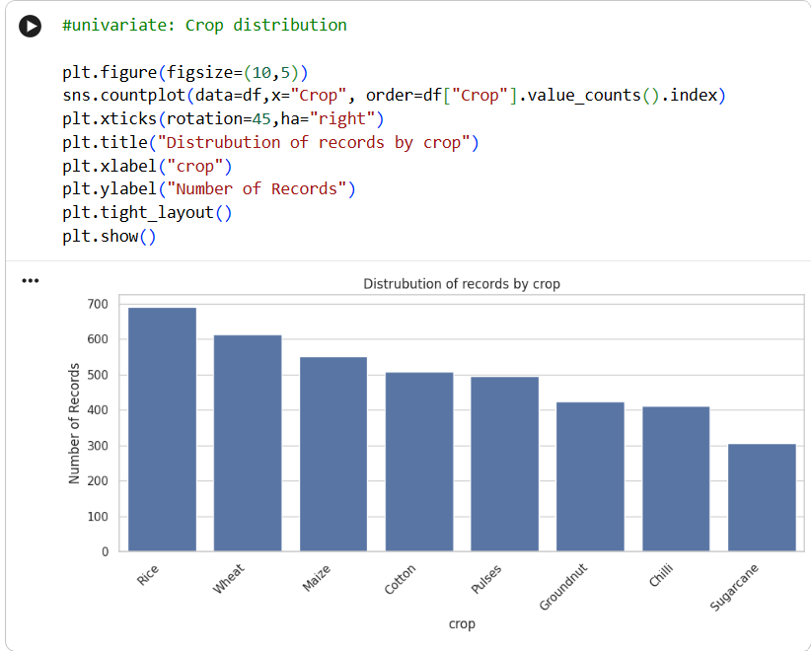
RESULTS
[Add screen shots of your code ]

Slide 7
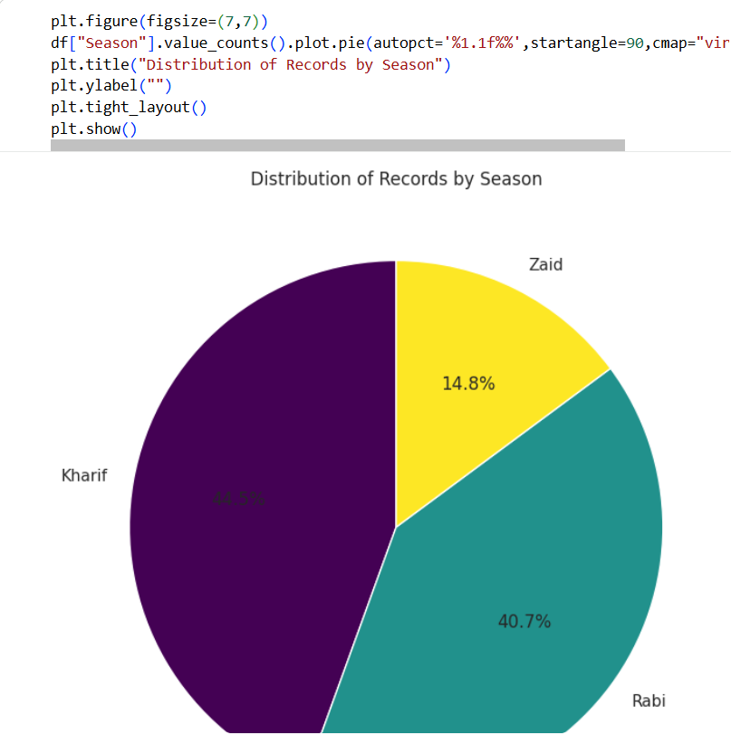
RESULTS
[Add screen shots of your code ]

Slide 8
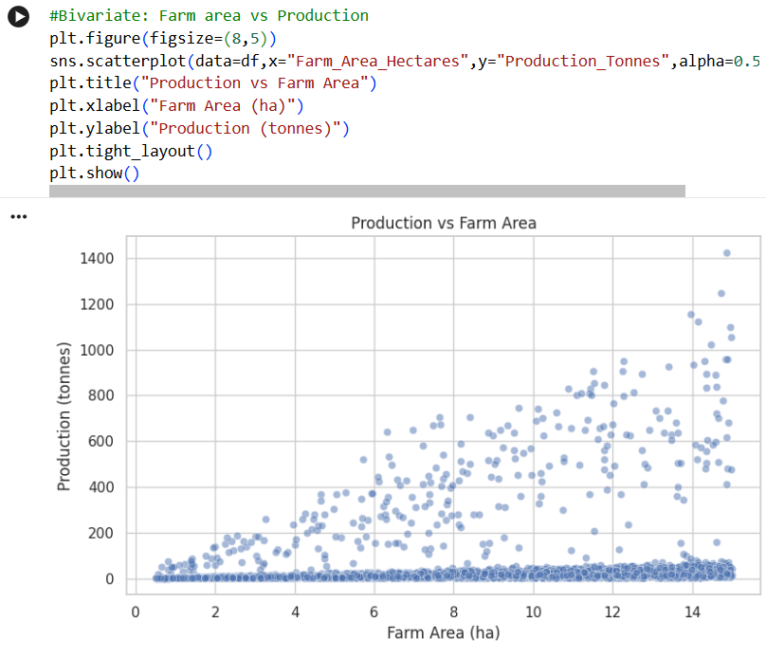
RESULTS
[Add screen shots of your code ]

Slide 9
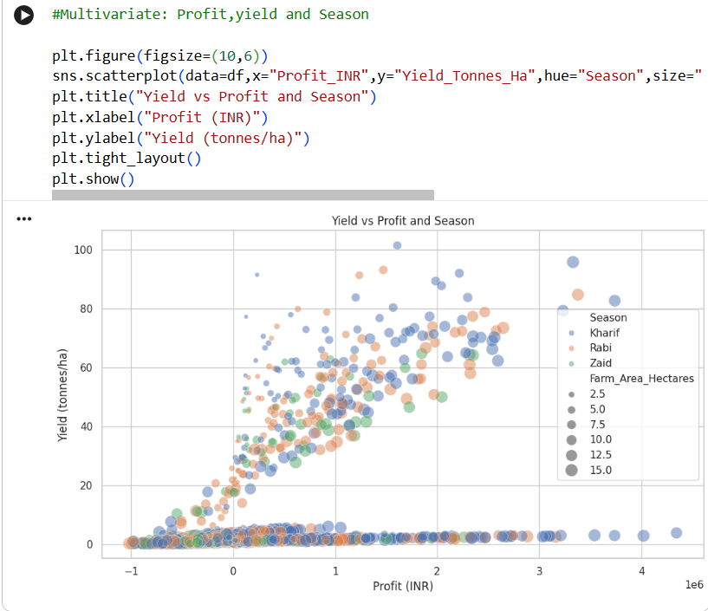
RESULTS
[Add screen shots of your code ]

Slide 10
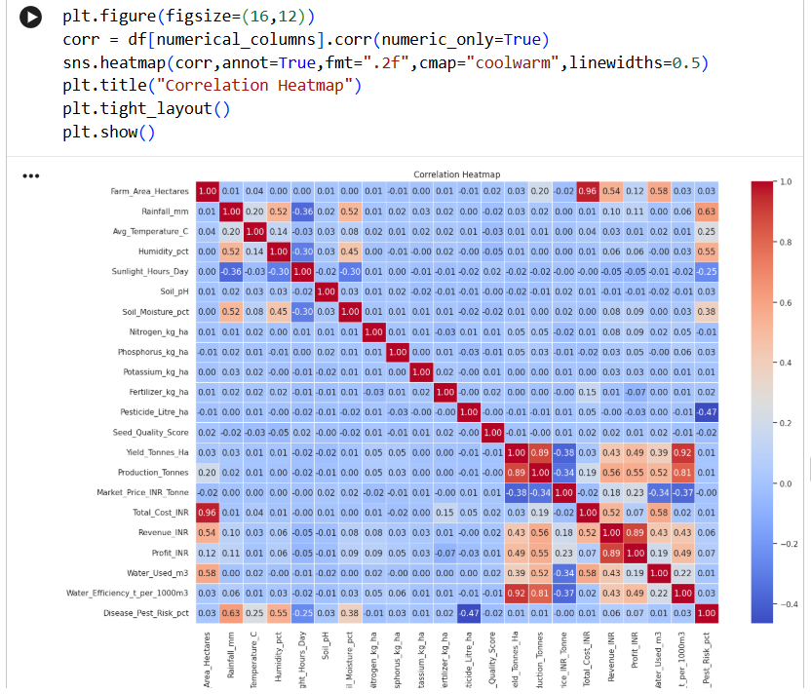
RESULTS
[Add screen shots of your code ]

Slide 11
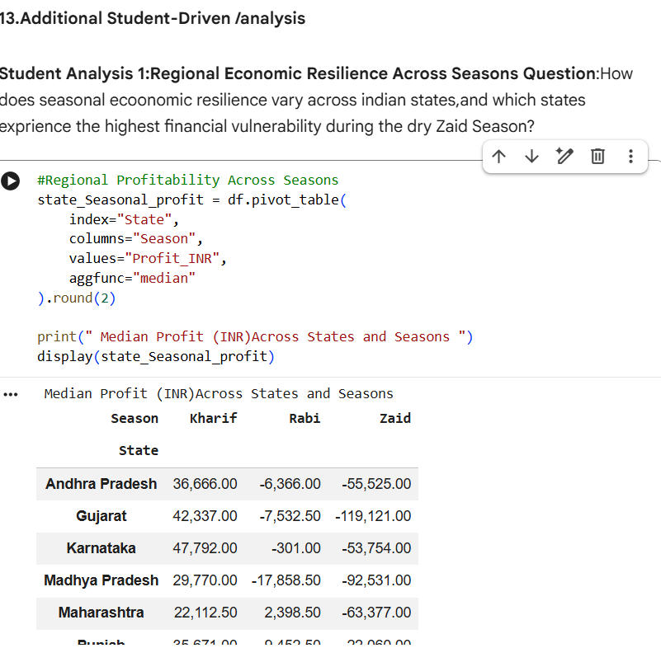
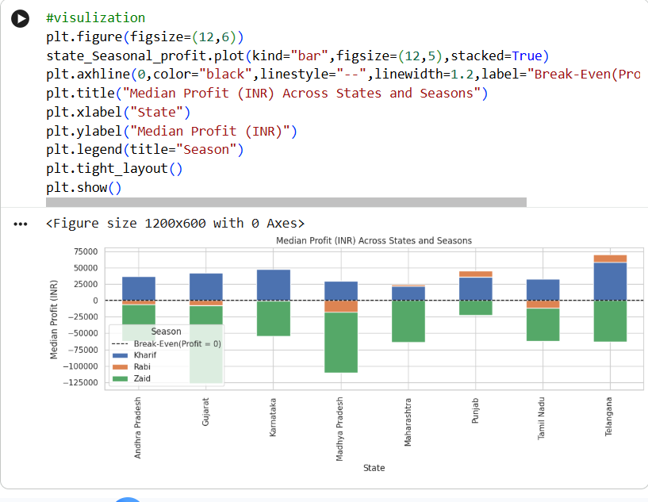

Slide 12
Future scope
Predictive ML Models: Train machine learning models to forecast crop yield and profit before sowing based on climate forecasts and soil quality.
​Multi-Year Trend Analysis: Add data from multiple consecutive years to study long-term monsoon shifts, climate change patterns, and soil nutrient depletion over time.
Smart IoT Irrigation: Connect the water-usage findings with real-time soil moisture sensors to automate drip irrigation and prevent water waste.
​Crop Advisory Engine: Build an app that suggests the most profitable, low-risk crops for a farmer's specific land size and seasonal climate.
​Policy and Subsidy Modeling: Simulate how government subsidies for drip irrigation equipment can reduce farm losses during dry seasons.
​Interactive Web Dashboard: Create a simple Streamlit dashboard where farmers and agricultural officers can simulate different farming scenarios and compare expected returns.

Slide 13
GitHub Link
https://github.com/pudarisanthosh07-ai/Seasonal-Agriculture-performance-dataset.git

Slide 14

VOIS Course completion certificate - Course name- Data Visualization

Slide 15
Thank you
.
.

