Slide 1


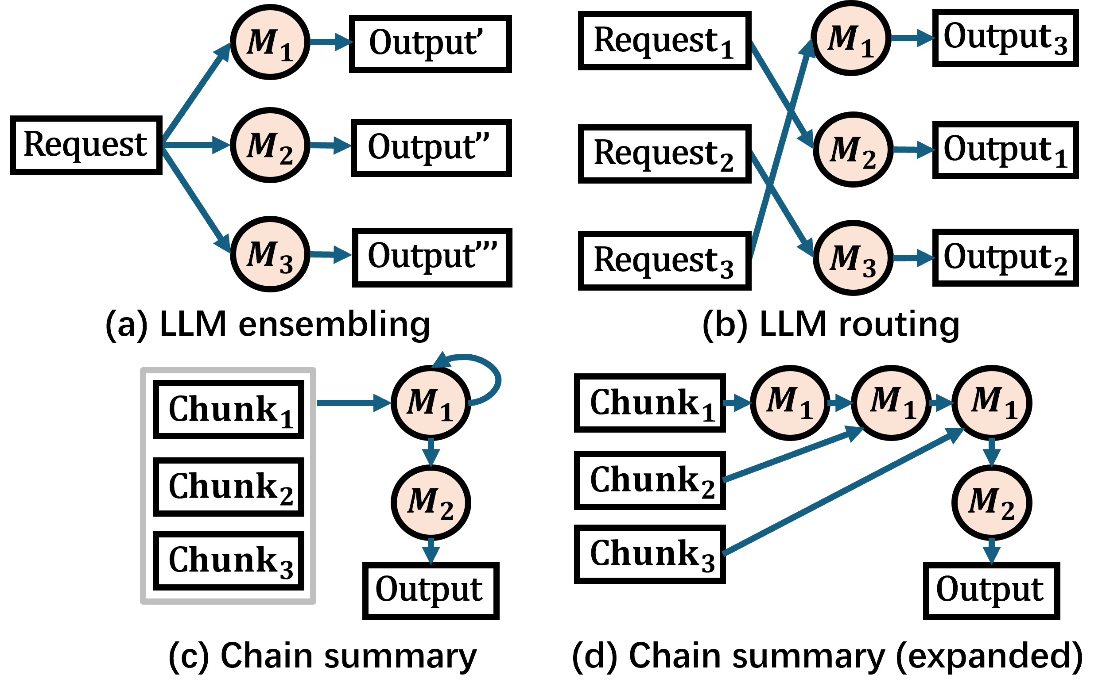
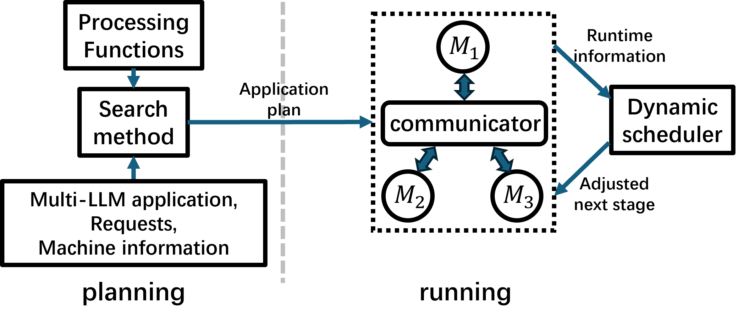
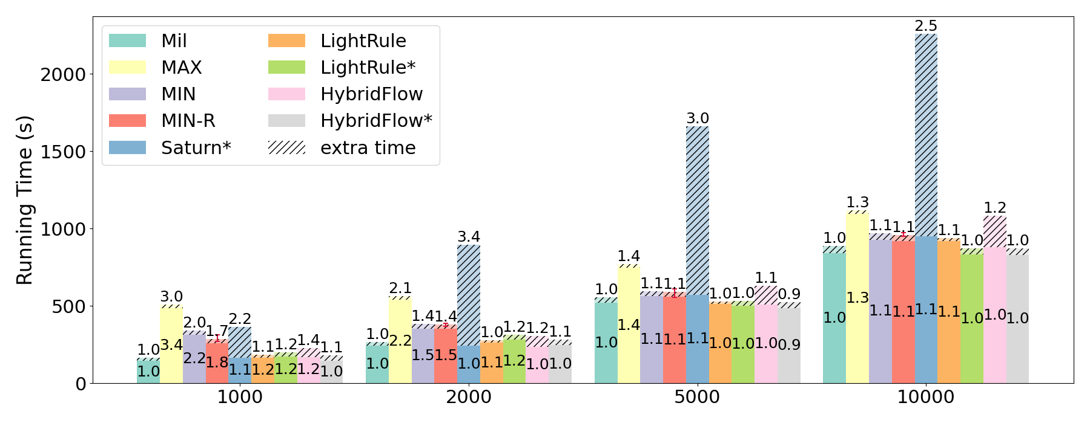
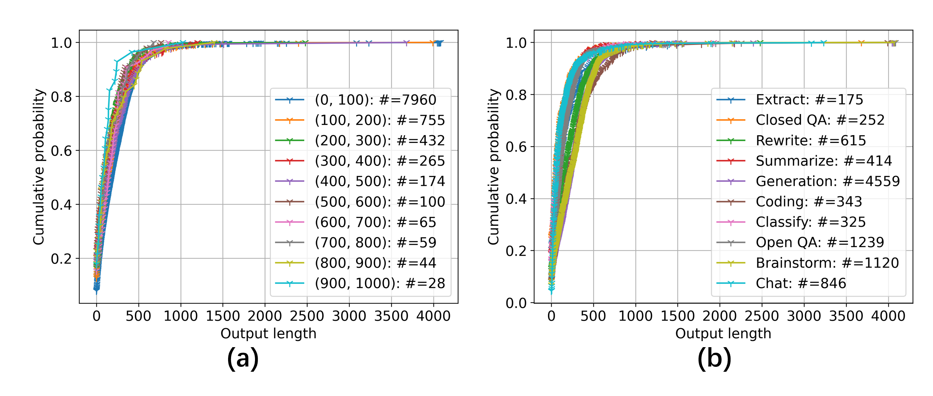
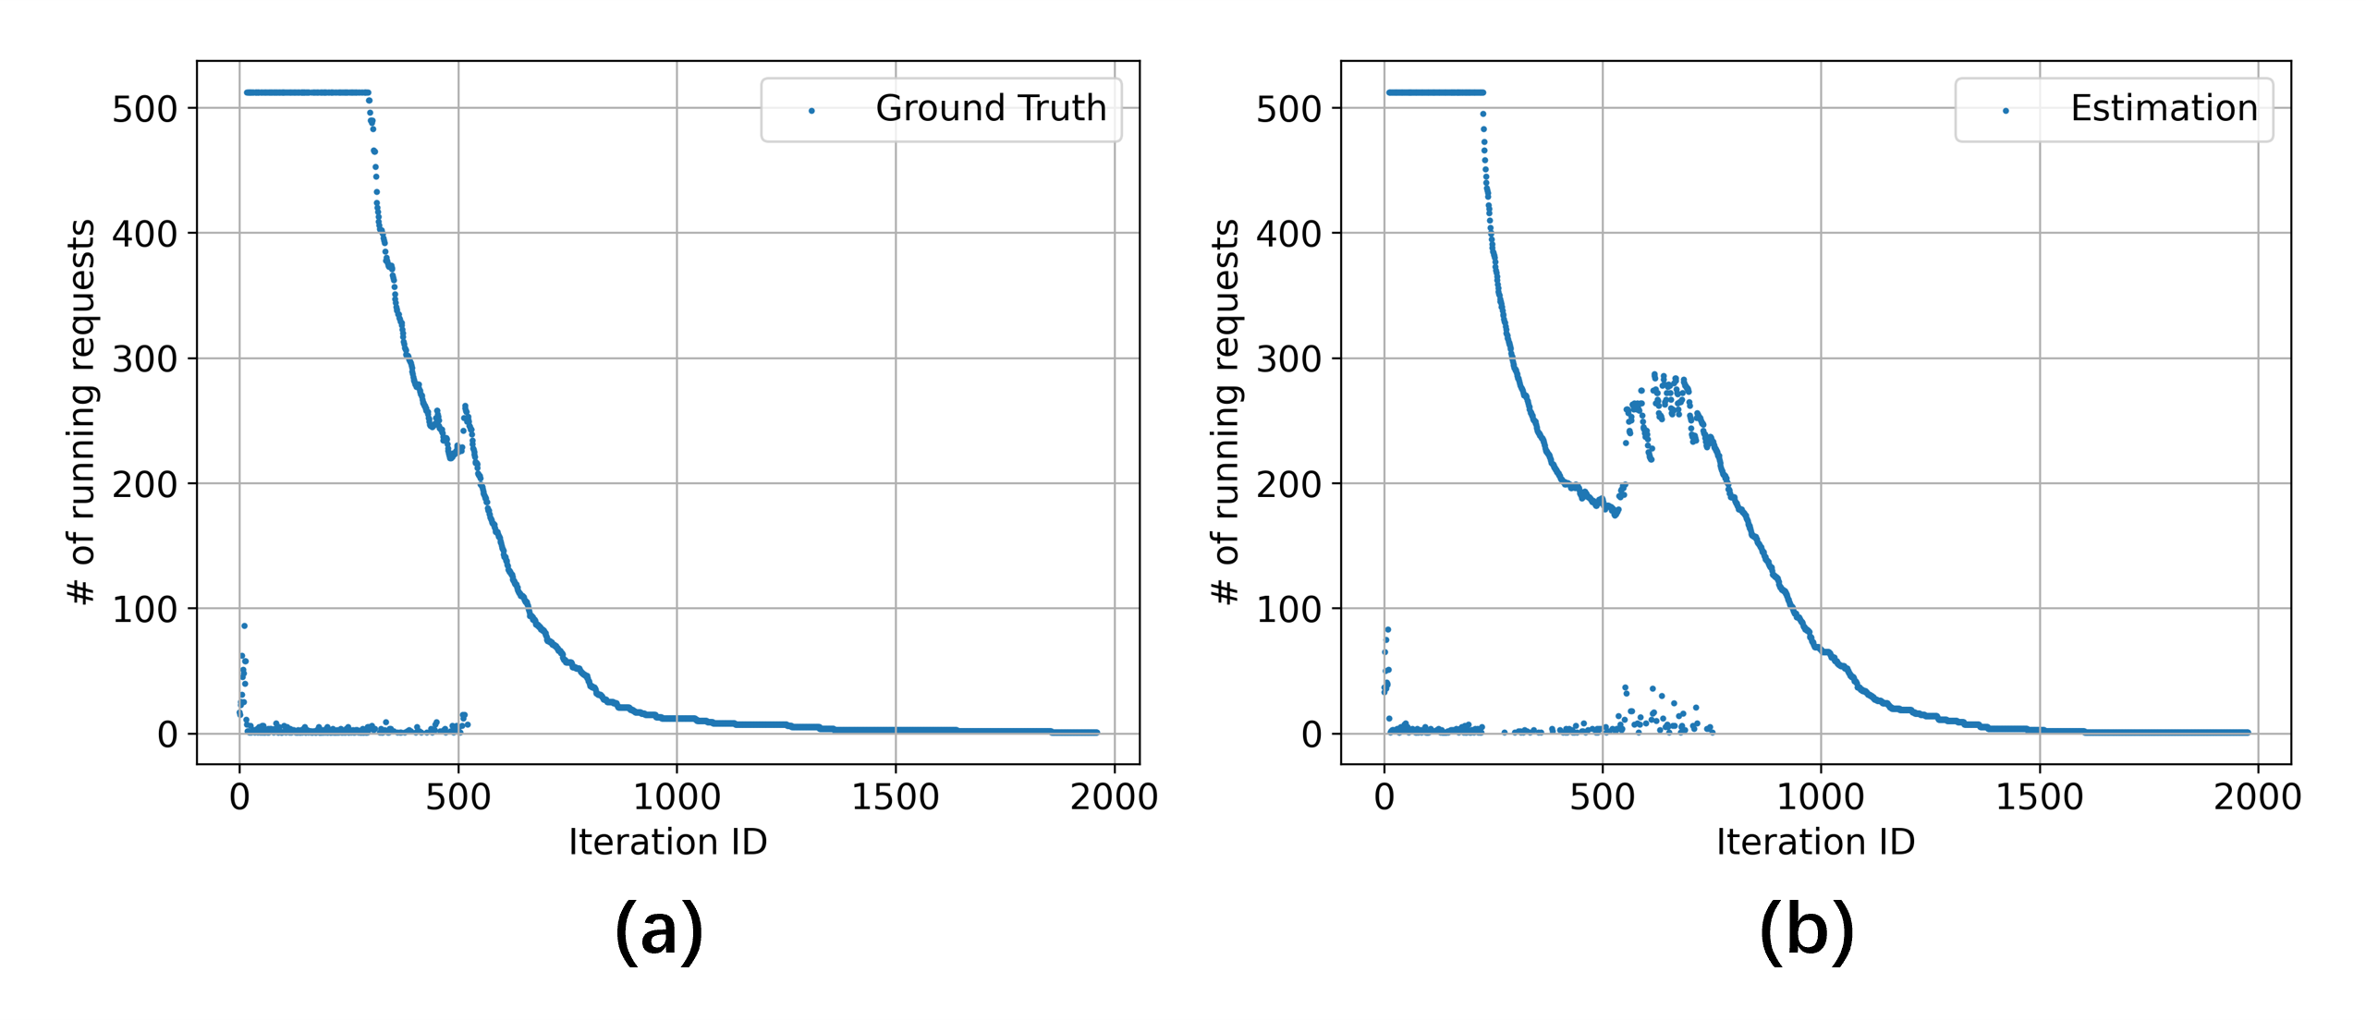
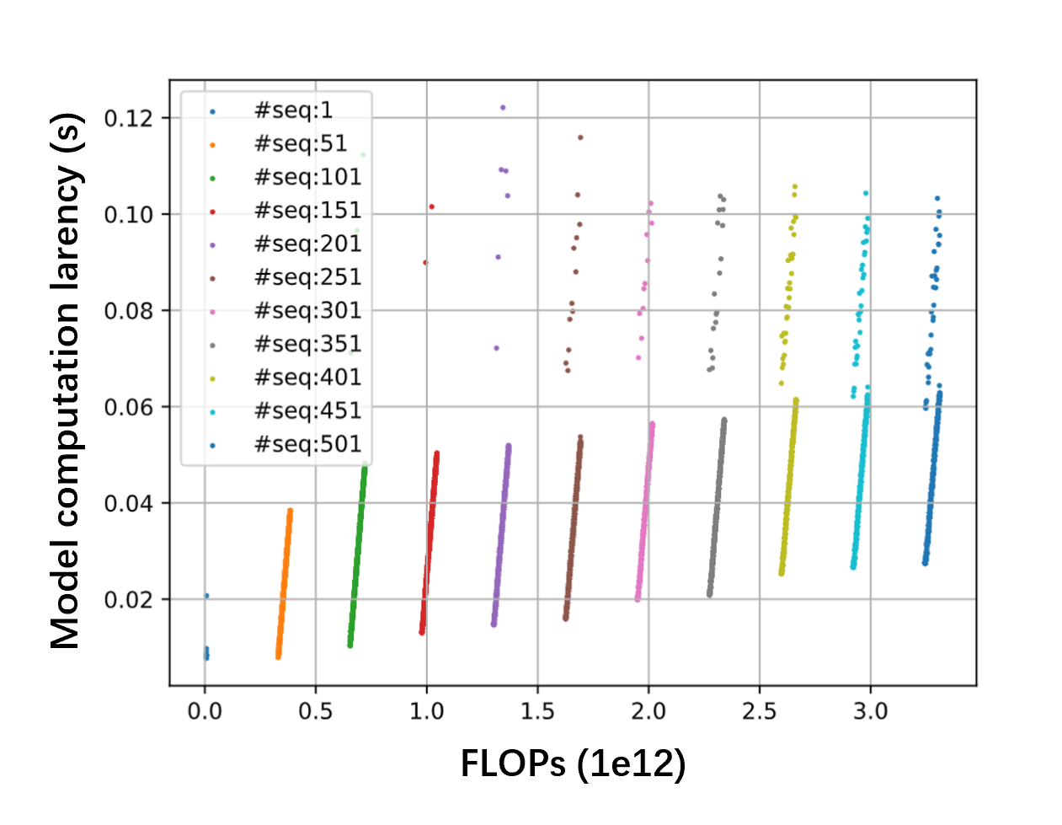
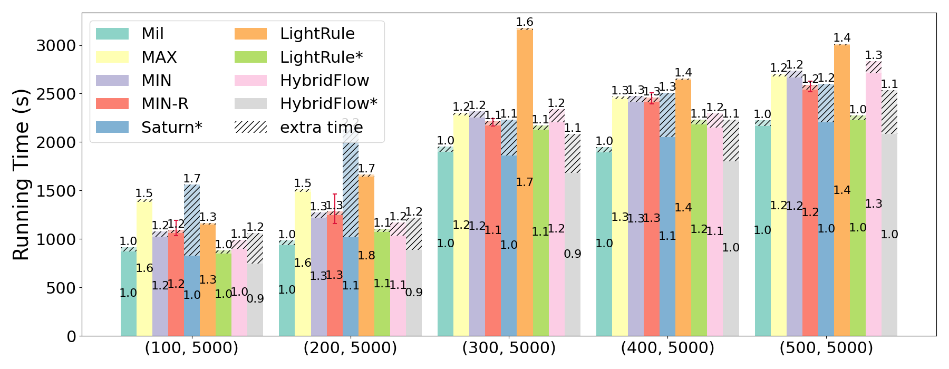
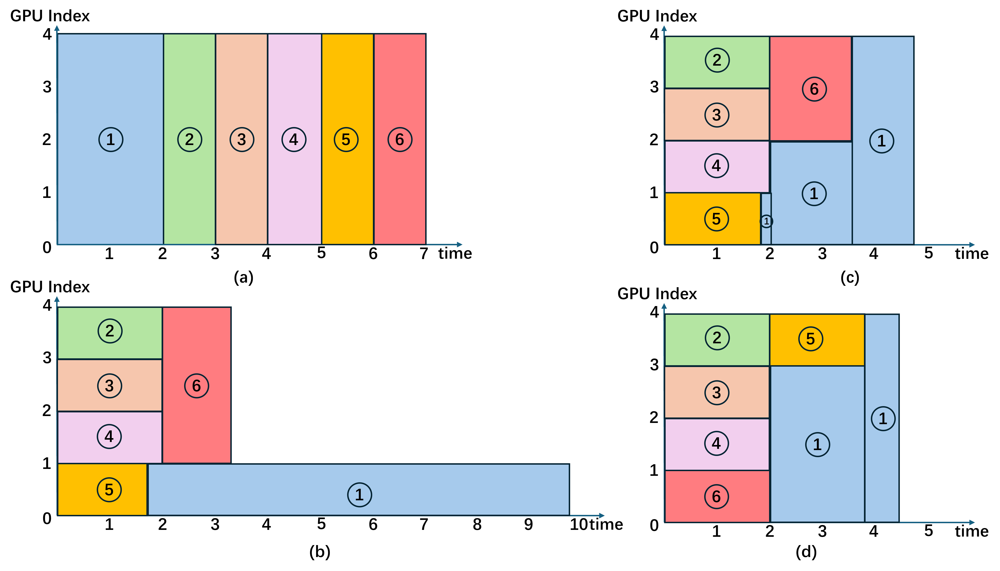
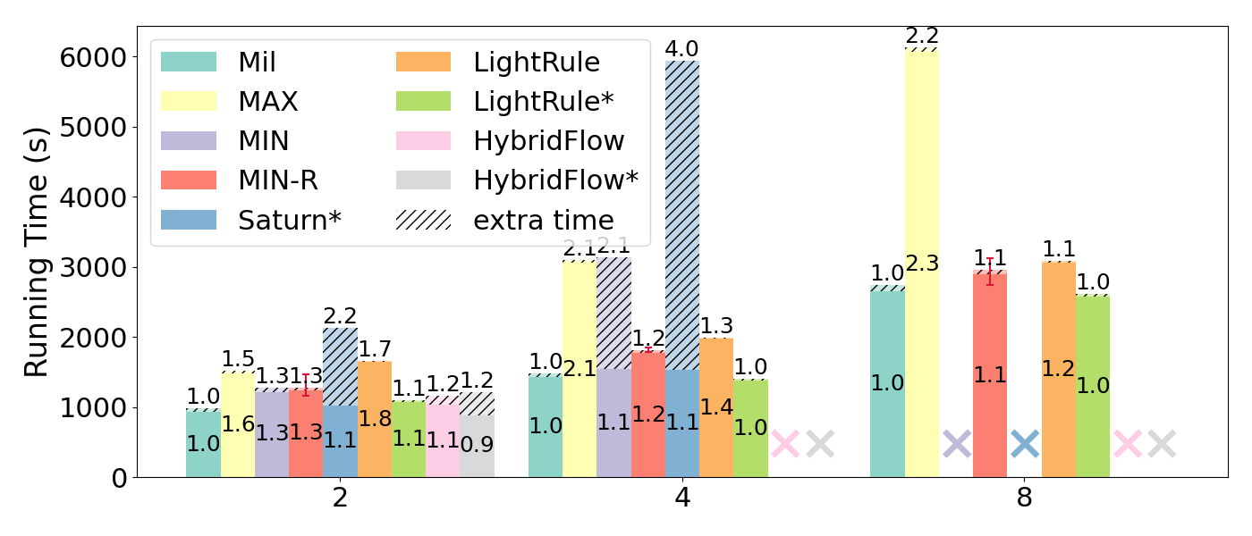

Mil: Cost-guided Minimum Makespan Scheduling
for Applications of Multiple LLMs
Jingzhi Fang · Yanyan Shen · Yue Wang · Lei Chen
HKUST · Shanghai Jiao Tong University · Shenzhen Institute of Computing Sciences · HKUST(GZ)
Goal: minimize offline inference makespan for multi-LLM applications.
01
PROBLEM
02
MIL
03
EVALUATION
Multi-LLM applications
Mil at a glance
3.4×
maximum end-to-end speedup
Up to 4.0× in the scalability test
Metric: end-to-end time = schedule search (extra time) + inference
8× A100-80GB · vLLM · single node
Applications
Offline planning builds the schedule; Mil adjusts it at runtime when actual model completion orders differ.
Ensembling · Routing · Chain summary · Mixed
8 baselines in three categories
Computation graphs: nodes are LLMs; edges carry data.
Heuristics: MAX · MIN/MIN-R · LightRule /LightRule* (list scheduling+greedy allocation)
MILP: Saturn*
Enumeration: HybridFlow · HybridFlow*
1 Processing-function estimation
* adapted/variant implementation · lower end-to-end time is better
Offline scheduling jointly decides
Key insight: sample output lengths for the entire request set, then simulate its continuous-batching trajectory—without training a per-request predictor.
Single application · LLM ensembling
INPUT: application graph + prepared requests + candidate execution plans + N GPUs
1
GPU allocation
how many GPUs for each model
1
SAMPLE OUTPUT LENGTHS
2
Execution plan
parallelism strategy for each model
To estimate the inference process for a model given a set of requests rather than predict the request latency, it is sufficient to know how the output length distribution.
For normal unconstrained prompts, distributions are similar across input lengths and request categories.
3
Model orchestration
timing, overlap, preemption
2
SIMULATE CONTINUOUS BATCHING
Request-set size varies from 1,000 to 10,000.
MLAS objective
min (maxⱼ Cⱼ)
Request-ready times + scheduling policy + KV cache → batch and sequence lengths at every generation iteration.
Mixed applications · chain summary + ensembling
Cⱼ is the completion time of model Mⱼ.
3
ESTIMATE EACH ITERATION
Why simple rules and prior art miss
Profile linear latency functions and estimate tₖ = tcomp + tprep + tsamp for every simulated iteration.
Example: ensembling six LLMs on four GPUs
Inputs: unfinished requests Iⱼᵗ · ready times Hⱼᵗ · execution plan P · interval Δt
Data parallelism only · rates fixed during inference · ρ₁ linear in GPU count · ρ₂–ρ₆ concave
(ρᵢ: the processing rate of model i)
ρⱼ(Iⱼᵗ, Hⱼᵗ, P, Δt) = Σ FLOPsₖ / Δt
Tuples denote (chain-summary requests, ensembling requests).
MAX
PREEMPTIVE MIN
Model loading cost and communication setup cost are added whenever a model starts or changes its execution plan.
Scalability · 2, 4, and 8 applications
NON-PREEMPTIVE MIN
RATE-AWARE
2 Greedy schedule search
Maximize total processing rate at each time point, while starting long-running ready LLMs early.
MAX: Runs one LLM at a time with all GPUs; MIN: Uses minimum-GPU plans to maximize concurrency
1
COMPUTE READY MODELS
2
START LONG JOBS EARLY
Key insight
The best allocation depends on each LLM’s processing function ρⱼ—not only on concurrency or GPU occupancy.
Find models whose precedence constraints are satisfied in the current tentative interval.
Sort by min-GPU completion time; move the longest into the candidate set, and return it if Step 3 selects no plan.
Jointly scheduling all applications rather than running each application independently.
3
SELECT ONE BEST UPDATE
4
FINALIZE ONE INTERVAL
• Unknown output lengths make future batching states—and therefore processing rates—unknown; predicting output length for each request adds runtime cost.
Enumerate feasible plan updates; maximize Δ processing rate / Δ GPUs.
End at the earliest predicted completion and record model–plan assignments.
Where the gains come from
PLAN UPDATE
Choose the next best feasible plan update iteratively (repeat Steps 2 and 3 iteratively).
• Processing functions capture how rate changes with the evolving remaining request set and execution plan.
• Cost-guided greedy search jointly chooses GPU allocation, parallel plans, and timing.
• Runtime adjustment fills released GPUs when actual completion order differs.
READY-SET REFRESH
All ready candidates have plans → refresh the ready set → repeat search for the current interval.
• Rates change with the remaining requests; dependency-constrained models may overlap through model-level pipelines; model preemption is allowed.
TIME ADVANCE
GPUs full / no improving update → finalize interval → advance time → update remaining requests.
Bound under simplified assumptions (a model's rate depends only on remaining request count; its best rate is concave in GPU count): t(𝒜) ≤ (1/α + β)N·t(𝒜*)
The bound tightens with stronger GPU scaling and smaller preemption cost.
• Fixed/phase-rate schedulers do not fit MLAS; a direct MILP becomes extremely complex with MLAS’s processing functions, preemption and pipeline overlap; generic heuristics ignore workload and rate differences.
3 Runtime schedule adjustment
If M₂ finishes before M₁, advance a ready model–plan pair from a later planned interval onto the released GPUs to reduce GPU idleness.
TAKEAWAY
MLAS is NP-hard
BEFORE ADJUSTMENT
Minimum-makespan scheduling for preemptive malleable jobs without precedence constraints is a strongly NP-hard special case.
GPU 0
Stage S₀ [t₀, t₁]
Stage S₁ [t₁, t₂]
Mil makes offline multi-LLM inference workload-aware: estimate processing rates, plan a good schedule, then adapt it to real completions.
GPU 1
M₁ / P₁
M₅ / P₅
GPU 2
M₂ / P₂
IDLE after M₂
M₄ / P₄ (waiting in S₁)
GPU 3
M₃ / P₃
τ: M₂ finishes early
AFTER ADJUSTMENT
GPU 0
Stage S₀ [t₀, t₁]
Stage S₁ [t₁, t₂]
github.com/puddingfjz/Mil
GPU 1
M₁ / P₁
M₅ / P₅
GPU 2
M₂ / P₂
M₄ / P₄ ← advanced from S₁
GPU 3
M₃ / P₃
PVLDB 19(9): 1893–1906, 2026 · DOI: 10.14778/3819518.3819522
Contact: jfangak@connect.ust.hk
Notes:
[Sources]
- p1914-fang (1).pdf — Abstract; Sections 1–6; Figures on multi-LLM applications, processing-function construction, and evaluation.
- MIL_VLDB_0801_resubmit.zip — LaTeX source and original figure assets.
- 给老板看/Mil-Fang.pptx — latest author-approved visible content and speaker notes for Slides 6 and 10–13; institution logos, result figures, and artifact QR code.
[/Sources]

