Slide 1
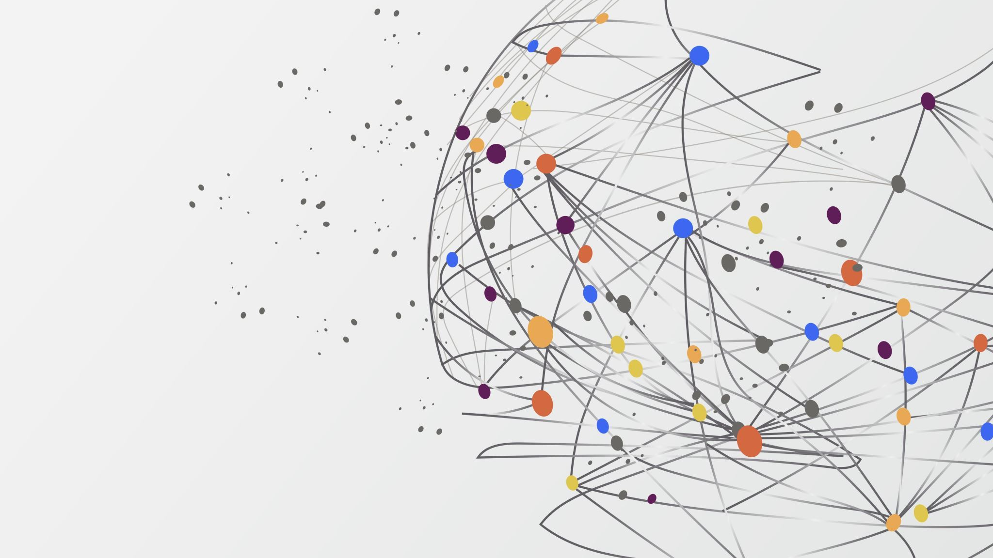

PyGame
NARRiki Aktan Nurzhan, Raiskanov Rasul

Slide 2
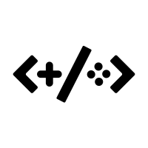

Pygame
Pygame is a set of modules (libraries) of the Python programming language designed for writing computer games and multimedia applications. Pygame is based on the discovered SDL library.

Slide 3
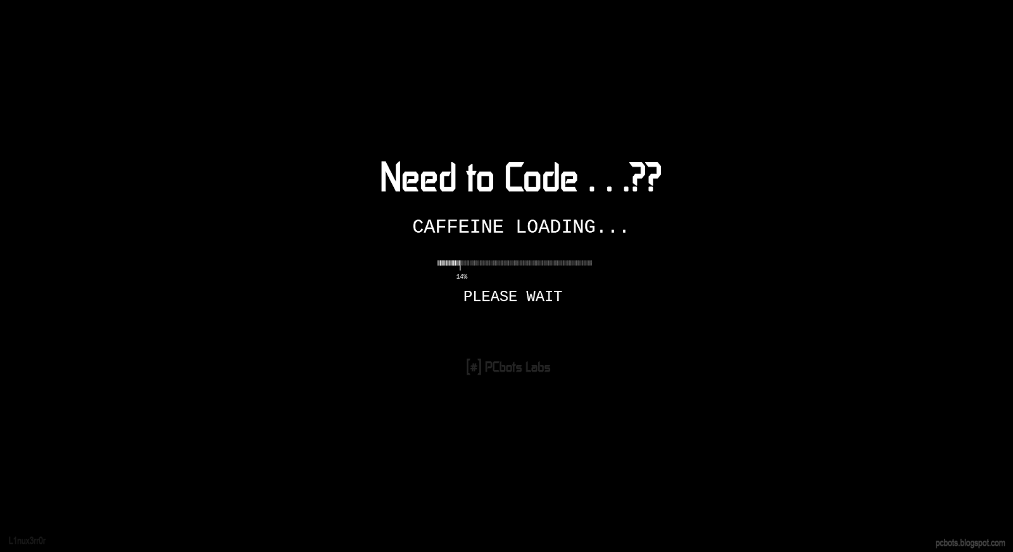



Responsibilities
Frontend
Backend

Slide 4


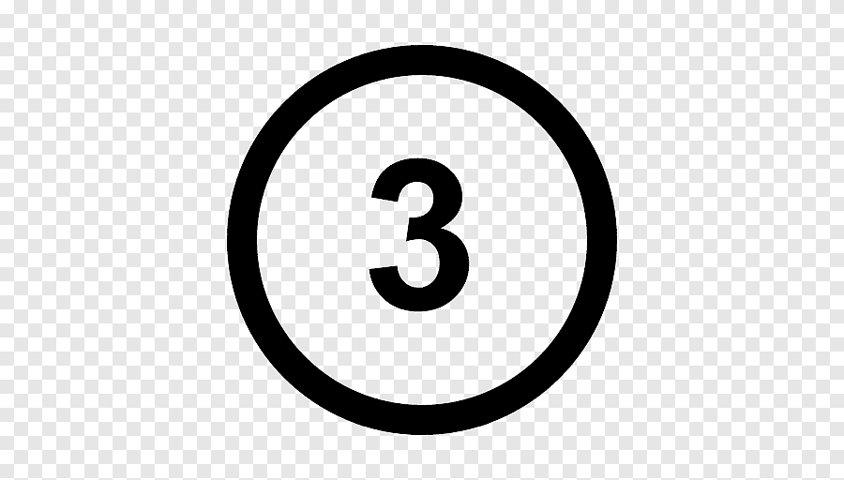


What did we learn
paygame library
work with files
work in the game more efficiently
game dev basics

Slide 5
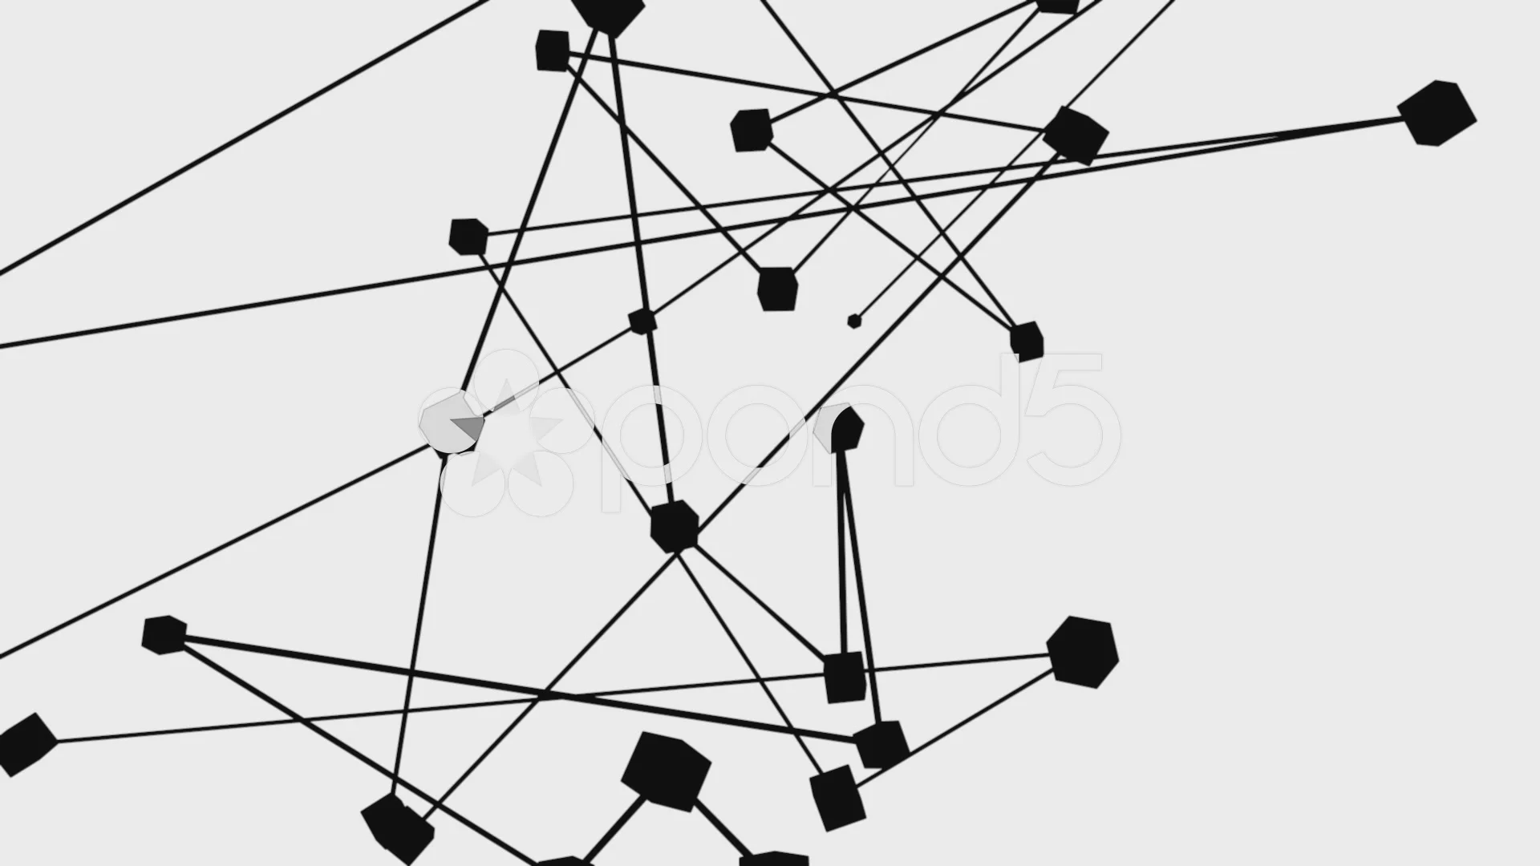
DIFFICULTS
connecting api to pygame
Deadlines
the complexity of creating games

Slide 6
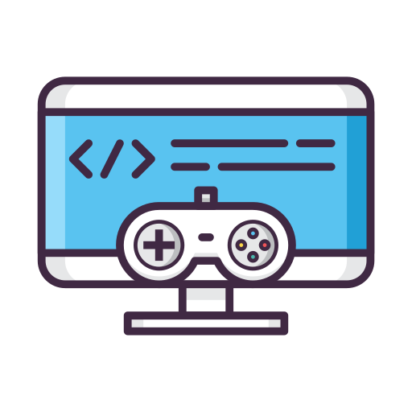

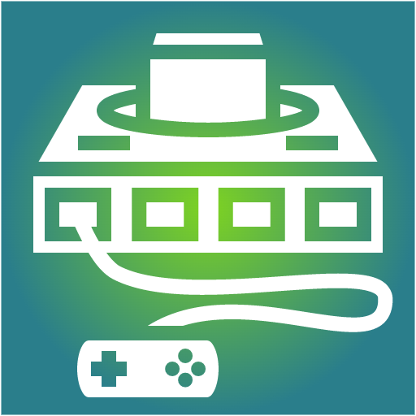
Experience
now we have a base for creating 2d game platforms based on pygame (like a snake, a sapper, zero-toe, space invador

