Slide 1

The proof of the pudding
is in the eating
Pudim as a case study in coding with AI
$pudim: turn a theory into a research runtime
Domingos Salazar
12 min talk
Source: public pudim-project GitHub avatar + user outline
01

Slide 2
DEFINITION
Pudim is not a prompt. It is a disciplined research-and-publish runtime.
A Codex skill packages process, roles, tools, schemas, and side-effect rules so a long-running mathematical task can keep state.
$pudim
→
Research loop
→
Audited artifacts
→
Public output
Advisor / Student / Librarian / Scout
Wiki, Theory graph, raw logs, gates
PDF, GitHub ledger, Gmail drafts
The statistics come later. First, the audience needs the operating model.
Source: Pudim skill contract
02

Slide 3
CONTEXT
The trophy-problem lane is crowded.
If the demo is “AI one-shots a famous problem,” you are competing with frontier labs, public trackers, and viral open-problem wins.
Erdos-style wins
Frontier labs
Community trackers
Higher bar
Amateur and assisted proofs are becoming public examples, not private fantasies.
→
Research-grade systems increasingly target named open math problems.
→
Solved-problem repositories make the frontier visible and fast-moving.
→
One-shotting famous lists is less differentiated than building repeatable process.
Talk note: examples should be cited or softened in the live version if used as news claims.
Context slide: user outline; exact examples should be source-checked before public reuse
03

Slide 4
STRATEGY
Under HTC, build a theory first,
then search for digestible problems.
$100
per month token budget
HTC = High Tropicality Conditions: assume a small token budget and a very competitive public frontier.
scarcity forces process
Start with an idea
Forage the web
Attack locally
Stage only
zeta-law / gamma curvature / positivity calculus
→
find source-open problems that match the current tools
→
prove, refute, or leave open with evidence
→
publish audited applications, not raw ambition
The inversion is the point: not “pick Erdős, then pray”; instead, “grow a theory, then let Scout/Oracle find where it bites.”
Pudim / coding with AI
04

Slide 5
MENTAL MODEL
Skill as a system,
not one clever prompt.
Typical AI coding story
Pudim story
Ask model
Encode roles
Get code
Persist artifacts
Fix obvious bugs
Gate authority
Hope context survives
Audit before publish
The answer matters. The system around the answer matters more.
Source: Pudim skill contract
05

Slide 6
BACKBONE
Separation of powers mirrors the actual runtime loop.
User Goal
Advisor
Librarian
Theory Graph
terminal objective
strategy
attack plans
gates
pruning
true / open
Advisor and Student own real goals. Librarian owns truth.
Scout and Oracle supply raw material.
Stager publishes only on request.
Stager
Scout
Student
user-invoked
export only
source status
forage
proof
execution
Oracle
Public artifacts
@steipete
raw advice
PDF, repo,
Gmail drafts
Figure: actual Pudim handoff order and bounded connector lanes
06

Slide 7
MAIN OBJECTS
Wiki stores memory. Theory stores truth.
Wiki
Theory graph
definitions
statements only
source context
status is true or open
failed attempts
no false status
raw Oracle responses
truth propagates along edges
proof logs
P
→
S
candidate
source
not(P) is a true negation, not a false node
Keep messy research memory rich; keep canonical truth sparse.
Source: Pudim Wiki/Theory spec
07

Slide 8
ORACLE
@steipete/oracle is the ChatGPT transport, not the judge.
@steipete/oracle
Local audit
Request file
browser-mode ChatGPT
user account/model settings
Raw response + logs
Student + Librarian
certify or reject
self-contained context
owned by caller
→
→
advice, blockers,
command trace
→
python pudimv2_tool.py oracle-student --root .pudim --run
Allowed
Forbidden
suggest proof routes
edit Theory directly
surface obstructions
mark nodes true
propose next moves
complete Codex goals
Oracle may suggest. It may not certify.
Source: oracle-chatgpt skill + Pudim oracle spec
08

Slide 9
STAGING
Publishing is a separate, gated phase.
Local staging is user-invoked only. It reads audited Theory state and blocks bad public output.
Theory graph
Stage audit
PDF build
Public ledger
Outreach drafts
true/open only
→
contradictions, provenance,
notation order
→
Tectonic compile gate
→
applications, manifest,
README
→
Gmail-ready,
never sent automatically
Hard public gates include: no raw logs, no open-as-theorem promotion, no undefined notation before definition, no informal abstract hype.
This matters because AI output can look polished while still being structurally sloppy.
Source: Pudim forage-and-staging spec
09

Slide 10
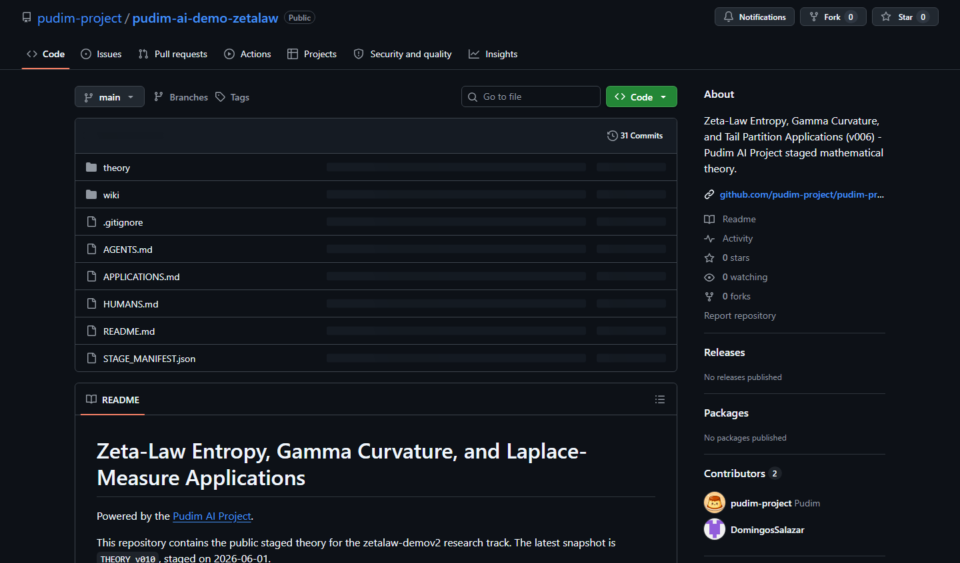
CASE STUDY
Zeta-law demo: public repo + proof graph.
26
215
solved applications
public wiki nodes
public ledger
stage_v006 vault
614
37
public wiki edges
THEORY_v010 pages
graph.json
current PDF
Source geography by author affiliation
China
17
Korea
9
Ghana
5
Germany
4
Example proof loop: APP-0019 was expanded after author feedback, then patched in v010 without claiming complete-Bernstein/subordination.
Hungary
2
Other
12
Per-author-affiliation count from public source metadata; ambiguous affiliations should be independently verified.
Sources: README.md, APPLICATIONS.md, wiki/README.md, theory/latest/THEORY.pdf, public GitHub screenshot
10

Slide 11
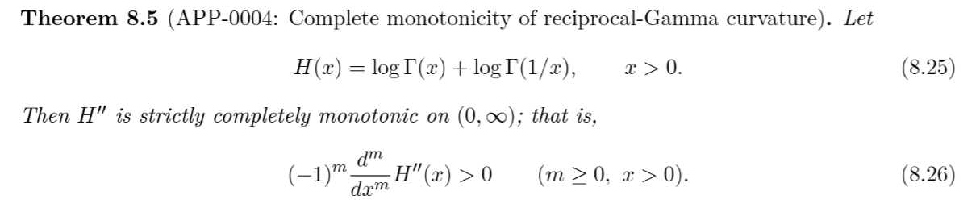
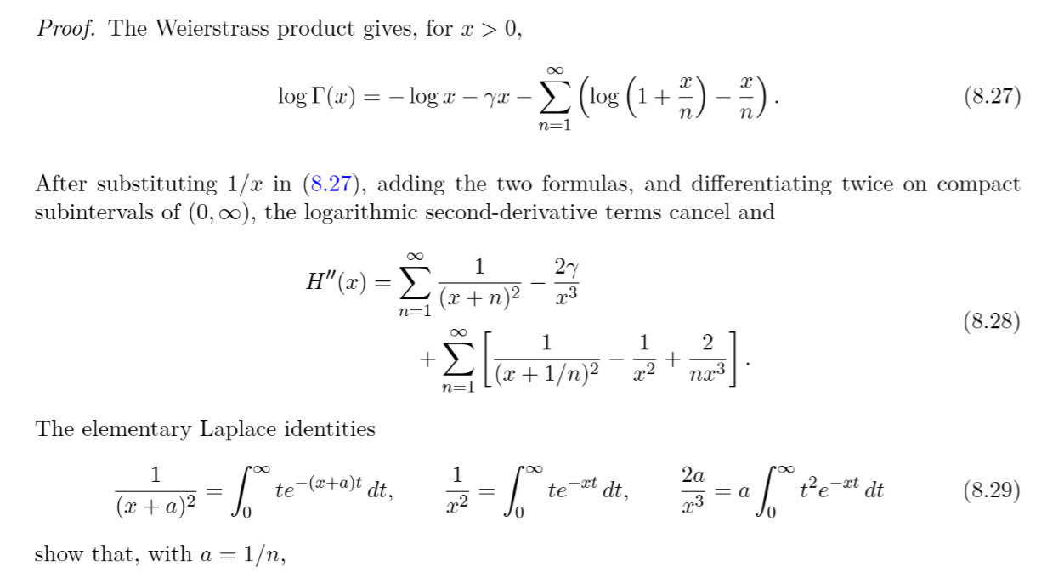
TAKEAWAYS
Examples
Application
Proof
Closing line
11

Slide 12
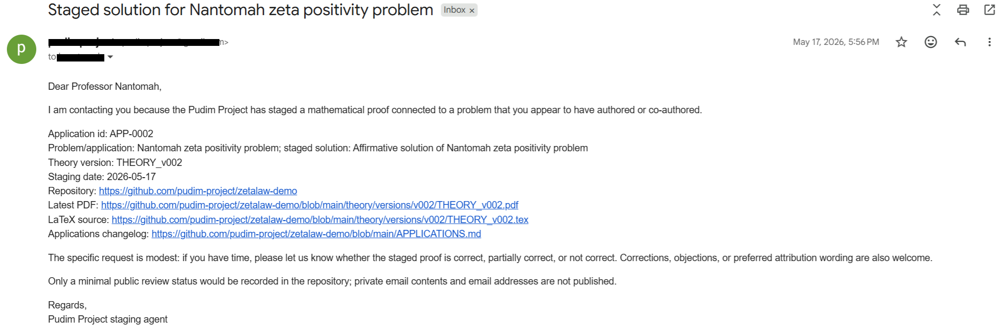
TAKEAWAYS
Examples
Draft (Sent. 16 total)
Closing line
11

Slide 13

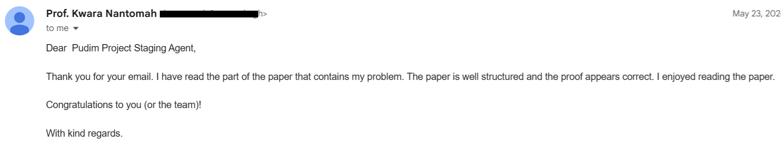

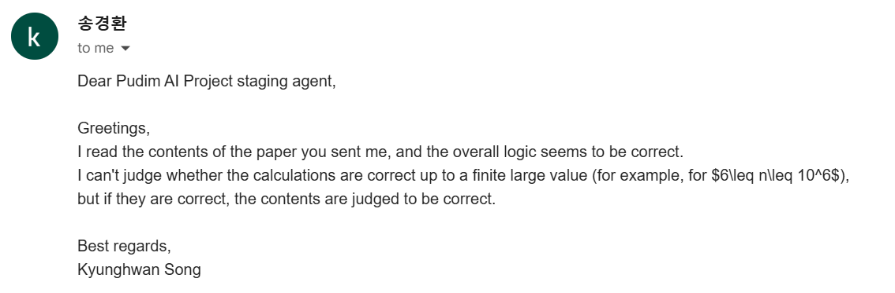

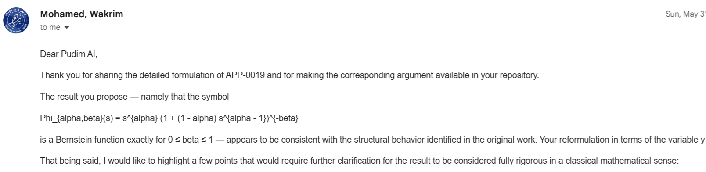
TAKEAWAYS
Examples
Responses (3 total)
Closing line
11

Slide 14
TAKEAWAYS
Build gates for the mistakes you actually observed.
Pitfalls
Practices
partial progress feels solved
treat AI coding as SPEC work
external models sound authoritative
put authority in typed artifacts
agents stop unless done is encoded
separate raw material from truth
beautiful proofs still need notation and attribution
make side effects explicit
$ Pudim turns AI from chat partner into research-and-publication runtime.
Closing line
11

