Slide 1
The proof of the pudding
is in the eating
Pudim v2 as a case study in coding with AI
$ pudimv2 --goal "turn a theory into a research runtime"
Domingos Salazar
12 min talk
Source: user outline + Pudim v2 skill
01

Slide 2
DEFINITION
Pudim is not a prompt. It is a disciplined research-and-publish runtime.
A Codex skill packages process, roles, tools, schemas, and side-effect rules so a long-running mathematical task can keep state.
$pudimv2
→
Research loop
→
Audited artifacts
→
Public output
Advisor / Student / Librarian / Scout
Wiki, Theory graph, raw logs, gates
PDF, GitHub ledger, Gmail drafts
26
215
37
4+1
public solved applications
public wiki nodes
theory PDF pages
roles + Oracle connector
current stage_v010 ledger
stage_v006 public vault
THEORY_v010
separation of powers
Source: README.md, wiki/README.md, theory/latest/THEORY.pdf
02

Slide 3
CONTEXT
The trophy-problem lane is crowded.
If the demo is “AI one-shots a famous problem,” you are competing with frontier labs, public trackers, and viral open-problem wins.
Erdos-style wins
Frontier labs
Community trackers
Higher bar
Amateur and assisted proofs are becoming public examples, not private fantasies.
→
Research-grade systems increasingly target named open math problems.
→
Solved-problem repositories make the frontier visible and fast-moving.
→
One-shotting famous lists is less differentiated than building repeatable process.
Talk note: examples should be cited or softened in the live version if used as news claims.
Context slide: user outline; exact examples should be source-checked before public reuse
03

Slide 4
STRATEGY
Under HTC, build a theory first,
then search for digestible problems.
$100
token budget
HTC = High Tropicality Conditions: assume a small token budget and a very competitive public frontier.
scarcity forces process
Start with an idea
Forage the web
Attack locally
Stage only
zeta-law / gamma curvature / positivity calculus
→
find source-open problems that match the current tools
→
prove, refute, or leave open with evidence
→
publish audited applications, not raw ambition
The inversion is the point: not “pick Erdős, then pray”; instead, “grow a theory, then let Scout/Oracle find where it bites.”
Pudim v2 / coding with AI
04

Slide 5
MENTAL MODEL
A skill is a SPEC, not one clever prompt.
Typical AI coding story
Pudim v2 story
Ask model
Encode roles
Get code
Persist artifacts
Fix obvious bugs
Gate authority
Hope context survives
Audit before publish
The answer matters. The system around the answer matters more.
Source: Pudim v2 skill contract
05

Slide 6
BACKBONE
Separation of powers keeps the research loop honest.
Advisor
Librarian
Student
Librarian
strategy, active open node,
3 attack plans
→
truth graph, Wiki health,
propagation, pruning
→
proof execution,
raw proof logs
→
admit true/open,
stop contradictions
↺
↗
↗
Scout
Oracle
source status, prior art,
terminology, candidates
external ChatGPT
advisory connector
Oracle is intentionally outside the canonical roles: it suggests, but cannot certify.
Figure: Advisor -> Librarian -> Student -> Librarian -> Advisor; Scout/Oracle are bounded helpers
06

Slide 7
MAIN OBJECTS
Wiki stores memory. Theory stores truth.
Wiki
Theory graph
definitions
statements only
source context
status is true or open
failed attempts
no false status
raw Oracle responses
truth propagates along edges
proof logs
P
→
S
candidate statement
source problem
not(P) is a true negation, not a false node
This is the discipline: keep messy research memory rich, but keep canonical truth sparse.
Source: Pudim v2 Wiki/Theory spec
07

Slide 8
ATTACK PLANS
The agent avoids random wandering by making routes explicit.
For an open source statement S, Advisor creates exactly three candidates by default.
wide
stronger
mixed
source S
equivalent or near-equivalent reformulation
→
prove P where P implies S
→
wider formulation plus a higher-risk strengthening
→
truth target
overshoot relaxation: O -> R -> S
If the old sufficient route O is too strong, try R: weaker than O, still strong enough for S.
Source: Pudim v2 attack-plans spec
08

Slide 9
ORACLE
External ChatGPT expands perspective without getting authority.
Oracle
Local audit
Student / Scout
@steipete/oracle
browser-mode ChatGPT
Raw response
Student + Librarian
certify or reject
prepared request
curated context
→
→
proof attempts
obstructions
next moves
→
Allowed
Forbidden
suggest routes
edit Theory directly
surface obstructions
mark nodes true
propose candidates
complete goals
One-line rule: Oracle may suggest. It may not certify.
Source: Pudim v2 oracle spec + oracle-chatgpt skill
09

Slide 10
TOOLS AND CONNECTORS
Every connector is a capability with a side-effect boundary.
Local runtime
Research surface
Publishing surface
External critic
.pudim/ artifacts
Web / Scout
Tectonic PDF
Oracle ChatGPT
JSON schemas
Browser / Chrome
GitHub sync
request files
pudimv2_tool.py
PDF inspection
Gmail drafts
response logs
rg / git diff / logs
primary-source gate
never send by default
raw until audited
The important implementation detail is not the tool list. It is where each tool is allowed to write.
Source: pudimv2_tool.py command surface and connector rules
10

Slide 11
STAGING
Publishing is a separate, gated phase.
Local staging is user-invoked only. It reads audited Theory state and blocks bad public output.
Theory graph
Stage audit
PDF build
Public ledger
Outreach drafts
true/open only
→
contradictions, provenance, notation order
→
Tectonic compile gate
→
applications, manifest, README
→
Gmail-ready, never sent automatically
Hard public gates include: no raw logs, no open-as-theorem promotion, no undefined notation before definition, no informal abstract hype.
This matters because AI output can look polished while still being structurally sloppy.
Source: Pudim v2 forage-and-staging spec
11

Slide 12
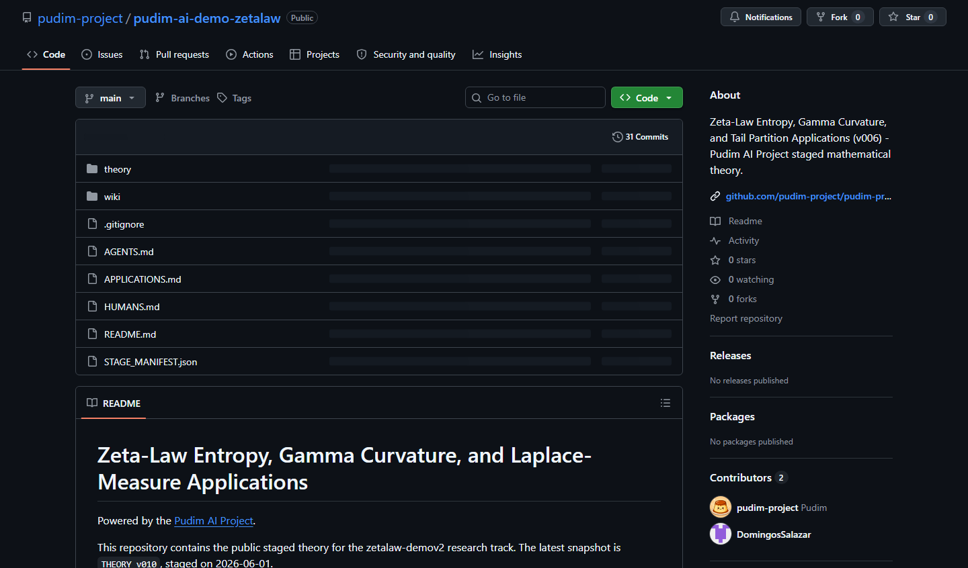
CASE STUDY
Zeta-law demo: public repo + proof graph.
26
215
solved applications
public wiki nodes
public ledger
stage_v006 vault
614
37
public wiki edges
THEORY_v010 pages
graph.json
current PDF
Closed problems by source geography
China
8
Multi-country
5
Korea
3
Example proof loop: APP-0019 was expanded after author feedback, then patched in v010 without claiming complete-Bernstein/subordination.
Other tags
10
Geography chart uses compact public-bibliography tags; audit affiliations before external publication.
Sources: README.md, APPLICATIONS.md, wiki/README.md, theory/latest/THEORY.pdf, public GitHub screenshot
12

Slide 13
TAKEAWAYS
Build gates for the mistakes you actually observed.
Pitfalls
Practices
partial progress feels solved
treat AI coding as SPEC work
external models sound authoritative
put authority in typed artifacts
agents stop unless done is encoded
separate raw material from truth
beautiful proofs still need notation and attribution
make side effects explicit
$ Pudim turns AI from chat partner into research-and-publication runtime.
Closing line
13

