Slide 1

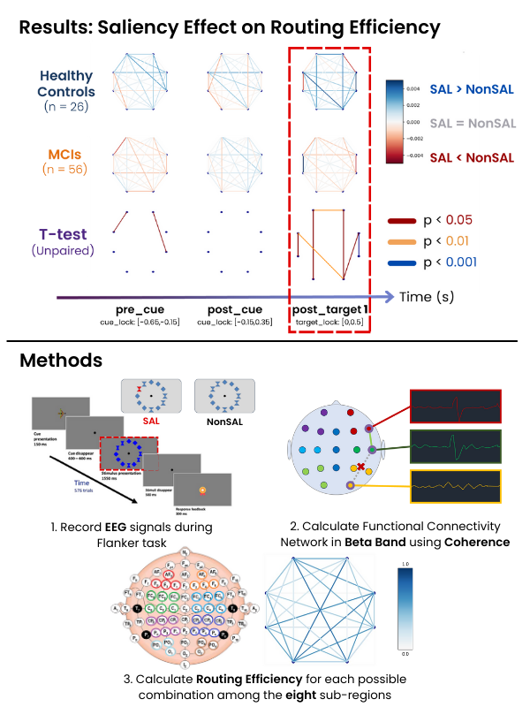


Slide 2
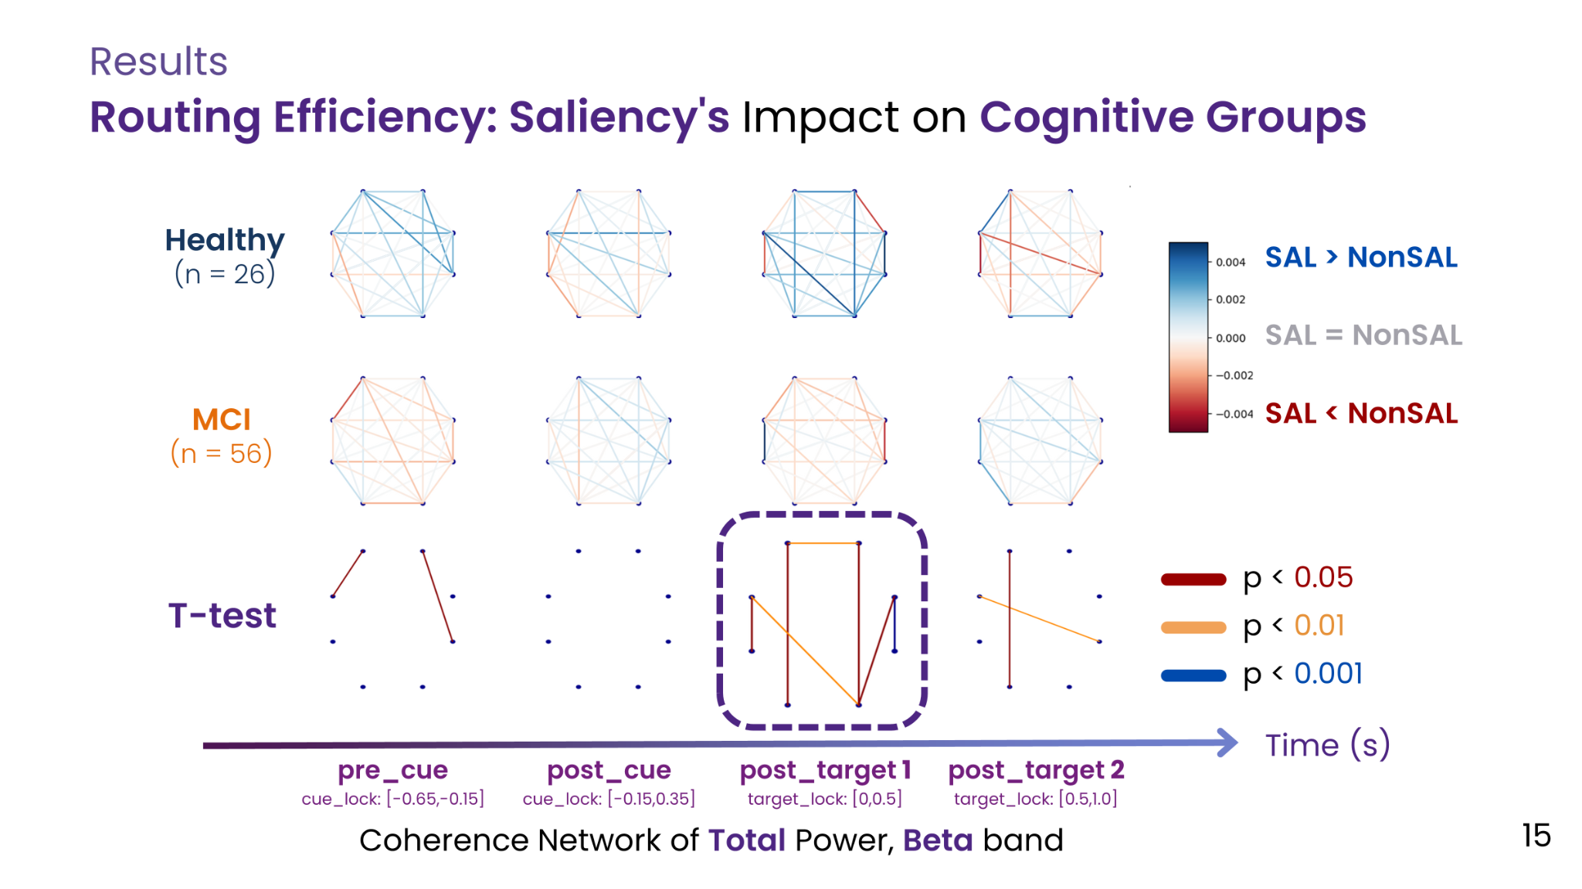
RECAP

Slide 3
AGENDA
Discussion: Do we have to shift channels position?
Brief Summary
(Optional) Literature Reviews
What’s next?

Slide 4
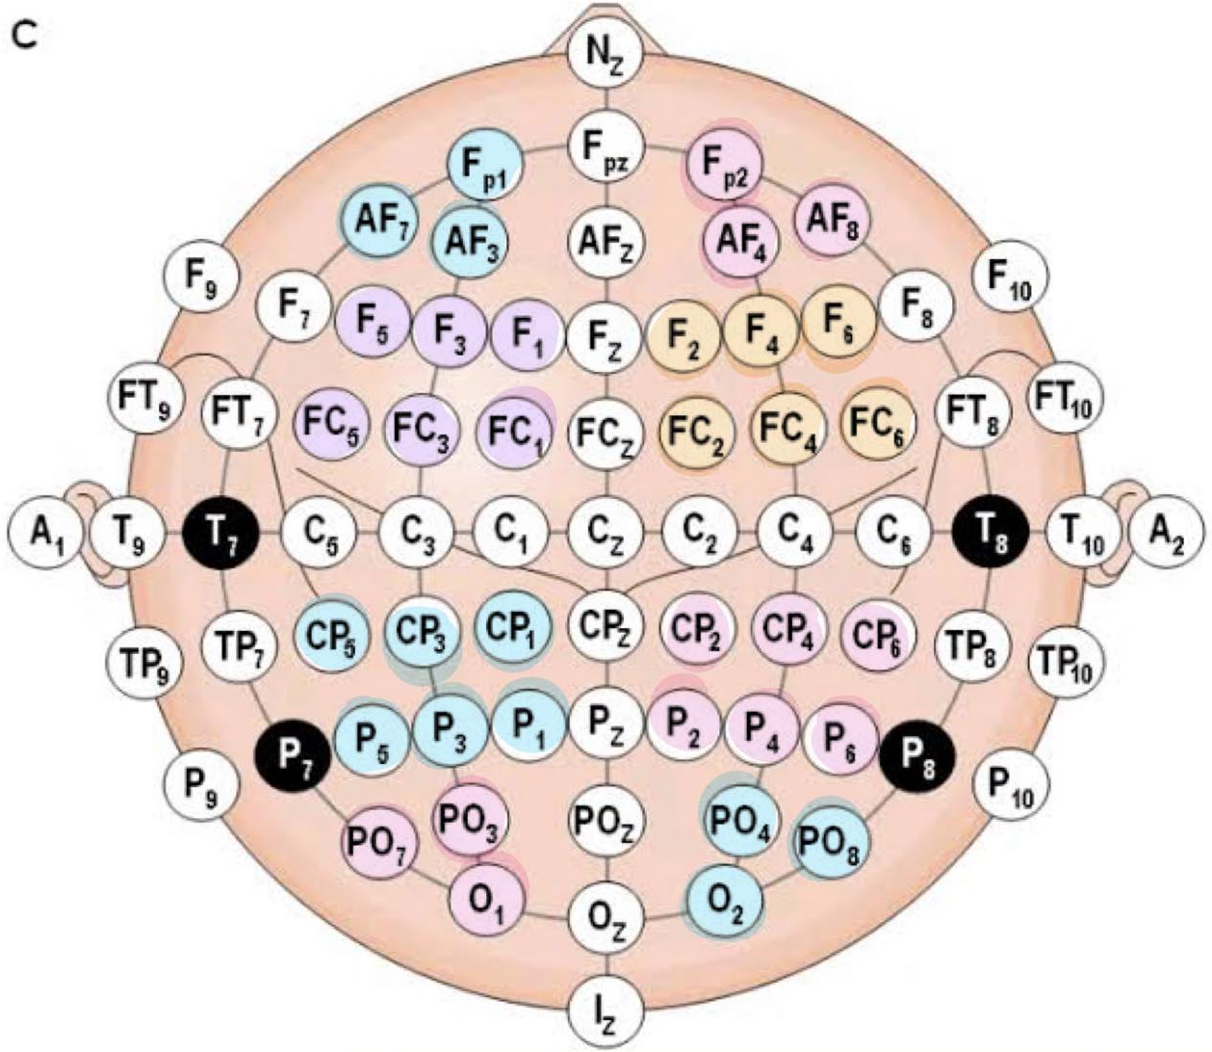
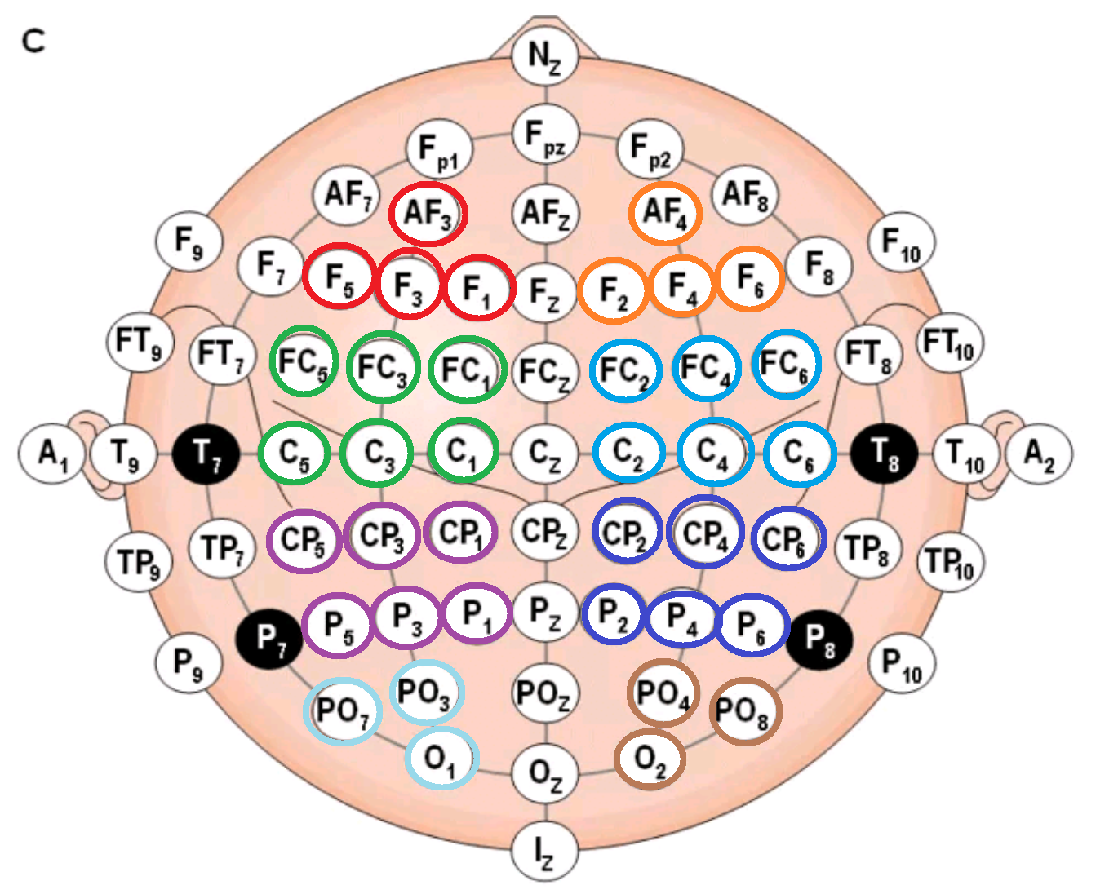
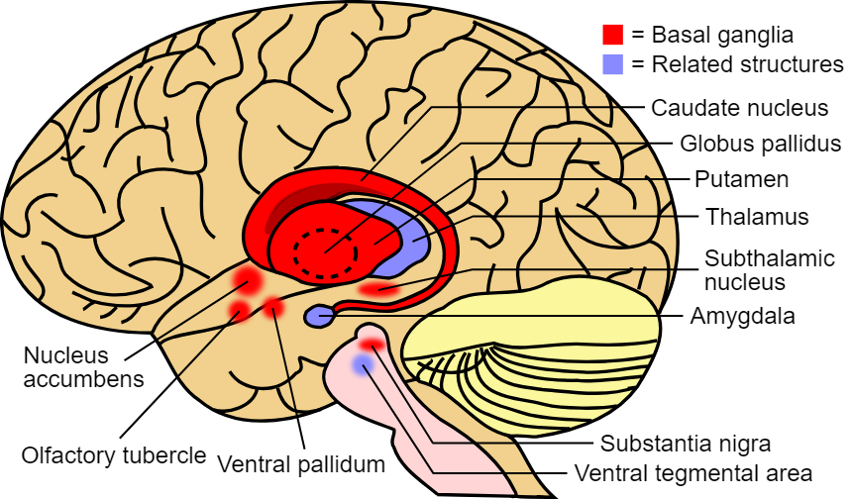
Region Position Shift
C
New
Old
Slightly shift up to avoid C row.
In order to suggest those F and FC as Frontal lobe clearer than prev version(?)

Slide 5
Brief Summary
In our results
Global Density and routing efficiency or RE (@Right Fronto-Parietal) significantly increased in SAL for HC but small decreased for MCI
Suggest that the area which involve this activity is Fronto-basal ganglia network
Support Evidence
Basal ganglion has the rules about cognitive function (including attention and working memory)
  In the resting state : have a research comparing working of neuron in basal ganglia network comparing in healthy, MCI and AD patients using EEG and fMRI. Resulting that in MCI group has decrease FCD but increase FC strength that it claims about compensating of external neuron compensation and the internal functional recession of neostriatum in early cognitive declines
  Surprising event can disrupt working memory via basal ganglia network suggested the chain of events in the motor suppression-independent component (MS-ICs)
Routing efficiency (RE) refers to efficient of the brain network
  Increase the task difficulty requires further synchronization of the brain network
  In MCI has lower RE in all cases (whole brain, intral left and right hemispheres)

Slide 6
What’s next?
Should we change the border area of the EEG electrodes?
  Potential overlapping signals of frontal and parietal lobe
RE increased in SAL for HC, causing by Basal Ganglia was activated by Surprising event, is this reasonable?
Any other brain area that can be the reason why this results happened?
Other mechanics, apart from fronto-basal ganglia network?

Slide 7
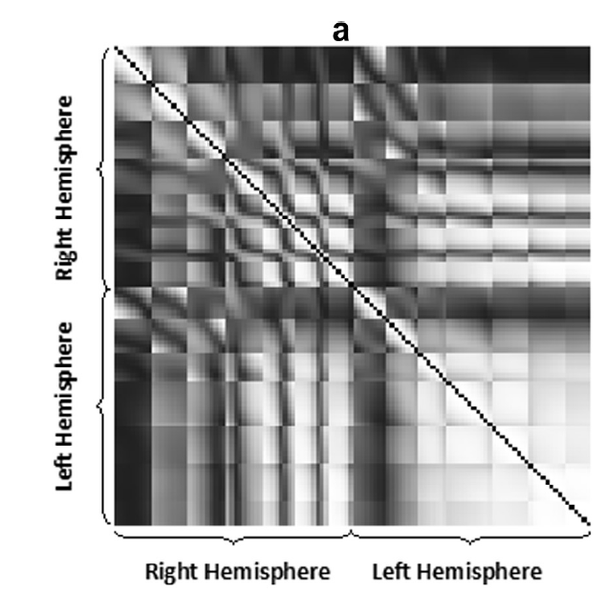
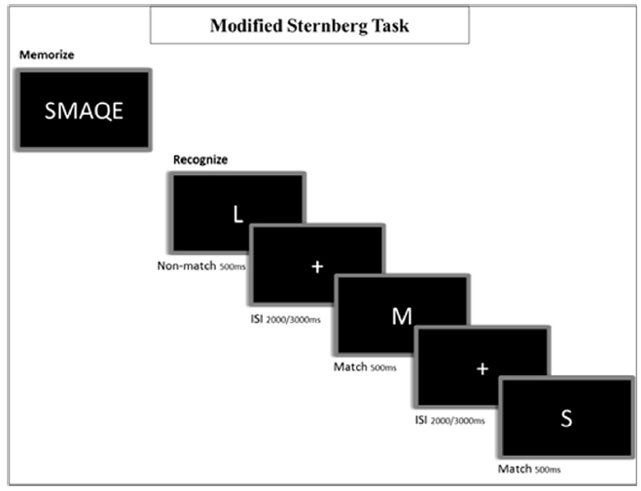
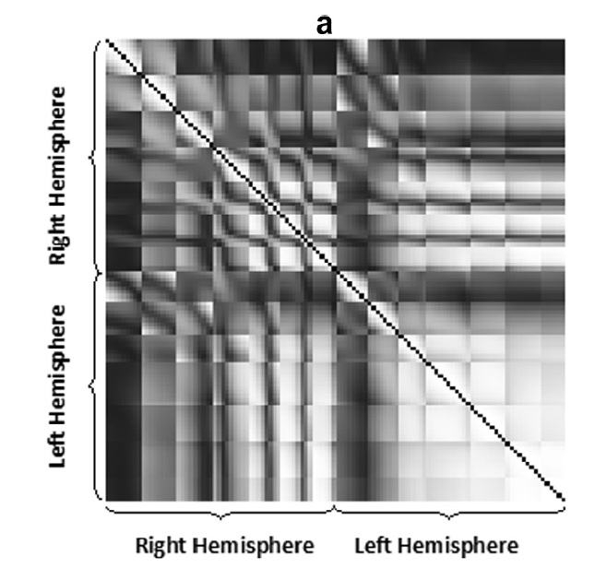
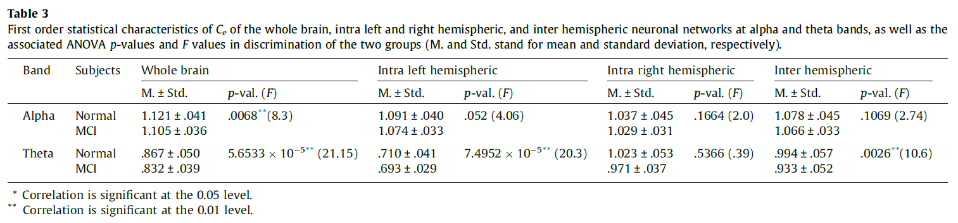
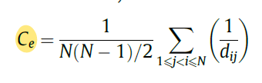
2
Complexity of functional connectivity networks in mild cognitive impairment subjects during a working memory task (MEG)
Quick Summary:
WM activities in MCI subjects is reduced at alpha and theta bands compared with HC
In theta band this reduction is more pronounced in the whole brain and intra left hemisphere.
1
3
Take away:
Overall method similar to our work
(Straight up claimed the meaning of Efficiency Complexity as the brain efficiency measurement)
This work claimed that having lower Ce in MCI indicated worsen efficiency and slower information transfer, especially that it being found in Left-hemis which processing Verbal and Phonological.
3
TLDR: Ce = Average (1/shortest path) for every pair of nodes in ROI
1. Record 148 chs MEG from subjects doing Sternberg Task |  | 2. Using Correlation -Coef for Brain Network. | 3. Calculating Efficiency Complexity (Ce) whole brain intra left and right hemispheric inter hemispheric Hyp: MCI Ce@area1 != HC Ce@area1
Notes:
Mehran Ahmadlou, Anahita Adeli, Ricardo Bajo, Hojjat Adeli,
Complexity of functional connectivity networks in mild cognitive impairment subjects during a working memory task,
Clinical Neurophysiology,
Volume 125, Issue 4,
2014,
Pages 694-702,
ISSN 1388-2457,
https://doi.org/10.1016/j.clinph.2013.08.033

Slide 8
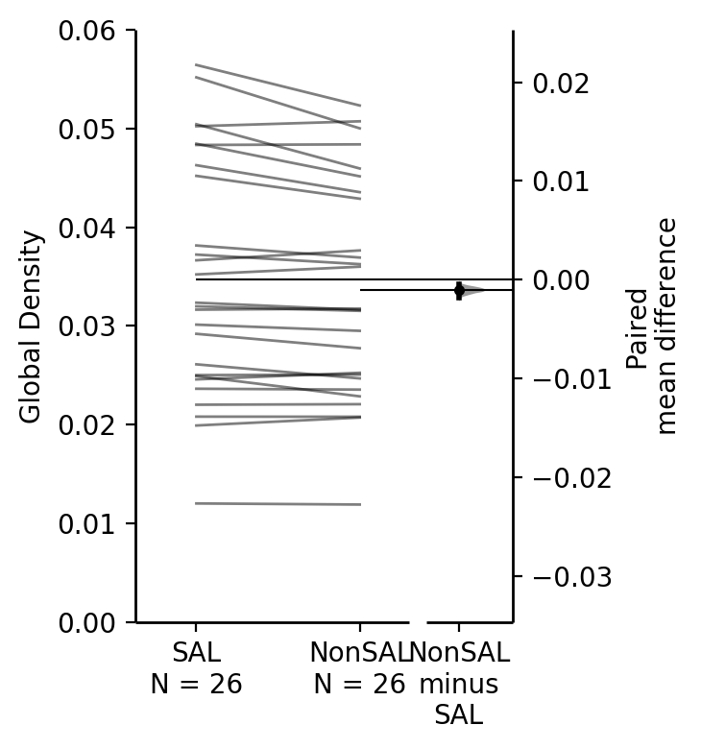
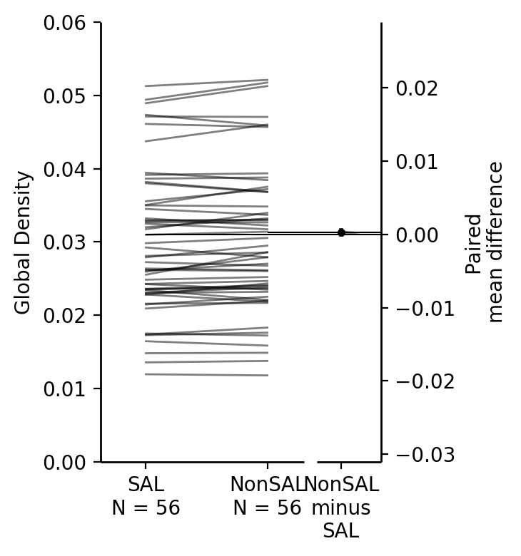
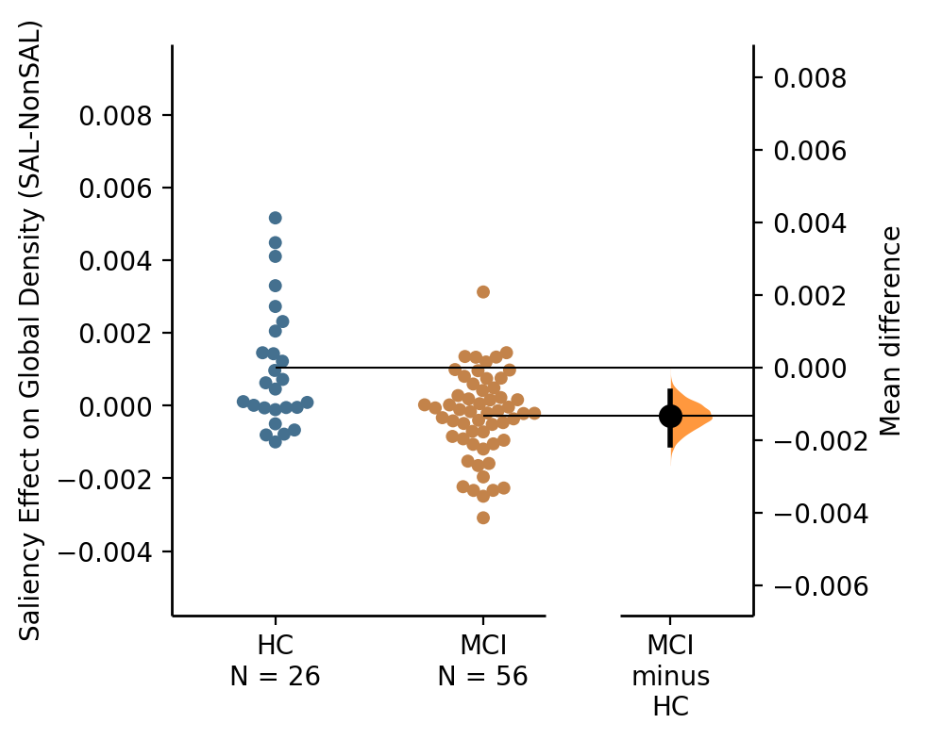
Interaction of Saliency and Group Effect on Global Density
(Coherence Network, Total Power, Beta Band)
Healthy Controls
MCI
Global Density Change
HC vs MCI
P value = 0.0047
SAL >> NonSAL
(paired)
P value = 0.088
SAL < NonSAL
(paired)
P value = 0.00011
(two-sample)
Several studies indicate that an increase in the task difficulty requires further synchronization of the brain network (Korobeinikova and Karatygin, 2012; Bernarding et al., 2013). The authors hypothesize that MCI subjects are more inefficient in the task execution.

Slide 9
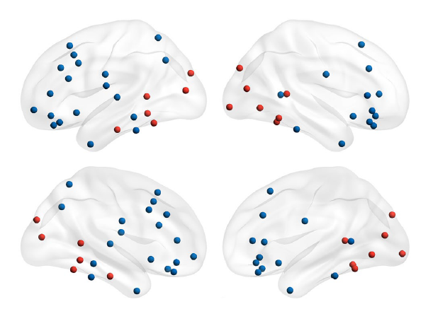
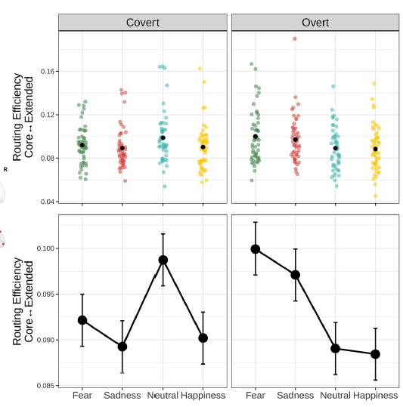
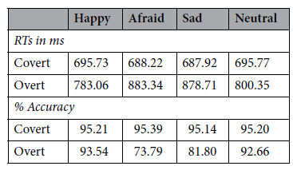
EEG alpha band functional connectivity reveals distinct cortical dynamics for overt and covert emotional face processing
Quick Summary:
Overt: Worsen behavior performance in Negative Expression with Higher RE -> Enhanced response of subcortical structures (Amygdala)
Covert: No behavior change due to the color patch, Higher RE in Neutral Expression -> Harder to detect emotional face for brain
2
3
Face Processing Network (FPN), separated into 2 regions
Core - mainly Occipital + Temporal
Extended - spread through Parietal, Temporal, Frontal
Take away:
This work claimed Amygdala as the reason while RE increased in Overt, Negative Emotion. (We might do the same with Basal Ganglia?)
1. Having subjects identify Facial Expression (Overt) Color patch on Facial Expression (Covert) |  | 2. Source modeling using BEM (MATLAB), and Phase Locking Value for the Brain Network | 3. Calculating RE from Core to Extended region
Notes:
Maffei, A., Coccaro, A., Jaspers-Fayer, F. et al. EEG alpha band functional connectivity reveals distinct cortical dynamics for overt and covert emotional face processing. Sci Rep 13, 9951 (2023). https://doi.org/10.1038/s41598-023-36860-4

Slide 10
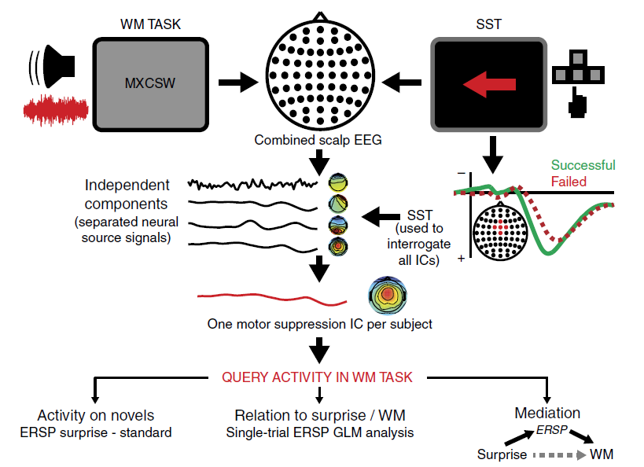
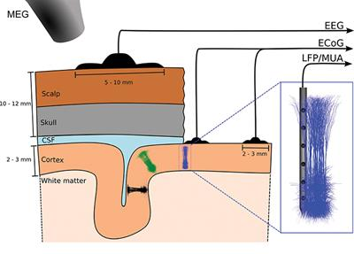
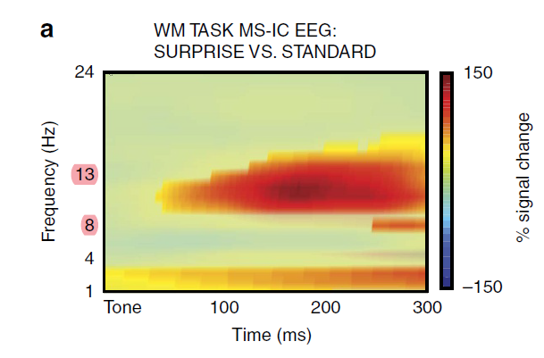
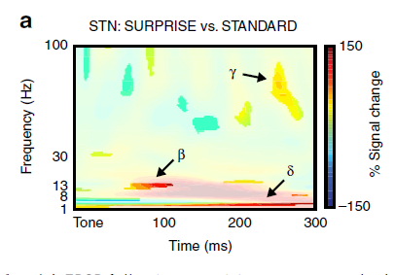
Surprise disrupts cognition via a fronto-basal ganglia suppressive mechanism
Quick Summary:
Subthalamic nucleus (STN) increase activity in post surprising event resulting in inhibition of working memory process, suggesting that a chain of surprising event activate motor suppression-independent component
1.1a
1b
2a
2b
Take away:
This work found increasing activity of STN in surprising event using scalp-EEG and LFP (can we suggest that the significant area activated is refer to be STN?)
Beta band signals also has a role in motor suppression and WM failure in surprising events
1.2a
1.1a Record EEG from - WM Task (distracted by bird sound) - Stop Signal Task () |  | 1.2a Getting Motor Suppression via ICA (MS-IC) | 2. Comparing Spectral Power in SURPRISE vs STANDARD | 3. Test the hypothesis : Significant spectral power difference between SURPRISE vs STANDARD
1b. Record activities in STN using LFP
Notes:
Deiber MP, Meziane HB, Hasler R, Rodriguez C, Toma S, Ackermann M, Herrmann F, Giannakopoulos P. Attention and Working Memory-Related EEG Markers of Subtle Cognitive Deterioration in Healthy Elderly Individuals. J Alzheimers Dis. 2015;47(2):335-49. doi: 10.3233/JAD-150111. PMID: 26401557.

Slide 11
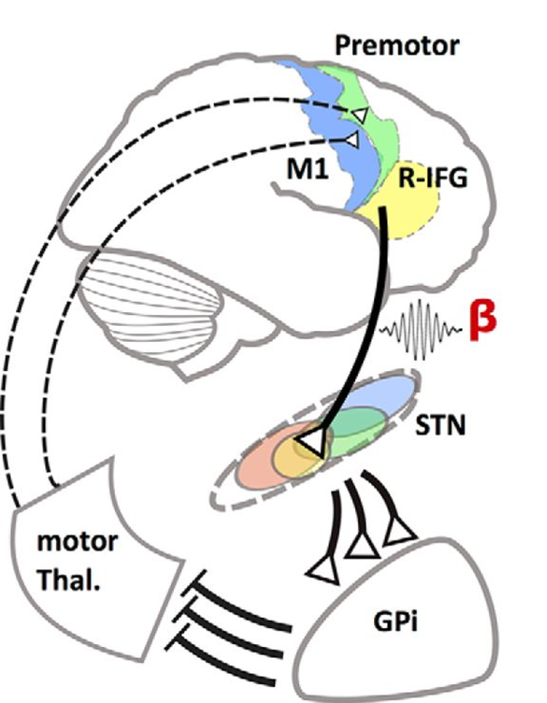
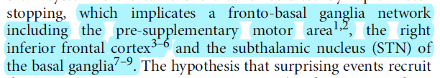
Basal ganglia network : cognitive function
Premotor cortex
Right inferior frontal gyrus
Subthalamic nucleus

Slide 12
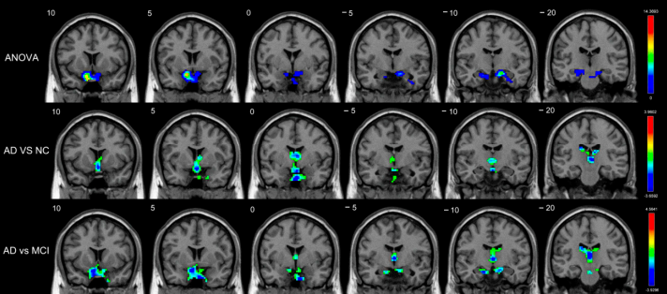
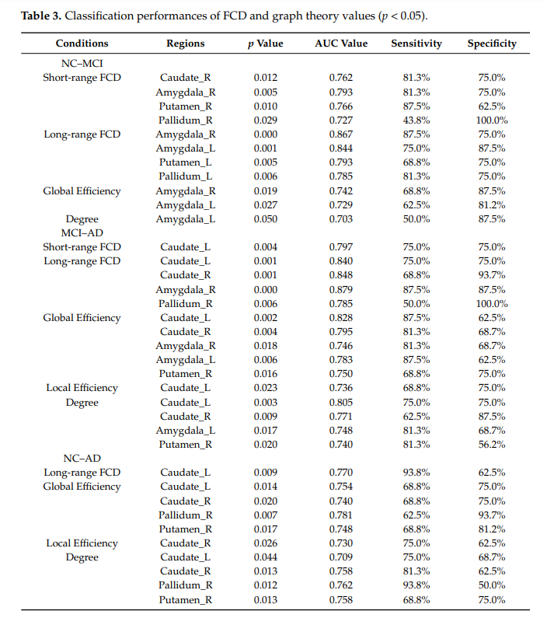
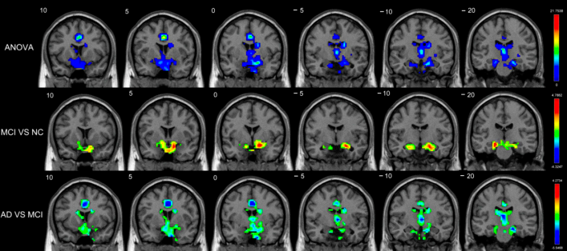
Altered Functional Connectivity of Basal Ganglia in Mild Cognitive Impairment and Alzheimer’s Disease :
In MCI : short range FCD decrease but long range FCD increase because compensation of external neuron for the recession of internal neuron (Basal ganglion network with utmost early-stage detection at amygdala)
In AD : Short and long range FCD both decrease
It claims that have close relationship between FCD and cognitive impairment
Take away:
Compensating mechanism may cause undifferentiated behavior between normal and MCI
This research have done in resting state ( If we assign brain to work more, does that compensation still working efficiency equal to normal brain?)
1. Record Resting State MRI from (16 NCs, 16 with MCI, and 16 with AD) |  | 2. Calculate Voxel-based Functional Connectivity Density (FCD), - Short vs Long-range FCDs (75mm interzone) | 3.
Notes:
Deiber MP, Meziane HB, Hasler R, Rodriguez C, Toma S, Ackermann M, Herrmann F, Giannakopoulos P. Attention and Working Memory-Related EEG Markers of Subtle Cognitive Deterioration in Healthy Elderly Individuals. J Alzheimers Dis. 2015;47(2):335-49. doi: 10.3233/JAD-150111. PMID: 26401557.

Slide 13
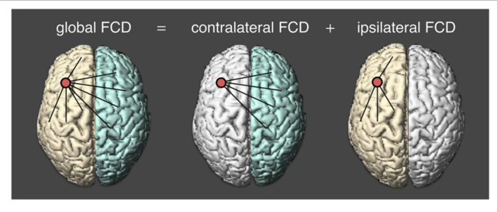
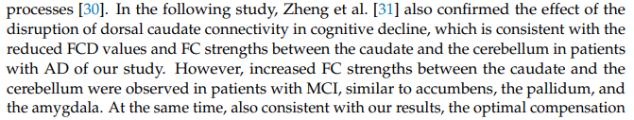
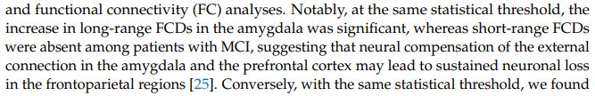
FCD : functional connectivity density
Short range FCD : connecting within local area
Long range FCD : connecting outside local functional mass

Slide 14
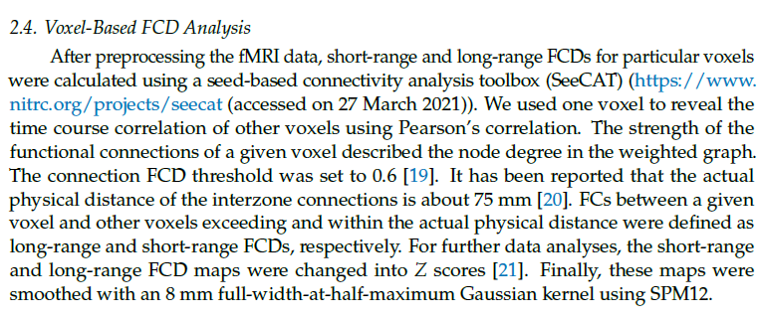
FCD (Functional Connectivity Density) -> Calculate Pearson’s Corr for every pair of voxels (thresh = 0.6)
Short-range and Long-range FCDs using 75mm physical distance as a threshold (interzone connection)
FC-strength -> Degree of the node -> Number of connections of that voxel

Slide 15
Coherence a measure of the brain networks: past and present
Quick Summary:
Coherence across the network is when populations of neurons are active the same time with other populations and have the similar signals
EEG measure the return or volume currents outside the neuron : show only sensor space
Take away:
Have other research using coherence to calculate the connection between brain position and claiming on top of it
Notes:
Deiber MP, Meziane HB, Hasler R, Rodriguez C, Toma S, Ackermann M, Herrmann F, Giannakopoulos P. Attention and Working Memory-Related EEG Markers of Subtle Cognitive Deterioration in Healthy Elderly Individuals. J Alzheimers Dis. 2015;47(2):335-49. doi: 10.3233/JAD-150111. PMID: 26401557.

Slide 16
Attention and Working Memory-Related EEG Markers of Subtle Cognitive Deterioration in Healthy Elderly Individuals
Experiment:
Quick Summary:
1.
1. |  | 2. | 3.
Notes:
Deiber MP, Meziane HB, Hasler R, Rodriguez C, Toma S, Ackermann M, Herrmann F, Giannakopoulos P. Attention and Working Memory-Related EEG Markers of Subtle Cognitive Deterioration in Healthy Elderly Individuals. J Alzheimers Dis. 2015;47(2):335-49. doi: 10.3233/JAD-150111. PMID: 26401557.

Slide 17
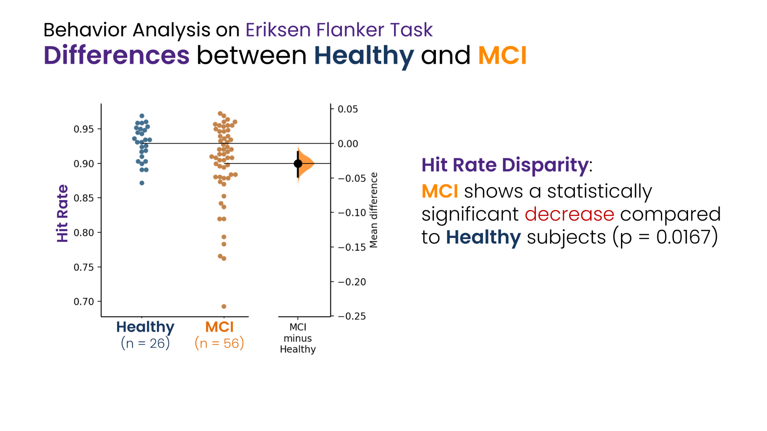

Slide 18
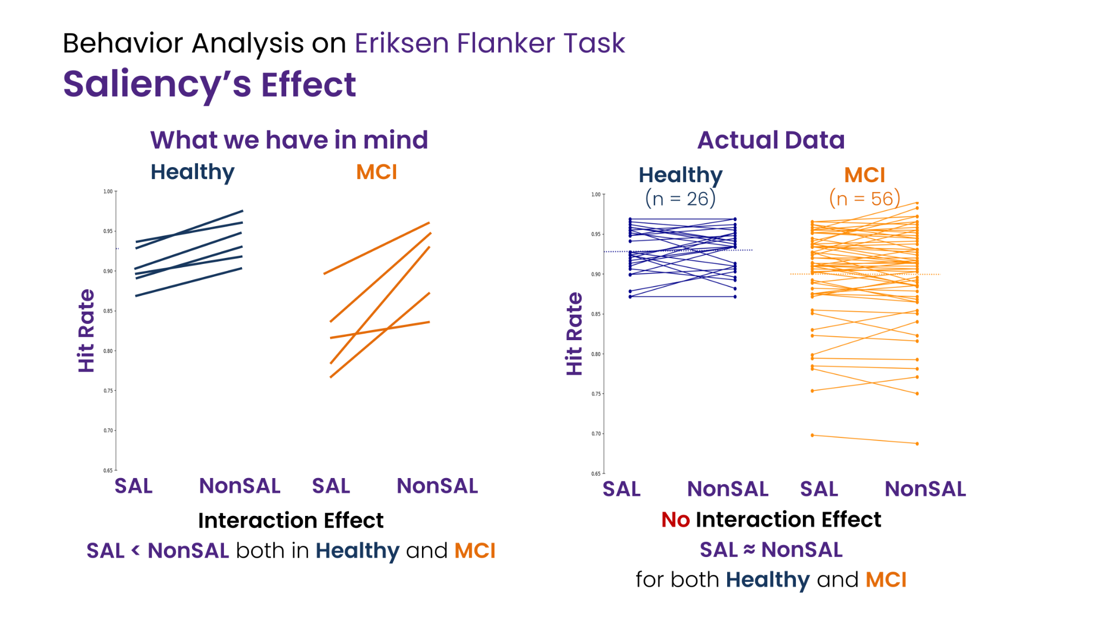

Slide 19
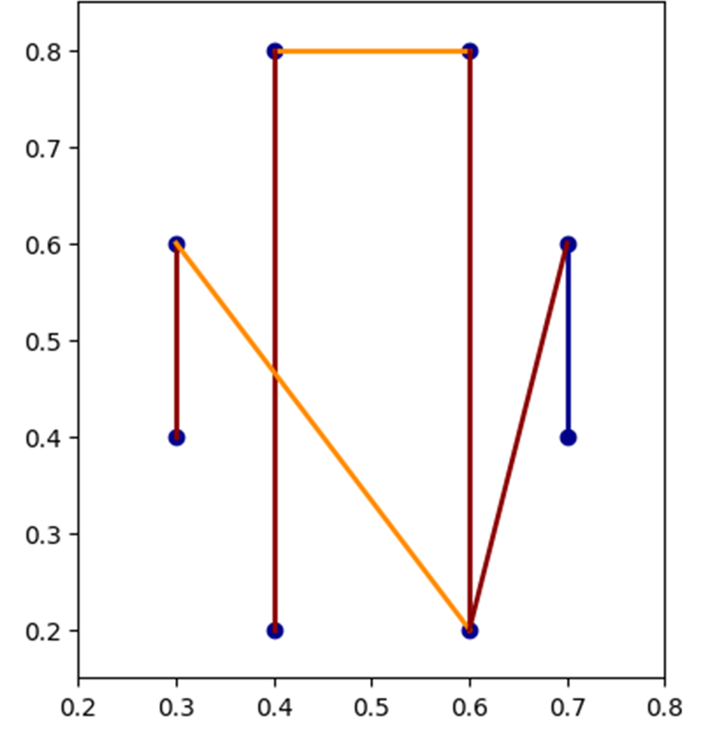
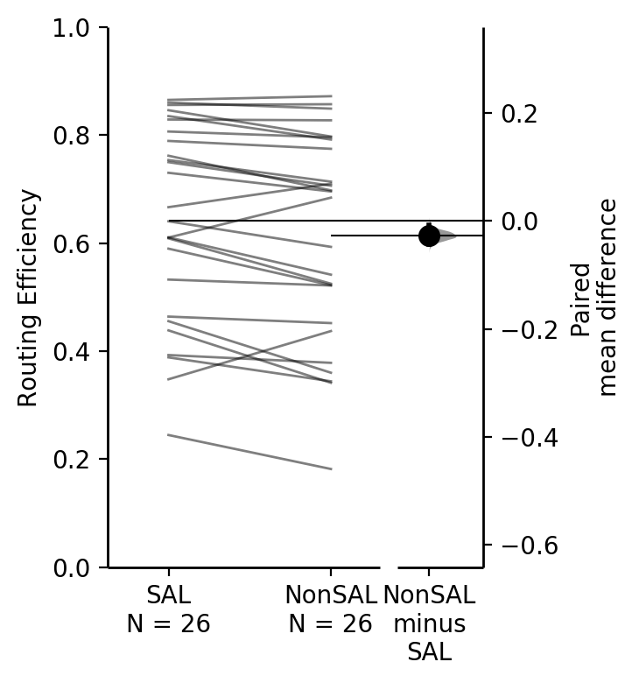
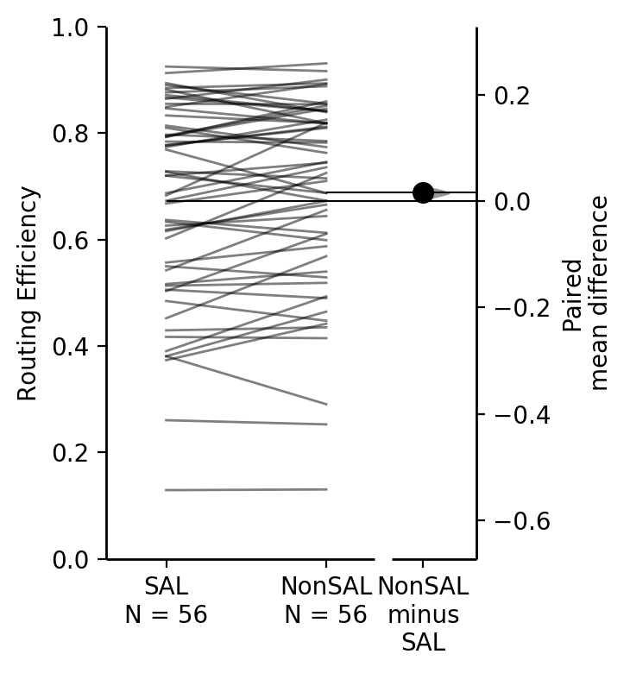
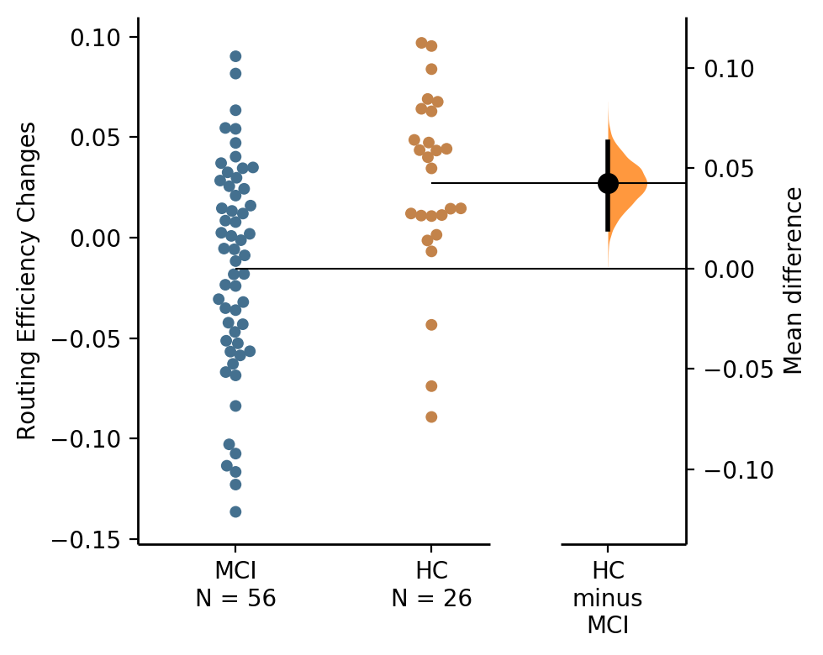
Analysis on Right Fronto-Central and Right Centro-Parietal
Healthy Controls
MCI
RE Changes Comparison
(Change = SAL - NonSAL)
P value = 0.0063
SAL >>> NonSAL
(paired)
P value = 0.0340
NonSAL > SAL
(paired)
P value = 0.0007
(two-sample)

Slide 20
Interaction of Saliency and Group Effect on Global Density
(Coherence Network, Total Power, Beta Band)
Healthy Controls
MCI
Global Density Change
HC vs MCI
P value = 0.0047
SAL >> NonSAL
(paired)
P value = 0.088
SAL < NonSAL
(paired)
P value = 0.00011
(two-sample)
Several studies indicate that an increase in the task difficulty requires further synchronization of the brain network (Korobeinikova and Karatygin, 2012; Bernarding et al., 2013).

Slide 21
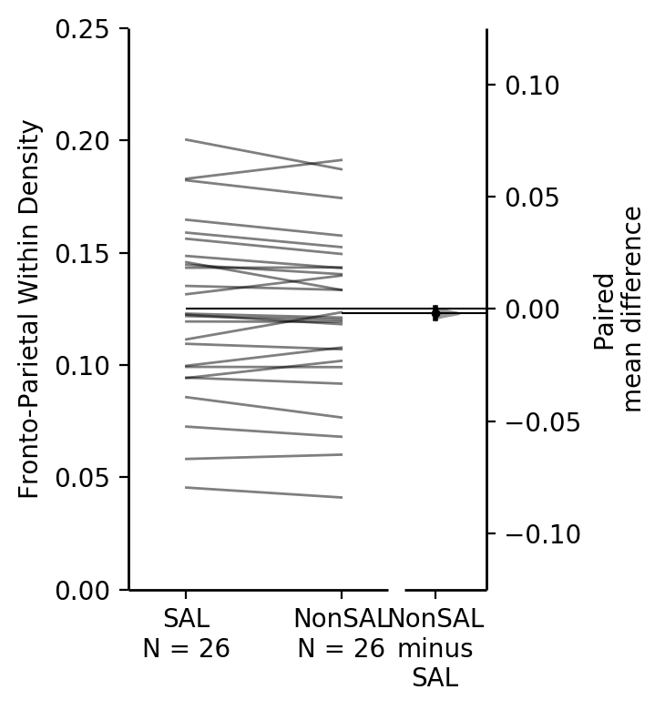
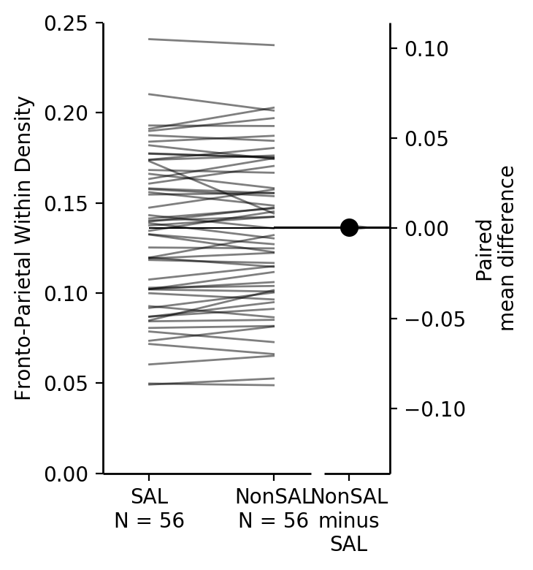
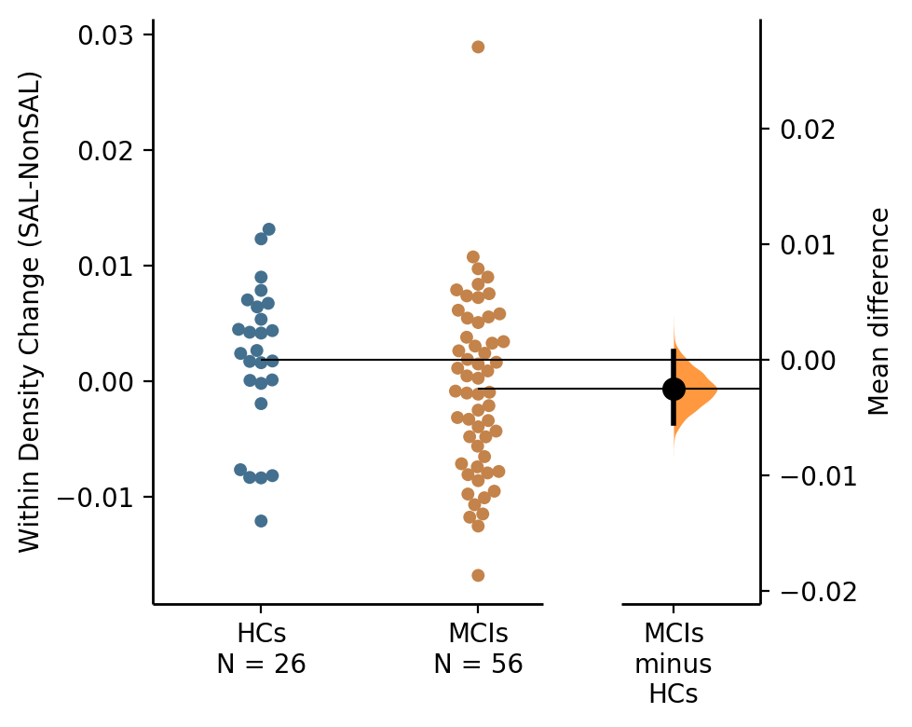
Interaction of Saliency and Group Effect on Within Density
(Coherence Network, Total Power, Beta Band)
P value = 0.153
P value = 0.147
SAL > NonSAL
(paired)
P value = 0.549
SAL == NonSAL
(paired)

Slide 22
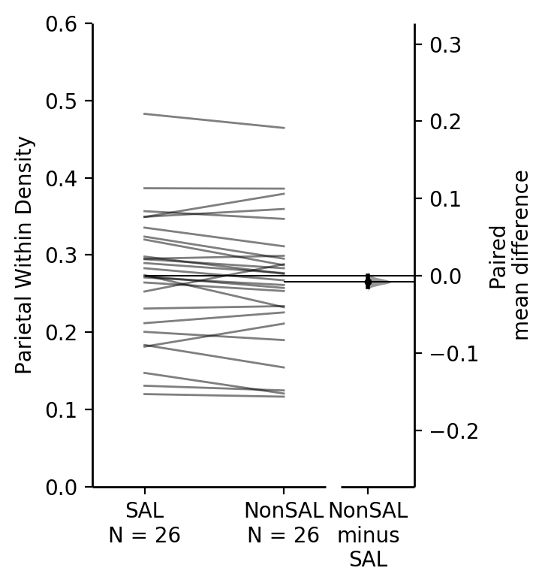
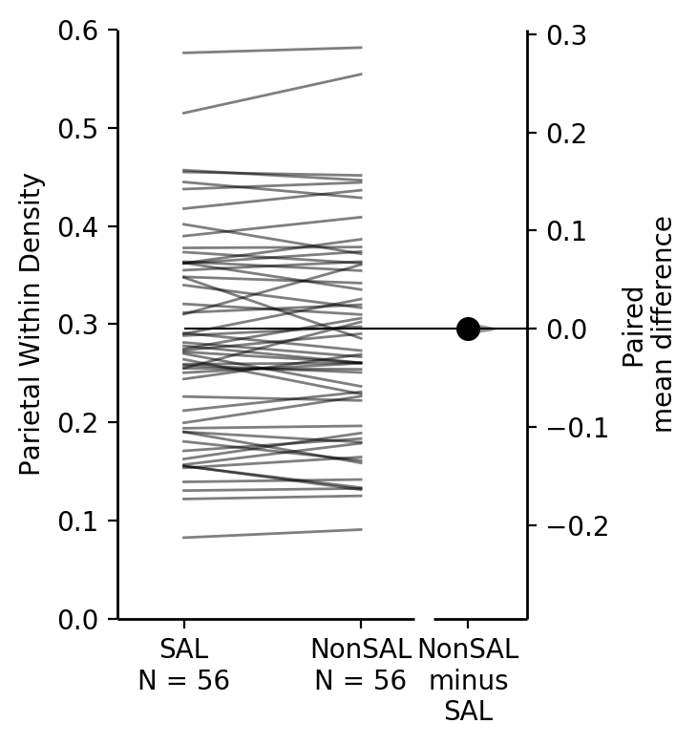
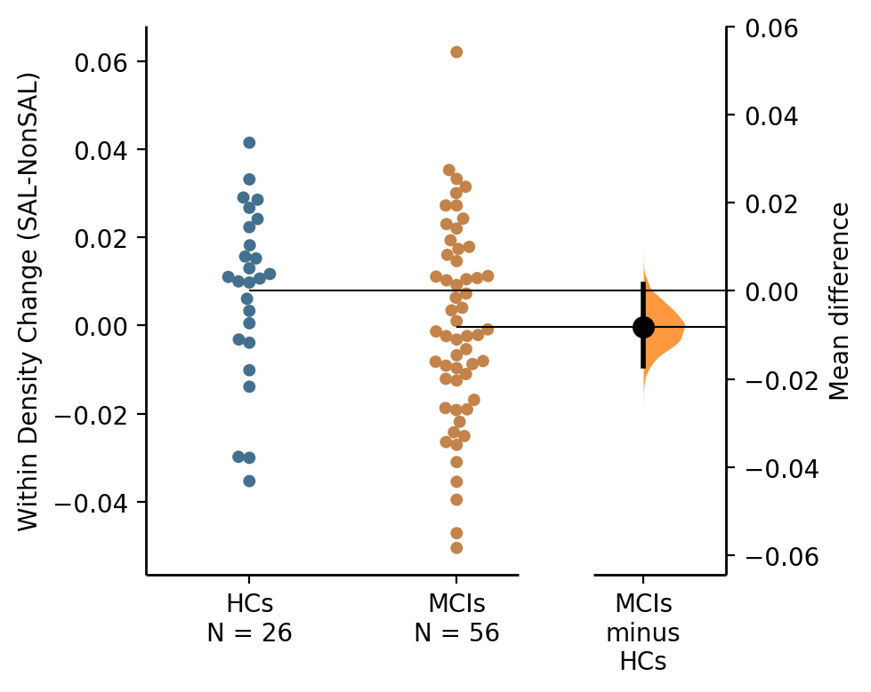
Interaction of Saliency and Group Effect on Within Density
(Coherence Network, Total Power, Beta Band)
P value = 0.052
SAL > NonSAL
(paired)
P value = 0.9
SAL == NonSAL
(paired)
P value = 0.11
(two-sample)

Slide 23
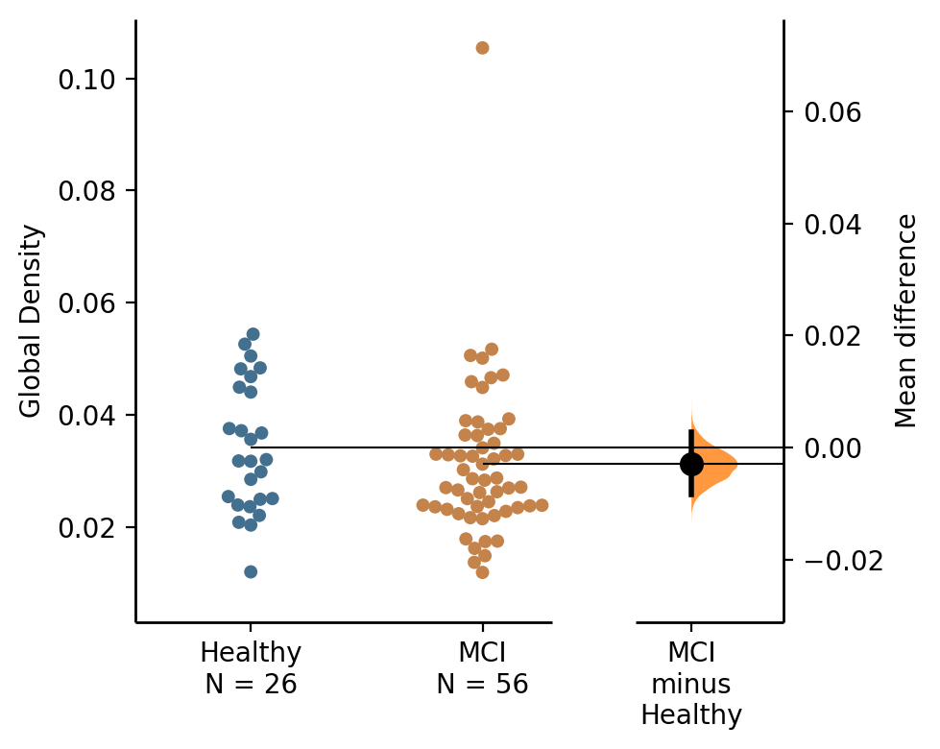
Group Effect on Global Density
(Coherence Network, Total Power, Beta Band)

Slide 24
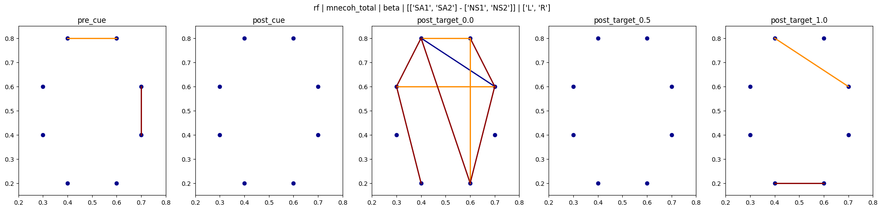
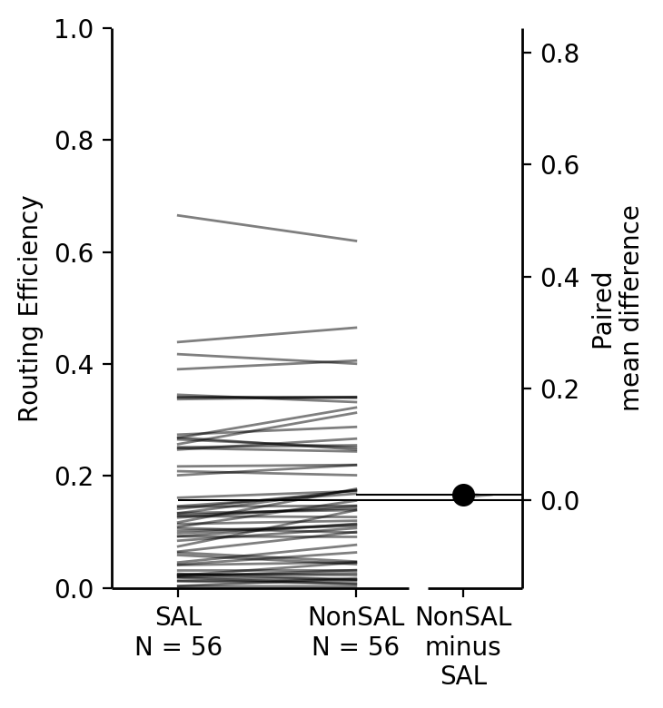
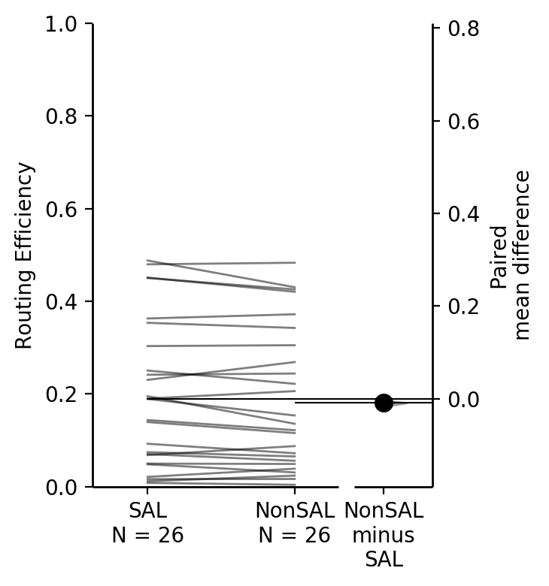
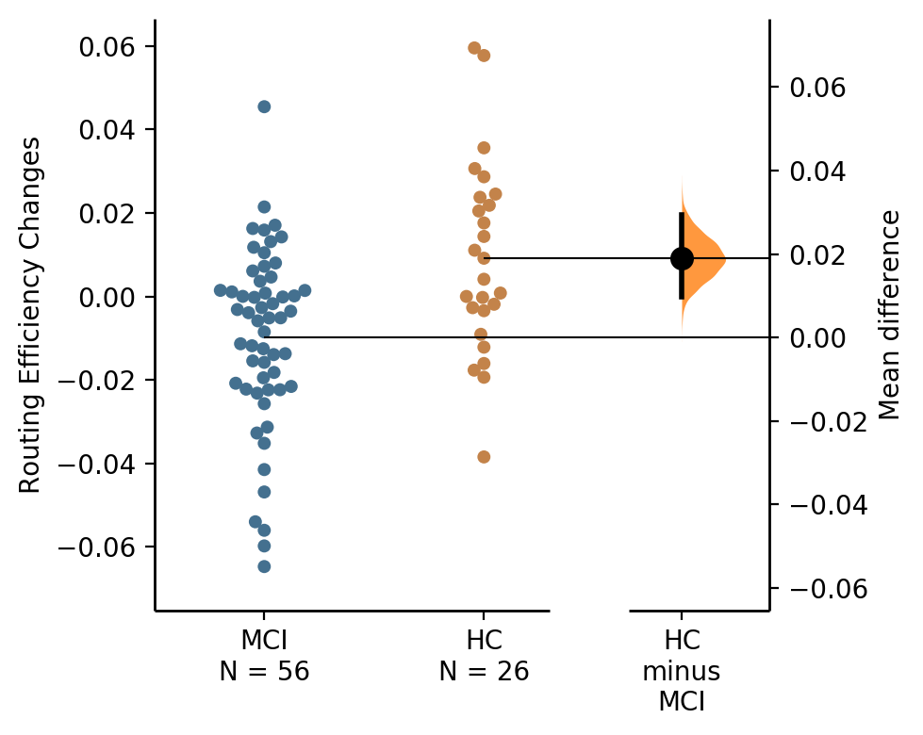
Analysis on Left Prefrontal and Right Frontal
Healthy Controls
MCI
RE Changes Comparison
P value = 0.0519
SAL > NonSAL
P value = 0.0012
NonSAL > SAL
P value = 0.00047

Slide 25
Interaction of Group and Saliency Effect on Routing Efficiency
Both Left and Right, Total Power, Beta Band
New Result
Old Result

Slide 26
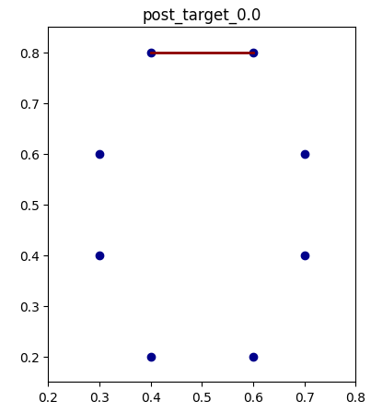
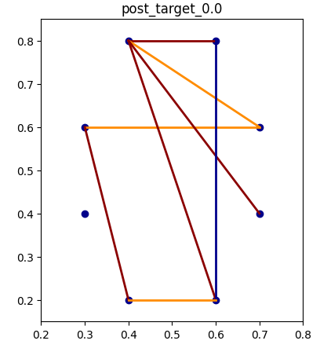
Interaction of Group and Saliency Effect on Routing Efficiency
Post_target [0,0.5]
(New sub-regions)
Left Cue
Both
Left and Right
Right Cue

Slide 27
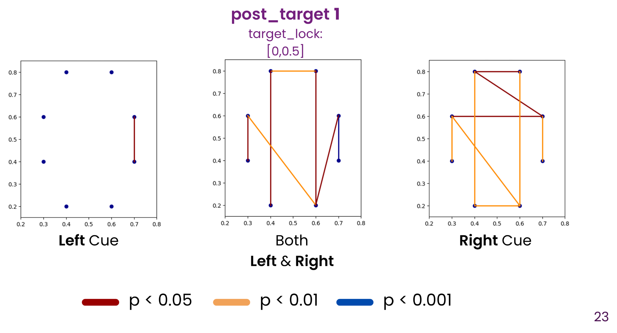

Slide 28
Attention: Top-Down vs Bottom-Up
Top Down: Pre-frontal blah blah
Bottom Up: blah blah
Question: Do Flanker count as a top-down attention while SAL occasionally activate bottom-up attention mechanism?

