Slide 1
PageRank Algorithm
Presented By :
Raju Khanal
110849511

Slide 2
Motivation
Search result is important.
The entire web/internet would not be relevant if the search query and ranking of pages is not proper.

Slide 3
Term Spam^{[2]} : The introduction into Web pages of words that misrepresented what the page was about.
Inverted index was used. Given a term find the pointers to all the places where that term occurs.
Presence of a term in a header of the page made more relevance than would the presence of the term elsewhere.
But large no. of occurrences of the term would add to the assumed relevance of the page for the search query.

Slide 4
Techniques employed to increase your “search result queries”^{[2]}
Add lot of unrelated terms in your webpage
Add contents of the first page that came up in the search query using the background color to make it invisible.
Solution?^{[2]}
Pages that would have a large number of surfers were considered more important than pages that would rarely be visited.
“Terms used in or near the links to that page was given more importance.” Cannot add false terms to other pages that link to your own

Slide 5
So what if you added millions of spam pages that linked to your own page?
Those pages would not be given much importance by PageRank since other “important” pages would not link to them.
A Page is important if important pages link to it.
Random surfer model^{[2]} : Each start at a random page and at any step move, at random, to one of the pages to which their current page links. The intuition is that people tend to create links to the pages they think are useful, so random surfers will tend to be at a useful page.

Slide 6

Computation/representation
Transition matrix
Rank vector
In the general case, the PageRank value for any page u can be expressed as:^{[1]}
i.e. the PageRank value for a page u is dependent on the PageRank values for each page v contained in the set Bu (the set containing all pages linking to page u), divided by the number L(v) of links from page v

Slide 7
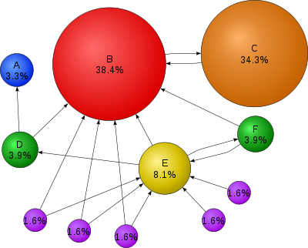
^{[3]}

Slide 8
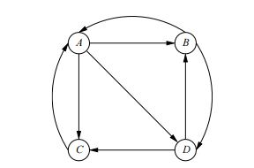

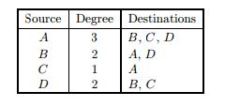
Rank Vector values after a few iterations
Sample Input Graph
 | A | B | C | D
A | 0 | 1/2 | 1 | 0
B | 1/3 | 0 | 0 | 1/2
C | 1/3 | 0 | 0 | 0
D | 1/3 | 1/2 | 0 | 1/2
Matrix representing the sample graph
Sparse representation

Slide 9
The vector is computed only once after each crawl of the web.^{[1]}
Square, stochastic matrix
The convergence of PageRank requires^{[1]} :
A ) Irreducible : Strongly connected( Needs dampening factor )
B ) Aperiodic : No cycles

Slide 10
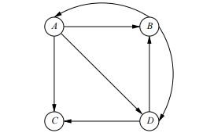
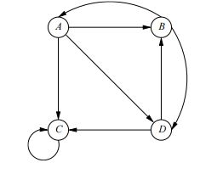


Dead end^{[2]} Spider Trap^{[2]}
vs
Dead End

Slide 11

Solution to Spider Traps and Dead Ends?
Taxation or introduction of the decay factor( β )^{[2]}
Value is generally between 0.8 to 0.9( generally 0.85 )^{[2]}
If stuck on dead ends, can leave the web.
^{[1]}

Slide 12
Efficient Representation^{[1]}
Column by column representation is efficient:
As matrix is sparse and the non zero entries have a special property that the value of each nonzero entry is the inverse of no. of non zero entries in that column, column by column representation is the efficient one.
Block based method
Break the vector into k segments and break the transition matrix into k*k squares called blocks, assigning each square to one machine. The vector segments are each sent to k machines. The columns are divided into k segments.

Slide 13
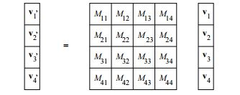
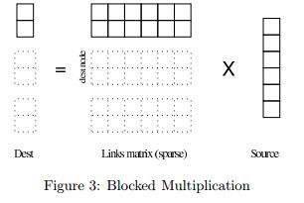
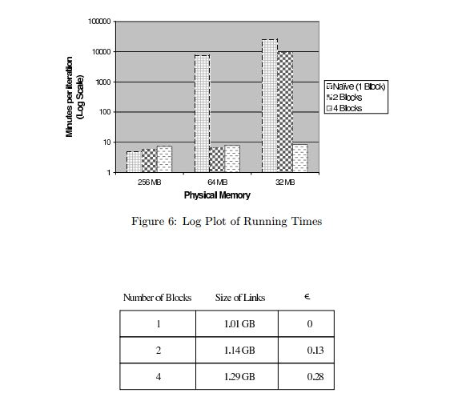
^{[2]}
^{[1]}
^{[1]}

Slide 14
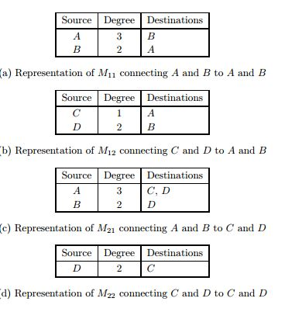
^{[2]}
Sparse representation of blocks of matrix

Slide 15
Final thoughts/Analysis^{[1]}
Single precision rank values are sufficient. Not much difference of Residual value( difference of the PageRank vectors from two successive iterations) if Double precision rank values are used.
Partition the Destination array into enough blocks so that a single Destination block an fit in physical memory.
PageRank can be run on modestly equipped machines.
Convergence result can be obtained in few iterations.

Slide 16
References
1. Taher H. Haveliwala 1999 “Efficient Computation of PageRank”
2. Jure Leskovec , Anand Rajaraman , Jeffrey Ullman 2014 “ Mining of Massive Database”
3. https://en.wikipedia.org/wiki/PageRank

