Slide 1
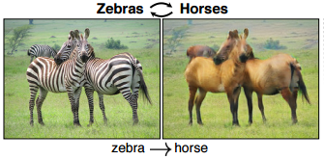
DiscoGAN
Raju Khanal
110849511

Slide 2
Introduction
GANs( Generative Adverserial Networks) are a generative model , used in unsupervised setting via an adverserial process.
Consists of two networks :
- A generative model G
- A discriminative model D
Notes:
Introduction ->
Our project is about analyzing chicago crime data and conducting Exploratory/Predicitive analysis to identify patterns of crimes ,
Better allocate police forces , discover potential risks and prevent tragedies from happening.

Slide 3
The generator adjusts its parameters so that the training data and generated data cannot be distinguished by the discriminator model. The goal is to find a setting of parameters that makes generated data look like the training data to the discriminator network.

Slide 4
DiscoGAN
Discover cross domain relations given unpaired data.
Successfully transfers style from one domain to another
Maps two domains without any extra label
Example can be pairing suit jacket with pants

Slide 5
Architecture
Each generator takes images and feeds it into an encoder decoder pair.
The encoder part of each generator is composed of convolutional layers with 4 * 4 filters each followed by a leaky ReLU.
The decoder part is composed of deconvolution layers with 4 * 4 filters followed by ReLU and outputs a target domain image.
The discriminator has an additional convolutional layer with 4 * 4 filters and a final sigmoid to output a scalar output between [ 0 , 1].
ReLU : Converts all negative values to 0

Slide 6
Convolution Networks Overview
Consist of 3 components :
Convolution layers : Applyies a specified number of convolution filters to the image
Pooling layers : Downsample the image data extracted by the convolutional layers to reduce the dimensionality of the feature map in order to decrease processing time
Dense(fully connected) layers : Perform classification
The convolution ops sweep a 2-D filter over a batch of images, applying the filter to each window of each image of the appropriate size
For pooling layer, uses stride of 2. Stride controls how depth columns around the spatial dimensions (width and height) are allocated
Filter is referred to as a set of shared weights on the input. Filter size is 4 * 4.

Slide 7
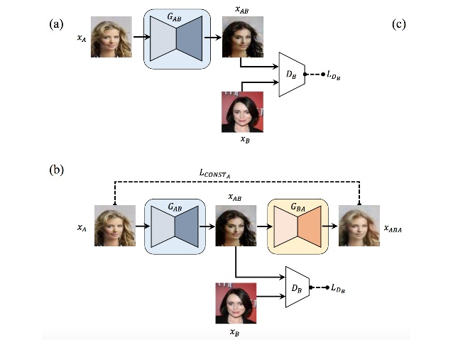
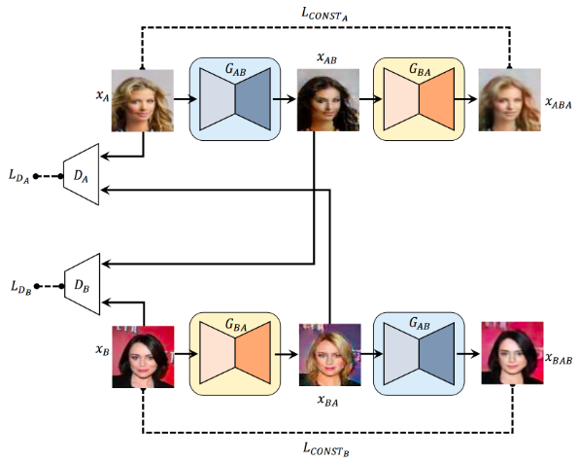
GANs vs GANs with reconstruction loss vs DiscoGAN
a) GANs b ) GANs with reconstruction work
DiscoGAN

Slide 8
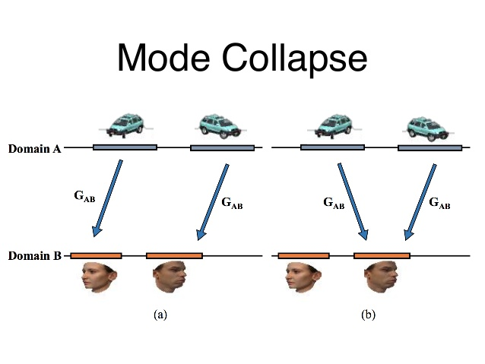
Problems with GANs
Mode Collapse Problem :
Data from multiple modes of a domain map
to a single mode
of a different domain.

Slide 9
Tensorflow code review
tf.nn.conv2d : This tensorflow API is used to generate the convolved image. Computes a 2-D convolution given 4-D input and filter tensors.
Each convolution layer is formed by using this API.
tf.nn.conv2d_t : Used to form the deconvolution network for the generator. This is the transpose of conv2d.
During the training phase , we use the AdamOptimizer to optimize the loss function.
Our loss function is the summation of the generator loss and the discriminator loss.
Loss is computed using the API : tf.nn.sigmoid_cross_entropy_with_logits which computes the sigmoid cross entropy given logits. It measures the probability error in discrete classification.
Reconstruction loss , LCONSTA is calculated from ABA.
Reconstruction loss, LCONSTB is calculated from BAB.

Slide 10





Results
The main problem with GANs is that it takes a lot of time for training and sometimes the results are not so good.
Below are some results from generating celebrity photos. Training steps were 19725.

Slide 11






Results – Houses to silhouettes and vice - versa
100000 iterations

Slide 12






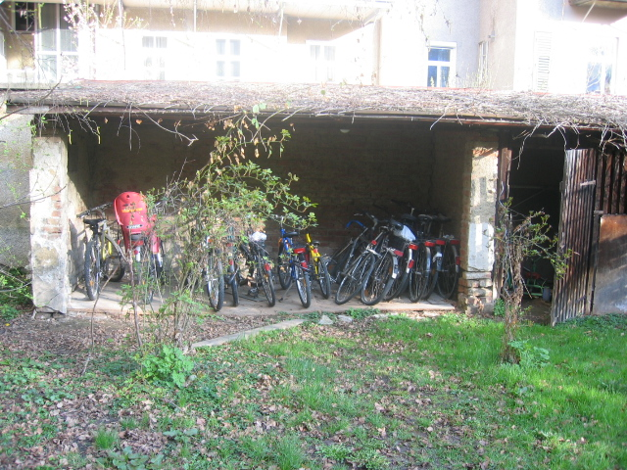
Results – Bikes and Car with some background
The blurry images seen above are a results of not so specific dataset like the one given on right.

Slide 13
Conclusion
GAN has a lot of potential. However, training takes a lot of time and does not give good results necessarily.
We can generate multiple domains and their counter data.
Can be used for replacing photoshops in the future.

