Slide 1
Semantic Analysis from verbs
AKSHAY VERMA – 110922993
RAJU KHANAL - 110849511

Slide 2
Task definition
The goal is to provide a scalable method for learning relations and/or verbs as operators (represented as tensors). These operators should take in one or more words, and map them to a new embeddings space. The goal of this new embedding space is to capture the semantics of the phrase (rather than the semantics of a single word).

Slide 3
Motivation
Word embedding for the verb should already give us plenty of information about the verb, so it is not unreasonable to believe that the tensor representation for the verb can be derived from it. This drastically reduces the storage and parameter requirements, from a tensor for every verb, to a single tensor used for computing verb tensors from verb embeddings.

Slide 4
Achievements
Implemented a novel approach
Achieved good results

Slide 5
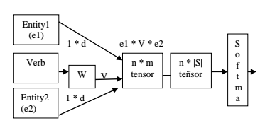

Slide 6
Dataset
1. Training
New York Times using
REVERB
StanfordCoreNLP
2. Test
EMNP
- 1945 instances

Slide 7
KEY RESULTS
Config | Embedding Size | Training Instances | Accuracy
1 | 50 | 5000 | 45.40%
2 | 50 | 7000 | 50.34%
3 | 50 | 9000 | 56.25%
4 | 50 | 10000 | 59.28%

Slide 9
FUTURE WORK
GloVE
Negative Sampling
Is orthogonality or independence of columns of W important?

Slide 10
CONCLUSION
Storage requirements decreased
Run time decreased
Low rank tensors for Verbs vs Full rank tensors for Sentences

