Slide 1
YACC
Yet Another Compiler-Compiler
IIT Patna

Slide 2
1. How It Works
A parser generator
YACC source program
“test.y”
YACC Compiler
“y.tab.c”
“y.tab.c”
C Compiler
exe
input
exe
output

Slide 3
2.YACC Structure
A YACC source program has 3 parts:
declarations
%%
translation rules
%%
support C code

Slide 4
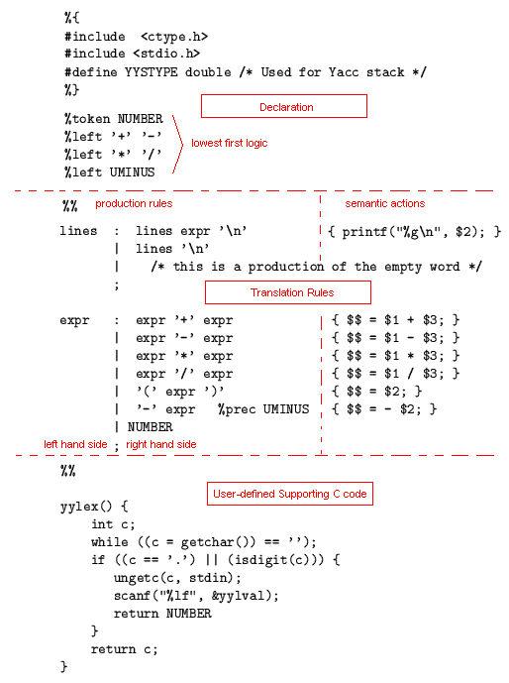

Slide 5
3. LEX & YACC
LEX: a tool for automatically generating a lexer or scanner given a lex specification (.l file); A lexer or scanner is used to perform lexical analysis, or the breaking up of an input stream into meaningful units, or tokens.
YACC: a tool for automatically generating a parser given a grammar written in a yacc specification (.y file); A grammar specifies a set of production rules, which define a language, and corresponding actions to perform the semantics.

Slide 6
How to run yacc
First Compile yacc program(open the file with .yacc extension)
yacc -d filename.yacc
It will generate two files- y.tab.c and y.tab.h
Compile lex file.
lex filename.lex
Now run the below commands:
gcc -o objectFileName y.tab.c lex.yy.c -lfl
./objectFileName < inputFile

Slide 7
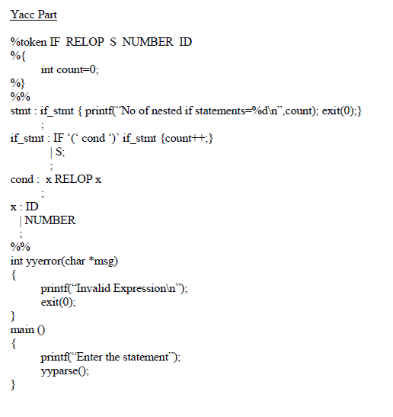
Example of yacc programs
Example 1.

Slide 8
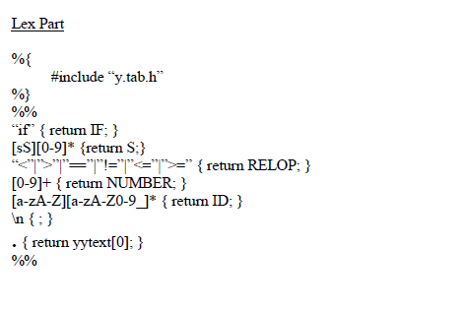

Slide 9
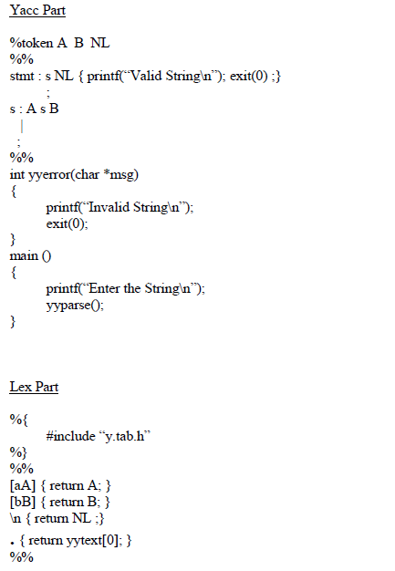
Example 2.

