Slide 1
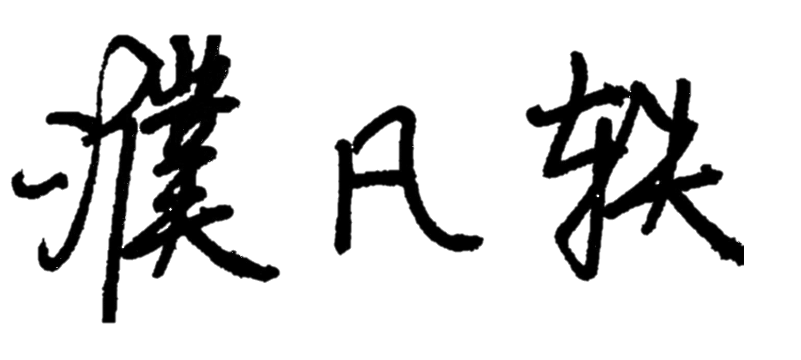
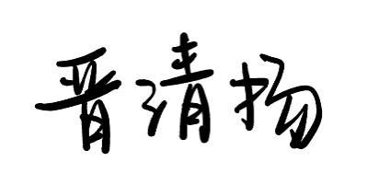
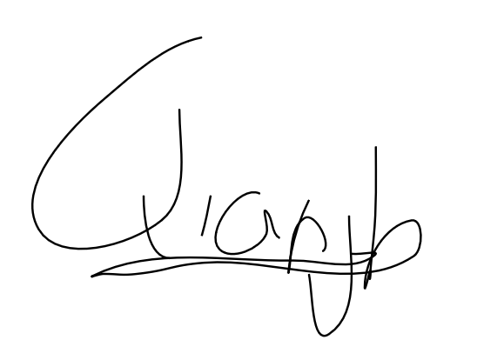
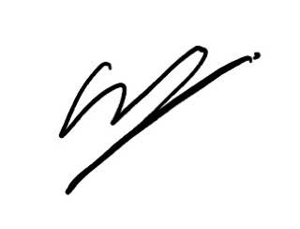

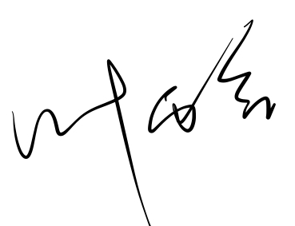
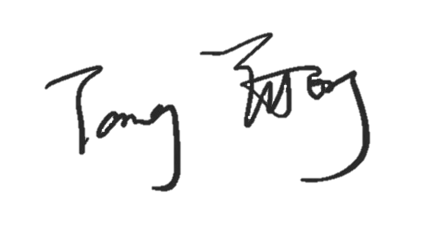
Team member (full name) | Signature | Date | A or B*
Pu Fanyi |  | 13/Feb/2024 | A
Jin Qingyang |  | 13/Feb/2024 | A
Qian Jianheng Oscar |  | 13/Feb/2024 | A
Soo Ying Xi |  | 13/Feb/2024 | A
Ting Ruo Chee |  | 13/Feb/2024 | A
Ye Yuhan |  | 13/Feb/2024 | A
Tang Yutong |  | 13/Feb/2024 | A
* Each team member should indicate either A or B:
I affirm that my contribution(s) to the lab work is my own, produced without help from any AI tool(s).
I affirm that my contribution(s) to the lab work has been produced with the use of AI tool(s).

