Slide 1
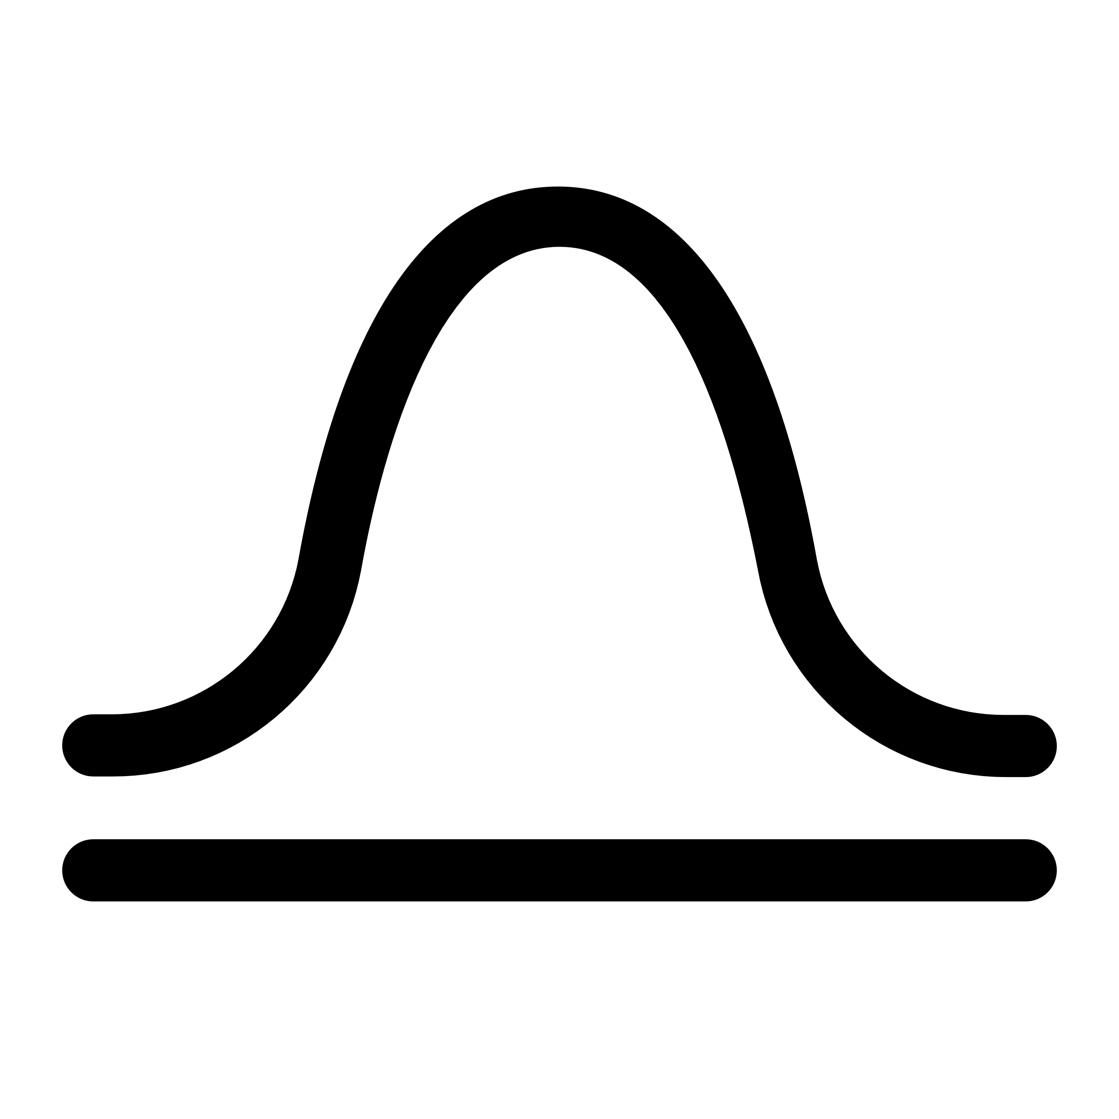








Visualizing the Data
Assessing Normality
Normal?
Yes!
Histogram
Normal Fit
Final Data
Boxplot
QQ Plot
No
Data Transformation
$$Y=log\left(X+β\right)$$
$$Y=e^{αX}$$
$$Y=X^{α}$$
$$Y=log\left(β_{1}⋅log\left(X+β_{2}\right)+β_{3}\right)$$

