Slide 1
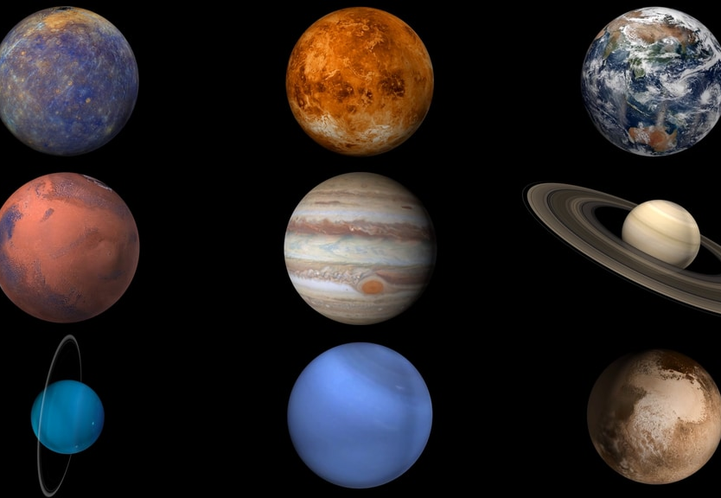
FIELD GUIDE
The solar system is a family held together by one star.
A compact tour of the Sun, eight planets, dwarf planets, belts, moons, and the frontier where sunlight becomes a very slow clock.
Sun -> rocky worlds -> asteroid belt -> giant planets -> Kuiper Belt -> Oort Cloud
1
8
5
STAR
PLANETS
OFFICIAL DWARF PLANETS
Not to scale. The real system is mostly distance.
Sources: NASA About the Planets; NASA Solar System Facts
01

Slide 2
SYSTEM CENSUS
Eight planets are only the headline; small bodies fill the map.
KUIPER BELT
OORT CLOUD
The Sun's gravity organizes worlds, moons, asteroids, comets, dwarf planets, and far-out icy regions into one connected system.
SYSTEM LEDGER
8
planets in the modern census
Saturn
5
officially named dwarf planets
Mars
Neptune
Venus
100s
Mercury
of moons orbit planets, dwarf planets, and asteroids
Earth
SUN
Jupiter
Uranus
main asteroid belt
Sources: NASA Solar System Facts; NASA About the Planets
02

Slide 3
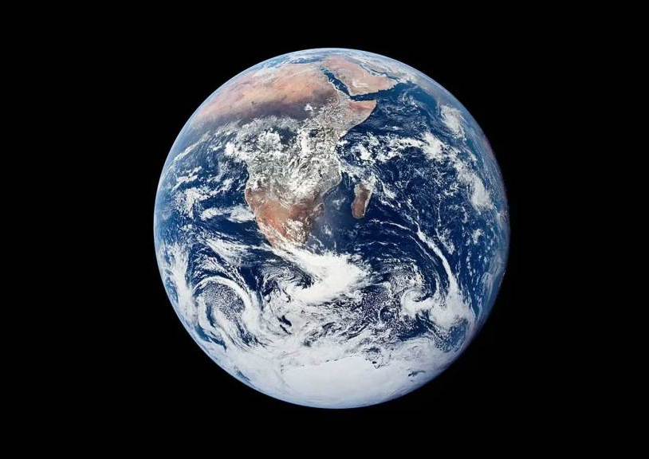
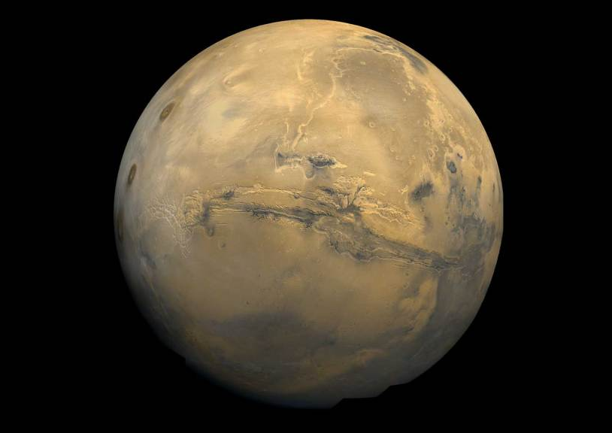
INNER WORLDS
The four inner planets are compact, rocky, and intensely different.
SOLID SURFACES
NEAR THE SUN
Mercury, Venus, Earth, and Mars are terrestrial planets with solid surfaces, but their atmospheres and histories point in very different directions.
Mercury
Venus
Earth
Mars
SMALLEST; CLOSEST TO SUN
HOTTEST PLANET
ONLY KNOWN LIFE
COLD DESERT WORLD
Cratered, airless, and extreme.
Thick atmosphere traps heat.
Liquid water and active climate.
Ancient water clues remain visible.
Sources: NASA About the Planets; NASA Solar System Facts
03

Slide 4
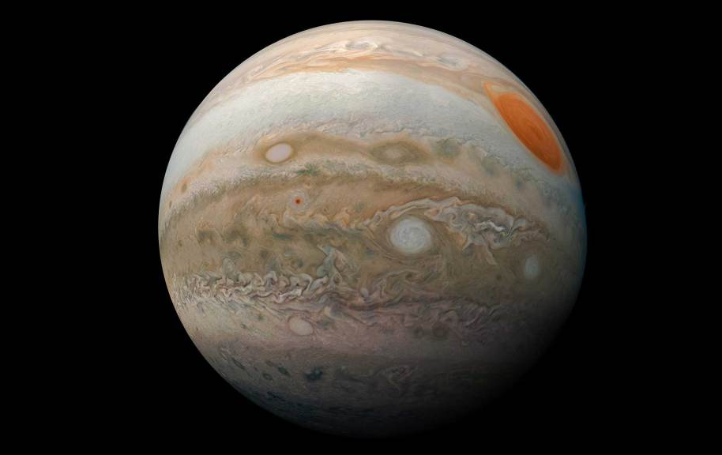
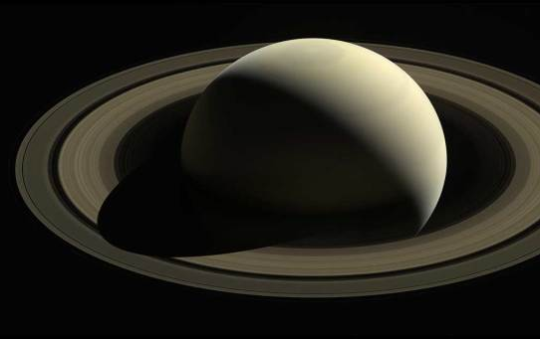
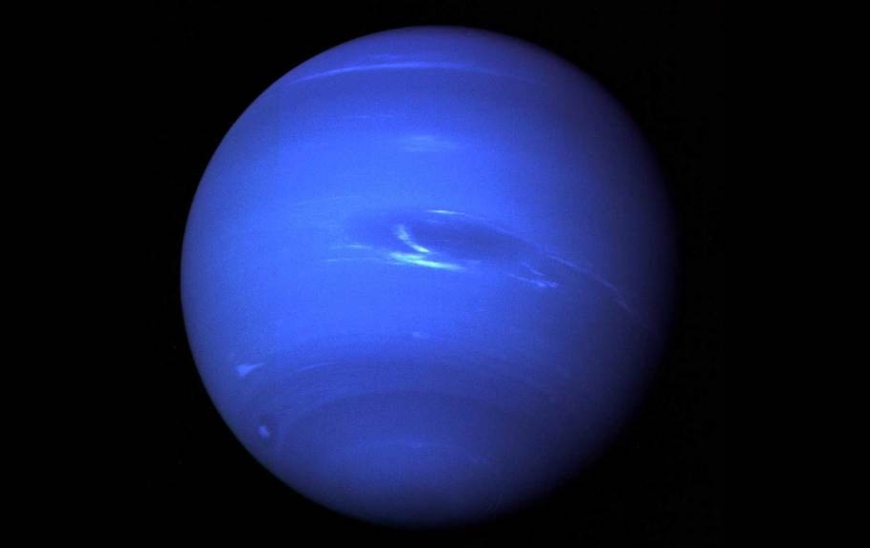
OUTER WORLDS
Past the asteroid belt, planets become systems of gas, ice, rings, and moons.
Jupiter and Saturn are gas giants; Uranus and Neptune are ice giants. All four giant planets have rings, though Saturn's dominate the view.
outer planet
shift
The story changes from rocky surfaces to atmospheres, magnetospheres, rings, and families of moons.
Jupiter
Saturn
Neptune
gas giant; largest planet
gas giant; ring icon
ice giant; farthest planet
Sources: NASA About the Planets; NASA Solar System Facts
04

Slide 5
SCALE SHOCK
Distance, not size, is the mind-bender.
Planet posters compress space. A more useful map treats Earth-Sun distance as one astronomical unit and then watches the gaps stretch.
Mercury
0.39 AU
Earth
Jupiter
Uranus
Oort Cloud
1 AU
5.2 AU
19.2 AU
Kuiper Belt
2,000+
AU
30-50 AU
Mars
Saturn
Neptune
Venus
1.52 AU
9.6 AU
30.1 AU
0.72 AU
1 AU = the average Earth-Sun distance, about 93 million miles or 150 million km.
Sources: NASA Solar System Facts; NASA Kuiper Belt Facts; NASA Oort Cloud Facts
05

Slide 6
LEFTOVERS
The leftovers are a memory of formation.
THREE REGIONS
Asteroids, Kuiper Belt objects, and Oort Cloud bodies preserve material from the solar system's early construction zone.
01
Main asteroid belt: most known asteroids orbit between Mars and Jupiter.
02
Kuiper Belt: a broad doughnut of icy bodies beyond Neptune.
03
Oort Cloud: theorized distant shell and likely source of long-period comets.
Sun
Asteroid belt
Kuiper Belt
Sources: NASA Asteroids In Depth; NASA Kuiper Belt Facts; NASA Oort Cloud Facts
06

Slide 7
LIFE QUESTION
Earth is the only confirmed living world,
but the search points outward.
NASA frames the search as a system question: where do energy, chemistry, water, and time line up well enough for life as we know it?
1
Energy
Sunlight, heat, or chemistry can power change.
2
Water
Liquid water is a strong habitability clue.
3
Chemistry
Carbon-rich molecules and minerals matter.
KNOWN ANSWER
So far, life is known only on Earth.
4
Time
Stable environments give complexity room.
Sources: NASA Solar System Facts; NASA Earth imagery
07

Slide 8
MENTAL MODEL
Read the solar system from inside out.
SOURCE TRAIL
NASA About the Planets
NASA Solar System Facts
NASA Sun Facts
NASA Kuiper Belt + Oort Cloud Facts
A good map is not a line of planets. It is a set of zones, each with a different kind of evidence.
Star
Rocky worlds
Belt
Giants
Icy frontier
energy + gravity
solid surfaces
failed planet zone
moons + rings
comet reservoirs
Takeaway
The solar system is simple enough to tour, but too large to flatten. Keep the zones in your head and the scale will start to make sense.
Sources: NASA Science pages listed in source notes
08

