Slide 1

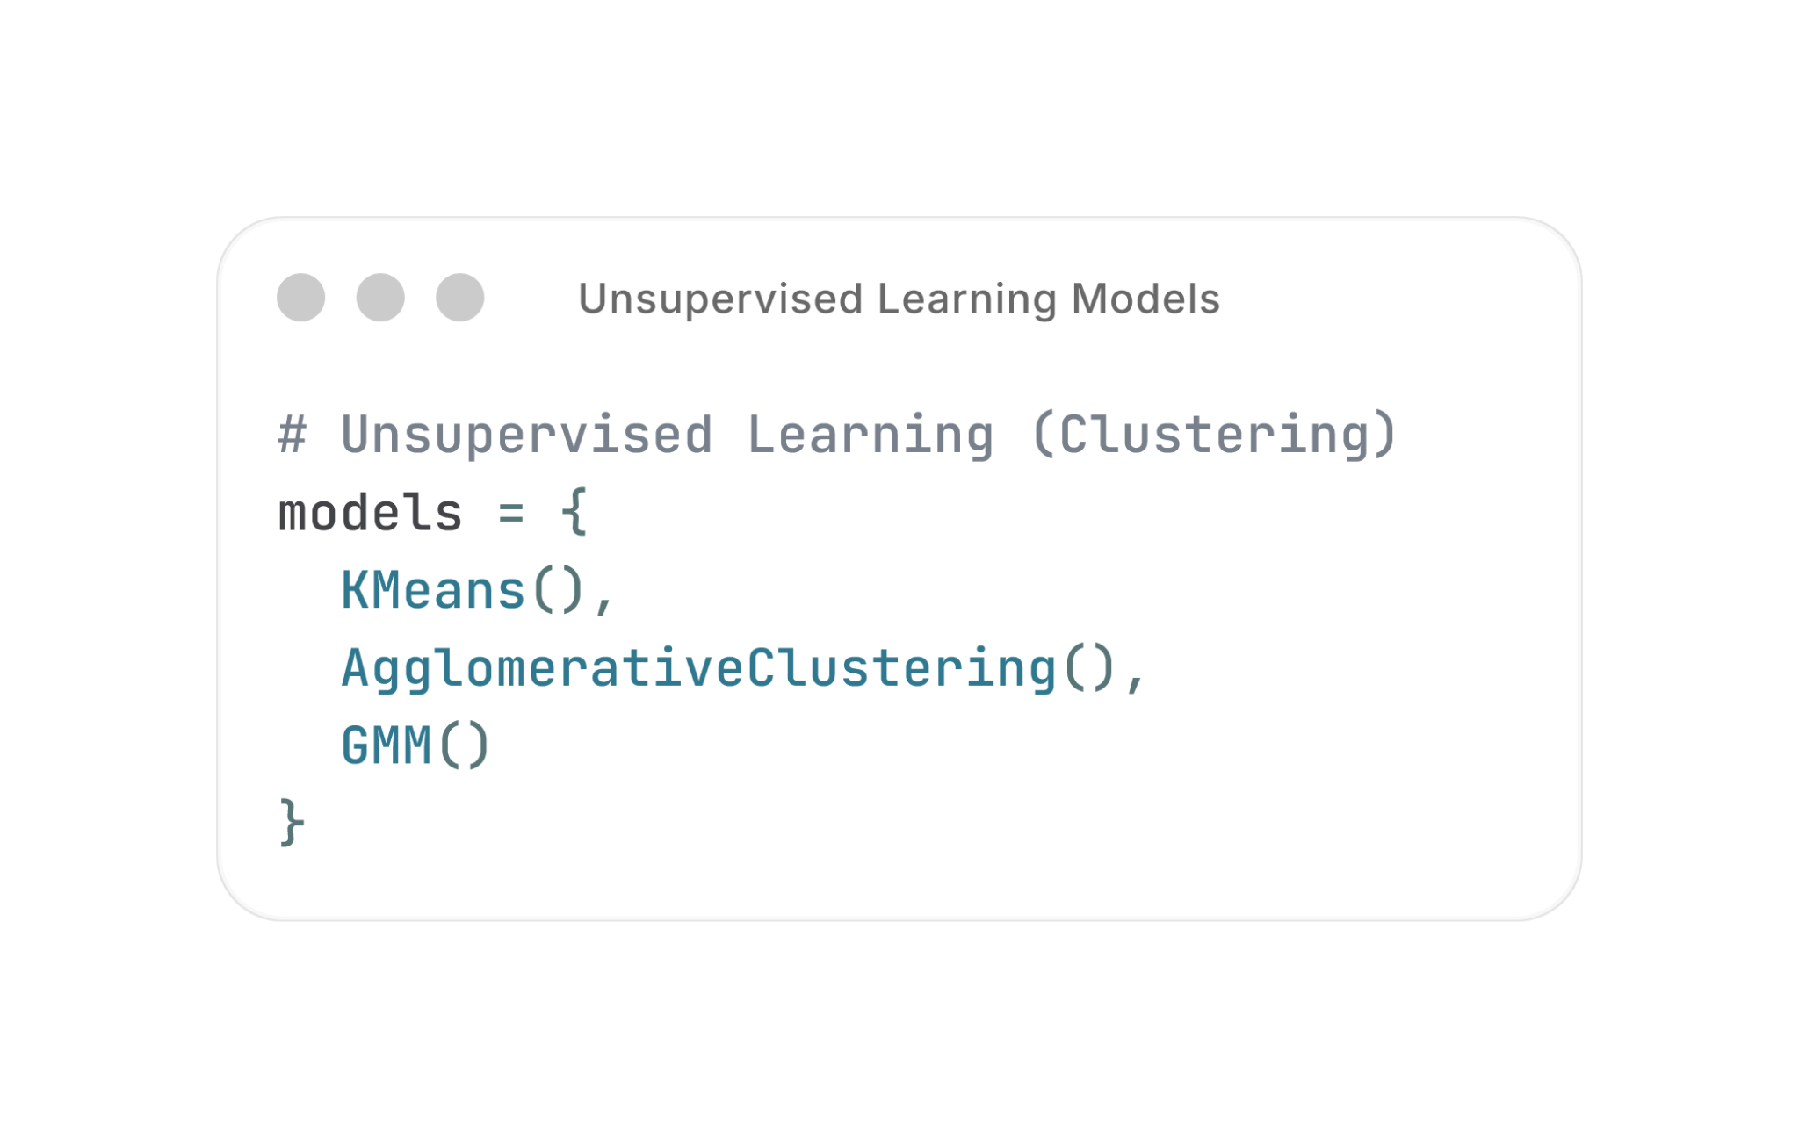
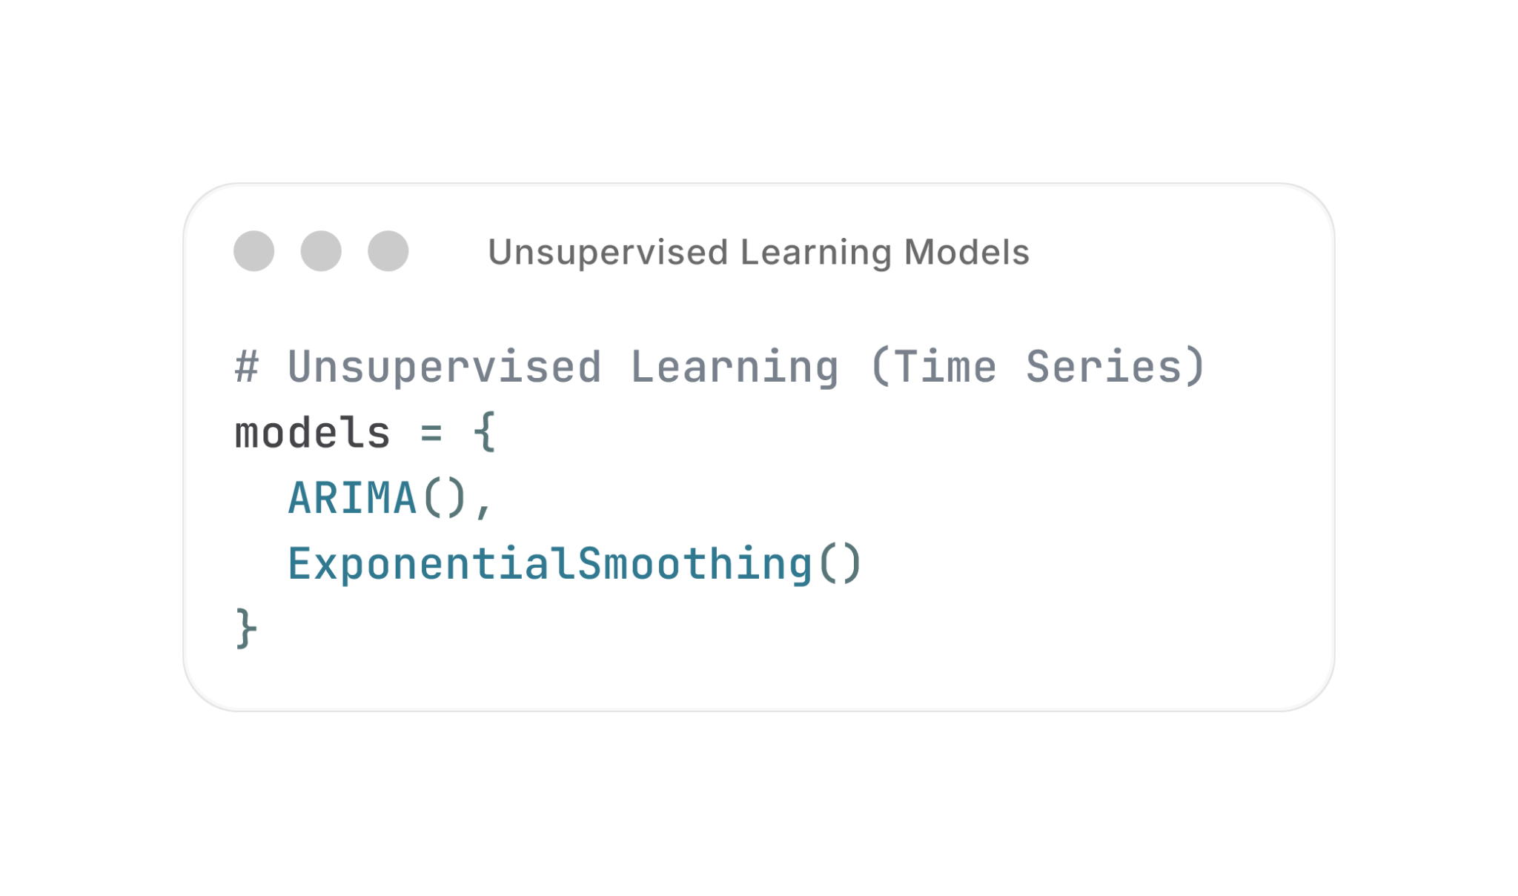
By: Kendrick Slamat, DAAA/03
Customer Segmentation
This project applies unsupervised learning to identify distinct customer segments based on demographic and spending behavior, enabling targeted business decisions rather than one-size-fits-all strategies.
This supports more targeted and effective business decisions.
Energy Consumption Forecasting
This project focuses on forecasting future energy consumption using historical time-series data. Accurate energy demand predictions support better planning, resource allocation, and sustainability efforts, especially in the presence of long-term trends and seasonal patterns.

Slide 2

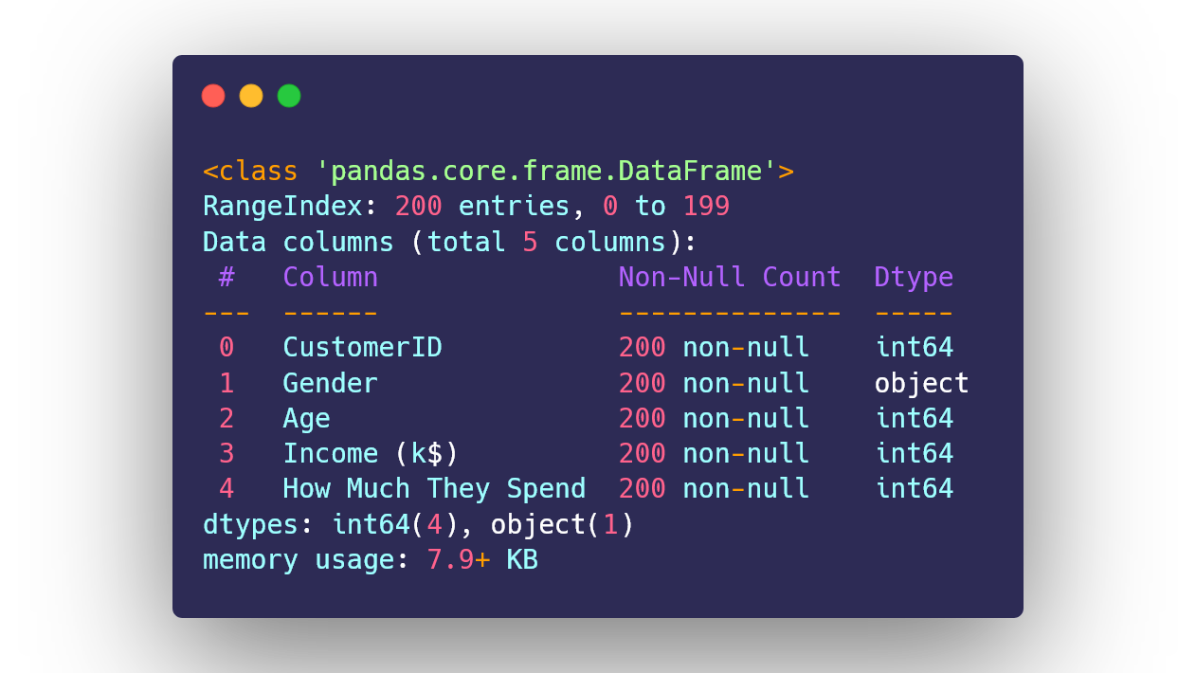
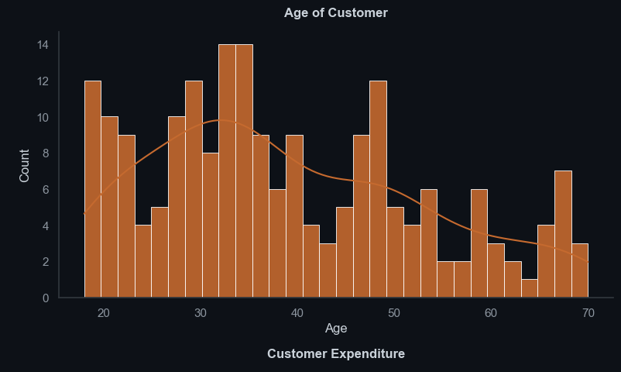
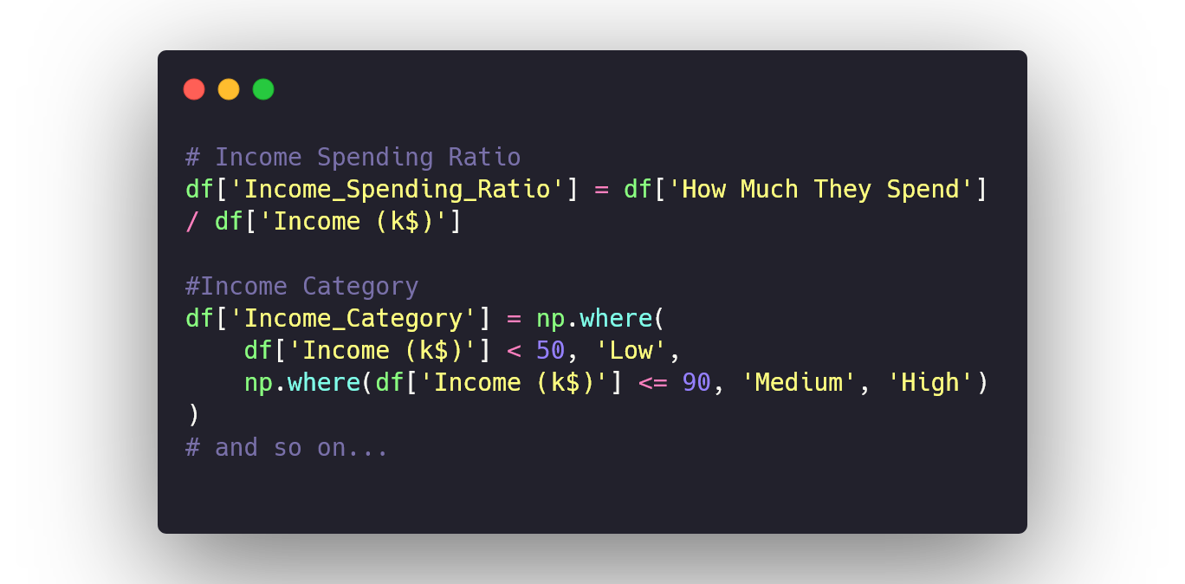
Data Preparation/EDA (Customer Segmentation)
Performed initial data inspection (df.info, df.describe),
Handled missing values and duplicates
Removed extreme outliers using IQR
Standardized features to ensure fair distance-based clustering
Data Visualization
Plot individual features (categorical + numerical)
Plot a pairplot of related features
Analyse relationships between features (visually)
Feature engineering
Created 3 new features to further capture customer behaviour.
  Income Spending Ratio
  Income Category (Low, Med, High)
  Spending Category (Low, Med, High)

Slide 3

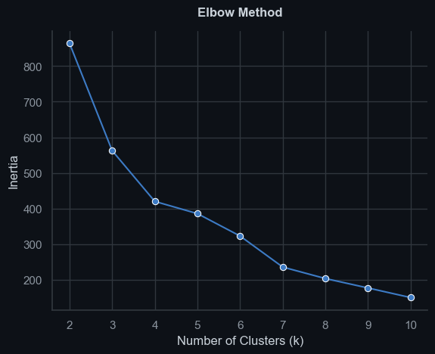
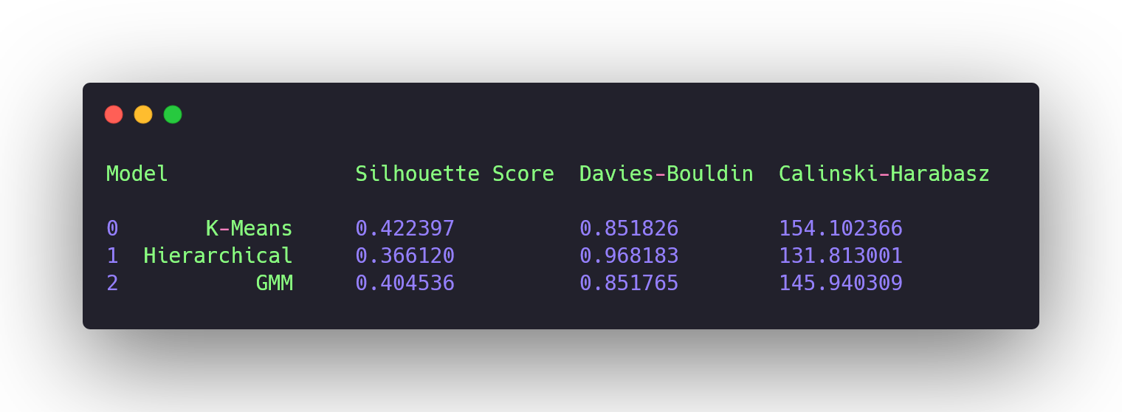
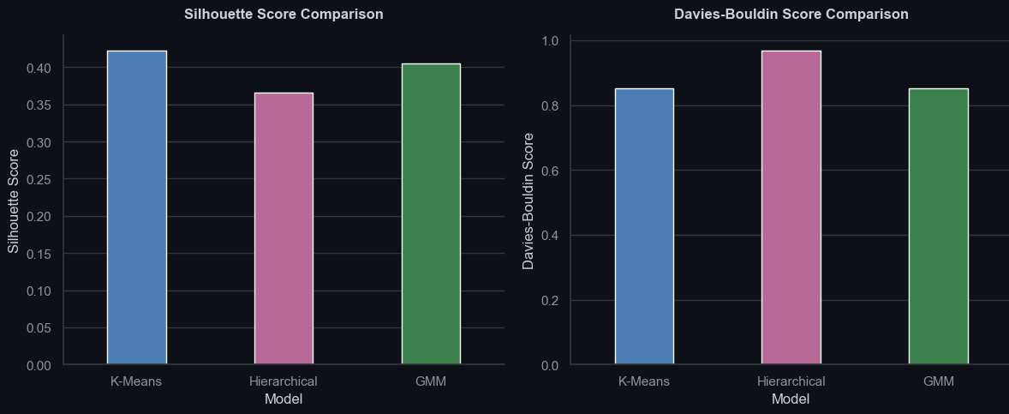
Finding Optimal K for model
Used Elbow Method and Silhouette Score to balance compactness and separation
k = 7 provided the best balance between cluster tendency and interpretability
Model Testing and Evaluation
Tested on KMeans, Hierarchical and GMM.
Models were evaluated based on:
Silhouette Score, Davies-Bouldin Score, Calinski-Harabasz Score
K-Means Clustering showed most consistent separation and stability.

Slide 4
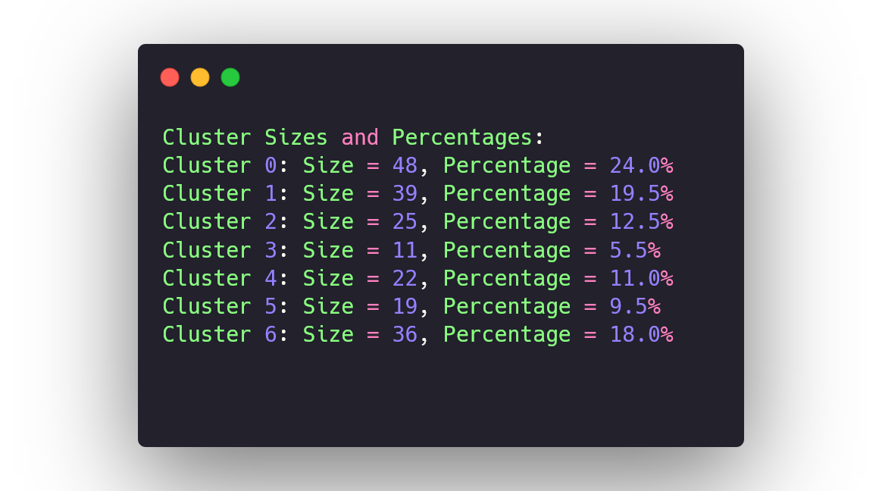

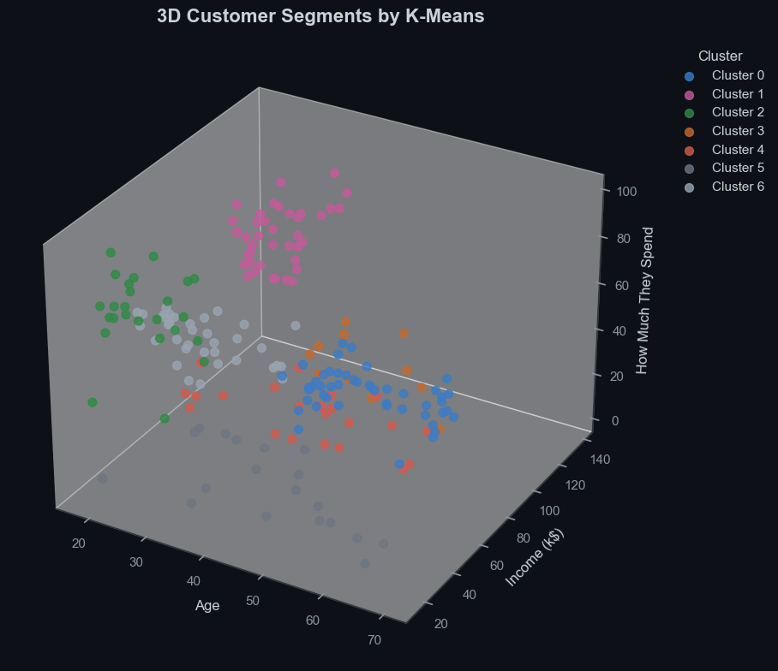
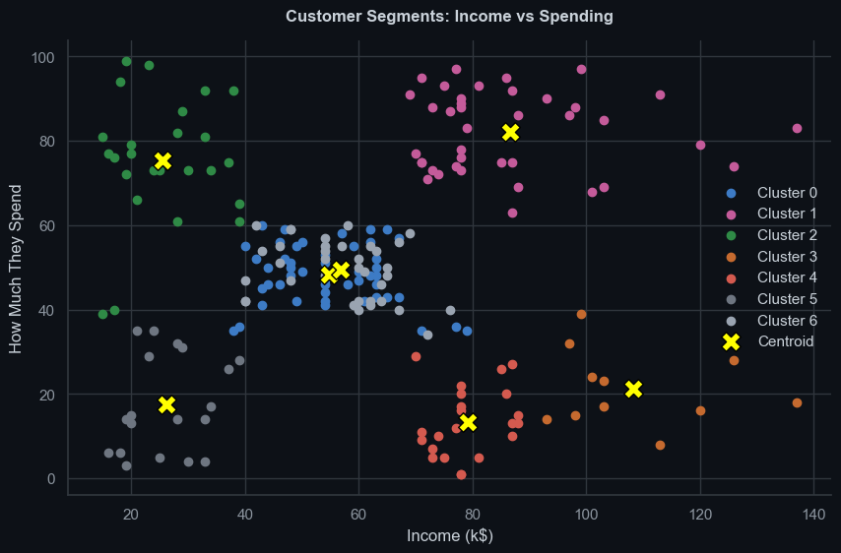
Cluster Analysis
Visualized clusters based on a comparison of features (Income vs Spending, Age vs Spending, Age vs Income)
Visualized clusters within a 3-dimensional space using a 3D scatterplot
Analysed cluster sizes, percentages, and cluster metrics
The analysis revealed distinct customer groups with different age, income, and spending patterns.

Slide 5
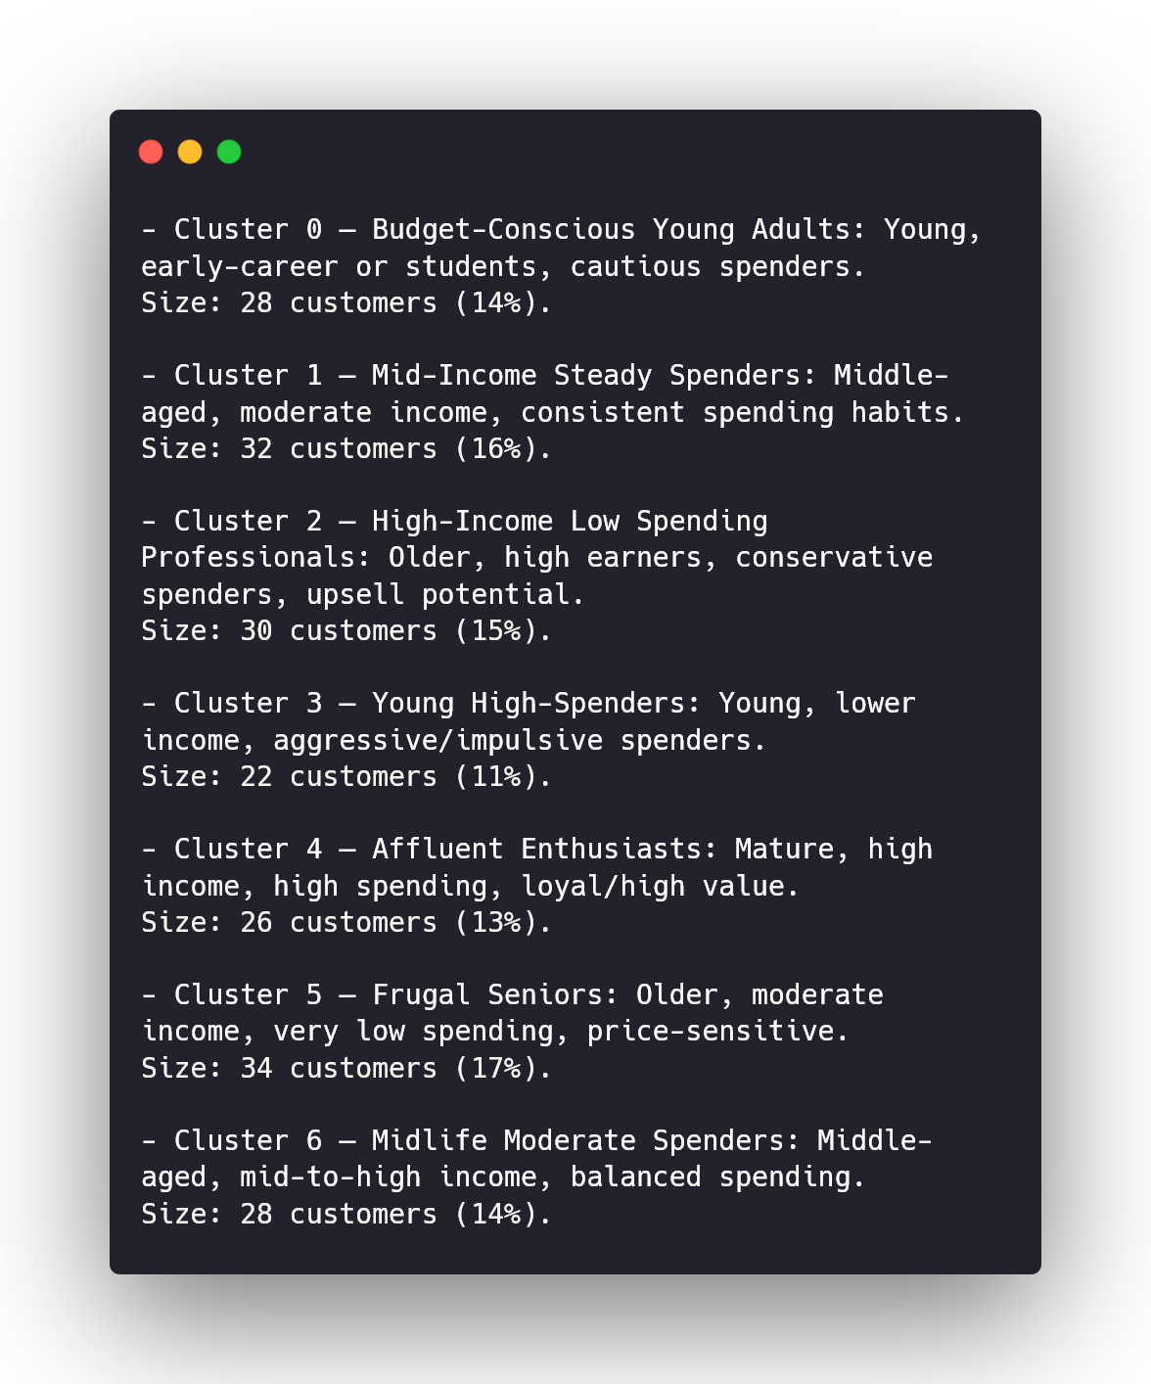
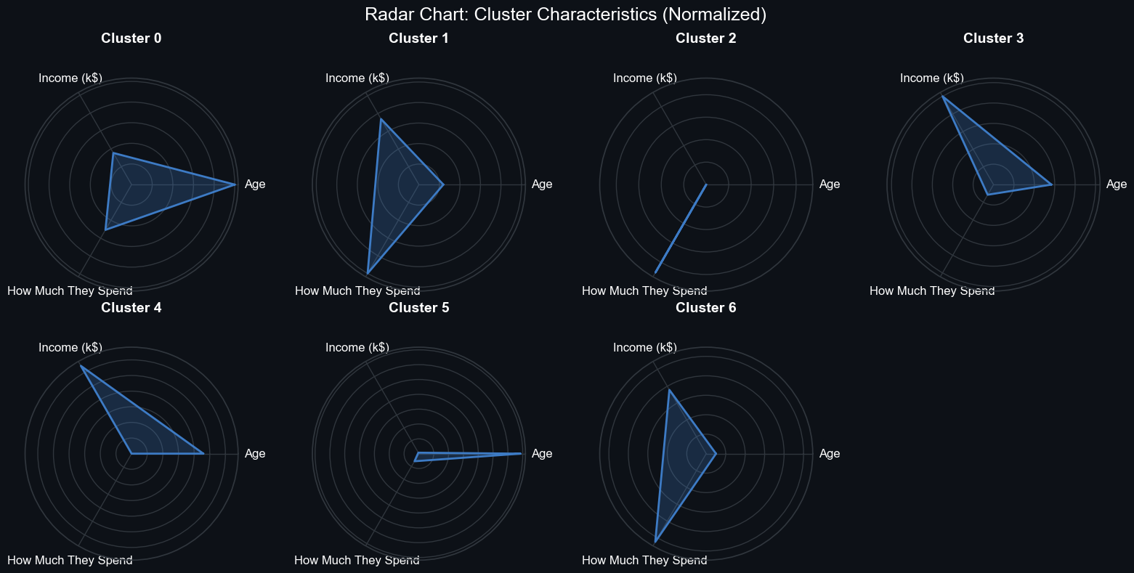
Insights and Conclusions
Used a spider chart to showcase the different quadrants that clusters fall into.
We then used the chart to form conclusions on the type of customers and groups within our dataset.
Conclusion:
High-income, high-spending customers were identified as key target groups because they contribute most to revenue, while low-income but high-spending customers may need retention strategies to prevent churn.

Slide 6
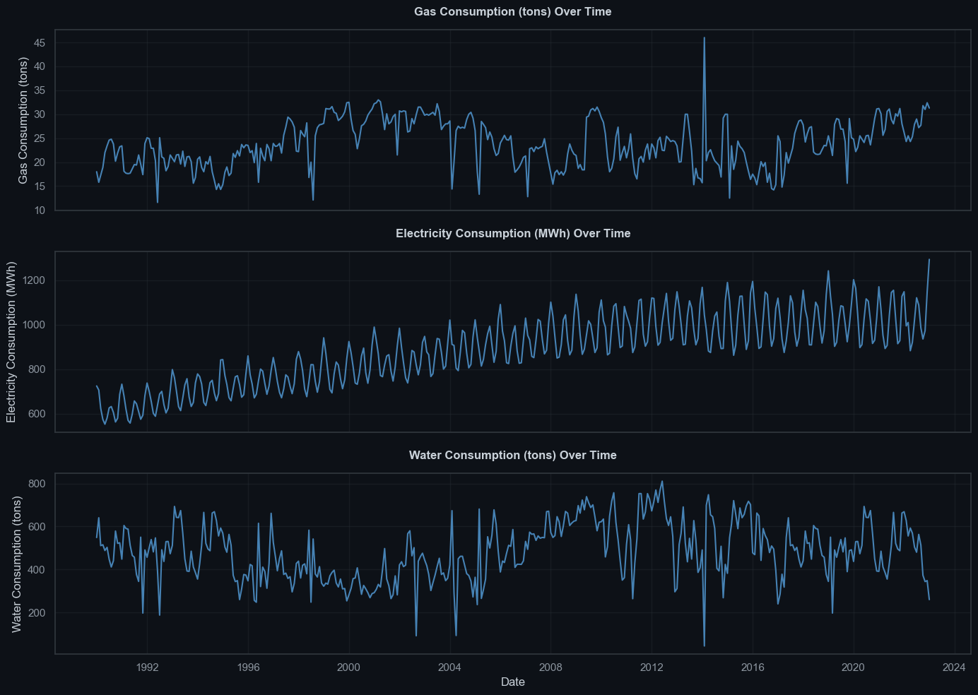
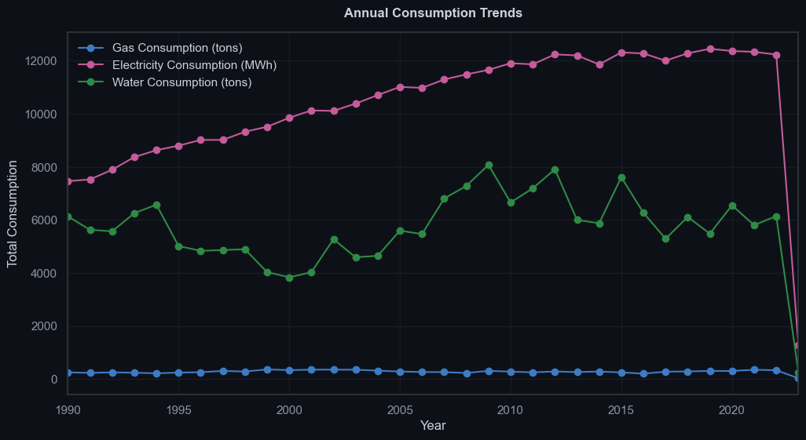
Data Preparation/ EDA (Time Series)
Loaded and inspected data using df.info() and df.describe()
Converted date column to datetime format using pd.to_datetime()
Checked for duplicate values and Missing values
Visualized individual features
Compared trends across all three features over time

Slide 7
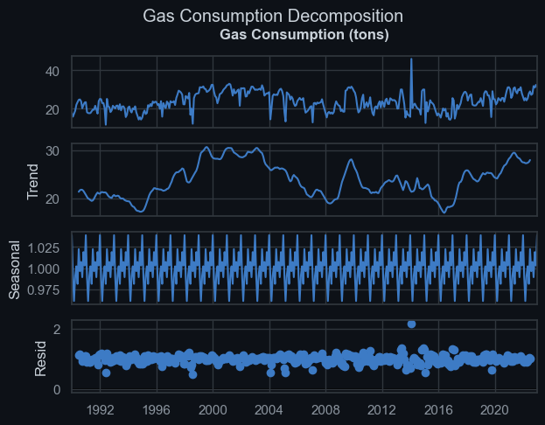
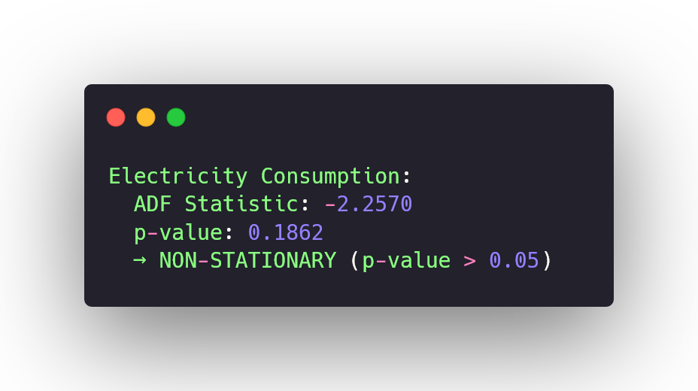
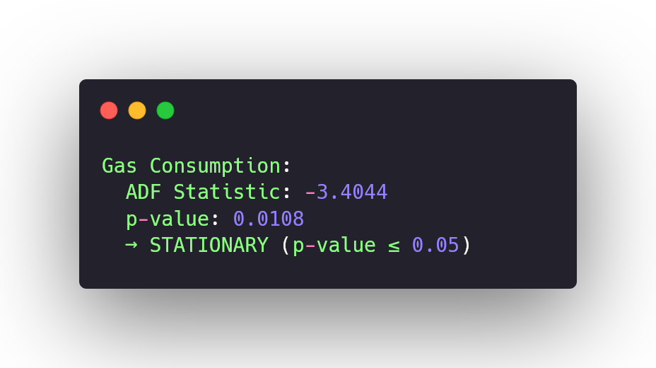
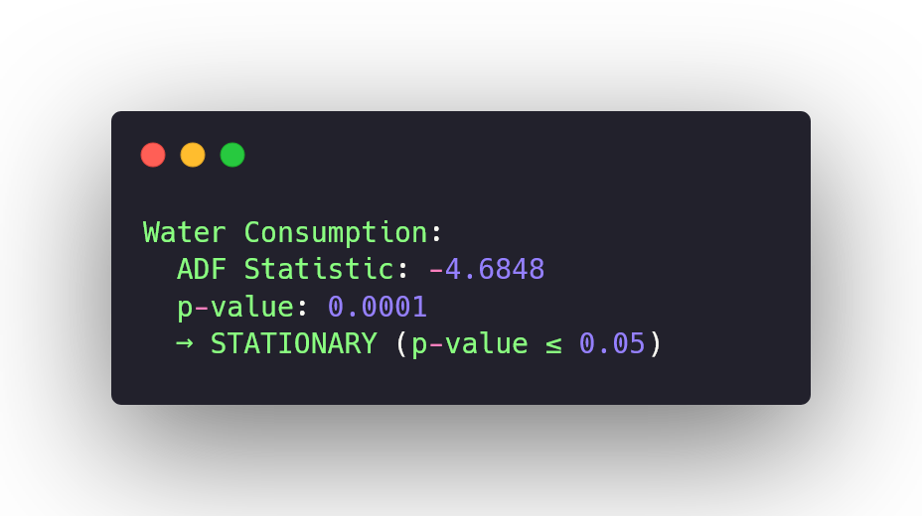
Time Series Decomposition
Decomposed series into trend, seasonality, and residuals
Perform a stationary test on each feature.
For stationary test, used ADF (augmented dickey fuller) test.
If p < 0.05, H0 is rejected, hence series is stationary.
ADF tests confirmed non-stationarity, so models that handle trend and seasonality were used.

Slide 8
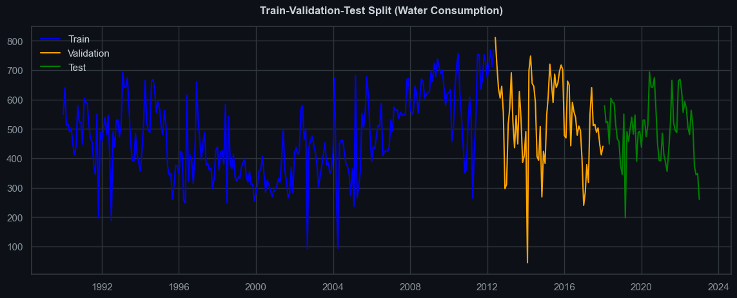
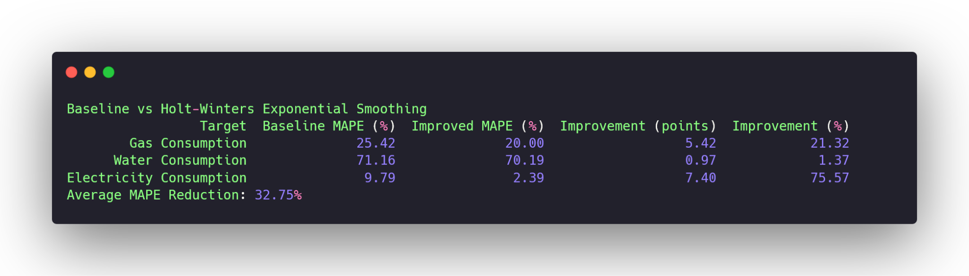
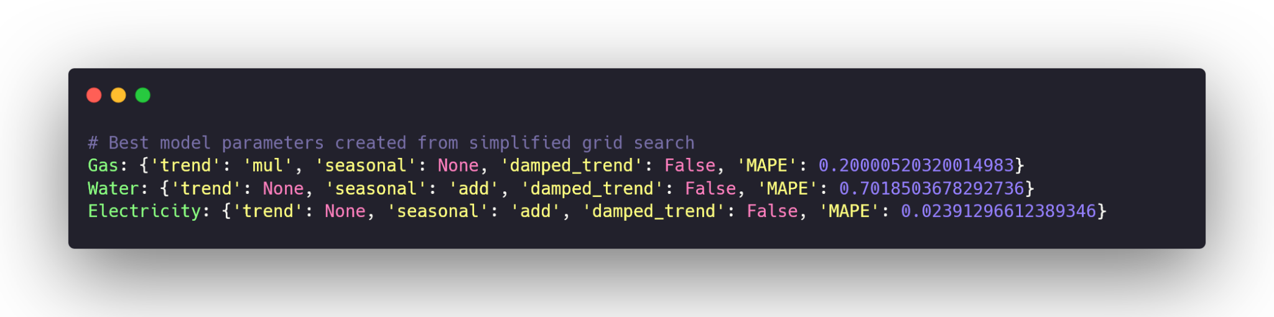
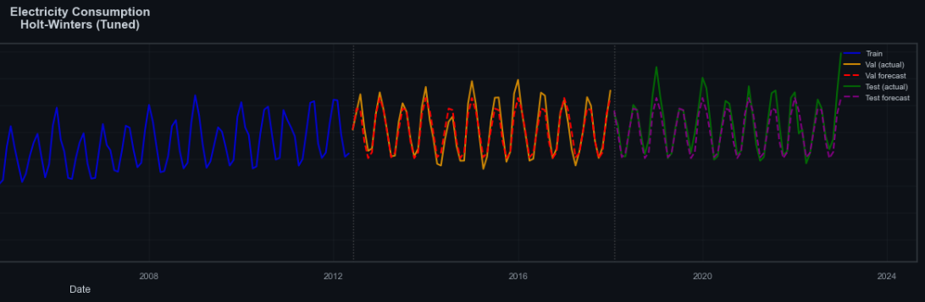
Train_val_test split
Split using df.iloc() to specify train, val and test size
Baseline Model
Used Simple Exponential Smoothing as my baseline model
No trend, No seasonality
Train Model on Training set, evaluate on validation set
Error Metrics
Used MSE (Mean Squared Error), MAE (Mean Absolute Error), and MAPE (Mean Absolute Percentage Error).
Model Weakness
Initial models showed high MAPE due to unmodeled trend and seasonality
Hyperparameter tuning (trend, seasonal, damped trend) was applied to improve fit

Slide 9
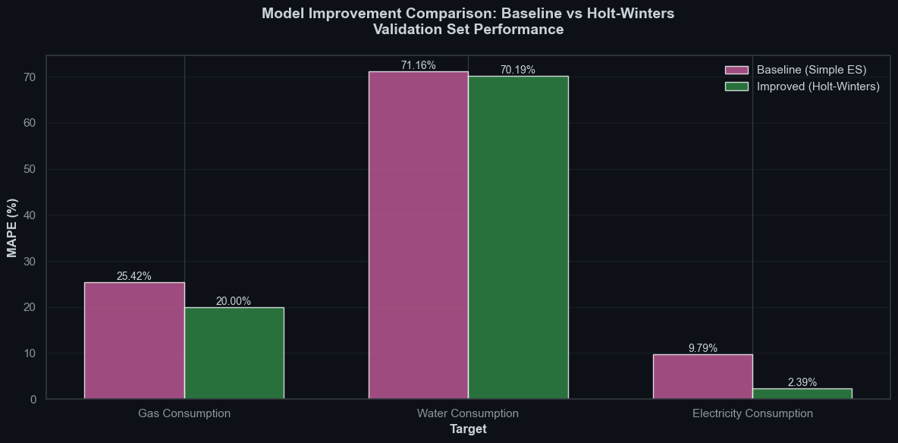
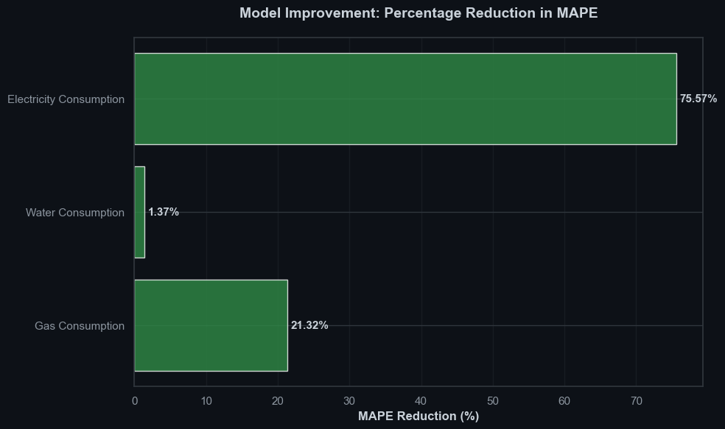
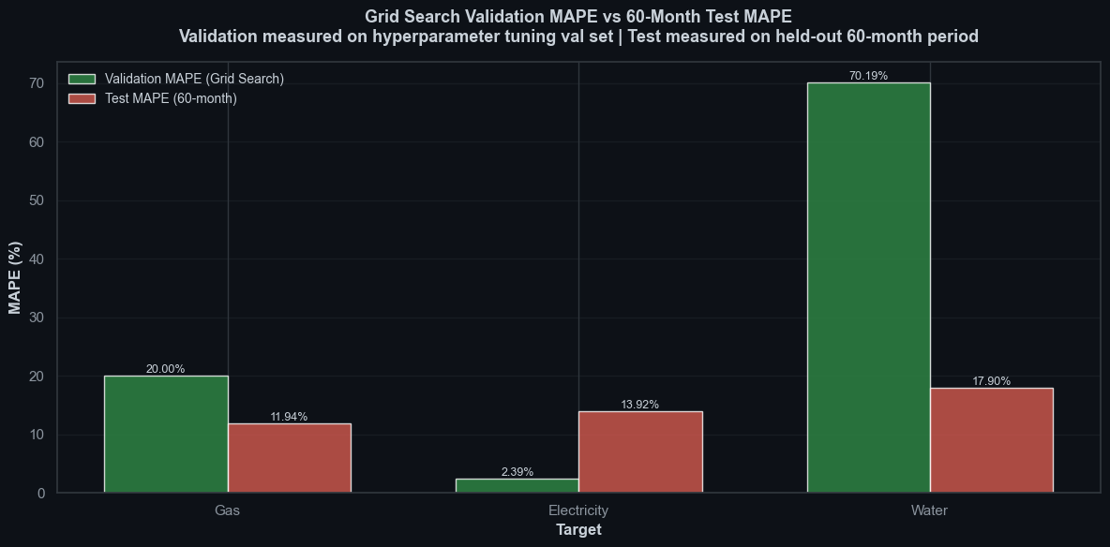
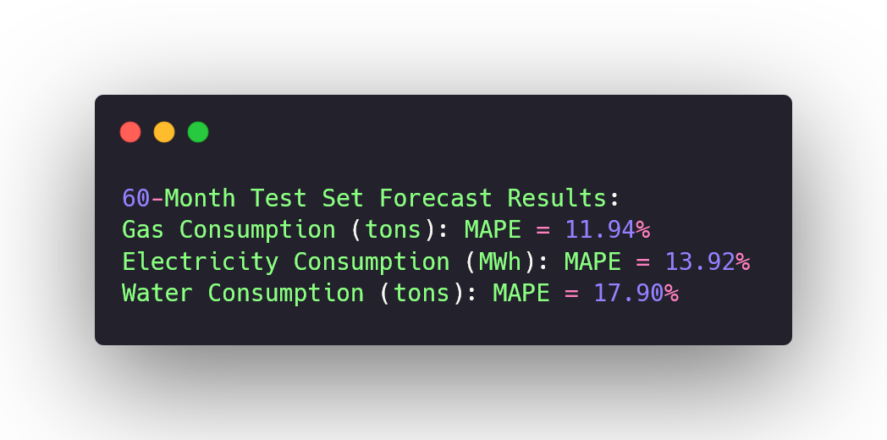
Model Effectiveness
Analysed effectiveness of model by comparing validation MAPE to test MAPE
Validation MAPE decreased across all features, with electricity showing the largest relative improvement
However, this did not fully generalize to test data
Model Forecasting (60 Months)
Forecasted 60 months ahead from the date of dataset using tuned model per feature.
Compared validation MAPE to 60-month forecast MAPE.
Electricity: test MAPE increased significantly, indicating poor generalization.
Water and Gas: test MAPE decreased, indicating more stable forecasts.

Slide 10
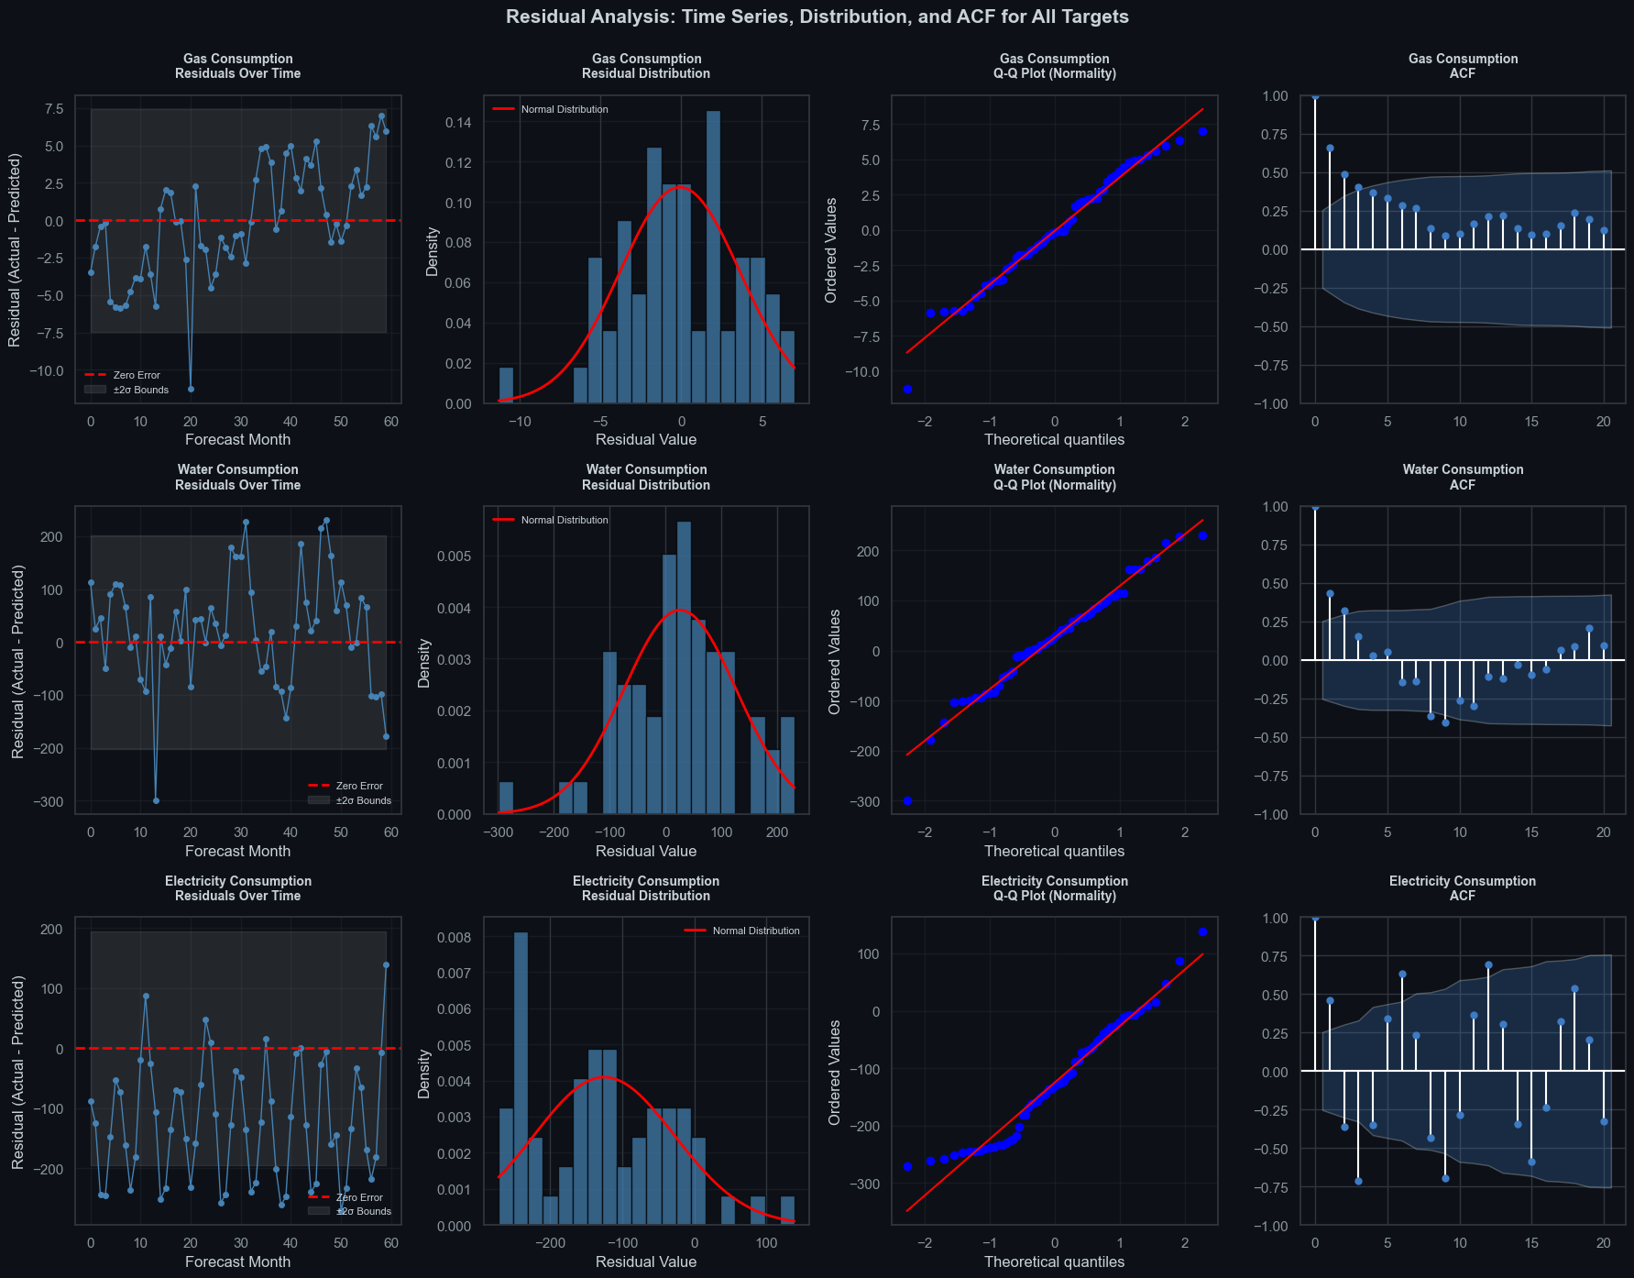
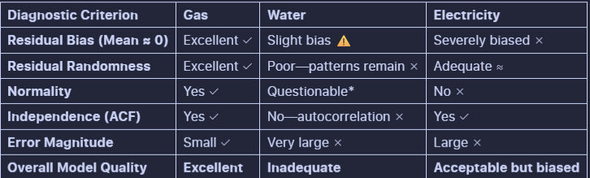
Insights and Conclusion
Residual Analysis
Residuals vs time: Checked for randomness over time to ensure no remaining trend or seasonality
Residual distribution: Verified residuals are centered around zero with no strong skewness
Q–Q plot: Assessed whether residuals approximately follow a normal distribution
ACF (autocorrelation): No significant autocorrelation remains in the residuals
Conclusion
Modelling trend + seasonality cut MAPE by 21–59%, hence seasonality is crucial for energy data.
Validation ≠ generalization: Electricity MAPE jumped from 1.84% (val) to 13.92% (test), indicating model overfitting on validation data. When something changes, model can’t adjust.
Metrics can deceive: A 13.92% MAPE flat forecast already underperforms simple baselines. Don’t just check metrics, check how much variability is being captured for a more accurate estimation.
Exogenous inputs: Adding temperature, economic, and policy variables lets the model explain demand shifts, lowering the current 17.90% MAPE limit.

