Slide 1
FLOOD MONITORING ANG EARLY WARNING SYSTEM
NAME: PUGALARASI K
EMAIL: pugalguru2721@gmail.com AU:721221106073
Flood monitoring and early warning systems are comprehensive, integrated tools designed to detect,
monitor, and provide advance notice of impending floods. These systems incorporate a range of
technologies, data sources, and communication channels to facilitate proactive response and reduce the
potential loss of life and property.
Hardware Components:
 | Warning and Notification Systems: |  |  |  | Hardware components for issuing warnings to the public and
authorities include sirens, emergency broadcast systems, public address systems, and automated phone call systems. Data Storage and Backup Systems: These systems store historical data, real-time data, and flood models for analysis and reference. They ensure data integrity and availability for decision-makers. Power Supply Systems: Uninterruptible power supply (UPS) units and backup generators are essential to ensure the continuous operation of monitoring and warning equipment during power outages, which can occur during severe weather events.
 | Remote Sensing Devices: |  | Drones, unmanned aerial vehicles (UAVs), and remote sensing devices
 | capture high-resolution images and data of specific areas affected by floods. They are valuable for
 | assessing damage and flood extent.
 | River Gauges: | River gauges, also known as stream gauges, are installed in rivers and water bodies to
 | measure water levels. They provide critical data for monitoring changes in water levels and potential
flooding.
Software Components:
Early Warning and Alert Generation Systems: These systems generate alerts and warnings based on data analysis and modeling results. They can trigger warnings through various communication channels, such as SMS, sirens, email, or social media.
 | Data Acquisition and Processing Software: | This software collects data from various sensors and
monitoring devices, including weather stations, river gauges, radar systems, and satellites. It processes and formats the data for analysis. Data Analysis and Modeling Tools: Advanced algorithms and models are used to analyze collected data, predict flood events, and assess their potential severity. These tools often incorporate meteorological data, hydrological models, and historical flood data. Real-Time Monitoring and Visualization Software: This software provides real-time monitoring of weather conditions and water levels. It offers graphical displays and dashboards for quick assessment of current flood situations. Early Warning and Alert Generation Systems: These systems generate alerts and warnings based on data analysis and modeling results. They can trigger warnings through various communication channels, such as SMS, sirens, email, or social media.
Step 1: Sign up for ThingSpeak
First go to ThingSpeak and create a new free MathWorks account if you don’t already have a MathWorks account.

Slide 2
Step 2: Sign in to ThingSpeak
Sign in to ThingSpeak using your credentials and create “New Channel“. Now fill the project details like
name, field names, etc. Here we need to create three field area names such as Flood Live Monitoring, and Flood Status. Then click “Save Channel”.
Step 3: Record the credentials
Select the created channel and record the following credentials.
Channel ID, which is at the top of the channel view.
API key, which can be found in the API Key tab of your channel view.
Step 4: Add widgets to your GUI
Click “Add Widgets” and add two appropriate Indicator widgets. In my case, I have taken an indicator of flooding. Choose the appropriate field names for each widget.
PROGRAM:
#include <Wire .h>
#include <LiquidCrystal_I2C.h> #include <New Ping .h> #include <Software Serial .h>
// LCD Display
LiquidCrystal_I2C lcd(0x27, 16, 2);
// Ultrasonic Sensor #define TRIGGER_PIN 12
#define ECHO_PIN 11
#define MAX_DISTANCE 200
New Ping sonar(TRIGGER_PIN, ECHO_PIN, MAX_DISTANCE);
// Float Sensor
#define FLOAT_SENSOR_PIN 10
// GSM Module
Software Serial gsm Serial(8, 9); // RX, TX #define GSM_BAUDRATE 9600
// Thresholds
#define FLOOD_THRESHOLD 50 // Example threshold in cm
// Phone Numbers
String phone Numbers[] = { "+9188305848xx", "+9188305848xx" }; // Example phone numbers void setup() {
// Initialize LCD Display lcd .begin(16, 2);
lcd .backlight();
// Initialize GSM Module
gsm Serial.begin(GSM_BAUDRATE); delay(2000); // Give GSM module time to initialize send Command("AT"); // Check communication
send Command("AT+CMGF=1"); // Set SMS text mode
// Display Initialization Message lcd .clear();
lcd .set Cursor(0, 0);
lcd .print("Flood Monitoring");

Slide 3
lcd .set Cursor(0, 1); lcd .print("System");
delay(3000); // Display initialization message for 3 seconds
}
void loop() {
// Read Ultrasonic Sensor
unsigned int distance = sonar. Ping _cm();
// Read Float Sensor
int float Sensor Value = digital Read(FLOAT_SENSOR_PIN);
// Calculate Flood Level int flood Level = distance;
// Update LCD Display lcd .clear();
lcd .set Cursor(0, 0);
lcd .print("Water Level: "); lcd .print(flood Level);
lcd .print("cm");
// Check Flood Threshold
if (flood Level > FLOOD_THRESHOLD && float Sensor Value == HIGH) {
// Send Alert SMS
Send Alert SMS (flood Level);
}
delay(500); // Delay for stability
}
void send Alert SMS(int flood Level) {
String message = "Flood Alert! Water level is "; message += flood Level;
message += "cm. Take necessary actions.";
for (int i = 0; i < size of(phone Numbers) / size of(phone Numbers[0]); i++) { send Command("AT+CMGS=\"" + phone Numbers[i] + "\"");
delay(1000);
send Command(message); delay(100);
send Command((String) char(26)); delay(1000);
}
}
void send Command(String command) { gsm Serial. println(command); delay(1000);
while (gsm Serial. available()) { gsm Serial. read();
}
}

Slide 4
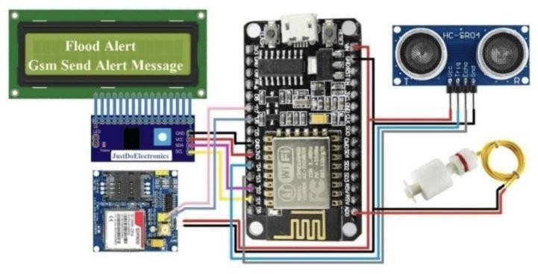
FINAL CIRCUIT:

