Slide 1

Focusing Wave Energy for
Wave Energy Converter Applications
Michael Raftery M.E.
Martin & Ottaway, Inc.

Slide 2
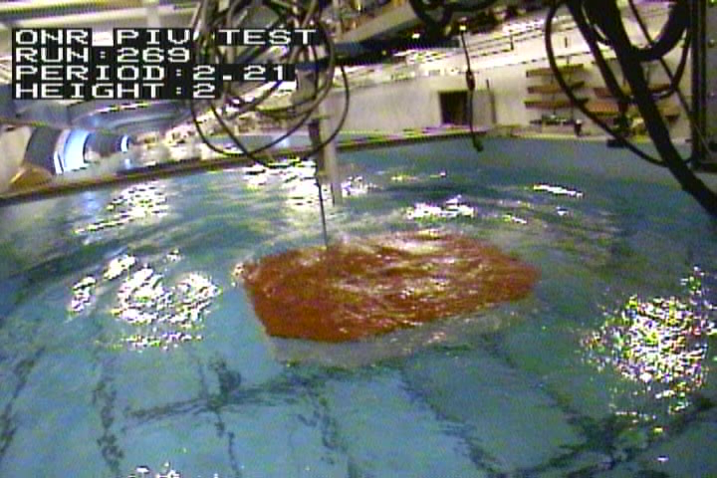
2.21 Second, 5.1cm (2 Inch)-High Waves – 15cm (6 Inch) Platform Depth
Wave Wire 2 (WW2) is Visible in this Photo over the Platform

Slide 3
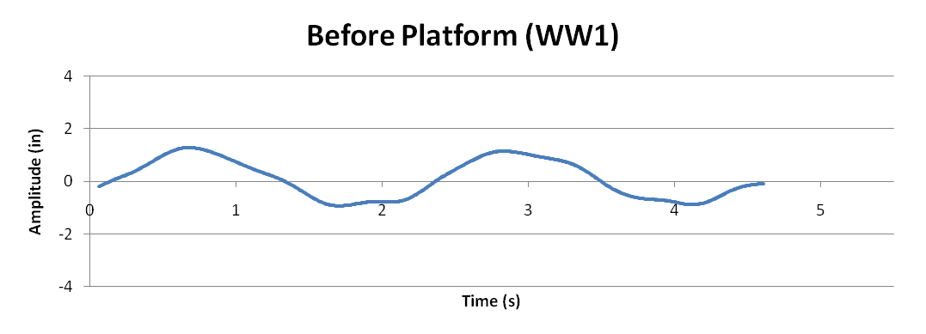
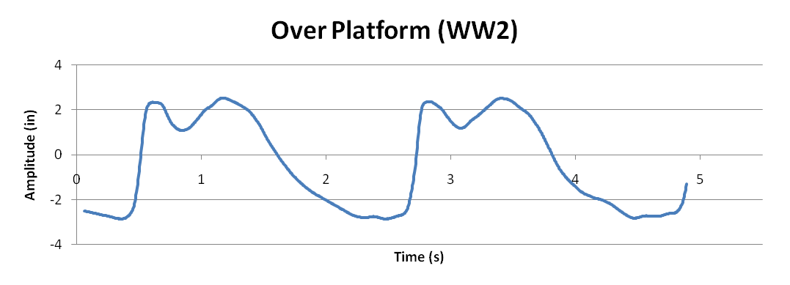
Submerged Platform Focuses Waves
Wave Wire 1 (WW1): H =0.051m (2.0in) ,Cg = 1.97 m/s at 1.98m tank depth, E = 3.27 J/m^2, P = 6.43 W/m
Wave Wire 2: H = 0.127m (5.0in), Cg = 1.14 m/s at 0.15m (6in) platform depth, E = 20.25 J/m^2, P = 23.07 W/m
259% increase in power density

Slide 5
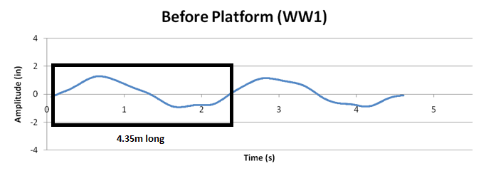
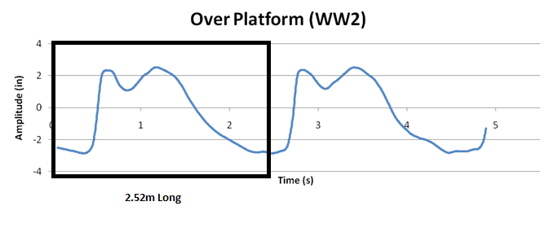
Same Power in Less Space

Slide 6
Conservative Process
Due to the instantaneous change in water depth,
Mass, Energy, and Power are Conserved in this Process.
The Energy and Power concentration factors ranged from
1 to 4 times the incident wave power as a function of incident
wave period, wave height, and platform depth. Platform slope
was set to zero for all 300 plus wave runs at platform top surface
depths varying from 0.15m to 1.10m

