Slide 1
Modeling and Efficiency Study of Large Scale Underground Thermal Battery Deployment
Yingqi Zhang¹, Xiaobing Liu², Christine Doughty¹ and Peter Nico¹
¹ Energy Geosciences Division, Lawrence Berkeley National Laboratory
² Oak Ridge National Laboratory

Slide 2
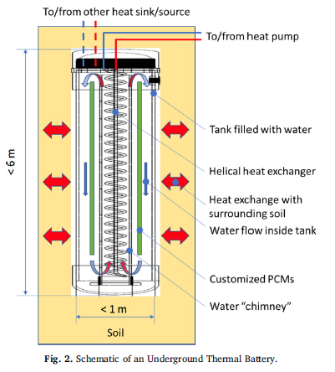
UTB is designed to be a cost-saving alternative to VBGHE
Drilling cost of the borehole is the primary factor to the high cost of VBGHE installation
Effort in improving the heat transfer performance of the borehole is limited
UTB (< 6 m depth) was invented at Oak Ridge National Laboratory as an alternative to the conventional VBGHE.
VBGHE: vertical bore ground heat exchanger
Warner et. al., 2020. A novel shallow bore ground heat exchanger for ground source heat pump applications —Model development and validation,

Slide 3
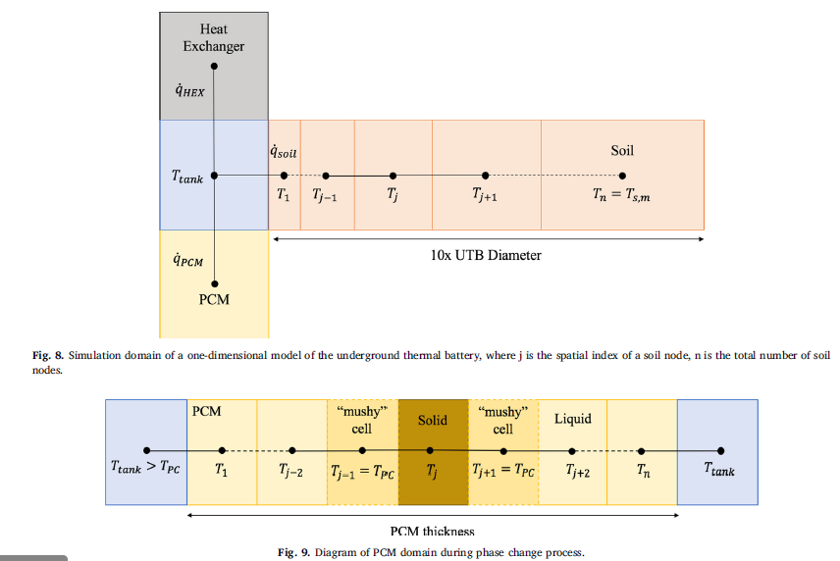
Original 1D radial UTB model provides a good approximation
Warner et. al., 2020. A novel shallow bore ground heat exchanger for ground source heat pump applications —Model development and validation,

Slide 4
But a UTB coupled with a multiphase flow model is needed to study many other effects
Heterogeneity impact on heat transfer
  Operations: day cycle of seasonal cycle.
  If rock density is between 2100~2650 kg/m3, heat conductivity is 1~3 (W/(m⋅c)), thermal penetration length is 24~50 cm for t=12 hr, or 4.9~9.5 m if t=0.5 yr
Battery placement with load uncertainty
Water table effects
Grounswater movement
Temperature change in soil

Slide 5
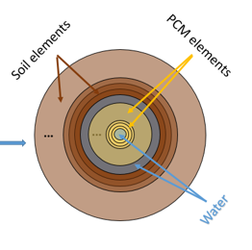
Re-write the 1D radial UTB model(Matlab) to couple with iTOUGH2/TOUGH model
TOUGH grids
. . .
TOUGH grid that interacts with the 1D UTB model
1D UTB model with its own discretization: boundary temperatures are provided by TOUGH grid (in green), heat flux is fed back to TOUGH
5

Slide 6
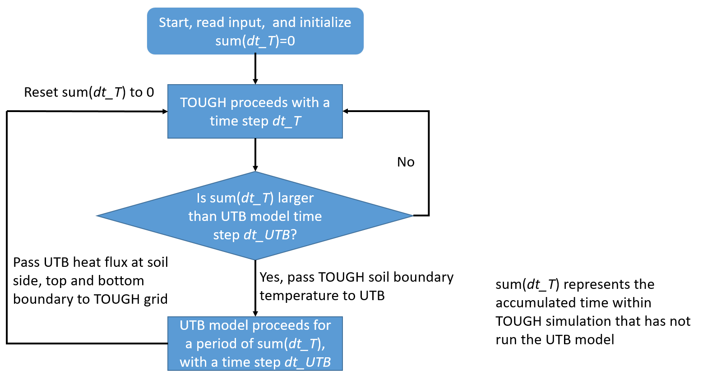
Different time steppings in TOUGH and the UTB model allow for fast and accurate calculation
4

Slide 7
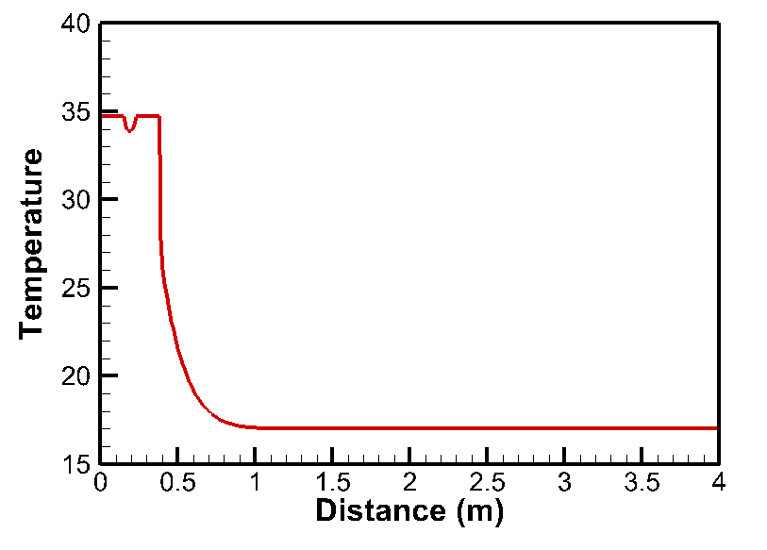
Comparison with original 1D Matlab code verifies correct implementation of the code
iTOUGH2 Model
Original Matlab Model
5

Slide 8
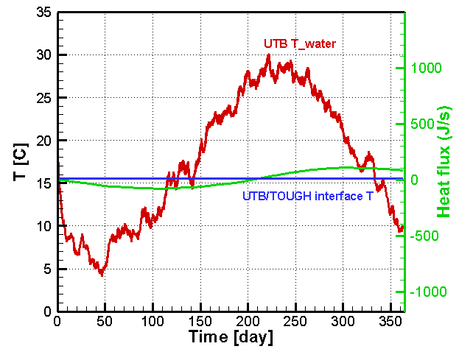
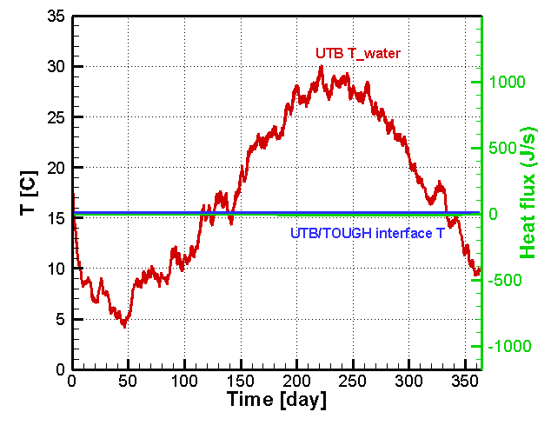
Hourly thermal load of a UTB in a residential building
in Knoxville, Tennessee
One element – 20 m x 20 m x 6.71 m (UTB height) – test compares well to the 1D soil model, verifying TOUGH coupled code
Include UTB heat loss to soil top and bottom
No UTB heat loss to soil top and bottom
6

Slide 9
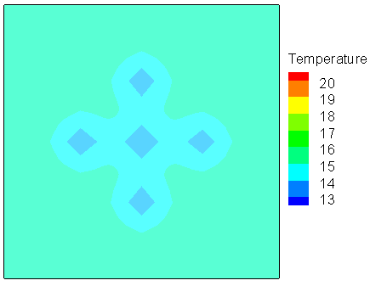
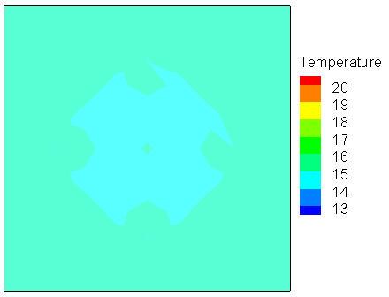
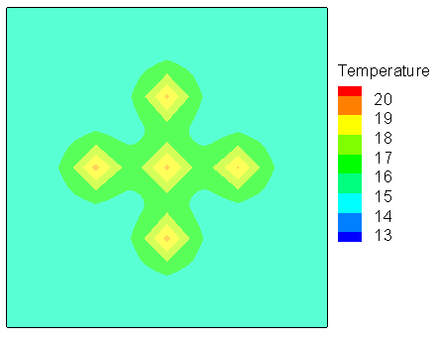
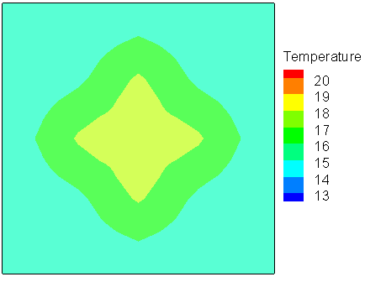
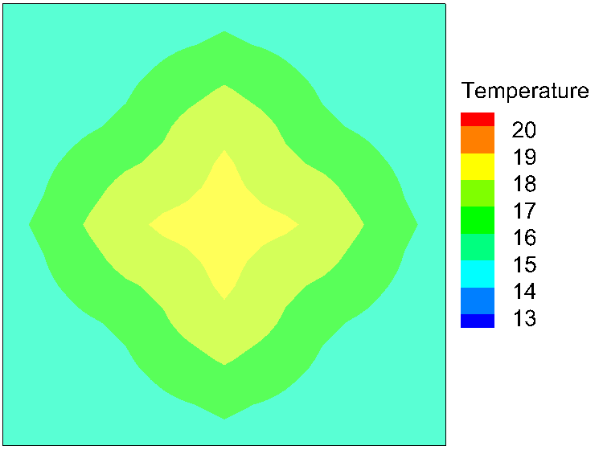
Soil temperature is 2°C elevated in the center after a year of operation at Knoxville
90 day
180 day
90 day
180 day
270 day
270 day
365 day
5 year
7

Slide 10
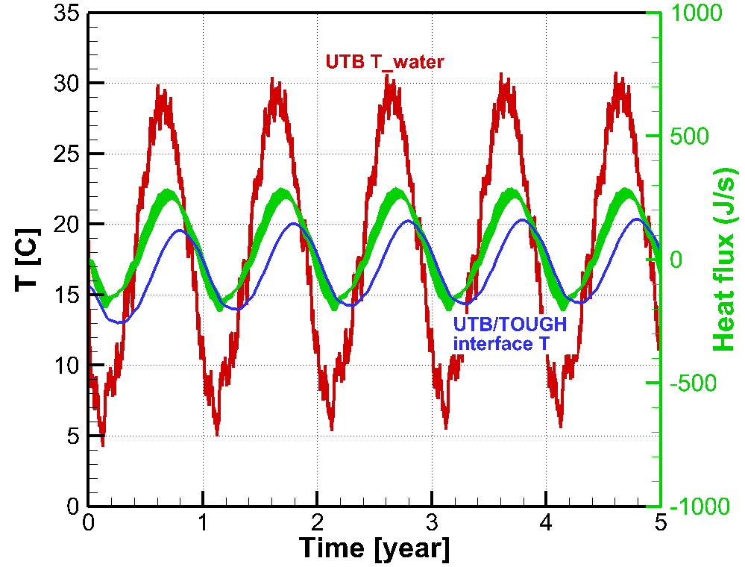
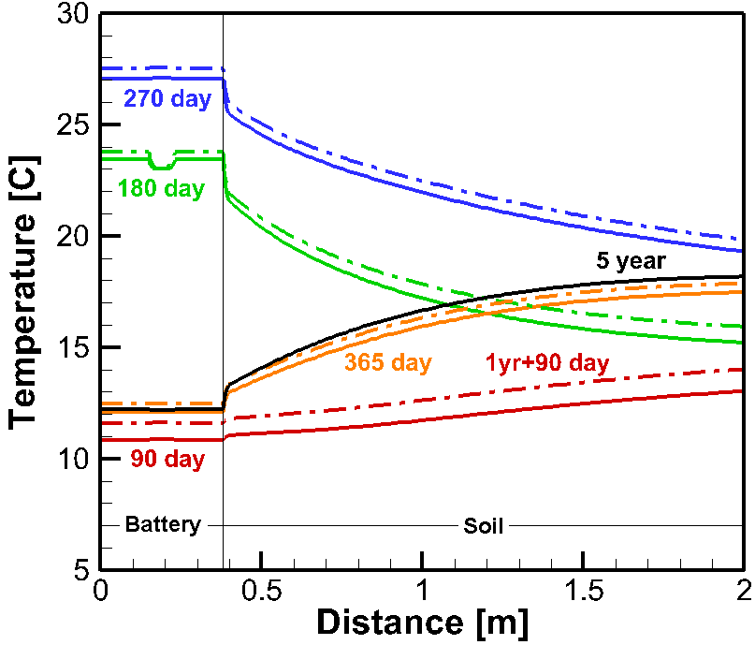
Tank water temperature is slightly elevated after years of operation at Knoxville
PCM melting point
8

Slide 11
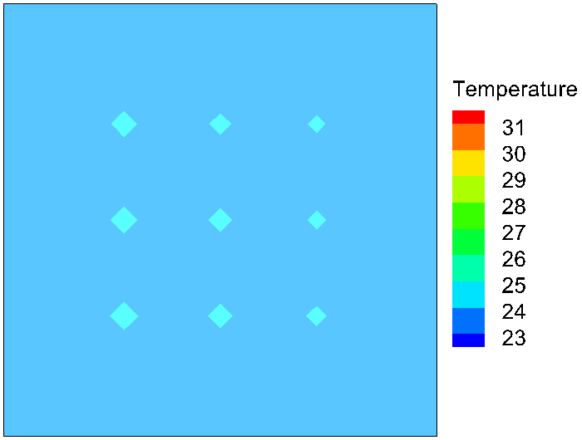
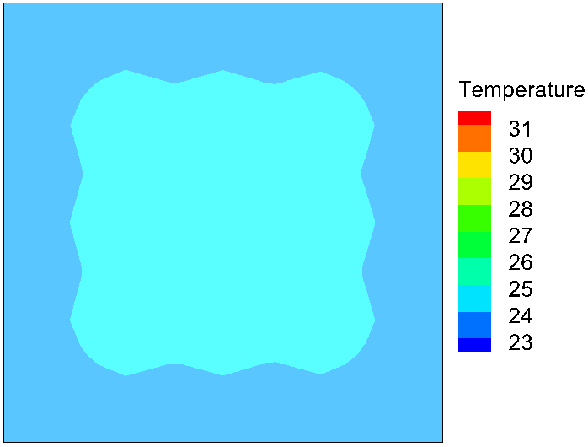
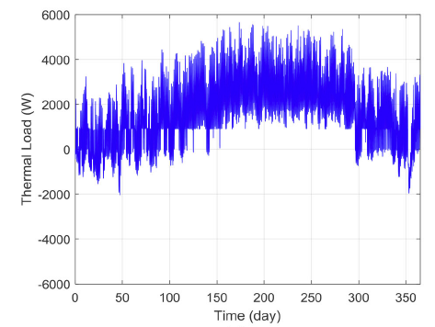
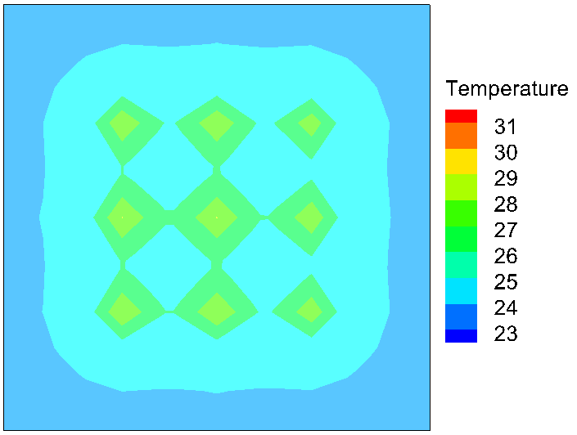
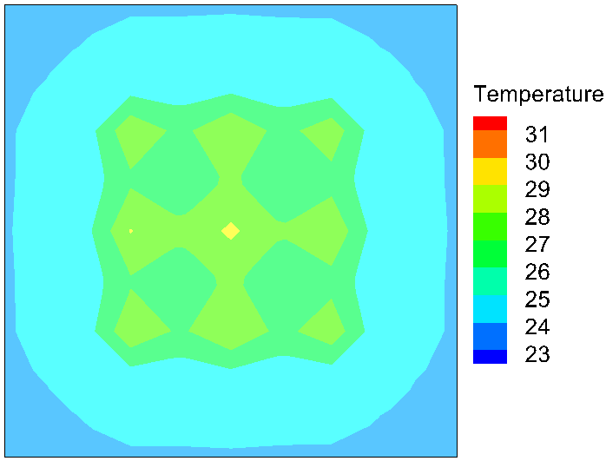
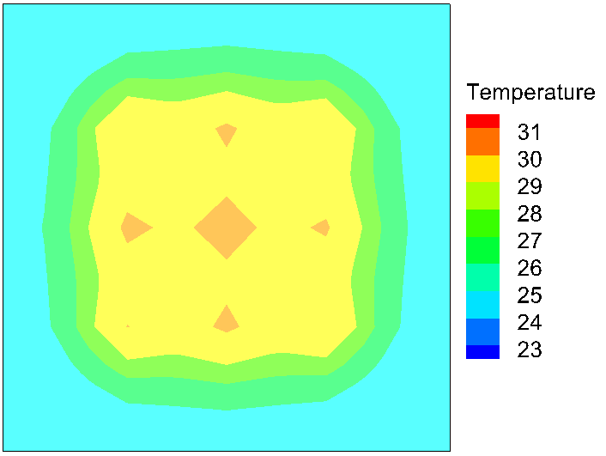
Soil temperature would be elevated by 6~7°C after five years of operation at Orlando
Thermal conductivity 1.72 W·m⁻¹·K⁻¹
90 day
180 day
270 day
365 day
5 year
9

Slide 12
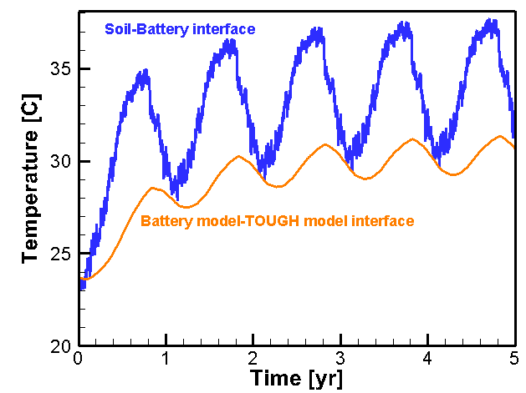
Soil at the battery in the middle has the highest temperature increase
The 1st year has the highest temperature increase
At year 5, the soil temperature next to the hottest battery (the one in the middle) is between 29.7-37.7, with the average being 34C, ~10C increased of the annual average temperature without UTB.
Thermal conductivity 1.72 W·m⁻¹·K⁻¹
Battery model is 2m radius, the TOUGH grid around the battery model is 4x4 m2.
Soil temperature at the battery in the middle

Slide 13
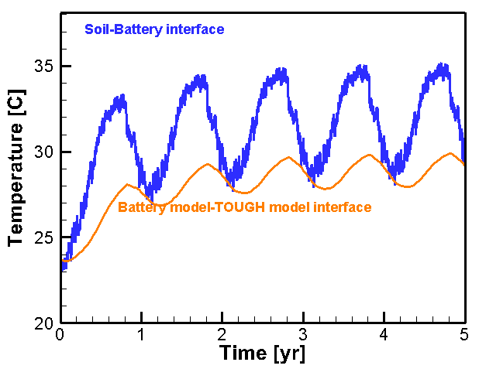
Temperature increase at the warmest location is less for a larger thermal conductivity
Thermal conductivity 2.22 W·m⁻¹·K⁻¹
The 1st year has the highest temperature increase
At year 5, the soil temperature next to the hottest battery (the one in the middle) is between 28-35, with the average being 32C, ~2C lower than the field with a thermal conductivity of 1.72 W·m⁻¹·K⁻¹ .

Slide 14



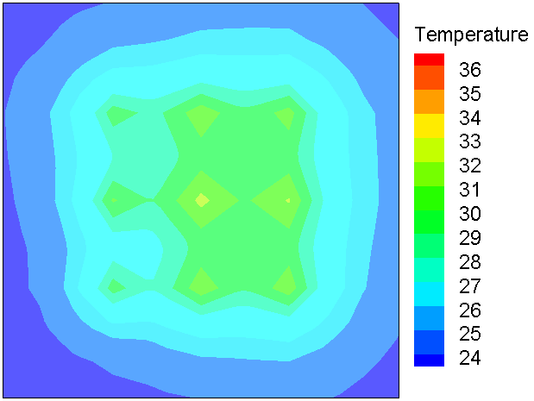
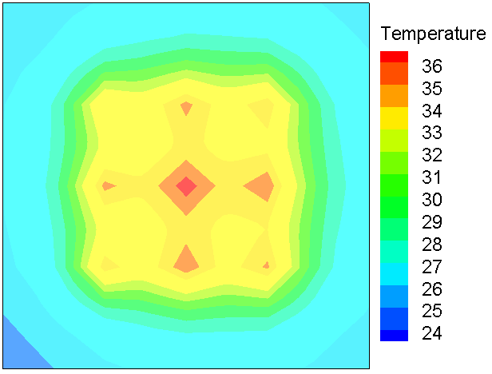
Heterogeneous thermal conductivity results in asymmetric soil temperature increase
Thermal conductivity of soil (W·m⁻¹·K⁻¹) – average is 1.72
90 day
180 day
1.22
2.02
2.22
0.92
1.72
2.52
0.72
1.42
2.72
270 day
365 day
5 year
10

Slide 15
Using a bigger model domain
New slides

Slide 16

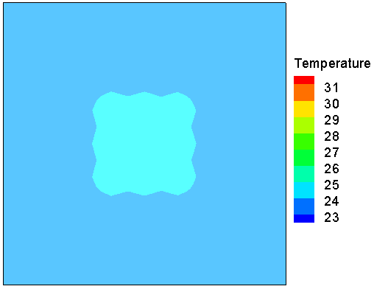


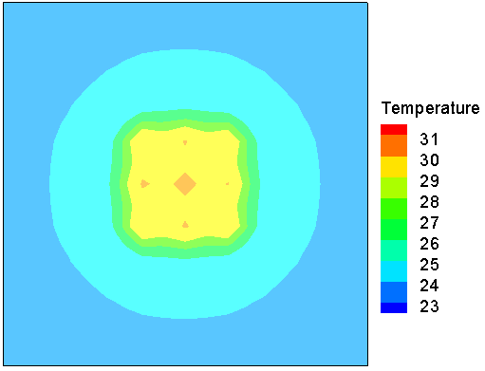
Homogeneous Field Orlando (thermal k=1.72 W·m⁻¹·K⁻¹)
180 day
90 day
365 day
5 year
270 day

Slide 17





Homogeneous Field Orlando (thermal k=2.22 W·m⁻¹·K⁻¹)
180 day
90 day
270 day
365 day
5 year

Slide 18



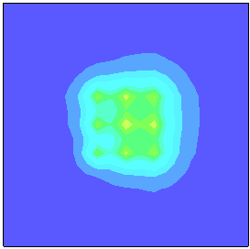
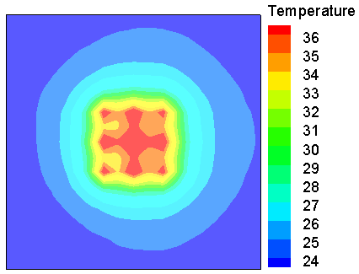
Modified heterogeneous slide (#14) with a bigger model domain, in addition, the thermal conductivity is as claimed in the figure
Thermal conductivity of soil (W·m⁻¹·K⁻¹) – average is 1.72
1.22
2.02
2.22
0.92
1.72
2.52
0.72
1.42
2.72

Slide 19
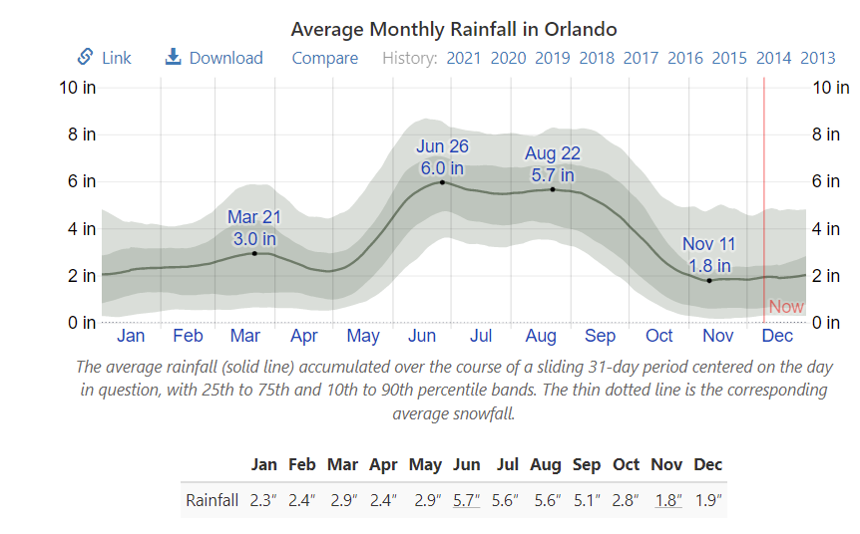
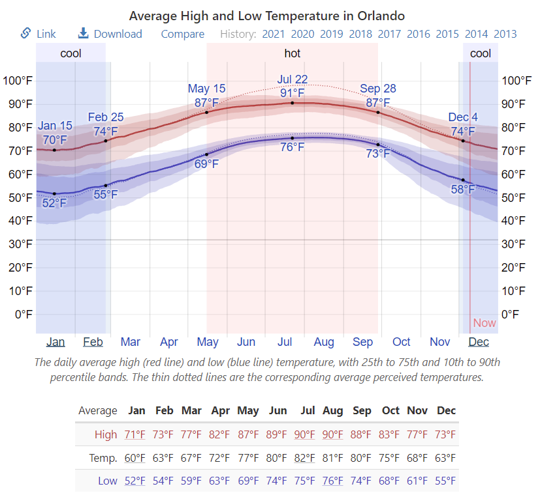
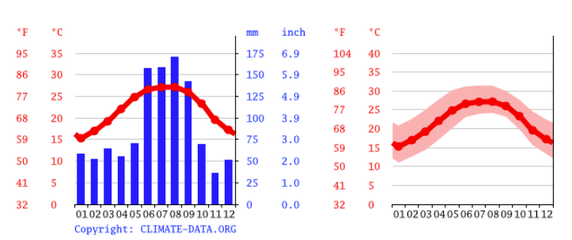
Using 10% of precipitation as infiltration, average of a month
Change the battery model to have a radius of 0.5m so infiltration can get in the soil around the battery
https://weatherspark.com/y/17721/Average-Weather-in-Orlando-Florida-United-States-Year-Round

Slide 20
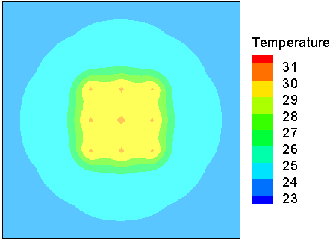
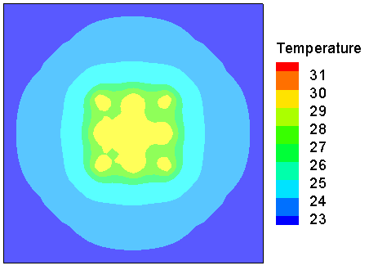
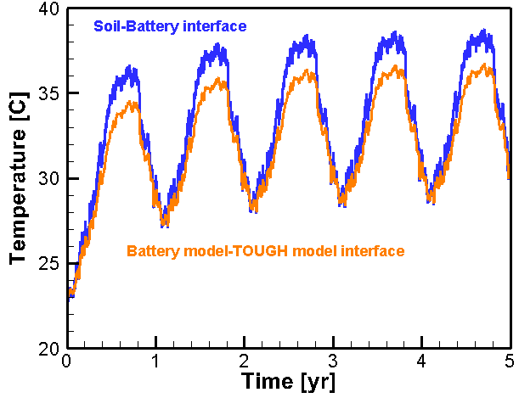
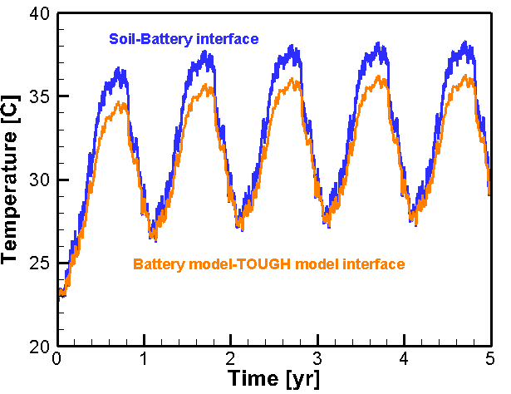
Homogeneous thermal conductivity
Rainfall temperature is the same as annual average temperature: 24C
Rainfall temperature is the same as monthly average temperature as shown in slide 16

Slide 21
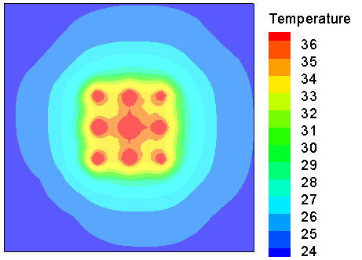
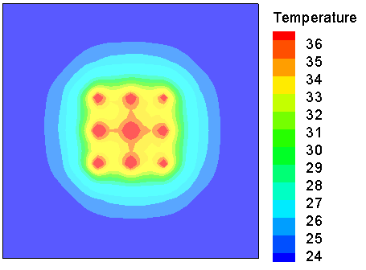
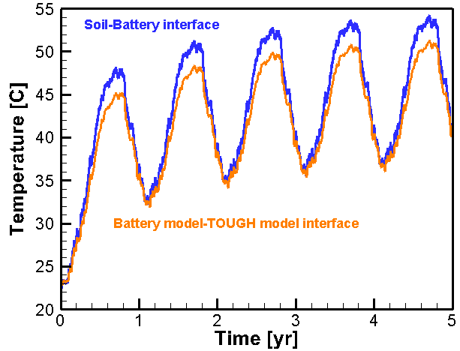
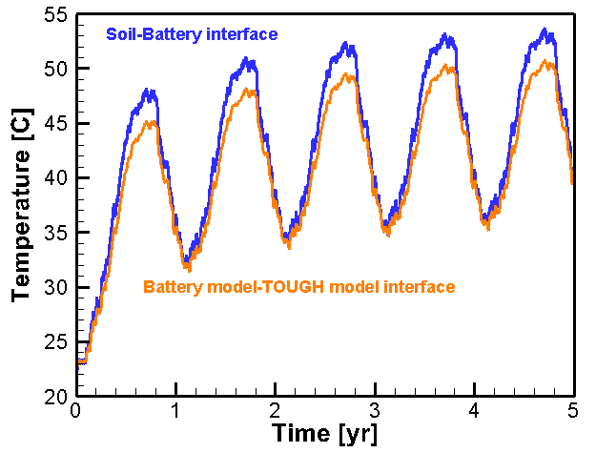
Heterogeneous thermal conductivity
Rainfall temperature is the same as annual average temperature: 24C
Rainfall temperature is the same as monthly average temperature as shown in slide 16

Slide 22
Comments
Sensitivity in thermal conductivities shows water content (higher content results in higher thermal conductivity) has an impact on temperature field
Apparently, heterogeneity has an impact on temperature increase. But keep in mind the variance used here for thermal conductivity is rather large.
Infiltration shows the impact due to (pure) heat convection, The dry and wet thermal conductivities are set the same in these simulation because : 1. there is no data on water table depth therefore it is not meaningful to get a realistic water content; 2. The simulation is to explore pure heat convection effect. Sensitivity in heat conduction is explore in the first item
Actual temperature of infiltration (instead of average) is preferred for accurate prediction of the temperature around heaters

Slide 23
Large-scale deployment can take advantage of symmetry of the system
. . .
6 m
11

Slide 24
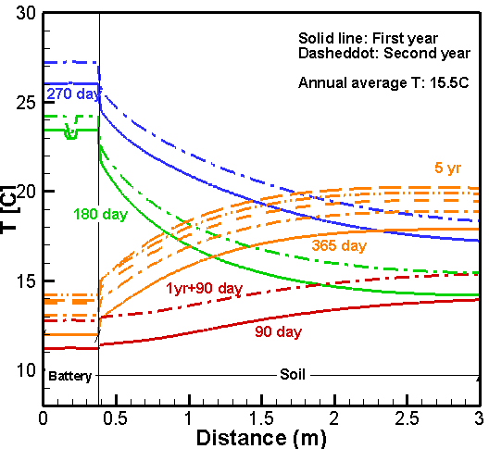
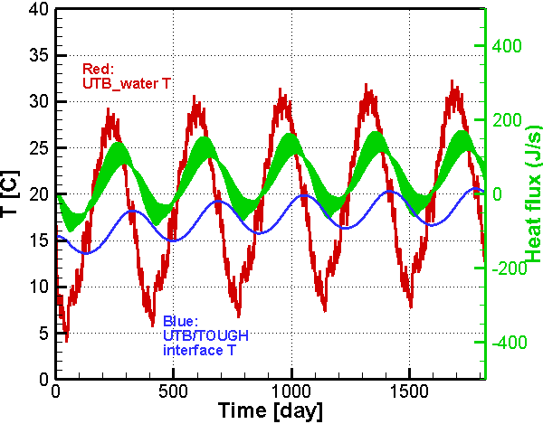
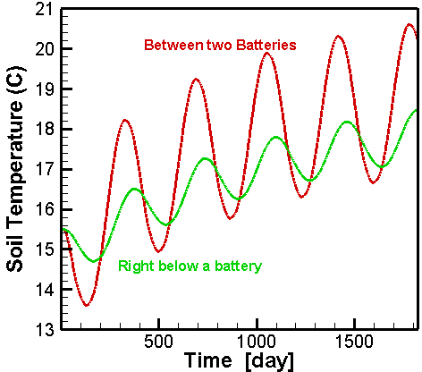
Soil temperature is 2C warmer compared to five batteries scenario at Knoxville
12

Slide 25
Conclusions
PCM should be selected to have a melting temperature around the average soil temperature
For seasonal energy storage, PCM latent heat is used in the period when the soil temperature is around the average temperature
However, if combined with heat pump, the UTB can take full advantage of the latent heat capacity of PCM
The UTB coupled model with TOUGH codes allows for understanding effects on the shallow subsurface from the multi-year large deployment of UTBs.
25

Slide 26
Acknowledgement
This work was supported by Lawrence Berkeley National Laboratory (LBNL) under with funding from the Geothermal Technologies Office and under Department of Energy Contract No. DE-AC02-05CH11231. The authors would like to thank Joseph Warner, Liang Shi, and Ming Qu for developing and providing the 1D UTB MATLAB code for the UTB.

