Slide 1
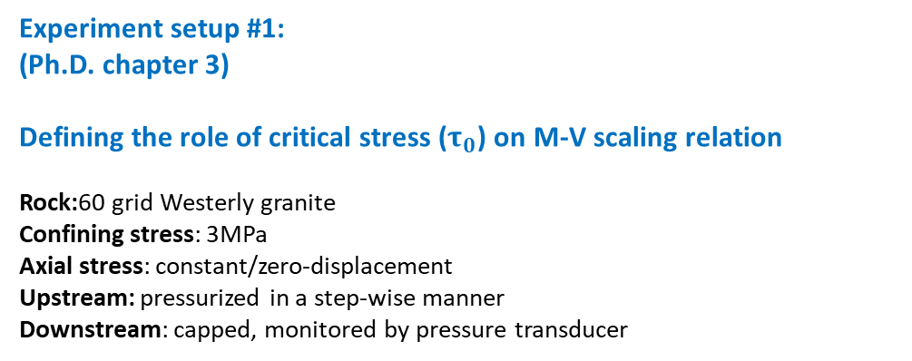
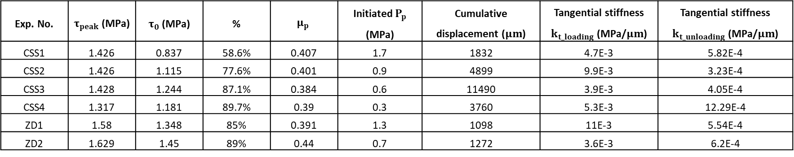
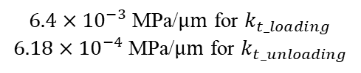
Experiment setup #1:
(Ph.D. chapter 3)
Defining the role of critical stress ($τ_{0}$) on M-V scaling relation
Rock:60 grid Westerly granite
Confining stress: 3MPa
Axial stress: constant/zero-displacement
Upstream: pressurized in a step-wise manner
Downstream: capped, monitored by pressure transducer
${6.4×10}^{−3}$ MPa/$μm$ for $k_{t_loading}$
${6.18×10}^{−4}$ MPa/$μm$ for $k_{t_unloading}$
Exp. No. | $τ_{peak}$ (MPa) | $τ_{0}$ (MPa) | % | $$μ_{p}$$ | Initiated $P_{p}$ (MPa) | Cumulative displacement ($μm$) | Tangential stiffness $k_{t_loading}$ (MPa/$μm$) | Tangential stiffness $k_{t_unloading}$ (MPa/$μm$)
CSS1 | 1.426 | 0.837 | 58.6% | 0.407 | 1.7 | 1832 | 4.7E-3 | 5.82E-4
CSS2 | 1.426 | 1.115 | 77.6% | 0.401 | 0.9 | 4899 | 9.9E-3 | 3.23E-4
CSS3 | 1.428 | 1.244 | 87.1% | 0.384 | 0.6 | 11490 | 3.9E-3 | 4.05E-4
CSS4 | 1.317 | 1.181 | 89.7% | 0.39 | 0.3 | 3760 | 5.3E-3 | 12.29E-4
ZD1 | 1.58 | 1.348 | 85% | 0.391 | 1.3 | 1098 | 11E-3 | 5.54E-4
ZD2 | 1.629 | 1.45 | 89% | 0.44 | 0.7 | 1272 | 3.6E-3 | 6.2E-4

Slide 2
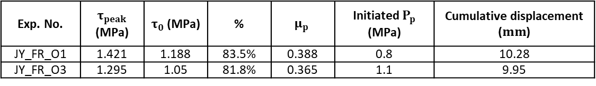
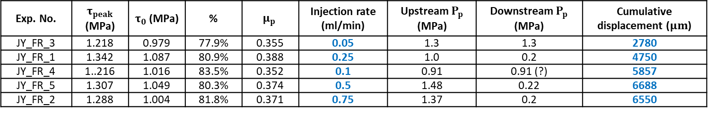
Experiment setup #2:
Defining the role of injection rate
Rock: Super smooth Westerly granite (low permeability)
Confining stress: 3MPa
Axial stress: constant
Upstream: constant injection rate
Downstream: capped, monitored by pressure transducer
Exp. No. | $τ_{peak}$ (MPa) | $τ_{0}$ (MPa) | % | $$μ_{p}$$ | Injection rate (ml/min) | Upstream $P_{p}$ (MPa) | Downstream $P_{p}$ (MPa) | Cumulative displacement ($μm$)
JY_FR_3 | 1.218 | 0.979 | 77.9% | 0.355 | 0.05 | 1.3 | 1.3 | 2780
JY_FR_1 | 1.342 | 1.087 | 80.9% | 0.388 | 0.25 | 1.0 | 0.2 | 4750
JY_FR_4 | 1..216 | 1.016 | 83.5% | 0.352 | 0.1 | 0.91 | 0.91 (?) | 5857
JY_FR_5 | 1.307 | 1.049 | 80.3% | 0.374 | 0.5 | 1.48 | 0.22 | 6688
JY_FR_2 | 1.288 | 1.004 | 81.8% | 0.371 | 0.75 | 1.37 | 0.2 | 6550
Experiment setup #3:
Rock: 60 grid Westerly granite (high permeability)
Exp. No. | $τ_{peak}$ (MPa) | $τ_{0}$ (MPa) | % | $$μ_{p}$$ | Initiated $P_{p}$ (MPa) | Cumulative displacement ($mm$)
JY_FR_O1 | 1.421 | 1.188 | 83.5% | 0.388 | 0.8 | 10.28
JY_FR_O3 | 1.295 | 1.05 | 81.8% | 0.365 | 1.1 | 9.95

Slide 3
Additional:
Normal stiffness measurement
System resistance

