Slide 1
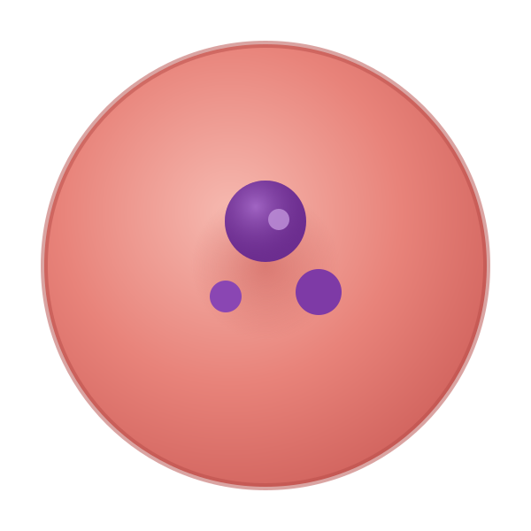
DEEP LEARNING · COMPUTER-AIDED DIAGNOSIS
Automated Malaria Cell Detection
using the NIH Malaria Cell Images Dataset
LITERATURE REVIEW → BASELINE & HYPOTHESIS
Pugazhendhi J
J Amathziah
C Murali Madhav
Ravi Yadav
Roll No. 230066
Roll No. 230139
Roll No. 230115
Roll No. 230131
Department of Computer Science · Rishihood University, Sonipat, India
Notes:
Open here. Title + team. Say: 'We reviewed 11 key studies on automated malaria detection using the NIH cell dataset — here's what the field has learned and the gaps we'll target.' [Presenter: Pugazhendhi J]

Slide 2



OUR TEAM
Four people, four jobs
AJ
MM
RY
PJ
Amathziah J
Murali Madhav C
Ravi Yadav
Pugazhendhi J
ROLE
ROLE
ROLE
ROLE
Kaggle experiments, repository
Code (notebook, scripts)
Slides
Report
Code, results & slides: github.com/amathziah/malaria-detection

Slide 3




MOTIVATION
Why does malaria diagnosis need automation?
The clinical gold standard is manual microscopy of Giemsa-stained blood smears — a technician visually inspects each cell for parasites. It works, but it doesn't scale.
Slow & laborious
Expert-dependent
Subjective & inconsistent
Each slide holds hundreds of cells; a microscopist counts them one by one, limiting large-scale screening.
Accuracy hinges on a trained microscopist's skill — scarce in the rural, endemic regions that need it most.
Results vary between (and within) observers and across labs, so the same smear can yield different diagnoses.
The opportunity: a deep-learning system that screens cells automatically — fast, consistent, and deployable where experts are not.
Literature Review · Automated Malaria Cell Detection
3
Notes:
Motivation. Gold standard = manual microscopy of Giemsa-stained smears. Three problems: slow, expert-dependent, subjective. Land the opportunity line: an automated system is fast, consistent, deployable. [Presenter: Pugazhendhi J]

Slide 4


PROBLEM STATEMENT
What we set out to build
Develop an automated deep-learning system that detects malaria parasites in red-blood-cell images, making screening more accurate, consistent, fast, and potentially deployable on low-resource / mobile devices.
Task
Method
Goal
Binary classification of single RBC crops: parasitized vs. uninfected
Convolutional / capsule deep networks — no hand-crafted features
Clinically reliable and light enough for point-of-care use
Scope: Stage 1 — literature survey of 11 studies (slides 5–16). Stage 2 — reproduce the base paper and state our hypothesis (slides 17–23).
Literature Review · Automated Malaria Cell Detection
4
Notes:
Our problem statement — read the big statement verbatim once. Then the 3 scope chips: binary task, deep networks (no hand-crafted features), point-of-care goal. Note this talk = Stage 1, the literature survey. [Presenter: Pugazhendhi J]

Slide 5
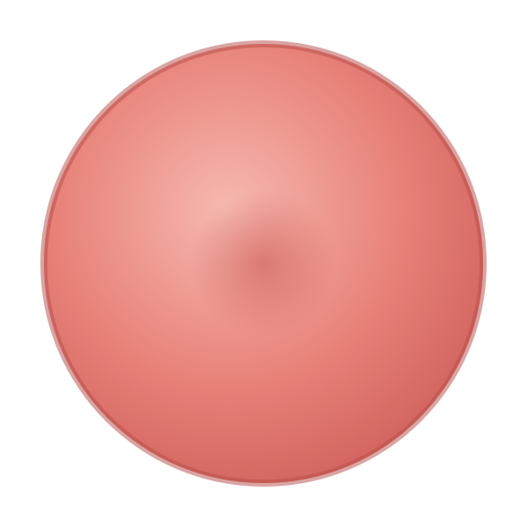

THE DATASET
NIH Malaria Cell Images Dataset
The common benchmark across all 11 studies. Built from Giemsa-stained thin blood smears at Chittagong Medical College Hospital, Bangladesh, and segmented into single cells.
What one cell looks like
27,558
50 / 50
200
segmented single-cell images
infected vs. uninfected — balanced
patients (150 infected, 50 healthy)
Uninfected
Parasitized
A hidden problem — noisy labels
The parasite appears as dark violet specks inside the cell (the Giemsa stain). The model must learn this cue — and ignore staining noise.
Fuhad et al. [5] found staining artifacts mislabeled as parasites and manually cleaned the set to 26,161 verified images (13,132 parasitized · 13,029 uninfected) — a cleaner, more trustworthy benchmark.
Literature Review · Automated Malaria Cell Detection
5
Notes:
The dataset everyone uses: NIH, 27,558 balanced single-cell images, 200 patients, Chittagong Bangladesh. Point at the two cells — parasite = violet specks. Flag Fuhad's label correction to 26,161 (foreshadows a gap). [Presenter: Pugazhendhi J]

Slide 6



THE STORY OF THE FIELD
How malaria CNNs evolved, 2016 → 2024
2016
2018
2019
2020
’22–’24
Custom CNN
beats transfer
Feature-extraction
mapping
Model
ensembles
Lightweight &
on-device
Capsules &
benchmarking
Liang [1]
Rajaraman [2]
Rajaraman [3]
Fuhad · Zhao · Masud · Umer
Madhu · Marques · others
The arc: from “can a CNN even do this?” → squeezing accuracy from big models → shrinking them to run on a phone → preserving cell structure and benchmarking rigorously.
Notes:
Hand off to Amathziah. This is the story slide — walk left to right along the timeline: 2016 custom CNN → 2018 feature extraction → 2019 ensembles → 2020 lightweight/mobile → 2022-24 capsules & benchmarking. [Presenter: J Amathziah]

Slide 7
PHASE 1 · 2016–2018
Custom CNNs vs. transfer learning
Liang et al. [1] — 2016
Rajaraman et al. [2] — 2018
A custom 16-layer CNN trained from scratch vs. off-the-shelf AlexNet features.
Mapped which layers of pre-trained backbones carry the most transferable features.
97.37%
91.99%
AlexNet
VGG-16
ResNet-50
Custom 16-layer CNN
AlexNet features
Xception
DenseNet-121
Froze optimal layers → tuned a small classifier: a scalable diagnostic aid.
Key insight
Domain-specific features beat generic ImageNet features for microscopy — but training from scratch is costly, so the field turned to smartly reusing pre-trained networks. This tension (accuracy vs. compute) drives everything that follows.
Literature Review · Automated Malaria Cell Detection
7
Notes:
Phase 1. Liang: a purpose-built 16-layer CNN (97.37%) beat generic AlexNet features (91.99%) — domain features win. Rajaraman [2] then mapped which pretrained layers transfer best. Insight: accuracy vs compute tension starts here. [Presenter: J Amathziah]

Slide 8


PHASE 2 · 2019–2022
Ensembles: many models, steadier answers
Single CNNs are high-variance — sensitive to how the data is split and shuffled. Averaging several diverse models cancels their individual errors and generalises better.
Rajaraman et al. [3] — 2019
Marques et al. [8] — 2022
VGG-19 + SqueezeNet ensemble
EfficientNet-B0 · 10-fold ensemble
Model averaging cut variance and overfitting, giving more reliable predictions under noisy, real-world training conditions.
Ensembling 10 folds lifted accuracy to 98.29% (AUC 99.76%); strict stratified cross-validation + open-source code for reproducibility.
The catch: ensembles are memory-hungry and slow to train (Marques' ran ~2 days). Great for a cloud server; impractical for a phone — which is exactly why the next wave went lightweight.
Literature Review · Automated Malaria Cell Detection
8
Notes:
Phase 2 ensembles. Single CNNs are high-variance; averaging diverse models is steadier. Rajaraman [3]: VGG-19+SqueezeNet cuts variance. Marques [8]: 10-fold EfficientNet ensemble → 98.29%. Catch: heavy & slow → motivates lightweight. [Presenter: J Amathziah]

Slide 9
PHASE 3 · 2020
Lightweight & on-device models
Getting diagnosis to endemic regions means running on a phone, offline — so researchers optimised for speed and size, not just accuracy.
Fuhad et al. [5]
Masud et al. [7]
Zhao et al. [6]
Autoencoder + knowledge distillation
Lightweight CNN + cyclical learning rate
Super-resolution (FSRCNN) + SSD300
99.23%
97.30%
96.5%
accuracy
accuracy in 50 epochs
on up-scaled 32→128 px images
4,600
409K
30.2
FLOPS — vs. ~19.6 billion for ensembles
parameters
PSNR — beats bicubic
< 1 s
~97 min
2 species
inference on a phone
to train, no augmentation
tested (P. falciparum + vivax)
Literature Review · Automated Malaria Cell Detection
9
Notes:
Phase 3 lightweight/mobile. Fuhad: 99.23% at only 4,600 FLOPS, <1s on a phone. Masud: 409K-param CNN, cyclical LR, ~97 min, no augmentation. Zhao: super-resolution + tested a 2nd species. Theme: optimise for size/speed. [Presenter: J Amathziah]

Slide 10
PHASE 4 · ARCHITECTURE & INPUTS
Capsule networks + smarter preprocessing
Madhu et al. [9] — 2023
Umer et al. [4] — 2020
Inception-V3 + Capsule Neural Network
Stacked CNN + YUV stain normalization
Standard CNNs lose spatial & pose information through pooling. Capsules use dynamic routing to keep the parasite's position and orientation inside the cell — state-of-the-art morphological modelling.
1
Resize to 120×120 — standardise crop size
2
Edge-detection filter — sharpen cell boundaries
3
Convert RGB → YUV — separate brightness from colour
99.35%
Sens. 99.57%
Spec. 99.12%
AUC 99.73%
4
Histogram equalisation — cancel staining differences
accuracy
5
Convert back → RGB — feed the CNN
Trade-off: capsule routing is slow to back-propagate.
Why it matters: stops the model from cheating on staining artifacts → ~99.9% accuracy, 100% precision.
Literature Review · Automated Malaria Cell Detection
10
Notes:
Hand off to Murali. Two ideas. Madhu's capsule net keeps spatial/pose info that pooling throws away — 99.35%. Umer's 5-step YUV pipeline normalises staining so the model can't cheat on stain colour — ~99.9%. [Presenter: C Murali Madhav]

Slide 11
PHASE 5 · 2023–2024
Rigorous benchmarking: does 'heavy' win?
Recent work stops chasing new architectures and instead asks: fairly compared, do big residual backbones actually beat small ones?
Hemachandran et al. [10] — 2023
Mujahid et al. [11] — 2024
CNN vs. MobileNetV2 vs. ResNet-50
Custom 12-layer CNN vs. 11 backbones
Lightweight MobileNetV2 reached 97.06% — matching a much heavier residual backbone. (The paper is honest about an internal inconsistency in its own conclusions.)
A carefully tuned custom CNN hit 97.57% with the lowest test loss (0.0995) — fine-tuned pooling & dropout can out-converge generic pre-trained nets.
Verdict: well-designed lightweight models rival heavy ones on this task. Efficiency is not a compromise — it's a viable design goal.
Literature Review · Automated Malaria Cell Detection
11
Notes:
Phase 5 benchmarking. Hemachandran: MobileNetV2 (97.06%) matches heavy ResNet. Mujahid: a tuned custom 12-layer CNN (97.57%) beats 11 pretrained nets. Verdict: lightweight ≈ heavy — efficiency is a real design goal. [Presenter: C Murali Madhav]

Slide 12
AT A GLANCE
All 11 studies on one page
# | Study (Year) | Approach | Headline result
1 | Liang (2016) | Custom 16-layer CNN from scratch | 97.37% — beats AlexNet features (91.99%)
2 | Rajaraman (2018) | Pre-trained CNNs as feature extractors | Mapped optimal transfer layers; scalable aid
3 | Rajaraman (2019) | VGG-19 + SqueezeNet ensemble | Lower variance, better generalization
4 | Umer (2020) | Stacked CNN + YUV stain normalization | ~99.9% acc, 100% precision (5-fold)
5 | Fuhad (2020) | Autoencoder + knowledge distillation | 99.23% · 4,600 FLOPS · <1 s · fixed labels
6 | Zhao (2020) | VGG16 + FSRCNN super-res + SSD300 | 96.5% · cross-species (P. vivax)
7 | Masud (2020) | Lightweight CNN + cyclical LR | 97.30% · 409K params · ~97 min
8 | Marques (2022) | EfficientNet-B0 · 10-fold ensemble | 98.29% · AUC 99.76% · open-source
9 | Madhu (2023) | Inception-V3 + Capsule network | 99.35% · preserves spatial pose
10 | Hemachandran (2023) | CNN vs MobileNetV2 vs ResNet-50 | MobileNetV2 97.06% · light ≈ heavy
11 | Mujahid (2024) | Custom 12-layer CNN vs 11 backbones | 97.57% · lowest test loss (0.0995)
Direct accuracy ranking is misleading — protocols, splits and data-cleaning differ across papers (see next slide).
12
Notes:
The at-a-glance table — don't read every row. Point out the spread of methods and that top accuracies cluster at 96-100%. Set up the caveat: these numbers are NOT directly comparable. [Presenter: C Murali Madhav]

Slide 13

COMPARATIVE ANALYSIS
Reported accuracy across studies
Read with care
Different splits
5-fold, 10-fold and 80:20 aren't comparable.
Different data
Some train on the noisy set, some on cleaned labels.
Possible leakage
High scores may hide patient-level data leakage.
Axis starts at 94% to reveal differences.
Literature Review · Automated Malaria Cell Detection
13
Notes:
The accuracy chart. All studies land 96-100%. BUT read with care (right panel): different splits, different data cleanliness, possible patient-level leakage. This caveat leads straight into the research gaps. [Presenter: C Murali Madhav]

Slide 14




★ THE BONUS
Research gaps — what nobody has solved
GAP 1
GAP 2
Patient-level data leakage
Single-species focus
Random image-level splits put cells from the same patient in both train and test — inflating accuracy and hiding poor generalisation. Only [1] and [2] split by patient.
Almost all models are trained only on P. falciparum. Performance on P. vivax, ovale, malariae, knowlesi is largely untested — only Zhao [6] tried.
GAP 3
GAP 4
Noisy ground-truth labels
Clinical-workflow gap
Except Fuhad [5], everyone trains and reports on the mislabeled public set — so many 'state-of-the-art' numbers are measured against imperfect labels.
Work centres on clean, pre-segmented single cells. Real labs need raw, unsegmented thick smears with overlapping cells and background noise.
Notes:
Hand off to Ravi. THE BONUS Kartik asked for — four gaps none of the papers fully solve: (1) patient-level data leakage, (2) single-species focus, (3) noisy labels, (4) raw thick-smear clinical workflow. Spend time here. [Presenter: Ravi Yadav]

Slide 15
FROM GAPS TO A PLAN
How the literature shapes our project
Each gap and lesson maps directly onto a design decision — the review is our roadmap, not just background reading.
YUV stain normalization
From Umer [4]
Immunise the model against staining variation between labs.
Verified, corrected dataset
From Fuhad [5]
Train on clean labels so we learn real features, not artifacts.
Patient-level 5-fold CV
From Rajaraman [2]
Group by patient before splitting — honest, leakage-free validation.
Lightweight architecture
From Masud [7] / Fuhad [5]
Target real-time, on-device inference for low-resource settings.
Literature Review · Automated Malaria Cell Detection
15
Notes:
Turn gaps into our plan: YUV normalization (Umer), Fuhad's corrected dataset, patient-level 5-fold CV (Rajaraman), lightweight architecture (Masud/Fuhad). The review is our roadmap. [Presenter: Ravi Yadav]

Slide 16
IN SUMMARY
A maturing field — and where we go next
The field has moved from proof-of-concept CNNs → variance-reducing ensembles → capsule networks that preserve cell structure → lightweight models that run offline on a phone. Accuracy is largely solved on clean data; the open problems are now about trust and deployment.
OUR NEXT STAGES
1
2
3
4
5
Pick base paper
Reproduce baseline
Form a hypothesis
Run ablations
Analyse & write up
with public code, on the NIH set
match its reported numbers
one variable, a direction & why
change one thing, compare
IEEE format, honest limits
Positioned to build a clinically reliable, deployable malaria-screening system — with the gaps above as our contribution.
Notes:
Conclusion. Field matured from proof-of-concept → deployment-aware; accuracy is largely solved on clean data, open problems are trust & deployment. Then our 5 next stages: base paper → reproduce → hypothesise → ablate → write up. [Presenter: Ravi Yadav]

Slide 17
PHASE 2 · INTRODUCTION
From literature review to a working baseline
Malaria is still confirmed by a technician scanning Giemsa-stained blood smears under a microscope: slow, subjective and expert-dependent. Deep CNNs trained on the NIH cell dataset now report 96–99.9 % accuracy, but our review found that most evaluate on random image-level splits, so cells from the same patient sit in both training and testing. Phase 2 makes this concrete: we rebuild one strong published model, then ask how it holds up under fairer, stain-robust conditions.
WHAT THIS PHASE DELIVERS
1 · Pick a base paper
2 · Reproduce it
3 · State our hypothesis
Marques et al. [8]: EfficientNet-B0 with a stratified 10-fold ensemble. Open-source, strict CV, 98.29 %.
Rebuild its training recipe on the NIH set and match its numbers. This becomes our baseline.
Two changes, one variable each: a leakage-free split (H1) and YUV stain normalisation (H2).
Milestones 2 & 3: baseline reproduction (notebook) + hypothesis for the proposed changes.
Notes:
Phase 2 opener and brief introduction. Recap the problem in one breath: manual microscopy is slow, subjective, and needs an expert. Then the key finding that carries over from Phase 1: published accuracies are high, but most papers split images at random, so the same patient's cells appear in training and testing. This phase has three steps: pick Marques [8] as the base paper, reproduce it, then state our hypothesis.

Slide 18
BASE PAPER · MARQUES ET AL. [8], 2022
Why EfficientNet-B0 + a 10-fold ensemble
Multimedia Tools and Applications 81 (2022). We need a published, reproducible model to compare our changes against.
Open-source code
THE METHOD WE REPRODUCE
Authors released their code, so a fair, faithful reproduction is possible.
NIH cells
27,558 crops · balanced
1
Strict, stratified 10-fold CV
2
Resize
224 × 224 RGB
The most rigorous protocol in our review. Every image is validated once.
3
EfficientNet-B0
ImageNet weights, fully fine-tuned
Light backbone (~4–5 M params)
4
Train
Adam 1e-4 · LR plateau decay → 1e-6
B0 is the smallest EfficientNet, so it stays close to our deployability goal.
5
Validate
stratified 10-fold cross-validation
Strong, but not at the ceiling
6
Ensemble
average the 10 fold models' probabilities
98.29 % leaves room to measure whether a change helps or hurts.
97.70 %
98.29 %
98.82 %
99.76 %
mean single-fold accuracy
ensemble accuracy
ensemble recall
ensemble ROC-AUC
Phase 2 · Baseline & Hypothesis · Automated Malaria Cell Detection
18
Notes:
Why this base paper. Four reasons: open-source code, so we can reproduce it faithfully; the strictest validation in our review (stratified 10-fold); a light backbone in line with our deployability goal; and results that are strong but not 99.9 %, so a change can move them either way. Walk the pipeline top to bottom, then land the four target numbers we have to match.

Slide 19
MILESTONE 2 · BASELINE REPRODUCTION
Rebuilding the paper's recipe
Same data, backbone, optimiser, schedule and validation. Deviations are listed openly.
Setting | Paper [8] | Our notebook
Data | NIH, 27,558 cells | Same (Kaggle mirror)
Backbone | EfficientNet-B0, ImageNet | Same
Optimiser | Adam, lr 1e-4 | Same
LR schedule | Plateau, p = 6 → 1e-6 | Same
Validation | Stratified 10-fold | Same + 10 % untouched test
Augmentation | Albumentations (unlisted) | Flips + 90° rotations
Epochs | Not reported | ≤ 15, early stop (p = 5)
Folds trained | 10 | 3 of 10 (free GPU)
RESULTS · NIH TEST SET
Metric | Paper | Ours
Mean fold accuracy | 97.70 % | 97.38 %
Ensemble accuracy | 98.29 % | 97.57 %
Recall (sensitivity) | 98.82 % | 96.81 %
Precision | 97.74 % | 98.31 %
F1-score | 98.28 % | 97.55 %
ROC-AUC | 99.76 % | 99.76 %
MCC | not reported | 0.95
Success criterion: within ≈ 1 pp of the paper. Ours = notebook §10 output (Kaggle 2× T4 GPU).
Same = matches the paper Amber = documented deviation (missing detail or compute budget)
Phase 2 · Baseline & Hypothesis · Automated Malaria Cell Detection
19
Notes:
Reproduction. Left: we kept every setting the paper reports. Amber rows are where the paper is silent (augmentation details, epochs) or where we cut compute (3 of 10 folds on a free GPU). Right: paper vs. ours. We landed within 1 point on both headline numbers (mean fold −0.32 pp, ensemble −0.72 pp), so the reproduction counts as successful and this is our baseline. Recall is the one gap (−2 pp).
Results (Kaggle run, 3 of 10 folds): mean single-fold accuracy 97.38 ± 0.74 % (SD across 3 folds). Ensemble of 3 fold models on the 2,756-image hold-out test set. MCC is shown as a coefficient (0–1). Ran on 2× Tesla T4 (MirroredStrategy), so the global batch was 128 (64 per GPU).

Slide 20
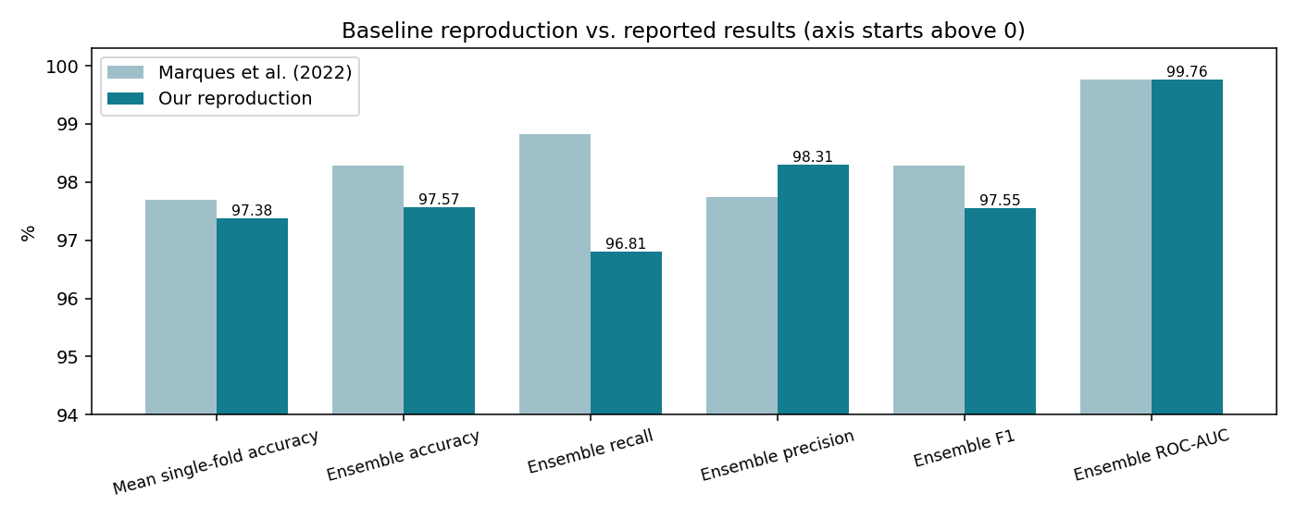
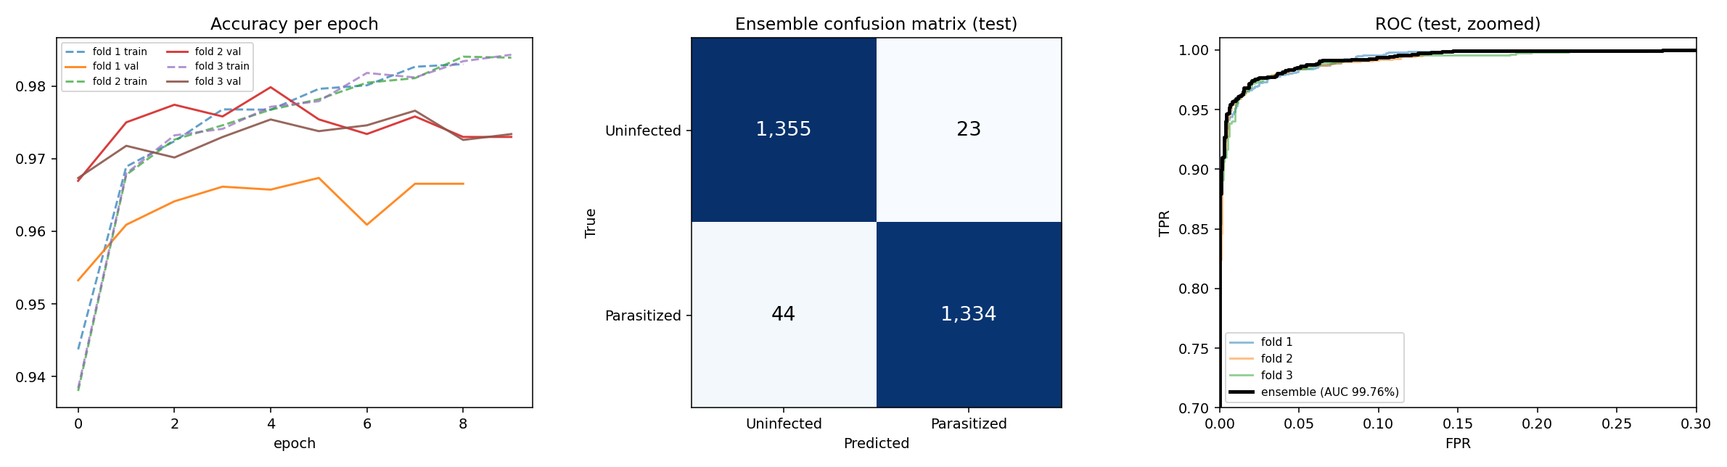
MILESTONE 2 · BASELINE REPRODUCTION
A0 results at a glance
Ensemble of our 3 fold models on the 2,756-image hold-out test set, next to what Marques et al. [8] report.
PAPER VS. OURS
TRAINING CURVES · CONFUSION MATRIX · ROC
Takeaway: Within 1 pp of the paper on both headline accuracies; recall is 2 pp lower (44 missed infected cells).
Phase 2 · Baseline & Hypothesis · Automated Malaria Cell Detection
20
Notes:
This slide is just the A0 results as pictures, so you can see them instead of reading the table.
Left, paper vs. ours: light bars are what Marques et al. report, dark bars are our run. The axis starts at 94 %, so the gaps look bigger than they are. Mean fold accuracy is 0.32 pp lower and ensemble accuracy 0.72 pp lower, both inside our 1 pp target. Precision is actually a bit higher than the paper, ROC-AUC is the same (99.76 %). Recall is the one real gap: 96.81 % vs. 98.82 %.
Right, first panel, training curves: accuracy per epoch for each of our 3 folds, dashed is training and solid is validation. Validation flattens out after a few epochs, which is why early stopping ended each fold after 9 or 10 epochs. Fold 1 (orange) sits lowest the whole time.
Middle panel, confusion matrix of the 3-model ensemble on the 2,756 test cells: 1,334 infected cells caught (true positives), 1,355 healthy cells correctly cleared (true negatives), 23 false alarms and 44 infected cells missed. Those 44 misses are why recall is lower, and for diagnosis a miss is the worse mistake.
Last panel, ROC curve, zoomed into the top-left corner: the curve hugs the top, ensemble AUC is 99.76 %, the same as the paper. So the model separates the two classes very well; the misses come from where the threshold sits, not from the model being bad at ranking.

Slide 21
MILESTONE 2 · BASELINE REPRODUCTION
A0 per-fold results
Each fold model scored on its own validation split (2,481 cells). Last row: mean ± SD over the 3 folds. MCC as a coefficient (0–1).
Fold | Epochs | Minutes | Accuracy | Recall | Precision | MCC
Fold 1 | 9 | 20.7 | 96.57 % | 94.84 % | 98.25 % | 0.93
Fold 2 | 10 | 21.9 | 98.02 % | 97.90 % | 98.14 % | 0.96
Fold 3 | 10 | 21.7 | 97.54 % | 97.18 % | 97.89 % | 0.95
Mean ± SD | — | — | 97.38 ± 0.74 % | 96.64 ± 1.60 % | 98.09 ± 0.18 % | 0.95 ± 0.01
Fold 1 is the weakest: recall 94.84 % (64 missed infected cells) vs. 97.90 % and 97.18 % on the other two folds.
Phase 2 · Baseline & Hypothesis · Automated Malaria Cell Detection
21

Slide 22
★ OUR HYPOTHESIS
Two proposed changes, one variable at a time
H1 · VALIDATION
H2 · PREPROCESSING
Leakage-free, slide-grouped split
YUV stain normalisation (Umer [4])
CHANGE
Split by slide/patient (StratifiedGroupKFold) instead of random images. Model unchanged.
CHANGE
Add RGB → YUV → histogram-equalise Y → RGB before EfficientNet-B0. Grouped split kept fixed.
WE EXPECT
Accuracy and MCC fall below the image-split baseline, and fold-to-fold spread widens.
WE EXPECT
Higher recall and MCC than the H1 model on unseen slides; little change on the random split.
BECAUSE
Cells from one slide share stain, lighting and the patient's cell shape. A random split lets the model recognise the slide rather than the parasite.
BECAUSE
Equalising brightness strips slide-specific colour cues, so the network has to rely on parasite morphology. That's the signal that carries across labs.
Falsifiable: if H2's gain over H1 is smaller than the fold-to-fold standard deviation, we reject H2. If grouped and random splits score the same, H1 is rejected and leakage is not a real issue on this dataset.
Notes:
The hypothesis. Two proposed changes, each changing exactly one thing. H1: switch to a slide-grouped split. We expect the reported accuracy to drop because the model can no longer recognise a slide it already saw in training. H2: keep the honest split and add Umer's YUV histogram-equalisation. We expect recall and MCC to recover, because stain colour stops being a shortcut. Close on the falsification rule: we say in advance what result would prove us wrong.

Slide 23
HOW WE WILL TEST IT
Ablation plan & success criteria
Each comparison changes exactly one thing (shown in brackets). Same seeds, epochs and folds throughout.
ID | Split | Preprocessing | What it answers | Status
A0 | Image-level (paper) | None | Baseline: does our reproduction match [8]? | Milestone 2 ✓
A1 | Slide-grouped | None | H1: how big is the leakage gap (A0 − A1)? | Next
A2 | Slide-grouped | YUV + hist-eq | H2: does stain normalisation help on unseen slides (A2 − A1)? | Next
A3 | Image-level | YUV + hist-eq | Control: is H2's gain specific to new slides (A3 − A0 ≈ 0)? | Next
Metrics
Clinical priority
Already built
Accuracy, recall (missed infections), MCC, ROC-AUC. Mean ± SD over folds plus the hold-out ensemble.
Recall first: a missed parasitized cell (false negative) costs more than a false alarm.
The notebook has the grouped split and YUV switches. A1–A3 are one flag each.
Phase 2 · Baseline & Hypothesis · Automated Malaria Cell Detection
23
Notes:
How we will test the hypothesis next milestone. A0 is done: that's the reproduction. A1 removes leakage (H1). A2 adds stain normalisation on top (H2). A3 is a control showing that any gain is about generalising to new slides, not a general boost. We report recall and MCC alongside accuracy, as mean ± SD over folds. All of these are already built into the notebook as on/off switches. Our A0 baseline already shows why recall comes first: 96.81 % vs. the paper's 98.82 %, i.e. 44 missed infected cells on the test set.

Slide 24

REFERENCES
The eleven reviewed studies
[1] Z. Liang et al., “CNN-Based Image Analysis for Malaria Diagnosis,” IEEE BIBM, 2016.
[2] S. Rajaraman et al., “Pre-trained CNNs as feature extractors toward improved malaria parasite detection,” PeerJ 6:e4568, 2018.
[3] S. Rajaraman et al., “Performance evaluation of deep neural ensembles toward malaria parasite detection,” PeerJ 7:e6977, 2019.
[4] M. Umer et al., “A Novel Stacked CNN for Malarial Parasite Detection in Thin Blood Smear Images,” IEEE Access 8, 2020.
[5] K. M. F. Fuhad et al., “Deep Learning Based Automatic Malaria Parasite Detection … Smartphone Application,” Diagnostics 10(5):329, 2020.
[6] O. S. Zhao et al., “Convolutional neural networks to automate the screening of malaria in low-resource countries,” PeerJ 8:e9674, 2020.
[7] M. Masud et al., “Leveraging Deep Learning Techniques for Malaria Parasite Detection Using Mobile Application,” WCMC 2020:8895429.
[8] G. Marques et al., “An ensemble-based approach for automated medical diagnosis of malaria using EfficientNet,” MTAP 81, 2022.
[9] G. Madhu et al., “Intelligent diagnostic model … imperative inception-based capsule neural networks,” Scientific Reports 13, 2023.
[10] K. Hemachandran et al., “Performance Analysis of Deep Learning Algorithms in Diagnosis of Malaria Disease,” Diagnostics 13(3):534, 2023.
[11] M. Mujahid et al., “Efficient deep learning-based approach for malaria detection using red blood cell smears,” Scientific Reports 14, 2024.
Thank you
Questions on methods, results, or our chosen research gap are welcome.
Presented by Pugazhendhi J · J Amathziah · C Murali Madhav · Ravi Yadav
24
Notes:
References + thank you. Invite questions, especially on our chosen research gap (patient-level leakage). Have the cheat-sheet numbers ready. [Presenter: Ravi Yadav]

