Slide 1




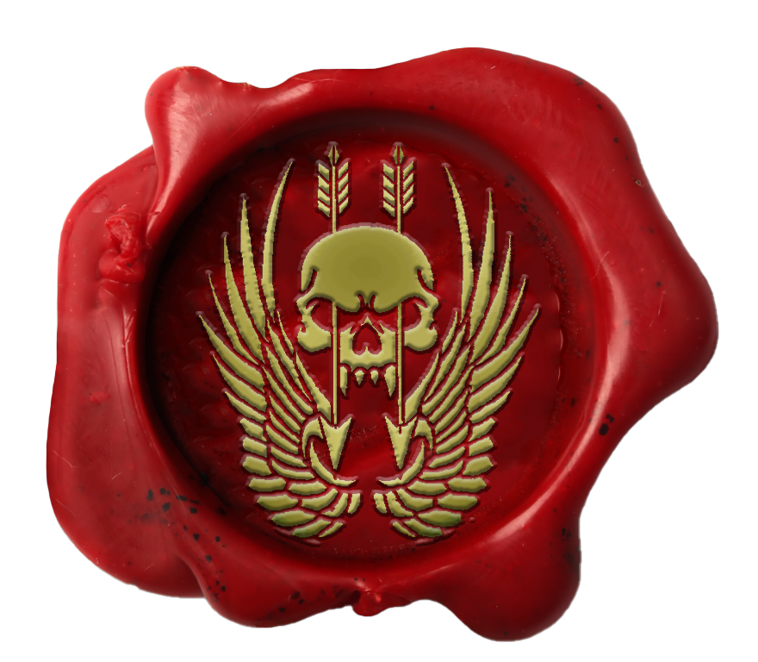
Certificate Of Return To Service
Private Ryan
Private Ryan has shown the desire, traits, attitude and eagerness that is required for the unit and has been deemed suitable in all areas required for reenlistment.
I, MAJ Trew, Commanding Officer, Australian Special Operations Taskforce, hereby grant
Private Ryan
entry back into the unit with effect 14 July 2023
MAJ Trew
MAJ Trew Commanding Officer Australian Special Operations Taskforce HQ

Slide 2


Certificate Of Promotion
Private Ryan
Private Ryan has completed all necessary trainings and been deemed suitable in all areas required for promotion.
I, MAJ Trew, Commanding Officer, Australian Special Operations Taskforce, hereby promote
Private Ryan
to the rank of Lieutenant Colonel with effect 14 July 2023
MAJ Trew
MAJ Trew Commanding Officer Australian Special Operations Taskforce HQ

Slide 3
Certificate Of Promotion
Private Ryan
Private Ryan has completed all necessary trainings and been deemed suitable in all areas required for promotion.
I, MAJ Trew, Commanding Officer, Australian Special Operations Taskforce, hereby promote
Private Ryan
to the rank of Major with effect 14 July 2023.
MAJ Trew
MAJ Trew Commanding Officer Australian Special Operations Taskforce HQ

Slide 4
Certificate Of Promotion
Private Ryan
Private Ryan has completed all necessary trainings and been deemed suitable in all areas required for promotion.
I, MAJ Trew, Commanding Officer, Australian Special Operations Taskforce, hereby promote
Private Ryan
to the rank of Captain with effect 14 July 2023.
MAJ Trew
MAJ Trew Commanding Officer Australian Special Operations Taskforce HQ

Slide 5
Certificate Of Promotion
Private Ryan
Private Ryan has completed all necessary trainings and been deemed suitable in all areas required for promotion.
I, MAJ Trew, Commanding Officer, Australian Special Operations Taskforce, hereby promote
Private Ryan
to the rank of Lieutenant with effect 14 July 2023
MAJ Trew
MAJ Trew Commanding Officer Australian Special Operations Taskforce HQ

Slide 6

Certificate Of Promotion
Private Ryan
Private Ryan has completed all necessary trainings and been deemed suitable in all areas required for promotion.
I, Major Trew, Commanding Officer, Australian Special Operations Taskforce, hereby promote
Private Ryan
to the rank of Wing Commander with effect 14 July 2023.
MAJ Trew
MAJ Trew Commanding Officer Australian Special Operations Taskforce HQ

Slide 7

Certificate Of Promotion
Private Ryan
Private Ryan has completed all necessary trainings and been deemed suitable in all areas required for promotion.
I, MAJ Trew, Commanding Officer, Australian Special Operations Taskforce, hereby promote
Private Ryan
to the rank of Squadron Leader with effect 14 July 2023.
MAJ Trew
MAJ Trew Commanding Officer Australian Special Operations Taskforce HQ

Slide 8

Certificate Of Promotion
Private Ryan
Private Ryan has completed all necessary trainings and been deemed suitable in all areas required for promotion.
I, MAJ Trew, Commanding Officer, Australian Special Operations Taskforce, hereby promote
Private Ryan
to the rank of Flight Lieutenant with effect 14 July 2023.
MAJ Trew
MAJ Trew Commanding Officer Australian Special Operations Taskforce HQ

Slide 9

Certificate Of Promotion
Private Ryan
Private Ryan has completed all necessary trainings and been deemed suitable in all areas required for promotion.
I, MAJ Trew, Commanding Officer, Australian Special Operations Taskforce, hereby promote
Private Ryan
to the rank of Warrant Officer 1 with effect 14 July 2023.
MAJ Trew
MAJ Trew Commanding Officer Australian Special Operations Taskforce HQ

Slide 10

Certificate Of Promotion
Private Ryan
Private Ryan has completed all necessary trainings and been deemed suitable in all areas required for promotion.
I, MAJ Trew, Commanding Officer, Australian Special Operations Taskforce, hereby promote
Private Ryan
to the rank of Warrant Officer 2 with effect 14 July 2023.
MAJ Trew
MAJ Trew Commanding Officer Australian Special Operations Taskforce HQ

Slide 11
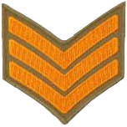
Certificate Of Promotion
Private Ryan
Private Ryan has completed all necessary trainings and been deemed suitable in all areas required for promotion.
I, MAJ Trew, Commanding Officer, Australian Special Operations Taskforce, hereby promote
Private Ryan
to the rank of Sergeant with effect 14 July 2023.
MAJ Trew
MAJ Trew Commanding Officer Australian Special Operations Taskforce HQ

Slide 12

Certificate Of Promotion
Private Ryan
Private Ryan has completed all necessary trainings and been deemed suitable in all areas required for promotion.
I, MAJ Trew, Commanding Officer, Australian Special Operations Taskforce, hereby promote
Private Ryan
to the rank of Corporal with effect 14 July 2023.
MAJ Trew
MAJ Trew Commanding Officer Australian Special Operations Taskforce HQ

Slide 13

Certificate Of Promotion
Private Ryan
Private Ryan has completed all necessary trainings and been deemed suitable in all areas required for promotion.
I, MAJ Trew, Commanding Officer, Australian Special Operations Taskforce, hereby promote
Private Ryan
to the rank of Lance Corporal with effect 14 July 2023.
MAJ Trew
MAJ Trew Commanding Officer Australian Special Operations Taskforce HQ

Slide 14
Certificate Of Promotion
Private Ryan
Private Ryan has completed all necessary trainings and been deemed suitable in all areas required for promotion.
I, MAJ Trew, Commanding Officer, Australian Special Operations Taskforce, hereby promote
Private Ryan
to the rank of Private with effect 14 July 2023.
MAJ Trew
MAJ Trew Commanding Officer Australian Special Operations Taskforce HQ

Slide 15
Certificate Of Enlistment
Private Ryan
Private Ryan has shown the traits, attitude and eagerness that is required for joining the unit and has been deemed suitable in all areas required for enlistment
I, MAJ Trew, Commanding Officer, Australian Special Operations Taskforce, hereby grant
Private Ryan
entry to the unit with effect 14 July 2023.
MAJ Trew
MAJ Trew Commanding Officer Australian Special Operations Taskforce HQ

