Slide 1




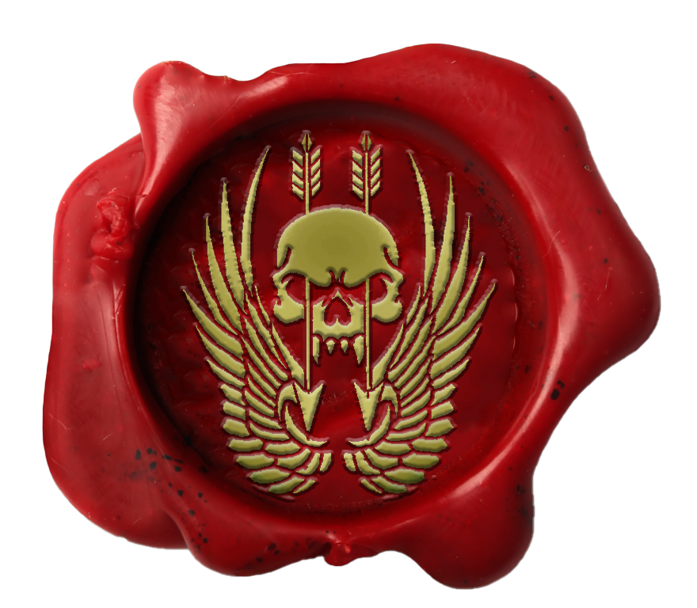
Certificate Of Return To Service
Private Fulcrum
Private Fulcrum has shown the desire, traits, attitude and eagerness that is required for the unit and has been deemed suitable in all areas required for reenlistment.
I, LTCOL Thomas, Commanding Officer, Australian Special Operations Taskforce, hereby grant
Private Fulcrum
entry back into the unit with effect 29 June 2023
LTCOL Thomas
LTCOL Thomas Commanding Officer Australian Special Operations Taskforce HQ

Slide 2


Certificate Of Promotion
Private Fulcrum
Private Fulcrum has completed all necessary trainings and been deemed suitable in all areas required for promotion.
I, LTCOL Thomas, Commanding Officer, Australian Special Operations Taskforce, hereby promote
Private Fulcrum
to the rank of Lieutenant Colonel with effect 29 June 2023
LTCOL Thomas
LTCOL Thomas Commanding Officer Australian Special Operations Taskforce HQ

Slide 3
Certificate Of Promotion
Private Fulcrum
Private Fulcrum has completed all necessary trainings and been deemed suitable in all areas required for promotion.
I, LTCOL Thomas, Commanding Officer, Australian Special Operations Taskforce, hereby promote
Private Fulcrum
to the rank of Major with effect 29 June 2023.
LTCOL Thomas
LTCOL Thomas Commanding Officer Australian Special Operations Taskforce HQ

Slide 4
Certificate Of Promotion
Private Fulcrum
Private Fulcrum has completed all necessary trainings and been deemed suitable in all areas required for promotion.
I, LTCOL Thomas, Commanding Officer, Australian Special Operations Taskforce, hereby promote
Private Fulcrum
to the rank of Captain with effect 29 June 2023.
LTCOL Thomas
LTCOL Thomas Commanding Officer Australian Special Operations Taskforce HQ

Slide 5
Certificate Of Promotion
Private Fulcrum
Private Fulcrum has completed all necessary trainings and been deemed suitable in all areas required for promotion.
I, LTCOL Thomas, Commanding Officer, Australian Special Operations Taskforce, hereby promote
Private Fulcrum
to the rank of Lieutenant with effect 29 June 2023
LTCOL Thomas
LTCOL Thomas Commanding Officer Australian Special Operations Taskforce HQ

Slide 6

Certificate Of Promotion
Private Fulcrum
Private Fulcrum has completed all necessary trainings and been deemed suitable in all areas required for promotion.
I, Major Trew, Commanding Officer, Australian Special Operations Taskforce, hereby promote
Private Fulcrum
to the rank of Wing Commander with effect 29 June 2023.
LTCOL Thomas
LTCOL Thomas Commanding Officer Australian Special Operations Taskforce HQ

Slide 7

Certificate Of Promotion
Private Fulcrum
Private Fulcrum has completed all necessary trainings and been deemed suitable in all areas required for promotion.
I, LTCOL Thomas, Commanding Officer, Australian Special Operations Taskforce, hereby promote
Private Fulcrum
to the rank of Squadron Leader with effect 29 June 2023.
LTCOL Thomas
LTCOL Thomas Commanding Officer Australian Special Operations Taskforce HQ

Slide 8

Certificate Of Promotion
Private Fulcrum
Private Fulcrum has completed all necessary trainings and been deemed suitable in all areas required for promotion.
I, LTCOL Thomas, Commanding Officer, Australian Special Operations Taskforce, hereby promote
Private Fulcrum
to the rank of Flight Lieutenant with effect 29 June 2023.
LTCOL Thomas
LTCOL Thomas Commanding Officer Australian Special Operations Taskforce HQ

Slide 9

Certificate Of Promotion
Private Fulcrum
Private Fulcrum has completed all necessary trainings and been deemed suitable in all areas required for promotion.
I, LTCOL Thomas, Commanding Officer, Australian Special Operations Taskforce, hereby promote
Private Fulcrum
to the rank of Warrant Officer 1 with effect 29 June 2023.
LTCOL Thomas
LTCOL Thomas Commanding Officer Australian Special Operations Taskforce HQ

Slide 10

Certificate Of Promotion
Private Fulcrum
Private Fulcrum has completed all necessary trainings and been deemed suitable in all areas required for promotion.
I, LTCOL Thomas, Commanding Officer, Australian Special Operations Taskforce, hereby promote
Private Fulcrum
to the rank of Warrant Officer 2 with effect 29 June 2023.
LTCOL Thomas
LTCOL Thomas Commanding Officer Australian Special Operations Taskforce HQ

Slide 11

Certificate Of Promotion
Private Fulcrum
Private Fulcrum has completed all necessary trainings and been deemed suitable in all areas required for promotion.
I, LTCOL Thomas, Commanding Officer, Australian Special Operations Taskforce, hereby promote
Private Fulcrum
to the rank of Sergeant with effect 29 June 2023.
LTCOL Thomas
LTCOL Thomas Commanding Officer Australian Special Operations Taskforce HQ

Slide 12

Certificate Of Promotion
Private Fulcrum
Private Fulcrum has completed all necessary trainings and been deemed suitable in all areas required for promotion.
I, LTCOL Thomas, Commanding Officer, Australian Special Operations Taskforce, hereby promote
Private Fulcrum
to the rank of Corporal with effect 29 June 2023.
LTCOL Thomas
LTCOL Thomas Commanding Officer Australian Special Operations Taskforce HQ

Slide 13

Certificate Of Promotion
LTCOL Thomas
Private Fulcrum has completed all necessary trainings and been deemed suitable in all areas required for promotion.
I, LTCOL Thomas, Commanding Officer, Australian Special Operations Taskforce, hereby promote
Private Fulcrum
to the rank of Lance Corporal with effect 29 June 2023.
LTCOL Thomas
LTCOL Thomas Commanding Officer Australian Special Operations Taskforce HQ

Slide 14
Certificate Of Promotion
Private Fulcrum
Private Fulcrum has completed all necessary trainings and been deemed suitable in all areas required for promotion.
I, LTCOL Thomas, Commanding Officer, Australian Special Operations Taskforce, hereby promote
Private Fulcrum
to the rank of Private with effect 29 June 2023.
LTCOL Thomas
LTCOL Thomas Commanding Officer Australian Special Operations Taskforce HQ

Slide 15
Certificate Of Enlistment
Private Fulcrum
Private Fulcrum has shown the traits, attitude and eagerness that is required for joining the unit and has been deemed suitable in all areas required for enlistment
I, LTCOL Thomas, Commanding Officer, Australian Special Operations Taskforce, hereby grant
Private Fulcrum
entry to the unit with effect 29 June 2023.
LTCOL Thomas
LTCOL Thomas Commanding Officer Australian Special Operations Taskforce HQ

