Slide 1




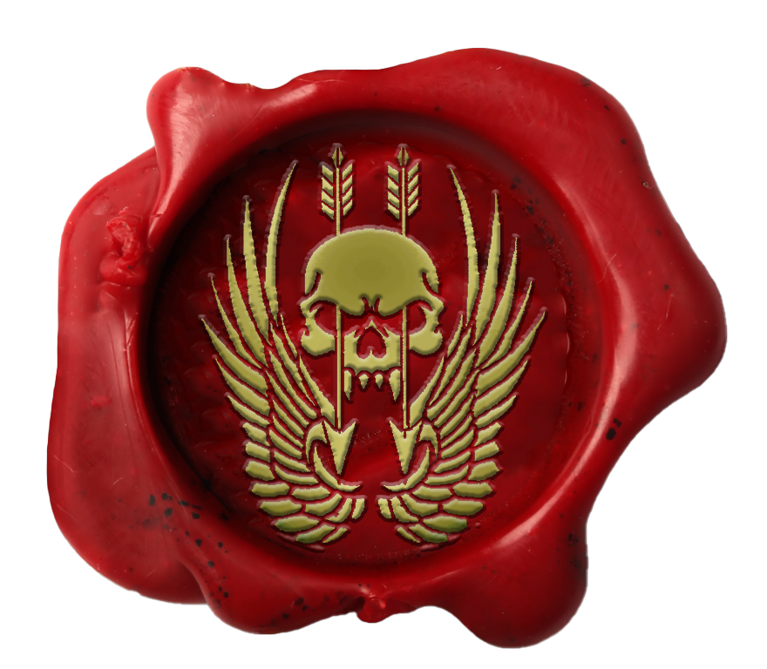
Certificate Of Return To Service
Private Fulcrum
Private Fulcrum has shown the desire, traits, attitude and eagerness that is required for the unit and has been deemed suitable in all areas required for reenlistment.
I, LT COL Thomas, Commanding Officer, Australian Special Operations Taskforce, hereby grant
Private Fulcrum
entry back into the unit with effect 29 JUNE 2023
LT COL Thomas
LT COL Thomas Commanding Officer Australian Special Operations Taskforce HQ

Slide 2


Certificate Of Promotion
Private Fulcrum
Private Fulcrum has completed all necessary trainings and been deemed suitable in all areas required for promotion.
I, LT COL Thomas, Commanding Officer, Australian Special Operations Taskforce, hereby promote
Private Fulcrum
to the rank of Lieutenant Colonel with effect 29 JUNE 2023
LT COL Thomas
LT COL Thomas Commanding Officer Australian Special Operations Taskforce HQ

Slide 3
Certificate Of Promotion
Private Fulcrum
Private Fulcrum has completed all necessary trainings and been deemed suitable in all areas required for promotion.
I, LT COL Thomas, Commanding Officer, Australian Special Operations Taskforce, hereby promote
Private Fulcrum
to the rank of Major with effect 29 JUNE 2023.
LT COL Thomas
LT COL Thomas Commanding Officer Australian Special Operations Taskforce HQ

Slide 4
Certificate Of Promotion
Private Fulcrum
Private Fulcrum has completed all necessary trainings and been deemed suitable in all areas required for promotion.
I, LT COL Thomas, Commanding Officer, Australian Special Operations Taskforce, hereby promote
Private Fulcrum
to the rank of Captain with effect29 JUNE 2023.
LT COL Thomas
LT COL Thomas Commanding Officer Australian Special Operations Taskforce HQ

Slide 5
Certificate Of Promotion
Warrant Thomas
Major Trew has completed all necessary trainings and been deemed suitable in all areas required for promotion.
I, Major Trew, Commanding Officer, Australian Special Operations Taskforce, hereby promote
Major Trew
to the rank of Lieutenant with effect 15th August 2020.
MAJ Trew
MAJ Trew Commanding Officer Australian Special Operations Taskforce HQ

Slide 6

Certificate Of Promotion
Private Thomas
Private Trew has completed all necessary trainings and been deemed suitable in all areas required for promotion.
I, Major Trew, Commanding Officer, Australian Special Operations Taskforce, hereby promote
Private Trew
to the rank of Wing Commander with effect 15th August 2020.
MAJ Trew
MAJ Trew Commanding Officer Australian Special Operations Taskforce HQ

Slide 7

Certificate Of Promotion
Private Thomas
Private Trew has completed all necessary trainings and been deemed suitable in all areas required for promotion.
I, Major Trew, Commanding Officer, Australian Special Operations Taskforce, hereby promote
Private Trew
to the rank of Squadron Leader with effect 15th August 2020.
MAJ Trew
MAJ Trew Commanding Officer Australian Special Operations Taskforce HQ

Slide 8

Certificate Of Promotion
PTE Castell
PTE Castell has completed all necessary trainings and been deemed suitable in all areas required for promotion.
I, Major Trew, Commanding Officer, Australian Special Operations Taskforce, hereby promote
PTE Castell
to the rank of Flight Lieutenant with effect 04th December 2022.
MAJ Trew
MAJ Trew Commanding Officer Australian Special Operations Taskforce HQ

Slide 9

Certificate Of Promotion
Recruit Sharpe
Recruit Sharpe has completed all necessary trainings and been deemed suitable in all areas required for promotion.
I, Major Trew, Commanding Officer, Australian Special Operations Taskforce, hereby promote
Recruit Sharpe
to the rank of Warrant Officer 1 with effect 19th September 2022.
MAJ Trew
MAJ Trew Commanding Officer Australian Special Operations Taskforce HQ

Slide 10

Certificate Of Promotion
Recruit Thomas
Sergeant Thomas has completed all necessary trainings and been deemed suitable in all areas required for promotion.
I, Major Trew, Commanding Officer, Australian Special Operations Taskforce, hereby promote
Sergeant Thomas
to the rank of Warrant Officer 2 with effect 15th August 2020.
MAJ Trew
MAJ Trew Commanding Officer Australian Special Operations Taskforce HQ

Slide 11
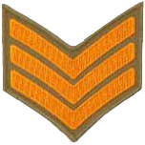
Certificate Of Promotion
Corporal Rox
Corporal Rox has completed all necessary trainings and been deemed suitable in all areas required for promotion.
I, Major Trew, Commanding Officer, Australian Special Operations Taskforce, hereby promote
Corporal Rox
to the rank of Sergeant with effect 1st August 2022.
MAJ Trew
MAJ Trew Commanding Officer Australian Special Operations Taskforce HQ

Slide 12

Certificate Of Promotion
LCPL Six
LCPL Six has completed all necessary trainings and been deemed suitable in all areas required for promotion.
I, Major Trew, Commanding Officer, Australian Special Operations Taskforce, hereby promote
LCPL Six
to the rank of Corporal with effect 03rd October 2022.
MAJ Trew
MAJ Trew Commanding Officer Australian Special Operations Taskforce HQ

Slide 13

Certificate Of Promotion
Private Titan
Private Titan has completed all necessary trainings and been deemed suitable in all areas required for promotion.
I, Major Trew, Commanding Officer, Australian Special Operations Taskforce, hereby promote
Private Titan
to the rank of Lance Corporal with effect 19th February 2023.
MAJ Trew
MAJ Trew Commanding Officer Australian Special Operations Taskforce HQ

Slide 14
Certificate Of Promotion
REC Yoshi
REC Yoshi has completed all necessary trainings and been deemed suitable in all areas required for promotion.
I, Major Trew, Commanding Officer, Australian Special Operations Taskforce, hereby promote
REC Yoshi
to the rank of Private with effect 7th January 2023.
MAJ Trew
MAJ Trew Commanding Officer Australian Special Operations Taskforce HQ

Slide 15
Certificate Of Enlistment
Recruit Sobel
Recruit Sobel has shown the traits, attitude and eagerness that is required for joining the unit and has been deemed suitable in all areas required for enlistment
I, Major Trew, Commanding Officer, Australian Special Operations Taskforce, hereby grant
Recruit Sobel
entry to the unit with effect 02nd January 2023.
MAJ Trew
MAJ Trew Commanding Officer Australian Special Operations Taskforce HQ

