Slide 1
EB
W
3
RANCESC
F
O
BARBERA

Slide 2
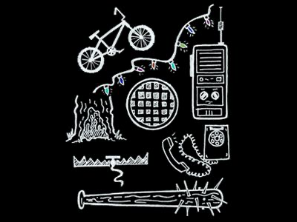
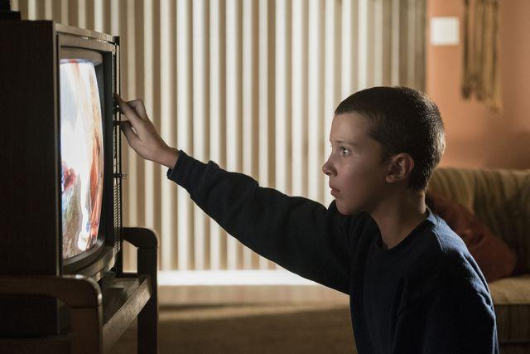
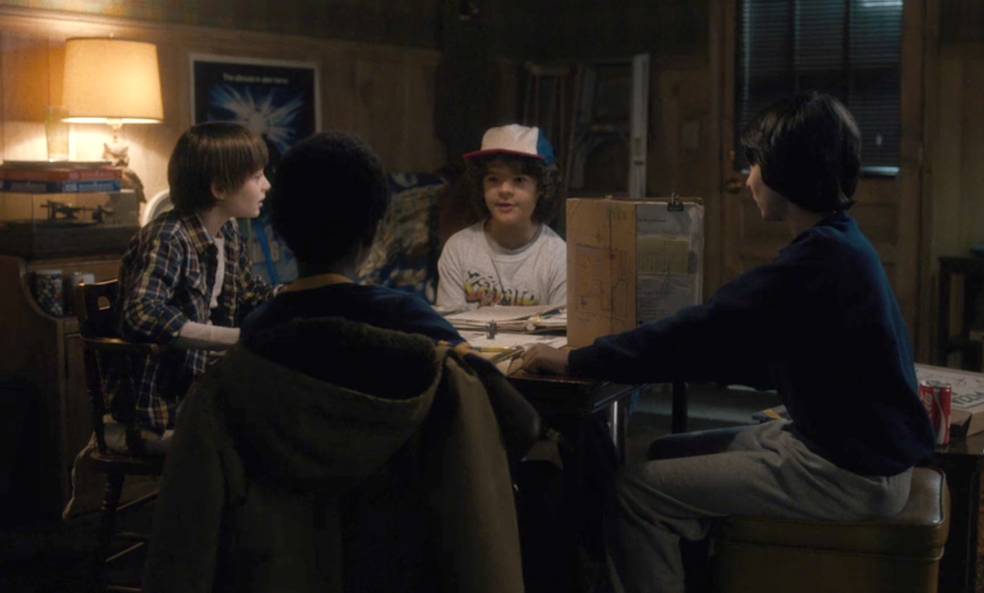


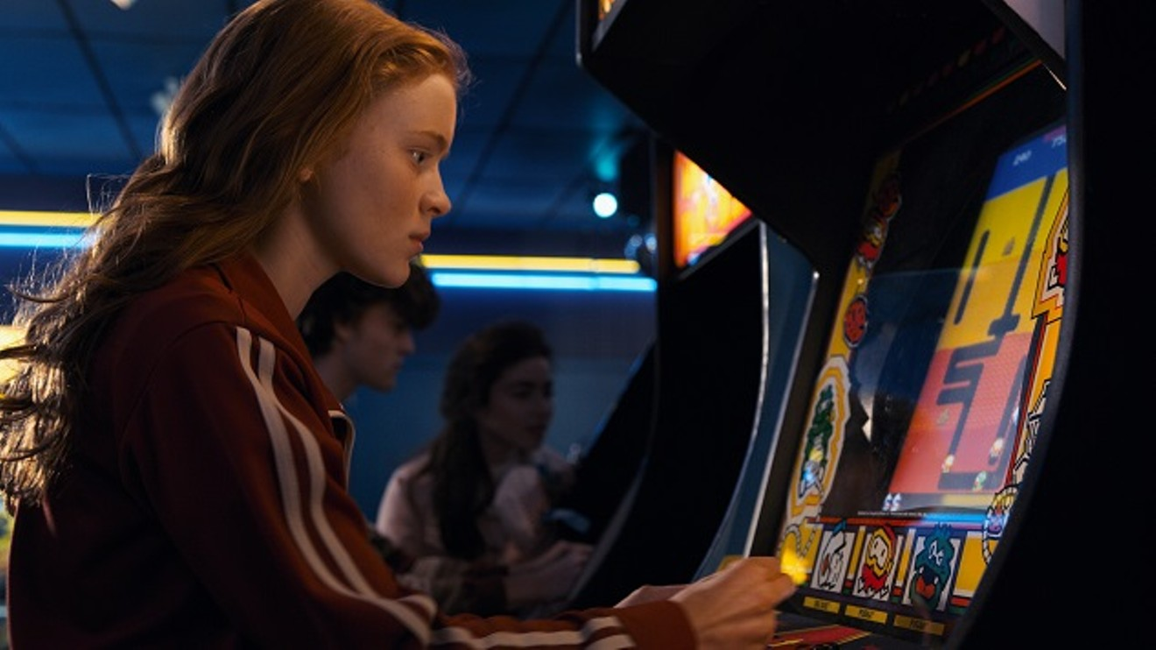

WEB1.0
WEB3.0
WEB2.0

Slide 3
MEDIUM
FB
IG
GitHuB

Slide 4
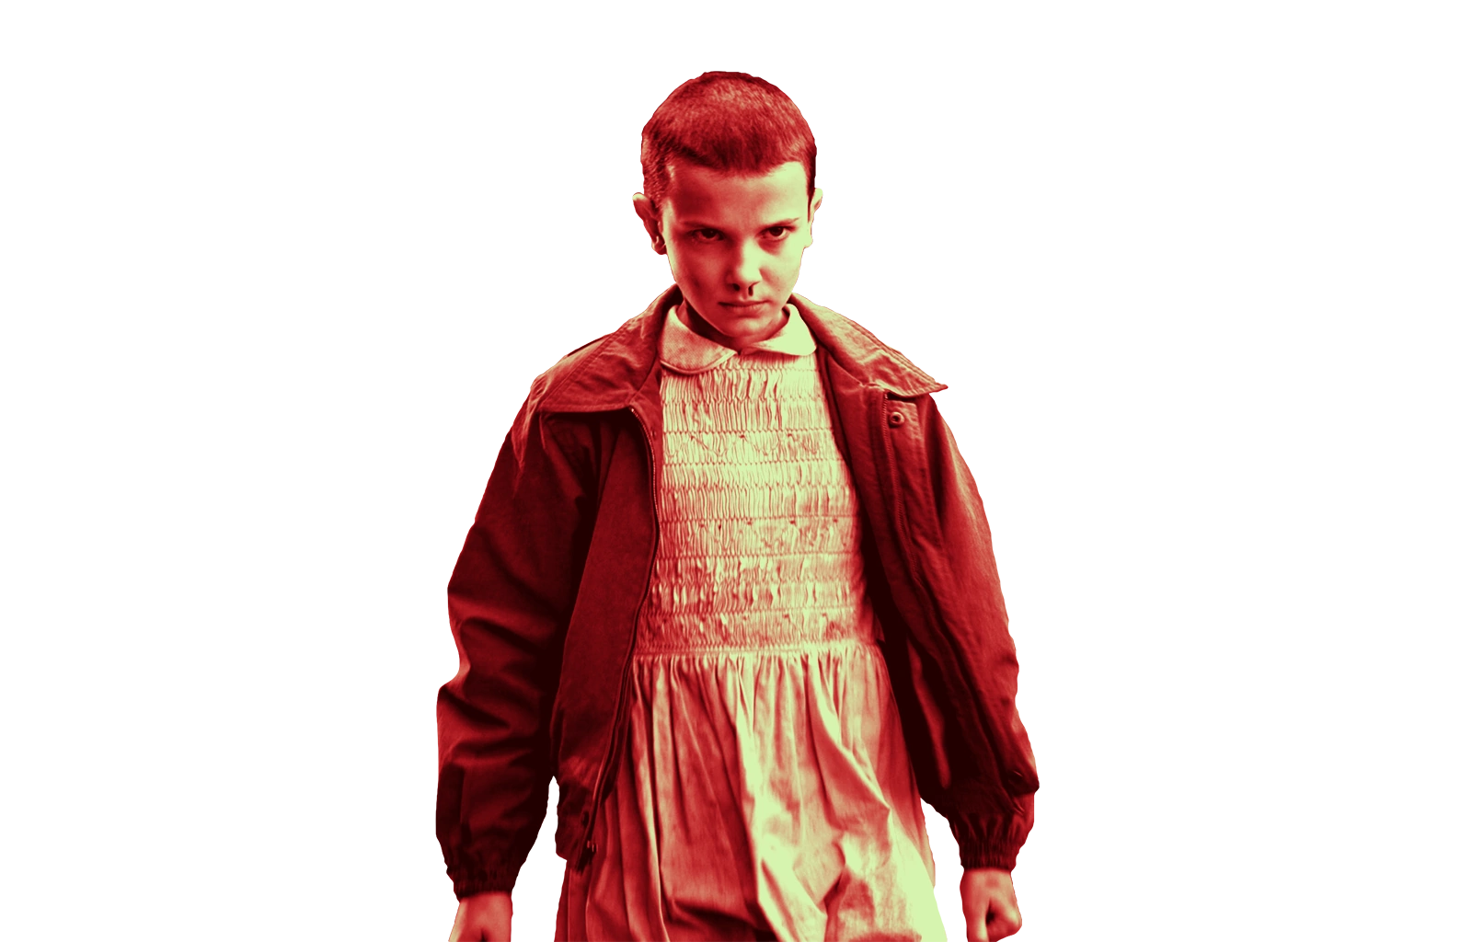
OWNER
OF THE
CONTENT
CERTIFIED
DIGITAL
IDENTITY

Slide 5
DAO
NFT
D
L
IGITA CERTIFICATES

Slide 6
HANK
T
S

