Slide 1




Kendo UI, Angular Framework and PASOE Session 2
TPUG, August 2018
Ion Pasea, Sr. Sys. Dev Manager
September 2018

Slide 2

Kendo UI, Angular Framework and PASOE Session 1, August 2018

Slide 3
Kendo UI, Angular Framework and PASOE Session 1, August 2018
HelloCustomers - Kendo UI Grid – Rest Call Example – Review
OpenEdge Explorer Tool
PDSOE Servers – Add the View
PDSOE Servers – Add the Server
PDSOE Servers – Start/Stop Server
PDSOE Building the Rest Application
Q&A

Slide 4
HelloCustomers - Kendo UI Grid – Rest Call Example - Review
Recap Angular
Recap Kendo UI
Run HelloCustomers

Slide 5
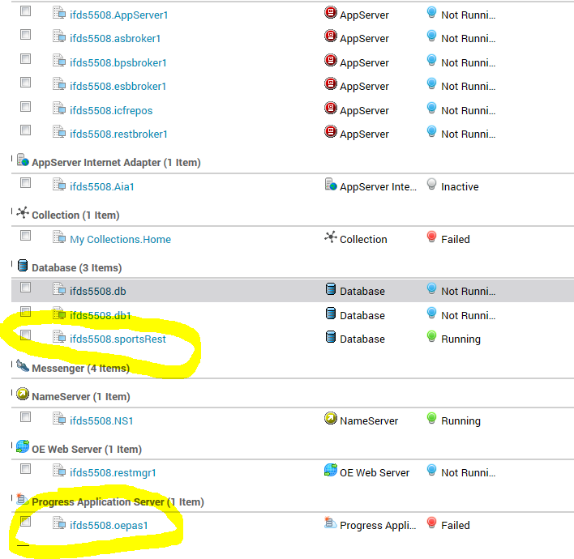
OpenEdge Explorer Tool

Slide 6
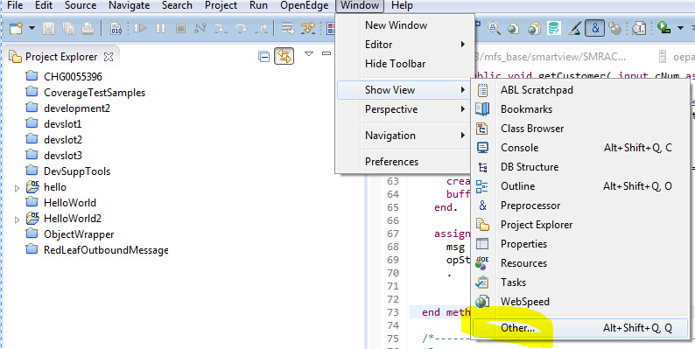
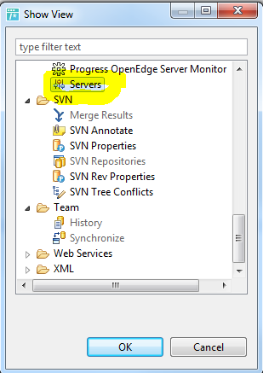
PDSOE Servers – Add the View

Slide 7
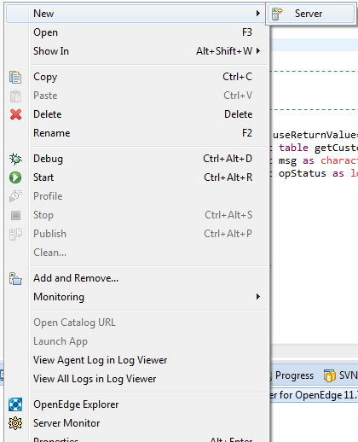
PDSOE Servers – Add the Server

Slide 8
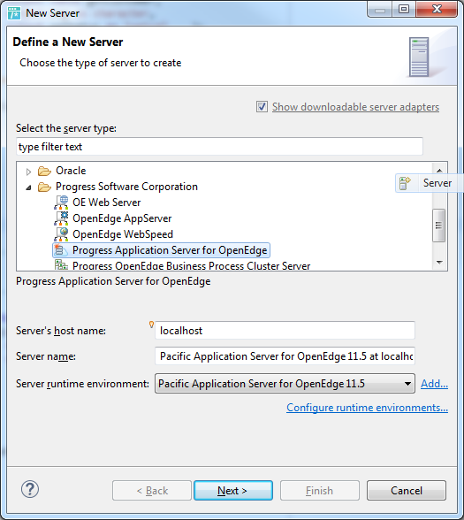
PDSOE Servers View – Add the Server

Slide 9
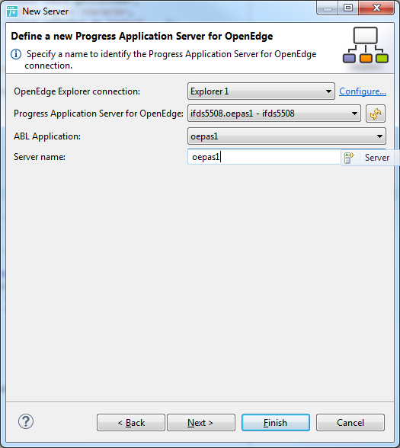
PDSOE Servers View – Add the Server

Slide 10
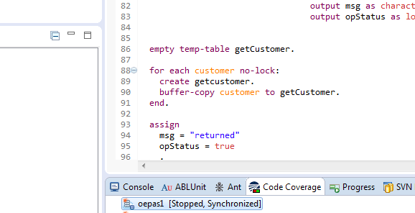
PDSOE Servers View – Add the Server

Slide 11
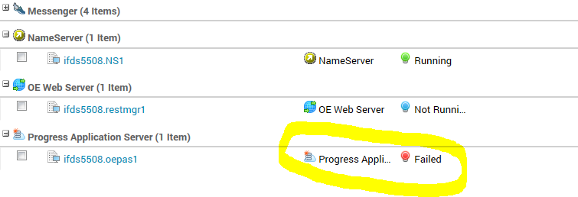
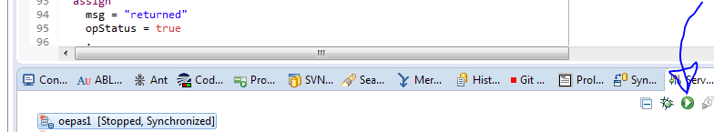
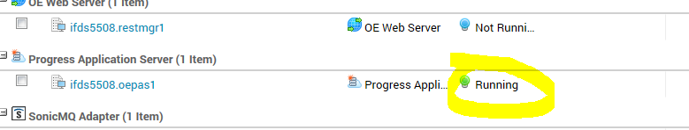
PDSOE Servers View – Add the Server

Slide 12
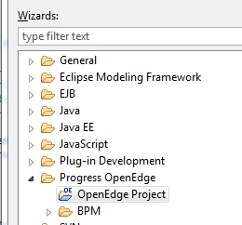
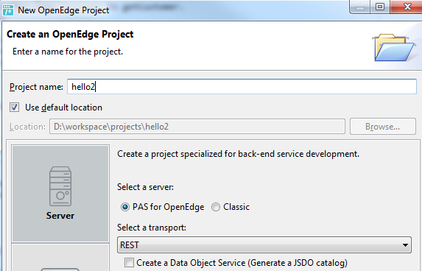
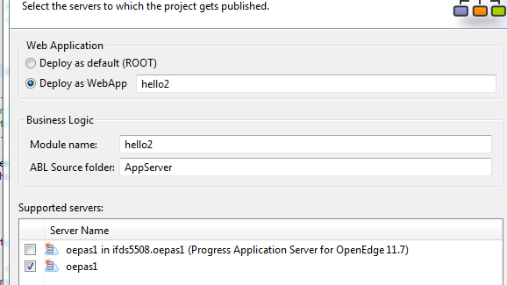
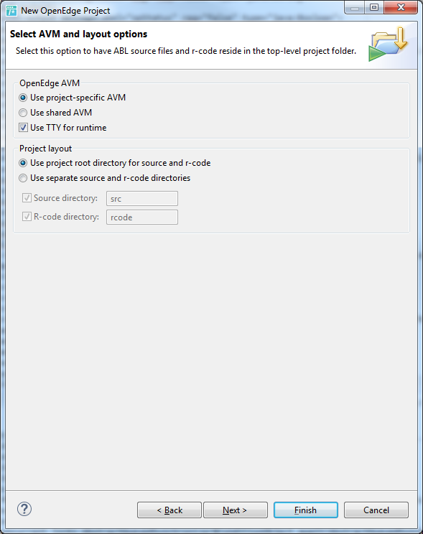
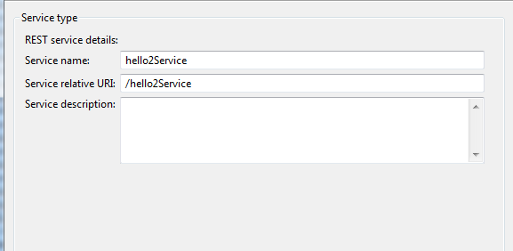
PDSOE Building the Rest Application

Slide 13
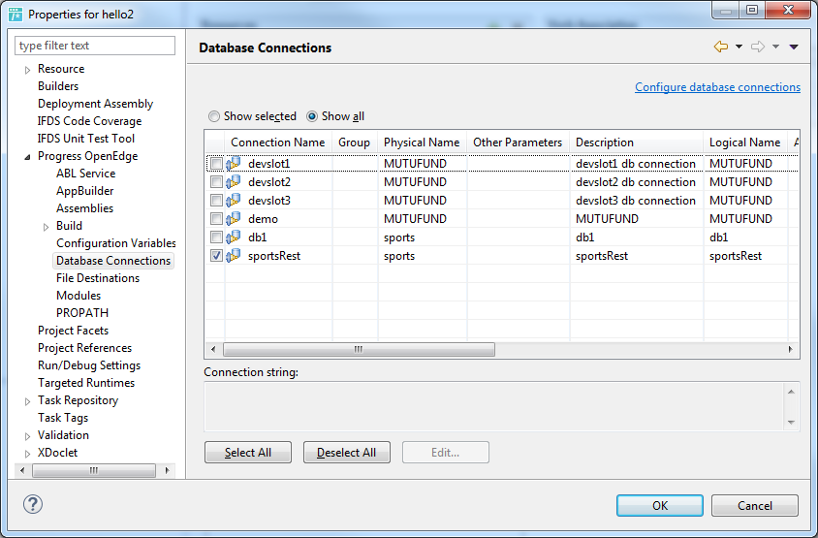
PDSOE – Database Connection

Slide 14
PDSOE – Database Connection

Slide 15
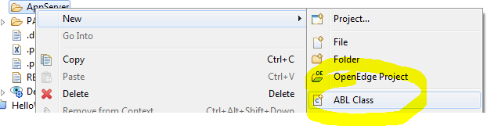
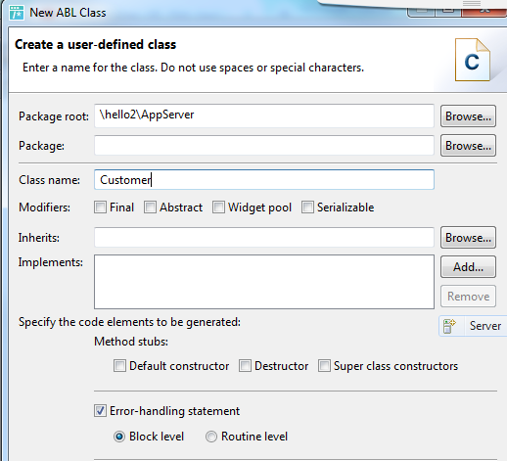
PDSOE – The Code

Slide 16
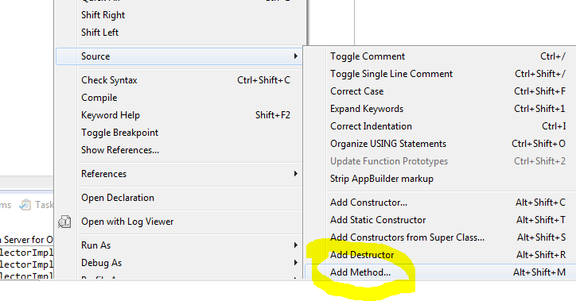
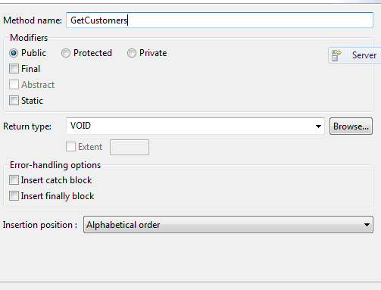
PDSOE – The Code

Slide 17
PDSOE – The Code
define temp-table getCustomer like Customer.
……
method public void GetCustomers(output table getCustomer,
output msg as character,
output opStatus as logical ):
……
empty temp-table getCustomer.
for each customer no-lock:
create getcustomer.
buffer-copy customer to getCustomer.
end.
assign
msg = "returned"
opStatus = true
.

Slide 18
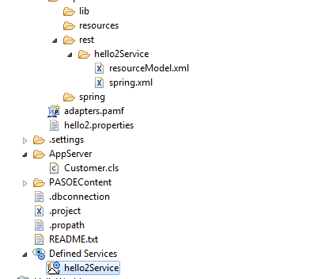
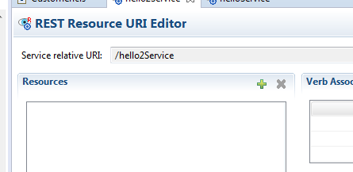
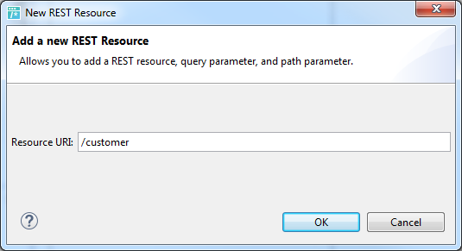
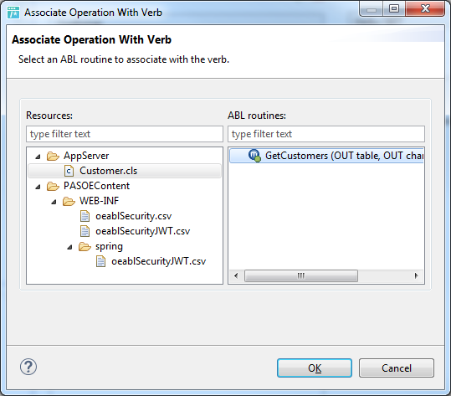
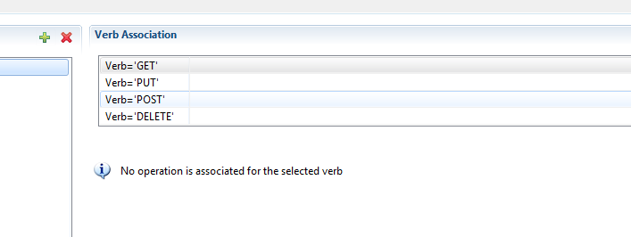
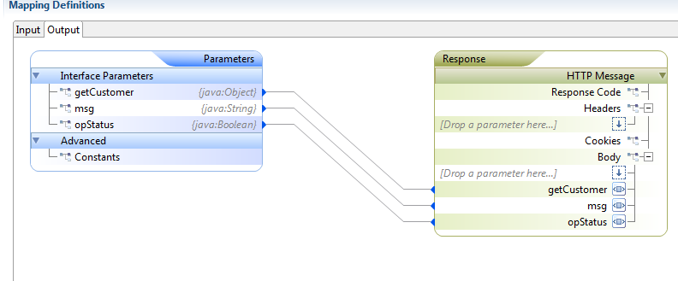
PDSOE – The Service Setup

Slide 19

Q & A

