Slide 1
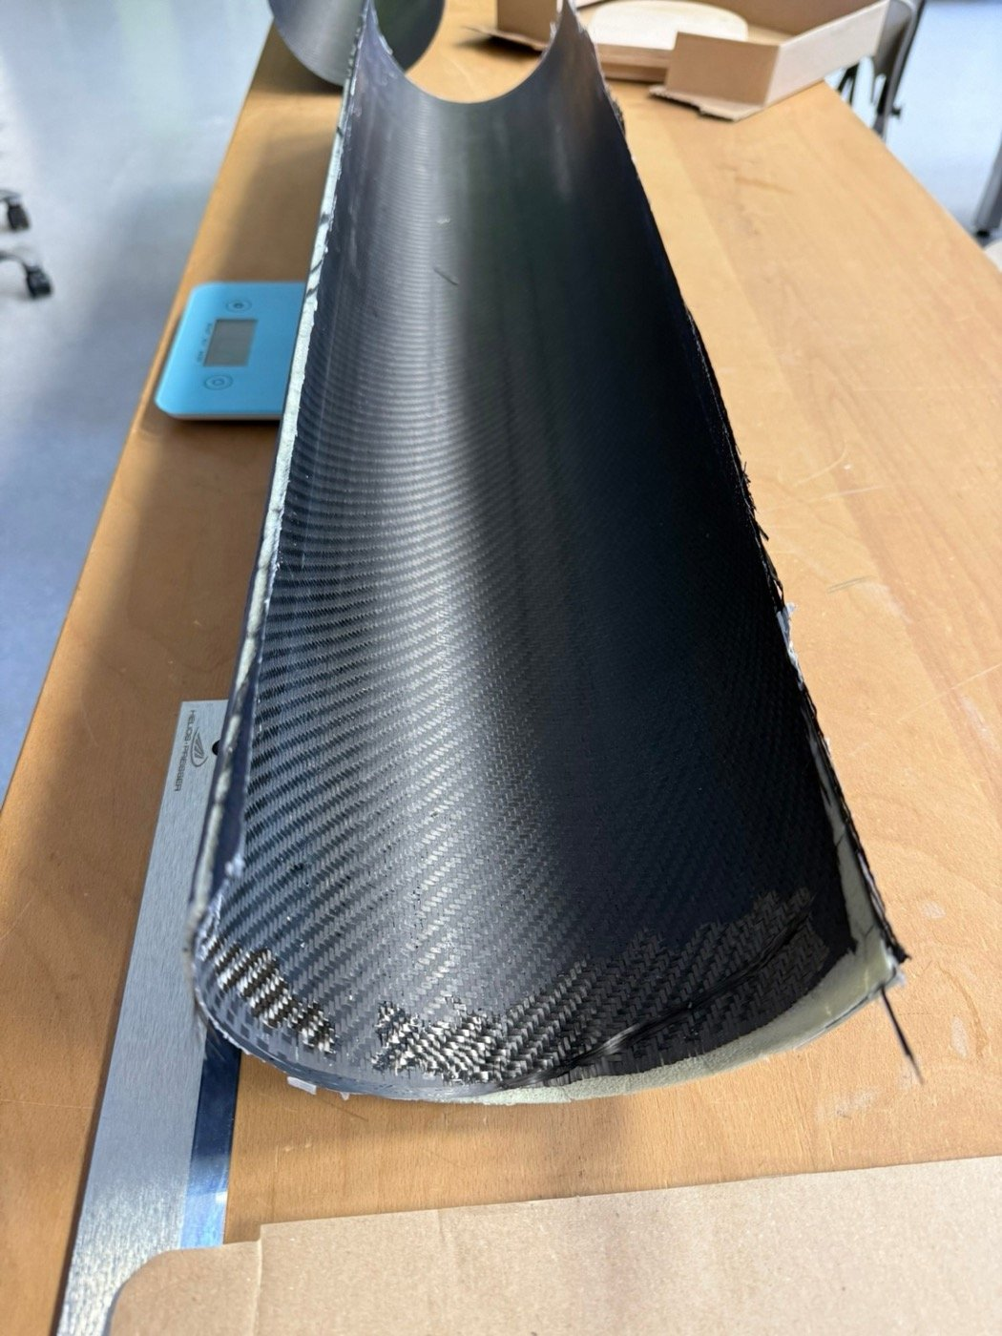
ERASMUS WORKSHOP · 18 NOVEMBER 2026
Building a
carbon rotor blade
Sandwich construction with vacuum infusion
Windmobile · LTEtt
Notes:
Welcome. Today every group builds one half-pipe shell from carbon fibre. Several shells become the blades of a wind turbine on one bicycle rim.

Slide 2
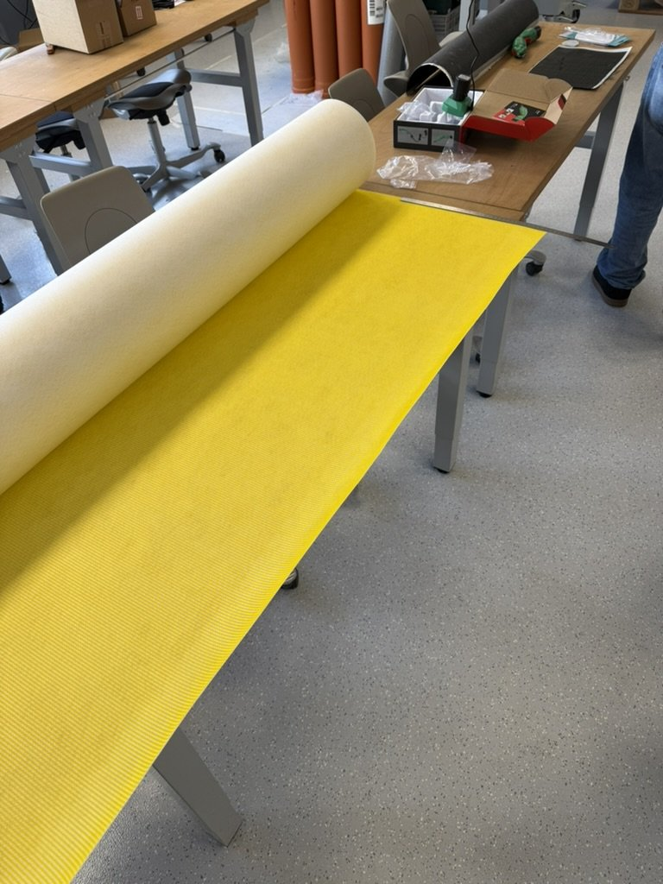
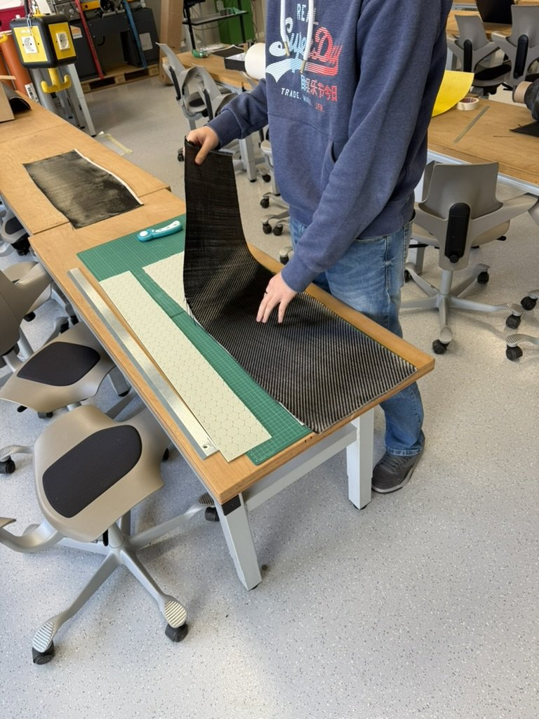
Five layers on a pipe
5
Vacuum bag (tube film)
width 86 cm
Everything slides inside; air pressure presses it together.
4
Peel ply + flow mesh
87 × 32 cm
Spreads the resin. Peeled off after curing.
3
Carbon
85 × 30 cm
Second structural layer.
2
Core: 3DCore PET 100, 3 mm
85 × 30 cm
Peel ply (light) and flow mesh (yellow) from the roll
Second carbon layer goes onto the core
Foam with honeycomb pattern: stiff, light, lets the resin flow.
1
Carbon
85 × 30 cm
Structural layer. Visible side on the outside.
Notes:
Layer 1 is the outside of the blade. Peel ply and flow mesh come as one material from the roll, so we count them as one layer.

Slide 3
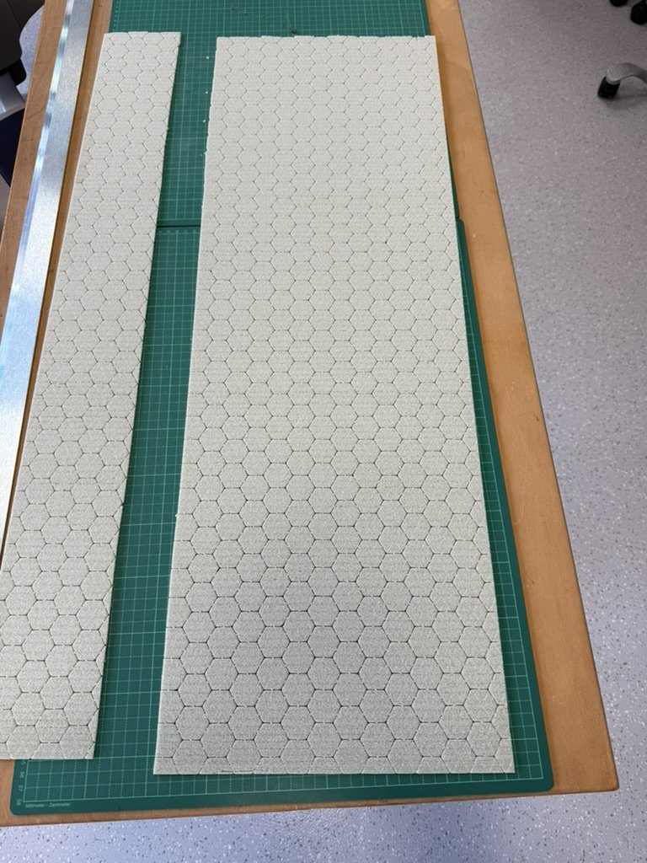
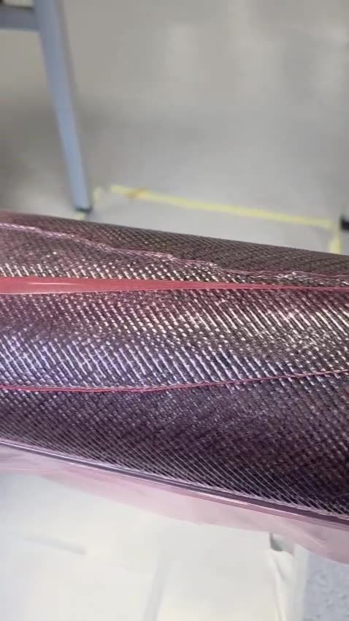
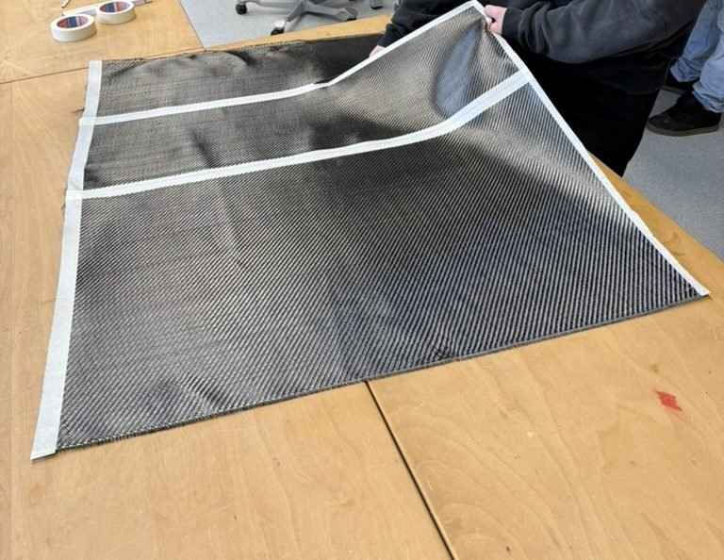
From dry fibres to blade
1
Cut
2
Lay up
3
Bag + vacuum
4
Infuse
5
Cure
Slide into the vacuum bag, attach and seal the hoses, pull the vacuum
Infrared lamp speeds it up. Ready in the evening or the next day
Tape the carbon, then cut carbon, core, peel ply + flow mesh
Carbon, core (spray adhesive), carbon, peel ply + flow mesh on the pipe
Mix 3 × (200 g resin + 60 g hardener), open the resin hose, watch the flow front
Notes:
Safety first: nitrile gloves, safety glasses, apron, good ventilation. Resin is mixed in three small portions of 200 g resin and 60 g hardener, ratio 100 to 30.

Slide 4
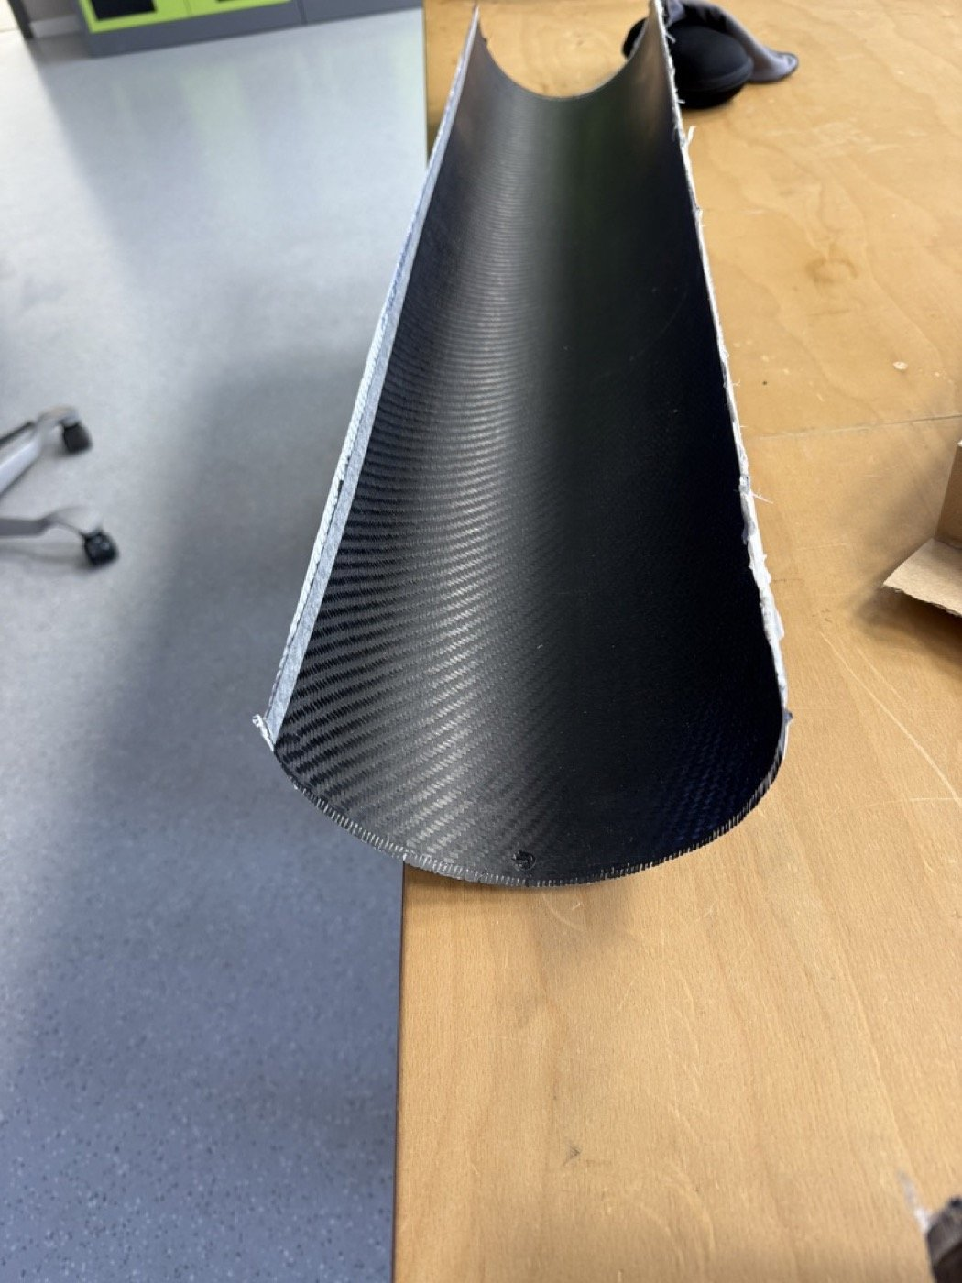
Our two trial runs
TRIAL A
TRIAL B · workshop
404 g
634 g
finished blade
finished blade
Core: Lantor Soric SF
Resin + hardener: 400 g + 120 g
2 carbon layers
Core: 3DCore PET 100, 3 mm
Resin + hardener: 600 g + 180 g
2 carbon layers
We build variant B: it is the only core material we have. Weigh your blade and compare.
Notes:
Blade B is 230 g heavier than blade A. Ask the group: why? Different core, more resin taken up, a larger blade.

