Slide 1
ritec2500

Slide 2
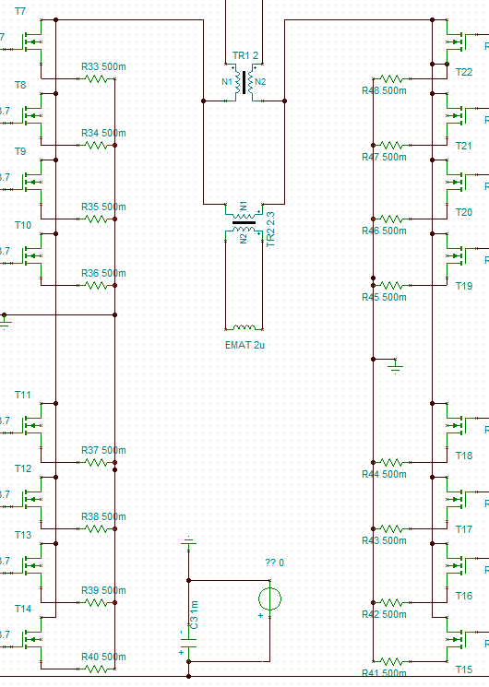
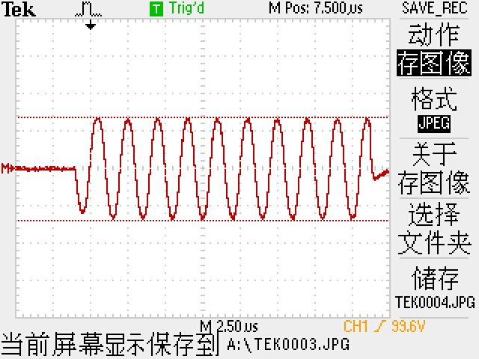
With load
U_primary = 96V
U_secondary = 440V
I1
I2

Slide 3
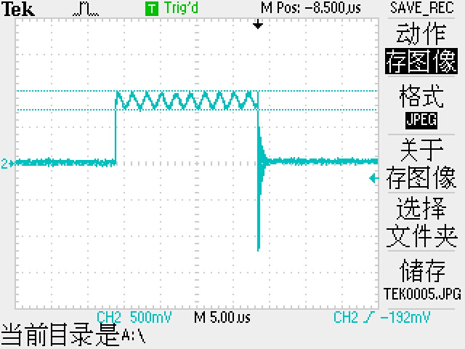
AC: 260mv
DC: 840mv
I = 0.26A
Liw = U
Without load
U_primary = 276V
U_secondary = 520V

Slide 4
问题梳理

Slide 5
1. 电源模块

Slide 6
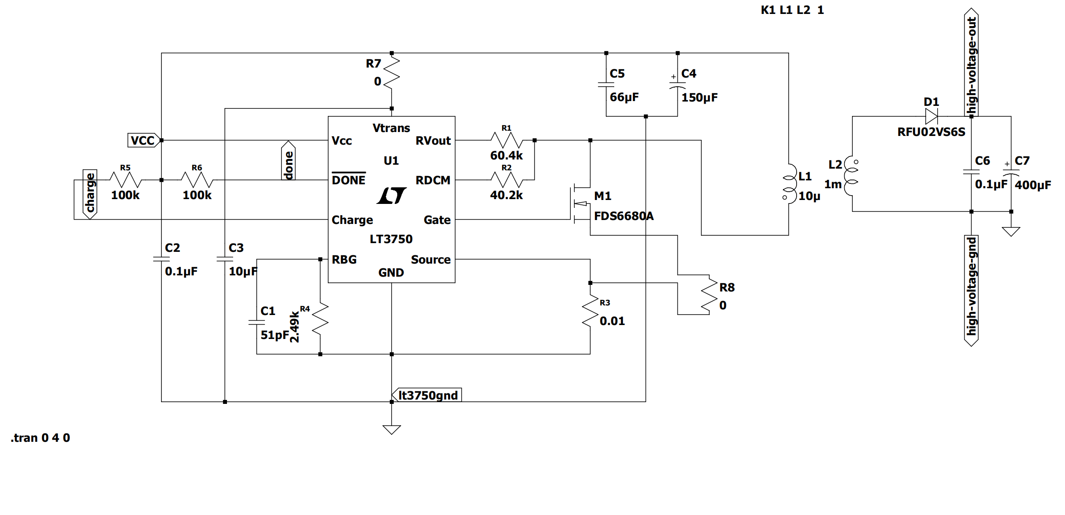

Slide 7
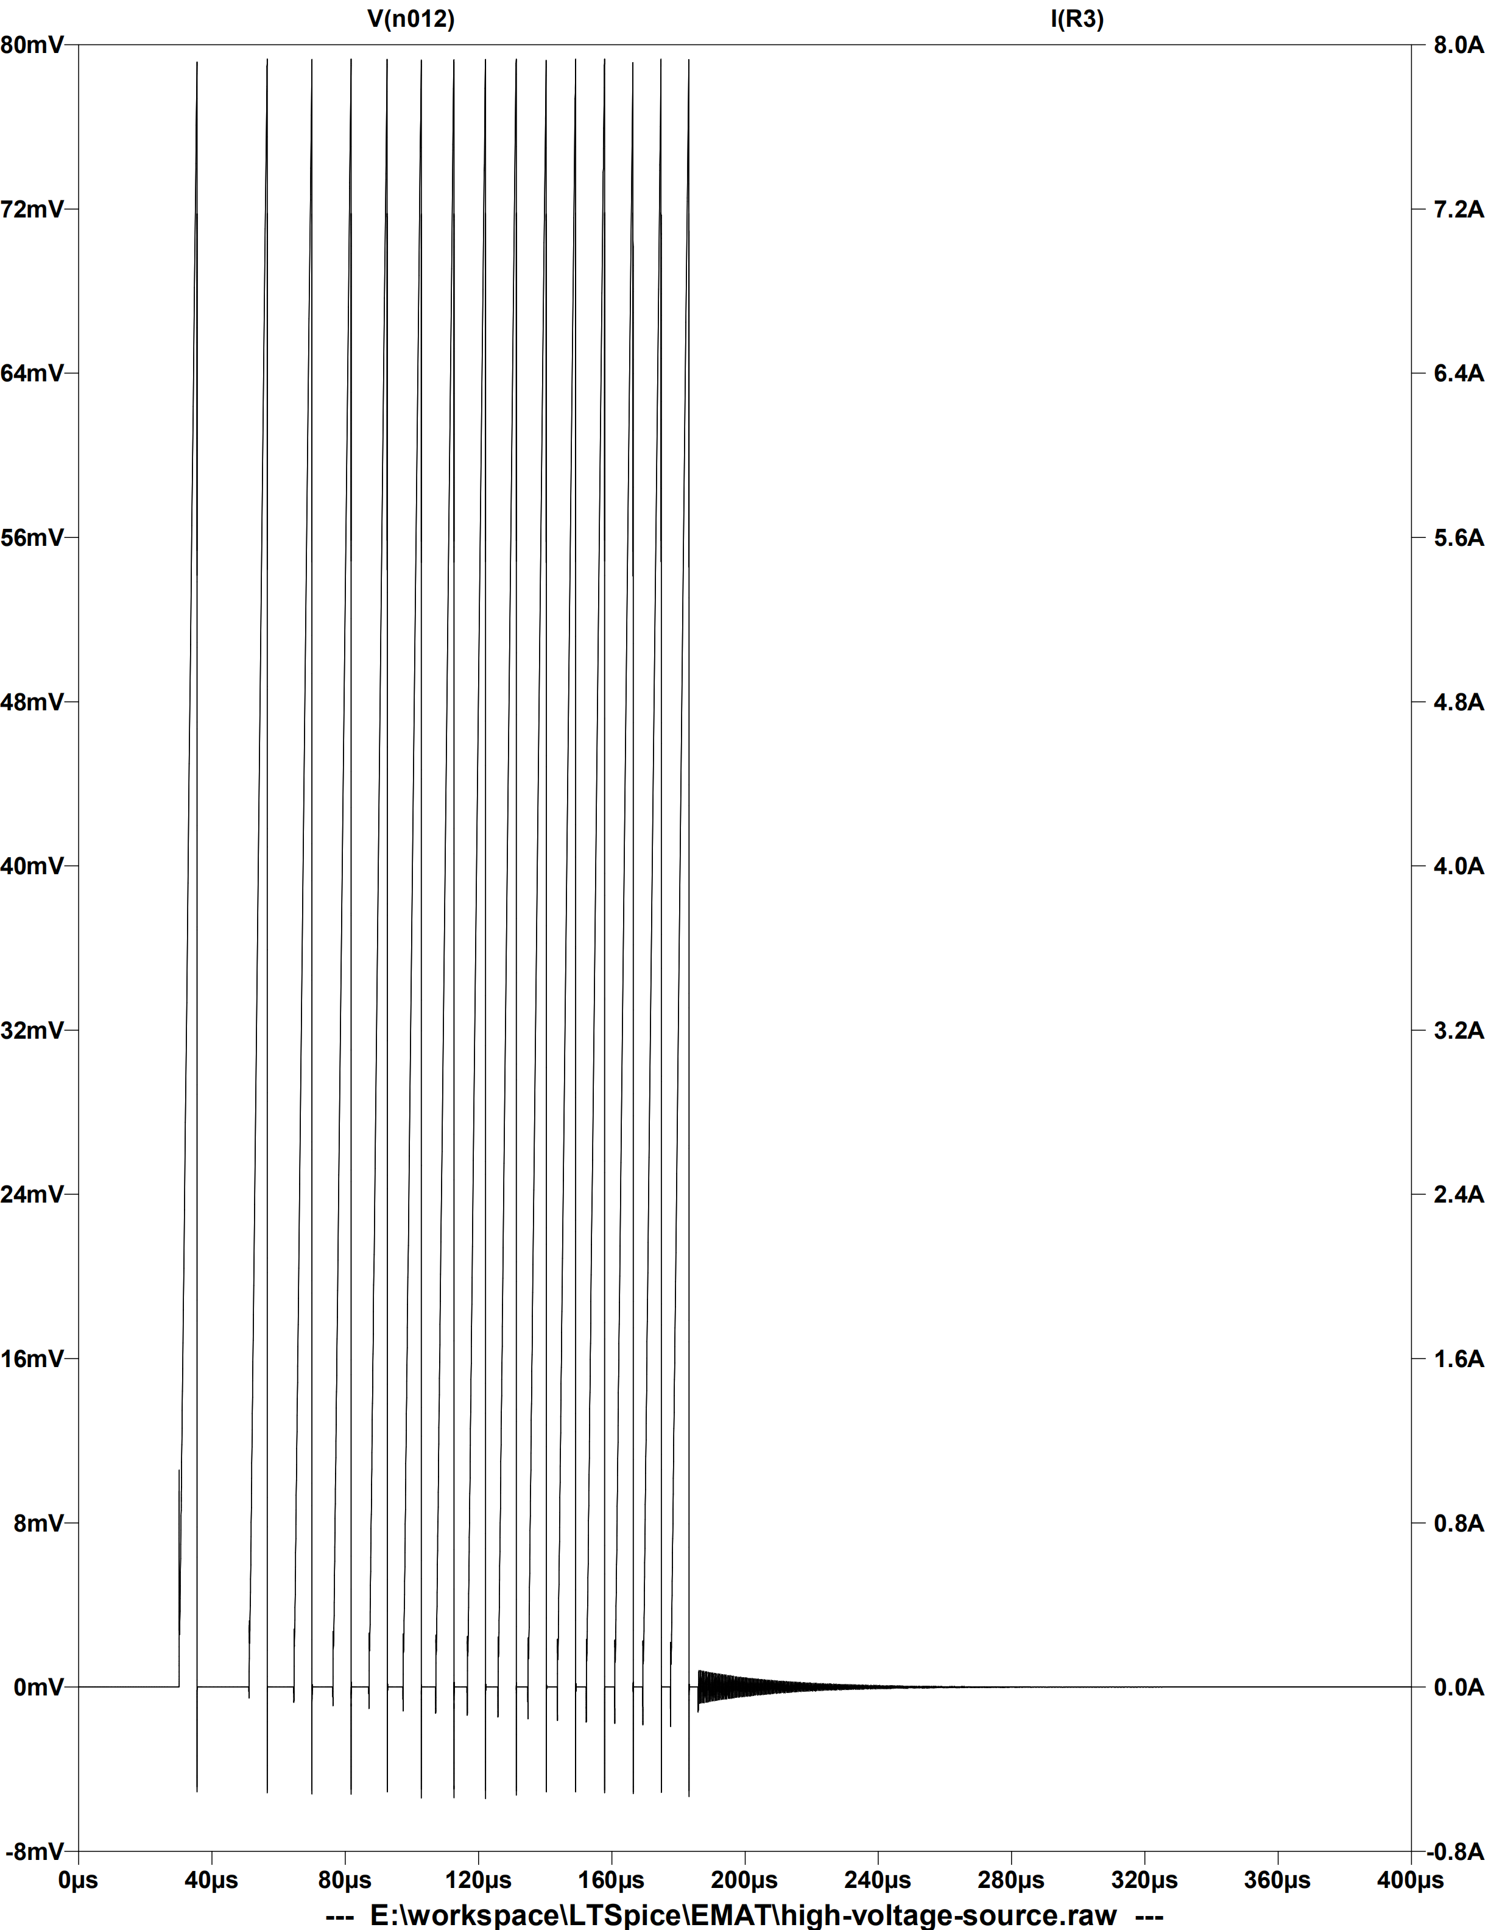
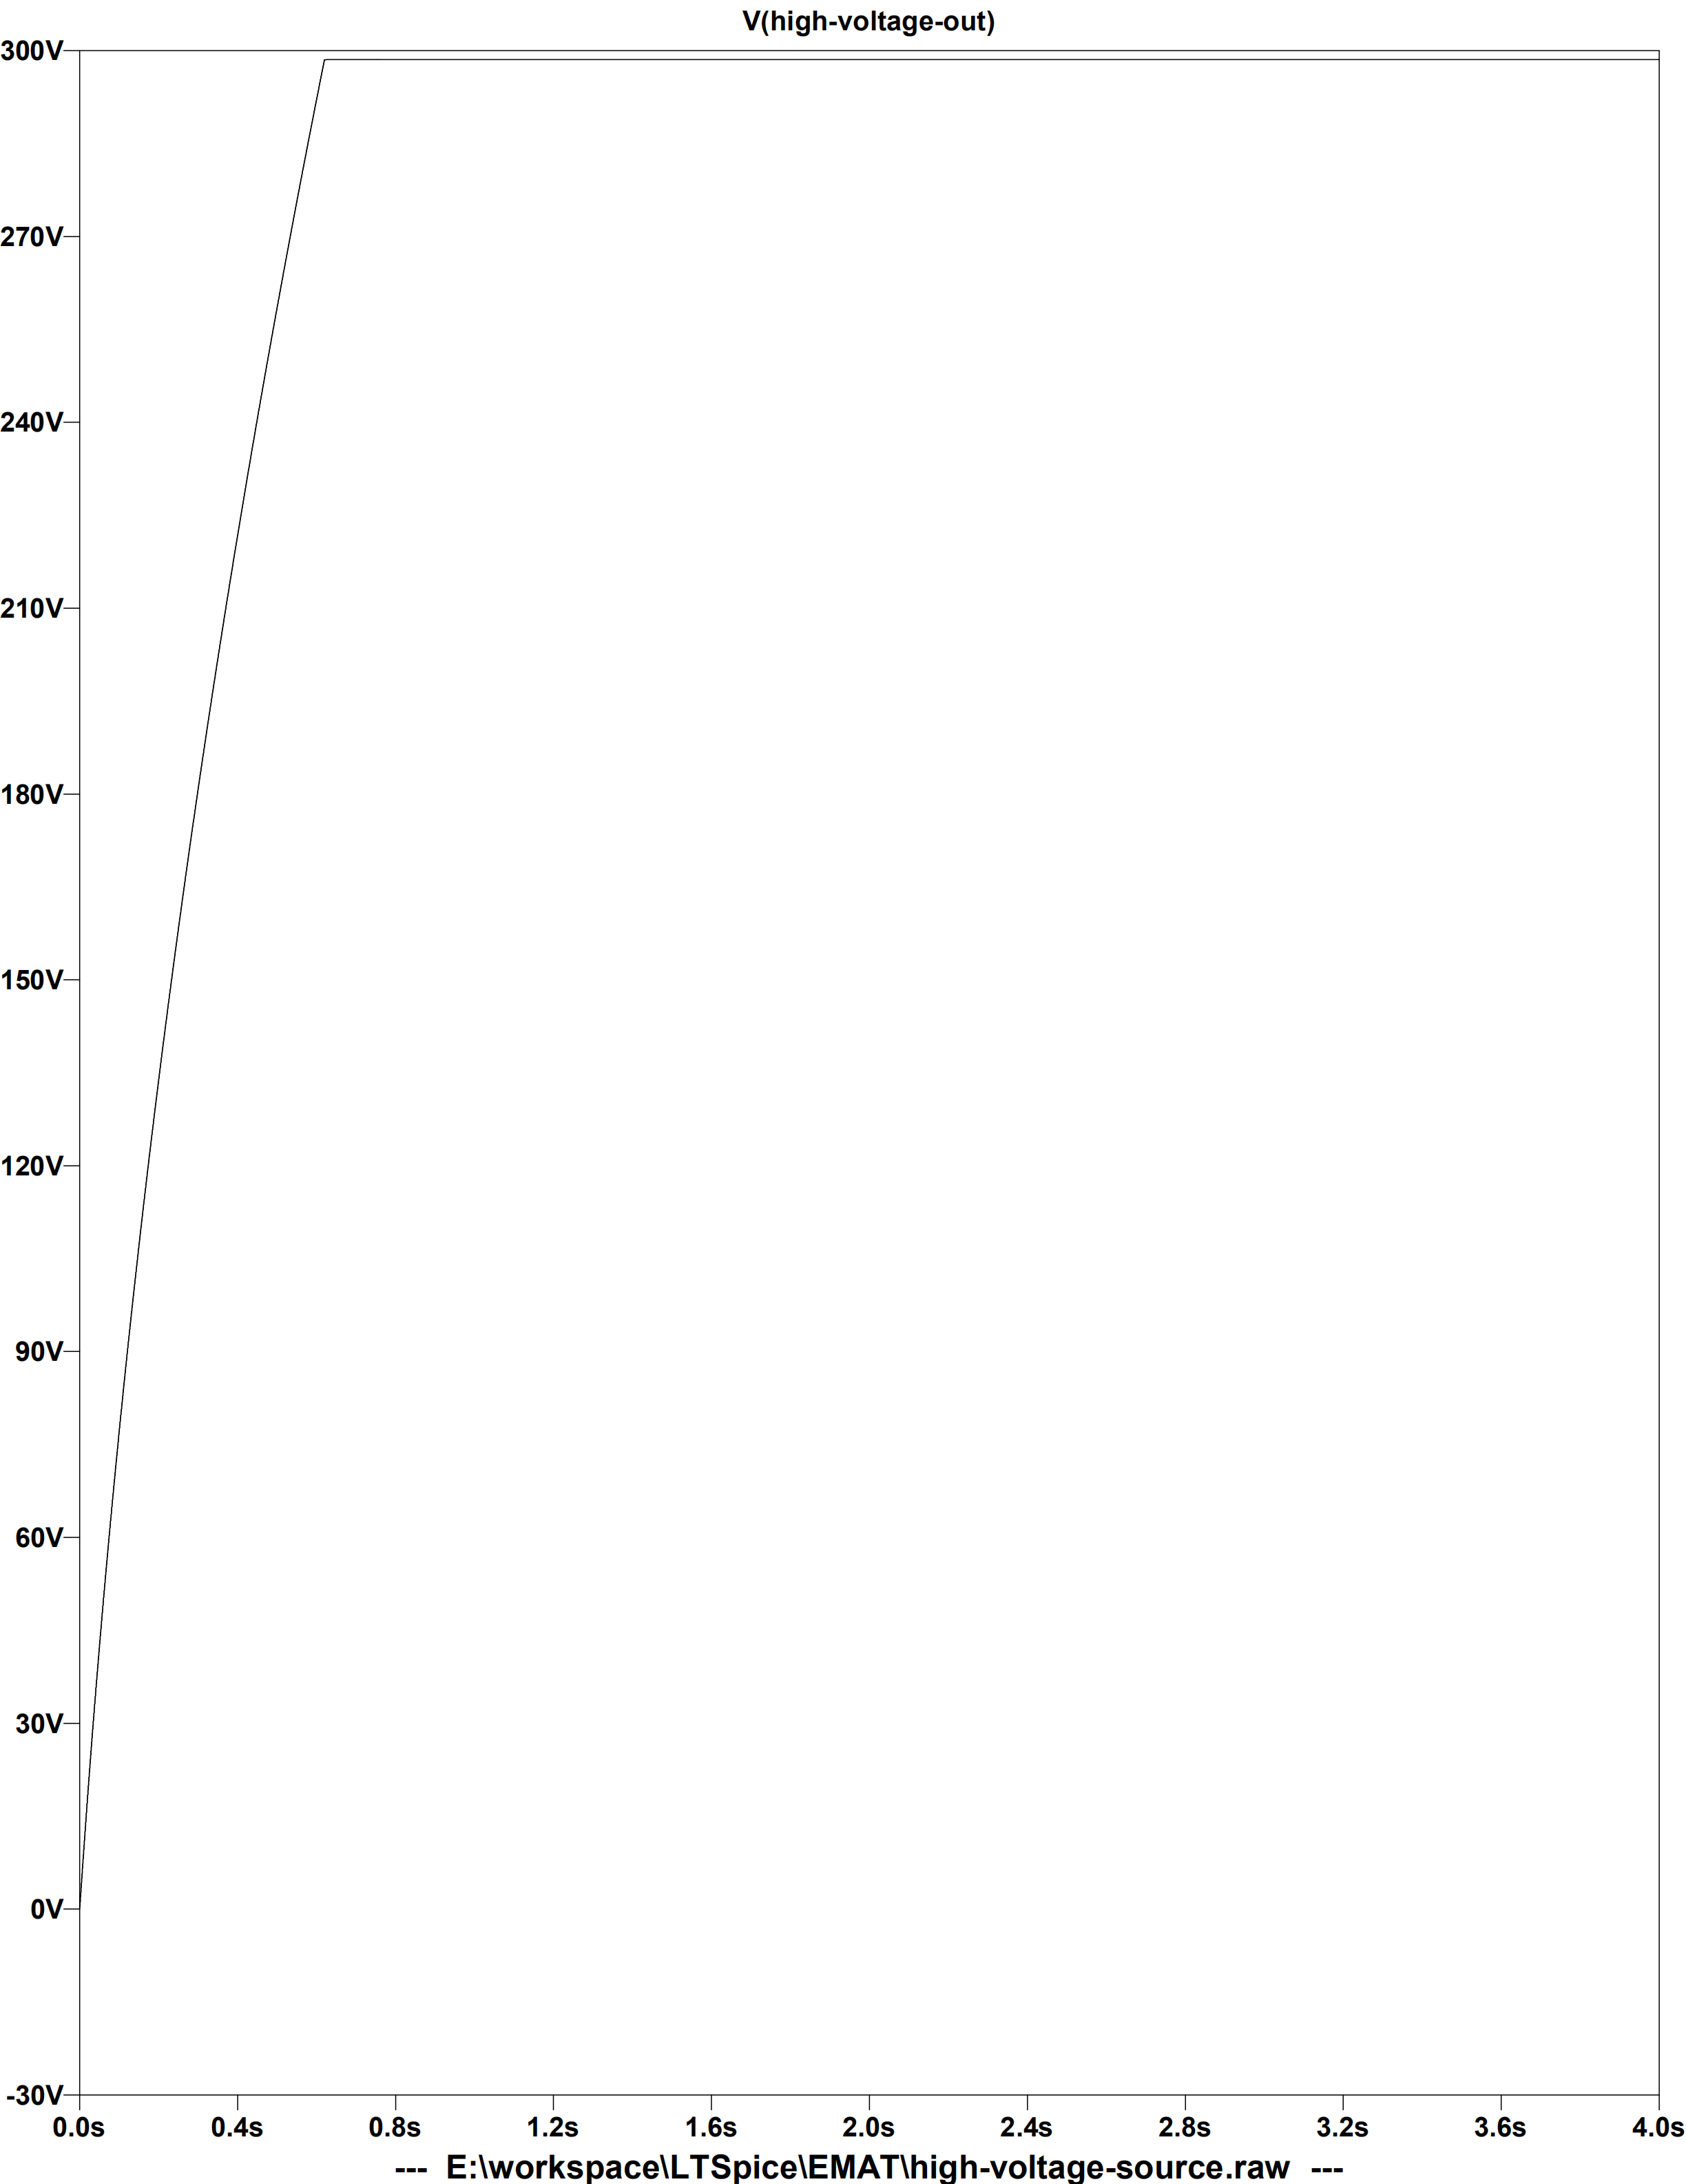
I(R3)
V(R3)
vout
Normal operation

Slide 8
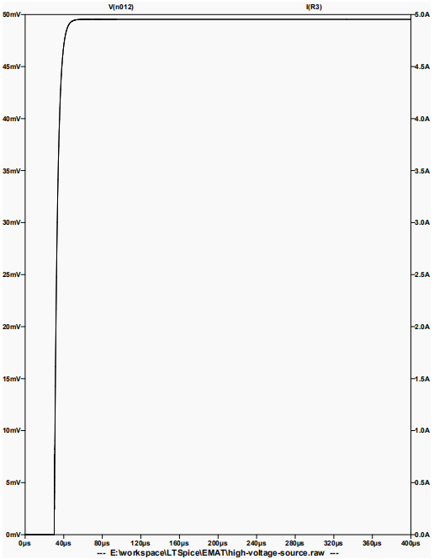
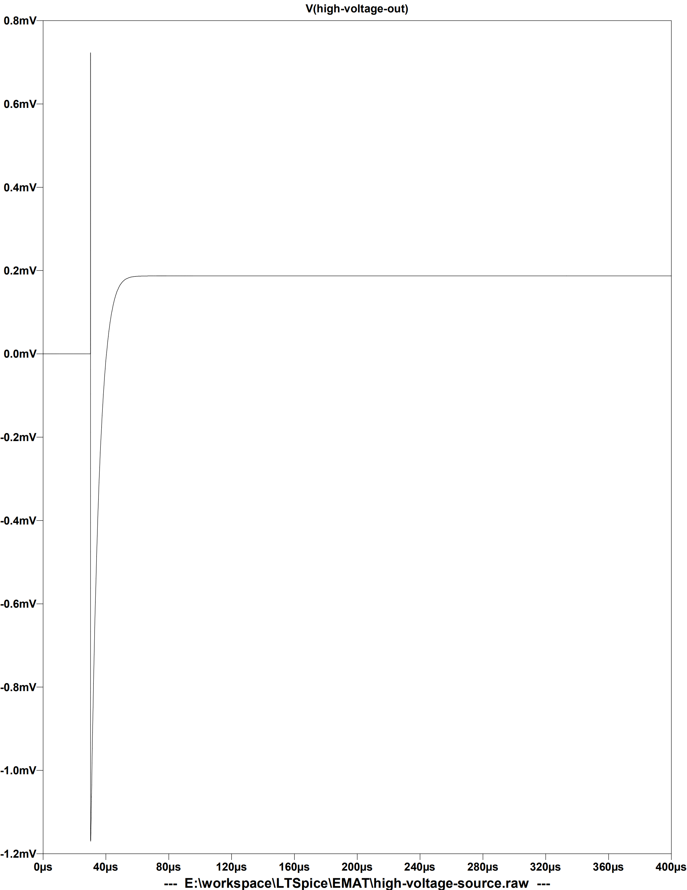
vout
I(R3)
V(R3)
Low current condition

Slide 9
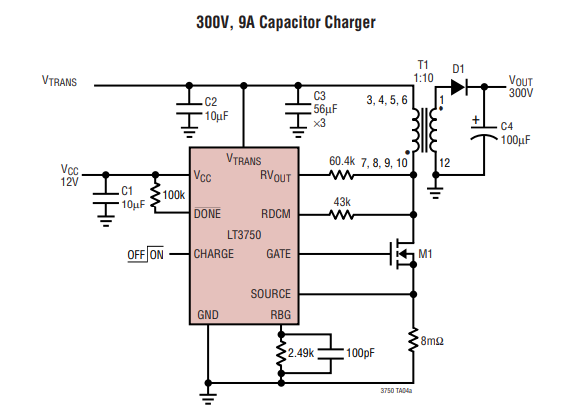
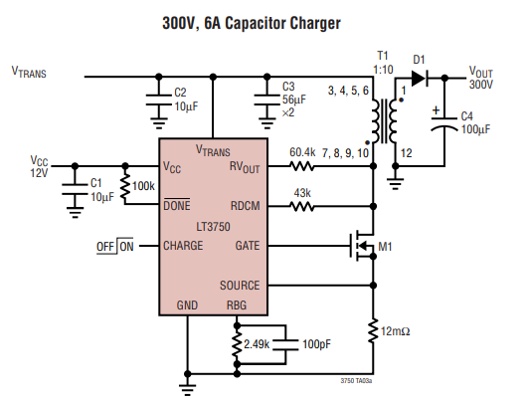
Solution:
Larger capacitor

Slide 10
2. 自举升压方案、体积与功率的问题

Slide 11
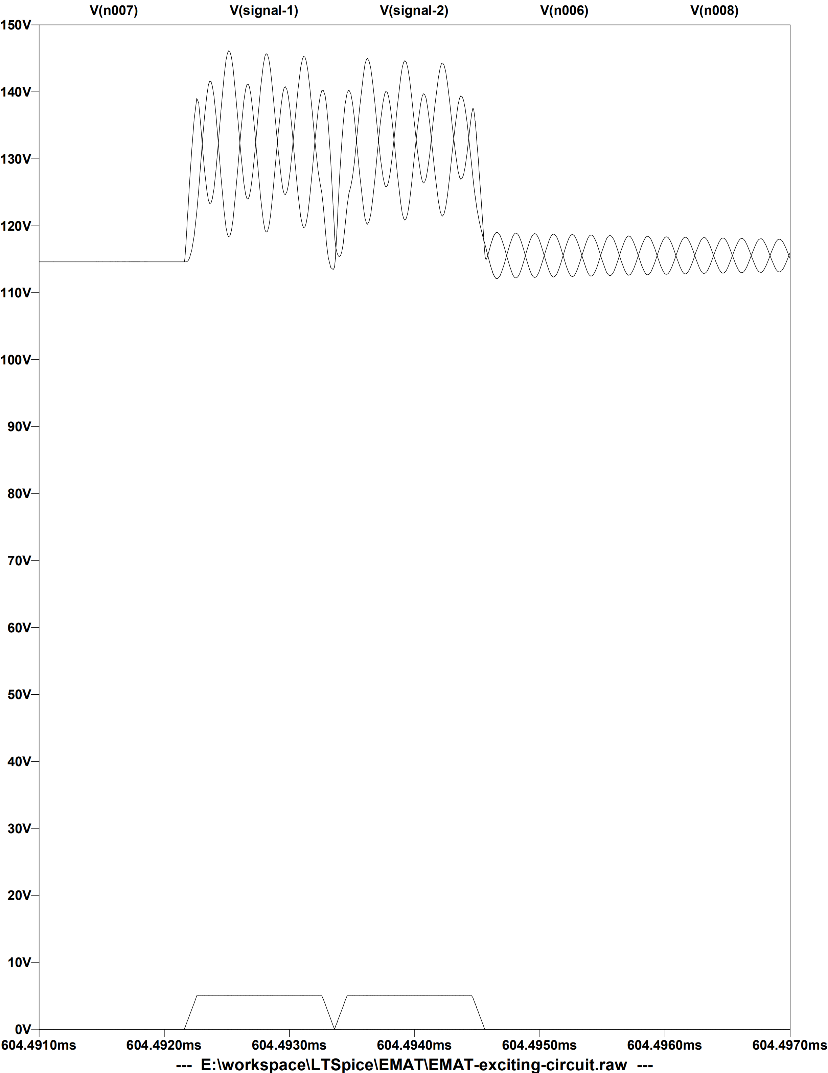
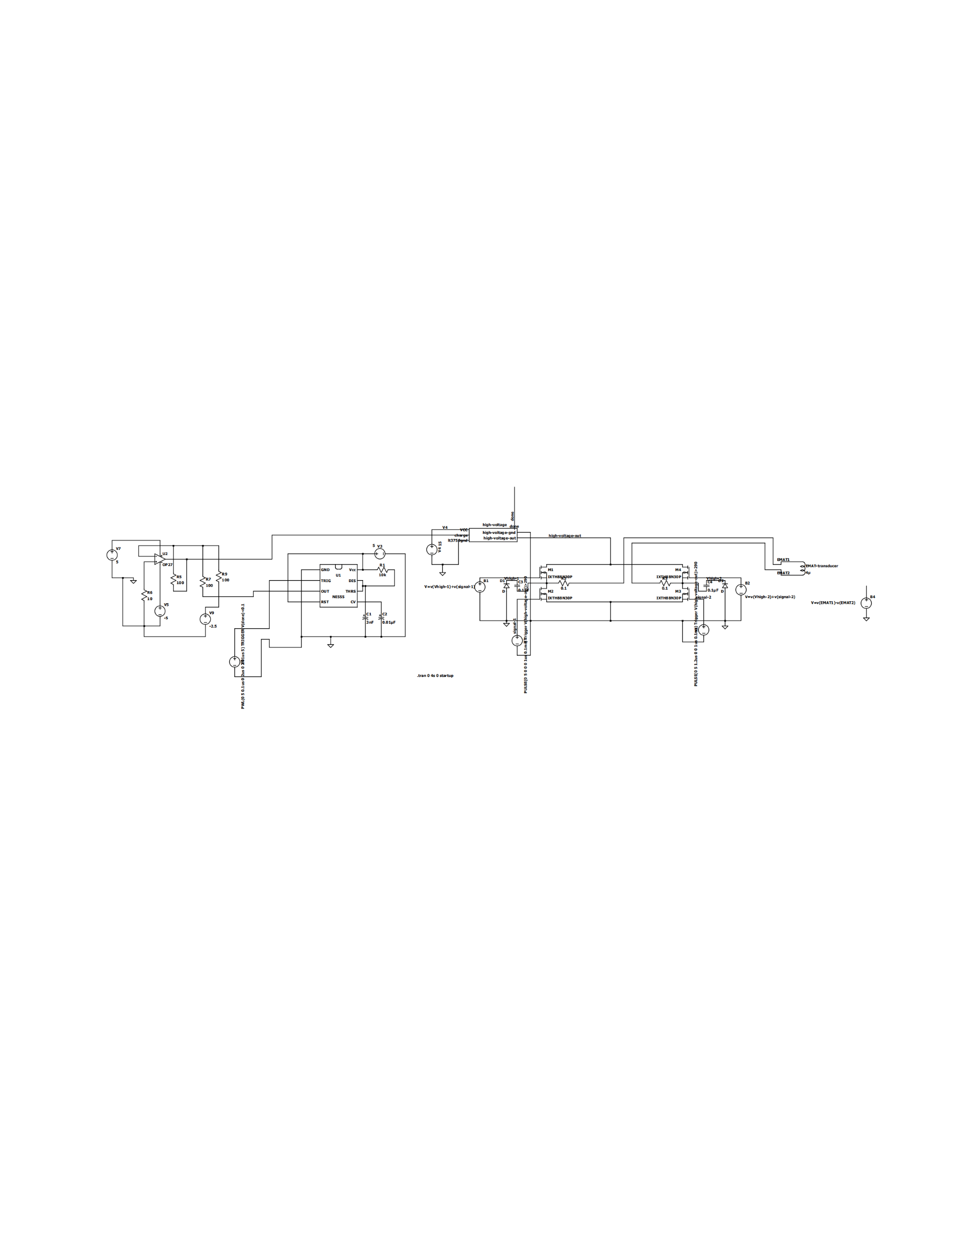
High-side drive voltage
Bootstrap
Low-side drive voltage

Slide 12
Monostable trigger
Full bridge

Slide 13
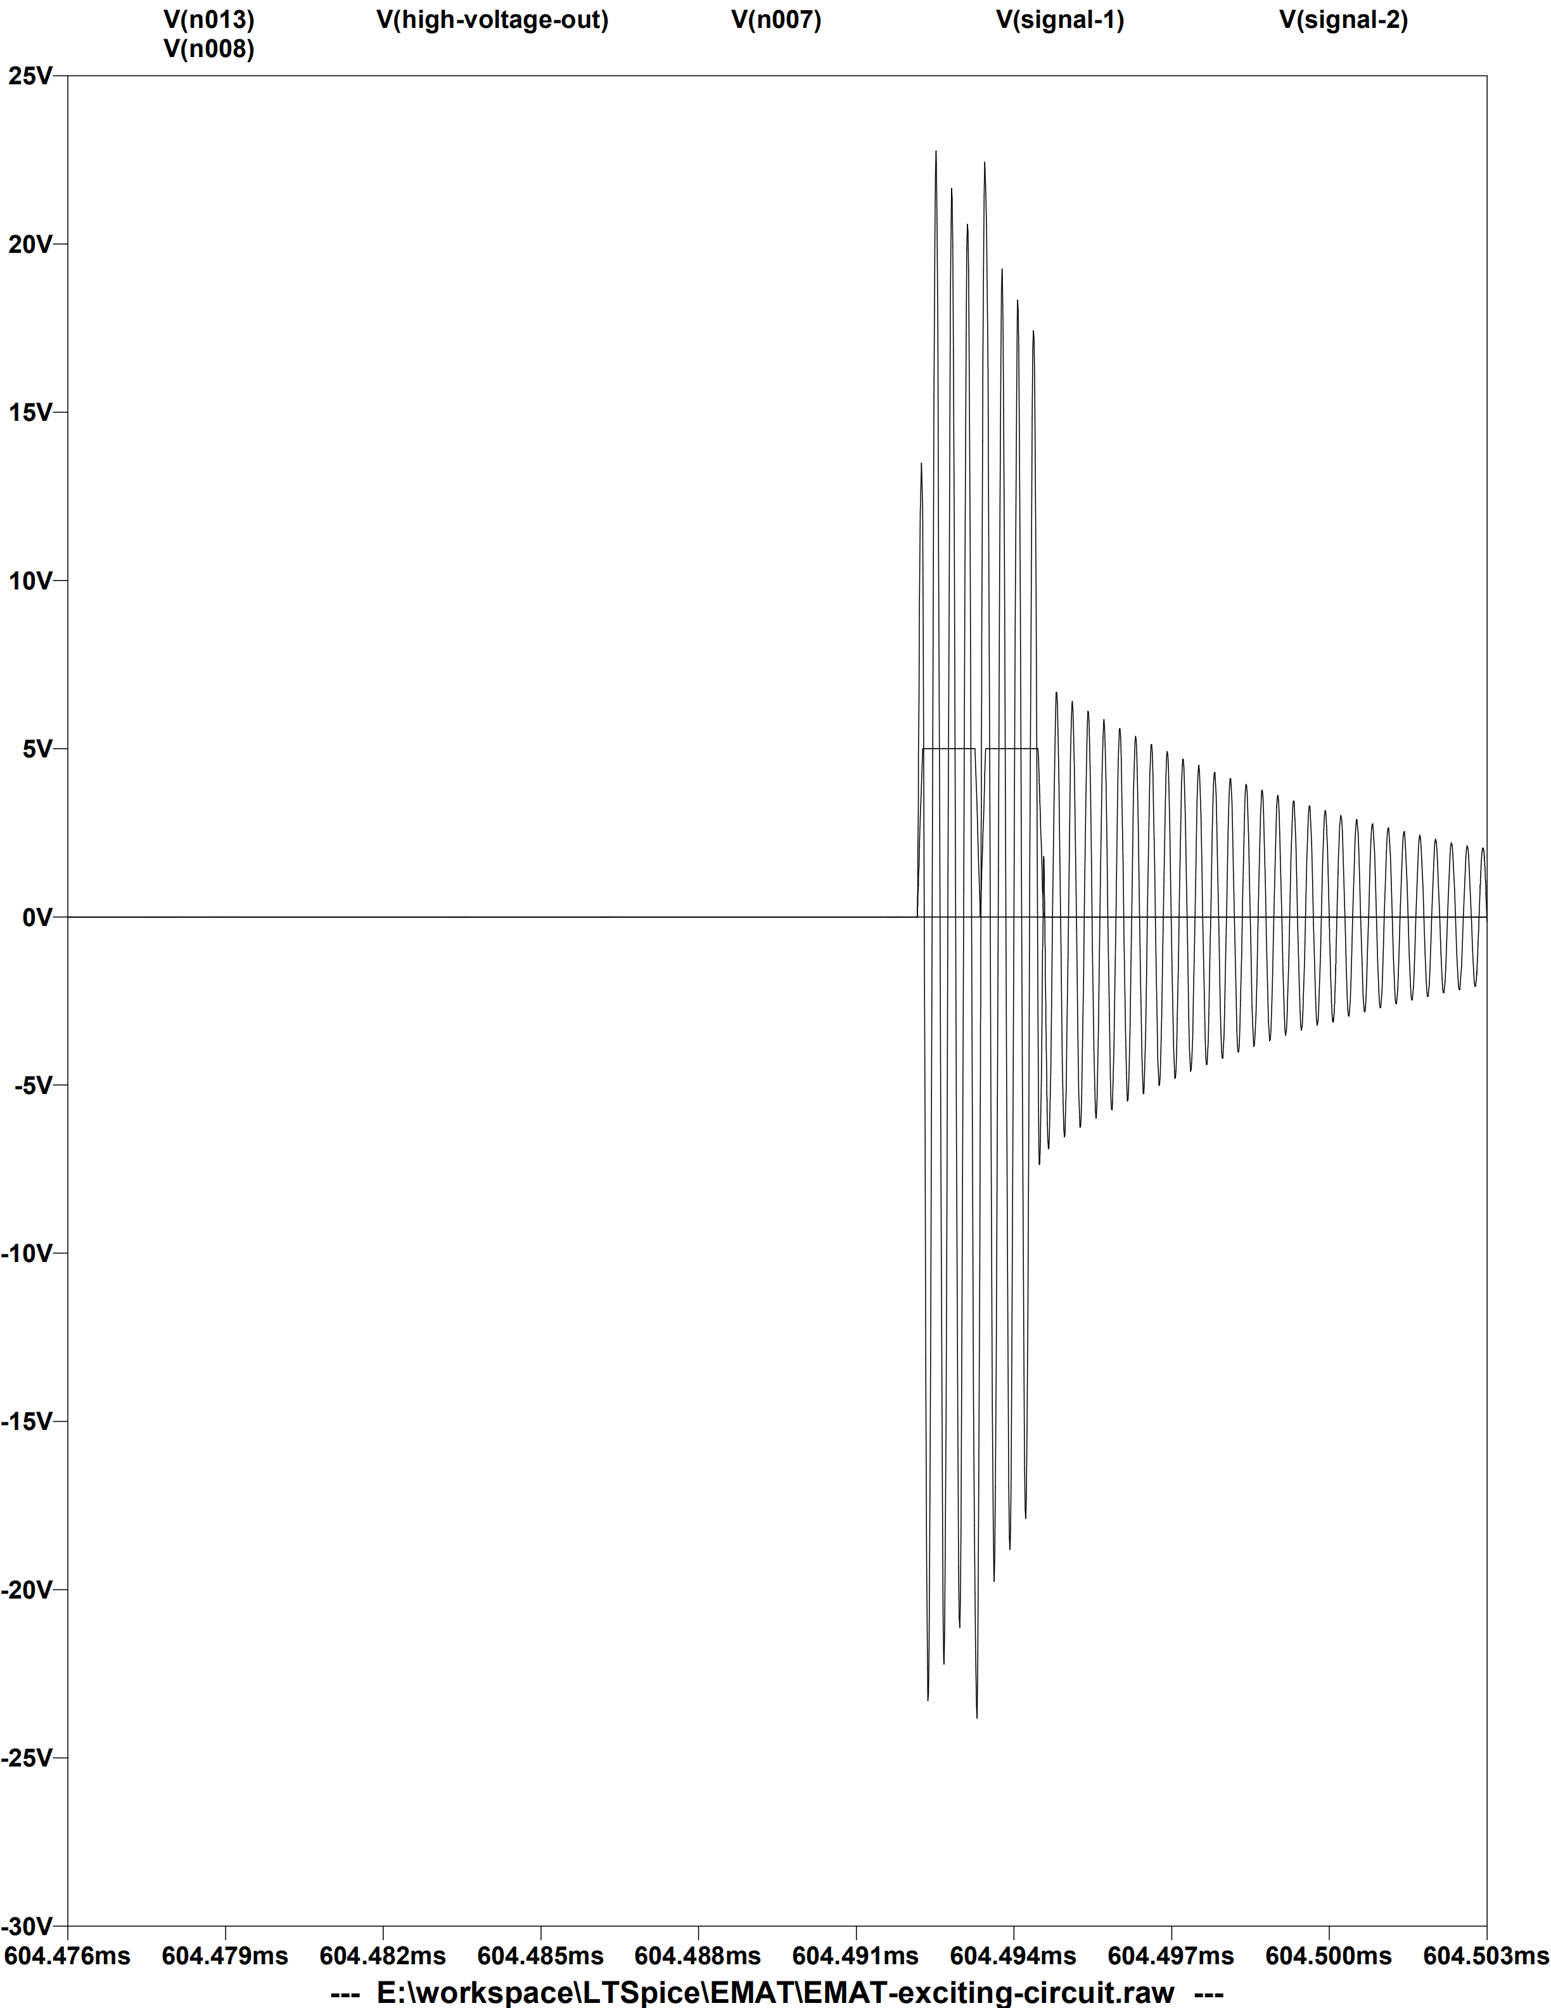
output

Slide 14
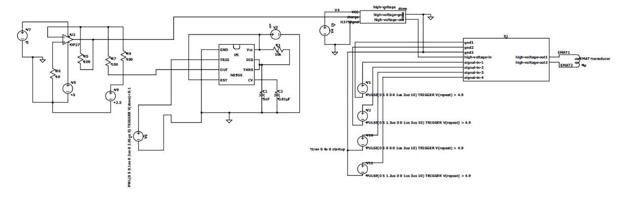
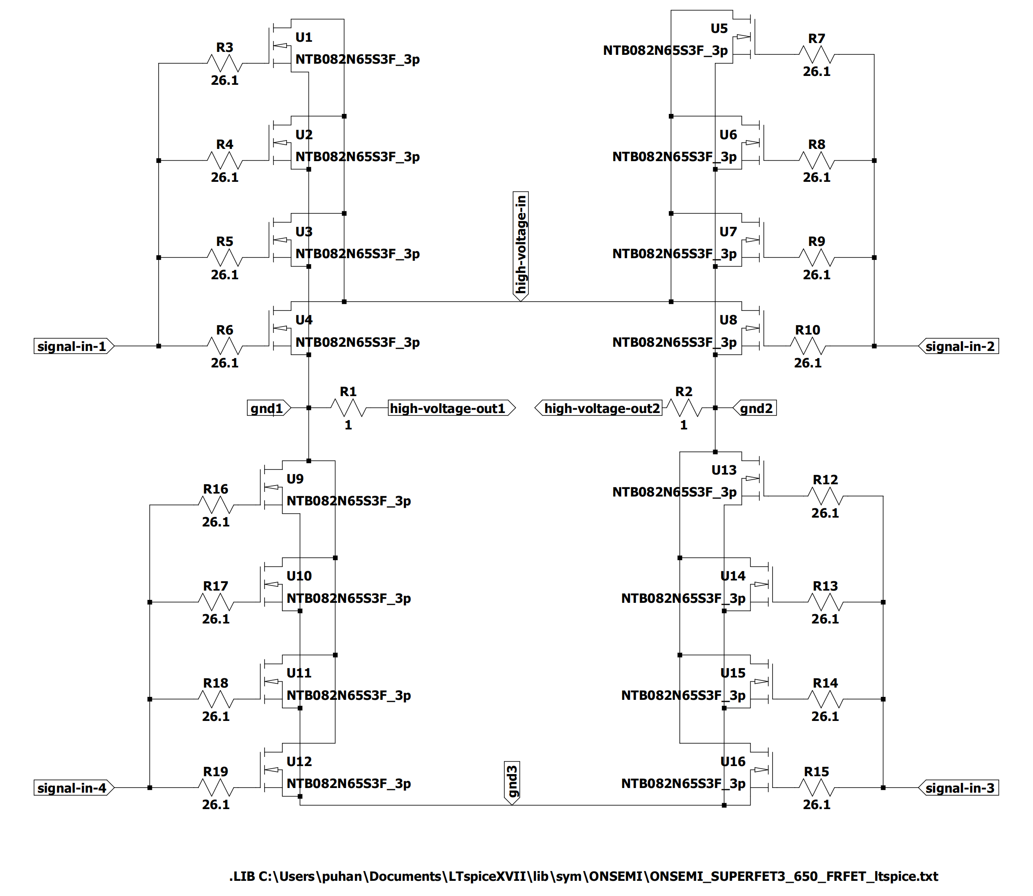

Slide 15
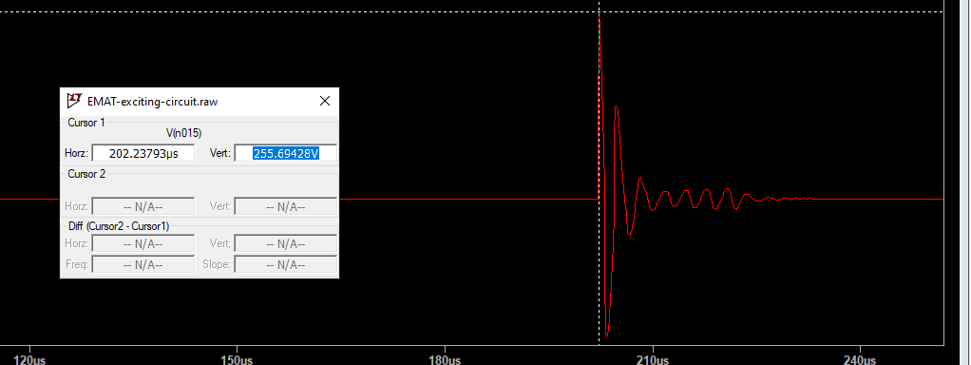
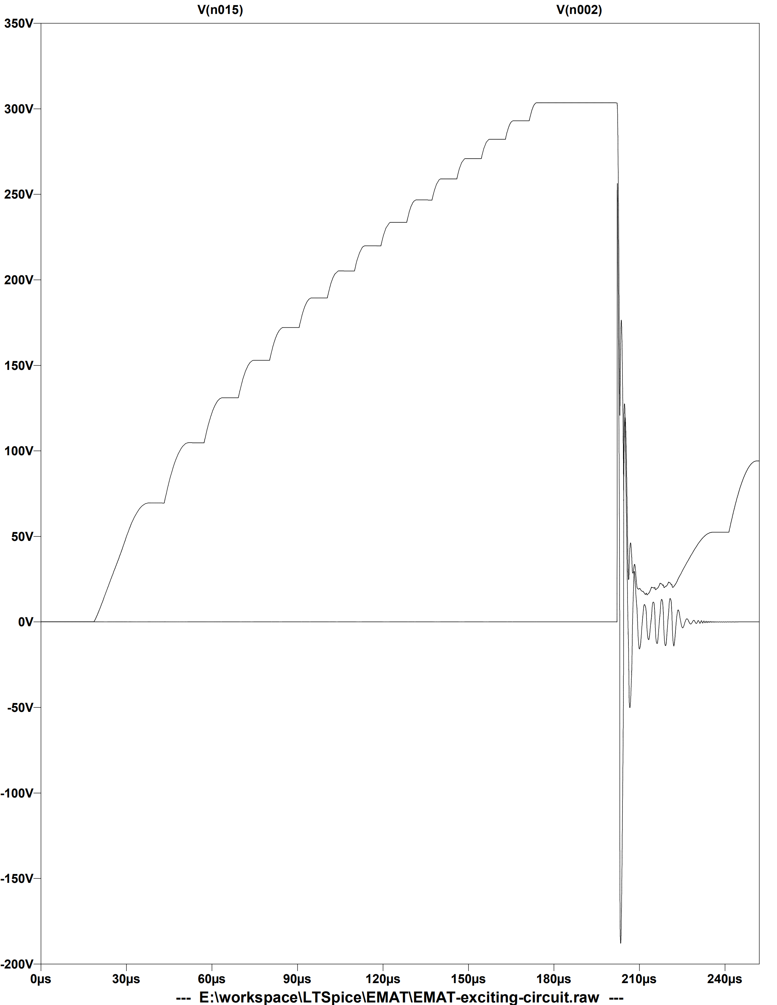
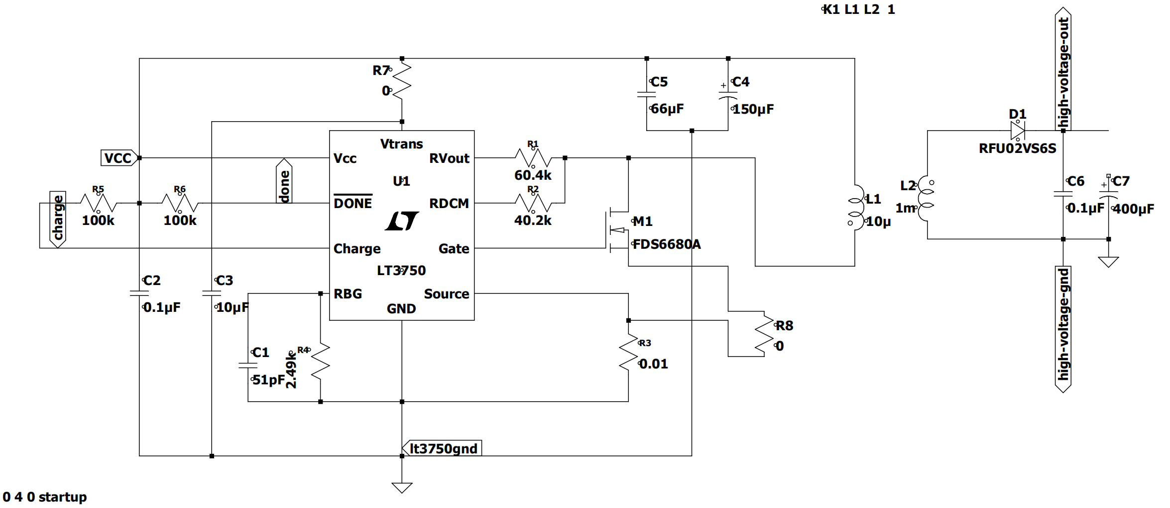

Slide 16
工作计划

Slide 17
重新制定手持式电磁超声设备方案
Ritec2500功率放大部分仿真，复现ritec2500，联系商家定制变压器
RF TRANSFORMER

Slide 18
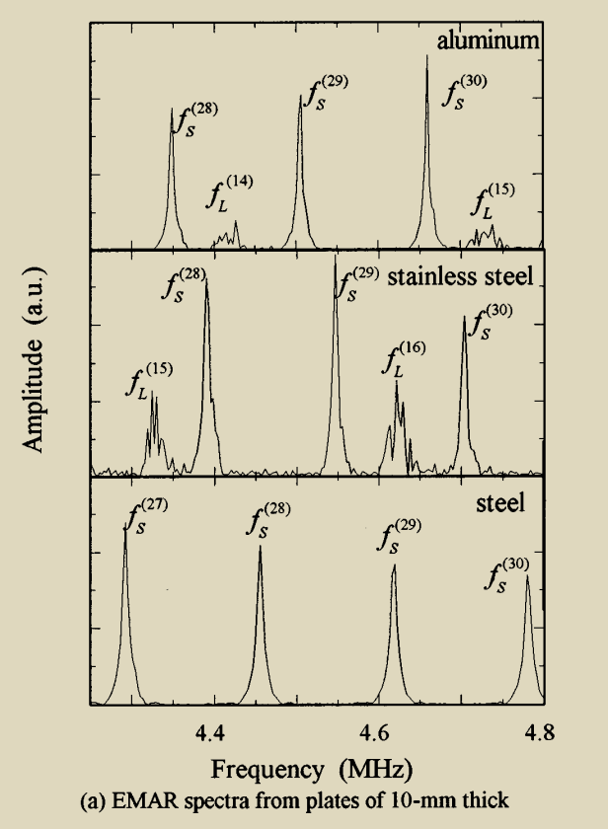
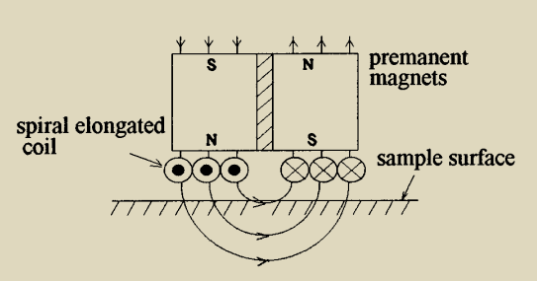
Field dependence of coupling efficiency between electromagnetic field and ultrasonic bulk waves
Different material
Different thickness

Slide 19
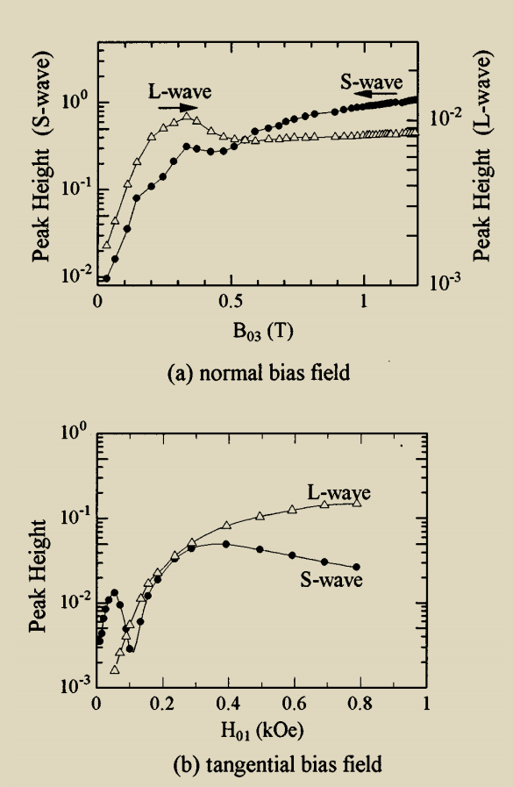
Static bias field
Permeability

Slide 20
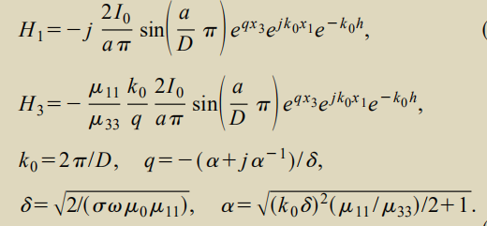
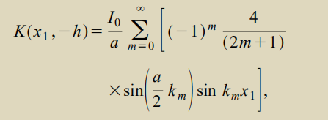
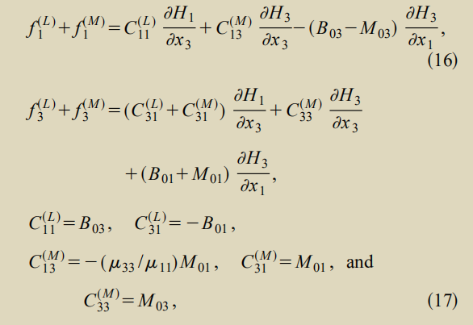
A
B
C
Find A B satisfies spiral coil

Slide 21
测厚线圈设计:
1. 理论分析
2. Solidworks
3. comsol
电路实验:
1. ADUM3223
2. 输出仿真

