Slide 1
文献阅读
Shear horizontal wave transducers for structural health monitoring and nondestructive testing :A review
Ultrasonics
The excitation mechanism of ultrasonic wave(bulk wave and guided wave)
SH wave
Lorenz force based EMAT and megnetostrictive EMAT
Piezoelectric acoustic transducer(wedge thickness-shear face-shear)

Slide 2

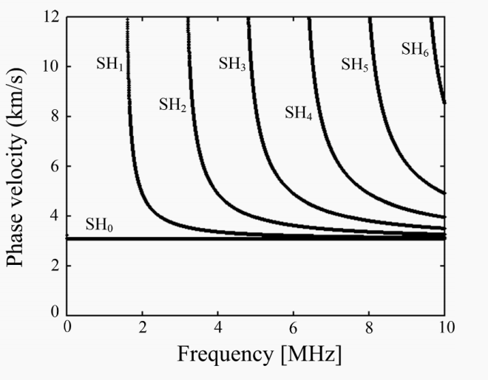




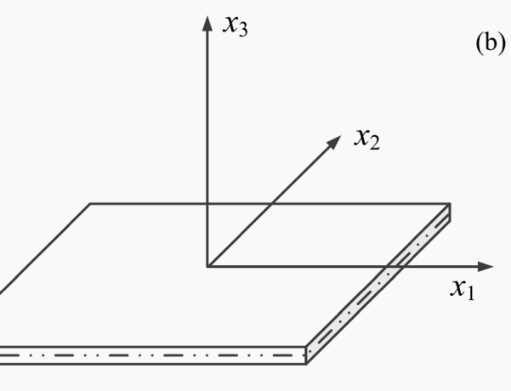

Slide 3
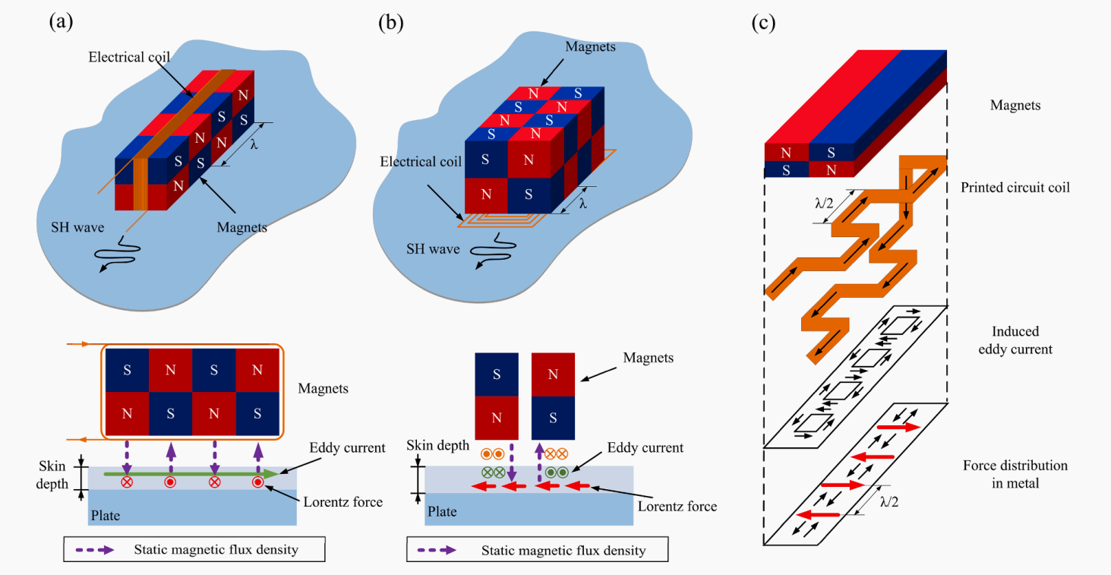

Slide 4
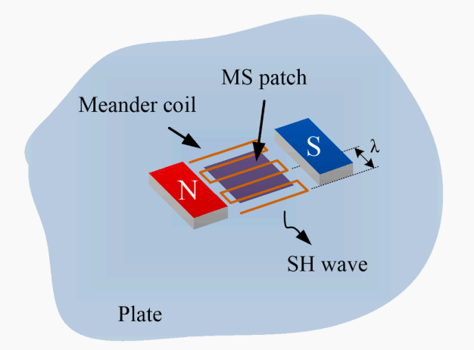
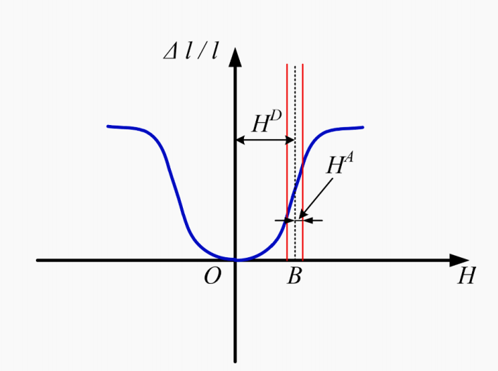

Slide 5
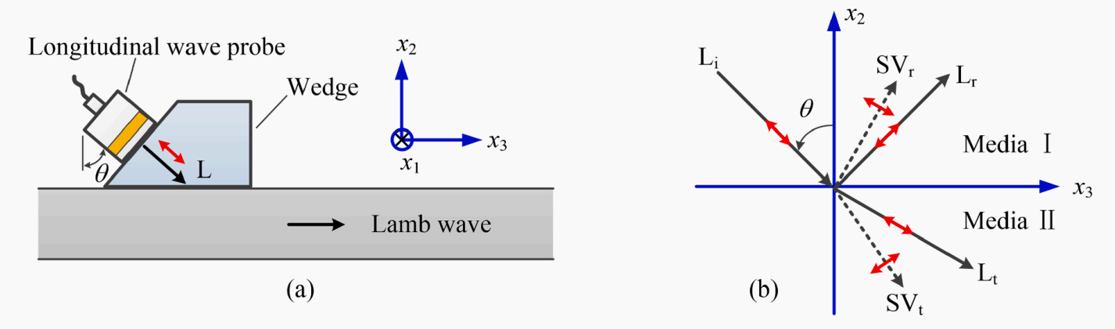
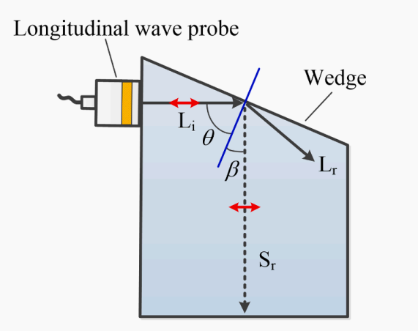

Slide 6
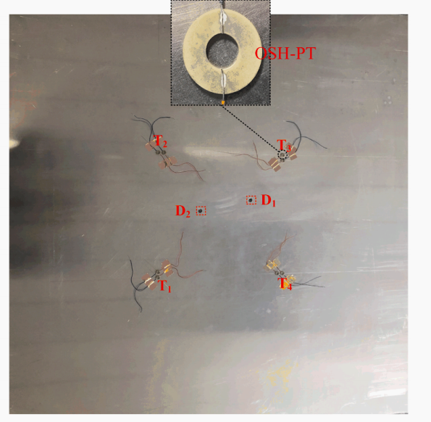
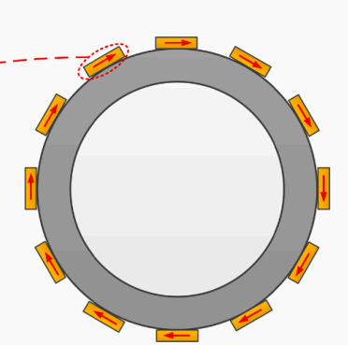
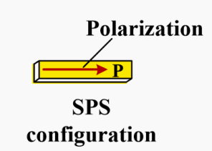
Thickness shear wafer
Face shear piezoelectric transducer

Slide 7
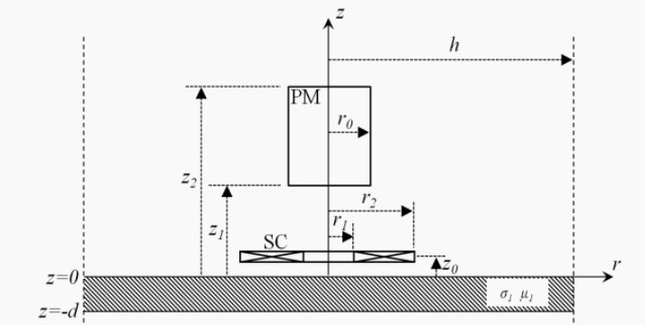
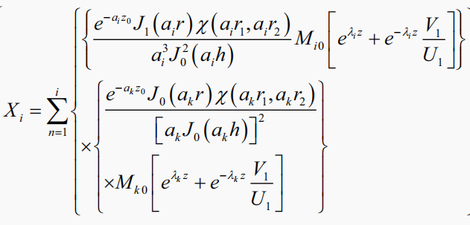
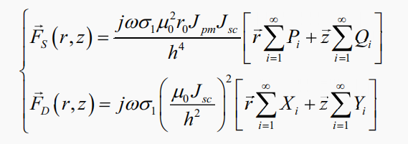
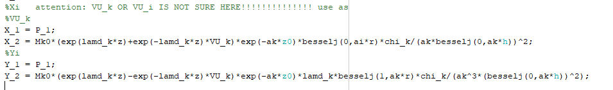
文献阅读
A Fast Analytical Model of Electromagnetic Acoustic Transducers for Evaluation of Flat Non-magnetic Conductors 2014 IEEE Far East Forum on Nondestructive Evaluation/Testing

Slide 8
数据处理算法
噪声水平
信噪比
接收信号幅值
衰减
激励电流

Slide 9
