Slide 1
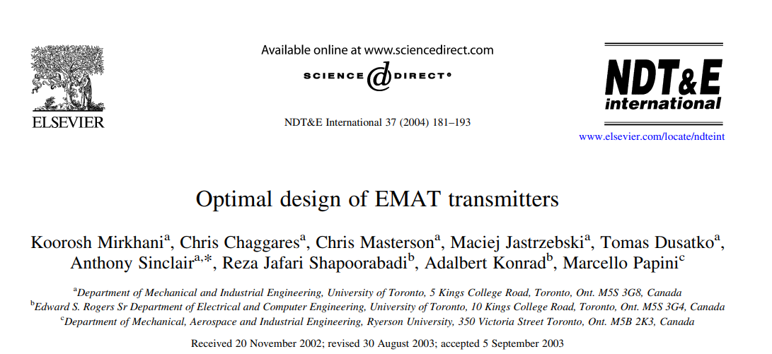



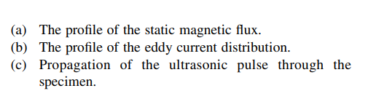
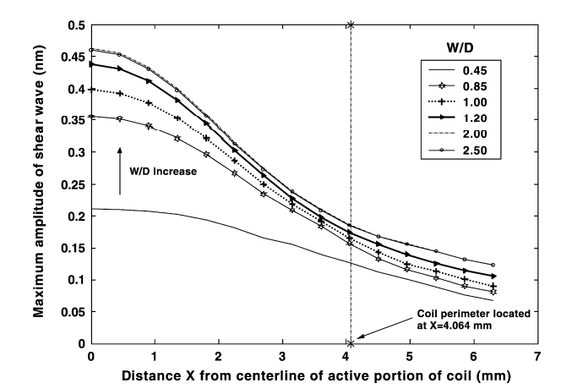
A preamplifier/amplifier arrangement typically provides of the order of 100 dB of receiver gain

Slide 2
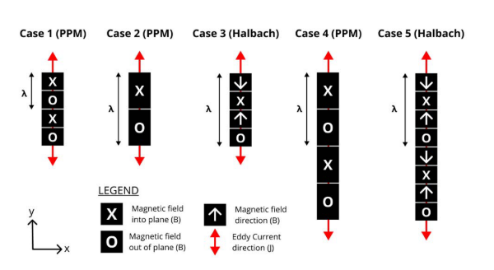

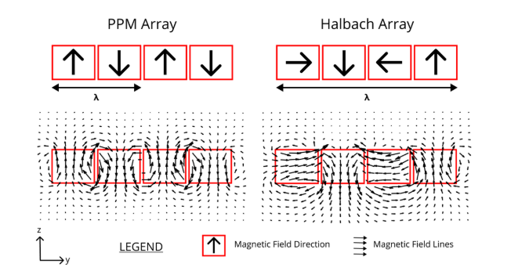
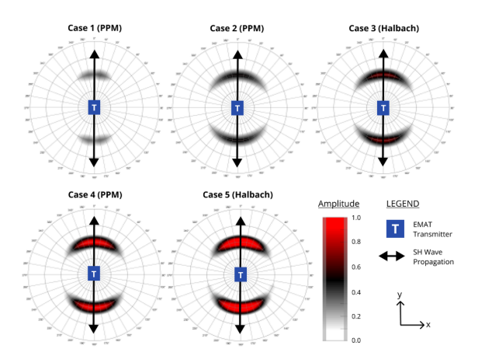
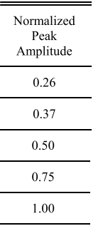
Use halbach array to increase Bz
1. Use FEM simulation get the relationship between magnet size and coil size
2. compare the magnitude of Bz of a whole magnet with halbach array in the same size

Slide 3
本周工作计划
完成发射板
设计接收板
FPGA 做信号发生器

