Slide 1
1. Performance indicators
a. Time measurement: resolution, precision ,range
b. Power consumption
Resolution: bandwidth
Precision: SNR
Range: average power, receiver gain (conversion efficiency)
4. Signal processing
Matched filter
Pulse compression method (chirp signal)
5. Hardware design
Impedance matching for EMAT coil
Broadband impedance matching
Narrowband impedance matching
Transmitter
Power combiner
Receiver
Signal conditioning unit(passive filter + OPAMP)
Signal sampling unit (FPGA+TI-ADC)
Power supply (filter, boost, sepic, cuk)
2. Mechanism of EMAT (Lorentz force)
Electromagnetic field（2D analytical model）
Harmonics mechanical waves in solid (Christoffel Equation)
3. Transducer design
Transducer structure
Improve power conversion efficiency: electromagnetic field (numeric solution of ferrite back, liftoff)
Applications: mechanical waves (Christoffel Equation & numeric solution of line source analytical model)
6. Software design
ARM + LINUX OS + program & driver

Slide 2
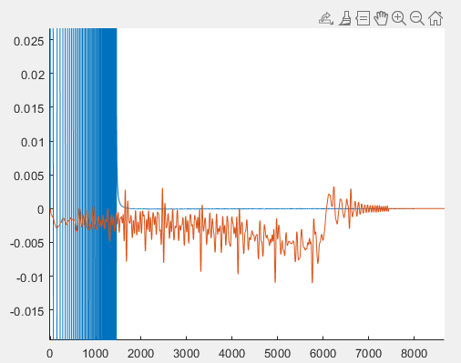
Guided wave (lamb)
The only wave mode can’t generate directly by EMAT: LCR
Analytical model of ultrasonic wave in solid (Semi-infinite plate model)
1. Bulk wave (longitudinal transverse)
2. Surface wave (Rayleigh SH)
Pulse compression
Bulk: chirp, coded phase
Guided: coded phase
Surface wave + bulk wave
Decoupled thickness calculation with material predefined velocity
Stiffness Constant calculation
near surface + inner measurement

Slide 3





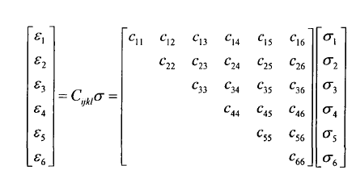
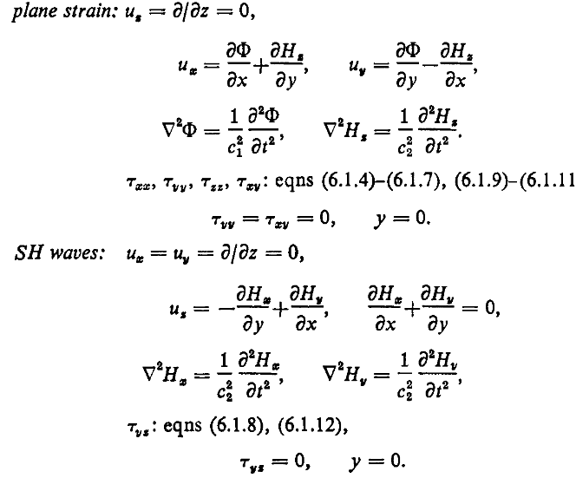
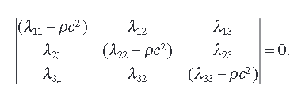
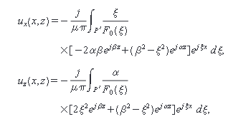
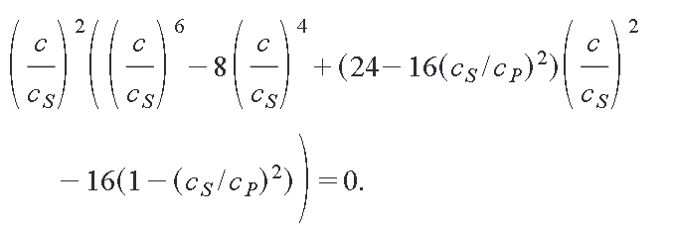
Governing equation
Christoffel Equation
Navier equation
Line source analytical model

Slide 4
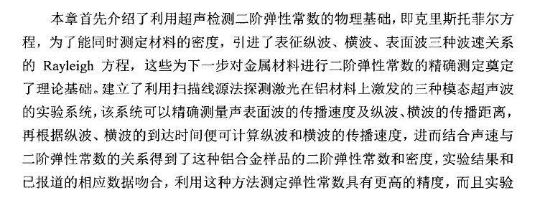
金属焊接残余应力的激光超声无损检测研究-南京理工大学（硕士学位论文）

