Slide 1
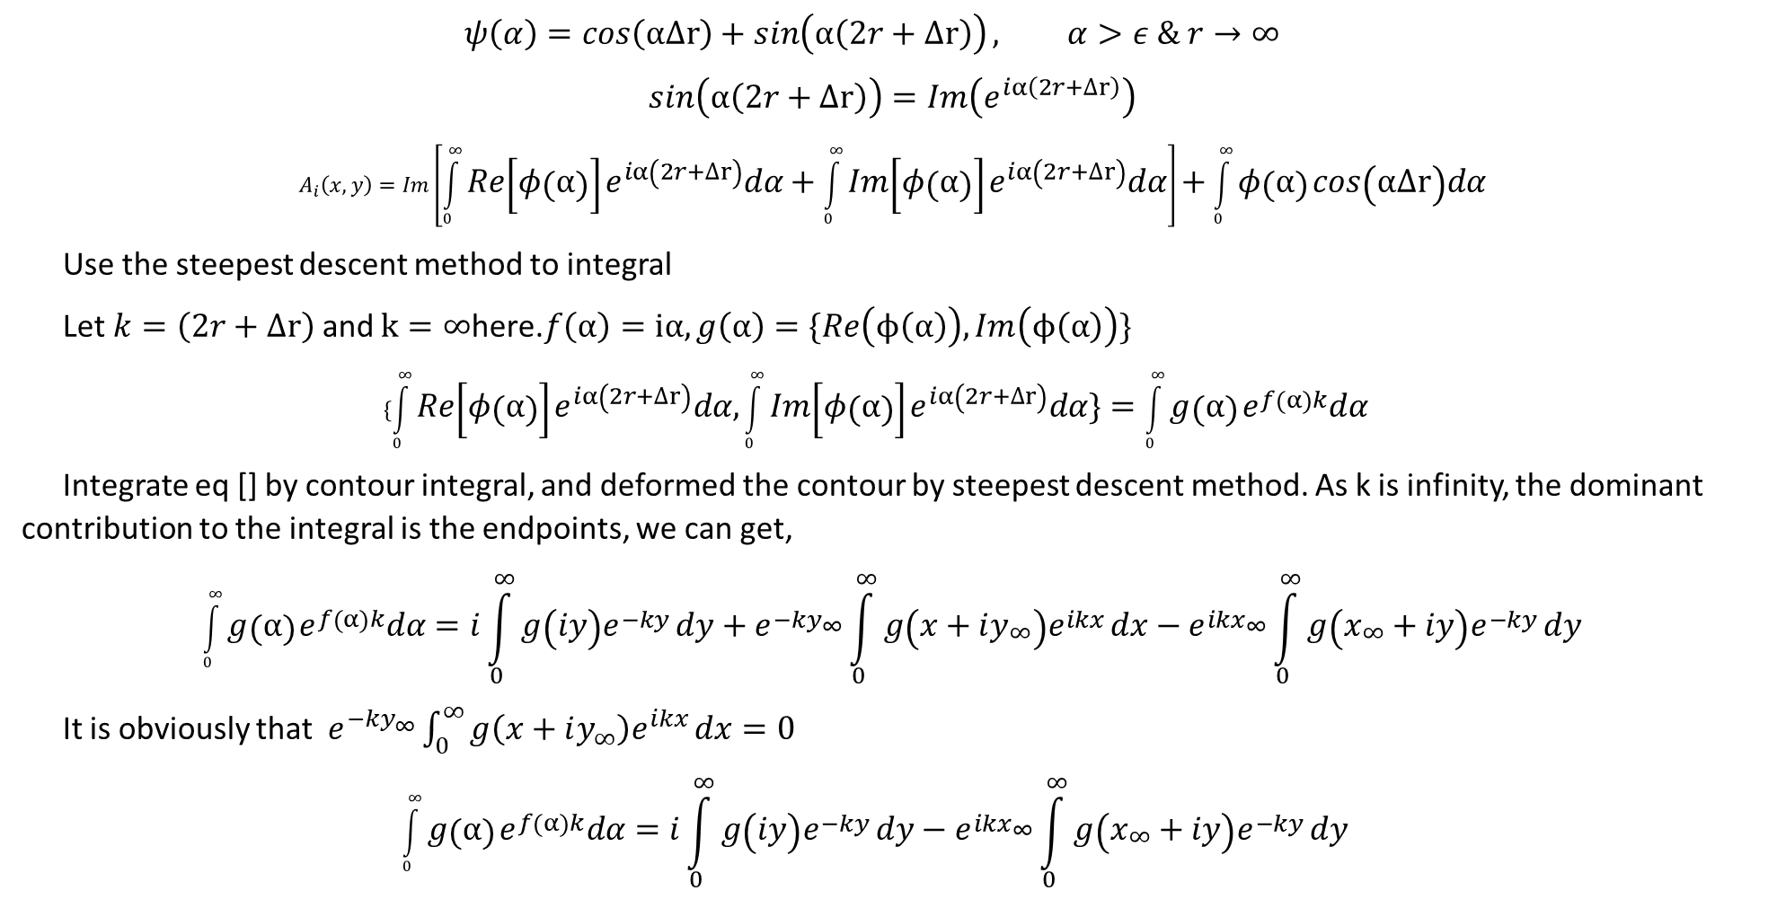
IFFT for straight line magnetic field calculation
$$ψ\left(α\right)=cos\left(α∆r\right)+\sin\left(α\left(2r+∆r\right)\right), α>ε \& r→∞$$
$$\sin\left(α\left(2r+∆r\right)\right)=Im\left(e^{iα\left(2r+∆r\right)}\right)$$
$$A_{i}\left(x,y\right)=Im\left[\int_{0}^{∞}{Re\left[φ\left(α\right)\right]}e^{iα\left(2r+∆r\right)}dα+\int_{0}^{∞}{Im\left[φ\left(α\right)\right]}e^{iα\left(2r+∆r\right)}dα\right]+\int_{0}^{∞}{φ\left(α\right)}cos\left(α∆r\right)dα$$
Use the steepest descent method to integral
Let $k=\left(2r+∆r\right)$ and $k=∞$here.$f\left(α\right)=iα,g\left(α\right)=\{Re\left(ϕ\left(α\right)\right),Im\left(ϕ\left(α\right)\right)\}$
$$\{\int_{0}^{∞}{Re\left[φ\left(α\right)\right]}e^{iα\left(2r+∆r\right)}dα,\int_{0}^{∞}{Im\left[φ\left(α\right)\right]}e^{iα\left(2r+∆r\right)}dα\}=\int_{0}^{∞}{g\left(α\right)}e^{f\left(α\right)k}dα$$
Integrate eq [] by contour integral, and deformed the contour by steepest descent method. As k is infinity, the dominant contribution to the integral is the endpoints, we can get,
$$\int_{0}^{∞}{g\left(α\right)}e^{f\left(α\right)k}dα=i\int_{0}^{∞}{g\left(iy\right)e^{−ky}}dy+e^{−{ky}_{∞}}\int_{0}^{∞}{g\left(x+iy_{∞}\right)e^{ikx}}dx−e^{ikx_{∞}}\int_{0}^{∞}{g\left(x_{∞}+iy\right)e^{−ky}}dy$$
It is obviously that $e^{−{ky}_{∞}}\int_{0}^{∞}{g\left(x+iy_{∞}\right)e^{ikx}}dx=0$
$$\int_{0}^{∞}{g\left(α\right)}e^{f\left(α\right)k}dα=i\int_{0}^{∞}{g\left(iy\right)e^{−ky}}dy−e^{ikx_{∞}}\int_{0}^{∞}{g\left(x_{∞}+iy\right)e^{−ky}}dy$$

Slide 2
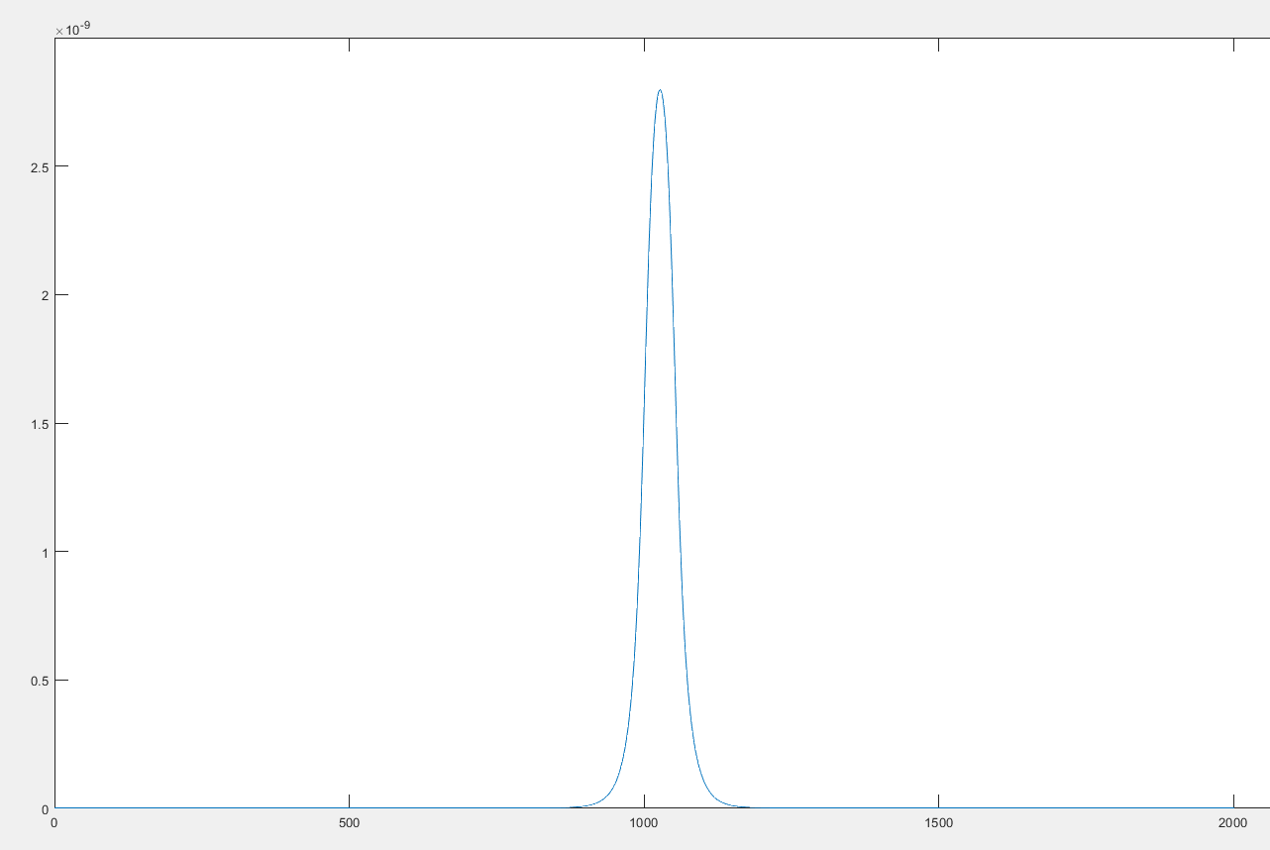
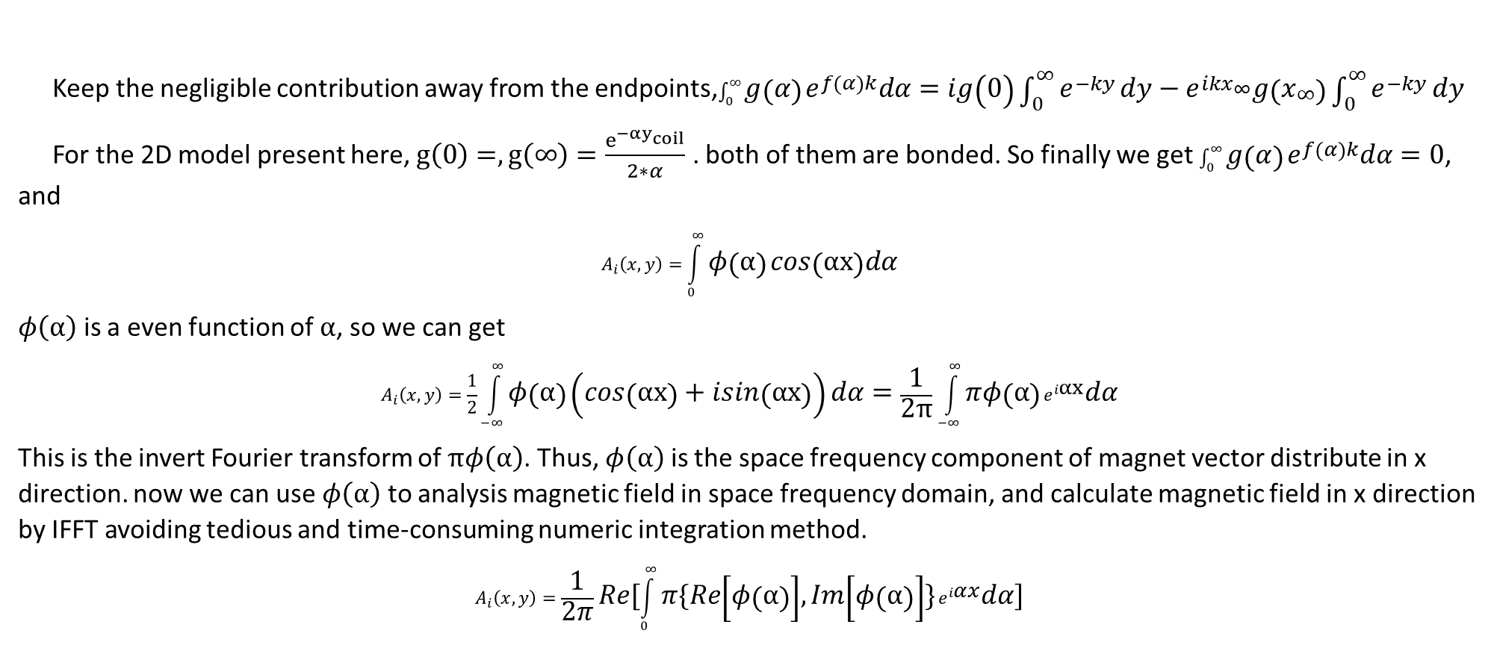
IFFT for straight line magnetic field calculation
Keep the negligible contribution away from the endpoints,$\int_{0}^{∞}{g\left(α\right)}e^{f\left(α\right)k}dα=ig\left(0\right)\int_{0}^{∞}{e^{−ky}}dy−e^{ikx_{∞}}g\left(x_{∞}\right)\int_{0}^{∞}{e^{−ky}}dy$
For the 2D model present here, $g\left(0\right)=,g\left(∞\right)=\frac{e^{−αy_{coil}}}{2∗α}$ . both of them are bonded. So finally we get $\int_{0}^{∞}{g\left(α\right)}e^{f\left(α\right)k}dα=0$, and
$$A_{i}\left(x,y\right)=\int_{0}^{∞}{φ\left(α\right)}cos\left(αx\right)dα$$
$φ\left(α\right)$ is a even function of $α$, so we can get
$$A_{i}\left(x,y\right)=\frac{1}{2}\int_{−∞}^{∞}{φ\left(α\right)}\left(cos\left(αx\right)+isin\left(αx\right)\right)dα=\frac{1}{2π}\int_{−∞}^{∞}{πφ\left(α\right)}e^{iαx}dα$$
This is the invert Fourier transform of $πφ\left(α\right)$. Thus, $φ\left(α\right)$ is the space frequency component of magnet vector distribute in x direction. now we can use $φ\left(α\right)$ to analysis magnetic field in space frequency domain, and calculate magnetic field in x direction by IFFT avoiding tedious and time-consuming numeric integration method.
$$A_{i}\left(x,y\right)=\frac{1}{2π}Re[\int_{0}^{∞}{π\{Re\left[φ\left(α\right)\right],Im\left[φ\left(α\right)\right]\}}e^{iαx}dα]$$

Slide 3
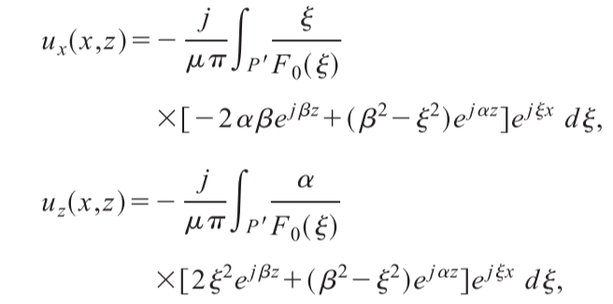
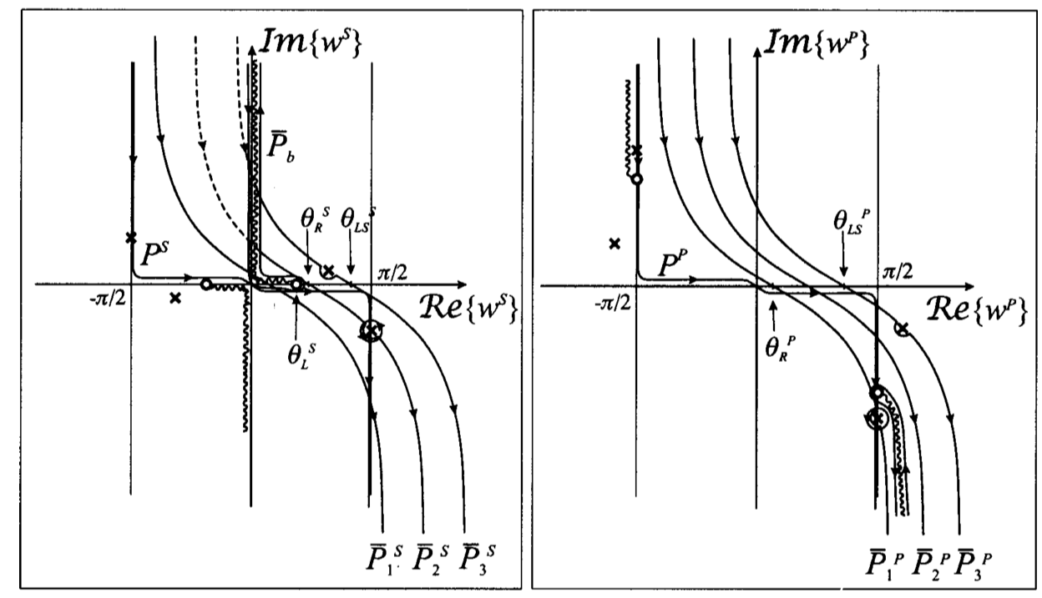
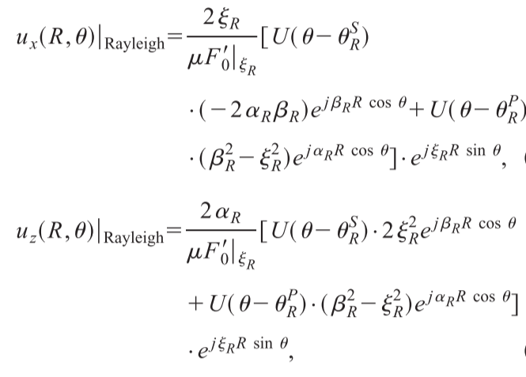
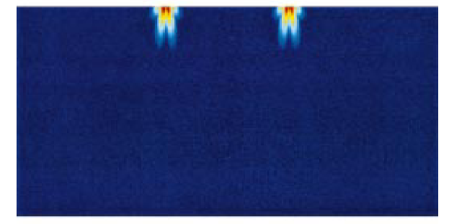
Analytical calculation of ultrasonic wave

Slide 4
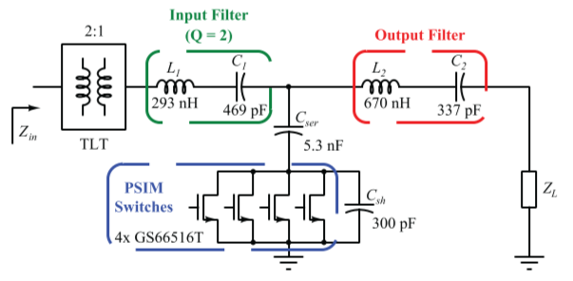
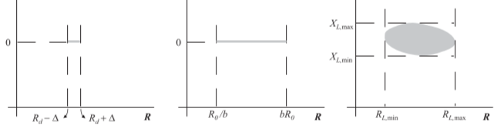
Tunable impedance matching
Phased-Switched impedance modulation
Resistance compression network

