Slide 1
Ethernet
ARM
DC POWER
LC network
LCD
Digital
Isolator
&
buffer
Power
Amp 1
Series & Parallel
Power combiner
Array
FPGA
Transformer
USB
Power
Amp N
Controller
SD card
Transmitter
Imp matching
Interface
Li-on battery
Power module
ADC
200MHz
Signal processing circuit
Lorentz force Transducer T/R
Transducer
Power
Receiver
EMAT SYSTEM
Non-magnet conductive plate

Slide 2
FPGA design
Set up
Set up
Freq
Num
Duty cycle
DEC
trig
INC
mode

Slide 3
Power management
Compensation
90 degree phase change → proportional to the negative derivative
Current and voltage of the inductor.
U = L*di/dt
Debug

Slide 4
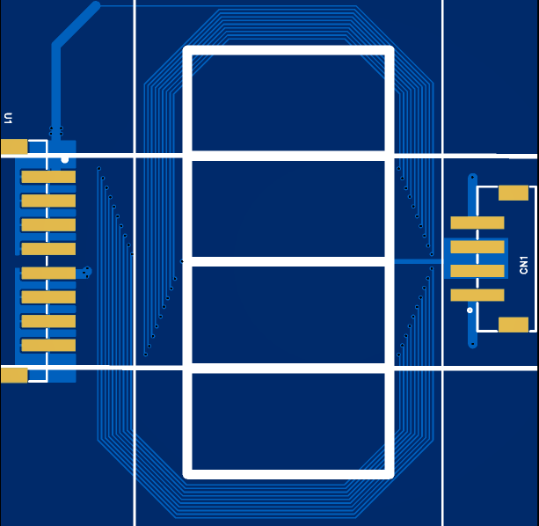
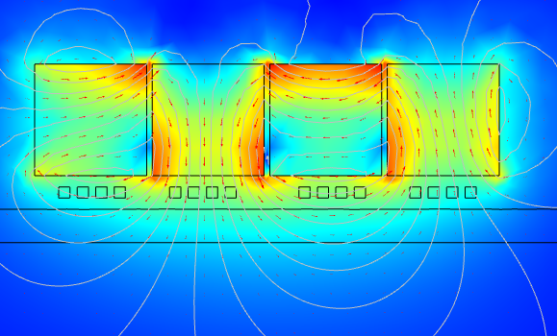
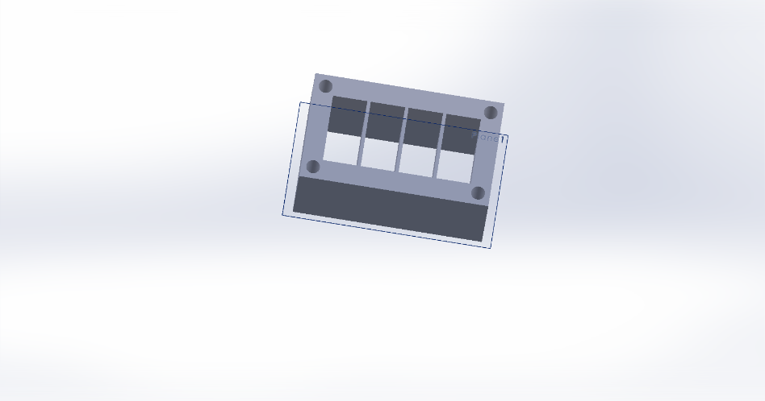
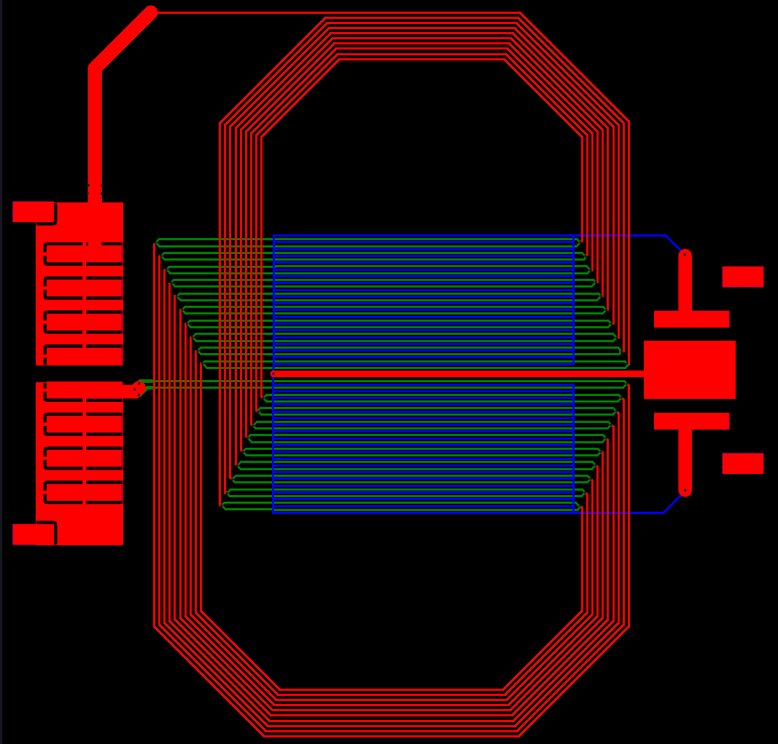

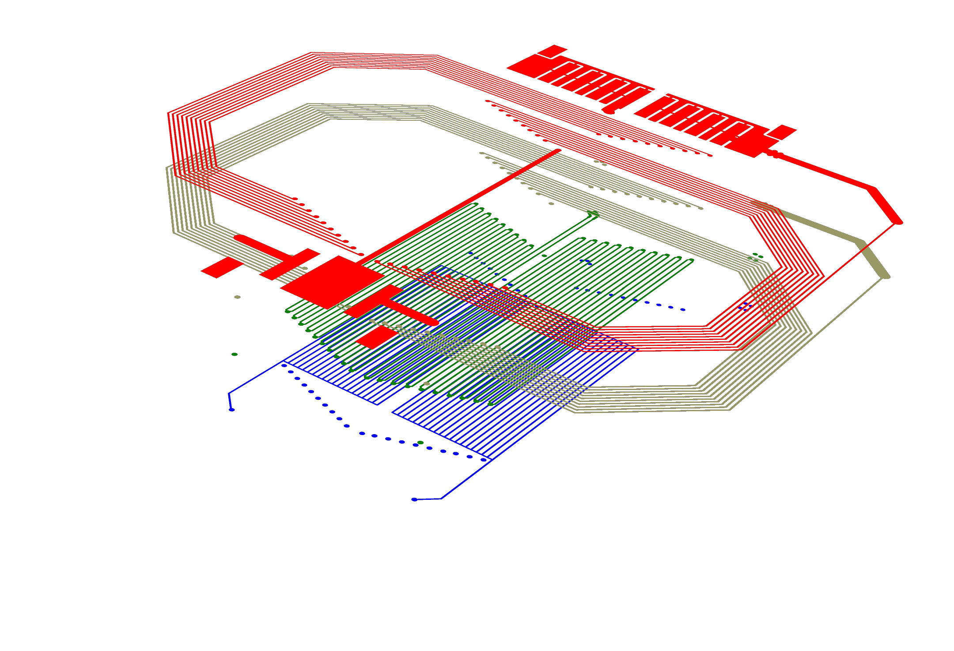
Transducer design

Slide 5
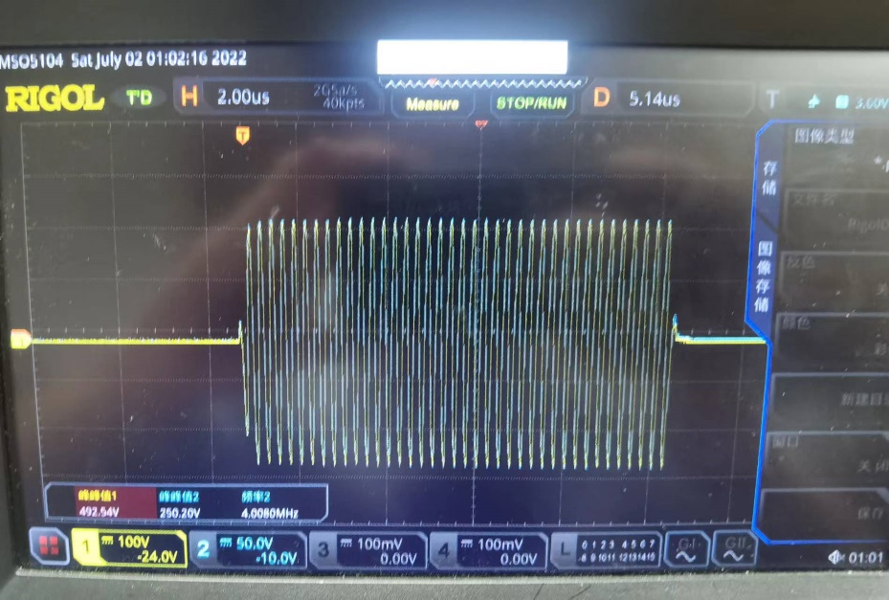
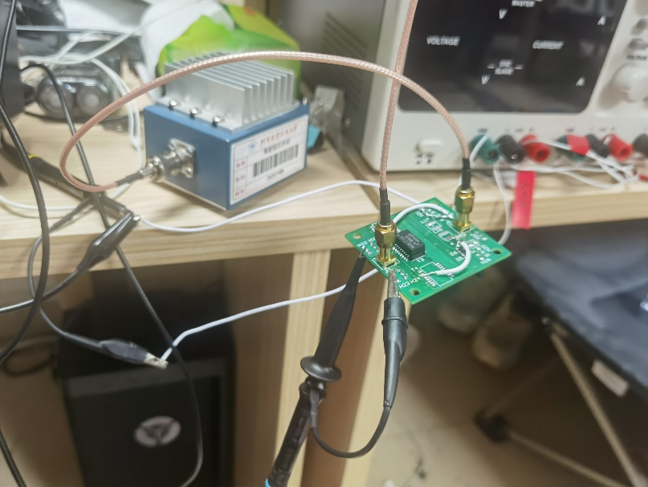
Transformer
Transmission line transformer：
Balun transformer
Magnetic coupled transformer：
RF-transformer (the primary magnetic flux keep invariant)
Max power transfer: Related to saturated magnetic flux density
Power transformer
Max power transfer: (VA)
Coupled inductor：

Slide 6
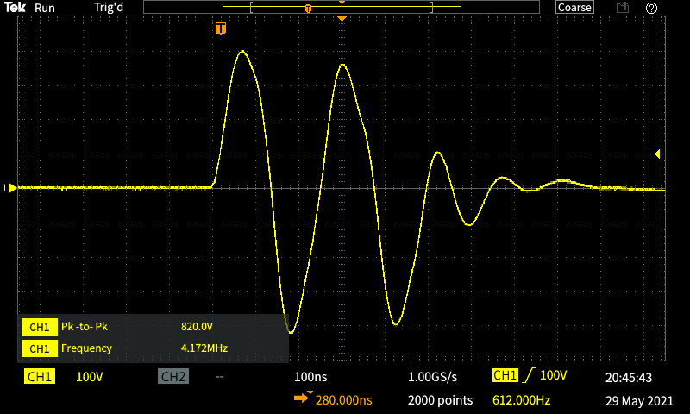
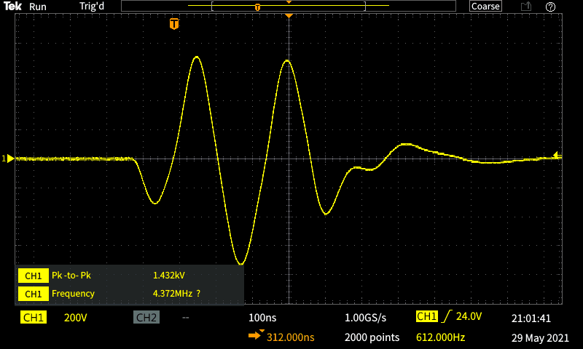
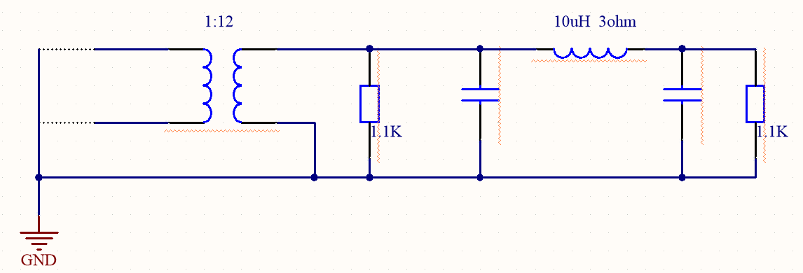

Slide 7
Balun transformer + broadband LC impedance matching
magnetic coupled transformer(power combiner):
narrowband impedance matching + RF-magnetic coupled transformer (imp matching)
LC filter

