Slide 1
Magnet array

Slide 2
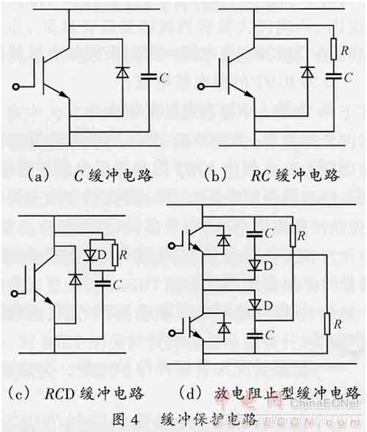
非平稳时间信号—
时间变量分析方法：
时频分析方法可分为两大类型：
线性类时频表示（STFT,Gabor,WT）和二次型时频表示(WVD)]
LFM 解决检测距离于距离分辨率之间的矛盾
米勒振荡
稳压管用来钳位
高压高频下，为高增益负反馈系统
仿真（加cascode）

Slide 3
板级电源设计
电压基准
低噪声；初始电压精度；温度稳定性；长期漂移；静态电流
LDO
输出电流能力；芯片最小压差；实际工况压差；封装热阻；RMS/PSRR；瞬态响应；静态电流
DCDC
输入输出电压；输出电流能力；开关频率，转换效率；瞬态响应；静态电流；纹波及EMI；
BOOST电路输出隔离，BUCK电路最大占空比

Slide 4

Detail
1. Q = w*energy stored/energy dissipated

Slide 5
Transmitter design procedure
Power Amplifier (based on H-bridge class D PA)
Power Combiner (based on rf-transformer)
Result
Transient simulation (LTspice)
Experiment

Slide 6
Receiver design procedure
Power Amplifier (based on H-bridge class D PA)
Power Combiner (based on rf-transformer)
Result
Transient simulation (LTspice)
Experiment

Slide 7
Compensation of switch mode power supply
Right-half-plane zero: magnitude increase 20dB/dec, phase lag 90
ESR zero
Topologies:
Buck-derived(buck , forward, two-switch forward, active-clamp forward, half-bridge converters)
Boost (a right-half-plane zero)
Buck-boost (a right-half-plane zero)
Control mode
Current mode boost: vo/vc----
(pole1: related to output capacitor and load resistance)
(pole2: related to inductance)
(zero1:RHZ, related to inductance and output resistance)
(zero2: related to ESR)
Transfer function
Boost:
power stage (duty cycle to output voltage; duty cycle to inductor current and output voltge)
Control stage(control to duty cycle)
Total (control to output voltage)

Slide 8
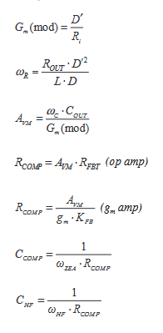
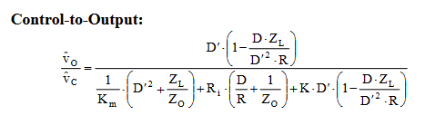

Buck-Boost:

Slide 9
Impedance matching network design procedure (impedance is scaled by transformer)
Function:
Matching; filtering; absorbing stray reactance
Narrowband:
Topology: L type; T type; PI type; Series L type (slightly broadband due to low Q);
Broadband:
Topology: Butterworth low pass
Parameter setup:
Zi (source impedance); Zo (load impedance); fc (frequency work point)
Condition: 1. 0.1<Zi/Zo<10:
2. Zi/Zo>10 or Zi/Zo<0.1:
Result
Smith chart (ADS)
Experiment (Impedance Analyzer)

Slide 10
设备与驱动模型 | 主要数据结构 | 作用
设备 | device | 连接到总线上的对象
驱动 | device_driver | 负责探测并关联设备的代码实体
总线 | bus_type | 为其他设备提供接入点的设备
LINUX总线驱动模型
设备 | 主要数据结构 | 主设备/从设备号
字符设备 | cdev | 将字符设备注册到系统中
块设备 | device_driver
网络设备 | bus_type
设备类型
创建方法 | 主要数据结构 | 主设备/从设备号
手动创建 | mknod | 主设备号决定使用的设备驱动 从设备号由具体的设备驱动设置
设备文件系统 | device_driver
网络设备 | bus_type
设备节点的创建
class_create(); device_create()<---include<linux/device.h>
Sys/class
目录将设备驱动按类别分组，每个类别下有类别名

Slide 11


对象 | method
设备节点 （设备文件） | mknod
设备标识 | dev_t=MKDEV(major,minor)
设备号 | MAJOR,MINOR
设备节点、标识、号（主次）
对象 | method
初始化 | cdev_init(&mydev,&mydevfops)
添加到内核 | cdev_add(&mydev)
mydevfops | Struct file_operations
字符设备cdev
创建方法 | 主要数据结构 | 备注
register_chrdev | static/dynamic obslete | 注册设备函数完成对一组设备号的分配 静态注册函数，需要通过MKDEV宏先获取设备标识。 动态注册函数可自动完成设备标识的获取和分配
register_chrdev_region | static
alloc_chrdev_region | dynamic
注册设备函数

Slide 12
计算机CPU之CISC、RISC、x86、IA32、x86-64、IA64、ARM
超标量处理器流水线 - 知乎 (zhihu.com)
流水线；超流水线；超标量

Slide 13
测VGS
测未连变压器时，对1欧姆负载的输出电压（变压器寄生参数对输出的影响）
测驱动电源电压，换10uF电容
测
UCC21759-Q1
MCP14A1202
集成的推挽式驱动，直接用于驱动变压器，死区时间不可调
分立式的图腾柱式MOSFET，实现高压，大电流的逆变
（NP）MOS对，需要互补的驱动信号，可调死区时间
High power density
电流钳位
Some common points between portable EMAT and SMPS
Some common points between portable EMAT and WPT
1. Energy is transfer through magnetic field (magnetostriction effect EMAT)
2. The inverters work in switch mode
Some common points between portable EMAT and IH

Slide 14
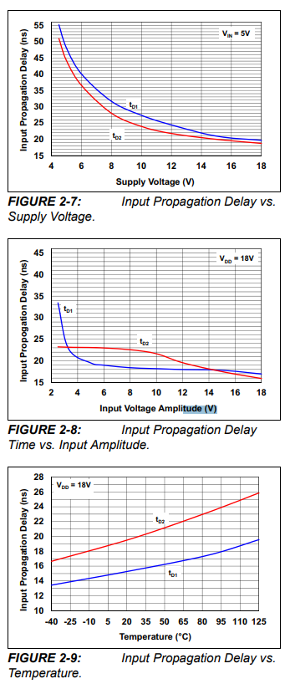

Slide 15
TTL&CMOS voltage level
TTL
VOL: <0.4V; VOH:>2.4V
VIL:<0.8V; VIH:>2.0V
CMOS
VOL:<0.1*VCC; VOH:>0.9*VCC
VIL:<0.3*VCC; VIH:>0.7*VCC
Noise margin:

Slide 16
WEEK 3

Slide 17
3.3V
5V
12V
VCC
HV=VCC*N
1
VBUS
POWER
COMBINER
&
IMPEDANCE
SCALING
PWM
ISOLATOR
DRIVER
H-bridge
2
1
1
2
3
GROUND
ICC
ICC/N
T0
T1
T2
T3
T4
Summary of portable EMAT transmitter
high frequency & high power density
ENERGY FLOW
POWER BARRIER
TIMING SKEW

Slide 18
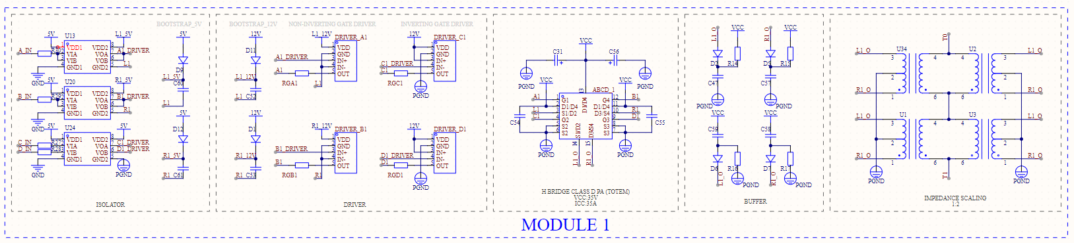
(Discrete Totem Pole v0.2)
DEBUG
Solve oscillation problem
Solve time skew problem
Alteration
1. Technical Indicator
Voltage: 70V{100V} (VPP)
Current: 70A{100A} (IPP)
2. Circuit Components
Boost strap: 1N4448WS
H bridge: DMHT6016LFJ
Driver: UCC27517
Impedance Scaling: 1:2
VCC Capacitor: T491D106K050AT
Transformer:TC1-1T+
3. Circuit Structure
Add Buffer circuit
Add Gate resistor
RM gate Zener diode
IMPROVEMENT
Single module reduce to 40+ ￥
Reduce space
VCC
v
A
B
GATE
OL
BUFFER
OR
GATE
C
D
GND
Schematic of H bridge class D PA

Slide 19
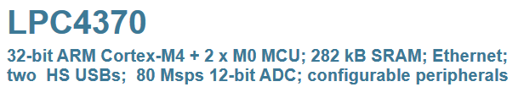
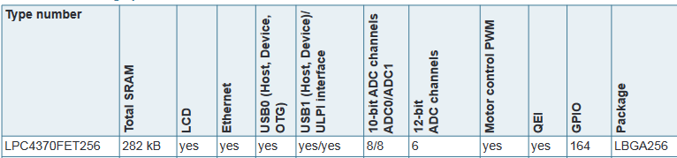
MCU selection

Slide 20
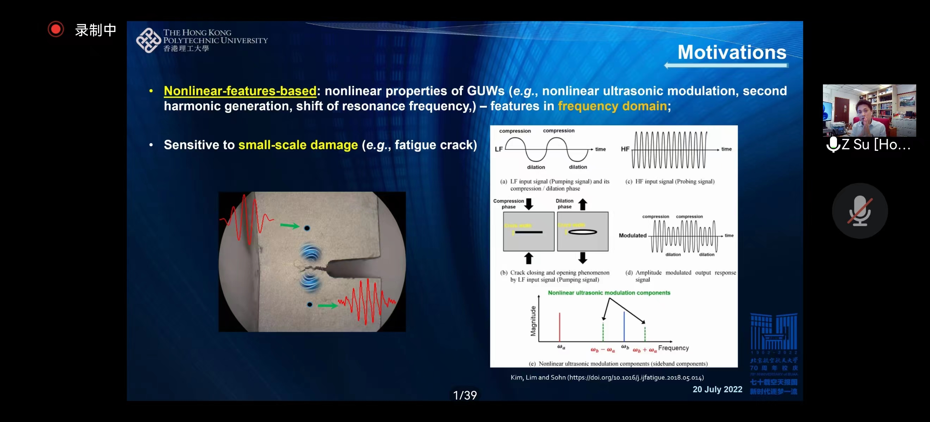
Non-linear ultrasonic test

Slide 21
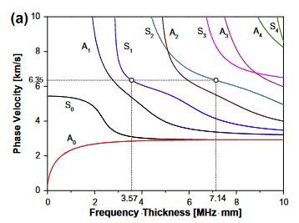
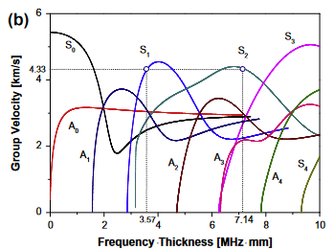
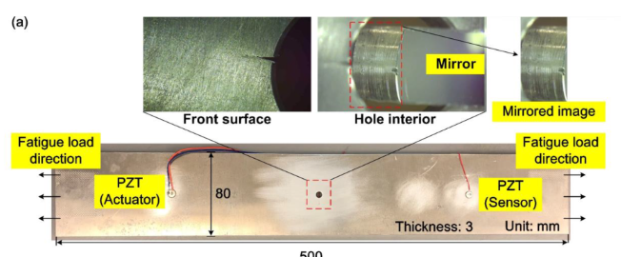
Non-linear ultrasonic test

Slide 22
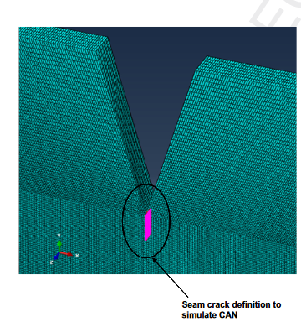
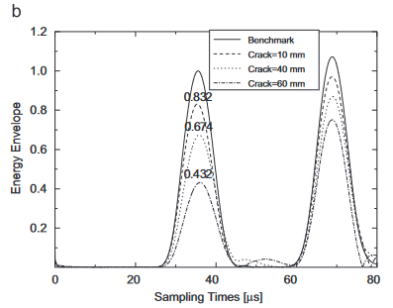
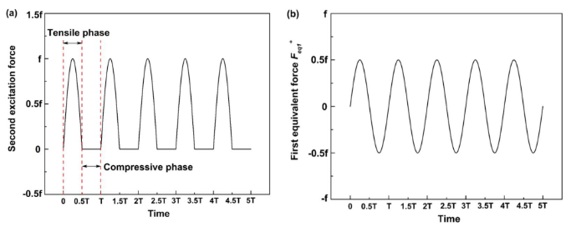
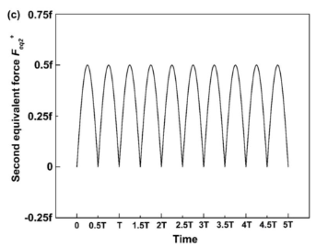
Non-linear ultrasonic test

Slide 23
WEEK 4

Slide 24
CLOSED FORM
NORMAL MODE EXPANSION
NUMERICAL
SOLUTION
INTEGRAL
TRANSFORM
Transient load analysis
METHOD

Slide 25


Abstracting excitation sources into loadings
Integral transform method
Normal mode expansion method

Slide 26
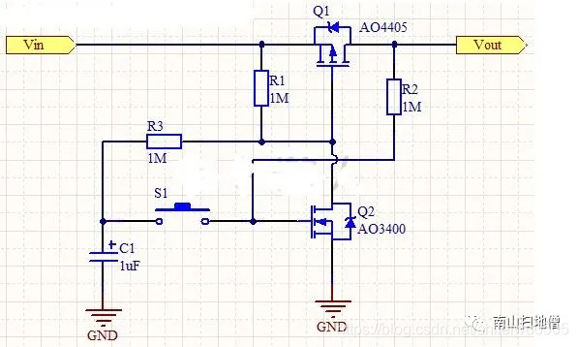
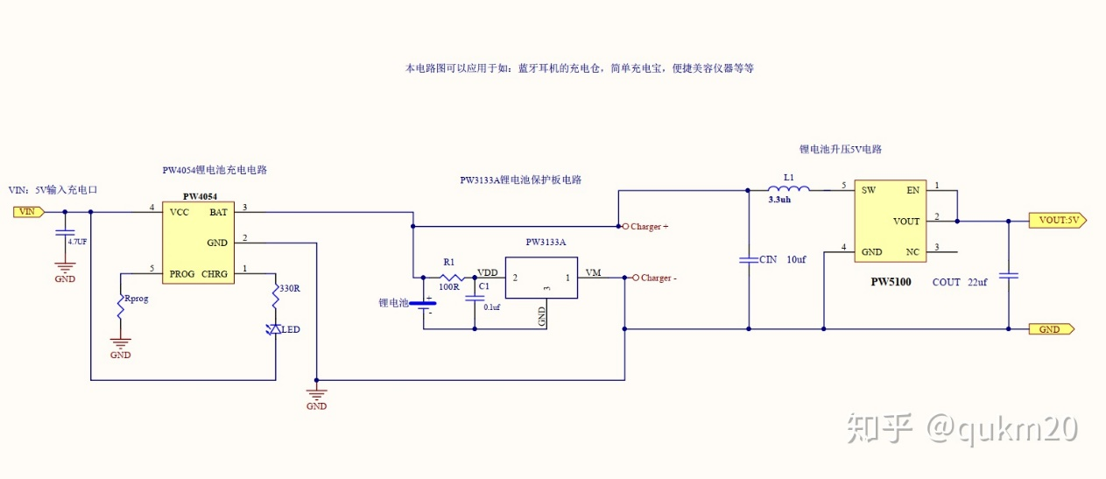
PFM
(pulse frequency modulation)
CCM
Peak current mode
PWM (pulse width modulation)
DCM
Control mode
Work mode
Modulation mode
Power supply

